Slide 1
Assignment 3 Custom UI Component
Assignment 3
Student Number: A…
Student Name: Ding Heng

Slide 2
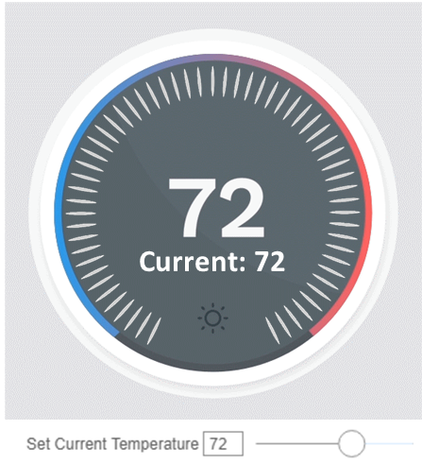

View Tree
MainPanel
ProtrudingPanel
RadialPanel
RadialBorder
RadialBackground
RadialMarkings
RadialTracker
TargetTemperatureIndicator
CurrentTemperatureIndicator
TimeIndicator
Notes:
As clarified, the TimeIndicator is not included in the scope of this assignment and hence it will be excluded in the rest of this assignment.

Slide 3
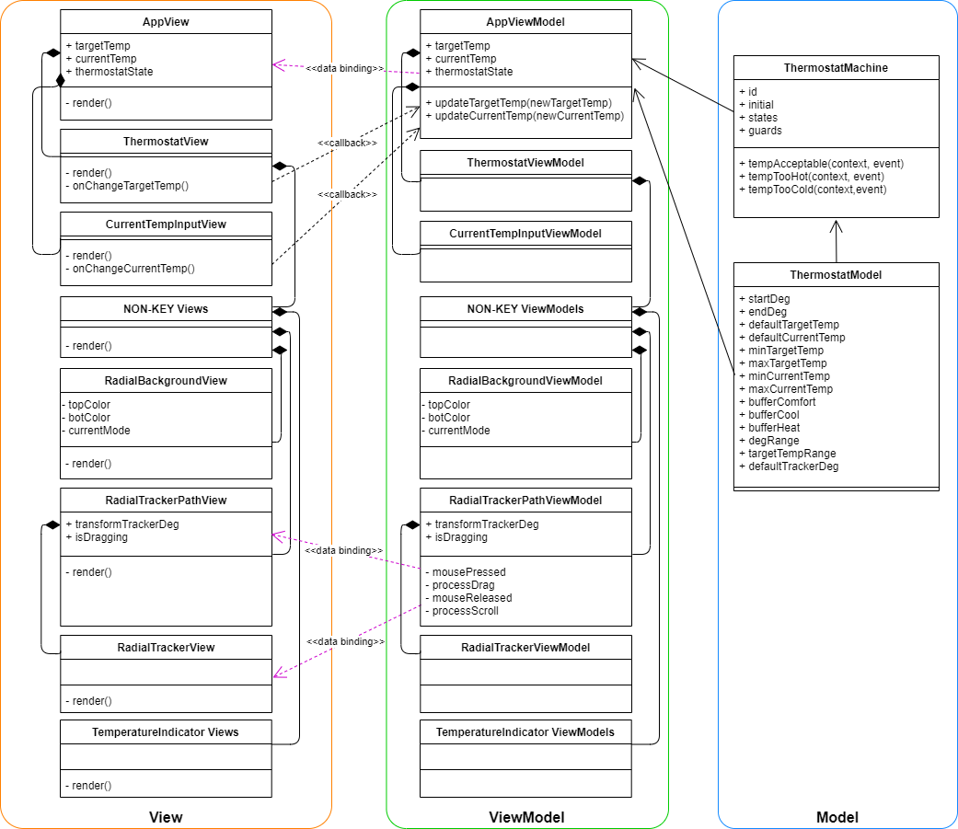
Class Diagrams (or list description)
https://github.com/dingheng4448/React-Thermostat-Radial-Slider/blob/master/documents/ClassDiagrams.drawio

Slide 4
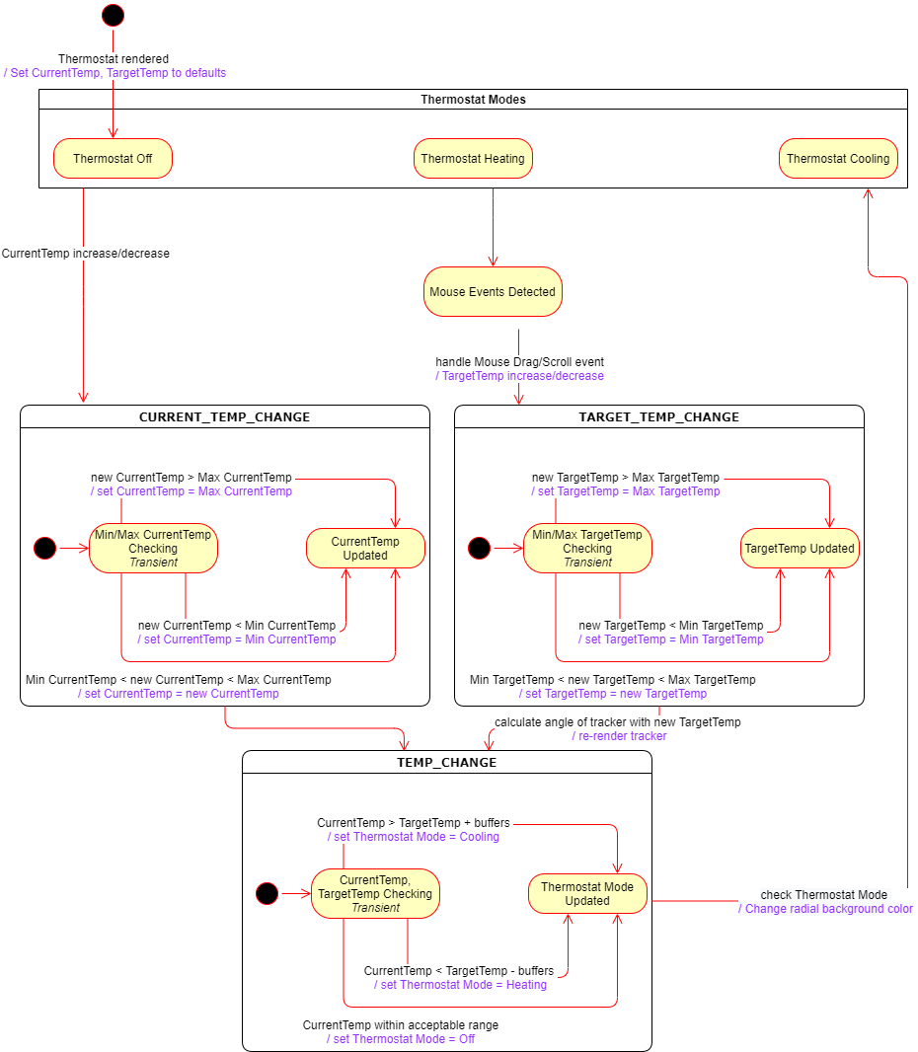
Statechart
https://github.com/dingheng4448/React-Thermostat-Radial-Slider/blob/master/documents/Statechart.drawio

Slide 5
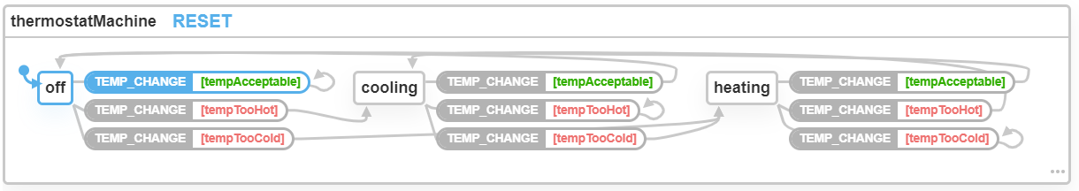
XState Statechart
Notes:
CODE TO COPY INTO XSTATE VISUALIZER ONLY:
const currentTemp = 72;
const targetTemp = 72;
const bufferComfort = 2;
const bufferCool = 1.5;
const bufferHeat = 1;
const ThermostatMachine = Machine(
{
id: 'thermostatMachine',
initial: 'off',
states: {
off: {
on: {
TEMP_CHANGE: [
{
target: 'off',
cond: 'tempAcceptable'
},
{
target: 'cooling',
cond: 'tempTooHot'
},
{
target: 'heating',
cond: 'tempTooCold'
}
]
}
},
cooling: {
on: {
TEMP_CHANGE: [
{
target: 'off',
cond: 'tempAcceptable'
},
{
target: 'cooling',
cond: 'tempTooHot'
},
{
target: 'heating',
cond: 'tempTooCold'
}
]
}
},
heating: {
on: {
TEMP_CHANGE: [
{
target: 'off',
cond: 'tempAcceptable'
},
{
target: 'cooling',
cond: 'tempTooHot'
},
{
target: 'heating',
cond: 'tempTooCold'
}
]
}
}
}
},
{
// Functions to help check if the current temperature is acceptable/too hot/too cold against the target temperature
guards: {
tempAcceptable: (context, event) => {
return ((targetTemp - (bufferComfort - bufferHeat)) < currentTemp &&
currentTemp < (targetTemp + (bufferComfort - bufferCool)))
},
tempTooHot: (context, event) => {
return (currentTemp > (targetTemp + bufferComfort + bufferCool))
},
tempTooCold: (context, event) => {
return (currentTemp < (targetTemp - bufferComfort - bufferHeat))
}
}
}
);

Slide 6
Define any Convenience Functions

Slide 7
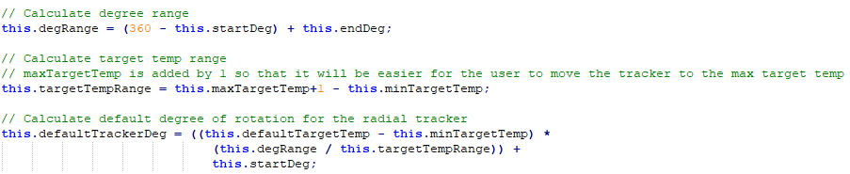
ThermostatModel.js
0
degRange is used to calculate the total range of degrees the user is allowed to slide the tracker through. Since I start with 0 or 360 from the top of the circle, my formula will calculate the left half of the radial before adding the right half.
targetTempRange calculates the range of the target temperature. However, I have added 1 to the max target temperature. Without it, the calculations would be very precise and the user would only be able to slide the tracker to the max target temperature on the 154th degree.
defaultTrackerDeg calculates the default angle which the tracker should be rotated to given the default target temperature.
208
154
180

Slide 8
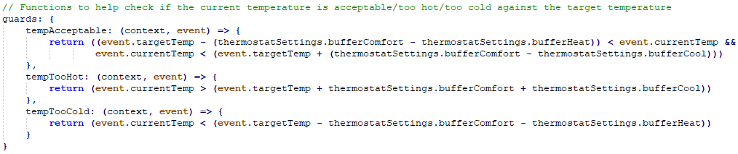
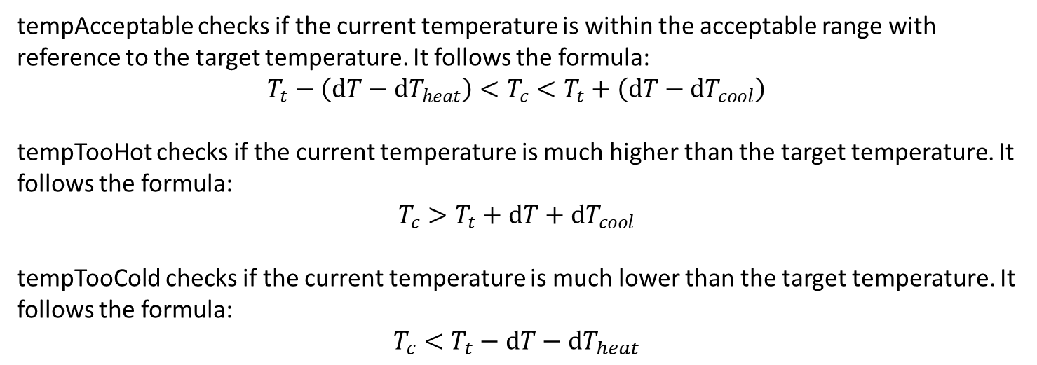
ThermostatMachine.js
tempAcceptable checks if the current temperature is within the acceptable range with reference to the target temperature. It follows the formula:
$$T_{t}−\left(dT−dT_{heat}\right)<T_{c}<T_{t}+\left(dT−dT_{cool}\right)$$
tempTooHot checks if the current temperature is much higher than the target temperature. It follows the formula:
$$T_{c}>T_{t}+dT+dT_{cool}$$
tempTooCold checks if the current temperature is much lower than the target temperature. It follows the formula:
$$T_{c}<T_{t}−dT−dT_{heat}$$

Slide 9
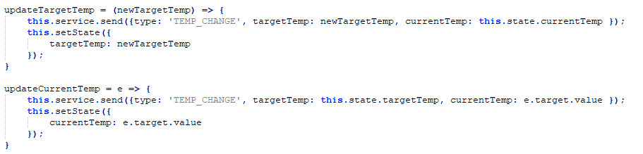
App.js
updateTargetTemp is used to update the state in the Xstate statechart as well as the target temperature displayed on the thermostat.
updateCurrentTemp is used to update the state in the Xstate statechart as well as the current temperature displayed on the thermostat.

Slide 10
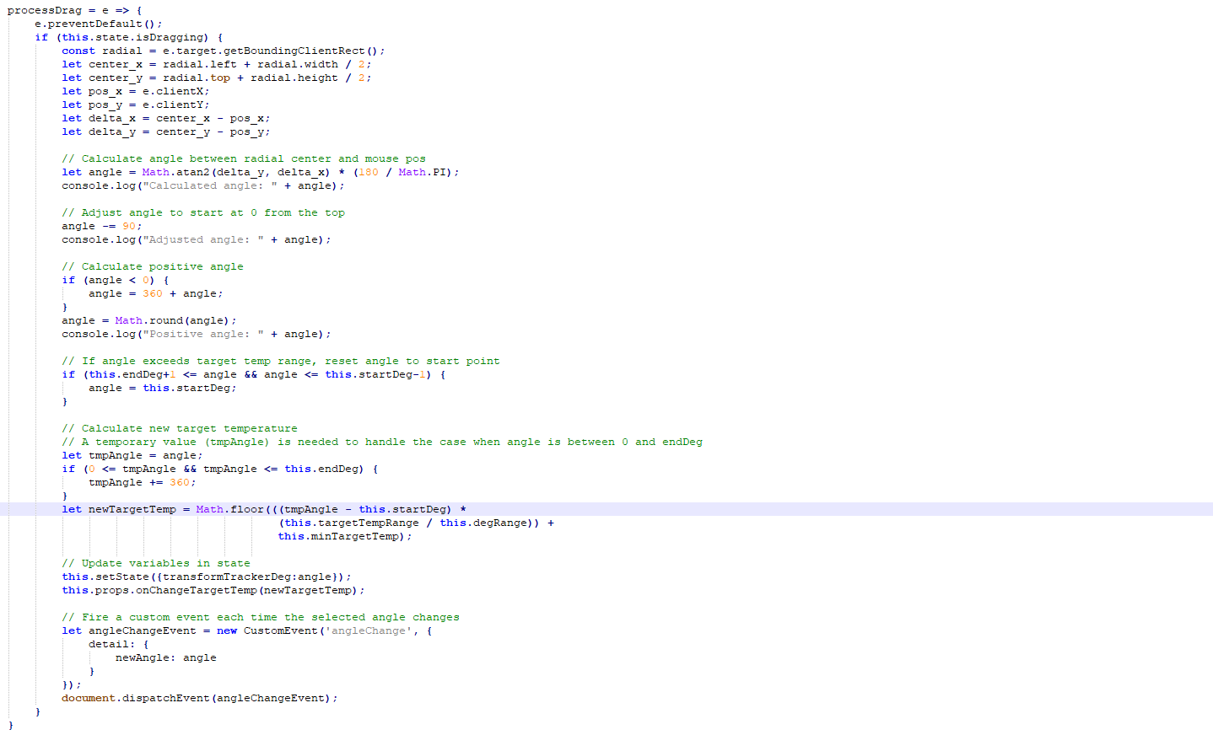
ThermostatView.js
processDrag is called upon detection that the user is dragging the radial tracker.
It calculates the angle of the tracker with respect to the center of the radial.
The calculated angle is then adjusted or reset if necessary.
The final calculated angle would be used to determine the new target temperature it corresponds to.
The state will then be updated to re-render the tracker’s rotation and reflect the new target temperature.
A custom event will also be fired each time the selected angle changes.

Slide 11
ThermostatView.js
pos(x,y)
delta_x
pos(x,y) are the coordinates of your current mouse pointer.
delta(x,y) is the length between the coordinates of the center and the mouse pointer.
delta_y
center(x,y)
The Math.atan2 formula will then help us calculate the angle using delta(y,x).
The formula calculates from the horizontal plane but I would like to start 0 degrees from the top of the circle. Hence, I have made some adjustments to the calculated angle and also ensured that the calculated angle is always positive.

Slide 12
ThermostatView.js
This ensures that the tracker will be limited to the boundaries of the predefined start and end angles.
Assuming we are using the default thermostat settings, 30 F covers an angle of 306 degrees.
1 F = 30 / 360.
From the angle the tracker is currently at, we can find its displacement from the start point and multiply it with 30/360 to find the increase in target temperature with respect to the min target temperature. Hence, adding the minimum target temperature at the end would give us our new target temperature.

Slide 13
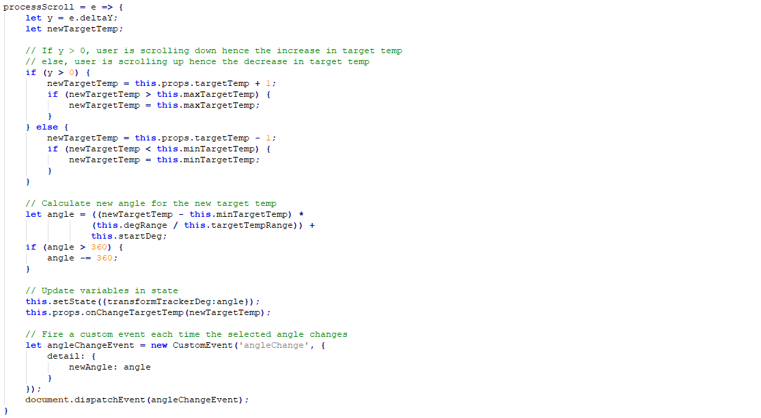
ThermostatView.js
processScroll adjusts the target temperature upon detecting the mouse scroll.
Like the processDrag function, the variables in state will be updated to reflect the new changes and a custom event will also be fired since the selected angle has changed.

Slide 14
ThermostatView.js
Depending on whether the user is scrolling up or down, the target temperature will be increased by a factor of 1. The will also be prevented from adjusting the target temperature beyond the min or max target temperature.
Assuming we are using the default thermostat settings, 30 F covers an angle of 306 degrees.
1 deg = 360 / 30.
From the new target temperature, we can find its displacement from the min target temperature and multiply it with 360/30 to find the increase in angle with respect to the start point. Hence, adding the starting angle at the end would give us our new angle which we would use to rotate the tracker.

Slide 15
Details of Radial Slider
The radial slider is setup according to the default values mentioned in the assignment brief. Only the starting and ending angles were hardcoded to ensure the UI resembles the required UI.
The radial slider is able to handle both mouse scroll and mouse drag to adjust the target temperature. To handle the mouse drag, the slider would first detect the user has pressed the mouse button (onMouseDown), followed by detecting the movement of the mouse (onMouseMove), and stop once the user is no longer pressing the mouse button (onMouseUp). A state (“isDragging” ) is used to facilitate this process.
The radial slider has been implemented with XState to manage the mode of the thermostat. Each time the target temperature or current temperature changes, a TEMP_CHANGE action would be sent to the service along with the current & target temperatures. The action would then complete and the state would change depending on the conditions specified in the guards{} section. Once the state has changed, the radial slider’s background would be re-rendered as its color will be changed depending on the mode of the thermostat.

Slide 16
Bonus: Overriding Mouse Wheel Scroll
The event onWheel is called on the RadialTrackerPath. It is used to detect if the user has scrolled while his mouse pointer is hovering above the RadialTrackerPath. Upon detecting the onWheel event, the processScroll function will be called and the thermostat will update its tracker, target temperature, and mode as described in the previous slides.

Slide 17
Justifications for Architecture and Technology Choices
The Model consists of ThermostatMachine and ThermostatModel. ThermostatModel is used to model the default settings of the thermostat. It can be used to instantiate a thermostat object by reading in values from a file. This will allow the app to be more dynamic as it will be easier to modify the default settings from a config file in future. The ThermostatMachine is also part of the Model and it handles business logic such as checking if the thermostat mode should be changed after temperature changes.
The View and ViewModel are actually coupled together in each component in React. However, it can still be seen that the render() functions in each component represents the View while the other logic and functions are used to dynamically change the UI and should thus be considered ViewModel.
From the assignment requirements, it can be seen that there are 2 main components, which are the thermostat view and the current temperature input view below the thermostat. Hence, I have split the View into these 2 main components and every other subcomponent of each View will be created in the respective View files, ThermostatView.js and CurrentTempInputView.js. Each subcomponent can actually be written in a separate file but I chose not to do so as the code of all the subcomponents can be easily managed in a single file. However, if this was a larger project, it would be better to split the code.
App.js is also used as the parent component of the entire application hence it is used to manage the states required for the thermostat to function.

Slide 18
Justification: Rendering Challenges and Approach
I used SVG to render each component as it was much easier for the application to handle events and easy for me to understand. Canvas would render graphics by pixels and thus not very suitable for an application like this.
Using SVG allowed me to dynamically set the properties of a component and CSS would work with it too.
The most challenging component to render was the RadialBorder where I had to use the SVG path to draw an arc. It was solved after researching examples online and a lot of trial and error.

Slide 19
References
Arc Initialization & Gradient
http://xahlee.info/js/svg_circle_arc.html
https://stackoverflow.com/questions/30147879/how-to-draw-a-linear-gradient-circle-by-svg
Radial Slider
https://codepen.io/jon-walstedt/pen/qlofJ
https://jsfiddle.net/b3k9hjLc/
https://codepen.io/MyXoToD/pen/xGRrgQ
https://codepen.io/bbx/pen/QBKYOy
Xstate with React JS
https://www.skcript.com/svr/finite-state-machines-in-react-js-using-xstate/
https://stackoverflow.com/questions/59602381/xstate-js-how-to-send-context-to-a-machine

Slide 20
README: project files organization
React-Thermostat-Radial-Slider/
src/
images/
radialLines.png (To render the grooves on the radial)
model/
ThermostatMachine.js (Describes the statechart for the thermostat and also contains the business logic to determine the mode of the thermostat.)
ThermostatModel.js (Describes the default settings for the thermostat.)
view/
current-temp-input-view.css (Styling for the current temperature input view below the thermostat.)
CurrentTempInputView.js (Renders the current temperature input view.)
thermostat-view.css (Styling for the thermostat view.)
ThermostatView.js (Renders the thermostat view and all its subcomponents. Also contains UI logic to dynamically render the UI.)
App.css
App.js (Parent component of the ThermostatView and CurrentTempInputView. Manages the state which subcomponents rely on to dynamically render their views.)
index.css
index.js
ThermostatSettings.json (Holds the data of the default settings for the thermostat.)
Provide more details describing purpose of each file.

