Slide 1

The Romantic Paradox
11/12/2024

Slide 2
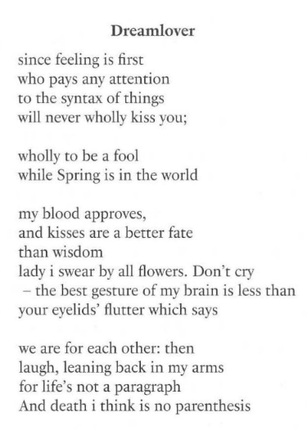
The Poem
Some features of and themes from the poem, according to Jenkins:
Benevolent Sexism
"Feeling First"
The idea is that we ought to focus on feeling positive emotions, like love, instead of being bothered by other things.
Feelings and rational thought are opposed to each other.

Slide 3
The Recipe for the Romantic Dream
"A rich man and a beautiful woman just have to stumble across each other by accident, fall passionately in love with each other at first sight, then, after some trials (which they eventually overcome) they will experience permanent happiness together."
"Contemporary romcoms proceed from a cute initial meeting, through a series of apparently insuperable obstacles, to a surprise resolution that brings about the desired "happy ending" for the couple."
We get a script here. But does the script really suffice to give us happiness? And is it necessary for happiness?
Jenkins suggests that you don't need to follow the script to be happy. For example, she says that she is happy, even though she is not monogamous.
Jenkins also argues that if we don't follow the script, we might feel less satisfied because of the lack of support from friends, family, and society.

Slide 4
Eros
An ancient Greek word that means something like love, passion, or erotic desire.
Often contrasted with agape and philia.
Anne Carson argues that eros as a bittersweet emotion.
That is, it isn't an exclusively pleasurable emotion—it is also painful!
Eros involves a kind of desire, on this picture. Jenkins says that it is a "desperate grasping for the "beloved"" that can never fully be satisfied. After all, you can't desire something that you already have!
Do you think that your own understanding of romantic love is simillar to this conception of eros?
Does this mean that the emotion is irrational?

Slide 5
The Romantic Mystique
"A piece of romantic ideology that tells us love is an ineffable mystery, in the face of which we do best simply to surrender."
Can we control/understand love?
Limerence vs love.
Jenkins worries that we often conflate the two!

Slide 6
The Paradox of Happiness
The Paradox of Happiness: Trying to be happy actually makes us unhappy!
We'll be too worried about what we don't have, too stressed about how we feel, etc.
We won't do things because they are meaningful in themselves, instead we will be doing them only because they might bring us to be happy.
Does this sound right?

Slide 7
The Romantic Paradox
Jenkins proposes that chasing the romantic "happily ever after" makes us unhappy.
The stakes are too high/stressful!
The cultural understanding of eros suggests that such a desire can't even be satisfied!
Nothing lasts forever!
Is Jenkins right about this?

Slide 8
Static vs Dynamic Love
The romantic ideal, says Jenkins, is static.
""Happy ever after" comes at the end of the story because, once it arrives, there's nothing else to tell. Nothing ever changes."
On a dynamic picture, love is seen as more of a journey, instead of a destination.
Jenkins cites some empirical work to make the case that people are more satisfied with their romantic relationships when they focus on a dynamic picture of love.

Slide 9
Some further topics to discuss (if we have time)
Hedonism
Cheating spouse case
The Experience Machine
Alternatives to Hedonism
Desire-satisfaction theory
Objective list theories
Is love ineffable? Are all experiences ineffable?
Mary's room
Types of Mental States
Propositional attitudes vs qualia
Direction of fit
Mind to world vs world to mind
Folk Psychology

