Slide 1
Differential Test with Generalized Linear Model
MCB 595A Genomics Journal Club
Jiacheng Ding
Cusanovich Lab
April 14th, 2025
An edgeR based discussion
edgeR tutorial - https://www.bioconductor.org/packages/devel/bioc/vignettes/edgeR/inst/doc/edgeRUsersGuide.pdf
limma paper - lhttps://pmc.ncbi.nlm.nih.gov/articles/PMC4402510/
edgeRv4 paper - https://academic.oup.com/nar/article/53/2/gkaf018/7973897
Notes:
https://statomics.github.io/SGA/sequencing_countData.html Var^2 = sum(xi – xm) ^ 2/ n-1 Var = standard deviation ^ 2

Slide 2
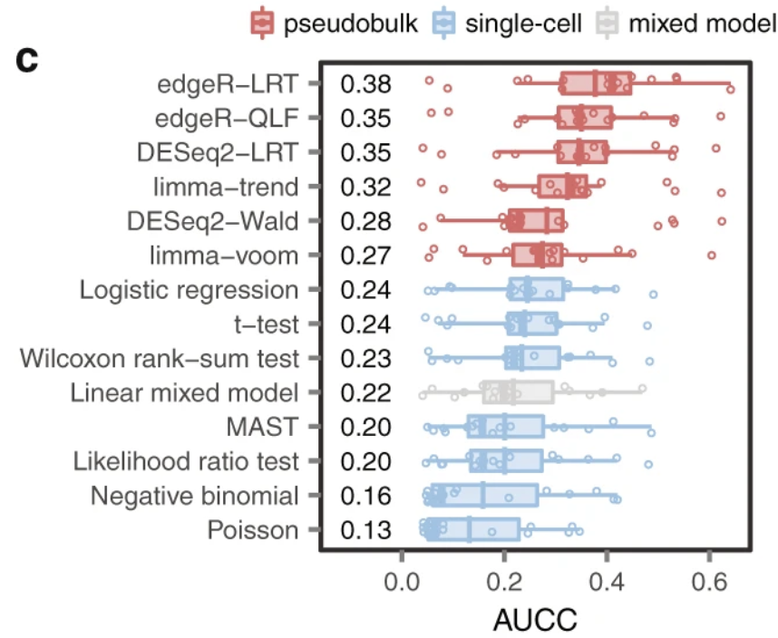
Center of quantification study: differential test
Differential testing is at the heart of most quantification-based genomics studies, not only for traditional bulk genomics assay, but also for single-cell genomics assay..
GRN
Gene Ontology
Differential Test
Biomar-kers
Motif Enrich-ment
…
Squair, J. W., et al. "Confronting false discoveries in single-cell differential expression. Nat. Commun. 12, 5692." 2021,
Murphy, Alan E., Nurun Fancy, and Nathan Skene. "Avoiding false discoveries in single-cell RNA-seq by revisiting the first Alzheimer’s disease dataset." Elife 12 (2023): RP90214.
Murphy, A. E., and N. G. Skene. "A balanced measure shows superior performance of pseudobulk methods in single-cell RNA-sequencing analysis. Nat Commun. 2022; 13: 7851."

Slide 3
What’s happening under the hood of differential test?
Have you encountered:
1) I observed grouping effects on PCA plots / heatmap, however only a handful of features tested significant.
2) I had one sample in a group, and I want do differential test.
3) I saw genes with very high log fold changes; however, p-values were not significant.
4) Differential test software asked me to plot a bunch of plots, however I don’t understand.
…
What’s going on under the hood of differential test?

Slide 4
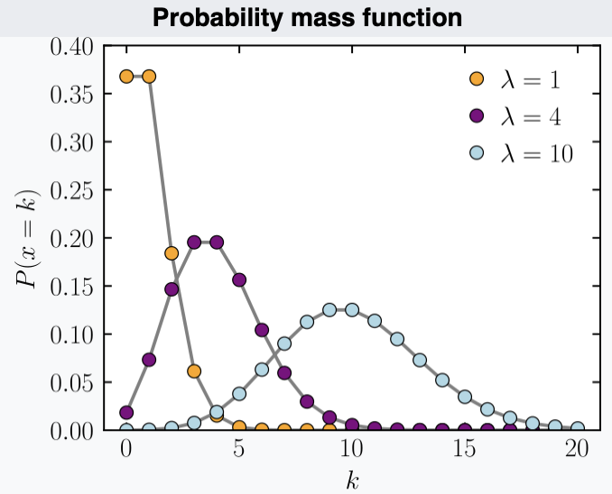


Quantification test relies on underlying model / assumptions
Quantification test hinges on proper model predicting what is true, because:
1) Raw data is noisy.
2) Models give expectation and a way to measure surprises (variations).
In RNA-seq word, we now know gene expression counts are often model as negative binomial distribution, however…
$$X\sim Poisson\left(μ\right)$$
There is a rationale behind modeling RNA-seq counts with Poisson distribution (especially for experiments with only technical replicates).
If we consider sequencing is a process of sampling molecules from a mixed soup of RNA, the only thing contributing to sampling probability is the relative abundance of those RNA molecules.
Under this assumption, the only source of randomness is the sampling process itself, and the number of reads assigned to a gene follows a Poisson distribution.
$$Var(X)=μ$$
Wikipedia: Poisson distribution
Bullard JH, Purdom E, Hansen KD, Dudoit S. Evaluation of statistical methods for normalization and differential expression in mRNA-Seq experiments. BMC Bioinform. 2010;11(1):1–13.

Slide 5
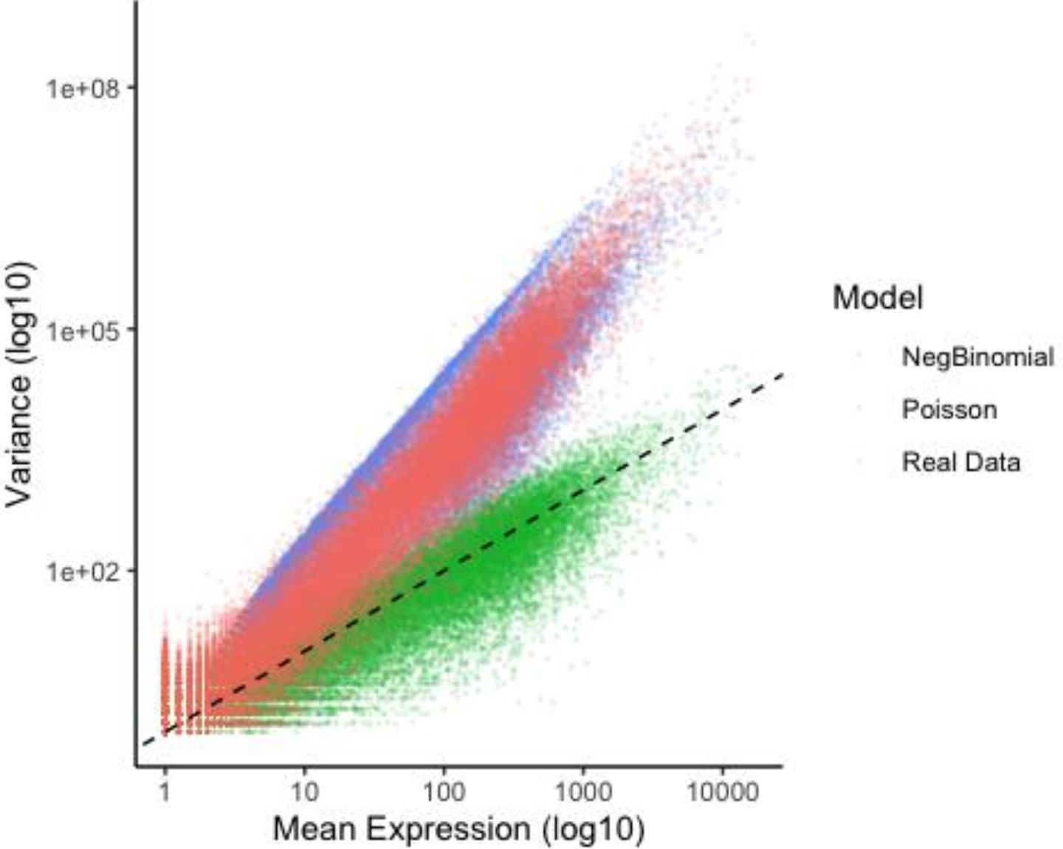

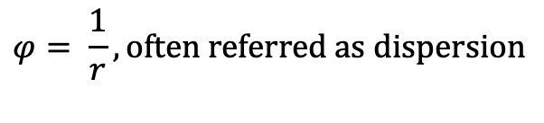

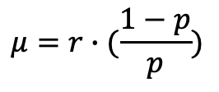

Real life is never perfect
Real life RNA-seq data is much nosier, because:
1) PCR amplification noise.
2) Sequencing bias (e.g., clustering efficiency).
3) Co-expression.
….
$$X\sim Poisson\left(μ\right)$$
$$Var(X)=μ$$
----------------------------------------
$$Y\sim NB\left(r, p\right) or equivalently Y\sim NB(μ,φ)$$
$$μ=r∙(\frac{1−p}{p})$$
$$Var\left(Y\right)=μ+φ∙μ^{2}$$
overdispersion / mean-variance trend
$$φ= \frac{1}{r}, often referred as dispersion$$

Slide 6
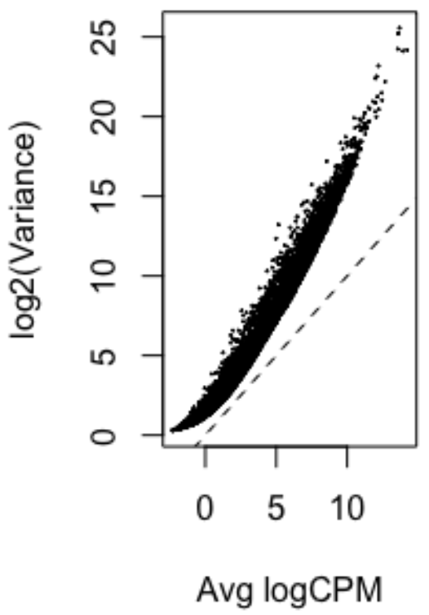
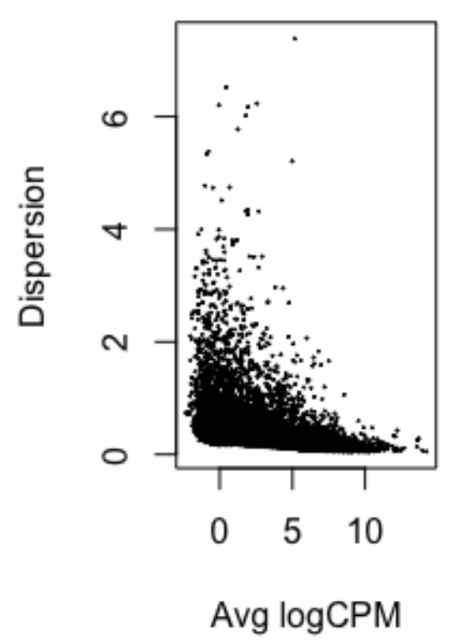
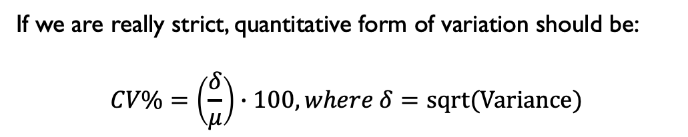
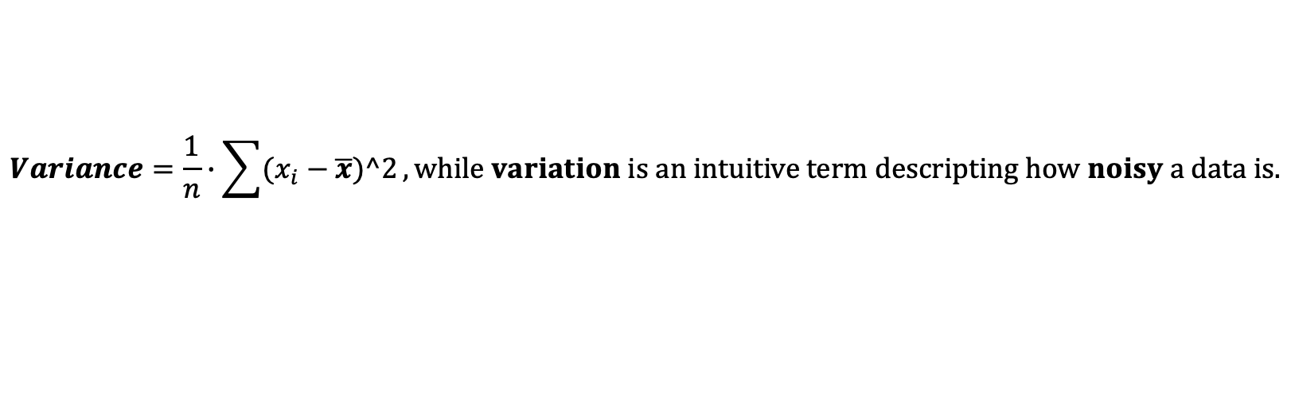

Variance & dispersion
When people talk about a distribution, we often hear mean, median, variance, variation, deviation, standard deviation, etc.…
$$Variance=\frac{1}{n}∙\sum{(x_{i}−\overline{x})^2}, while variation is an intuitive term descripting how noisy a data is.$$
$$Y=NB\left(r, p\right) or equivalently Y=NB(μ,φ)$$
$$Var\left(Y\right)=μ+φ∙μ^2$$
Variance
of unit of (counts)^2
‘variation’, unitless
If we are really strict, quantitative form of variation should be:
$$CV\%=\left(\frac{δ}{μ}\right)∙100, where δ=sqrt(Variance)$$
Notes:
CV = SD / mean SD = sqrt(Var)

Slide 7
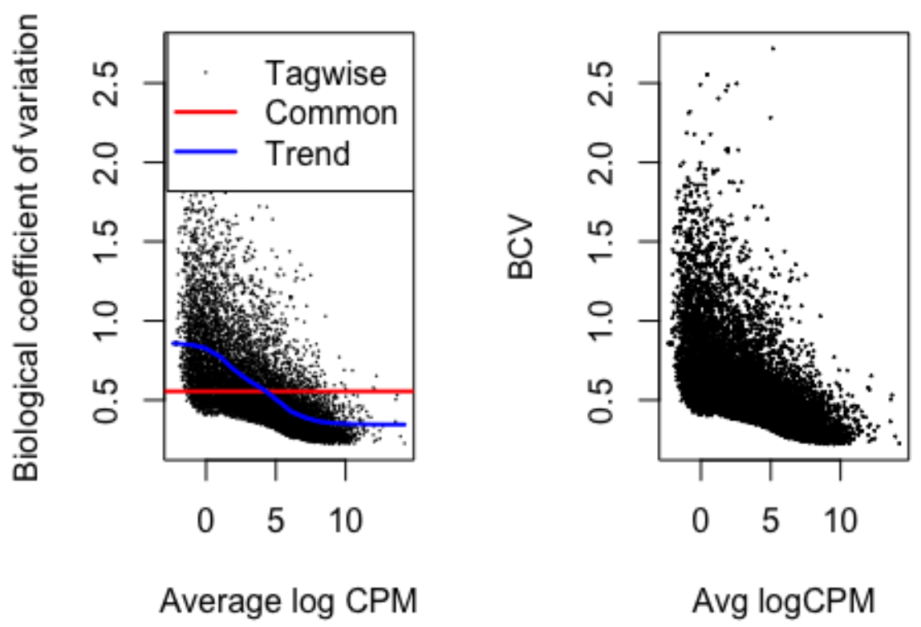

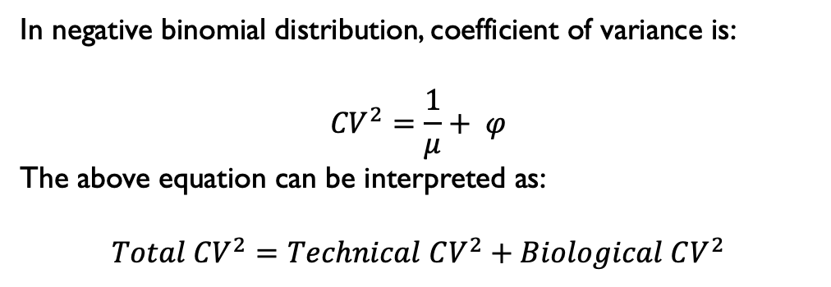
Coefficient of variance
In negative binomial distribution, coefficient of variance is:
$${CV}^{2}=\frac{1}{μ}+ φ$$
The above equation can be interpreted as:
$$Total {CV}^{2}=Technical CV^{2}+Biological CV^{2}$$
Noise from Poisson model (ideal model)
Additional noise (real world correction)
$$Biological CV^{2}= φ$$
Notes:
CV = SD / mean SD = sqrt(Var)

Slide 8
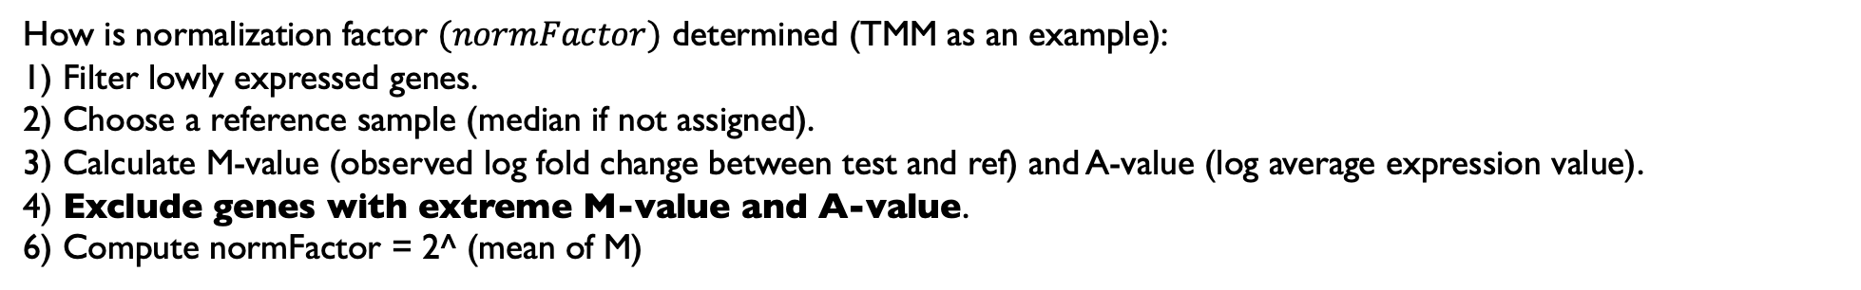
Normalization
What’s the goal of normalization?
Normalization: to make non-differentially expressed genes have similar expression values across samples, and true biological differences stand out.
$$log\left(μ\right)=log\left(libSize ∙normFactor\right)+β$$
Expression value adjustment
Often referred as normalization offset / effective library size
where expression adjustment happens
How is normalization factor $(normFactor)$ determined (TMM as an example):
1) Filter lowly expressed genes.
2) Choose a reference sample (median if not assigned).
3) Calculate M-value (observed log fold change between test and ref) and A-value (log average expression value).
4) Exclude genes with extreme M-value and A-value.
6) Compute normFactor = 2^ (mean of M)
Reflects the assumption that most of genes are not differential!

Slide 9
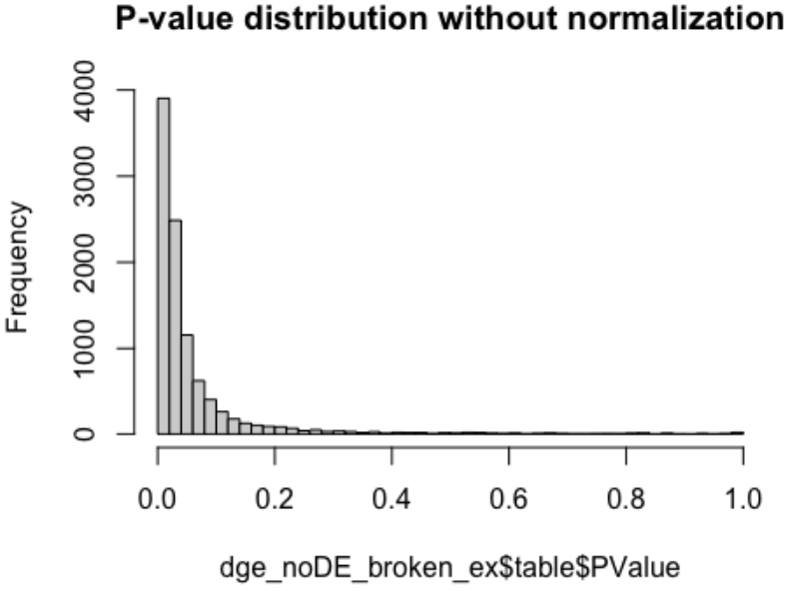
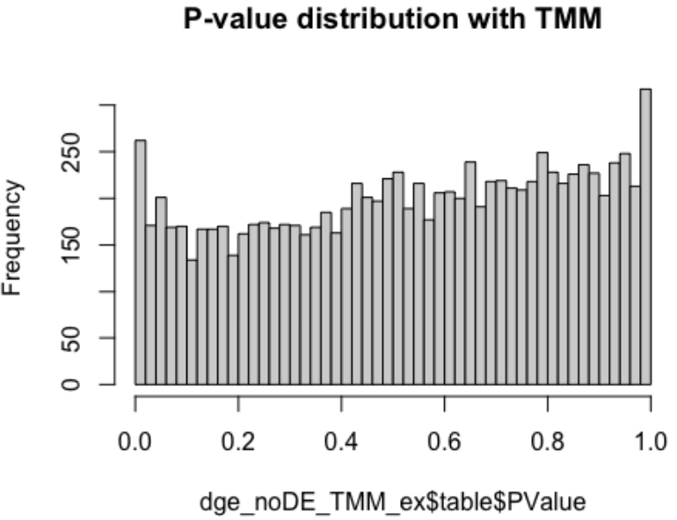
What if I don’t normalize my data?
Matrices | Simulation_1 | Simulation_2
N condition | 2 | 2
N Samples | 4 | 4
N genes | 10,000 | 10,000
N true DEs | 0 | 0
Lib Size control | 1e7 | 1e7
Lib size treatment | 1e8 | 1e8
Normalization | None | TMM
Detected Des (p-va < 5%) | 7,053 | 538
Detected Des (FDR < 5%) | 320 | 13
Please refer R script for an extension about batch effects.
Notes:
The probability, under the null hypothesis, of observing a test statistic as extreme or more extreme than the one observed.

Slide 10
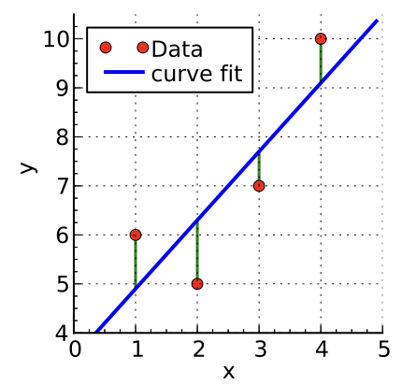
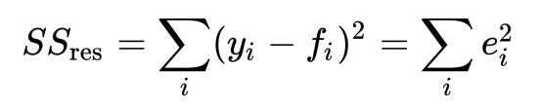
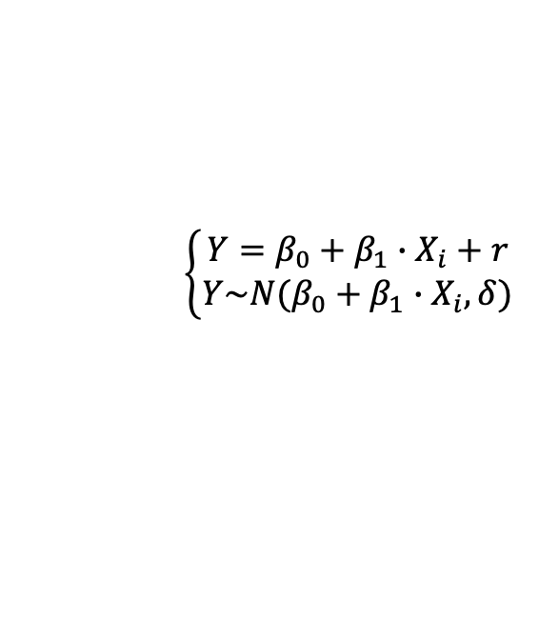


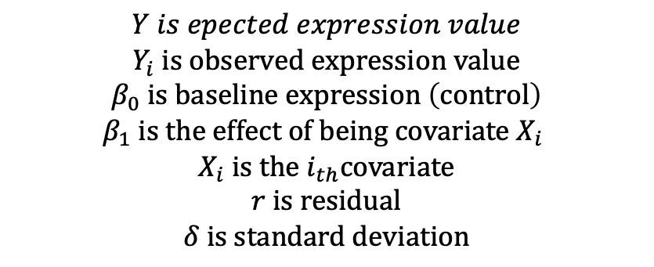


Classic linear model (CLM)
Classic linear model (CLM):
$$Y is epected expression value$$
$$Y_{i} is observed expression value$$
$$β_{0} is baseline expression \left(control\right)$$
$$β_{1} is the effect of being covariate X_{i}$$
$$X_{i} is the i_{th}covariate$$
$$r is residual$$
$$δ is standard deviation$$
$$\left\{\begin{aligned}Y=β_{0}+β_{1}∙X_{i}+r \\ Y\sim N(β_{0}+β_{1}∙X_{i},δ) \end{aligned}\right.$$
mean
$$Var\left(Y\right)= δ^{2}, constant across genes$$
$$r=Y −Y_{i}, with r \sim N(0,δ)$$
$$residual r is used to estimate δ$$
How spread $β_{1}$ is (uncertainty)
Doesn’t account for mean-variance relationship / overdispersion
Wikipedia: linear regression

Slide 11
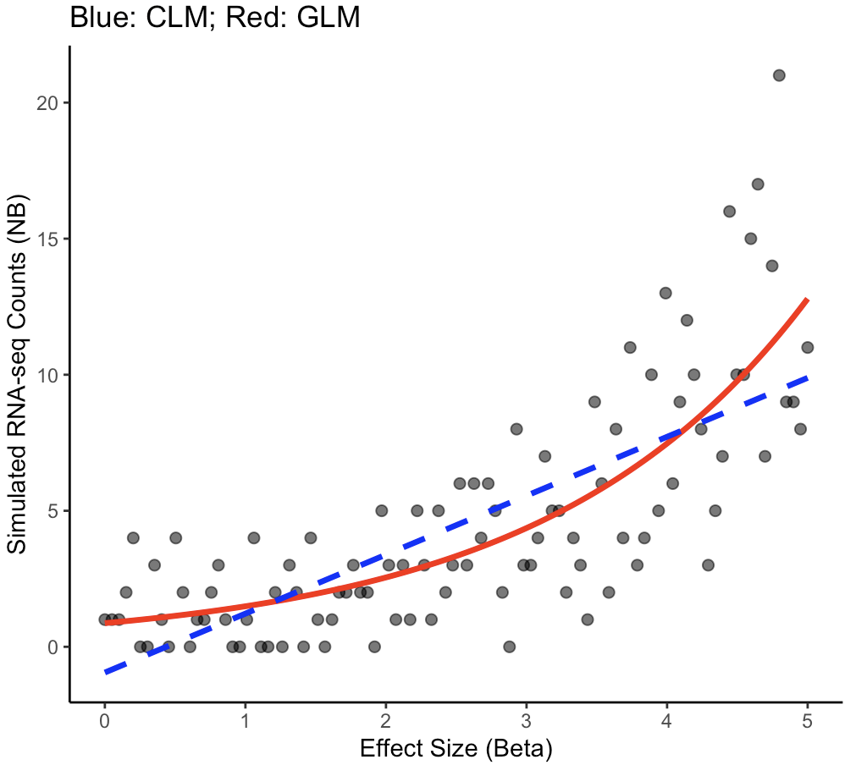

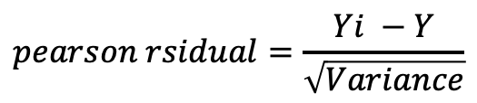
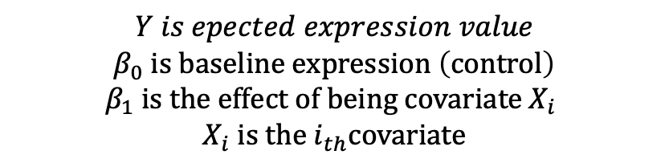
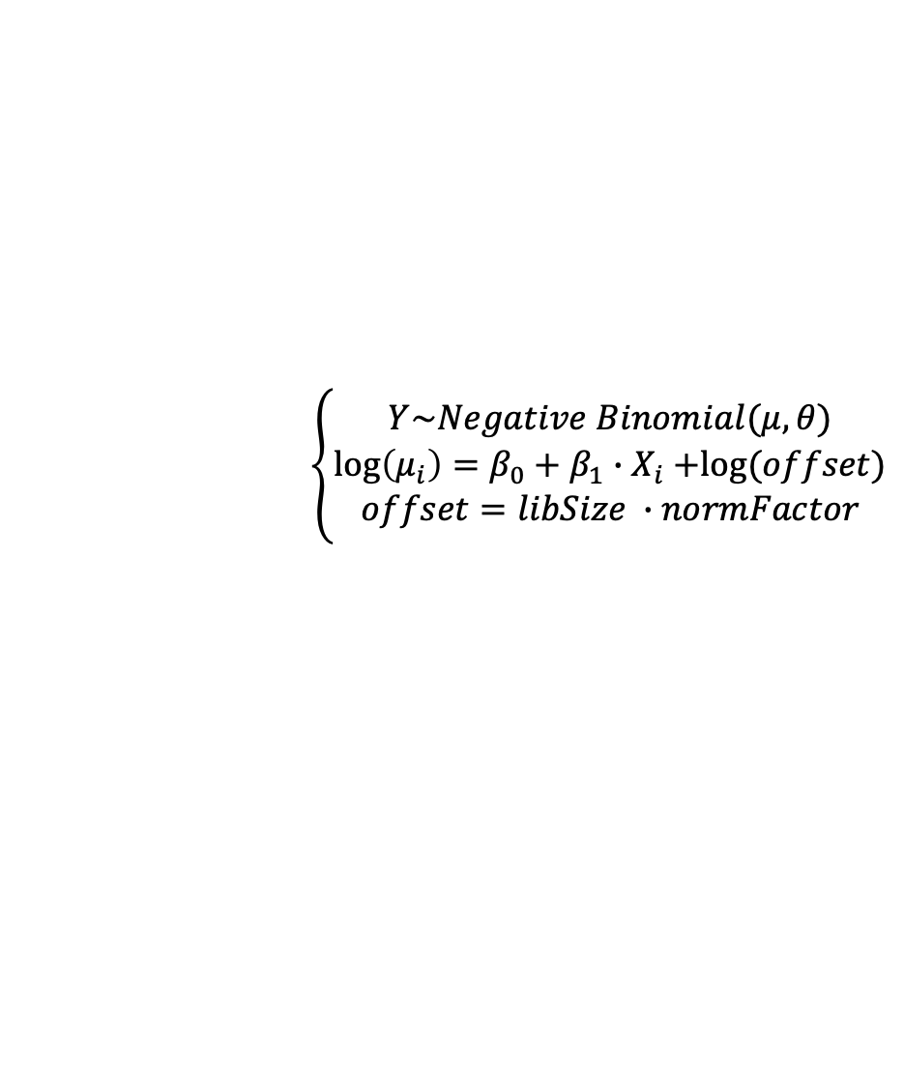
Generalized liner model (GLM)
Generalized linear model (GLM via NB):
$$\left\{\begin{aligned}Y\sim Negative Binomial(μ,θ) \\ \log\left(μ_{i}\right)=β_{0}+β_{1}{∙X}_{i}+log⁡(offset) \\ offset=libSize ∙normFactor\end{aligned}\right.$$
link function
$$,with Var\left(Y\right)=μ+φ∙μ^{2}, varies across genes with different mean$$
$$Y is epected expression value$$
$$β_{0} is baseline expression \left(control\right)$$
$$β_{1} is the effect of being covariate X_{i}$$
$$X_{i} is the i_{th}covariate$$
You may notice there is no explicit residual in GLM, because variance is a function of mean, while CLM variance is an independent term.
However, it does NOT mean residual doesn’t exist. It is implicit instead.
$$pearson rsidual=\frac{Yi −Y}{\sqrt{Variance}}$$

Slide 12
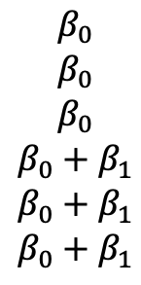

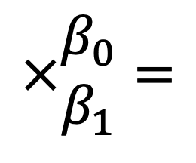
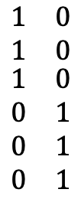
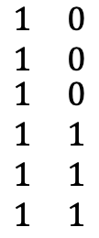

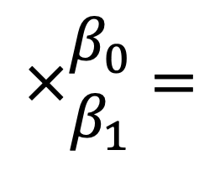
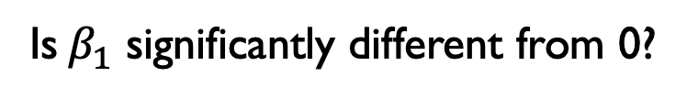
”A gene is differentially expressed”
Sampe1, Sample2, Sample3 – control – $β_{0}$
Sample4, Sample5, Smaple6 – treatment – $β_{1}$
Is $β_{1}$ significantly different from 0?
treatment
treatment
Intercept
control
Sampe1
Sample2
Sample3
Sample4
Sample5
Sample6
Sampe1
Sample2
Sample3
Sample4
Sample5
Sample6
$$\begin{matrix}1 & 0 \\ 1 & 0 \\ \begin{aligned}1 \\ 1 \\ 1 \\ 1\end{aligned} & \begin{aligned}0 \\ 1 \\ 1 \\ 1\end{aligned}\end{matrix}$$
$$\begin{matrix}β_{0} \\ β_{0} \\ \begin{aligned}β_{0} \\ {β_{0}+β}_{1} \\ β_{0}+β_{1} \\ {β_{0}+β}_{1}\end{aligned}\end{matrix}$$
$$\begin{matrix}1 & 0 \\ 1 & 0 \\ \begin{aligned}1 \\ 0 \\ 0 \\ 0\end{aligned} & \begin{aligned}0 \\ 1 \\ 1 \\ 1\end{aligned}\end{matrix}$$
$$\begin{matrix}β_{0} \\ β_{0} \\ \begin{aligned}β_{0} \\ β_{1} \\ β_{1} \\ β_{1}\end{aligned}\end{matrix}$$
$$×\begin{matrix}β_{0} \\ β_{1}\end{matrix}=$$
$$×\begin{matrix}β_{0} \\ β_{1}\end{matrix}=$$
6 X 2 %*% 2 x 1 = 6 x 1
6 X 2 %*% 2 x 1 = 6 x 1
X = model.matrix(~0 + treatment) # no intercept
More flexibility – draw any comparisons
X = model.matrix(~treatment) # with intercept (common baseline)
fit.test <- glmQLFtest(fit, coef = 2)

Slide 13
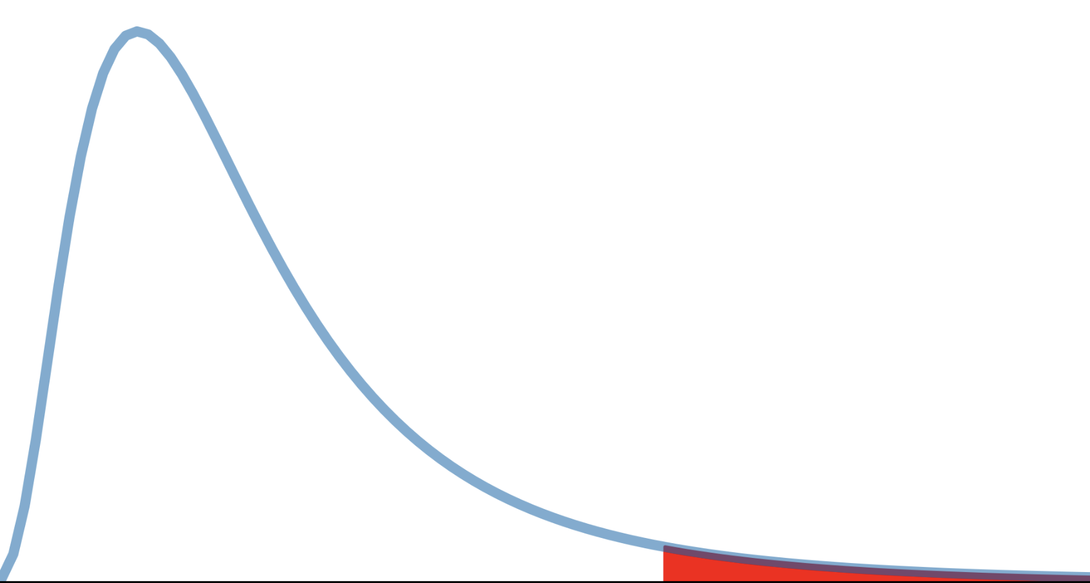
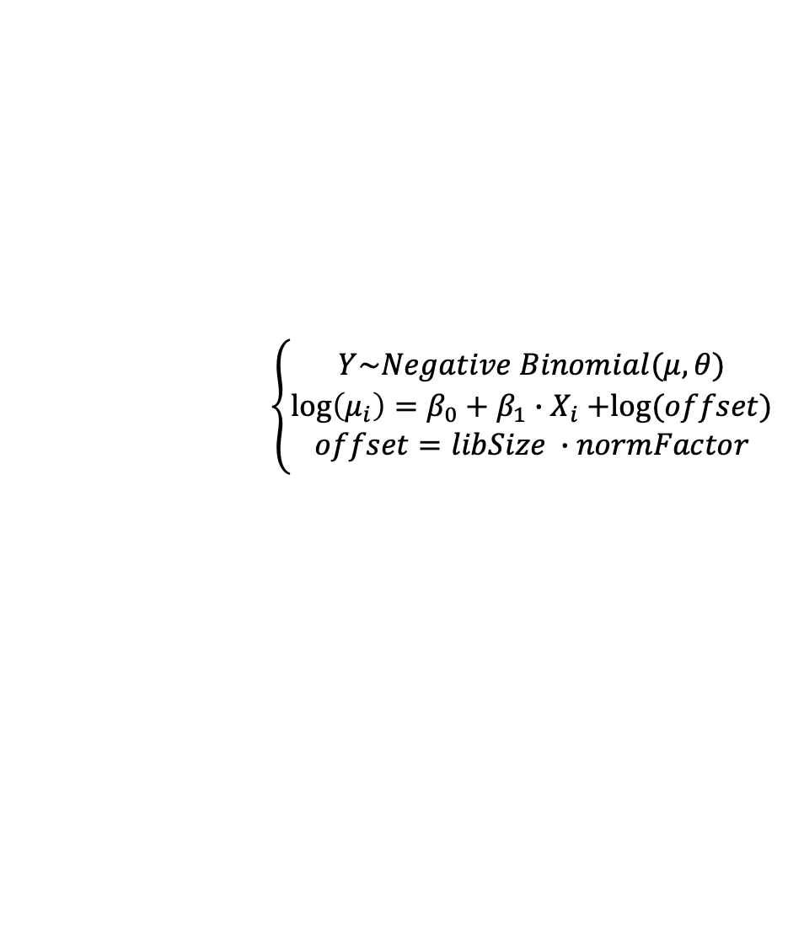
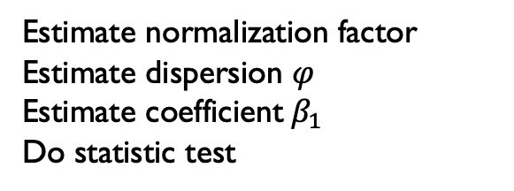
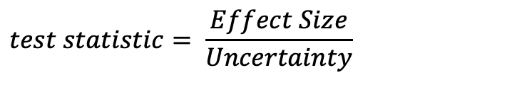
Two Pillars of GLM via NB
Two pillars of GLM with NB model are: dispersion and coefficients
y <- calcNormFactors(y, method = ‘TMM’)
y <- estimateDisp(y, tagwise = T)
fit <- glmFit(y)
fit.test <- glmLRT(fit)
Estimate normalization factor
Estimate dispersion $φ$
Estimate coefficient${ β}_{1}$
Do statistic test
$$\left\{\begin{aligned}Y\sim Negative Binomial(μ,θ) \\ \log\left(μ_{i}\right)=β_{0}+β_{1}{∙X}_{i}+log⁡(offset) \\ offset=libSize ∙normFactor\end{aligned}\right.$$
$Log\left(μ\right)=\log\left(libSize ∙normFactor\right)+β_{1}{∙X}_{i},β is effect size$
$$Var\left(β\right)= μ+θ∙μ^{2} , hence SE\left(β\right) ∝sqrt\left(φ\right) is uncertainty$$
$$test statistic= \frac{Effect Size}{Uncertainty}$$
FDR is enough for determining significance. LogFC > 0.5 is redundant
Wikipedia: F test

Slide 14
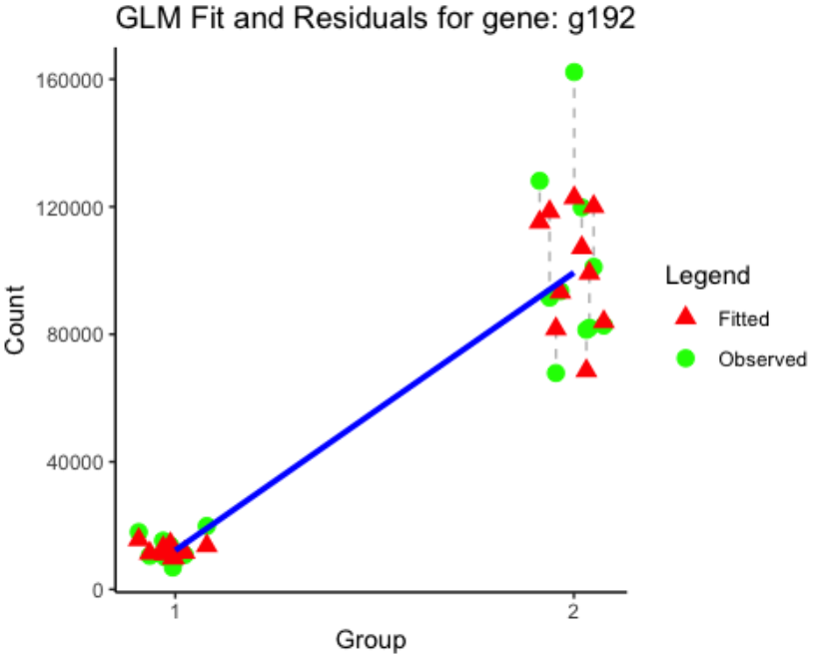
It’s fun to reconstruct GLM with internalized knowledge
One function is all we need for reconstructing the generalized linear model:
$Y_{i}\sim Y=2^(β_{0}$+ $β_{1}{∙X}_{i}+\log\left({libSize}_{i}∙{normFactor}_{i}\right))$

