Slide 1
Image-Service
AFS

Slide 2
Directory
Summary
Domain
Overview
What can I do
Structure
The App how to work
How Can I Use AFS
MogileFS ?

Slide 3
Summary
Anjuke File System ==➔ AFS Also Image-Service ?
For the storage and display of pictures
Almost all the pictures of Anjuke.Inc

Slide 4
Domain
Pic1.ajkimg.com ==➔ Display
Upd1.ajkimg.com ==➔ Upload
New:
pic1.ajkimg.com/display/anjuke/$verify-$description/$key-$widthx$height.jpg
Images.anjuke.com
Upd1.anjuke.com
Upload1~18.anjuke.com
Images1~18.anjukestatic.com
…….

Slide 5
Overview
30,000,000 display on LB without CDN every day
900,000 upload every day
More than two hundred million pictures
More than one hundred million comment info
60 TB hard disk + 14TB hard disk
1~1.5TB monthly growth
16 squid machines + more than 12 app machines + 13 mogilefs machines + 2 LB

Slide 6
What can I do
No single point of failure & No raid
Rebalance & Replicate
For application is transparent
Disk expansion

Slide 7
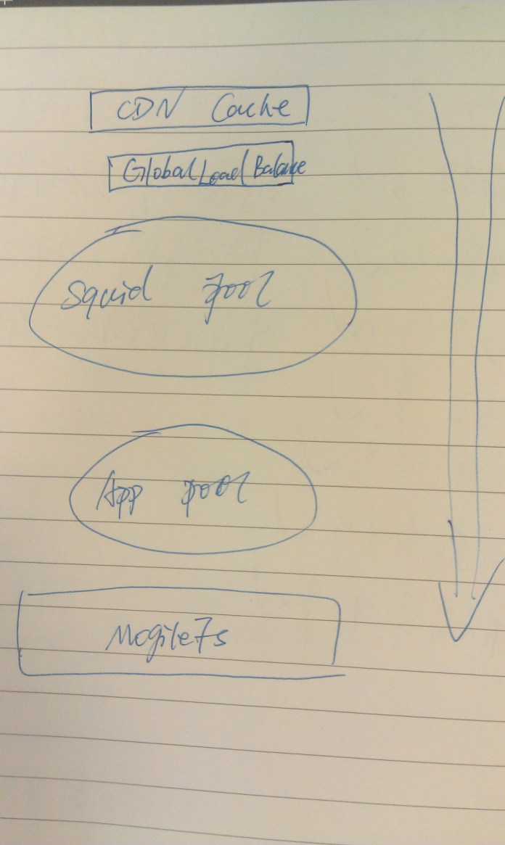
Structure

Slide 8
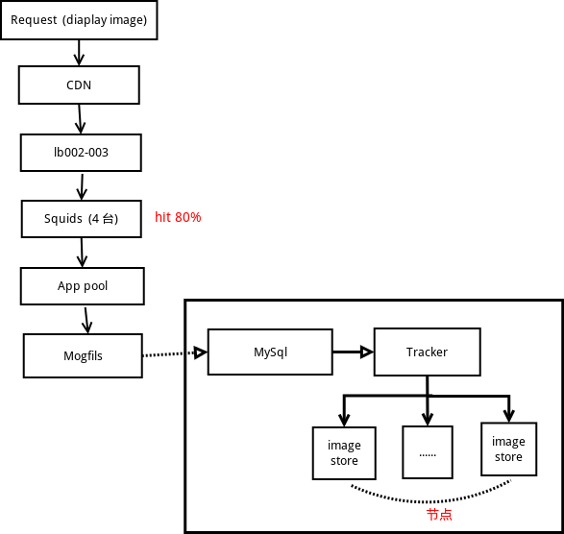
Structure

Slide 9
The App how to work
Nginx + PHP-FPM
ImageMagick PHP API (Imagick) OR GD?
Develop by V2
Simple to implement & convenient to deploy & acceptable performance
33 pictures display one machine per second

Slide 10
Display
http://pic1.ajkimg.com/display/aifang/c99f019dcb363e239c63617c05220a36/120x90.jpg
Filename == c99f019dcb363e239c63617c05220a36
Width = 120 & height = 90 (comonconfig check)
And more parameters…
Route ==➔ $config['mappings']['Image_Aifang_Display'] = array(
'^/display/aifang/([0-9a-z_\-]+)/([0-9]+)x([0-9]+)([a- z]?)\.jpg$’)
APF_Route ==➔ image/aifang/display.php controller

Slide 11
How Can I Use AFS Upload
<?php
$file_path = "foobar.png";
$finfo = finfo_open(FILEINFO_MIME_TYPE);
$file_type = finfo_file($finfo, $file_path);
$params = array(
"file" => "@" . $file_path.";type=".$file_type,
);
$ch = curl_init();
curl_setopt($ch,CURLOPT_URL,
"http://upd1.ajkimg.com/upload");
curl_setopt($ch, CURLOPT_POST, 1);
curl_setopt($ch, CURLOPT_POSTFIELDS, $params);
curl_setopt($ch, CURLOPT_RETURNTRANSFER, 1); echo
curl_exec($ch);

Slide 12
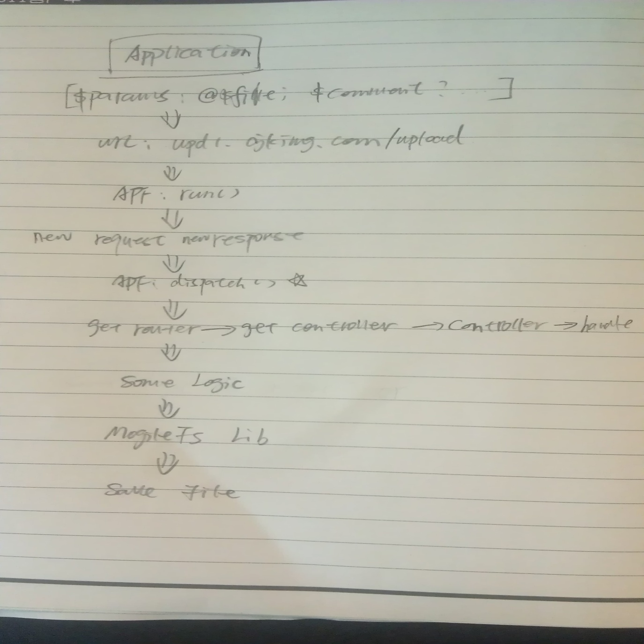
Upload Process

Slide 13
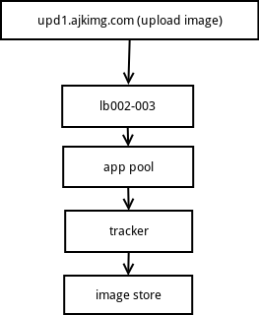
Upload Process

Slide 14
Display
String concatenation
http://pic1.ajkimg.com/display/${id}/600x600.jpg
Reference app-images/config/route.php & app-images/config/common.php
http://git.corp.anjuke.com/cgit/corp/image-service.git/tree/HOWTOUSE.markdown

Slide 15
Display Process
Like the Upload Process

Slide 16
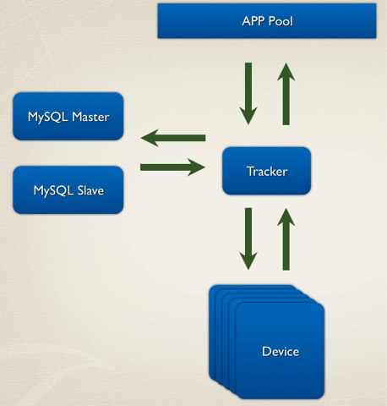
MogileFS

Slide 17
Install
http://wiki.corp.anjuke.com/index.php?title=Dfs#tracker
Any question:
Sysdev
mingshi@anjuke.com
8023

Slide 18
Thank You!

