Slide 1
Automatic 3D neuron tracing using all-path pruning
(APP)
Keywords
ICR : initial over-complete reconstruction
MCMR: Maximal-covering minimal redundant
DLP: Dark-leaf pruning
CLP: Covered-leaf pruning
INP: Inter-node pruning

Slide 2
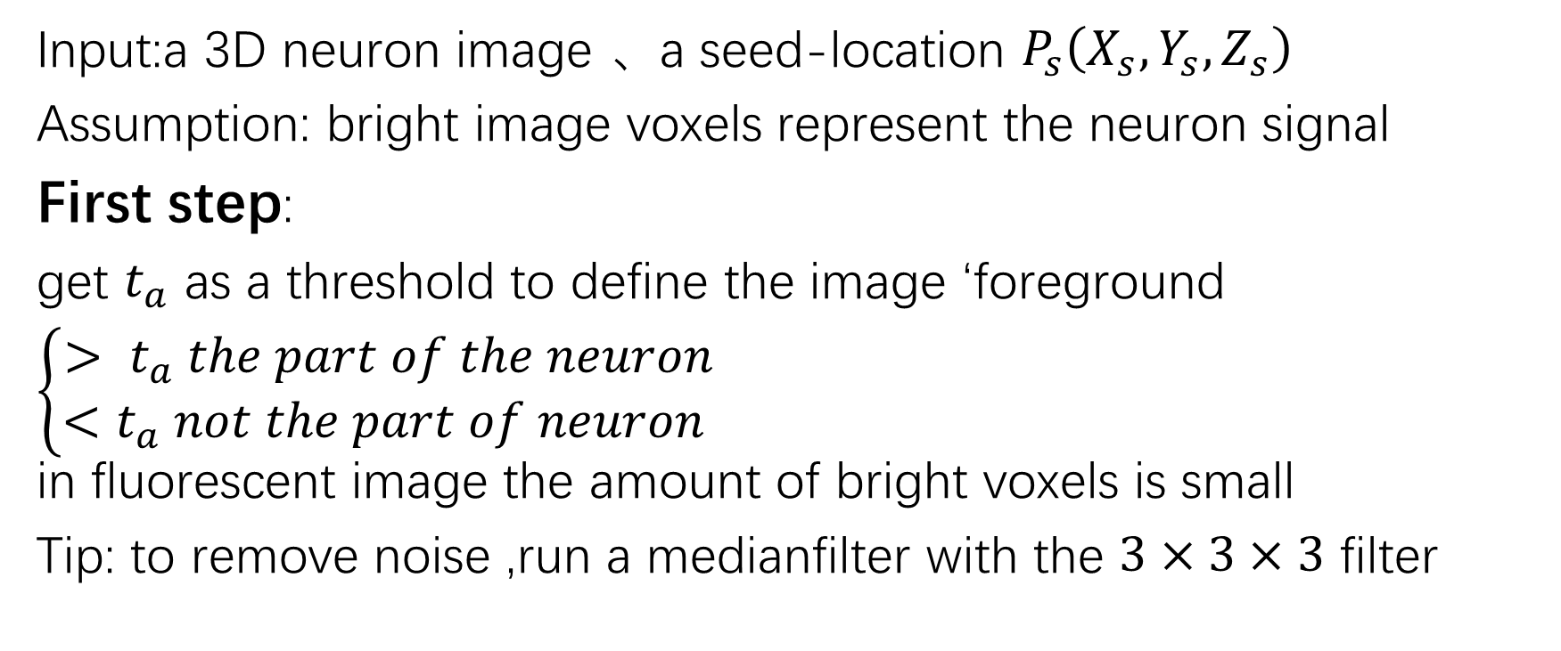
ICR
Input:a 3D neuron image 、a seed-location $P_{s}\left(X_{s},Y_{s},Z_{s}\right)$
Assumption: bright image voxels represent the neuron signal
First step:
get $t_{a}$ as a threshold to define the image ‘foreground
$\left\{\begin{aligned}> t_{a} the part of the neuron \\ <t_{a} not the part of neuron \end{aligned}\right.$
in fluorescent image the amount of bright voxels is small
Tip: to remove noise ,run a medianfilter with the $3×3×3$ filter

Slide 3
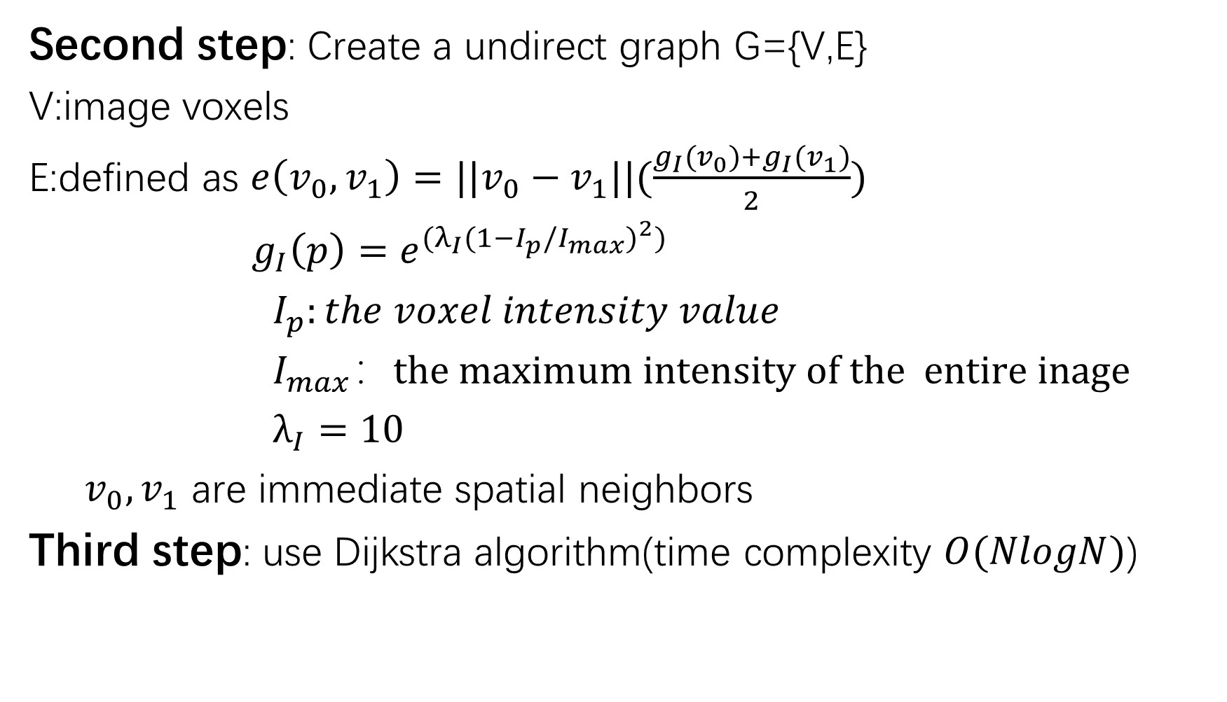
Second step: Create a undirect graph G={V,E}
V:image voxels
E:defined as $e\left(v_{0},v_{1}\right)=||v_{0}−v_{1}||(\frac{g_{I}(v_{0})+g_{I}(v_{1})}{2})$
$g_{I}\left(p\right)=e^{(λ_{I}{(1−I_{p}/I_{max})}^{2})}$
$I_{p}:the voxel intensity value$
$I_{max}：the maximum intensity of the entire inage$
$λ_{I}=10$
$v_{0},v_{1}$ are immediate spatial neighbors
Third step: use Dijkstra algorithm(time complexity $O(NlogN)$)

Slide 4
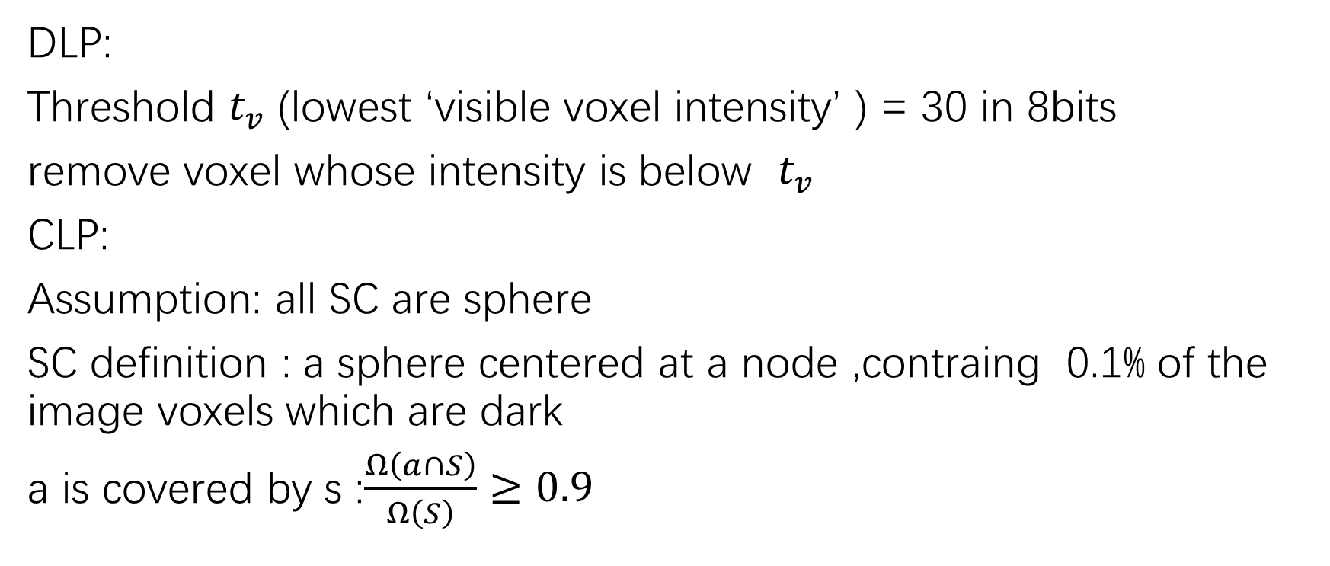
MCMR
DLP:
Threshold $t_{v}$ (lowest ‘visible voxel intensity’ ) = 30 in 8bits
remove voxel whose intensity is below $t_{v}$
CLP:
Assumption: all SC are sphere
SC definition : a sphere centered at a node ,contraing 0.1% of the image voxels which are dark
a is covered by s :$\frac{Ω\left(a∩S\right)}{Ω\left(S\right)}≥0.9$

Slide 5
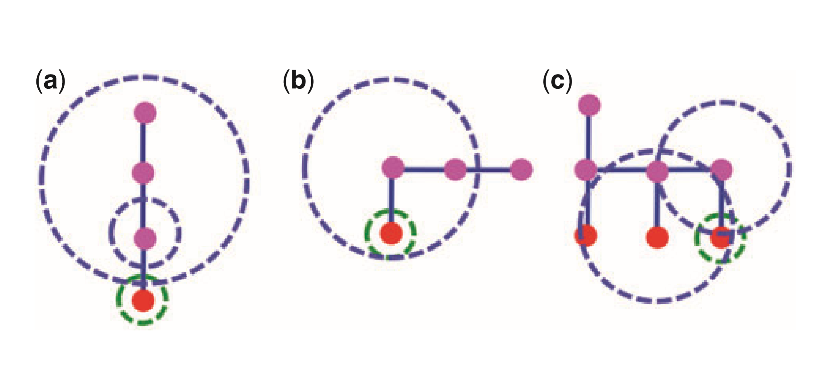
Rules of removing leaf node
No node cover, keep (Fig (a))
Cobered by another node ,safely remove (Fig (b))
Covered by several other nodes ,find sphere with biggest radius ,merge it (Fig (c))

Slide 6
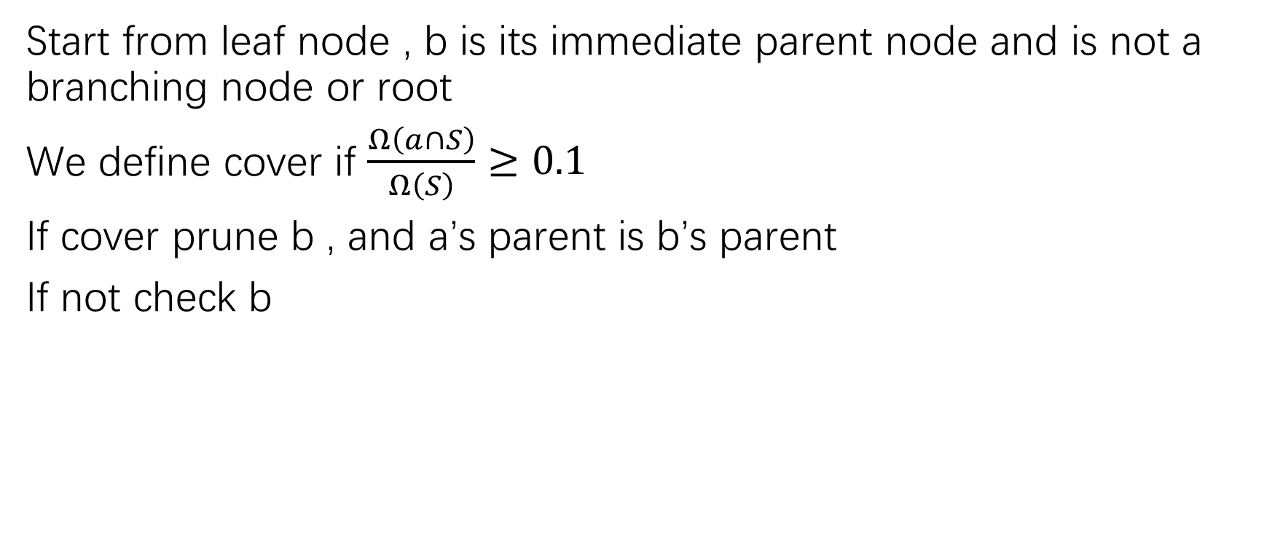
INP
Start from leaf node , b is its immediate parent node and is not a branching node or root
We define cover if $\frac{Ω\left(a∩S\right)}{Ω\left(S\right)}≥0.1$
If cover prune b , and a’s parent is b’s parent
If not check b

