Slide 1

数字图像处理实验二补充材料
姚鸿勋 刘绍辉
shliu@hit.edu.cn
哈尔滨工业大学计算机科学与技术学院
2018秋

Slide 2

内容
大部分数学变换都可以用矩阵的形式来表示
  例如DFT、DCT、DWT等
    都属于采用张量积的形式从一维扩展到多维
  但有专门设计的二维和多维数学变换，这时无法将其二维变换通过一维变换表示出来，称为不可分离变化

Slide 3
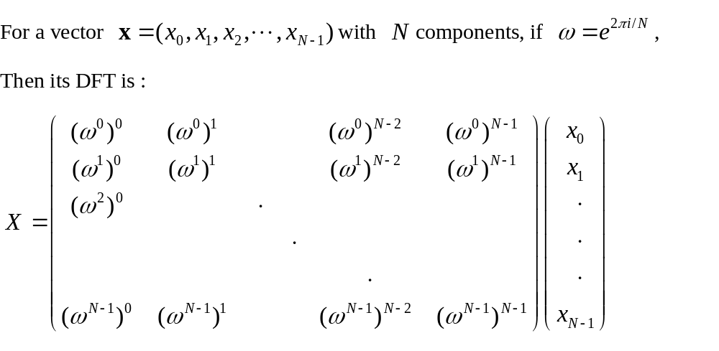
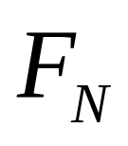

DFT
DFT

Slide 4

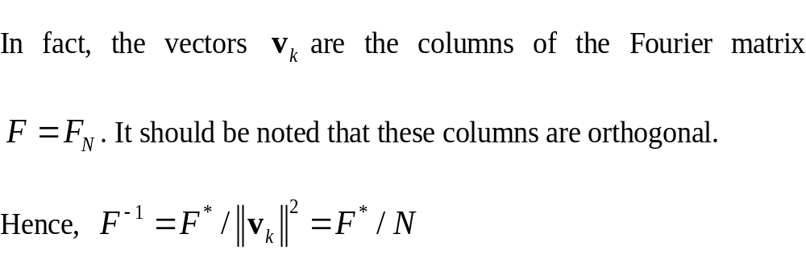
DFT-basis vector
Let
then is a combination of these special basis vectors

Slide 5
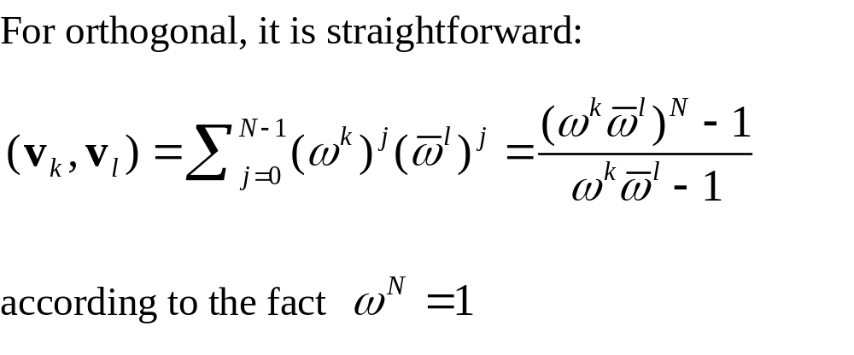
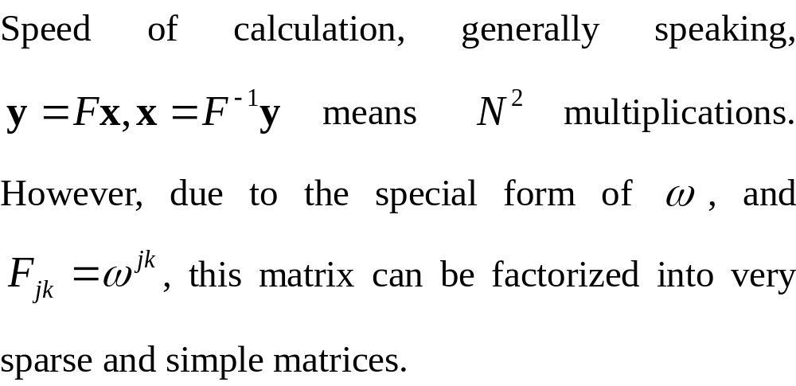

orthogonal
FFT

Slide 6
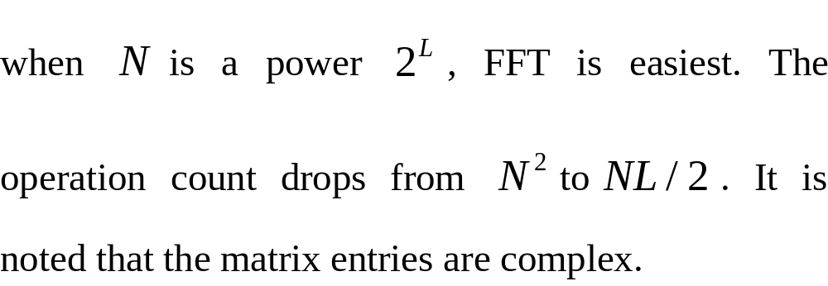
FFT
FFT
DCT
  A special form of DFT which only consider real transforms that involve cosines.
  In fact, there are four types DCT, namely DCT-1 through DCT-4, which differ in the boundary conditions at the ends of the interval. The DCT-2 and DCT-4are commonly used in image processing, and have FFT implementations.

Slide 7
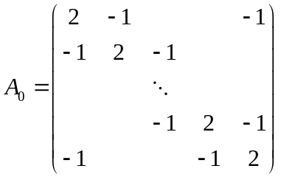
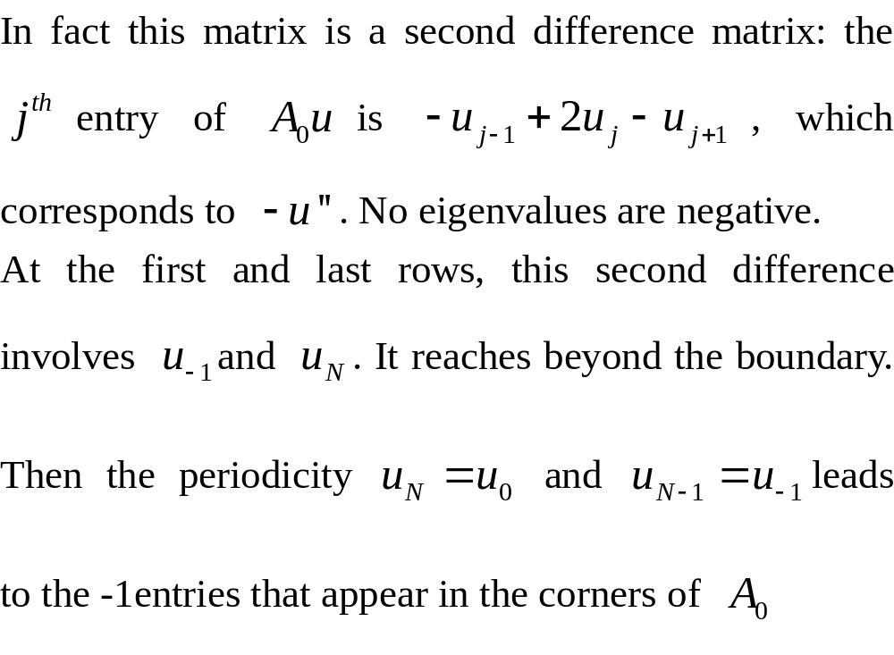
DFT
First, we give a circulant matrix

Slide 8
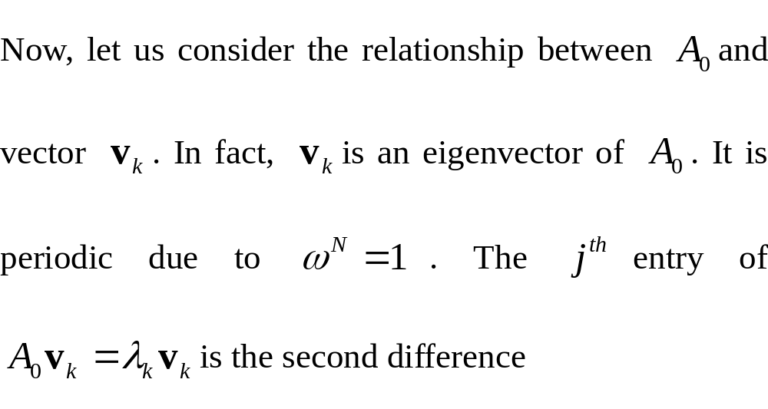
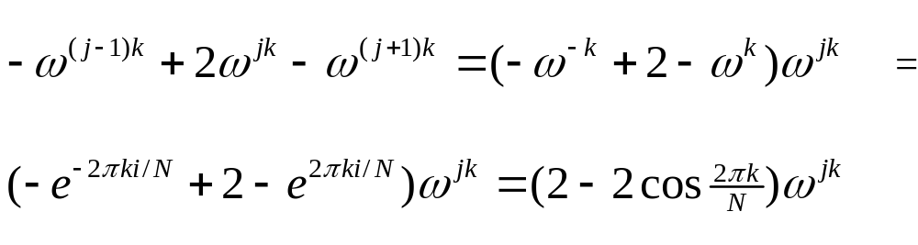
DFT
Second

Slide 9
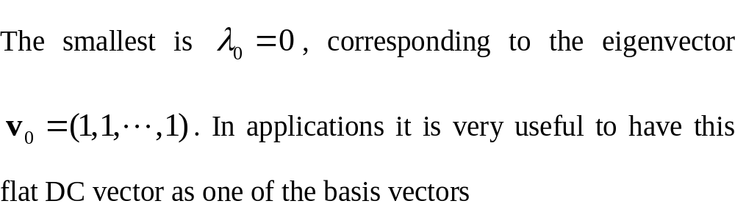
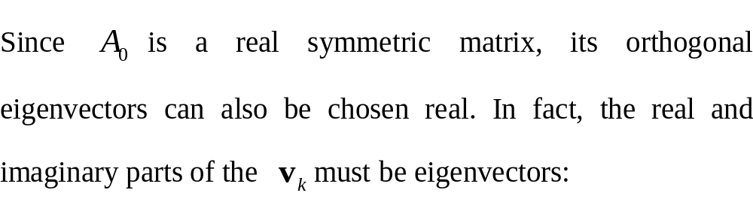
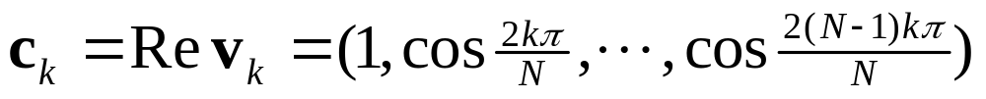
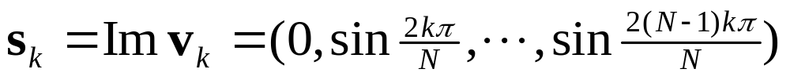
DFT
Eigenvalues and eigenvectors
,

Slide 10
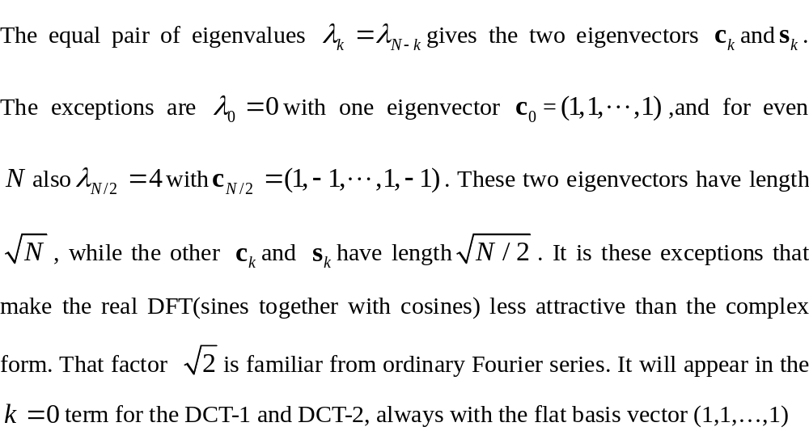
Length of eigenvector

Slide 11
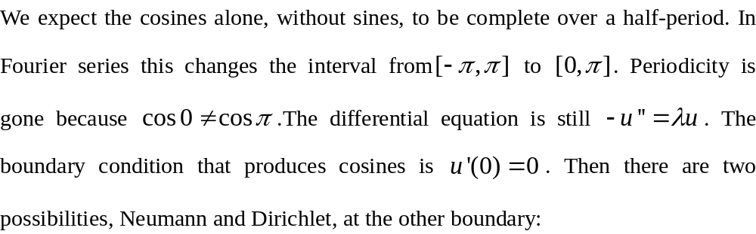
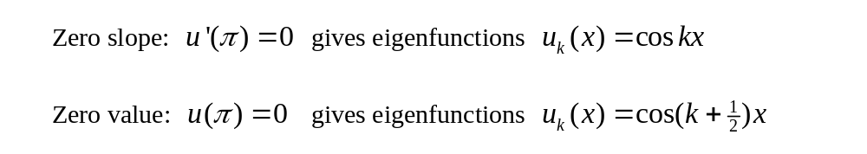
From DFT to DCT
DCT only involves cosines
  How to do?

Slide 12
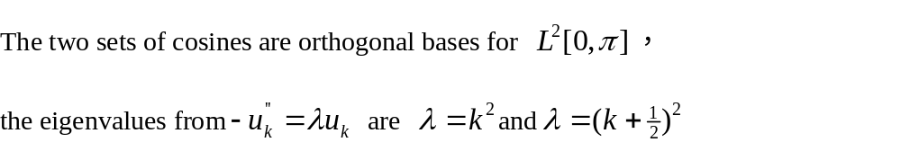
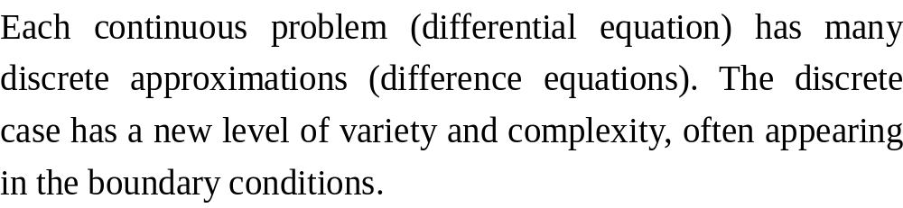
Eigenvalues
For two cases mentioned above:

Slide 13
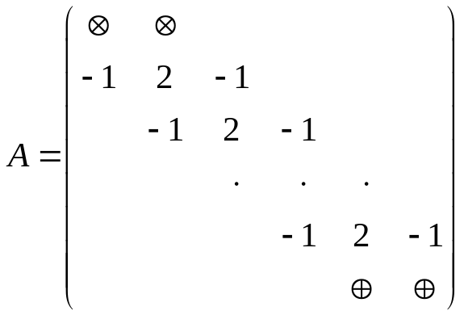
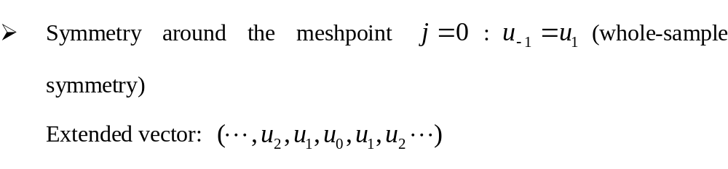
Boundary conditions
A matrix

Slide 14
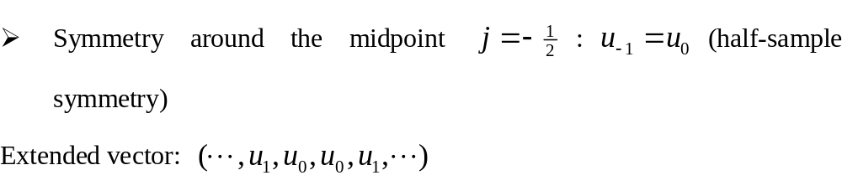
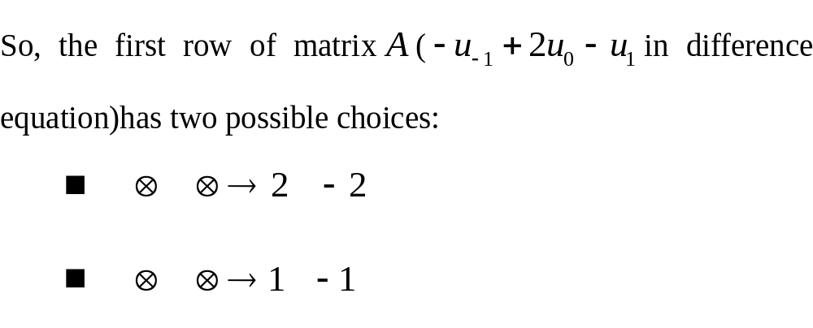
Boundary conditions
Second,

Slide 15
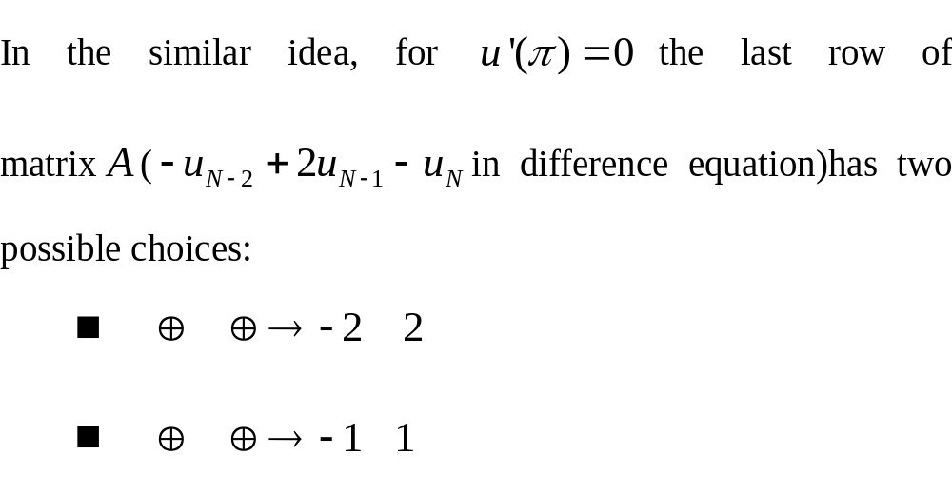
Another end

Slide 16
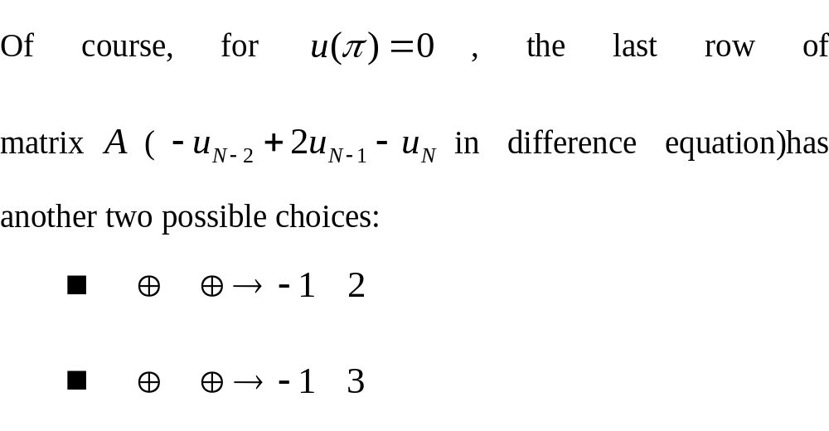
Dirichlet condition at another end

Slide 17
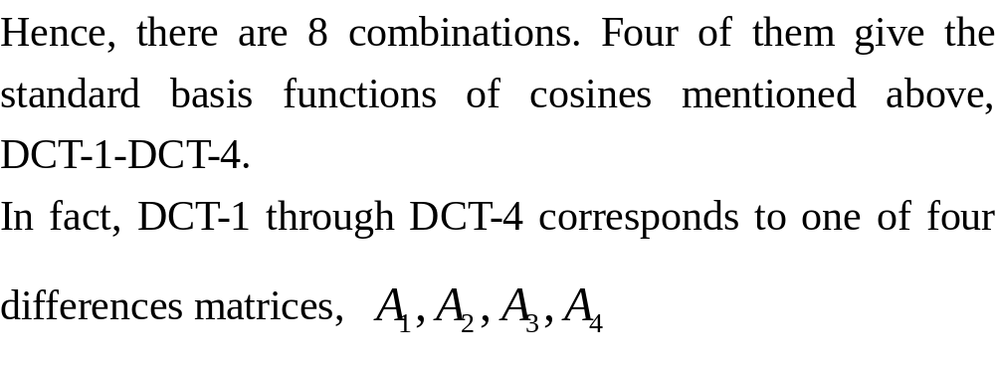
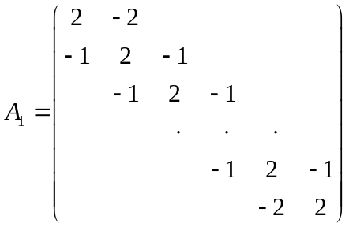
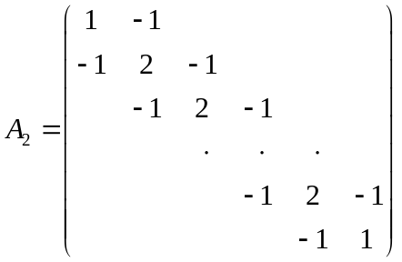
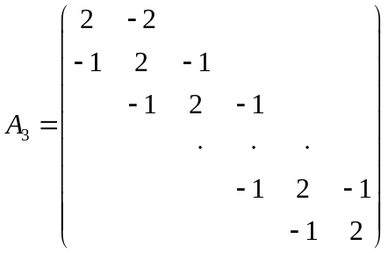

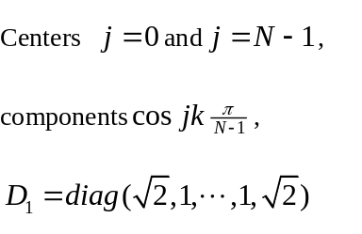
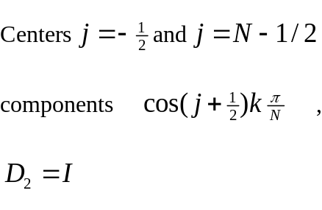
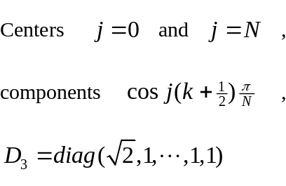
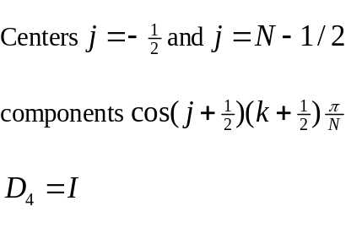
Eight combinations of BC
,
Similar Boundary conditions at two ends!

Slide 18
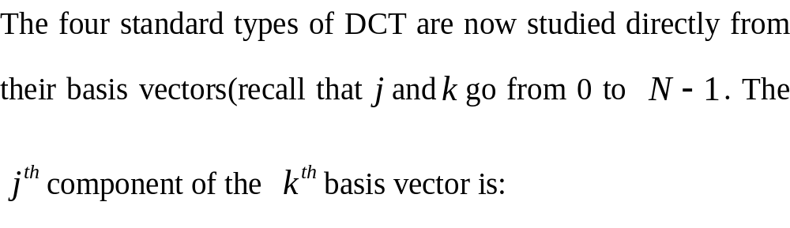
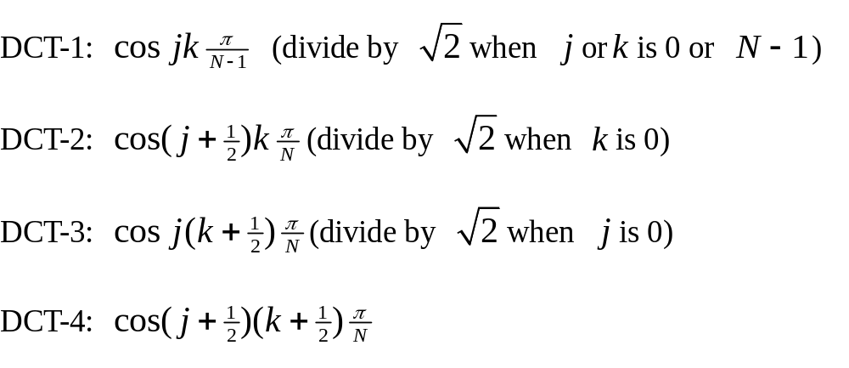
Four standard types of DCT

Slide 19
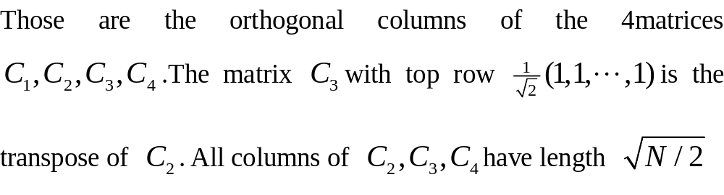
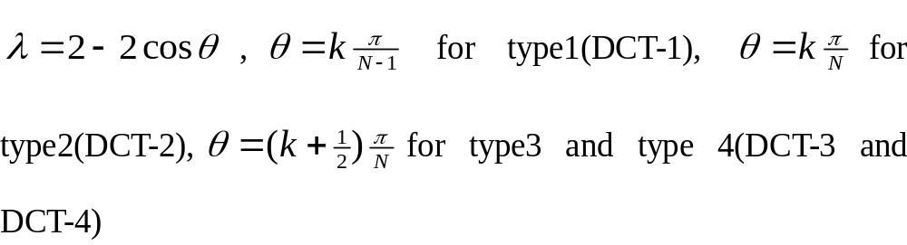
Entries of DCT matrix
Orthogonality

Slide 20
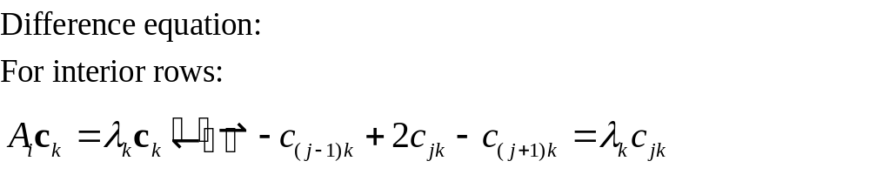
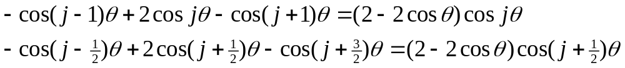
Orthogonality
  Only two cases
  For boundary rows:
  All are ok!
  Giving the proof for DCT-4

Slide 21
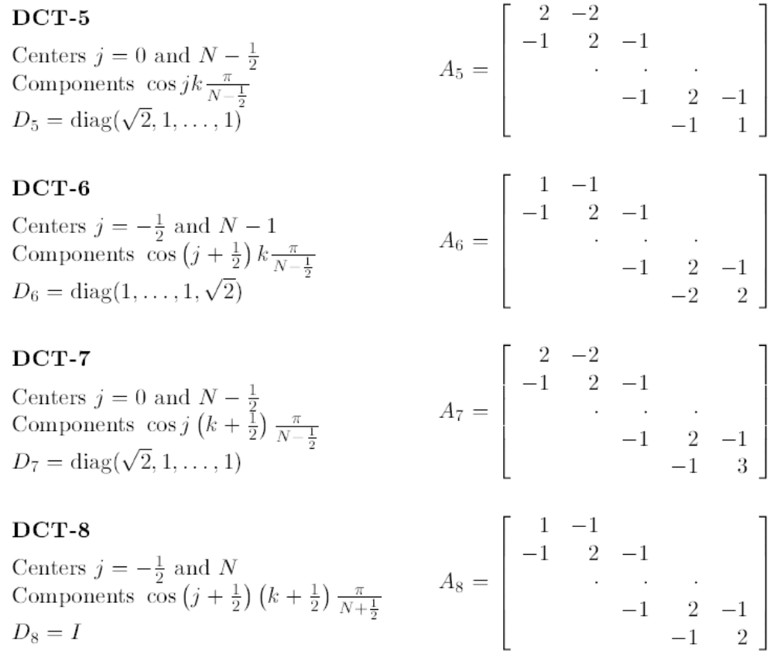
DCT5-DCT8(ODD DCT)
Even DCT
  DCT1-DCT4

Slide 22
End
Reference：
  The discrete cosine transform, SIAM Review 41 (1999) 135-147

