Slide 1

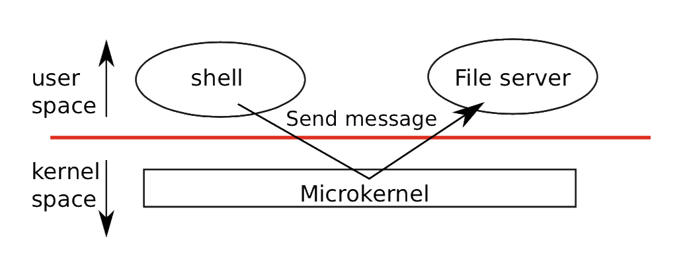
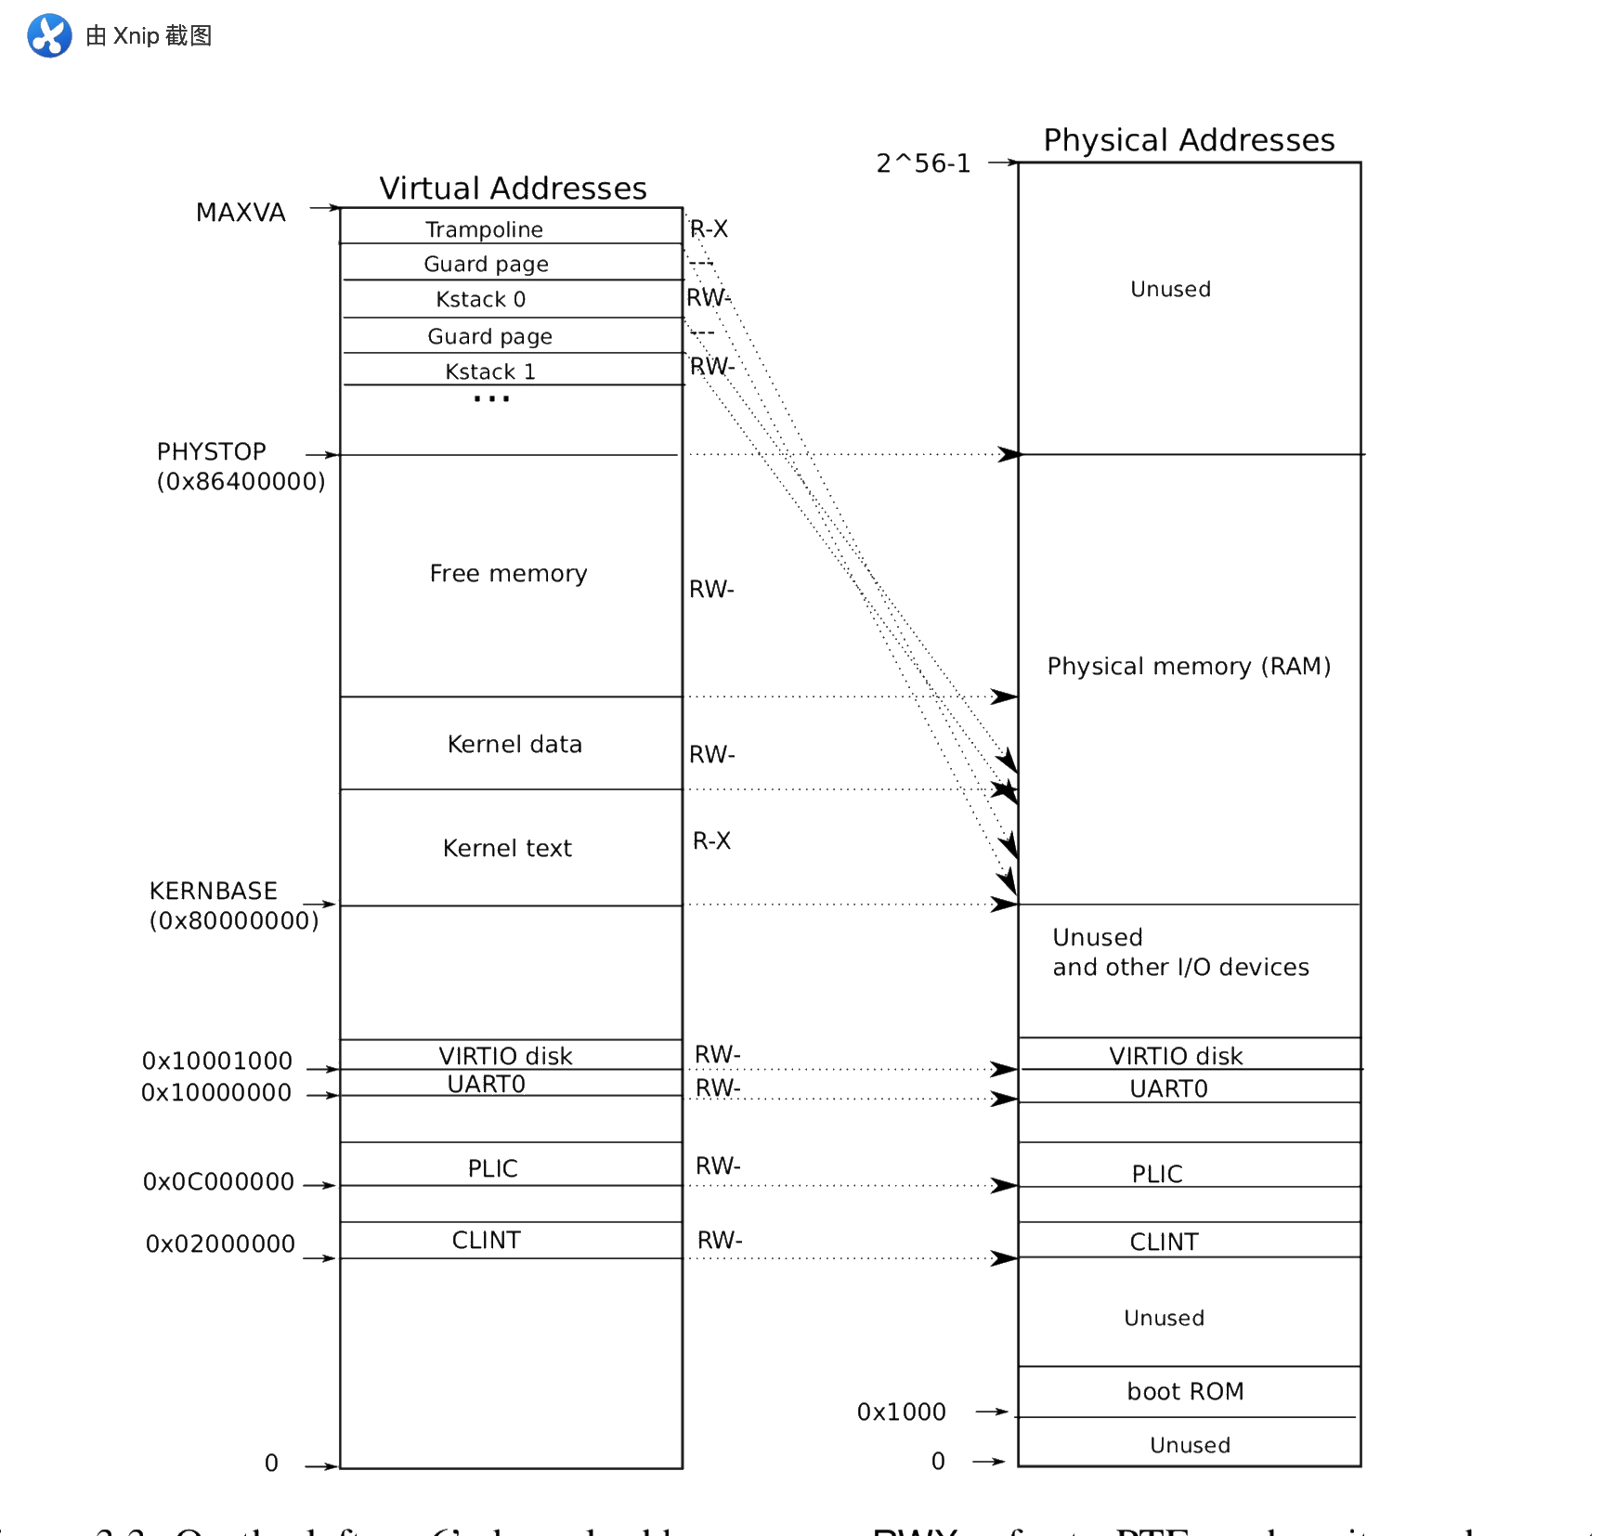
System on chip with RISC-V microprocessor and Linux operating system
Supervisor: Mark Bowden
Students: Gan Fang, Qiyang Ding, Yufeng Chen
Linux OS ----xv6
This operating system is designed for running on single core CPU and does not support multiprocess. Although limited by its performance, it can still finish many functions, such as printing message, pause, read/write, message transfer and searching. The following sections will explain how to achieve these.
Interfaces
Process identification, pid: For most of time, process ID is 1. When a parent process create a child process, whose pid is 2.
I/O and File Descriptor, fd: File descriptors is a small integer representing a kernel-managed object that a process may read from or write to.
Pipes: message transfer between parent process and child process.
Organization
User mode, kernel mode and system calls: instructions in kernel mode have full privilege, such as enabling and disabling interrupts, reading and writing registers. In user mode, it can only execute some functions, such as adding number. System calls are switches from user mode to kernel mode.
3. Page tables
It is used to give each process its own address space. The RISC-V page table translates a virtual address to physical address.
Traps
4. File system
This file system is organized in seven layers, including
Disk layer
Buffer cache layer
Logging layer
Inode layer
Directory layer
Pathname layer
File descriptor layer
Traps from kernel space
Exceptions
Device interrupts
Traps from user space
System calls
Device interrupts
Illegal operations

Slide 2
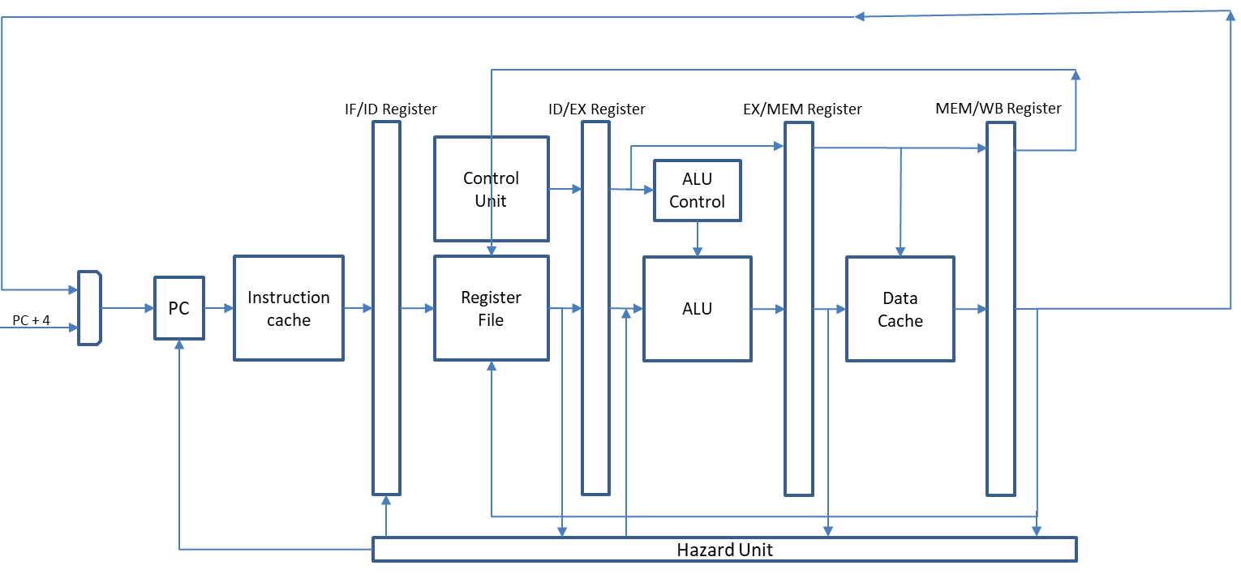
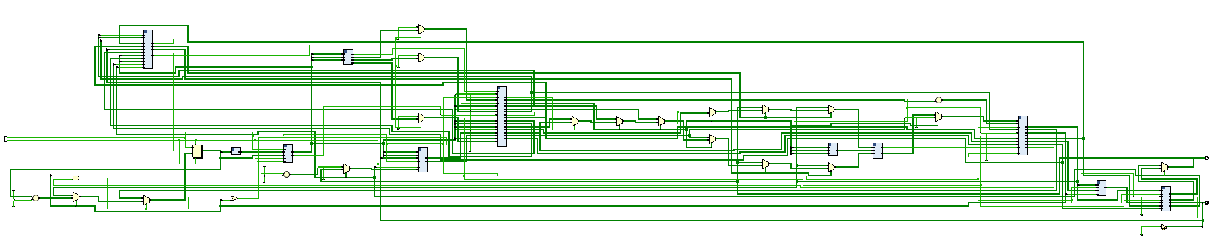
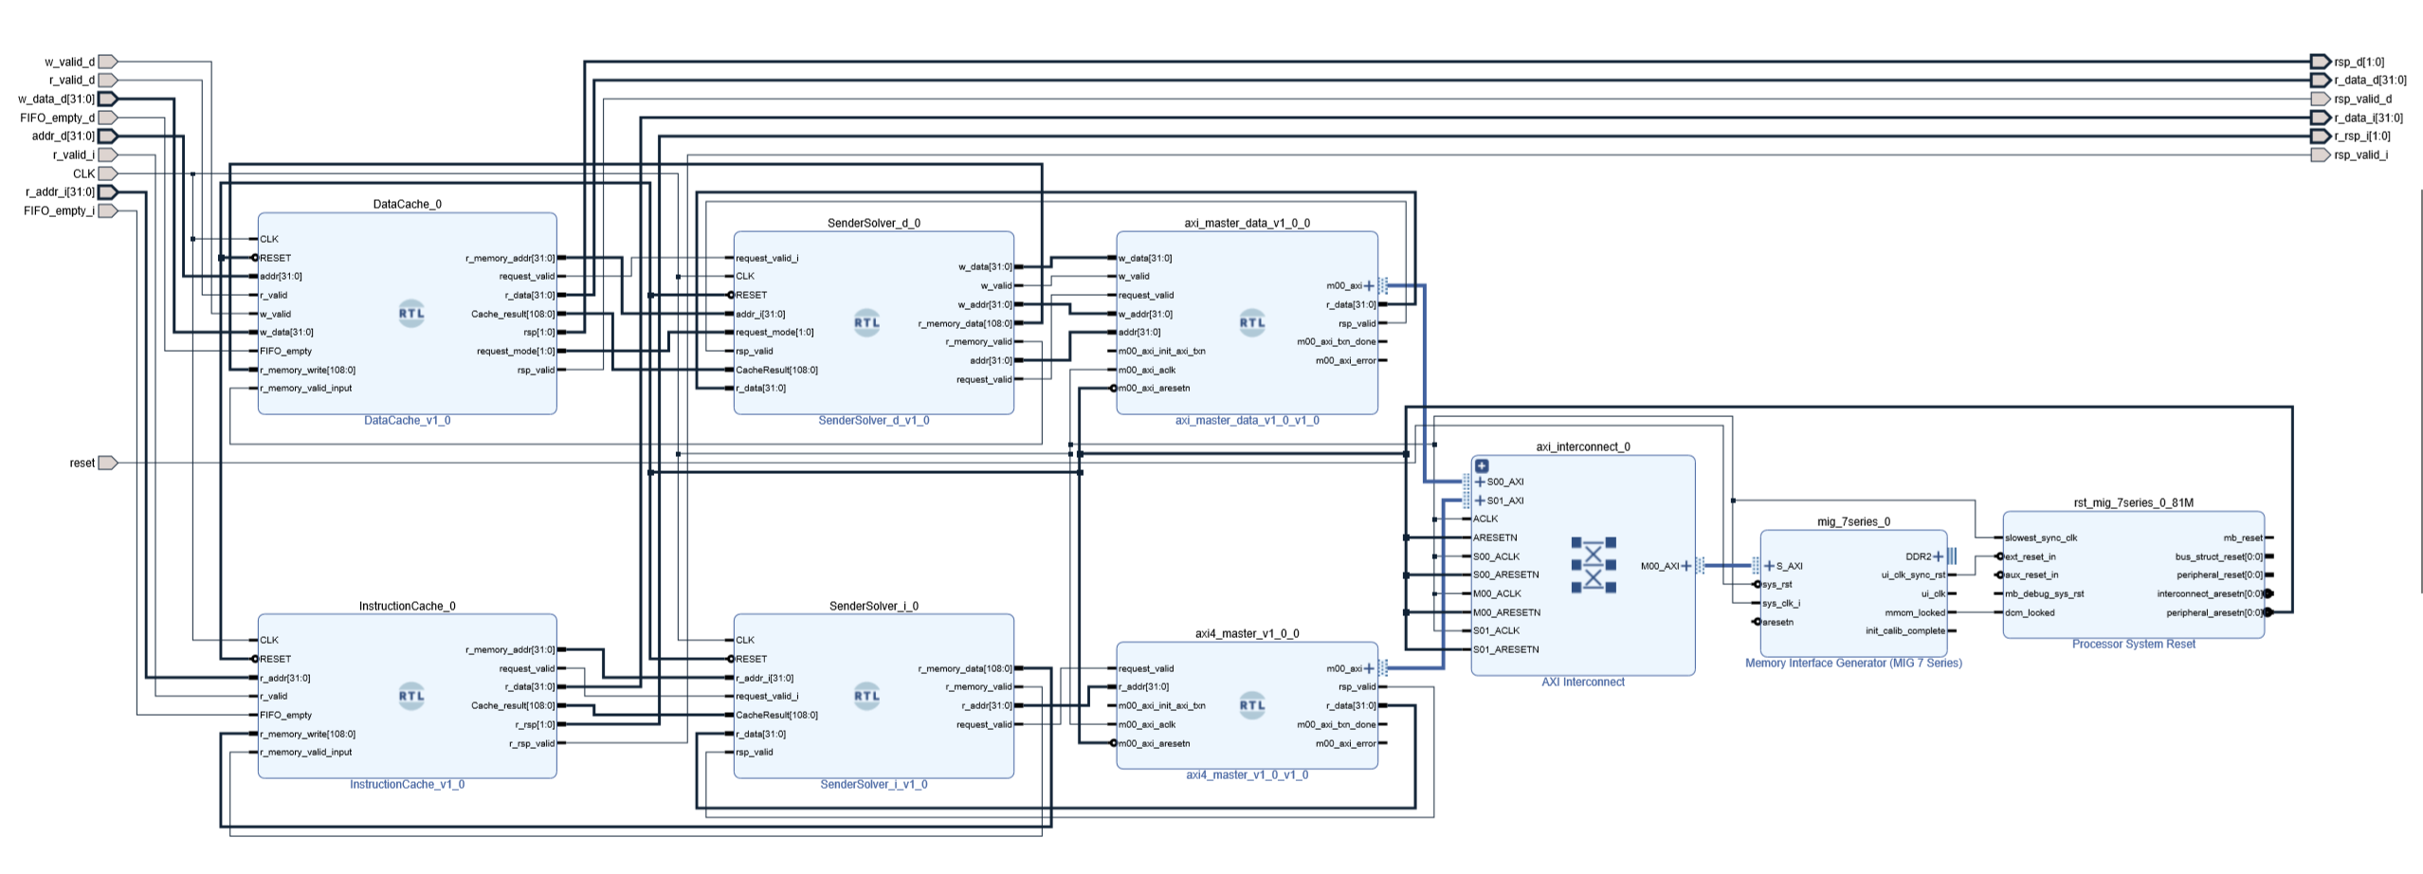
The simple structure of CPU core
RTL of the Verilog of CPU core
Block Design Diagram of Cache

Slide 3
System On Chip
CPU Core
RISC-V 32 bits instruction set architecture (ISA)
RISC-V 32 bits extension (RV32IM)
5 stages pipeline structure
Static branch prediction
Cache system (two way associativity and LRU (Least recently used policy))
Asynchronous FIFO between cache system and CPU
Interruption Controller (not complete)
Reorder buffer and Out of order execution (not complete)
Superscalar processor (not complete)
Hardware support
Management Unit of DDR2 SDRAM on FPGA (Xilinx Memory Interface Generator)
Communication between cache system and memory (Two AXI4 masters and one slave with Xilinx IP core AXI interconnect)
GPIO to AXI4 (not complete)
Ethernet Driver to AXI4 (not complete)
USB Driver to AXI4 (not complete)

