Slide 1

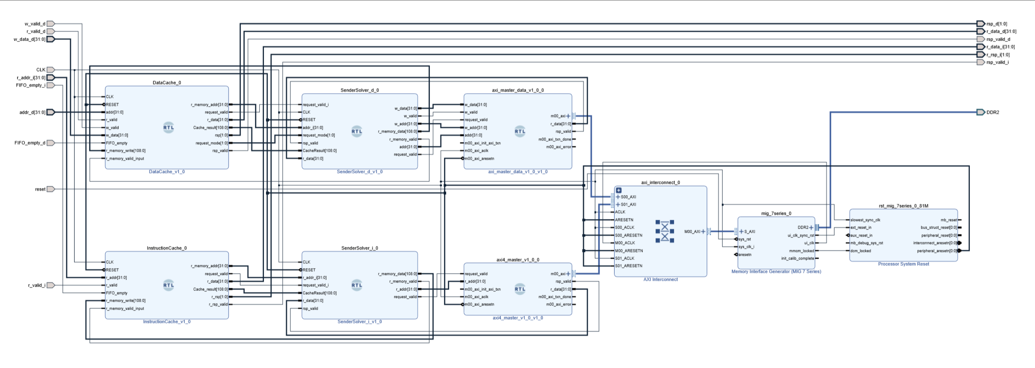
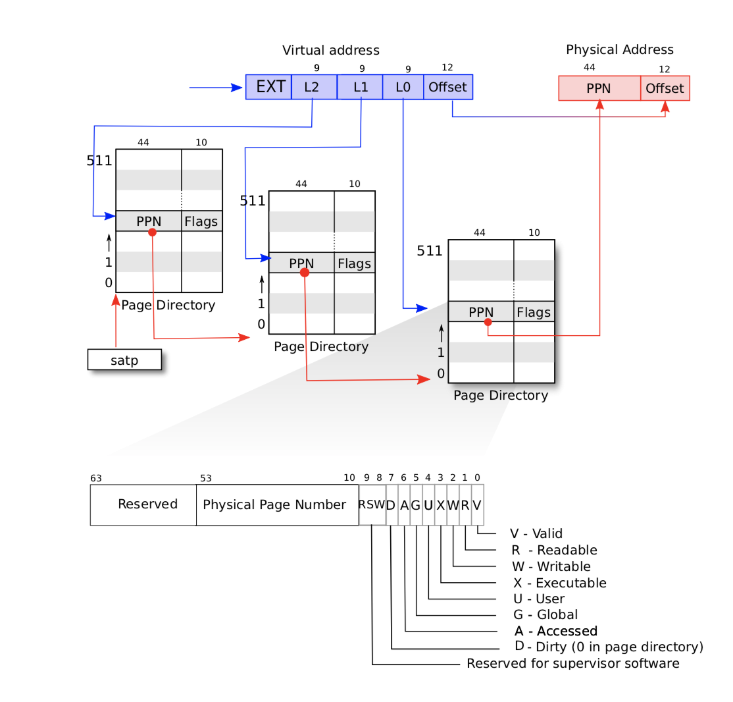
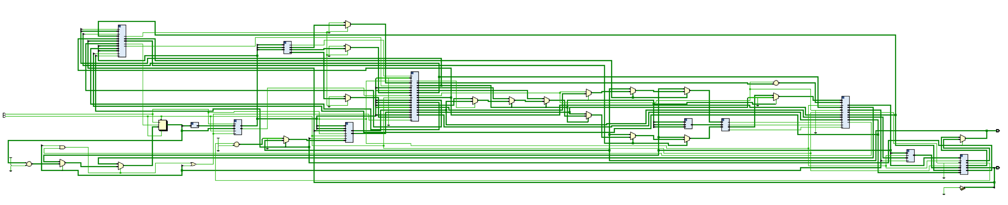
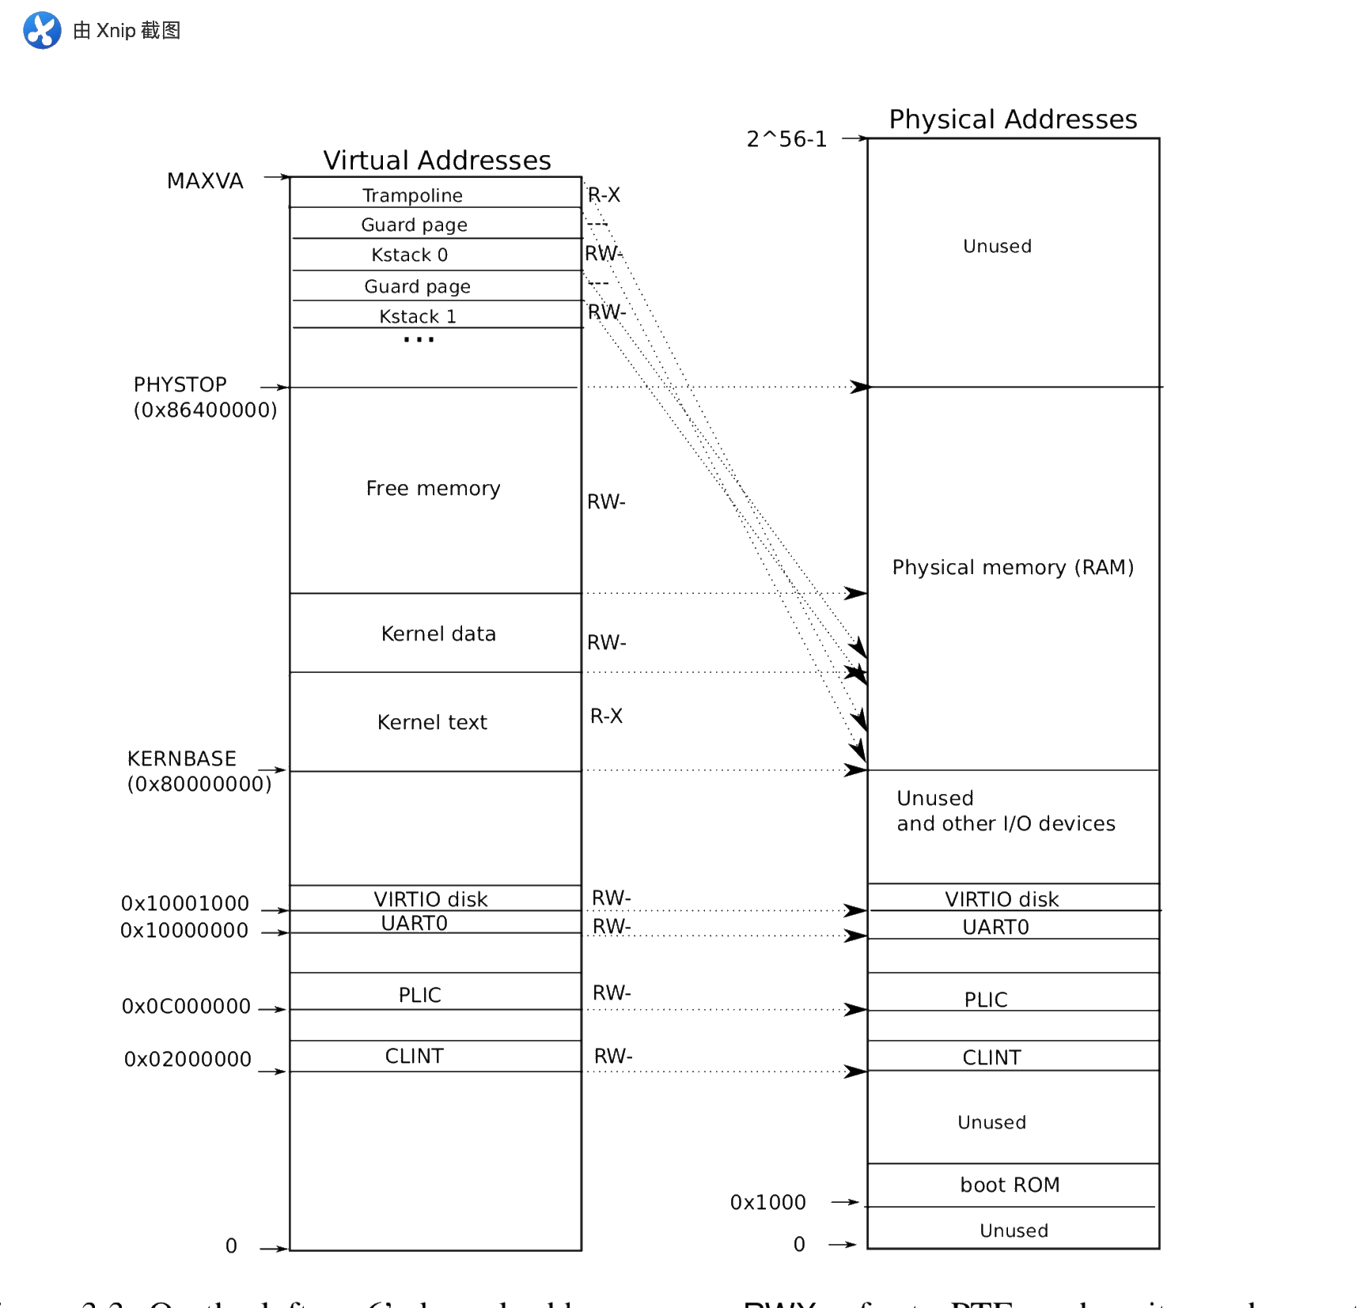
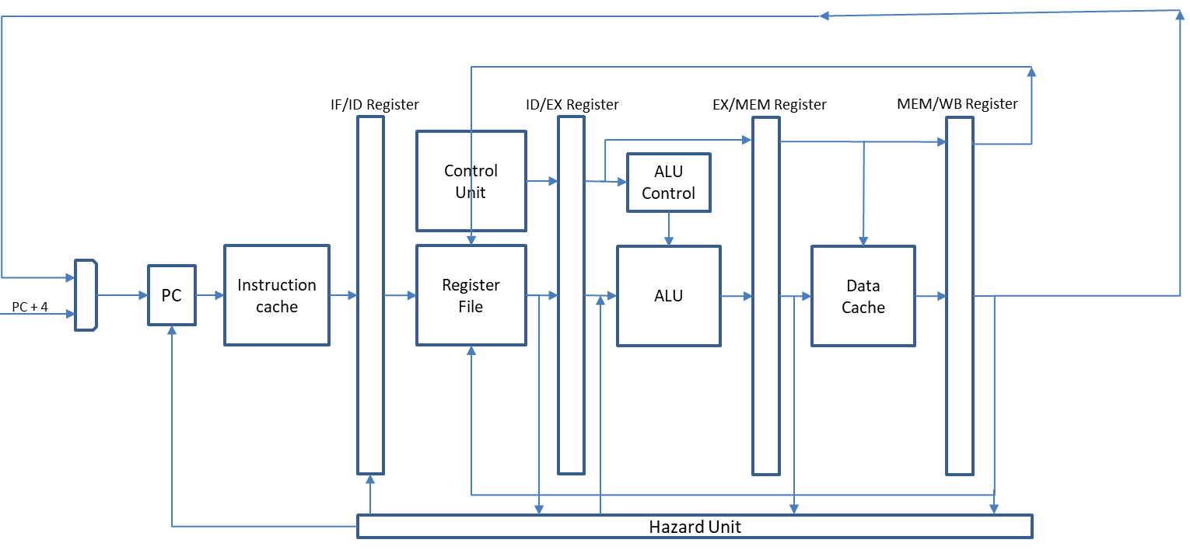

System on chip with RISC-V microprocessor and Linux operating system
Supervisor: Mark Bowden
Students: Gan Fang, Qiyang Ding, Yufeng Chen
4. File system (limited)
This file system is organized in seven layers, including
Disk layer
Buffer cache layer
Logging layer
Inode layer
Directory layer
Pathname layer
File descriptor layer
Linux OS ----xv6
This operating system is designed for running on single core CPU. It can finish many functions, such as printing message, pause, read/write, message transfer and searching.
1. Organization
User mode and kernel mode.
Abstract physical resources by system call.
Starting process includes running bootloader, loading the kernel into 0x80000000, creating a stack (4.96 bytes), initializing several devices.
2. Interfaces
Process identification, pid.
I/O and File Descriptor, fd.
Pipes, message transfer.
3. Page tables
Sv39 RISC-V, which has 39-bits virtual addresses (27-bits for PTE and 12-bits for offset).
Kernel address space (most are directed-mapped, except trampoline page and kernel stack page).
Physical memory allocation: buddy allocation and lazy allocation
Traps
Traps from kernel space
Exceptions
Device interrupts
Traps from user space
System calls
Device interrupts
Illegal operations
Bootloader ----U-boot
U-boot needs to have the ability to read and write flash. Its ultimate purpose is to read the kernel from flash, put it into memory, and start the kernel. U-boot starts in two stages. The first stage is the assembly stage running mainly in the start.S file. The main job on this stage is to initialize the hardware. When the program jumps to the start_boot function, the second stage the C language running in the DDR starts.
Figure 3: Block Design Diagram of Cache
System On Chip
CPU Core
RISC-V 32 bits instruction set architecture (ISA)
RISC-V 32 bits extension (RV32IM)
5 stages pipeline structure
Static branch prediction
Cache system (two ways associativity and LRU (Least recently used policy))
Asynchronous FIFO between cache system and CPU
Interruption Controller (not complete)
Reorder buffer and Out of order execution (not complete)
Superscalar processor (not complete)
Hardware support
Management Unit of DDR2 SDRAM on FPGA (Xilinx Memory Interface Generator)
Communication between cache system and memory (Two AXI4 masters and one slave with Xilinx IP core AXI interconnect)
GPIO to AXI4 (not complete)
Ethernet Driver to AXI4 (not complete)
USB Driver to AXI4 (not complete)
Figure 1: virtual and physical address
Figure 4: The simple structure of CPU core
Figure 5: RTL structure diagram of CPU core
Look our blog by scanning here or access: https://sggfangy2.blogspot.com
Figure 2: kernel address space (left) and physical address space (right)

