Slide 1


Application of P4 technology
in SDN scenario
Ding Rui

Slide 2

P4₁₆ Language Brief Introduction
Brief History:
Apr 2016: P4₁₆ First commits
Dec 2016: First P4₁₆ draft sepecification
May 2017: P4₁₆ 1.0.0 specification released
May 2018: P4₁₆ 1.1.0 draft sepecification
...
Design Goals:
Logical Evolution of P4₁₄
Target-Independence
Support for a variety of targets
Language/Architecture separation
Flexible data plane model
Compiler:
P4C, new, alpha-quality, supports both P4₁₄ & P4₁₆
Provides a standard frontend
Contains four sample backends, p4c-bm2-ss, p4c-ebpf, p4c-graphs and p4test
Program Portability:
Target-Independent.
Architecture-Dependent.
Targets can implement mulitiple architecutres.
Mulitple targets can support the same architecure
Community-Developed
Vendor-Supplied
P4₁₆ Core Library
Extern Libraries
Architecture Definition
Backend
Compiler
P4₁₆
Language
Frontend Compiler

Slide 3
P4₁₆ Language Example
parser MyParser(packet_in packet,
out headers hdr,
inout metadata meta,
inout standard_metadata_t standard_metadata) {
state start {
transition parse_ethernet;
}
state parse_ethernet {
packet.extract(hdr.ethernet);
transition select(hdr.ethernet.etherType) {
0x800: parse_ipv4;
default: accept;
}
}
state parse_ipv4 {
packet.extract(hdr.ipv4);
transition accept;
}
}
typedef bit<9> egressSpec_t;
typedef bit<48> macAddr_t;
typedef bit<32> ip4Addr_t;
header ethernet_t {
macAddr_t dstAddr;
macAddr_t srcAddr;
bit<16> etherType;
}
header ipv4_t {
...
ip4Addr_t srcAddr;
ip4Addr_t dstAddr;
}
struct metadata { ... }
struct headers {
ethernet_t ethernet;
ipv4_t ipv4;
}
control MyIngress(inout headers hdr,
inout metadata meta,
inout standard_metadata_t standard_metadata) {
action drop() { ... }
action ipv4_forward(macAddr_t dstAddr, egressSpec_t port) {
standard_metadata.egress_spec = port;
...
}
table ipv4_lpm {
key = { hdr.ipv4.dstAddr: lpm; }
actions = { drop; ipv4_forward; NoAction; }
size = 1024;
default_action = NoAction();
}
apply {
if (hdr.ipv4.isValid()) {
ipv4_lpm.apply();
}
}
}
control MyDeparser(packet_out packet, in headers hdr) {
apply {
packet.emit(hdr.ethernet);
packet.emit(hdr.ipv4);
packet.emit(hdr.arp);
packet.emit(hdr.icmp);
packet.emit(hdr.mpls[0])
...
}
}
V1Switch(
MyParser(),
MyVerifyChecksum(),
MyIngress(),
MyEgress(),
MyComputeChecksum(),
MyDeparser()
) main;
v1model
Memory
ALU
PRE

Slide 4
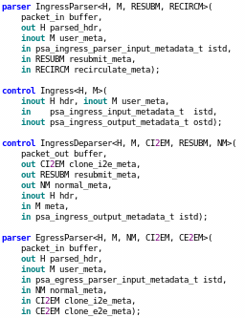
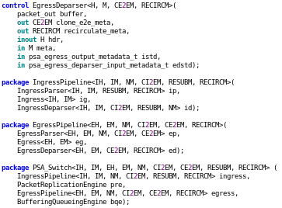
Typical Architecture
V1 Architecture:
Comatible with P4₁₄ architecture
Implemented on top of bmv2 simple_swtich target
See the previous slide
PSA Architecture:
Portable Switch Architecture, not support in P4₁₄
More general, standard and clear
Implemented on top of bmv2 psa_swtich target
PSA
Parser
Ingress
Deparser
Parser
Egress
Deparser
Memory
ALU
PRE

Slide 5
How to use P4 in SDN scenario
Data-plane
Defined by P4 program
P4Runtime
A control plane specification for controlling the data plane
elements of a device defined by P4 program
OpenConfig (gNMI & gNOI)
Vendor-neutral, model-driven network management
Controller
Control
Management
Pipeline Control
Configuration
Operations
Switch
P4Runtime
gNMI
gNOI
O S
programmable
pipeline
match
action
steps

Slide 6

P4Runtime Architecture
P4 Runtime API
Open and silicon-independent
Program-independent
Extended without restarting the control plane
gRPC/Protobuf
P4Runtime Configuration
P4Info
Master Controller
Slave Controller(s)
P4Blob
gRPC Client
gRPC Client
P4Runtime API
p4runtime
.proto
P4 Source
Code
gRPC Server
Platform Drivers
Entities
Config

Slide 7
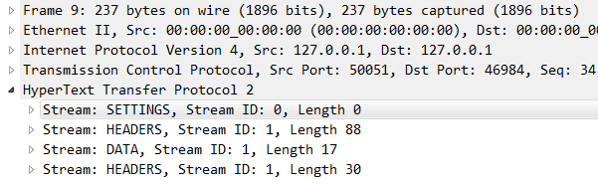
P4Runtime & gRPC
P4Runtime is based on gRPC
Protobuf language (IDL) is used to describe serivce and message
Protobuf is used for serialization and de serialization
Client
Server
P4Runtime
P4Runtime
gRPC
gRPC
Protobuf
Protobuf
HTTP2
HTTP2
TCP
TCP
IP
IP
Data Link
Data Link
Physical Layer
Physical Layer
s
t
r
e
a
m

Slide 8
P4Runtime Service-Read/Write
Map-like message sequences, each message contains an unique ID and a value
Due to the use of bytes, the value will not be subject to any restrictions
syntax = "proto3";
import "p4/config/v1/p4info.proto";
...
package p4.v1;
service P4Runtime {
rpc Write(WriteRequest) returns ...
rpc Read(ReadRequest) returns ...
...
}
message WriteRequest {
uint64 device_id = 1;
...
repeated Update updates = 3;
}
message Update {
enum Type {
UNSPECIFIED = 0;
INSERT = 1;
MODIFY = 2;
DELETE = 3;
}
Type type = 1;
Entity entity = 2;
}
message Entity {
oneof entity {
TableEntry table_entry = 2;
...
}
}
message TableEntry {
uint32 table_id = 1;
repeated FieldMatch match = 2;
TableAction action = 3;
}
message TableAction {
oneof type {
Action action = 1;
...
}
}
message Action {
uint32 action_id = 1;
message Param {
uint32 param_id = 2;
bytes value = 3;
}
repeated Param params = 4;
}
message FieldMatch {
uint32 field_id = 1;
...
message Exact {
bytes value = 1;
}
message Ternary {
bytes value = 1;
bytes mask = 2;
}
message LPM {
bytes value = 1;
int32 prefix_len = 2;
}
oneof field_match_type {
Exact exact = 2;
Ternary ternary = 3;
LPM lpm = 4;
...
}
}

Slide 9
P4Runtime Service-Set/Get Pipine Config
Support for dynamic loading pipeline configuration
The P4Info file is generated by the front-end compiler.
Target related configuration, e.g, for bmv2 the format is JSON
syntax = "proto3";
import "p4/config/v1/p4info.proto";
...
package p4.v1;
service P4Runtime {
rpc SetForwardingPipelineConfig(SetForwardingPipelineConfigRequest)
returns (SetForwardingPipelineConfigResponse) {
}
rpc GetForwardingPipelineConfig(GetForwardingPipelineConfigRequest)
returns (GetForwardingPipelineConfigResponse) {
}
}
message SetForwardingPipelineConfigRequest {
enum Action {
UNSPECIFIED = 0;
VERIFY = 1;
VERIFY_AND_SAVE = 2;
VERIFY_AND_COMMIT = 3;
...
}
uint64 device_id = 1;
...
Action action = 4;
ForwardingPipelineConfig config = 5;
}
message SetForwardingPipelineConfigResponse {}
message ForwardingPipelineConfig {
config.v1.P4Info p4info = 1;
bytes p4_device_config = 2; //Target-specific P4 configuration.
}
message GetForwardingPipelineConfigRequest {
uint64 device_id = 1;
}
message GetForwardingPipelineConfigResponse {
ForwardingPipelineConfig config = 1;
}
message P4Info {
...
repeated Table tables = 2;
repeated Action actions = 3;
repeated ActionProfile action_profiles = 4;
repeated Counter counters = 5;
repeated DirectCounter direct_counters = 6;
repeated Meter meters = 7;
repeated DirectMeter direct_meters = 8;
repeated ControllerPacketMetadata controller_packet_metadata = 9;
repeated ValueSet value_sets = 10;
...
}

Slide 10
P4Runtime Service-StreamChannel
Bi-directional stream service, this RPC usually kept open always
Packet-In/Out packet
Other packet, e.g. master arbitration
syntax = "proto3";
import "p4/config/v1/p4info.proto";
...
package p4.v1;
service P4Runtime {
rpc StreamChannel(stream StreamMessageRequest)
returns (stream StreamMessageResponse) {
}
}
message StreamMessageRequest {
oneof update {
MasterArbitrationUpdate arbitration = 1;
PacketOut packet = 2;
...
}
}
message PacketOut {
bytes payload = 1;
repeated PacketMetadata metadata = 2;
}
message StreamMessageResponse {
oneof update {
MasterArbitrationUpdate arbitration = 1;
PacketIn packet = 2;
...
}
}
message PacketIn {
bytes payload = 1;
repeated PacketMetadata metadata = 2;
}

Slide 11
P4Info Example
The P4Info file is generated by the front-end compiler, target-independent
The P4Info file needs to be parsed into the corresponding P4Info object at runtime
control MyIngress(inout headers hdr,
inout metadata meta,
inout standard_metadata_t standard_metadata) {
action drop() {
mark_to_drop();
}
action ipv4_forward(macAddr_t dstAddr, egressSpec_t port) {
standard_metadata.egress_spec = port;
hdr.ethernet.srcAddr = hdr.ethernet.dstAddr;
hdr.ethernet.dstAddr = dstAddr;
hdr.ipv4.ttl = hdr.ipv4.ttl - 1;
}
table ipv4_lpm {
key = {
hdr.ipv4.dstAddr: lpm;
}
actions = {
ipv4_forward;
drop;
NoAction;
}
size = 1024;
default_action = NoAction();
}
apply {
if (hdr.ipv4.isValid()) {
ipv4_lpm.apply();
}
}
}
tables {
preamble {
id: 33574068
name: "MyIngress.ipv4_lpm"
alias: "ipv4_lpm"
}
match_fields {
id: 1
name: "hdr.ipv4.dstAddr"
bitwidth: 32
match_type: LPM
}
action_refs {
id: 16799317
}
action_refs {
id: 16805608
}
action_refs {
id: 16800567
}
size: 1024
idle_timeout_behavior: NO_TIMEOUT
}
actions {
preamble {
id: 16800567
name: "NoAction"
alias: "NoAction"
}
}
actions {
preamble {
id: 16805608
name: "MyIngress.drop"
alias: "drop"
}
}
actions {
preamble {
id: 16799317
name: "MyIngress.ipv4_forward"
alias: "ipv4_forward"
}
params {
id: 1
name: "dstAddr"
bitwidth: 48
}
params {
id: 2
name: "port"
bitwidth: 9
}
}
Compile

Slide 12
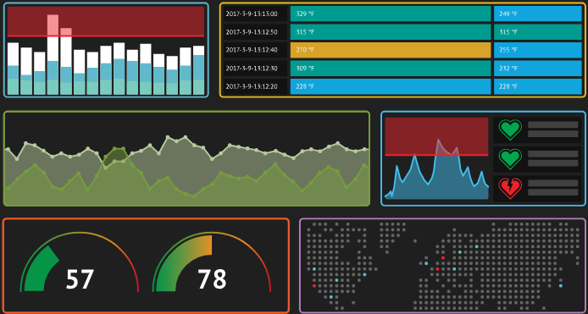

OpenDaylight-P4Plugin Project
Bi-directional stream rpc convert to Yang rpc & notification
An application corresponds to a P4 program plus a p4info file
Telemetry data write into TSDR(Time Series Data Repository)
P4Plugin
Application
Simple Router
Packet Replication
Loopback
Application'(s)
RPC/Notification
Service Provider
P4Runtime
gNMI
TSDR
Table
Packet
Pipeline
...
Telemetry
Device
P4Runtime Client
gNMI Client

Slide 13
Opendaylight & P4 Demo-Simple Router(1)
Simple router based on bmv2 simple_switch target
H1 can ping H2 successfully
ODL
Simple Router
RPC/Notification
P4Plugin
Mininet
ip:50051
bmv2
eth0
2
1
eth0
simple_router.p4
Host1
IP : 10.0.0.10/24
Mac: 00:04:00:00:00:00
GW : 10.0.0.1
Static arp:
10.0.0.1 00:aa:bb:00:00:00
Host2
IP : 10.0.1.10/24
Mac: 00:04:00:00:00:01
GW : 10.0.1.1
Static arp:
10.0.1.1 00:aa:bb:00:00:01

Slide 14
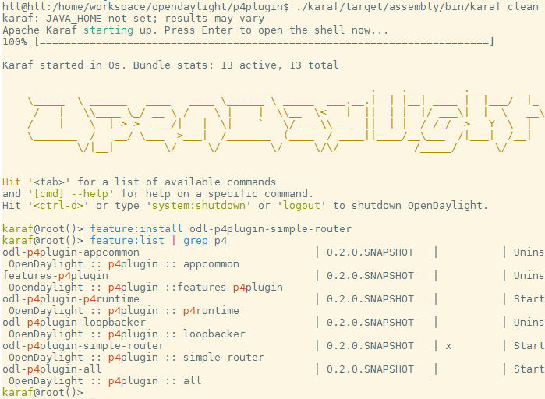
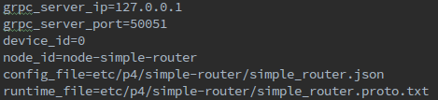
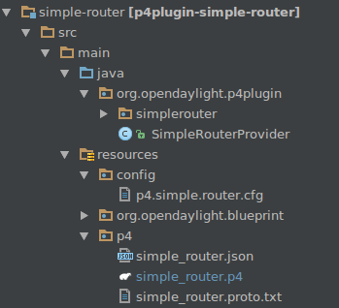
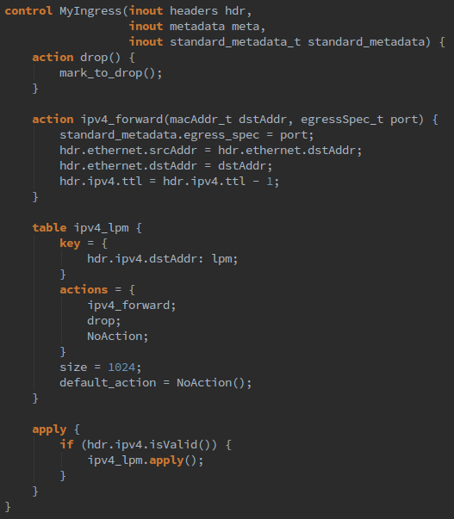
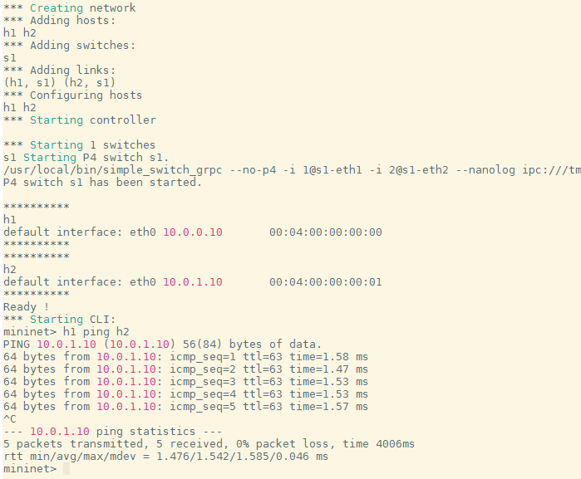
Opendaylight & P4 Demo-Simple Router(2)
Detailed info

Slide 15
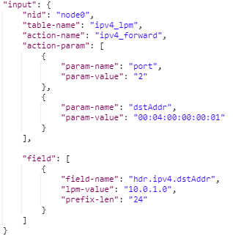
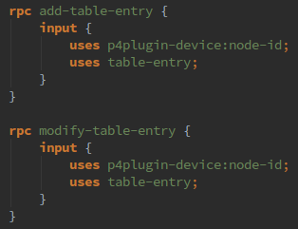
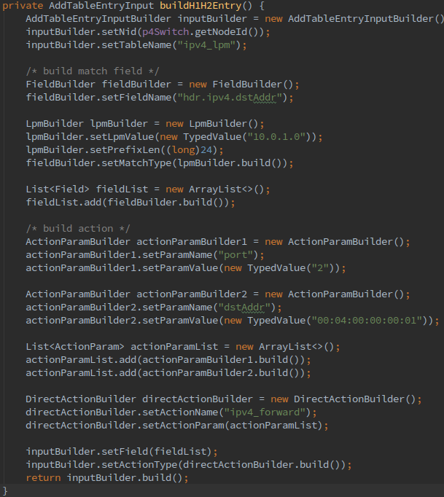
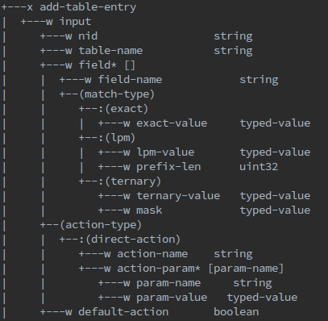
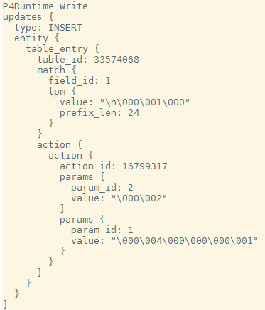
Opendaylight & P4 Demo-Simple Router(3)
Populate table entry
Input Data
Yang
Java Code
Data tree
Receive Data

Slide 16
Opendaylight & P4 Demo-Packet-In/Out(1)
Packet-In/Out path
ODL
Apps
RPC/Notification
P4Plugin
Packet-In
Packet-Out
Switch
Control Plane
gRPC Server
CPU
Driver
Port
Port
Port
Port
Port
Data Plane
Port
Port
Port
Port
Port

Slide 17
Opendaylight & P4 Demo-Packet-In/Out(2)
Any metadata associated with controller Packet-IO is modeled as P4 headers carrying special annotations
@controller_header("packet_out") and @controller_header("packet_in")
There can be at most one header each with these annotations. This message captures the info contained
within these special headers, and used in p4runtime.proto to supply the metadata.
...
@controller_header("packet_in")
header packet_in_header_t {
bit<9> ingress_port;
bit<16> reason;
}
@controller_header("packet_out")
header packet_out_header_t {
bit<64> cpu_preamble;
bit<9> egress_port;
}
...
action send_packet_in() {
standard_metadata.egress_spec = CPU_PORT;
hdr.my_packet_in.setValid();
hdr.my_packet_in.ingress_port = standard_metadata.ingress_port;
hdr.my_packet_in.reason = (bit<16>)packet_in_reason.arp;
}
action send_packet_out() {
standard_metadata.egress_spec = hdr.my_packet_out.egress_port;
hdr.my_packet_out.setInvalid();
}
...
controller_packet_metadata {
preamble {
id: 67146229
name: "packet_in"
annotations: "@controller_header(\"packet_in\")"
}
metadata {
id: 1
name: "ingress_port"
bitwidth: 9
}
metadata {
id: 2
name: "reason"
bitwidth: 16
}
}
controller_packet_metadata {
preamble {
id: 67121543
name: "packet_out"
annotations: "@controller_header(\"packet_out\")"
}
metadata {
id: 1
name: "cpu_preamble"
bitwidth: 64
}
metadata {
id: 2
name: "egress_port"
bitwidth: 9
}
}
Compile
Parser
message PacketOut {
bytes payload = 1;
repeated PacketMetadata metadata = 2;
}
message PacketIn {
bytes payload = 1;
repeated PacketMetadata metadata = 2;
}
message ControllerPacketMetadata {
Preamble preamble = 1;
message Metadata {
uint32 id = 1;
string name = 2;
repeated string annotations = 3;
int32 bitwidth = 4;
}
repeated Metadata metadata = 2;
}
Use
Fill

Slide 18
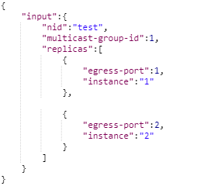
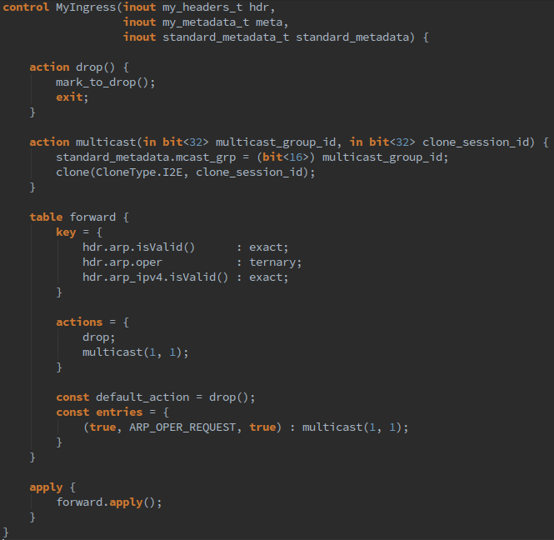
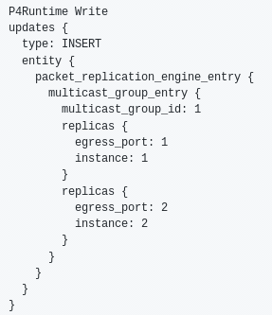
Opendaylight & P4 Demo-Packet Replication
Multicast and Clone is architecture-dependent
message PacketReplicationEngineEntry {
oneof type {
MulticastGroupEntry multicast_group_entry = 1;
CloneSessionEntry clone_session_entry = 2;
}
}
...
message MulticastGroupEntry {
uint32 multicast_group_id = 1;
repeated Replica replicas = 2;
}
...
message CloneSessionEntry {
uint32 session_id = 1;
repeated Replica replicas = 2;
uint32 class_of_service = 3;
int32 packet_length_bytes = 4;
}
...
message Replica {
uint32 egress_port = 1;
uint32 instance = 2;
}
...

Slide 19
Opendaylight & P4 Demo-Telemetry
Advantages
Push intead of pull,
model driven, e.g. Yang
The gNMI protocol contains both configuration and data delivery.
gNMI Telemetry? OpenConfig Telemetry? In-band Telemetry?
ODL
App
Config
Collect
TSDR
RPC/Notification
P4Plugin
Collect & Analysis
gNMI
gRPC
GPB
ip:50051
Mininet
Yang Models ...
Data Source
bmv2
eth0
2
1
eth0

Slide 20
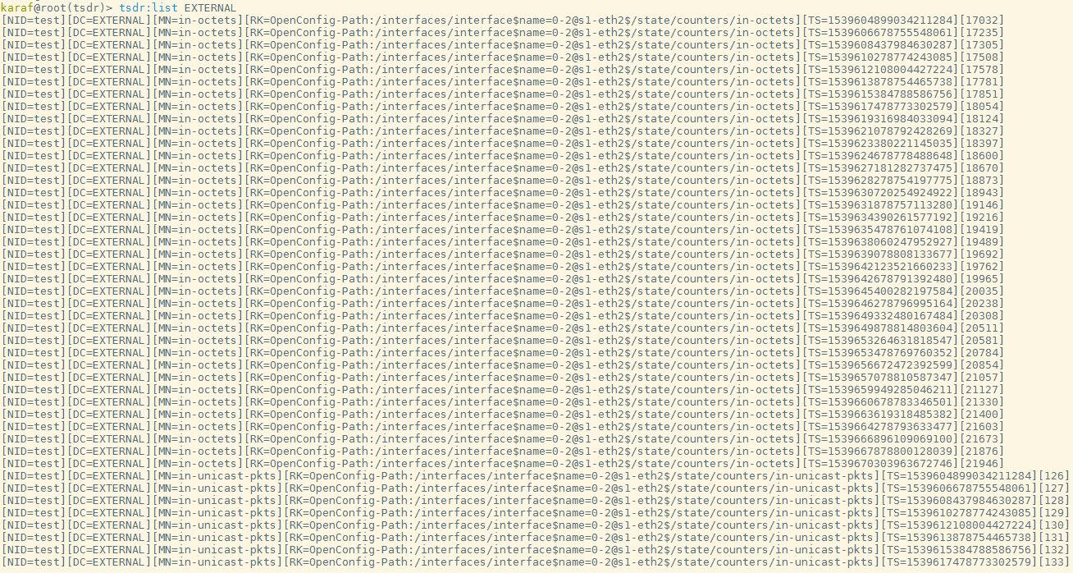
Opendaylight & P4 Demo-Telemetry
Telemetry data can not be displayed in Grafana currently

Slide 21



Thank you.

