Slide 1


P4 Runtime integration with ODL

Slide 2
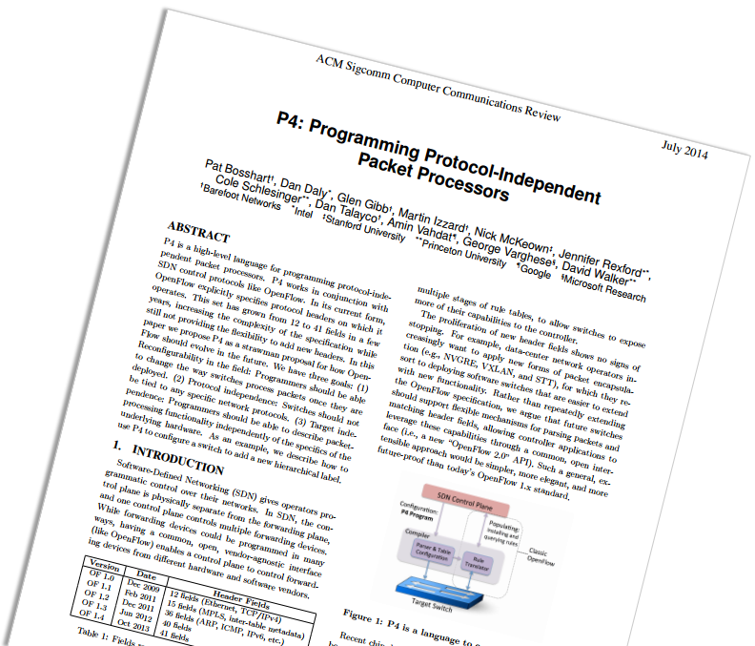
What's P4?
P4 stands for Programming Protocal-Independent Packet Processors.
P4 is a high-levle language, P4 programs specify how a switch processes packets.
table routing {
key = {
ipv4.dstAddr : lpm;
}
actions = {
drop;
route;
}
size : 2048;
}
control ingress() {
apply {
routing.apply();
}
}

Slide 3
What's P4?
P4 itself is protocol independent but allows for the expression of forwarding plane protocols.
It is based upon an abstract forwarding model called PISA (Protocol Independent Switch Architecture)
A machine that can run a P4 program is called target.
Programmer declares what tables are needed and how packets are processed
PISA
Programmer declares which
headers are recognized
Match + Action
Memory
ALU
Programmable
Parser

Slide 4
Why P4?
Benefits of a Programmable Forwarding Plane
Programmability VS Performance
New protocols and Apps.
Remove unused protocols.
Flexible use of tables.
New diagnostics, telemetry.
Easily Add
New
Features
Increase
Network
Reliability
Programmability
Greater
Visibility
Programmability
Efficient
use of
Resources
Performance

Slide 5
How to Use P4?
Control plane or NOS decides what the switch actually does
program.p4
SDN controller or Network OS
Data Declarations
header_type ethernet_t { … }
header_type l2_metadata_t { … }
header ethernet_t ethernet;
header vlan_tag_t vlan_tag[2];
metadata l2_metadata_t l2_meta;
match:action entries
Parser Program
parser parse_ethernet { extract(ethernet); return switch(ethernet.ethertype) { 0x8100 : parse_vlan_tag; 0x0800 : parse_ipv4; 0x8847 : parse_mpls; default: ingress; }
Header / Metadata
Queueing, Replication & Scheduling
Parser
Deparser
Parser
...
Table + Control Flow Program
table port_table { … }
control ingress { apply(port_table); if (l2_meta.vlan_tags == 0) { process_assign_vlan();
} }
P4 program defines what each table CAN do

Slide 6













P4 Ecosystem
Application
Language
Architecture
Chip
P4₁₄/P4₁₆
PISA/PSA
Tofino
SmartCard

Slide 7

Traditional Network Equipment
BGP
OSPF
VXLAN
etc.
Switch ASIC API
OS
Switch ASCI API
Closed
Fixed
Proprietary

Slide 8
In The SDN Era
BGP
OSPF
VXLAN
etc.
Remote Control Plane
OpenFlow
Open
Silicon-independent
Fixed
OpenFlow
OpenFlow
OpenFlow
ASIC A API
ASIC B API
ASIC C API
OS
OS
OS
A
B
C

Slide 9
After P4 Generation
BGP
OSPF
VXLAN
etc.
Remote Control Plane
P4 Runtime Agent
P4 Runtime API
Open and silicon-independent
Program-independent
Extended without restarting the control plane
P4 Runtime Agent
Driver
OS

Slide 10

South Channel Compare and Contrast
OpenFlow
P4 Runtime
OpenFlow protocol
gRPC/protoBuf
OpenFlow
HTTP2
TCP
TCP
Client and Server
Client and Server
Controller
Controller
Server
Client
Switch
Switch
Client
Server
It only gives us a way to populate
a set of well-known tables
It is a protocol-independent API, it doesn't
be tied to any specific network protocols
Device discovery
Set pipeline config
etc.
etc.

Slide 11
How to Use P4 Runtime
P4 program
APP
Apps
P4 Compiler
Frontend
ODL
Backend A
Backend B
P4 Runtime Info
P4Plugin
Data-plane A Configuration
Data-plane B Configuration
gRPC Server
gRPC Server
Driver
Driver
Target A
Target B

Slide 12
What's gRPC?
gRPC stands for Goole Remote Procedure Calls.
A high performance, open source universal RPC framework.
Works across languages and platforms.
Bi-directional streaming.
gRPC Stub
Request
Client
Server
protobuf
Response
Java Client
gRPC Server
Request
Response
gRPC Stub
Client
Server
C++ Service
Client
Python Client

Slide 13



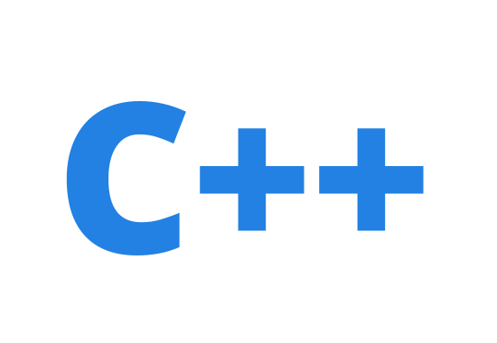
gRPC Workflow
Define protobuf.
Compile and generate specific language code.
Implement Server and Client.
hellworld.proto
service HelloService {
rpc SayHello (HelloRequest) returns (HelloResponse);
}
message HelloRequest {
string greeting = 1;
}
message HelloResponse {
string reply = 1;
}
Java
Runtime Library
gRPC Server
Protobuf definitions
Compiler
network
① Define
② Compile
Runtime Library
gRPC Client
③ Implement

Slide 14
Introduce to P4Plugin in ODL
ODL
L2Switch
RPC/Notification
DataStore
P4Plugin
REST API
Device
Packet
Table
Cluster
Adapter
gRPC Client
Netconf
Switch
Linux OS
gRPC Server
Netconf Server
Driver
Hardware

Slide 15
Packet-In/Out
APP
Apps
RPC/Notification
ODL
P4Plugin
Packet-In
Packet-Out
Switch
Control Plane
gRPC Server
CPU
Driver
Port
Port
Port
Port
Port
Data Plane
Port
Port
Port
Port
Port

Slide 16
Stream Channel
ODL
device id = 1
device id = 2
device id = 3
gRPC Client
Stream channel, bi-directional
Single TCP connection, multiplexing
IP:Port:Device : Stream channel = 1 : 1
Switch
gRPC Server
Device
device id = 1
device id = 2
device id = 3

Slide 17
How to Implement Program Independent
service P4Runtime {
rpc Write(WriteRequest) returns ...
rpc Read(ReadRequest) returns ...
...
}
message WriteRequest {
uint64 device_id = 1;
Uint128 election_id = 2;
repeated Update updates = 3;
}
message Update {
enum Type {
UNSPECIFIED = 0;
INSERT = 1;
MODIFY = 2;
DELETE = 3;
}
Type type = 1;
Entity entity = 2;
}
message Entity {
oneof entity {
TableEntry table_entry = 2;
...
}
}
message TableEntry {
uint32 table_id = 1;
repeated FieldMatch match = 2;
TableAction action = 3;
}
message TableAction {
oneof type {
Action action = 1;
...
}
}
message Action {
uint32 action_id = 1;
message Param {
uint32 param_id = 2;
bytes value = 3;
}
repeated Param params = 4;
}
message FieldMatch {
uint32 field_id = 1;
...
message Exact {
bytes value = 1;
}
message Ternary {
bytes value = 1;
bytes mask = 2;
}
message LPM {
bytes value = 1;
int32 prefix_len = 2;
}
oneof field_match_type {
Exact exact = 2;
Ternary ternary = 3;
LPM lpm = 4;
...
}
}
Map-like message sequences, each message contains an unique ID and a value.
Due to the use of bytes, the value will not be subject to any restrictions.
What about API exposed to SDN Apps?

Slide 18
P4 Runtime Infomation
header_type ethernet_t { ... }
header_type ipv4_t { ... }
header ethernet_t ethernet;
header ipv4_t ipv4;
parser start { ... }
parser parse_ethernet { .. }
action set_nhop(nhop_ipv4, port) { ... }
table ipv4_lpm {
reads {
ipv4.dstAddr : lpm;
}
actions {
set_nhop;
_drop;
}
size: 1024;
}
control ingress {
if(valid(ipv4) and ipv4.ttl > 0) {
apply(ipv4_lpm);
apply(forward);
}
}
tables {
preamble {
id: 33581985
name: "ipv4_lpm"
alias: "ipv4_lpm"
}
match_fields {
id: 1
name: "ipv4.dstAddr"
bitwidth: 32
match_type: LPM
}
action_refs {
id: 16812204
}
action_refs {
id: 16784184
}
action_refs {
id: 16800567
annotations: "@defaultonly()"
}
size: 1024
}
actions {
preamble {
id: 16812204
name: "set_nhop"
alias: "set_nhop"
}
params {
id: 1
name: "nhop_ipv4"
bitwidth: 32
}
params {
id: 2
name: "port"
bitwidth: 9
}
}
actions {
preamble {
id: 16784184
name: "_drop"
alias: "_drop"
}
}
Compile
simple_router.p4
simple_router.proto.txt

Slide 19
ODL & P4 Demo
Simple router based on bmv2
Remote
Chrome
ip:8181
Linux
ODL
P4Plugin
ip:50051
Mininet
Host1
IP : 10.0.0.10/24
Mac: 00:04:00:00:00:00
GW : 10.0.0.1
Static arp:
10.0.0.1 00:aa:bb:00:00:00
bmv2
Host2
IP : 10.0.1.10/24
Mac: 00:04:00:00:00:01
GW : 10.0.1.1
Static arp:
10.0.1.1 00:aa:bb:00:00:01
eth0
2
1
eth0
simple_router.p4

Slide 20
Detailed Steps I
Compile
Start Mininet
hll@hll:/home/opendaylight/p4lang/behavioral-model/mininet$ p4c-bm2-ss simple_router.p4 --p4v 14 -o simple_router.json
simple_router.p4(107): warning: -1: negative value with unsigned type
add_to_field(ipv4.ttl, -1);
^
hll@hll:/home/opendaylight/p4lang/behavioral-model/mininet$ p4c-bm2-ss simple_router.p4 --p4v 14 --p4runtime-file simple_router.proto.txt --p4runtime-format text
simple_router.p4(107): warning: -1: negative value with unsigned type
add_to_field(ipv4.ttl, -1);
^
hll@hll:/home/opendaylight/p4lang/behavioral-model/mininet$
hll@hll:/home/opendaylight/p4lang/behavioral-model/mininet$ sudo python ./1sw_grpc_demo.py --behavioral-exe ../targets/simple_switch_grpc/simple_switch_grpc --cpu-port 64
[sudo] password for hll:
*** Creating network
*** Adding hosts:
h1 h2
*** Adding switches:
s1
*** Adding links:
(h1, s1) (h2, s1)
*** Configuring hosts
h1 h2
*** Starting controller
*** Starting 1 switches
s1 Starting P4 switch s1.
../targets/simple_switch_grpc/simple_switch_grpc --no-p4 -i 1@s1-eth1 -i 2@s1-eth2 --nanolog ipc:///tmp/bm-0-log.ipc --device-id 0 --log-console -- --cpu-port 64
P4 switch s1 has been started.
**********
h1
default interface: eth0 10.0.0.10 00:04:00:00:00:00
**********
**********
h2
default interface: eth0 10.0.1.10 00:04:00:00:00:01
**********
Ready !
*** Starting CLI:
mininet>
Start ODL
hll@hll:/home/opendaylight/odl/new/p4plugin$ ./karaf/target/assembly/bin/karaf
karaf: JAVA_HOME not set; results may vary
Apache Karaf starting up. Press Enter to open the shell now...
100% [==================================================================]
Karaf started in 0s. Bundle stats: 10 active, 10 total
________ ________ .__ .__ .__ __
\_____ \ ______ ____ ____ \______ \ _____ ___.__.| | |__| ____ | |___/ |_
/ | \\____ \_/ __ \ / \ | | \\__ \< | || | | |/ ___\| | \ __\
/ | \ |_> > ___/| | \| ` \/ __ \\___ || |_| / /_/ > Y \ |
\_______ / __/ \___ >___| /_______ (____ / ____||____/__\___ /|___| /__|
\/|__| \/ \/ \/ \/\/ /_____/ \/
Hit '<tab>' for a list of available commands
and '[cmd] --help' for help on a specific command.
Hit '<ctrl-d>' or type 'system:shutdown' or 'logout' to shutdown OpenDaylight.
opendaylight-user@root>feature:install odl-p4plugin-a
odl-p4plugin-adapter odl-p4plugin-all
opendaylight-user@root>feature:install odl-p4plugin-all

Slide 21
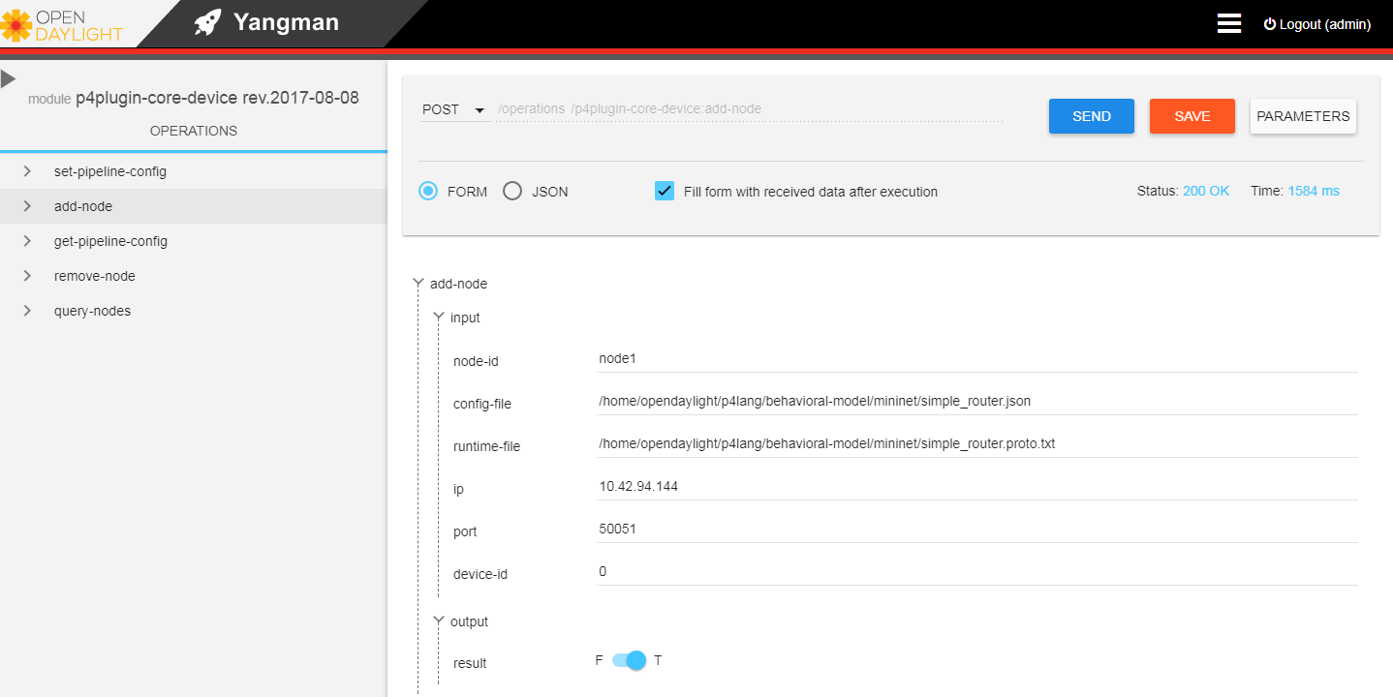
Detailed Steps II
Add node

Slide 22
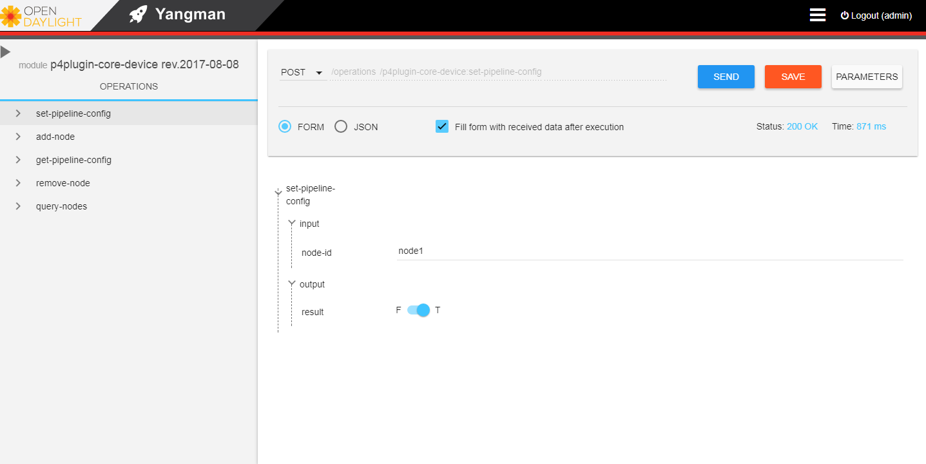
Detailed Steps III
Set pipeline config

Slide 23
Detailed Steps IV
TCP connection
Log
hll@hll:/home/opendaylight/p4lang/behavioral-model/mininet$ netstat -tuan | grep 50051
tcp6 0 0 :::50051 :::* LISTEN
hll@hll:/home/opendaylight/p4lang/behavioral-model/mininet$ netstat -tuan | grep 50051
tcp6 0 0 :::50051 :::* LISTEN
tcp6 0 0 10.42.94.144:38464 10.42.94.144:50051 ESTABLISHED
tcp6 0 0 10.42.94.144:50051 10.42.94.144:38464 ESTABLISHED
hll@hll:/home/opendaylight/p4lang/behavioral-model/mininet$ more /tmp/p4s.s1.log
Thrift port was not specified, will use 9090
Calling target program-options parser
Adding interface s1-eth1 as port 1
[09:50:25.359] [bmv2] [D] [thread 4008] Adding interface s1-eth1 as port 1
Adding interface s1-eth2 as port 2
[09:50:25.425] [bmv2] [D] [thread 4008] Adding interface s1-eth2 as port 2
Server listening on 0.0.0.0:50051
P4Runtime SetForwardingPipelineConfig
[10:11:56.557] [bmv2] [D] [thread 4025] Set default entry for table 'ipv4_lpm': NoAction -
[10:11:56.557] [bmv2] [D] [thread 4025] Set default entry for table 'forward': NoAction -
[10:11:56.557] [bmv2] [D] [thread 4025] Set default entry for table 'send_frame': NoAction -
[10:11:56.559] [bmv2] [D] [thread 4761] [0.0] [cxt 0] Processing packet received on port 1
[10:11:56.559] [bmv2] [D] [thread 4761] [0.0] [cxt 0] Parser 'parser': start
[10:11:56.559] [bmv2] [D] [thread 4761] [0.0] [cxt 0] Parser state 'start' has no switch, going to default next state
[10:11:56.559] [bmv2] [T] [thread 4761] [0.0] [cxt 0] Bytes parsed: 0
[10:11:56.559] [bmv2] [D] [thread 4761] [0.0] [cxt 0] Extracting header 'ethernet'
[10:11:56.559] [bmv2] [D] [thread 4761] [0.0] [cxt 0] Parser state 'parse_ethernet': key is 86dd
[10:11:56.559] [bmv2] [T] [thread 4761] [0.0] [cxt 0] Bytes parsed: 14
[10:11:56.559] [bmv2] [T] [thread 4761] [0.0] [cxt 0] Skipping checksum 'cksum' verification because target field invalid
[10:11:56.559] [bmv2] [D] [thread 4761] [0.0] [cxt 0] Parser 'parser': end
[10:11:56.559] [bmv2] [D] [thread 4761] [0.0] [cxt 0] Pipeline 'ingress': start
[10:11:56.559] [bmv2] [T] [thread 4761] [0.0] [cxt 0] simple_router.p4(153) Condition "and" is false
[10:11:56.559] [bmv2] [D] [thread 4761] [0.0] [cxt 0] Pipeline 'ingress': end
[10:11:56.559] [bmv2] [D] [thread 4761] [0.0] [cxt 0] Egress port is 0
[10:11:56.559] [bmv2] [D] [thread 4762] [0.0] [cxt 0] Pipeline 'egress': start
[10:11:56.559] [bmv2] [T] [thread 4762] [0.0] [cxt 0] Applying table 'send_frame'
[10:11:56.559] [bmv2] [D] [thread 4762] [0.0] [cxt 0] Looking up key:
* standard_metadata.egress_port: 0000
Captured packet
hll@hll:/home/opendaylight/p4lang/behavioral-model/mininet$ sudo tcpdump -i lo port 50051
tcpdump: listening on lo, link-type EN10MB (Ethernet), capture size 262144 bytes
11:22:33.475071 IP 10.42.94.144.38464 > 10.42.94.144.50051: Flags [S], seq 2577324257 ...
11:22:33.475088 IP 10.42.94.144.50051 > 10.42.94.144.38464: Flags [S.], seq 3272263691 ...
11:22:33.475101 IP 10.42.94.144.38464 > 10.42.94.144.50051: Flags [.], ack 1, win 86, ... length 0
11:22:33.475375 IP 10.42.94.144.50051 > 10.42.94.144.38464: Flags [P.], seq 1:28, ack 1 ... length 27
11:22:33.475387 IP 10.42.94.144.38464 > 10.42.94.144.50051: Flags [.], ack 28... length 0
11:22:33.478076 IP 10.42.94.144.38464 > 10.42.94.144.50051: Flags [P.], seq 1:71, ack 28 ... length 70
11:22:33.478089 IP 10.42.94.144.50051 > 10.42.94.144.38464: Flags [.], ack 71 ... length 0
11:22:33.478180 IP 10.42.94.144.50051 > 10.42.94.144.38464: Flags [P.], seq 28:37, ack 71 ... length 9
11:22:33.479914 IP 10.42.94.144.38464 > 10.42.94.144.50051: Flags [P.], seq 71:80, ack 37 ... length 9
11:22:33.482040 IP 10.42.94.144.38464 > 10.42.94.144.50051: Flags [P.], seq 80:208, ack 37... length 128
11:22:33.482076 IP 10.42.94.144.50051 > 10.42.94.144.38464: Flags [.], ack 208 ... length 0

Slide 24
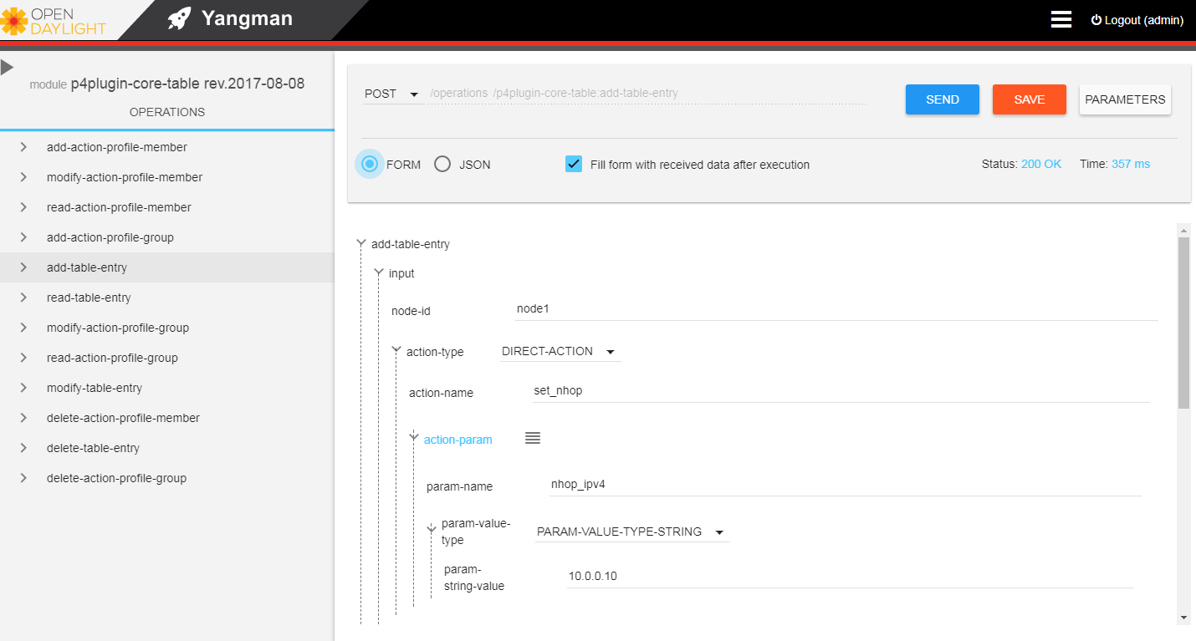
Detailed Steps IV
Add table entry (Form format)

Slide 25
Detailed Steps IV (continued)
Json format
Data
{
"add-table-entry": {
"input": {
"node-id": "node1",
"action-name": "set_nhop",
"action-param": [
{
"param-name": "port",
"param-string-value": "1"
},
{
"param-name": "nhop_ipv4",
"param-string-value": "10.0.0.10"
}
],
"priority": "0",
"controller-metadata": "0",
"table": "ipv4_lpm",
"field": [
{
"field-name": "ipv4.dstAddr",
"lpm-string-value": "10.0.0.0",
"lpm-prefixLen": "24"
}
]
}
}
}
P4Runtime Write
updates {
type: INSERT
entity {
table_entry {
table_id: 33581985
match {
field_id: 1
lpm {
value: "\n\000\000\000"
prefix_len: 24
}
}
action {
action {
action_id: 16812204
params {
param_id: 2
value: "\000\001"
}
params {
param_id: 1
value: "\n\000\000\n"
}
}
}
controller_metadata: 0
}
}
}

Slide 26
Detailed Steps V
Ping test
Match key:
* ipv4.dstAddr : LPM 0a000100/24
Action entry: set_nhop - a00010a,2,
[15:57:51.604] [bmv2] [D] [thread 27525] [25.0] [cxt 0] Action entry is set_nhop - a00010a,2,
[15:57:51.604] [bmv2] [T] [thread 27525] [25.0] [cxt 0] Action set_nhop
[15:57:51.604] [bmv2] [T] [thread 27525] [25.0] [cxt 0] simple_router.p4(104) Primitive nhop_ipv4, port) { ...
[15:57:51.604] [bmv2] [T] [thread 27525] [25.0] [cxt 0] simple_router.p4(104) Primitive port) { ...
[15:57:51.604] [bmv2] [T] [thread 27525] [25.0] [cxt 0] simple_router.p4(107) Primitive add_to_field(ipv4.ttl, -1)
[15:57:51.604] [bmv2] [T] [thread 27525] [25.0] [cxt 0] Applying table 'forward'
[15:57:51.604] [bmv2] [D] [thread 27525] [25.0] [cxt 0] Looking up key:
* routing_metadata.nhop_ipv4: 0a00010a
[15:57:51.604] [bmv2] [D] [thread 27525] [25.0] [cxt 0] Table 'forward': hit with handle 1
[15:57:51.604] [bmv2] [D] [thread 27525] [25.0] [cxt 0] Dumping entry 1
Match key:
* routing_metadata.nhop_ipv4: EXACT 0a00010a
Action entry: set_dmac - 400000001,
[15:57:51.604] [bmv2] [D] [thread 27525] [25.0] [cxt 0] Action entry is set_dmac - 400000001,
[15:57:51.604] [bmv2] [T] [thread 27525] [25.0] [cxt 0] Action set_dmac
[15:57:51.604] [bmv2] [T] [thread 27525] [25.0] [cxt 0] simple_router.p4(121) Primitive dmac) { ...
[15:57:51.604] [bmv2] [D] [thread 27525] [25.0] [cxt 0] Pipeline 'ingress': end
[15:57:51.604] [bmv2] [D] [thread 27525] [25.0] [cxt 0] Egress port is 2
[15:57:51.604] [bmv2] [D] [thread 27528] [25.0] [cxt 0] Pipeline 'egress': start
[15:57:51.604] [bmv2] [T] [thread 27528] [25.0] [cxt 0] Applying table 'send_frame'
[15:57:51.604] [bmv2] [D] [thread 27528] [25.0] [cxt 0] Looking up key:
* standard_metadata.egress_port: 0002
[15:57:51.604] [bmv2] [D] [thread 27528] [25.0] [cxt 0] Table 'send_frame': hit with handle 1
[15:57:51.604] [bmv2] [D] [thread 27528] [25.0] [cxt 0] Dumping entry 1
Match key:
* standard_metadata.egress_port: EXACT 0002
Action entry: rewrite_mac - 10203040506,
[15:57:51.604] [bmv2] [D] [thread 27528] [25.0] [cxt 0] Action entry is rewrite_mac - 10203040506,
[15:57:51.604] [bmv2] [T] [thread 27528] [25.0] [cxt 0] Action rewrite_mac
[15:57:51.604] [bmv2] [T] [thread 27528] [25.0] [cxt 0] simple_router.p4(136) Primitive smac) { ...
[15:57:51.604] [bmv2] [T] [thread 27528] [25.0] [cxt 0] simple_router.p4(138) Primitive modify_field(standard_metadata.egress_port, 2)
[15:57:51.604] [bmv2] [D] [thread 27528] [25.0] [cxt 0] Pipeline 'egress': end
[15:57:51.604] [bmv2] [D] [thread 27528] [25.0] [cxt 0] Deparser 'deparser': start
[15:57:51.604] [bmv2] [D] [thread 27528] [25.0] [cxt 0] Updating checksum 'cksum'
[15:57:51.604] [bmv2] [D] [thread 27528] [25.0] [cxt 0] Deparsing header 'ethernet'
[15:57:51.604] [bmv2] [D] [thread 27528] [25.0] [cxt 0] Deparsing header 'ipv4'
[15:57:51.604] [bmv2] [D] [thread 27528] [25.0] [cxt 0] Deparser 'deparser': end
[15:57:51.604] [bmv2] [D] [thread 27530] [25.0] [cxt 0] Transmitting packet of size 98 out of port 2
*** Starting CLI:
mininet>
mininet> pingall
*** Ping: testing ping reachability
h1 -> h2
h2 -> h1
*** Results: 0% dropped (2/2 received)
mininet> h1 ping h2 -c 4
PING 10.0.1.10 (10.0.1.10) 56(84) bytes of data.
64 bytes from 10.0.1.10: icmp_seq=1 ttl=63 time=1.32 ms
64 bytes from 10.0.1.10: icmp_seq=2 ttl=63 time=1.42 ms
64 bytes from 10.0.1.10: icmp_seq=3 ttl=63 time=2.07 ms
64 bytes from 10.0.1.10: icmp_seq=4 ttl=63 time=1.14 ms
--- 10.0.1.10 ping statistics ---
4 packets transmitted, 4 received, 0% packet loss, time 3004ms
rtt min/avg/max/mdev = 1.149/1.494/2.070/0.347 ms
Packet processing log
[15:57:51.603] [bmv2] [D] [thread 27525] [25.0] [cxt 0] Processing packet received on port 1
[15:57:51.603] [bmv2] [D] [thread 27525] [25.0] [cxt 0] Parser 'parser': start
[15:57:51.603] [bmv2] [D] [thread 27525] [25.0] [cxt 0] Parser state 'start' has no switch, going to default next state
[15:57:51.603] [bmv2] [T] [thread 27525] [25.0] [cxt 0] Bytes parsed: 0
[15:57:51.603] [bmv2] [D] [thread 27525] [25.0] [cxt 0] Extracting header 'ethernet'
[15:57:51.603] [bmv2] [D] [thread 27525] [25.0] [cxt 0] Parser state 'parse_ethernet': key is 0800
[15:57:51.603] [bmv2] [T] [thread 27525] [25.0] [cxt 0] Bytes parsed: 14
[15:57:51.603] [bmv2] [D] [thread 27525] [25.0] [cxt 0] Extracting header 'ipv4'
[15:57:51.603] [bmv2] [D] [thread 27525] [25.0] [cxt 0] Parser state 'parse_ipv4' has no switch, going to default next state
[15:57:51.603] [bmv2] [T] [thread 27525] [25.0] [cxt 0] Bytes parsed: 34
[15:57:51.603] [bmv2] [D] [thread 27525] [25.0] [cxt 0] Verifying checksum 'cksum': true
[15:57:51.603] [bmv2] [D] [thread 27525] [25.0] [cxt 0] Parser 'parser': end
[15:57:51.603] [bmv2] [D] [thread 27525] [25.0] [cxt 0] Pipeline 'ingress': start
[15:57:51.603] [bmv2] [T] [thread 27525] [25.0] [cxt 0] simple_router.p4(153) Condition "and" is true
[15:57:51.603] [bmv2] [T] [thread 27525] [25.0] [cxt 0] Applying table 'ipv4_lpm'
[15:57:51.604] [bmv2] [D] [thread 27525] [25.0] [cxt 0] Looking up key:
* ipv4.dstAddr : 0a00010a
[15:57:51.604] [bmv2] [D] [thread 27525] [25.0] [cxt 0] Table 'ipv4_lpm': hit with handle 1
[15:57:51.604] [bmv2] [D] [thread 27525] [25.0] [cxt 0] Dumping entry 1

Slide 27
ODL & P4 Demo
Packet in/out based on bmv2
packet_io.p4
#define CPU_PORT 64
parser start {
return ingress;
}
action redirect() {
modify_field(standard_metadata.egress_spec, CPU_PORT);
}
table t_redirect {
actions { redirect; }
default_action: redirect();
}
control ingress {
apply(t_redirect);
}
control egress { }
Remote
Chrome
ip:8181
Linux
ODL
P4Plugin
Packet-In
Packet-Out
ip:50051
Mininet
bmv2
eth0
2
1
eth0
packet_io.p4

Slide 28
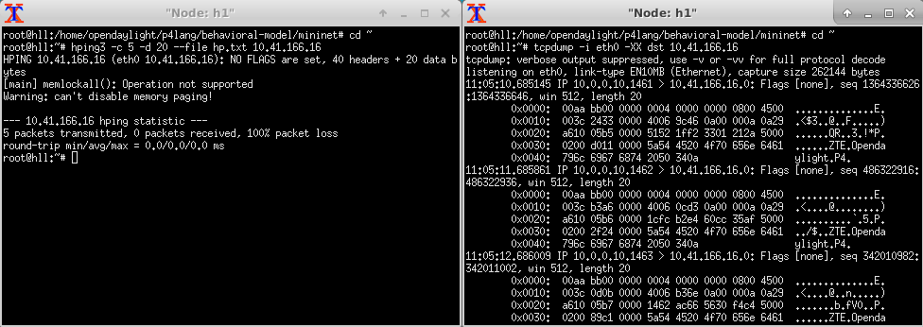
Detailed Steps I
Packet in
Transmit and Capture
Receive log

Slide 29
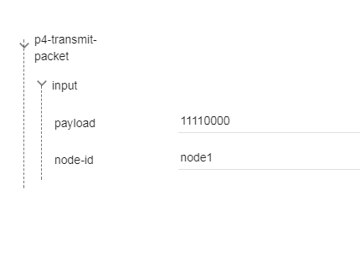
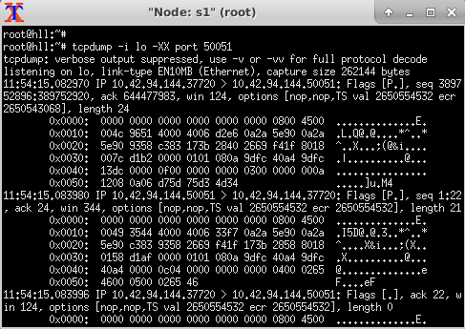

Detailed Steps II
Packet out
Transmit and Capture
YangUI
* “11110000” base64 decode = d75d75d34d34
Receive log

Slide 30


Thank you.

