Slide 1


Porting freeRTOS to
Renesas RH850

Slide 2
This video is not about using freeRTOS.
This video is about porting freeRTOS to RH850 mcu.

Slide 3
RH850 : MCU used

Slide 4
RH850/F1KM-S1
64 pins
R7F701690
Main Clock crystal : 8 MHZ
IDE used = CS+
Compiler = CCRH
OSTM0 = used as RTOS timer = 1 msec interval timer
TAUJ0 = 1 msec interval timer (this timer do not have any thing to do with RTOS)
freeRTOS = V10.4.1

Slide 5
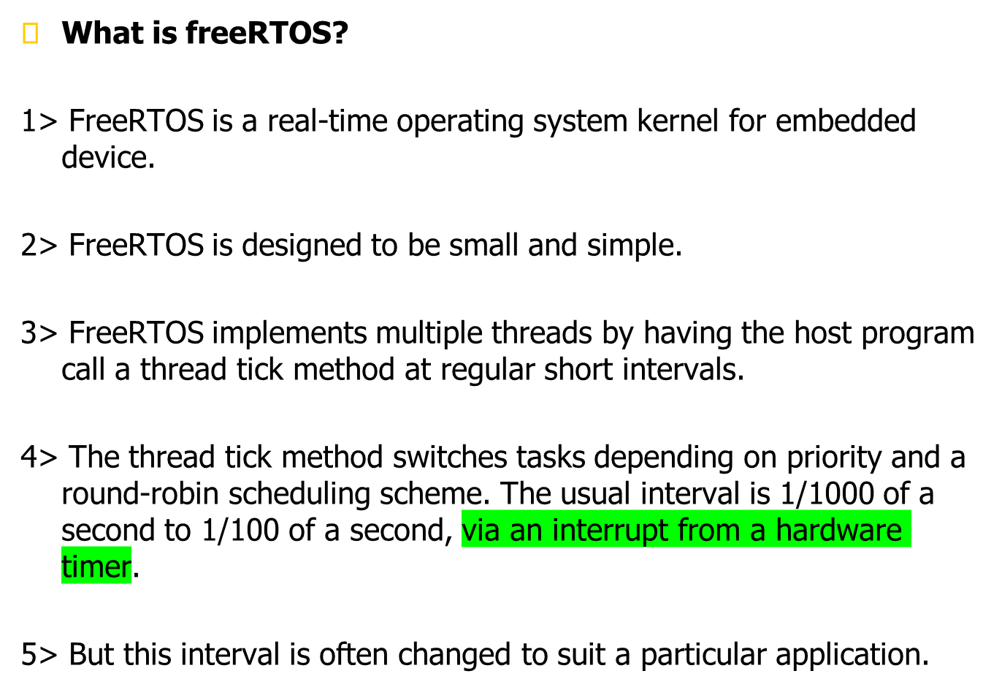

Slide 6
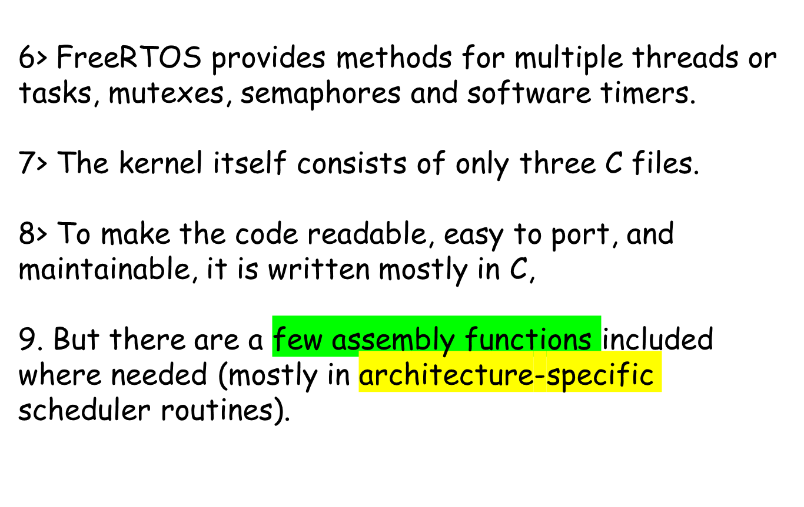

Slide 7
How tasks are created in freeRTOS
And
Scheduler started

Slide 8
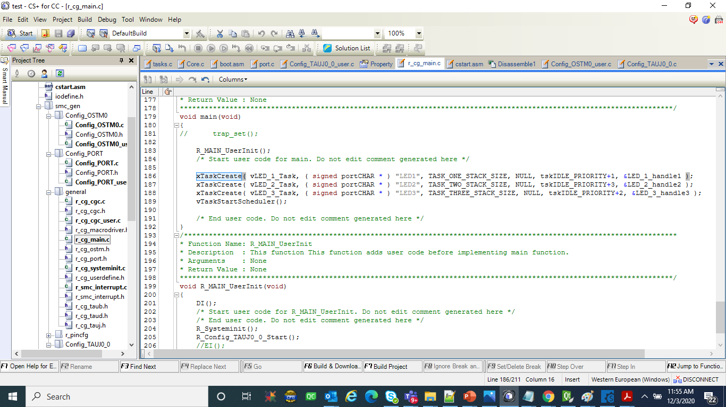

Slide 9
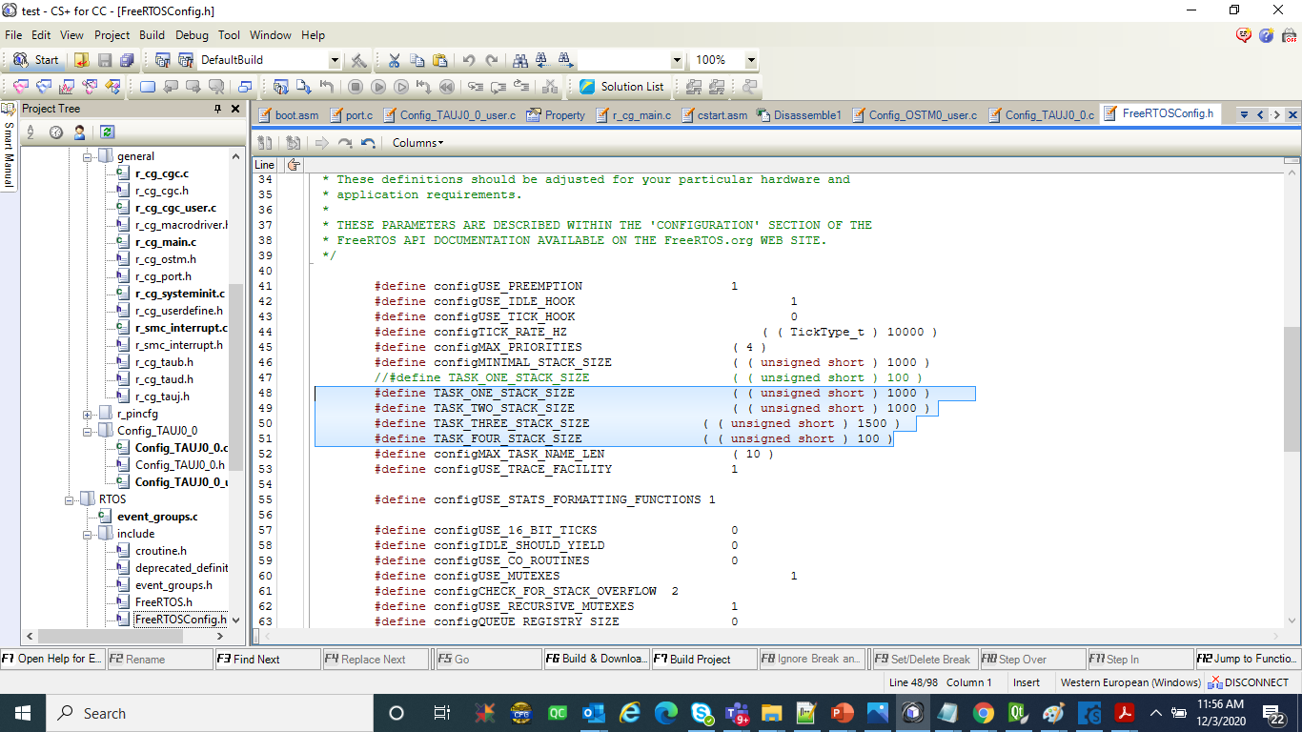

Slide 10
This example I simply create three task :--
vLED_1_Task
vLED_2_Task
vLED_3_Task
These task simply increment a counter.

Slide 11
Few architecture-specific assembly functions are needed

Slide 12
pxPortInitialiseStack : funtion called during each xTaskCreate(), and initialise the stack frame for each task
xPortStartScheduler : Start the RTOS hardware timer
vPortEndScheduler : Stop the RTOS hardware timer
prvSetupTimerInterrupt : called from xPortStartScheduler to start the OS Timer
portSAVE_CONTEXT : Saving the RTOS Task Context
portRESTORE_CONTEXT : Restoring the Context
vPortStart : Restore the context of the first task that is going to run.
vPortYield : This TRAP0 ISR routine
r_Config_OSTM0_interrupt : This is hardwate timer ISR for RTOS tic. OSTM0 of RH850 is used as RTOS timer.

Slide 13
PATH location for RTOS portable code :--
V10.4.1\CS+\RTOS\portable

Slide 14
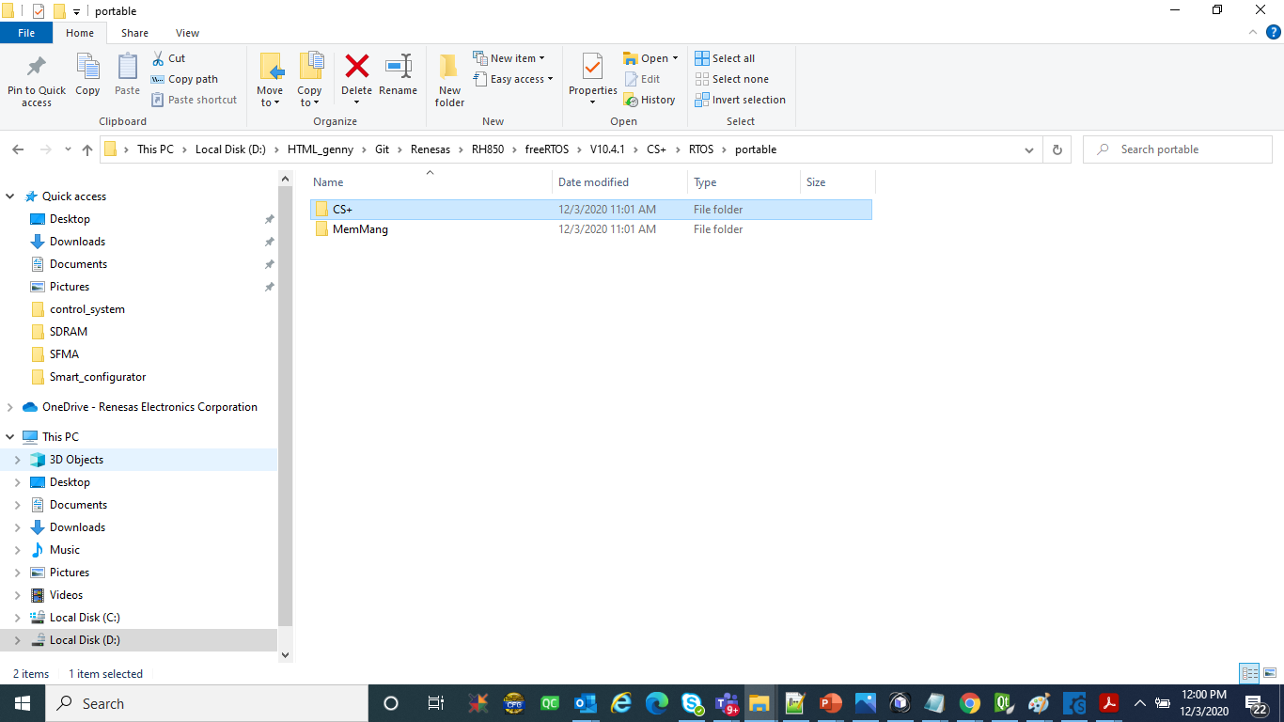

Slide 15
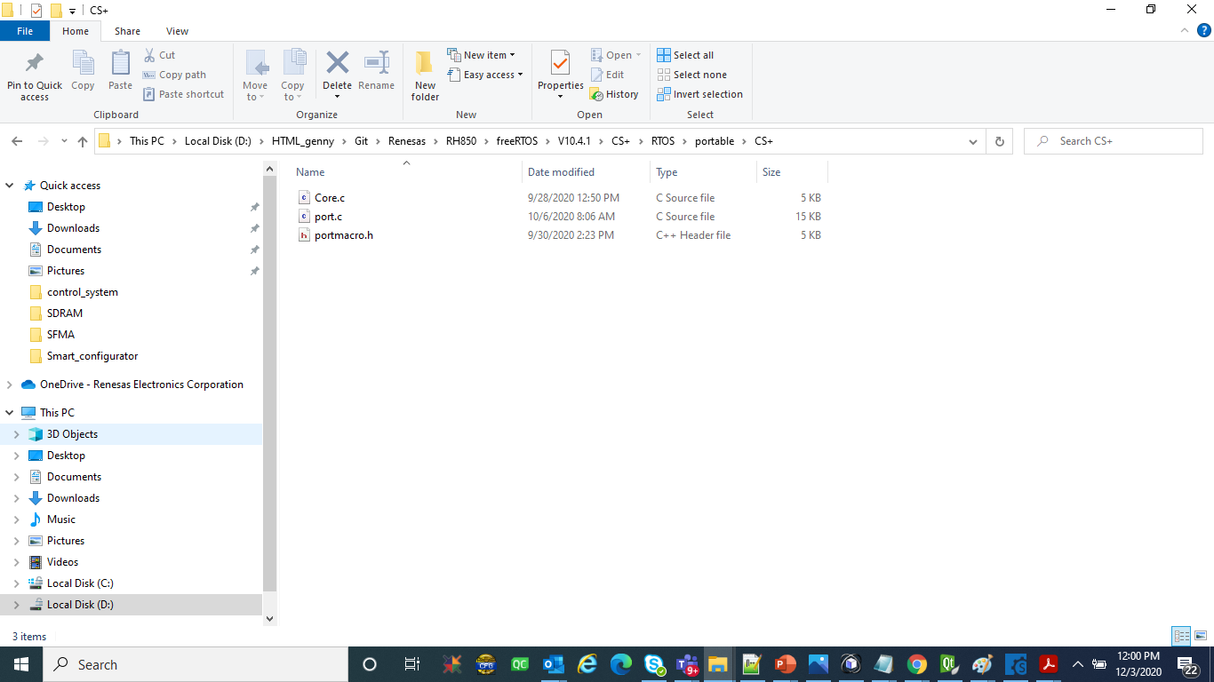

Slide 16


Slide 17
HOW freeRTOS execute TRAP:--
trap_set()

Slide 18
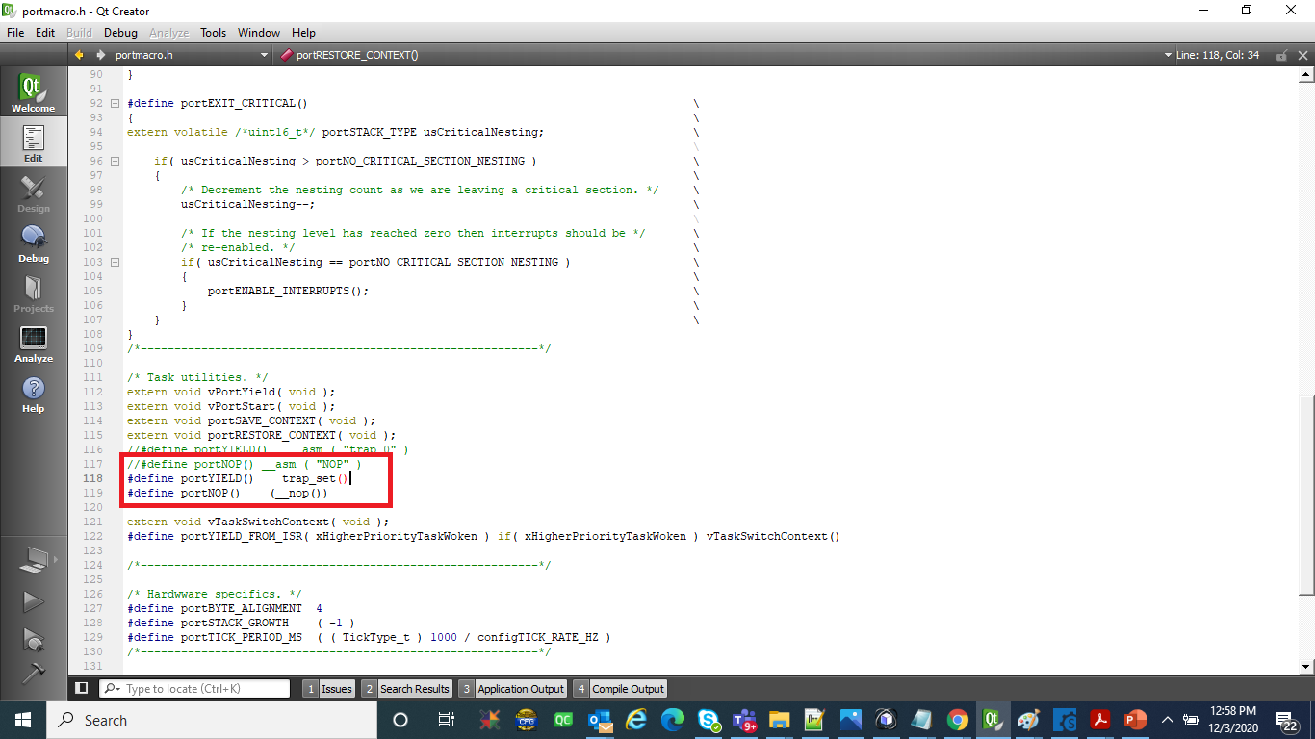

Slide 19
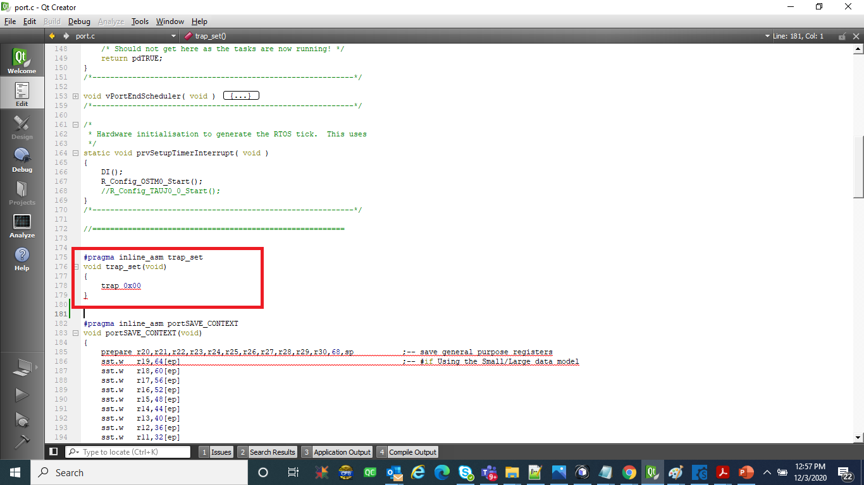

Slide 20
vPortYield :--
This TRAP0 ISR routine

Slide 21
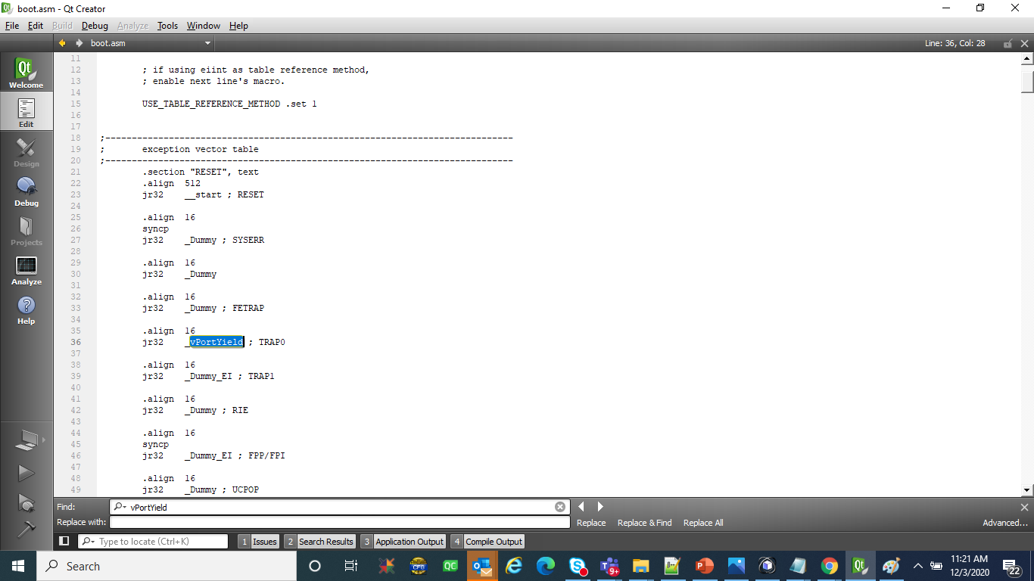

Slide 22
r_Config_OSTM0_interrupt :--
This is hardwate timer ISR for RTOS tic. OSTM0 of RH850 is used as RTOS timer.

Slide 23
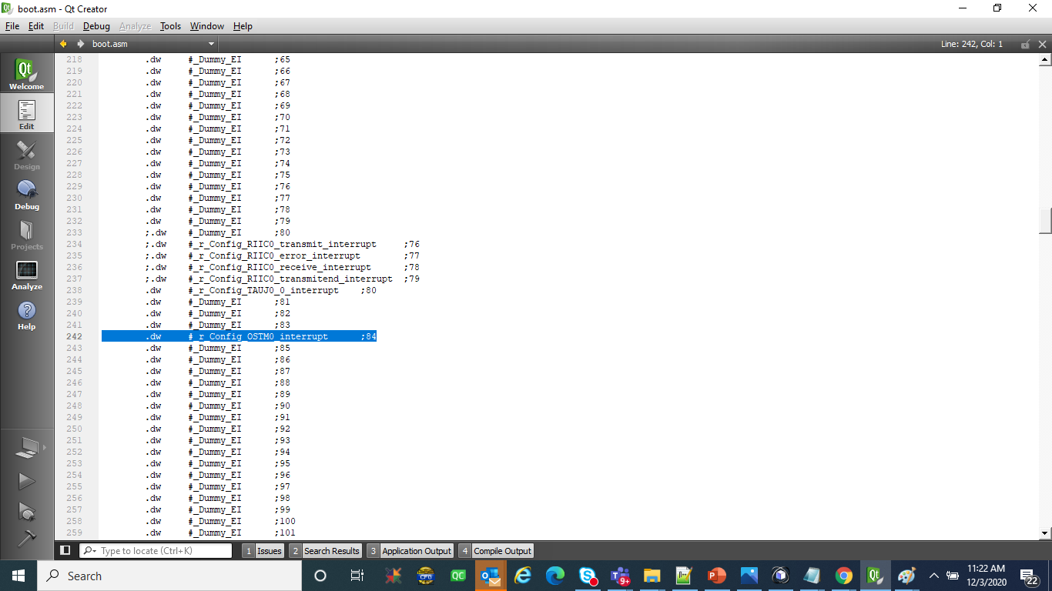

Slide 24
Main Important points to be considered while porting

Slide 25
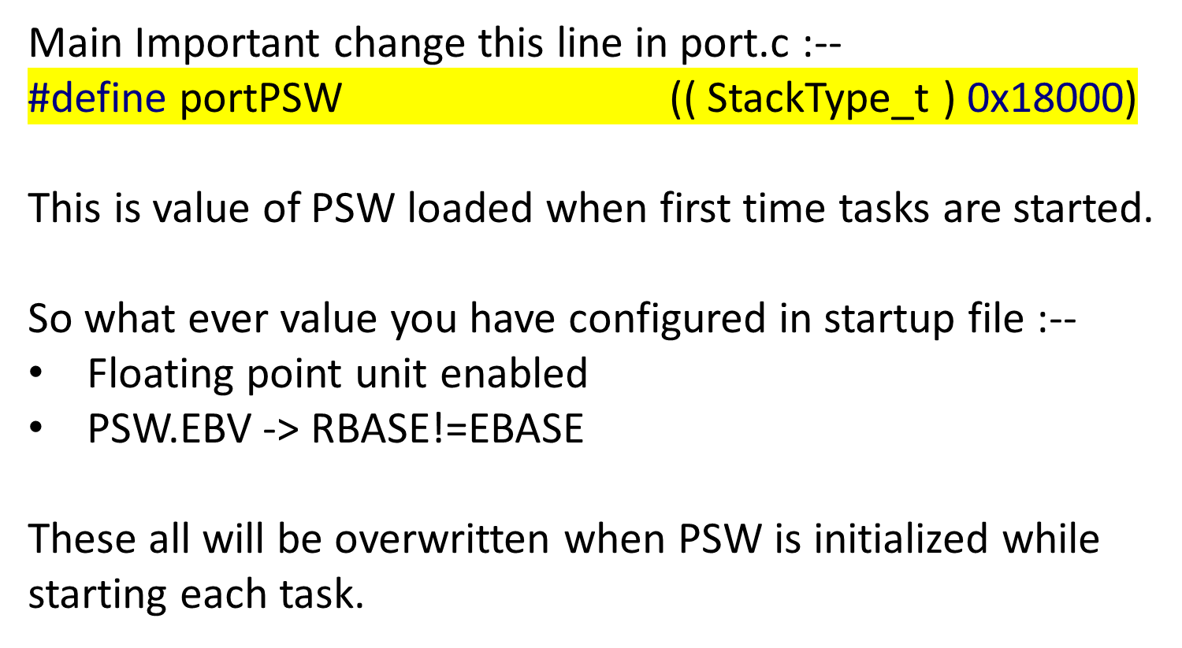

Slide 26
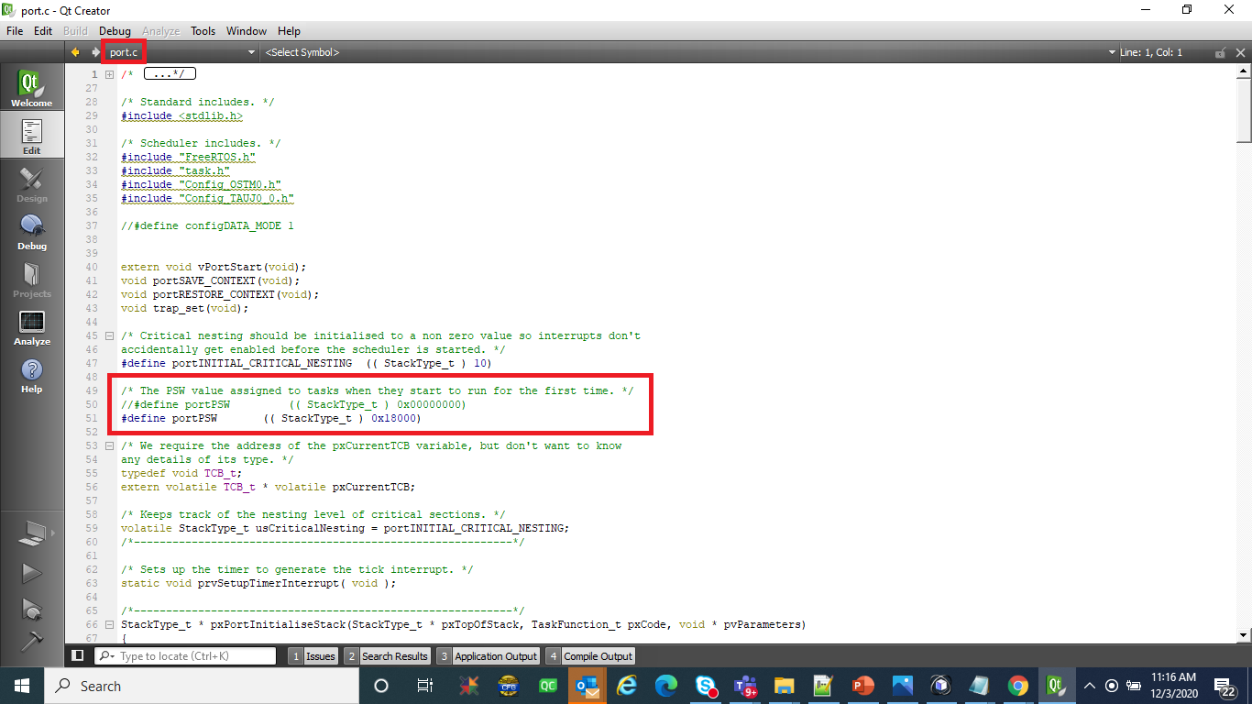

Slide 27
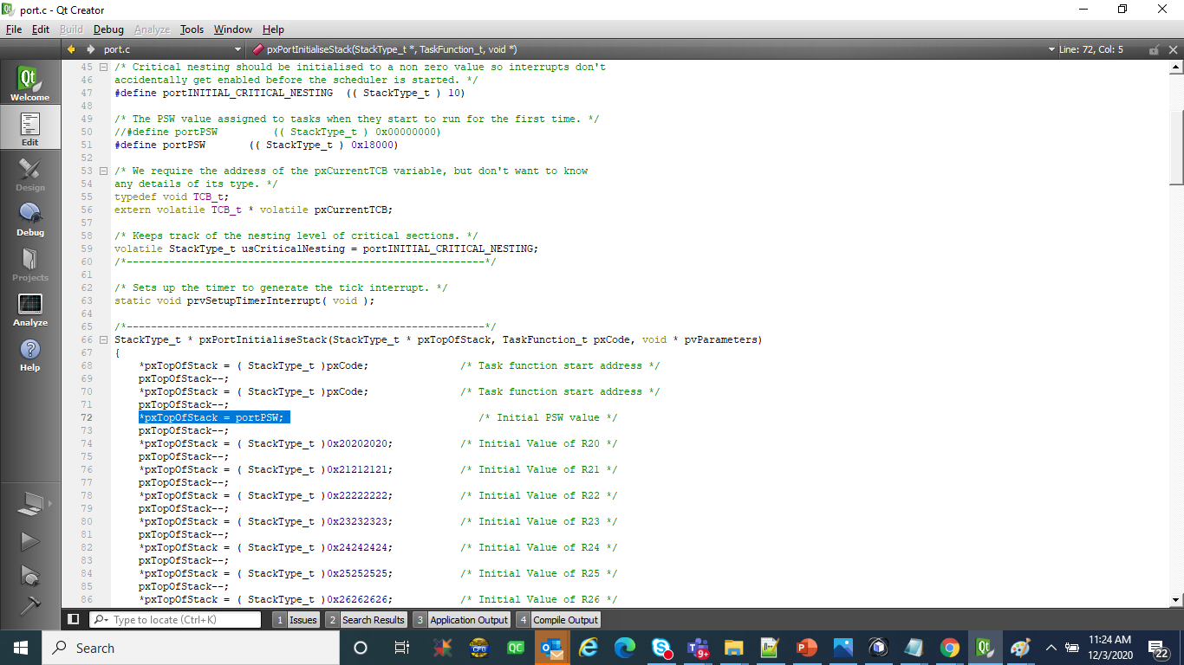

Slide 28
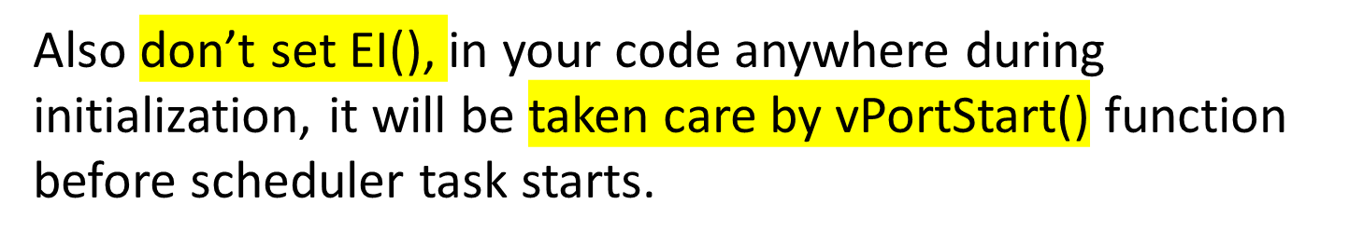

Slide 29
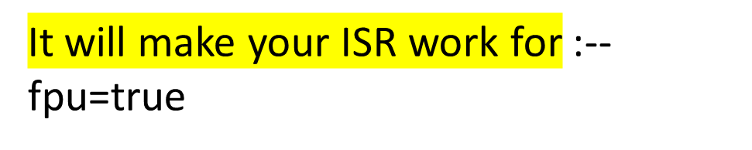

Slide 30
But enable this option(fpu=true) in ISR only if you want to use floating point calculation in your ISR handler.
Other wise Using “fpu=true” will generate unnecessary instruction to push & POP on stack for floating point registers & your isr will have to do this unnecessary task.
And also set this option -xfloat to true, to use hardware floating point instruction, in your application code for floating point operations.

Slide 31
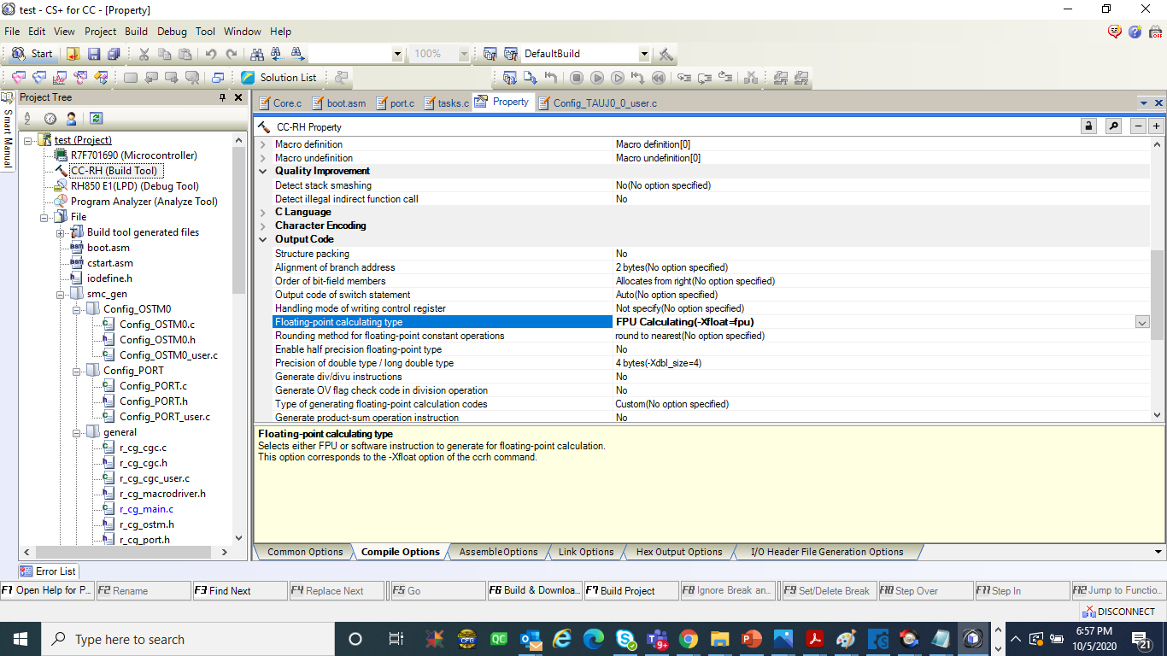

Slide 32
GIT hub link for source code

Slide 34
freeRTOS Documentation

Slide 35
https://www.freertos.org/
https://en.wikipedia.org/wiki/FreeRTOS
FreeRTOS Kernel Quick Start Guide :--
https://www.freertos.org/FreeRTOS-quick-start-guide.html
https://www.freertos.org/RTOS_ports.html --> FreeRTOS Kernel Ports
https://www.freertos.org/implementation/a00016.html --> portSAVE_CONTEXT
https://www.freertos.org/implementation/a00017.html --> portRESTORE_CONTEXT
https://www.freertos.org/a00125.html --> xTaskCreate
https://www.freertos.org/a00126.html --> vTaskDelete
https://www.freertos.org/a00017.html --> Source Organization
https://www.freertos.org/a00110.html --> FreeRTOSConfig.h
https://www.freertos.org/Documentation/RTOS_book.html --> FreeRTOS Documentation
https://www.freertos.org/a00104.html --> download
======================= IMP IMP IMP ===============
Keep OS timer to lowest priority

Slide 36
Thank you
Please subscribe to channel for further updates

