Slide 1


Tutorial - III
UiMagician & vscpd

Slide 2

UiMagician :
HTML & Mobile App Generator
vscpd:
Cross Platform Daemon/server for VSCP

Slide 3


UiMagician
vscpd

Slide 4

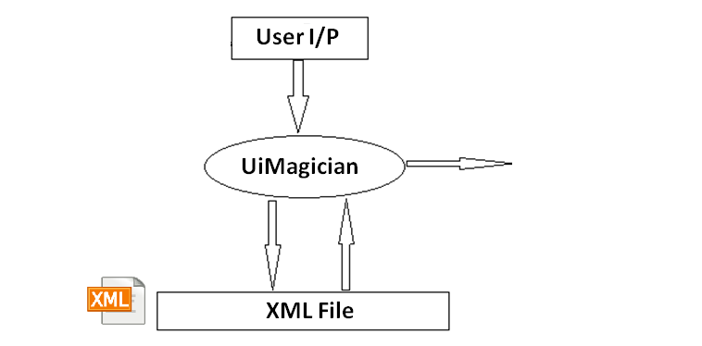
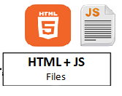
UiMagician HTML app generation Logic :---

Slide 5
Mobile Apps Generation

Slide 6
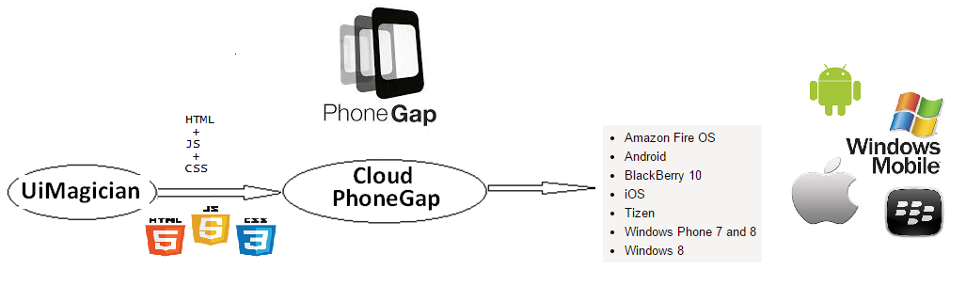
Cloud : Mobile Apps generation

Slide 7
UiM Apps controlling – Type of Buildings

Slide 8
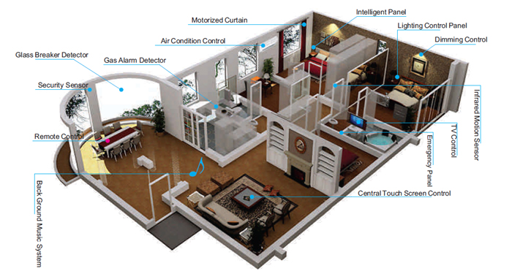
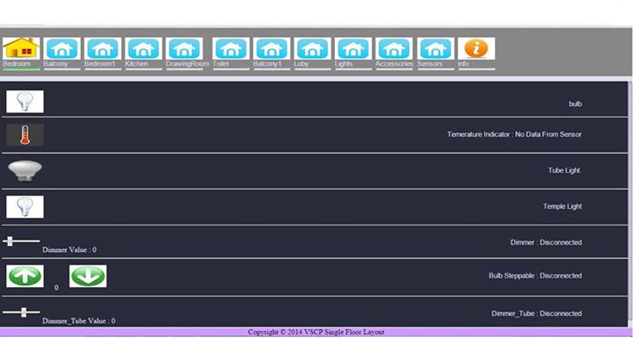
Single Floor Building Control HTML APP

Slide 9
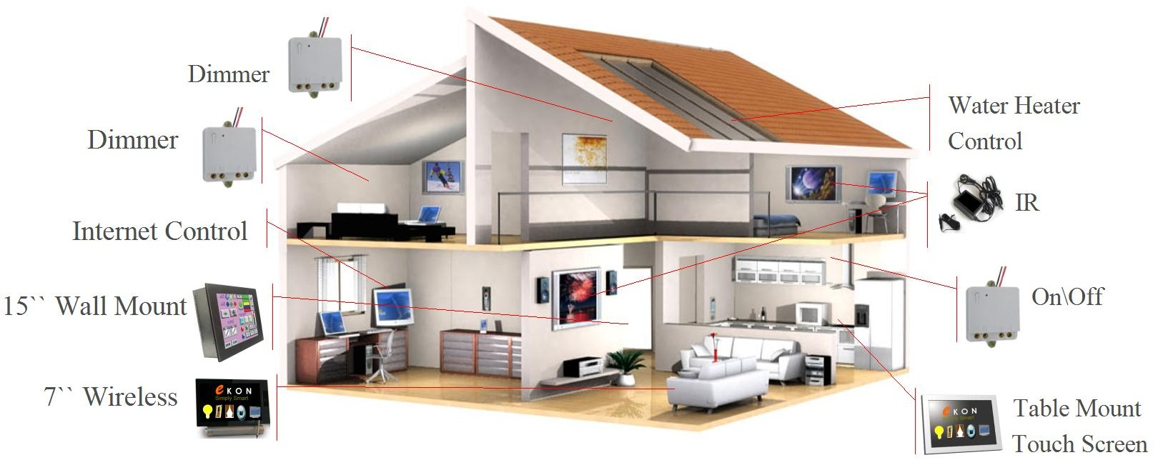
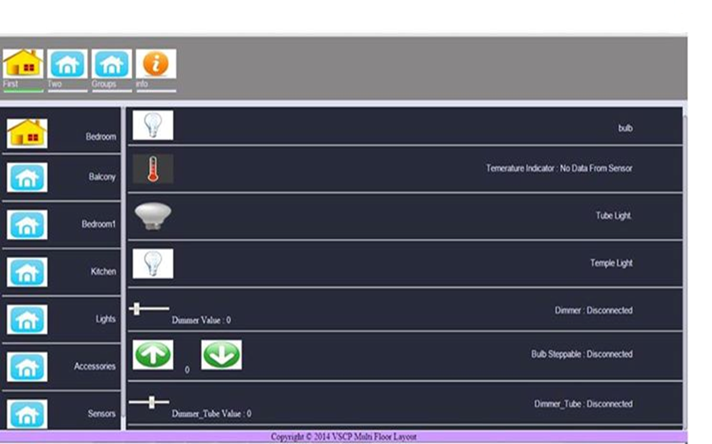
Multi Floor Building control HTML APP

Slide 10

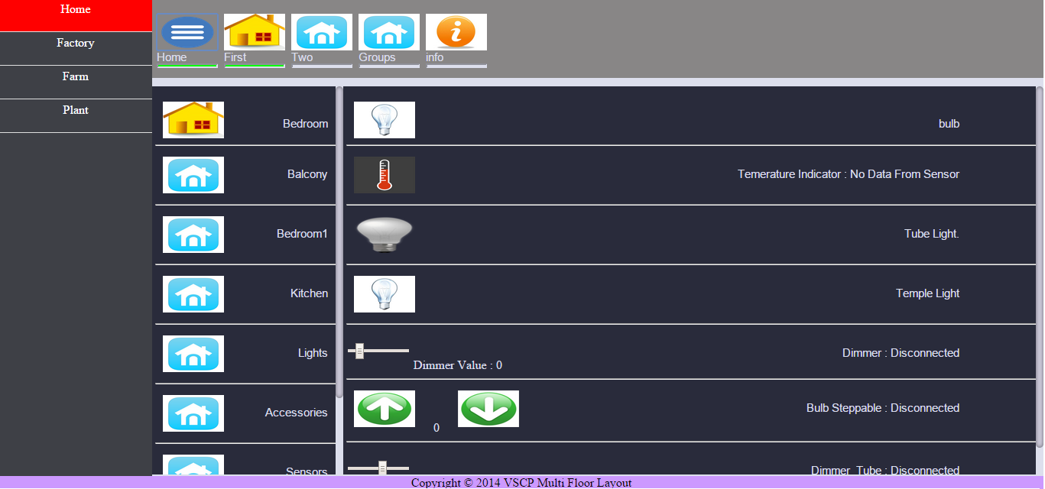
Multiple Building controlling
HTML APP

Slide 11
UiM Apps & VSCPD controlling - Buildings

Slide 12
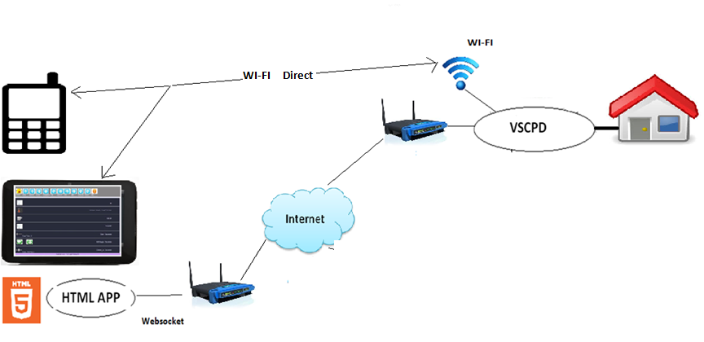
Single – floor house control

Slide 13
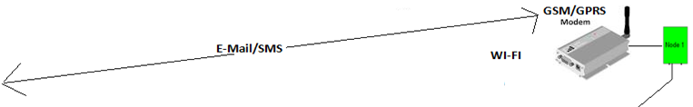
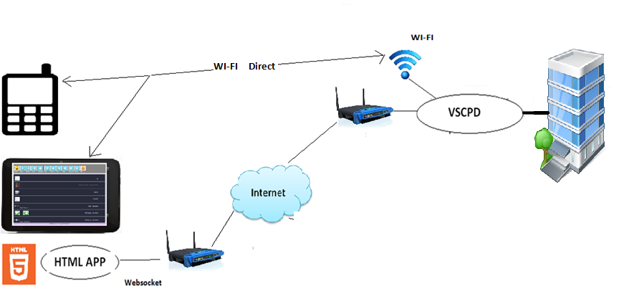
Multi – floor house control

Slide 14
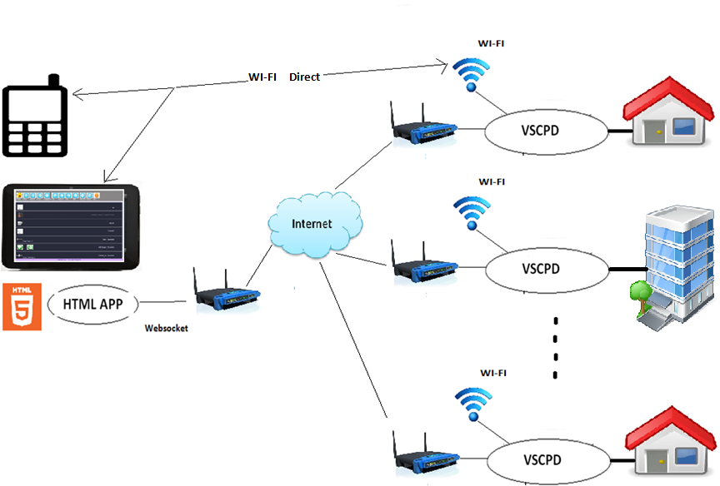
Multiple House control
Single APP

Slide 15
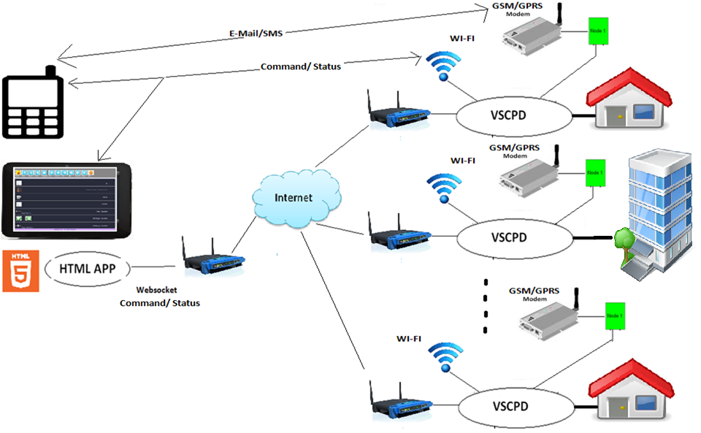
vscpd & GSM/GPRS Access

Slide 16
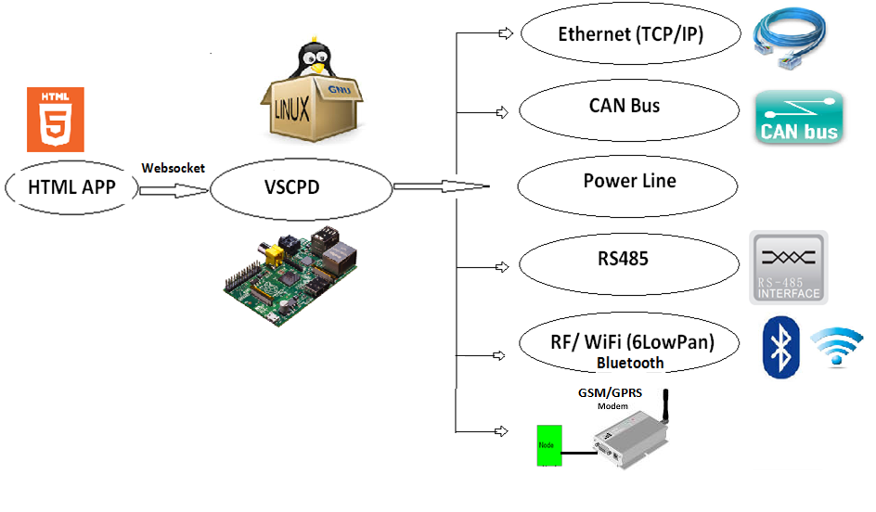
VSCPD control Logic :---

Slide 17
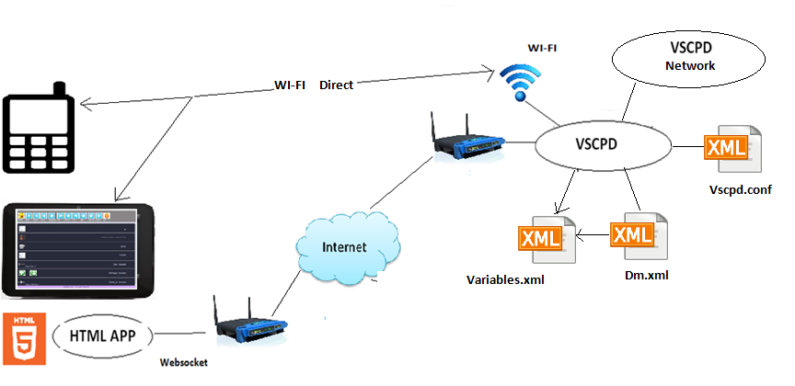
Vscpd & xml
dm.xml, variables.xml, vscpd.conf

Slide 18
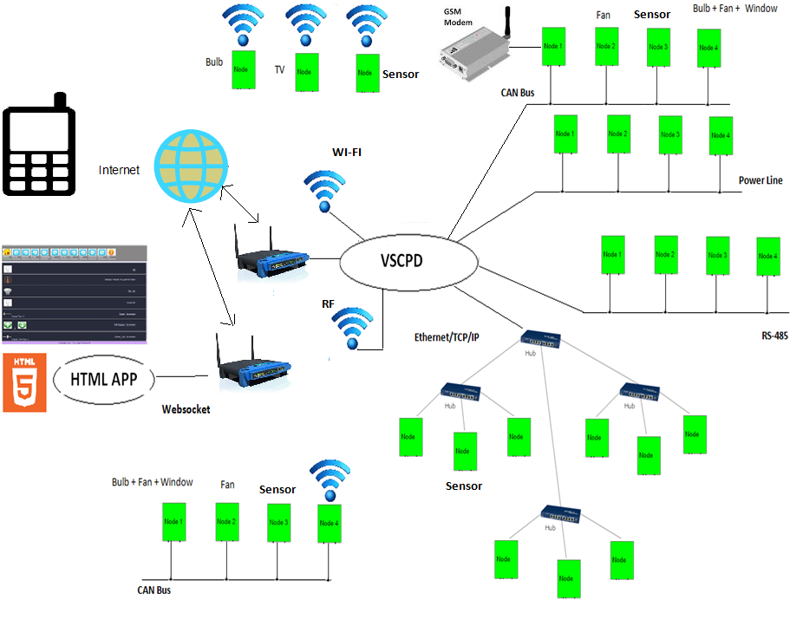
Vscpd N/W :

Slide 19
VSCP Modules : Available
1> RF based
2> Wifi based
3> CAN based - relay control/ sensors
4> Ethernet based - relay control/ sensors
5> GSM/GPRS based nodes
6> Powerline based - relay control
7> Temprature & humidity sensor

Slide 20
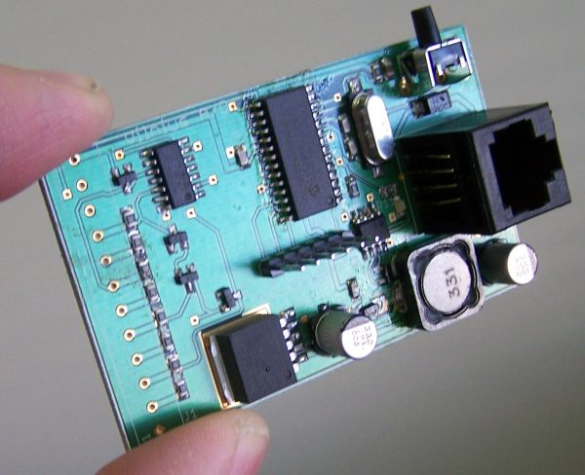

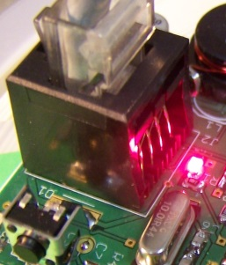
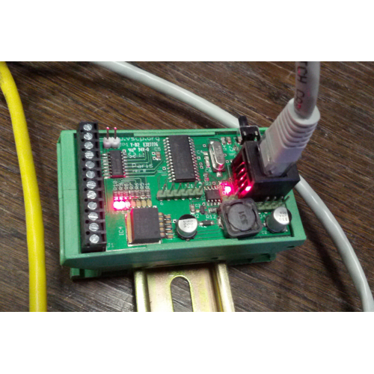
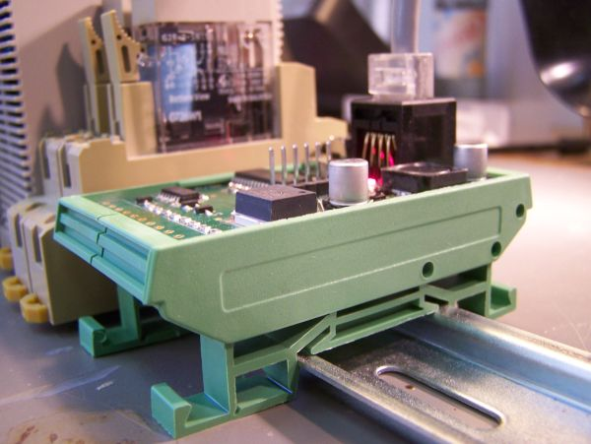
VSCP Modules

Slide 21
VSCP Modules : Buy
List of modules :--
http://www.grodansparadis.com/wiki/doku.php?id=alphabetic_list_of_modules
http://www.grodansparadis.com/products.html
http://www.frogshop.se/ → Shop here

Slide 22
Mailing List :
vscp@googlegroups.com

Slide 23
Thank You!

