Slide 1


UiMagician
HTML & Mobile App Generator VSCP
Designer & Developer :
Name : Dinesh Guleria

Slide 2







Development Tools used
Programming language used C++.
GUI development library QT.
HTML app is using following language :--
a> HTML5
b> Javascript
c> CSS

Slide 3

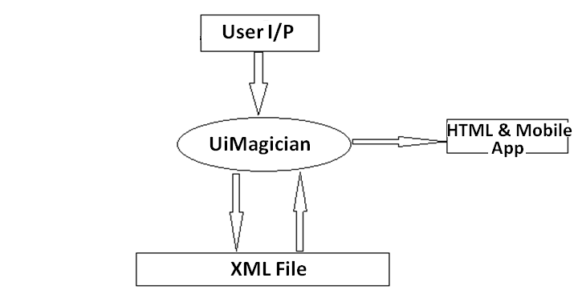
UiMagician Working Logic :---

Slide 4
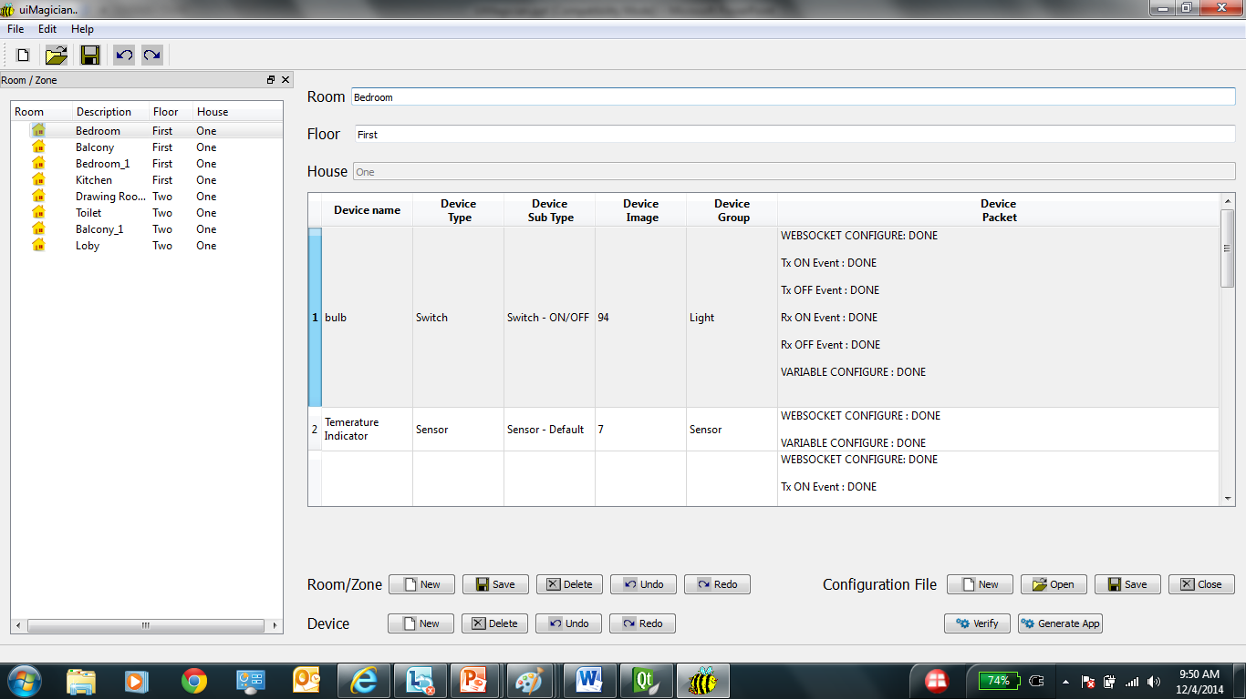

Slide 5
Advantages
Reduction in development time.
No need for skillset in GUI development.
Reduces manual error – Auto Generation.
XML configuration file – Editable.
Creating new Zone/Device Easily - VSCP Knowledge.

Slide 6
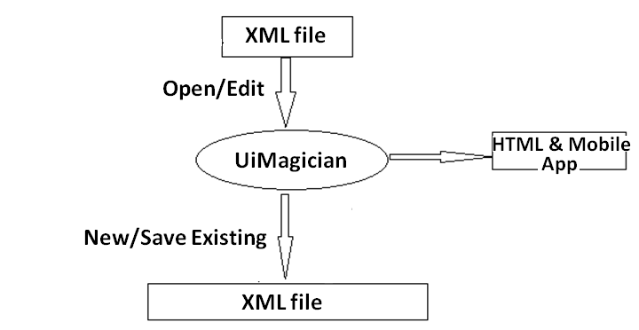
High Level Design for UiMagician:---

Slide 7
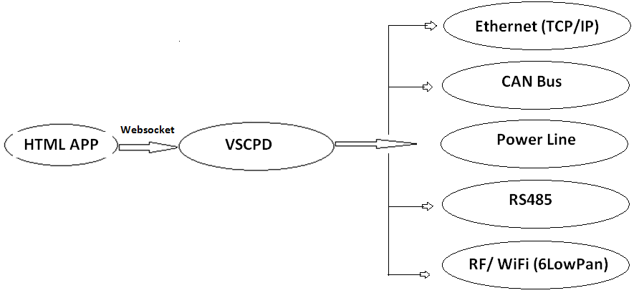
HTML App control Logic :---

Slide 8
UiMagician Tool

Slide 9
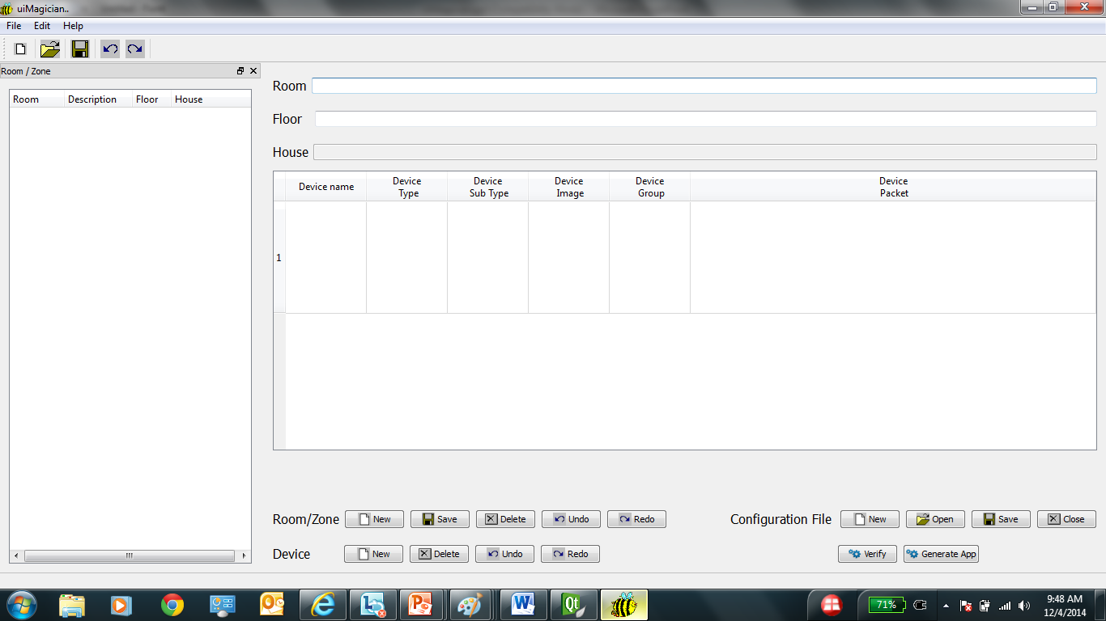

Slide 11

XML File Format

Slide 12

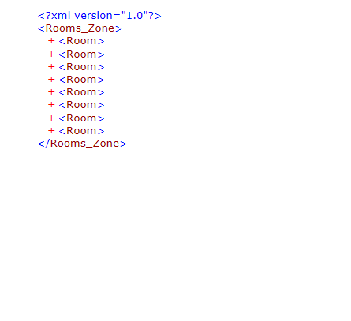

Slide 13
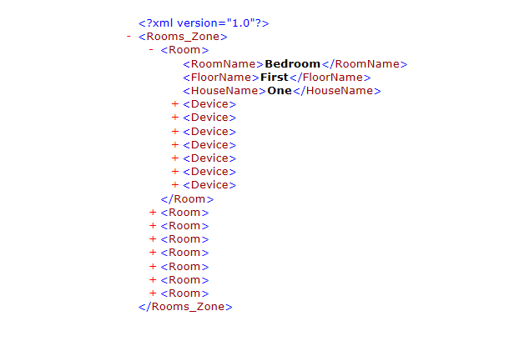

Slide 14
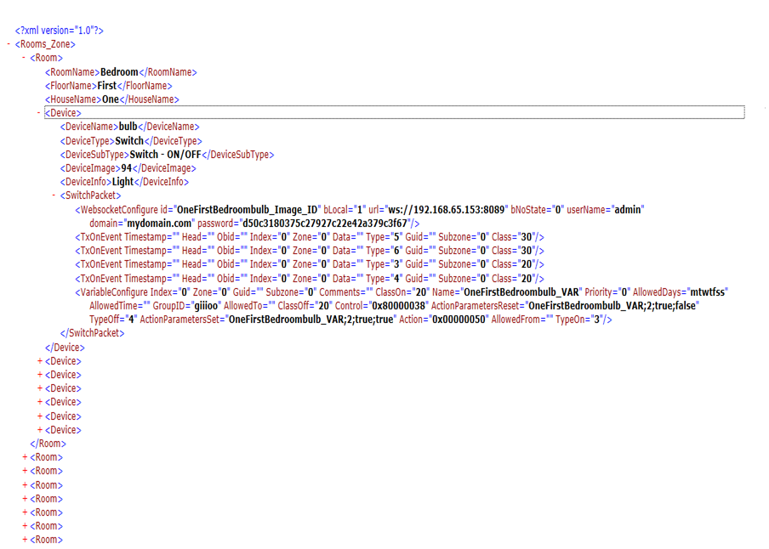

Slide 15
HTML Apps Generated

Slide 16
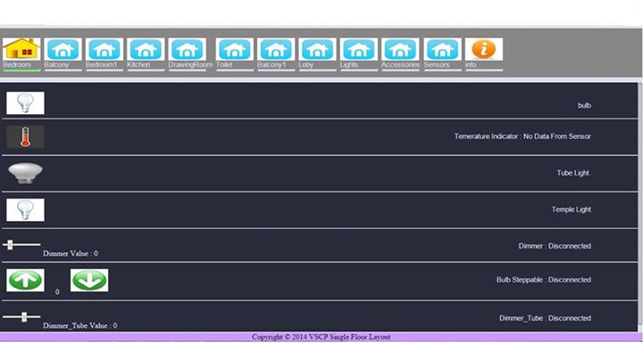
Single Floor House HTML APP :

Slide 17
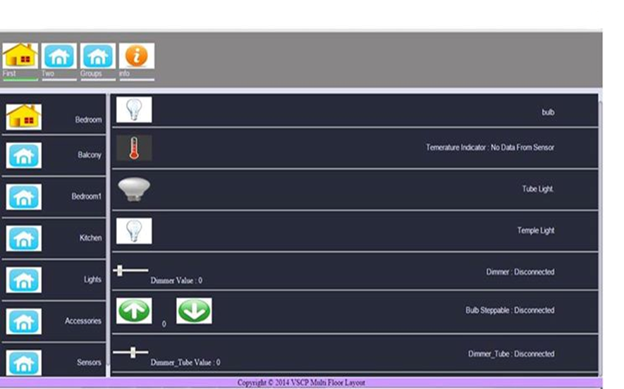
Multi Floor House HTML APP :

Slide 18
Mobile Apps Generation

Slide 19
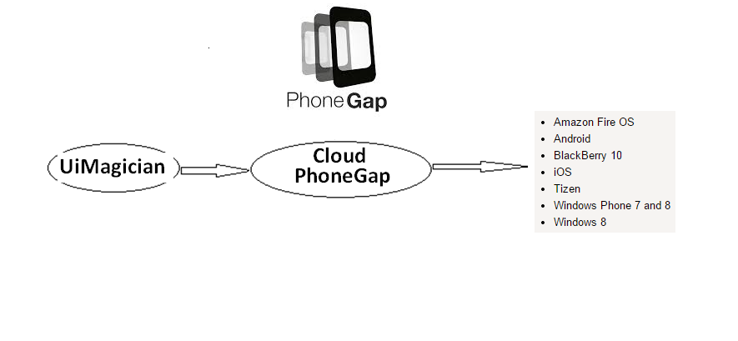

Slide 20
Future addition :
Multi House control.
GPS map.
Auto update of HTML app on vscpd webserver.
Mobile App generation.

Slide 21
Mailing List :
vscp@googlegroups.com
Download Link :
http://sourceforge.net/projects/uimagician/

Slide 22
Thank You!

