Slide 1

CitiJourn
The citizen journalism app
MEDIA AND ENTERTAINMENT
Mentor: Sanjeev Sir
Namespace

Slide 2
OBJECTIVE
DEMOCRATISE JOURNALISM

Slide 3
KEY FEATURES
Empower every citizen
Use the mobile camera to curate the news
To provide the fastest news
Authenticate

Slide 4
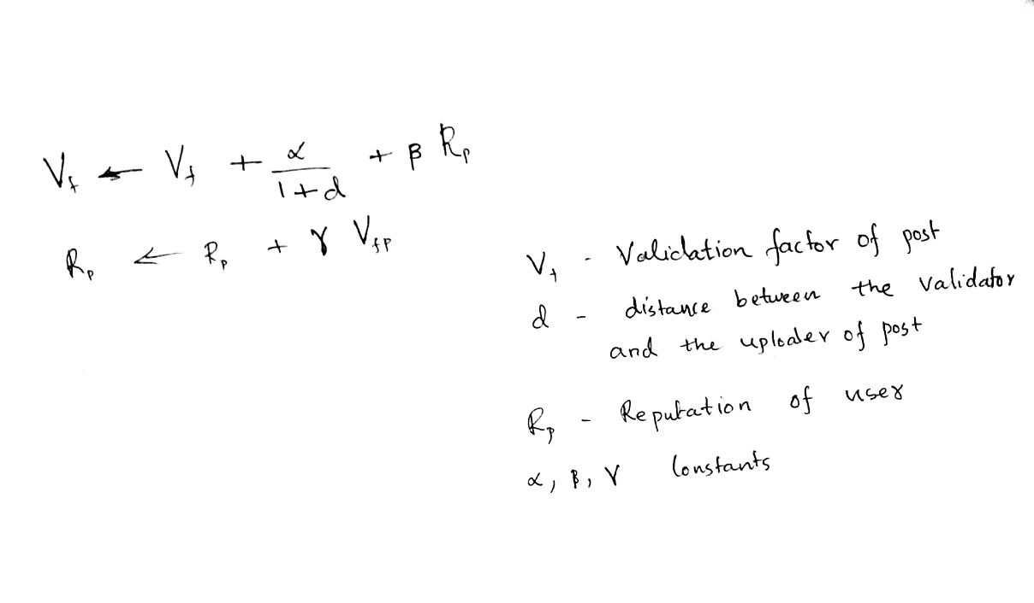
FAKE NEWS DETECTION
The vicinity of the validator of the news.
The reputation of the news reporter.
The reputation of the validator.
The news up votes.

Slide 5

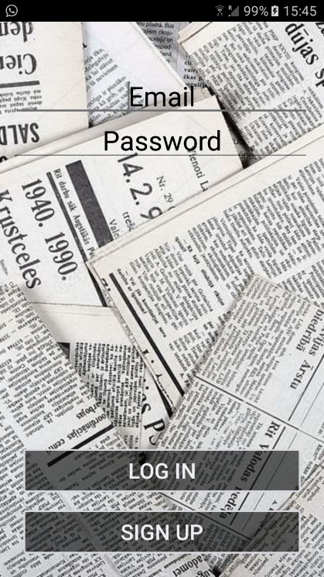
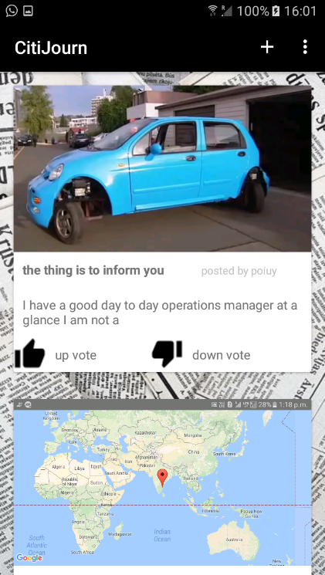
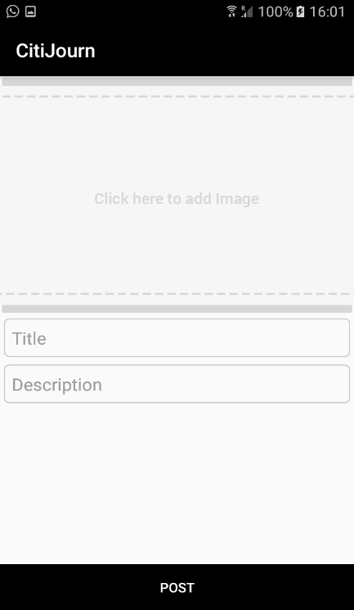
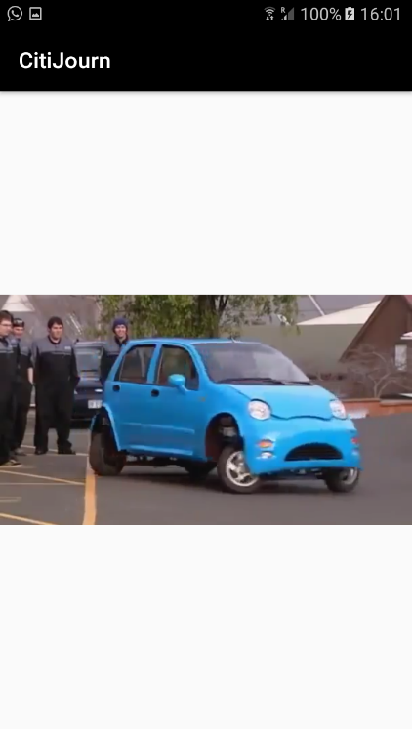
SCREENSHOTS
LOGIN AUTHENTICATION
NEWS DISPLAY
NEWS REPORTING
NEWS PLAYING

Slide 6
Benefits
Possible reduction in corruption
Democratise journalism
Eyes everywhere
No harm to the reporter

