Slide 1


1
Introduction to Computing and Programming
Lecture: Dr. Too Chian Wen
Room No. : FE35(1), Level 8
Email: toocw@utar.edu.my
Consultation Hours:
- Tuesday 10am – 12 pm
- Tuesday 2.30pm – 4.30pm
Tutor: Sneha Kanchan
Email: sneha@utar.edu.my

Slide 2
Chapter Outline
Programming Methodologies
The Java Programming Language
Types of Applications
Software Development Process
First Java Program

Slide 3
1. Programming Methodologies
Programming Methodologies
Structured Procedural Programming
Object-Oriented Programming

Slide 4
Programming Methodologies
Structured Procedural Programming
Older approach
Process oriented – focus first on the actions; then on the data needed for the actions
Uses top-down design to break problem into sub problems
Object-Oriented Programming
Newer approach
Object oriented – focus on objects; objects have both data and related actions
Uses classes for describing objects of same type

Slide 5
Structured Procedural Programming
Programs are written using functions with parameters and return values to pass data to and from functions
Program execution usually involves execution of a main function calling/invoking other functions
Example programming language: C

Slide 6
Diagram Used - Structure Chart
main function
(Payroll Program)
hours, rate
pay
hours, rate
pay
getPayData function
(reads hours worked and pay rate)
computePay function (computes pay)
printPay function (displays
pay)

Slide 7
Object-Oriented Programming
Programs are written using classes
Program execution usually involves creating and using objects
Example programming language: C#, Java

Slide 8
Object-Oriented Approach
Focus on objects the program will use
Applies concept of objects or entities from the real world and models it in the program
Entity – a person, place, or thing; normally a noun
Example: Employee entity represents employees in a company
(not verbs)

Slide 9
Diagram Used – Class Diagram
Modeling technique for OOAD
Class diagram has three sections:
Top section contains name of the class
Middle section lists the data items/attributes
Bottom section shows what actions are to be performed on the data
DFD is a modeling technique for structured approach

Slide 10
Diagram Used – Class Diagram
Employee
class name

Slide 11
Diagram Used – Class Diagram
Employee
name
hoursWorked
payRate
data

Slide 12
Diagram Used – Class Diagram
Employee
name
hoursWorked
payRate
computePay
actions

Slide 13
Encapsulation
Class implements concept of encapsulation
Encapsulation – data (or attributes) are combined with actions (or behaviours) to form a class

Slide 14
Abstraction
Class implements concept of abstraction (intangible)
Abstraction – description of the essential, relevant properties of an entity i.e. the characteristics (or attributes) and behaviours (or actions(function/method)) that can describe the entity

Slide 15


Classes and Objects
A class is like a template from which objects are created
This is similar to jelly mould and jellies
Using one jelly mould, we can create many jellies of different colours(data) but all of them will have the same shape or pattern(characteristics)

Slide 16
Object-Oriented Approach
In the same way, we can create (instantiate) many different objects of one class
An object is an instance of a class
Employee
Employee
name=Jane Tan
hoursWorked=45
payRate=72.00
Employee
name=John Lee
hoursWorked=40
payRate=50.00
name
hoursWorked
payRate
Employee
name=Ravi Nathan
hoursWorked=50
payRate=65.00
computePay

Slide 17
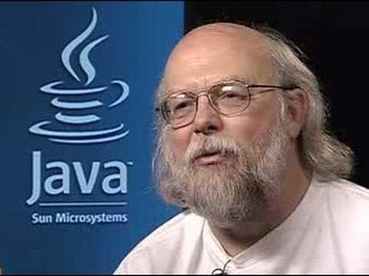
2. The Java Programming Language
Simple(r)
Object-oriented
Platform-independent ("write once, run anywhere")
Rich library (packages)
Designed for the internet
Benefits
Safety
Portability
Father of JAVA: James Gosling

Slide 18
Java – Platform Independent
Platform Dependent
myprog.c
C source code
myprog.exe
machine code
gcc
(compiler)
OS/Hardware
Platform Independent
myprog.java
javac
(compiler)
myprog.class
bytecode
Java source code
JVM
(Java Virtual Matchine)
java
(interpreter)
OS/Hardware

Slide 19
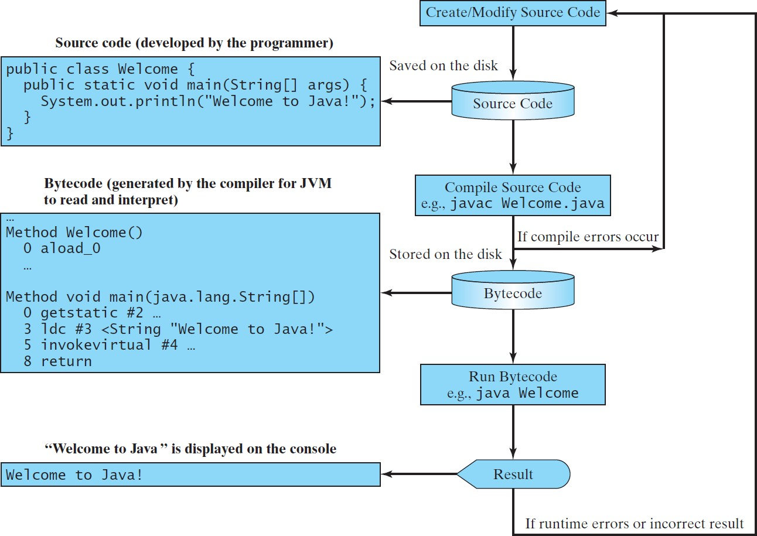
Creating, Compiling, and Running Programs

Slide 20
Java JDK vs JRE
JDK (Java development kit) – for developing Java software
(creating Java programs).
JRE (Java Runtime environment) – only good for running pre-created Java programs.
Java Plug-in – a special version of the JRE designed to run through web browsers.

Slide 21
Java JDK Version History
JDK Alpha & Beta (1995)
JDK 1.1 (1997)
J2SE 1.2 (1998)
J2SE 1.3 (2000)
J2SE 1.4 (2002)
Java 5 (2004)
Java 6 (2006)
Java 7 (2011)
Java 8 (2014)
………
Java 14 (March 2020)

Slide 22
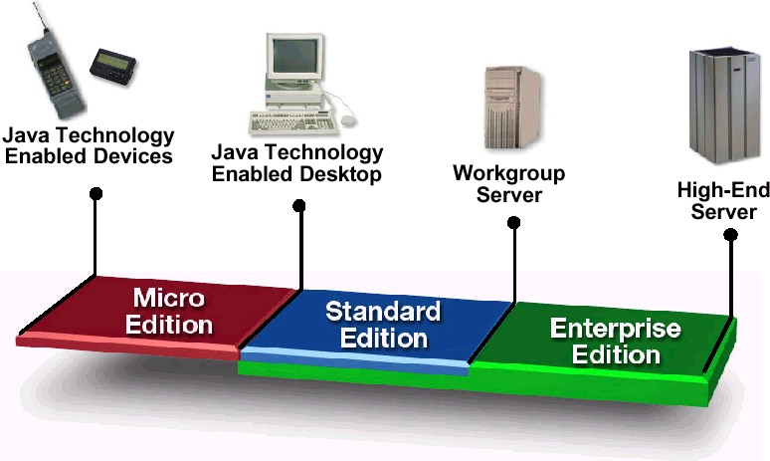
Java – Support 3 JDK versions
Java EE (Java Enterprise Edition)
Business applications, server-side.
Java SE (Java Platform Standard Edition)
General applications, client-side.
Java ME (Java Platform Micro Edition)
Small devices such as mobile phone, car navigation.

Slide 23
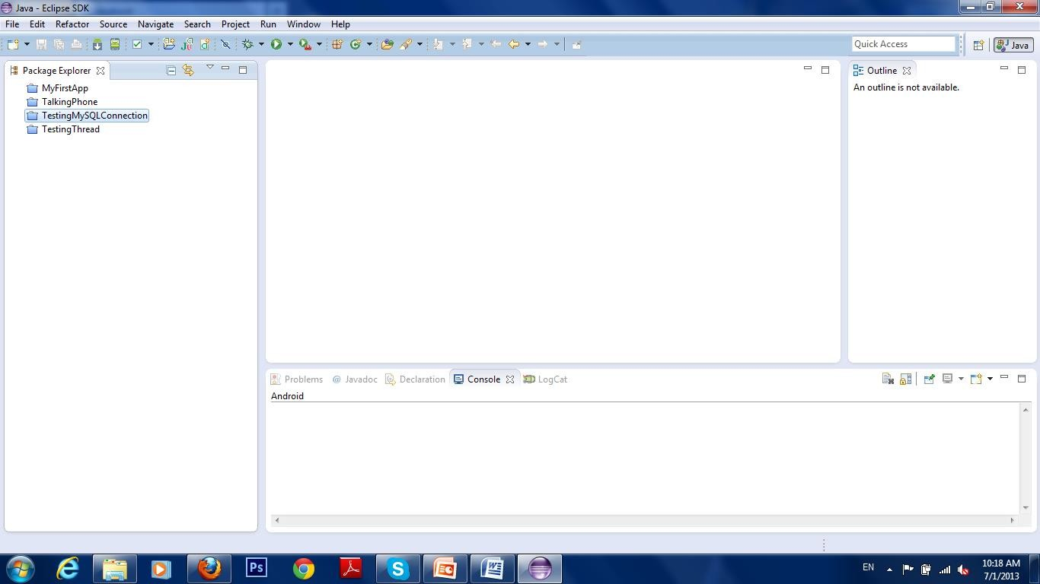
Eclipse - Integrated Development Environment (IDE)
Popular Java IDE: Eclipse, NetBeans, IntelliJ

Slide 24
Software Used
Java 8 SE JDK and above
https://www.oracle.com/java/technologies/javase-jdk14-downloads.html
https://www.oracle.com/java/technologies/javase/javase-jdk8-downloads.html
Eclipse IDE for Java Developers
https://www.eclipse.org/downloads/download.php?file=/oomph/epp/2020-03/R/eclipse-inst-win64.exe
or
https://www.eclipse.org/downloads/packages/release/2020-03/r/eclipse-ide-java-developers

Slide 25
3. Types of Applications
Several types of application can be developed using Java:
Console-based applications
Windows graphical user interface (GUI) applications
Web applications
Class libraries and stand-alone components (.dlls)
Smart device applications, services

Slide 26
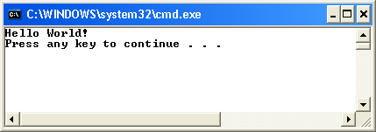
Console-based Applications

Slide 27
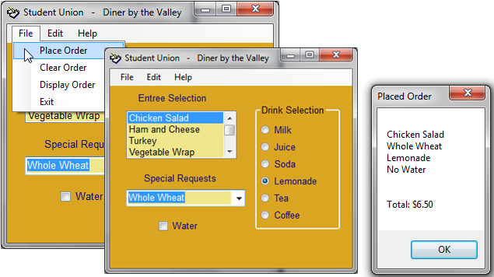
Windows Applications
Figure 1-15 Windows application written using Java

Slide 28
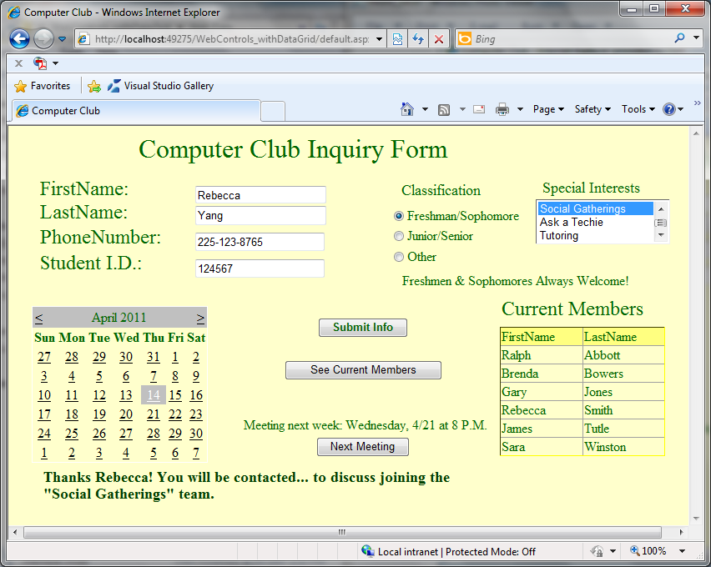
Web Applications

Slide 29
4. Software Development Process
Programming is problem solving
Programming involves following a organized plan or process i.e. a software development process

Slide 30

Steps in the Process
1. Analyze the problem
2. Design a solution
3. Code the solution (write the program)
4. Implement the code (compile the program)
5. Test and debug

Slide 31
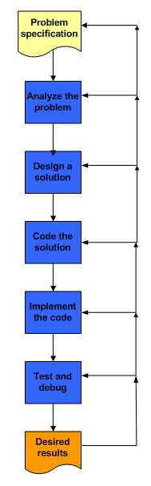

Slide 32
Steps in the Process
Start with problem specification
Analyze problem to understand exactly what the software is supposed to do
Review program inputs
For each program input, determine its type and domain/range of values

Slide 33
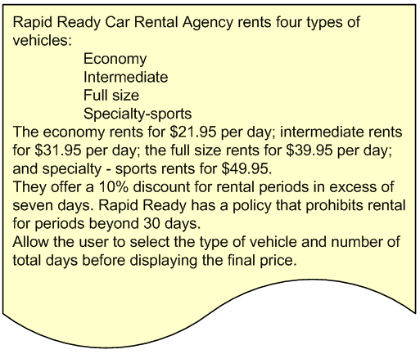
Example Problem Specification

Slide 34
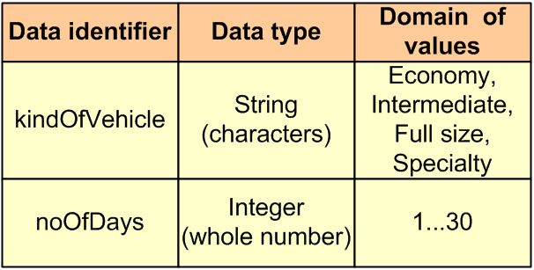
Program Inputs

Slide 35
Steps in the Process (cont’d)
Design a solution and verify that the design is correct
Code the solution by translating the design into source code
Implement the code by compiling the source code and correcting any compilation errors
Test the program and debug any logic or runtime errors

Slide 36
5. First Java Program: Welcome.java
1: public class Welcome
2: {
3:
4:
5:
6:
7:
8:
9: }
public static void main(String[] args)
{
// Display a greeting in the console window
System.out.println("Welcome to Java!");
}
// Hello world in c#
using System;
public class Welcome
{
static void Main() {
Console.WriteLine("Hello world\n");
}
}
Output:
Welcome to Java!

Slide 37
Standard Library
Like C programming, Java comes with standard library – which we call the
package.
java.lang package – Consists of common classes, such as general Math,
String, System, etc.
You don’t need to import this, by default, Java will do it for you.
In order to use classes in other packages, you have to first import them. import <PackageName>.<ClassName>.
If the package has sublevel, then it would be:
import <PackageName>.<SubPackageName>.<ClassName>
e.g.: import java.lang.System;
If you want to include all classes in a package, use .*,
import java.io.*
In Eclipse, press Shift+Control+O to automatically organize imports

Slide 38
Class
Every Java program must have at least one class. Each class
has a name.
Java is fully object-oriented, all codes exists in a class
(identified with class keyword).
class <ClassName>
The <ClassName> must be the same as the file name.
<ClassName>.java
public class Welcome {
public static void main(String[] args) { System.out.println("Welcome to Java!");
}
}

Slide 39
main Method
If a class is run, Java will invoke/call the static main method in that file. Similar to C++ main function. (to be implemented)
public static void main(String[] args) { … }
public class Welcome {
public static void main(String[] args) {
System.out.println("Welcome to Java!");
}
}

Slide 40
Writing Procedural Program using Java – static method
The static keyword identifies the method in a class that can be
used without the need to create an object instance of that class.
A static method is similar to a function in C/C++, but in Java the method must reside in a class.
Java is fully object-oriented, all codes must exist in a class

Slide 41
Comparison Between C/C++ and Java
#include <iostream> |  |  | import java.lang.*;
using namespace std; |  |  | public class Test
int max(int, int); |  |  | {
void main() |  |  | public static void main(String[] args)
{ |  |  | {
int a=10, b=20; |  |  | int a=10, b=20;
int c= max(a, b); |  |  | int c = max(a,b); // Test.max(a,b)
cout << c <<endl; // printf("%d\n“, c); |  |  | System.out.println(c);
} |  |  | }
int max(int a, int b) |  |  | public static int max(int a, int b)
{ |  |  | {
if(a>b) |  |  | if(a>b)
return a; |  |  | return a;
else |  |  | else
return b; |  |  | return b;
} |  |  | }
 | C++ |  | } | Java | 30

Slide 42
Comparison Between C/C++ and Java
public class ClassX | public class Test
{ | {
public static int max(int a, int b) | public static void main(String[] args)
{ | {
if(a>b) | int a=10, b=20;
return a; | int c = ClassX.max(a,b);
else | System.out.println(c);
return b; | System.out.println(Math.sin(a));
} | }
} | }
If you want to use a static method declared in another class, use the class
name and (.) to refer to the method you want to call.
ClassX.max(a,b);
Math.sin(a);
Class name

