Slide 1


2
Data Types
and
Expressions

Slide 2
Chapter Outline
Identifiers
Reserved Words in Java
Types and Variables
Primitive Data Types
Reference Types
Casting
Constants
Programming Errors
Java Package
Getting Input using the Scanner Class
Formatting Output

Slide 3
1) Identifiers
Identifier: name of a variable, method, or class
Rules for identifiers in Java:
Can be made up of letters, digits, underscore (_), and dollar sign ($)
Cannot start with a digit
Cannot use other symbols such as ? or %
Spaces are not permitted inside identifiers
You cannot use reserved words (keywords)
They are case sensitive
By convention, variable and method names start with a lowercase letter
int myNumber_1
void computeArea(…)
By convention, class names start with an uppercase letter
class Student
Easy to differentiate/read/identify

Slide 4
2) Reserved Keywords in Java
abstract | boolean | break | byte | case | catch | char
class | const | continue | default | do | double | else
extends | final | finally | float | for | goto | if
implements | import | instanceof | int | interface | long | native
new | package | private | protected | public | return | short
static | super | switch | synchronized | this | throw | throws
transient | try | void | volatile | while

Slide 5
Special Symbols
Character Name
Description
{}
[]
//
Opening and closing braces
Opening and closing parentheses
Opening and closing brackets
Double slashes
Opening and closing quotation marks
Semicolon
Denotes a block to enclose statements.
()
Used with methods.
Denotes an array.
Precedes a comment line.
" "
Enclosing a string (i.e., sequence of characters).
;
Marks the end of a statement.

Slide 6
3. Types and Variables
Java is strongly-typed language, every variable must has a type, which must be declared before its use
Two different types of variables:
Primitive type – the variables store the actual values (discuss next)
int luckyNumber = 13; // primitive type
double total;
Reference type – the variables store the addresses of the objects or arrays they refer to, the referred objects must be created using the new keyword (more in Unit 3 “Objects and Classes”)
MyClass myobject = new MyClass(); // reference type
int [] array = new int[10]; // reference type
Scanner input = new Scanner (System.in);

Slide 7
Differences between Variables of
Primitive Data Types and Reference Types
Stack
Heap
Primitive type: Reference type:
int i = 1; i
Car c; c
1
null
Haven’t declare
7

Slide 8

Differences between Variables of
Primitive Data Types and Reference Types
Stack
Heap
Primitive type: int i = 1; i Reference type: Car c; c
object
1
c: Car
model "BMW" distance = 0
reference
c = new Car("BMW");
Created using new Car()
8

Slide 9
4) Primitive Data Types
Type | Description | Size
int | The integer type, with range -2,147,483,648 . . . 2,147,483,647 | 4 bytes
byte | The type describing a single byte, with range -128 . . . 127 | 1 byte
short | The short integer type, with range -32768 . . . 32767 | 2 bytes
long | The long integer type, with range -9,223,372,036,854,775,808 . . . - 9,223,372,036,854,775,807 | 8 bytes
double | The double-precision floating-point type, with a range of about ±10³⁰⁸ and about 15 significant decimal digits | 8 bytes
float | The single-precision floating-point type, with a range of about ±10³⁸ and about 7 significant decimal digits | 4 bytes
char | The character type, representing code units in the Unicode encoding scheme | 2 bytes
boolean | The type with the two truth values: false and true | 1 bit

Slide 10
Number Types
int: integers, no fractional part
1, -4, 0
double: floating-point numbers (double precision)
0.5, -3.11111, 4.3E24, 1E-14
float: floating-point numbers( have to use f at the end of the number)
float a = 10.02f;
long: have to add L at the end of the number
long a = 1000000000000L;
A numeric computation overflows if the result falls outside the range for the number type:
short n = (short)100000;
System.out.println(n); // prints -31072

Slide 11
Character Data Type
char letter = 'A';
char numChar = '4';
char letter = '\u0041'; char numChar = '\u0034';
Four hexadecimal digits.
(Unicode) (Unicode)
Java characters use Unicode, a 16-bit encoding scheme to support the interchange, processing, and display of written texts in the world’s diverse languages.
Unicode takes two bytes, preceded by \u, expressed in four hexadecimal numbers that run from '\u0000' to '\uFFFF'. So, Unicode can represent 65536 characters.

Slide 12
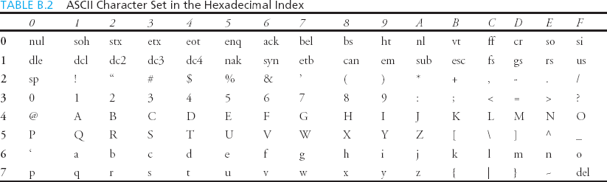
ASCII Character Set
ASCII Character Set is a subset of the Unicode from \u0000 to
\u007F

Slide 13
Primitive Data Types as Objects
Owing to performance considerations, primitive data type
values are not objects in Java.
However, many Java methods require the use of objects as arguments. Java offers a convenient way to incorporate, or wrap, a primitive data type into an object.
Java provides Boolean, Character, Double, Float, Byte, Short, Integer, and Long wrapper classes in the java.lang package for primitive data types.
Java allows primitive types and wrapper classes to be converted automatically.
Integer intObj = 3;
int i = intObj;
// boxing
// unboxing
Notes:
Boxing = conversion that the java compiler makes between the primitive types and their corresponding object wrapper class, eg: convert an int to Integer

Slide 14
5) Reference Types (The String Type )
The char type only represents one character. To represent a string of
characters, use the data type called String. For example,
String message = "Welcome to Java";
String is actually a predefined class in the Java library just like the
System class.
The String type is not a primitive type, it is a reference type.
Reference data types (classes and arrays) will be thoroughly discussed in Unit 3 & 4. For the time being, you just need to know how to declare a String variable, how to assign a string to the variable, and how to concatenate strings.
Both method can be used
String message = new String(“Welcome to Java”);

Slide 15
String Concatenation
// s0 = "Welcome to Java"
String s0= "Welcome " + "to " + "Java";
// s1 = "Chapter2"
String s1 = "Chapter" + 2;
// s2 = "SupplementB"
String s2 = "Supplement" + 'B';

Slide 16
Converting Strings to Integers
To convert a String into an int value, you can use the static
parseInt method in the Integer class as follows:
int i = Integer.parseInt("257");
To convert an int into a String object, you can use the static
toString method in the Integer class as follows:
String s = Integer.toString(i);
Notes:
Scanner input = new Scanner (System.in);
String str = input.NextLine ( );
int number =Integer.parseInt (str);
double number1 = Double.parseDouble (str);

Slide 17
Converting Strings to Doubles
To convert a String into a double value, you can use the static parseInt method in the Double class as follows:
double d = Double.parseDouble("23.57");
To convert a double into a String object, you can use the static toString method in the Double class as follows:
String s = Double.toString(d);

Slide 18
6) Casting
Casting is an operation that converts a value of one data
type into a value of another data type
Casting a type with a small range to a type with a larger range (e.g. int to double) is known as widening a type.
Casting a type with a large range to a type with a smaller range (e.g. double to int) is known as narrowing a type.
Java will automatically widen (implicit) a type, but you must narrow a type explicitly.
int a = 10;
double b = 7.3;
b a | = = | a; b; | // // | ok NOT ok
a | = | (int) b; | // | ok

Slide 19
7) Constants
Constant – value is fixed for the entire execution of your program
Declare with keyword final,
Note: In Java, const is a reserved keyword. It is not used.
final int NUM_STUDENT = 1000;
Once a constant variable is defined, its value cannot be
changed:
NUM_STUDENT = 0; // compile error!
Java API has defined some useful constants, such as:
Math.E; Math.PI;
// Euler number 2.71828
// 3.14159

Slide 20
Numeric Operators
Name | Meaning | Example | Result
+ | Addition | 34 + 1 | 35
- | Subtraction | 34.0 – 0.1 | 33.9
* | Multiplication | 300 * 30 | 9000
/ | Division | 1.0 / 2.0 | 0.5
% | Remainder | 20 % 3 | 2
Operator
Example
Equivalent
+= | i | += | 8 | i | = | i | + | 8
-= | f | -= | 8.0 | f | = | f | - | 8.0
*= | i | *= | 8 | i | = | i | * | 8
/= | i | /= | 8 | i | = | i | / | 8
%= | i | %= | 8 | i | = | i | % | 8
++ | i++ |  | i |  | = | i | + | 1
-- | i-- |  | i |  | = | i | - | 1

Slide 21
Integer Division
5 / 2 yields an integer 2.
5.0 / 2 yields a double value 2.5
5 % 2 yields 1 (the remainder of the division)

Slide 22

8) ProgrammingErrors
Syntax Errors
Detected by the compiler
Runtime Errors
Causes the program to abort
Logic Errors
Produces incorrect result
Detected (hopefully) through testing

Slide 23
Syntax Errors
public class ShowSyntaxErrors {
public static main(String[] args) {
System.out.println("Welcome to Java);
}
}
missing "

Slide 24
Runtime Errors
public class ShowRuntimeErrors {
public static void main(String[] args) {
System.out.println(1 / 0);
}
}
divided by zero

Slide 25
Logic Errors
public class ShowLogicErrors {
public static void main(String[] args) { System.out.println("Celsius 35 is Fahrenheit degree "); System.out.println((9 / 5) * 35 + 32);
}
}
integer division:
9/5 = 1 (not 1.8)
Output:
Celsius 35 is Fahrenheit degree
67 (true answer = 95)

Slide 26
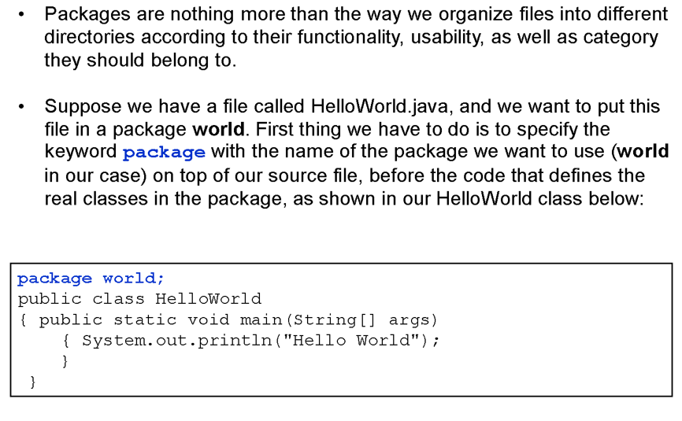
9) Java Package
Package is a identifier too (must be meaningful

Slide 27
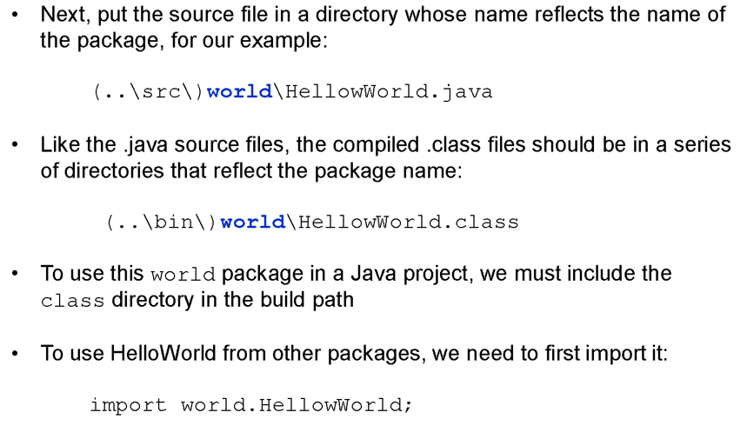
Default package
Class name
Package name

Slide 28
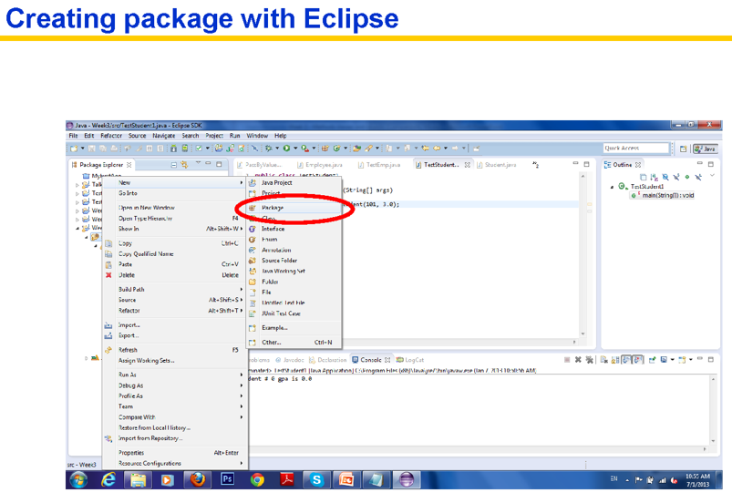

Slide 29
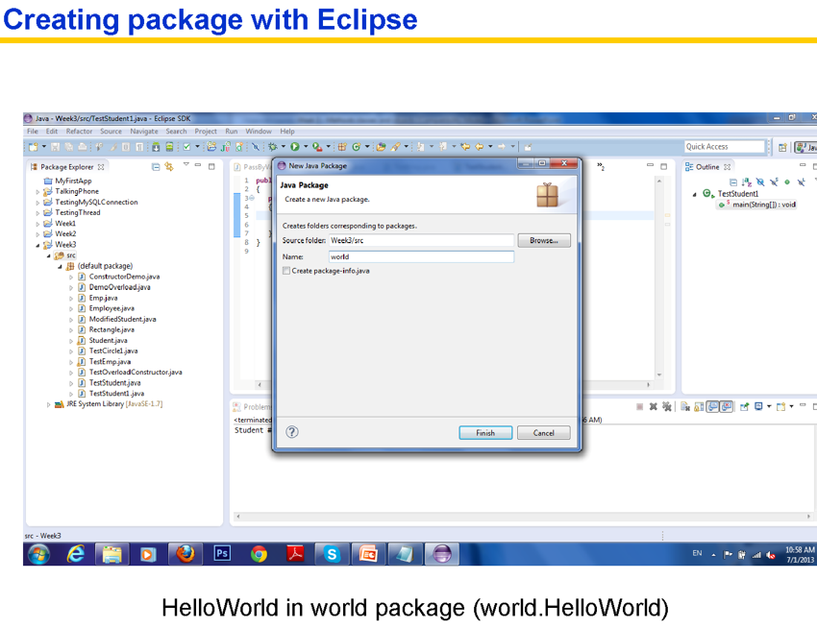

Slide 30
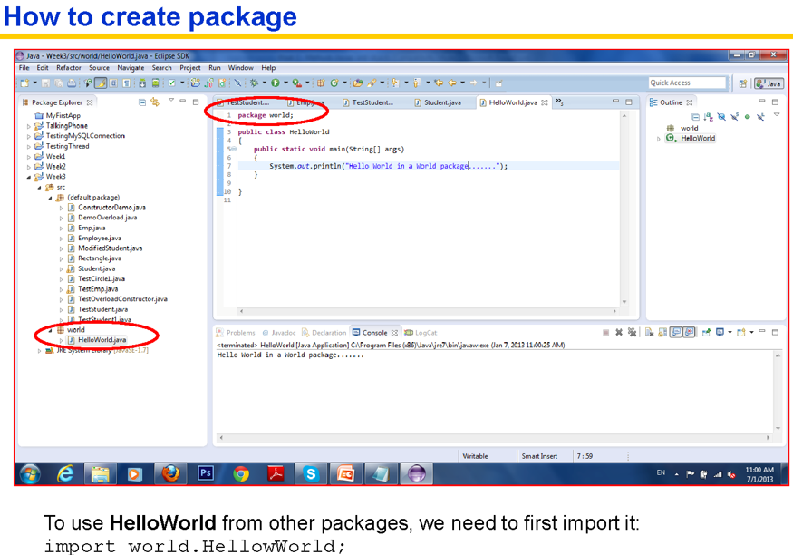

Slide 31
10) Getting Input Using Scanner
a. Create a Scanner object
Scanner scanner = new Scanner(System.in);
b. Use the methods next(), nextByte(), nextShort(), nextInt(), nextLong(), nextFloat(), nextDouble(), or nextBoolean() to obtain to a string, byte, short, int, long, float, double, or boolean value. For example,
System.out.print("Enter a double value: ");
Scanner scanner = new Scanner(System.in);
double d = scanner.nextDouble();
Notes:
Using the JDK 1.5 Scanner class

Slide 32

Examples
int age;
Scanner scanner = new Scanner (System.in);
System.out.println(“Enter your age: “);
age = scanner.nextInt( );
System.out.printf(“Your age next year”
+ “ will be %d ”, ++age);

Slide 33
Examples
double aValue, result;
Scanner scanner = new Scanner (System.in);
System.out.print (“Enter a value to be squared: ”);
aValue = scanner.nextDouble( );
result = aValue * aValue;
System.out.printf(“%f squared is %f ”,
aValue, result);

Slide 34
11) Formatting Output using printf
Specifier | Output | Example
%b | A boolean value | true or false
%c | A character | ‘a’
%d | A decimal integer | 200
%f | A floating-point number | 45.4600000
%e | A number in standard scientific notation | 4.556000e+01
%s | A string | “Java is cool”

Slide 35
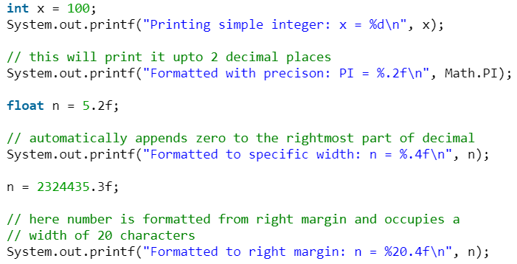
Example

