Slide 1
Chapter 3 Methods

Slide 2
Objectives
Method Definition
Static Modifier
Class Methods
Access Modifier
Formal parameter and actual parameter
Calling methods
Overloaded Method
Math Class Methods
User Defined Methods

Slide 3
1. Method Definition
A method is a collection of statements that are grouped together to perform an operation.
Syntax of a method:
modifier returnValue methodName (parameters) {
//method body;
}

Slide 4
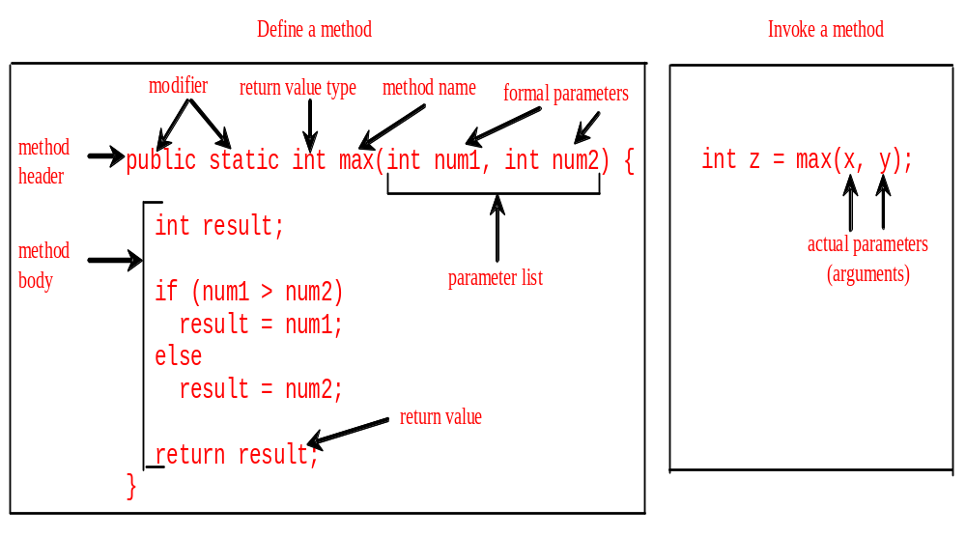
Introducing Methods
no static =instance method

Slide 5
Method Definition
public class Methods {
public void sub() {
System.out.println(“hello world”);
}
public void calc (int n, int m) {
int sum = n + m;
System.out.println(“The sum is “ + sum);
}
public int multiply (int m) {
return m * 10;
}
}

Slide 6
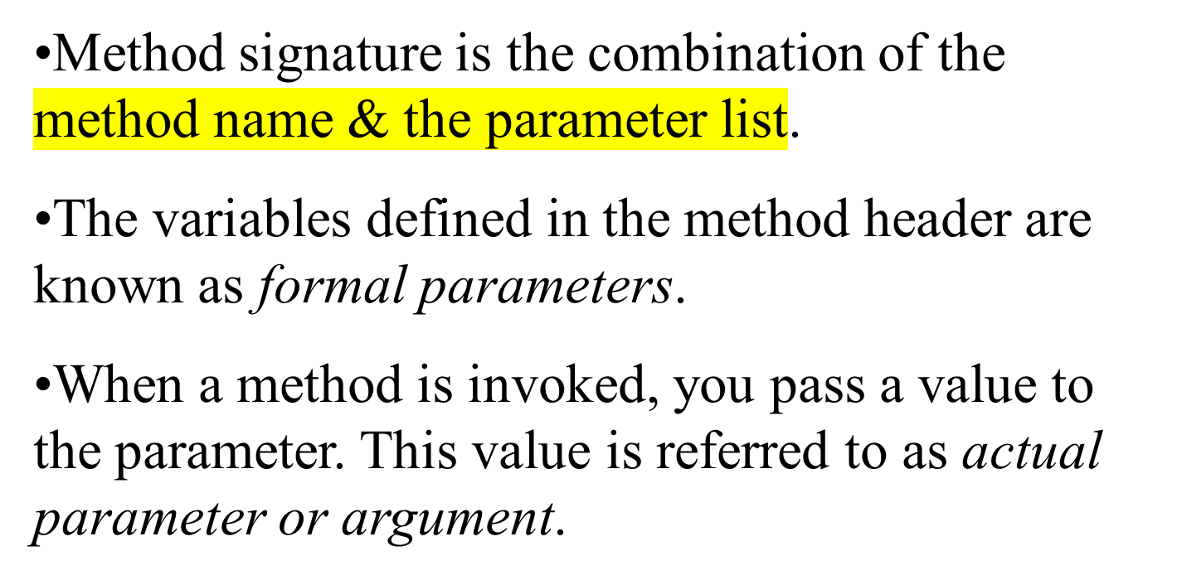
Method Definition
Define whole method

Slide 7
Method Definition
A method may return a value.
The returnValueType is the data type of the value the method returns.
If the method does not return a value, the returnValueType is the keyword void.
For example, the returnValueType in the main method is void.

Slide 8
2. Static Modifier
Method main() must include static modifier in the method definition
All methods of Math class also include the static modifier in their method definitions
to call static method, use “ class.method”
Ex: math.max (x, y)
Instance method has its own value
No static, to access to it, need to create a new class for it
Ex: scanner

Slide 9
3. Class Methods
Methods that use the static modifier are called class methods
To invoke/call a class method, use format:
<class-name>.<method-name>
Example: to call max() method:
double result = Math.max(2.0, 8.9);

Slide 10
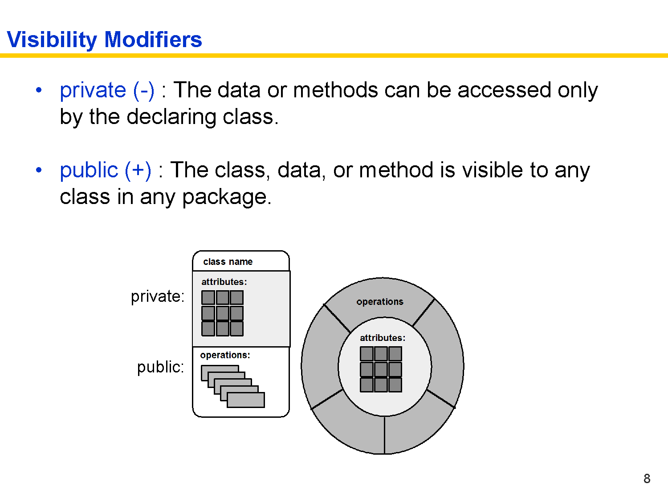
4. Access Modifier

Slide 11
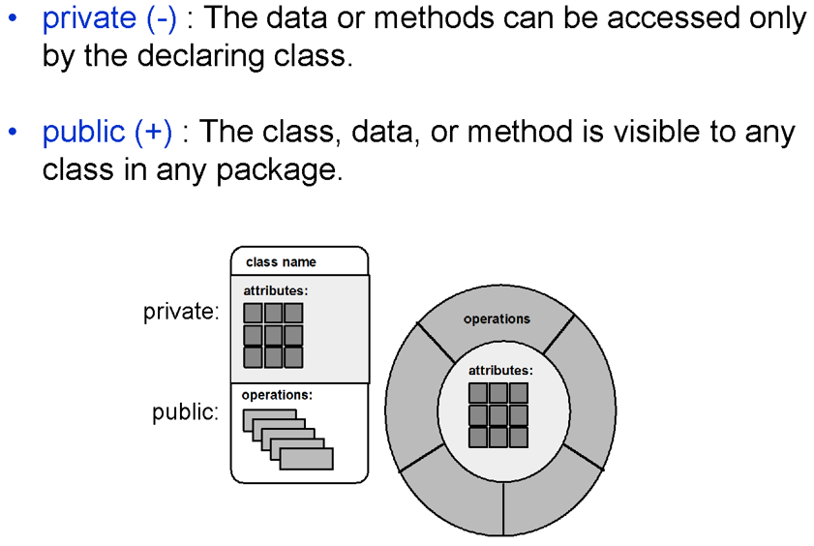
Access Modifiers
Another type of modifier is an access modifier
The following are access modifiers:
C# Programming: From Problem Analysis to Program Design

Slide 12
public Access Modifier
public access modifier in a method definition indicates that the method can be called (accessed) from other methods in any class
All methods of the Math class include public access modifier in their method definitions
These methods can be called from other methods in any class
C# Programming: From Problem Analysis to Program Design

Slide 13
private Access Modifier
private access modifier for a method indicates that the method can only be called from other methods defined in the same class where the method is defined
C# Programming: From Problem Analysis to Program Design

Slide 14
5. Formal & actual parameter
formal parameters
public void calc (int n, int m) {
int sum = n + m;
System.out.println(“sum = “ + sum);
}
calc(20, 10);
Actual parameter

Slide 15
Formal & actual parameter
formal parameters
class Testing {
public void calc (int n, int m) {
int sum = n + m;
System.out.println(“sum = “ + sum);
}
public static void main (String args[]) {
Testing test = new Testing();
test.calc(20, 10);
}
}
Actual parameter

Slide 16
6. Calling Methods (within class)
public class Methods {
public void sub1 () {
sub (); //called method’s name
}
public void sub() {
System.out.println(“hello world”);
}
public void calc (int n, int m) {
int sum = n + m;
System.out.println(“sum = “ + sum);
sub();
}
}

Slide 17
Calling Methods (within class)
public class Methods {
public int calc (int n, int m) {
return n + m;
}
public void sub () {
calc(4, 5); //ignore the return value
int ans = calc(2,3); //assign return value
//to a variable
}
public void sub1() {
System.out.println(calc(20,25));
//display the return value
}
}

Slide 18
Passing value to Methods
Passing by value for primitive type value (the value is passed to the parameter)
Passing by reference for reference type value (the value is the reference to the object)

Slide 19
Pass by Value
The Java language passes arguments by value if the argument’s type is either primitive (int, float, char, etc) or String.
public void changeInt (int value) {
value = 55;
}
public static void main (String args[]) {
int num = 10;
Testing test = new Testing();
test.changeInt(num);
System.out.println(num);
}

Slide 20
Passing Objects to Methods.
class Student {
int age;
String name;
}
class MyClass
void sub( int n) {
n = 20;
}
void sub2 (Student stud) {
stud.name = “Mary”;
stud.age = 20;
}
void sub3( Student stud) {
stud = new Student();
stud.name = “Lisa”;
}
}
class Testing
public static void main (String a[]){
Student s1 = new Student();
s1.name = “john”;
s1.age = 25;
int num = 100;
MyClass mc = new MyClass();
mc.sub(num);
System.out.println(num);
mc.sub3(s1);
System.out.println(s1.name);
System.out.println(s1.age);
mc.sub2(s1);
System.out.println(s1.name);
System.out.println(s1.age);
}
}

Slide 21
7. Overloading Methods
public int max(int num1, int num2) {
if (num1 > num2)
return num1;
else
return num2;
}
max(20,56);
// max(3.45, 45); - invalid statement
// max(40, 3.45); - invalid statement
// max(3.45, 5.67); - invalid statement

Slide 22
Method overloading
When two or more different methods with the same name, with different number and types of formal parameters, is known as method overloading.
Example :
public int max(int n, int m)
public double max(double n, double m, double p)
public String max(String n, String m)
Argument lists must differ
Return types & modifier can be different

Slide 23
8. The Math Class
Class constants:
Class methods:
  Trigonometric Methods
  Exponent Methods
  Rounding Methods
  min, max, abs, and random Methods
– PI | // | 3.1415926..
– E | // | 2.71828..

Slide 24
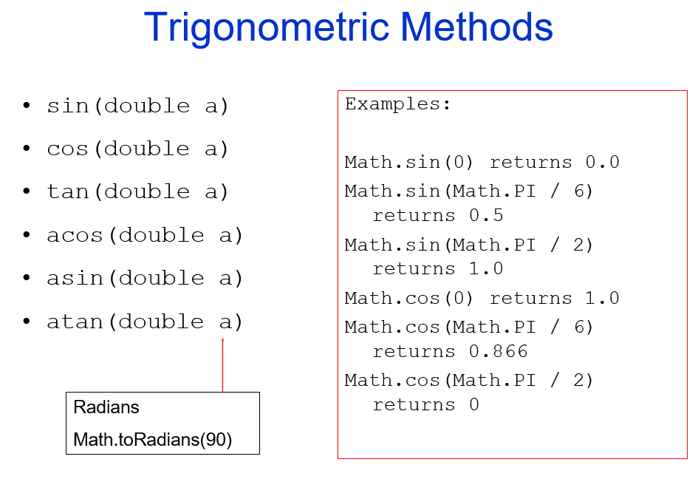


Slide 25
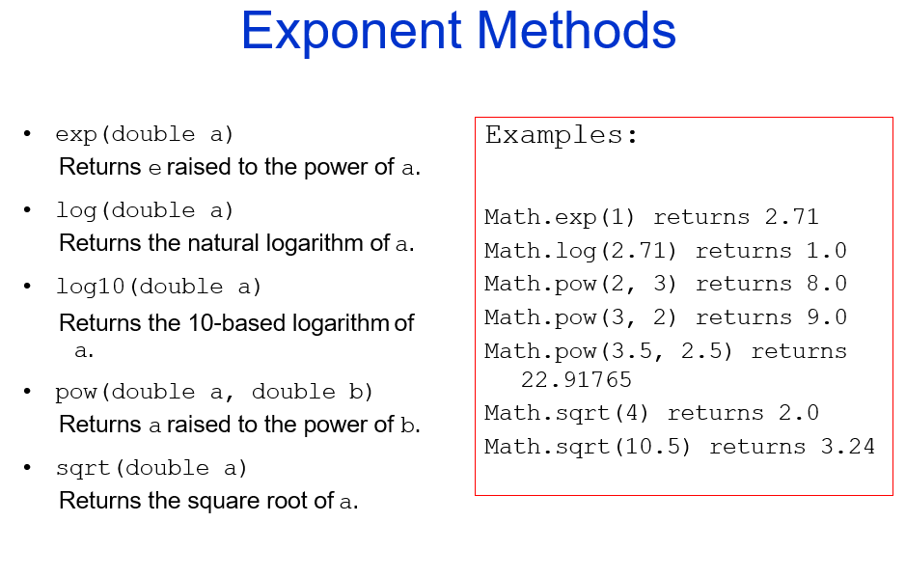

Slide 26
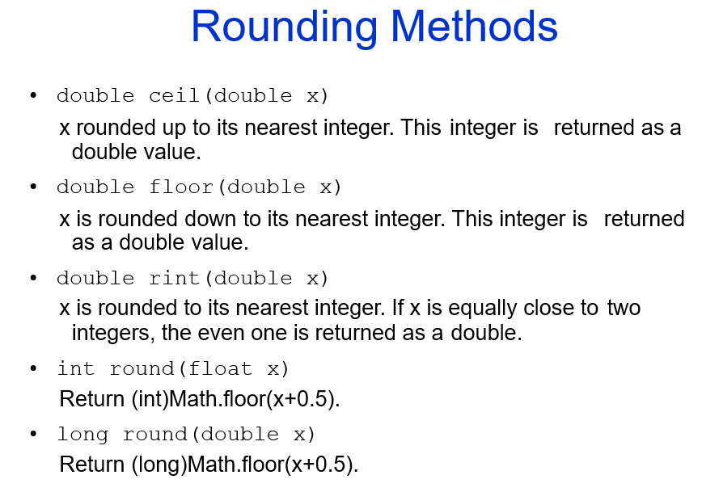

Slide 27
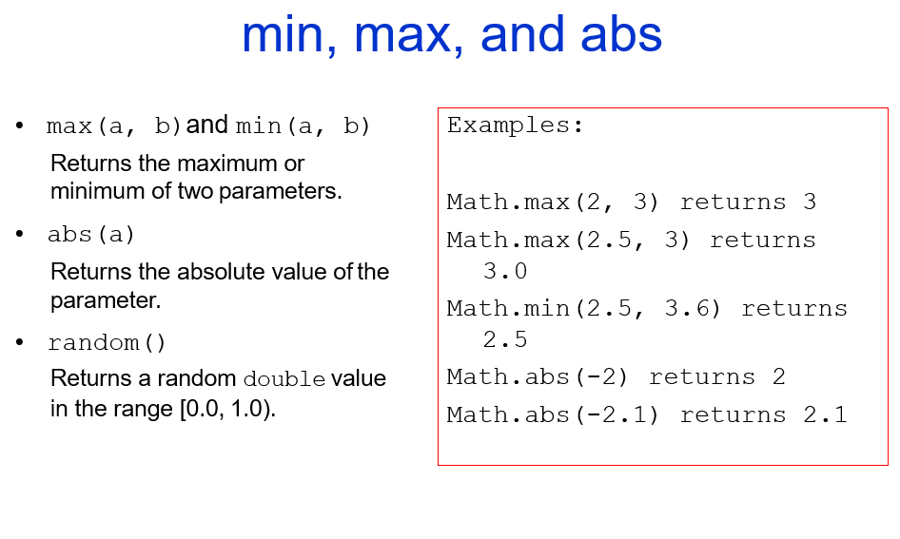

Slide 28
9. User-Defined Methods
Suppose we want to develop a payroll program which inputs the hours worked and the pay rate for an employee and then computes and displays the pay.
If we do not apply the object-oriented approach, we can define 4 static methods to do the work:
  Main( ), GetPayData( ), ComputePay(), and PrintPay()
C# Programming: From Problem Analysis to Program Design

Slide 29
User-Defined Methods
class PayrollProgram
{
public static void main( )
{ . . . }
public static double ComputePay( . . . )
{ . . . }
public static void PrintPay( . . . )
{ . . . }
}
C# Programming: From Problem Analysis to Program Design

Slide 30
Payroll Program
import java.util;
class PayrollProgram
{
public static void main(String [] args )
{
String name;
double hoursWorked;
double payRate, pay;
C# Programming: From Problem Analysis to Program Design

Slide 31
Payroll Program
Scanner scanner = new Scanner(System.in);
System.out.print("Enter name: ");
name = scanner.next();
System.out.print("Enter hours worked: ");
hours = scanner.nextDouble();
System.out.print("Enter pay rate: ");
rate = scanner.nextDouble();
C# Programming: From Problem Analysis to Program Design

Slide 32
Payroll Program
pay = ComputePay(hoursWorked, payRate);
PrintPay(name, pay);
}//end of main method
C# Programming: From Problem Analysis to Program Design

Slide 33
Payroll Program
public static double ComputePay(
double hours,
double payPerHour)
{
return hours * payPerHour;
}
C# Programming: From Problem Analysis to Program Design

Slide 34
Payroll Program
public static void PrintPay(String name,
double pay)
{
System.out.printf("Pay for %s"
+ “ is %.2f}",
name, pay);
}
} // End of class
C# Programming: From Problem Analysis to Program Design

