Slide 1


7
Arrays

Slide 2
Chapter Outline
Array Basics
Array as Method Parameter
Array as Return Type
Array in Classes
Array of Objects
Objects and Methods

Slide 3
1. Array Basics
General form of the array declaration:
<type> [ ] <identifier>;
Example:
int [] score;
double [] temperature;
These statements only declare the arrays with a name and type but do not create them

Slide 4
Array Basics
We create an array in the same way we instantiate an object of a user-defined class
Use the new operator

Slide 5
Array Basics
General form for creating an array
new <type> [<size>]
<type> can be any predefined types like int or string, or a class that you create in java
<size> is the number of elements
Example:
new int[14]
new double[7];

Slide 6
Array Basics
We need to assign the newly created array to an array variable
Example:
int [] score;
score = new int[14];
We can combine this into one statement
Example:
int [] score = new int[14];

Slide 7
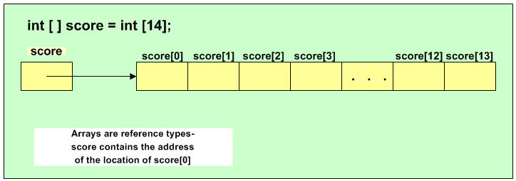
Array Basics
Should be new int [14];

Slide 8
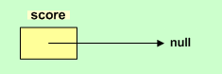
Array Basics
An array variable is a reference type variable
An array variable can be assigned to null if no array is created and assigned to it yet
Example:
int [] score;
score = null;

Slide 9
Array Initializers
Arrays can be initialized when they are created
Example:
int [] anArray = {100, 200, 400, 600};
char [] grade = {'A' , 'B' , 'C'};
double [] depth = {2.5, 3.0};
The length of the array is determined by the number of values inside the curly braces

Slide 10
Array Initializers (additional)
int [] anArray = {100, 200, 400, 600};
is equivalent to:
int [] anArray;
anArray = new int[4];
anArray[0] = 100;
anArray[1] = 200;
anArray[2] = 400;
anArray[3] = 600;

Slide 11
Array Access
Access array elements using an index enclosed in square brackets
score[0] = 100;
Arrays have a property called length that tells us the size of the array (length for array class is an instances variable while for string class it is a method)
for (int i = 0; i < score.length; i++)
score[i] = i;

Slide 12
Array Access
Note: if the array index is out of the range, a runtime error called IndexOutOfRangeException will be generated
Example:
for (int i = 0; i <= score.length; i++)
score[i] = i;
Should be < not <=

Slide 13
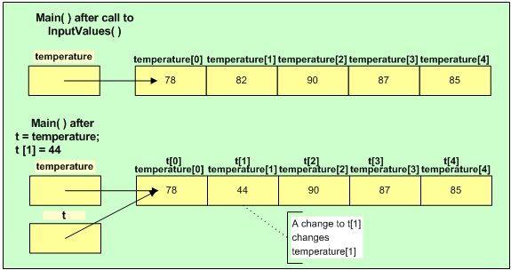
Array Assignment
temperature refers to array with following values
t = temperature;
Now temperature and t refer to same array

Slide 14
2. Array as Method Parameter
We can send arrays as arguments to methods
Method heading must include array as a parameter
General format:
<return type> <m-name> (<type> [ ] <param-name> ...)
Length or size of the array is not included
Example: method heading
void DisplayArrayContent(double[] anArray)

Slide 15
Array as Method Parameter
Arrays are reference variables
No copy is made of the contents
Call to the method sends the address of the array (not a copy of the array)
Example: method call
DisplayArrayContent(waterDepth);

Slide 16
Array Parameter Example
import java.util.*;
class TemperatureApp
{
public static void main(String [] args )
{
double [ ] temperature = new double[5];
inputValues(temperature);
display(temperature);
}

Slide 17
Array Parameter Example
public static void inputValues(double[] temp)
{
Scanner sc =new Scanner(System.in);
for(int i = 0; i < temp.length; i++)
{
System.out.print("Enter Temperature: ");
temp[i] = sc.nextDouble ( );
}
}

Slide 18
Array Parameter Example
public static void display(double [] anArray)
{
System.out.print("Temperature > 0: ");
for(double wVal : anArray)
{
if (wVal > 0)
System.out.print(wVal + " ");
}
System.out.println();
}
}

Slide 19
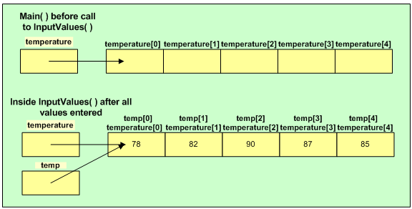
Array Parameter Example

Slide 20
3. Array as Return Type
Methods can have arrays as their return type
Example: method heading
public static int [ ] readScores()
Example: call to the method
int [ ] points;
points = readScores();
Method would include a return statement with an array

Slide 21
4. Array in Classes
Arrays can be used as instance variables in classes
Example: instance variable declaration
private int[] pointsScored;
Normally array is created and assigned to instance variable in constructor
Example: in constructor
pointsScored = new int[size];

Slide 22
Array in Classes Example
class Player
{
private String name;
public String getName( )
{
return name;
}
private int[] pointsScored;

Slide 23
Array in Classes Example
private int numberOfGames;
public int getNumberOfGames ()
{
return numberOfGames;
}
public Player(String aName, int gamesPlayed)
{
name = aName;
numberOfGames = gamesPlayed;
pointsScored = new int[numberOfGames];
}

Slide 24
Array in Classes Example
public void fillScores(int[] scores)
{
for (int i=0; i < pointsScored.length; i++)
pointsScored[i] = scores[i];
}
public double getAverage()
{
double total = 0.0;
double average;

Slide 25
Array in Classes Example
if (pointsScored.length > 0) {
for(int s : pointsScored)
total += s;
average = total / numberOfGames;
}
else
average = 0.0;
return average;
}
}

Slide 26
Array in Classes Example
class PlayerTest
{
public static void main(String [] args)
{
Player p = new Player("Jordan", 3);
int[] scores = {5, 12, 3};
p.fillScores(scores);

Slide 27
Array in Classes Example
System.out.print("Average is %.2f",
p.getAverage());
}
}

Slide 28
1. Array of Objects
Just as you can create an array of int or an array of double, you create an array of objects
Example:
Suppose we have 12 players
We can create an array of Player objects to represent the 12 players

Slide 29
Array of Objects
Example:
Player [ ] teamMember = new Player[12];
Note: this just creates the array, not the Player objects
We must create each Player object and assign it into the array
Example:
teamMember[0] = new Player("Jordan", 3);

Slide 30
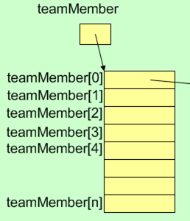
Array of Objects
Player Object
null
name
Jordan
null
numberofGames
3
null
pointsScored
5
12
3
null
null
null
null

Slide 31
Array of Objects Example
class Car
{
private String regNumber;
public String getRegNumber()
{
return regNumber;
}
public Car(String number)
{
regNumber = number;
}
}

Slide 32
Array of Objects Example
class CarArray
{
public static void main(String [] args)
{
Car[] cars = new Car[10];
Car c1 = new Car("ABC1234");
cars[0] = c1;
cars[1] = new Car("ABC5678");
cars[2] = new Car("ABC9999");

Slide 33
Array of Objects Example
// Display car details - version 1
for (int i = 0; i < cars.length; i++)
{
if (cars[i] != null)
{
Car c = cars[i];
System.out.println(c.getRegNumber());
}
}

Slide 34
Array of Objects Example
// Display car details – version 2
for (int i = 0; i < cars.length; i++)
{
if (cars[i] != null)
System.out.println(cars[i]. getRegNumber());
}

Slide 35
Array of Objects Example
// Display car details - version 3
for (Car c : cars)
{
if (c != null)
System.out.println(c.getRegNumber());
}
}
}

Slide 36
2. Objects and Methods
Just as a method can return an array, a method may also return an object
The method would include a return statement with the object
Example: method heading
public static Car getCarInfo()
Example: call to the method
Car car = getCarInfo();

Slide 37
Objects and Methods
Similarly, just as we can send an array as an argument to a method, we can send an object
Example: method heading
static void displayCarInfo(Car aCar)
Example: call to method
Car car = new Car("ABC1234");
displayCarInfo(car);

Slide 38
Objects and Methods Example
import java.util.*;
class CarApp
{
public static void main(String [] args)
{
Scanner sc = new Scanner (System.in);
System.out.println("How many cars? ");
int count = sc.nextInt();
Car[] cars = new Car[count];

Slide 39
Objects and Methods Example
for (int i = 0; i < count; i++)
{
System.out.println("Car“+ (i+1));
Car car = getCarInfo();
cars[i] = car;
}
for (int i = 0; i < count; i++)
{
Car car = cars[i];
displayCarInfo(car);
}
}

Slide 40
Objects and Methods Example
public static Car getCarInfo()
{
System.out.print("Enter reg. number: ");
Scanner sc = new Scanner (System.in);
String number = sc.next();
Car c = new Car(number);
return c;
}
public static void displayCarInfo(Car car)
{
System.out.print(car.getRegNumber());
}
}

