Slide 1


Chapter 7a
Advanced
Collections

Slide 2
Chapter Outline
Multidimensional Array
ArrayList Class

Slide 3
1. Multidimensional Array
Arrays can be;
One-dimensional
Two-dimensional
Multidimensional
Two-dimensional and multidimensional arrays follow same guidelines as one-dimensional

Slide 4
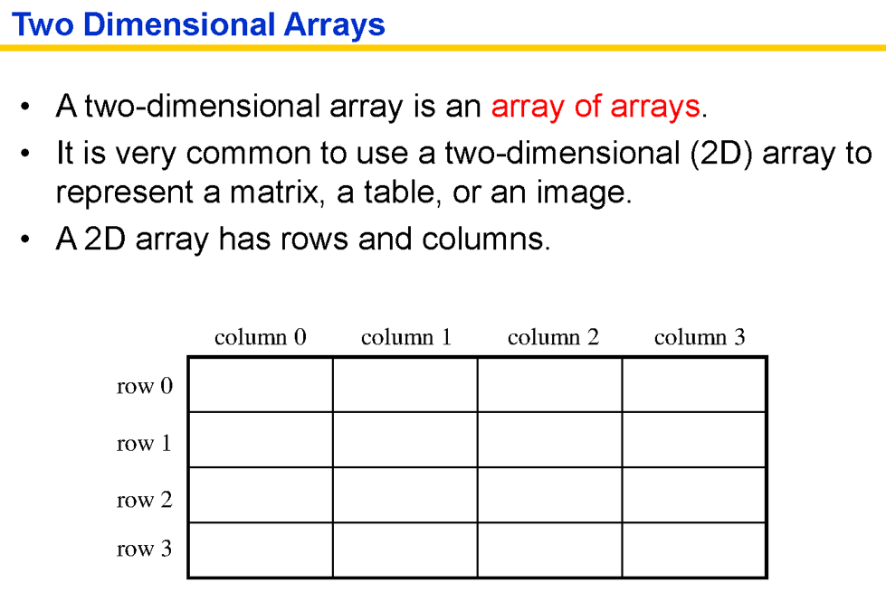

Slide 5
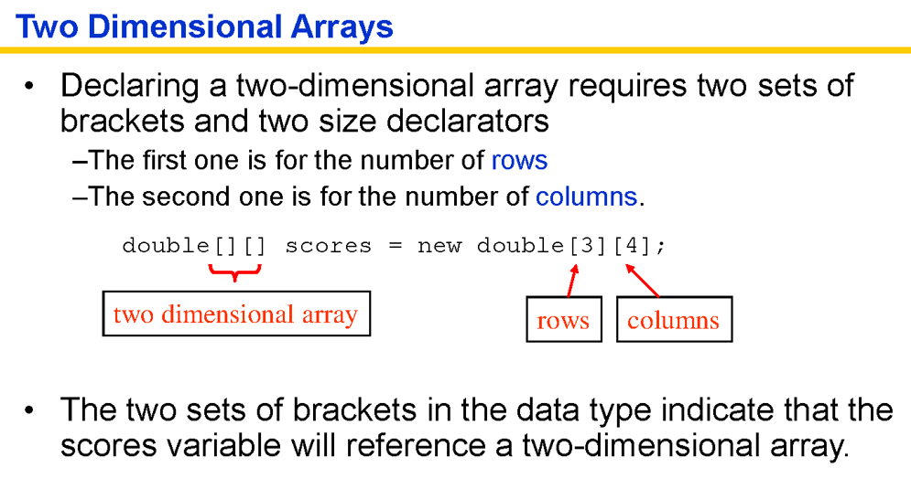

Slide 6
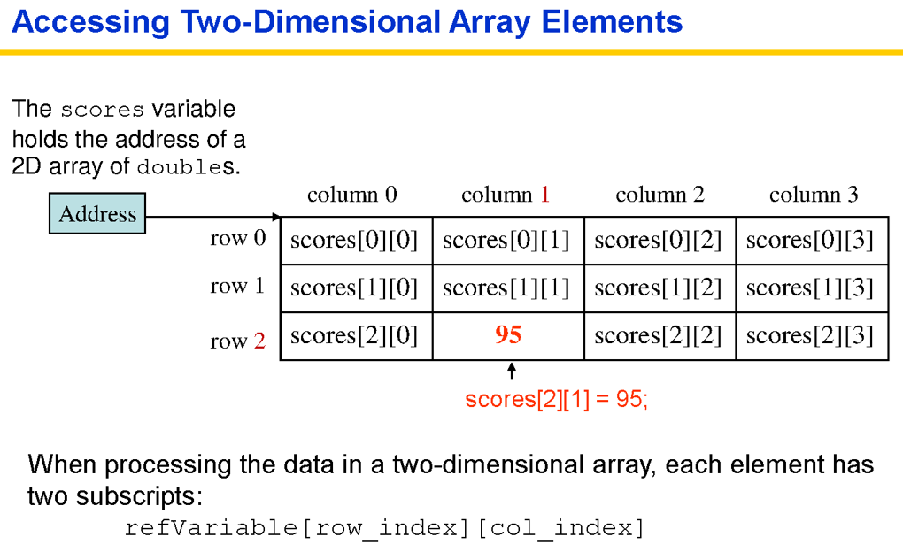

Slide 7
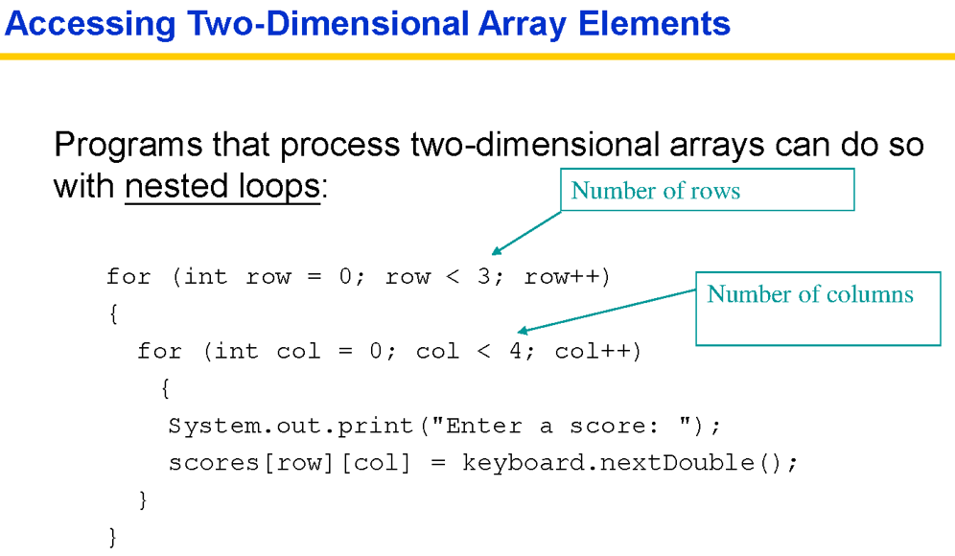

Slide 8
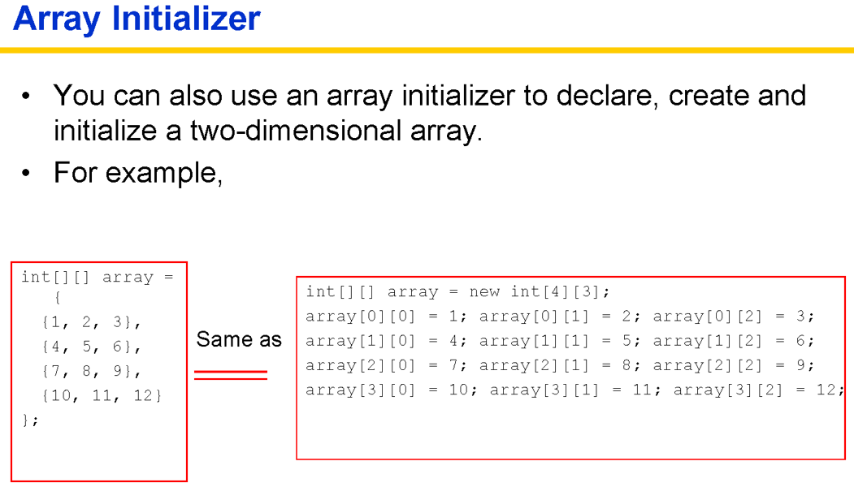

Slide 9
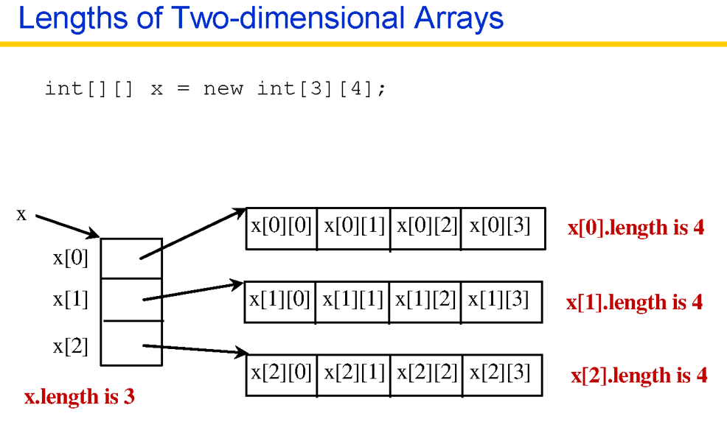

Slide 10
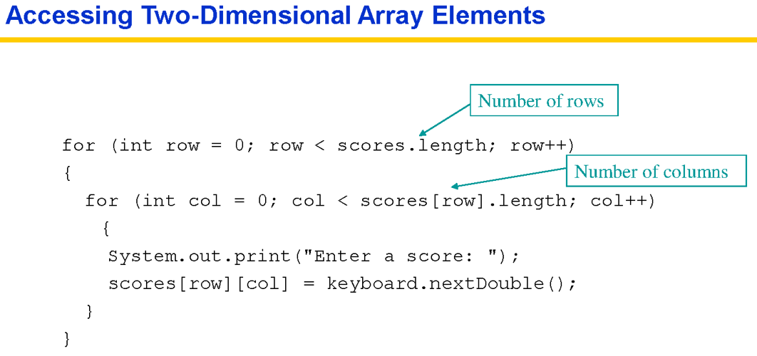

Slide 11
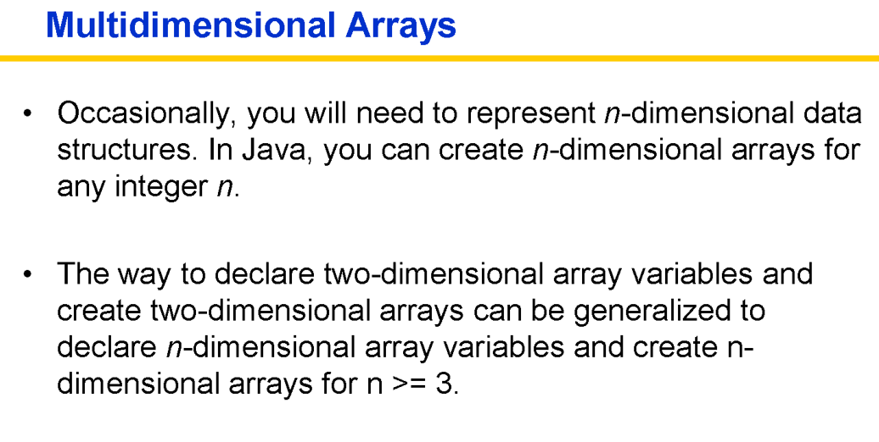

Slide 12
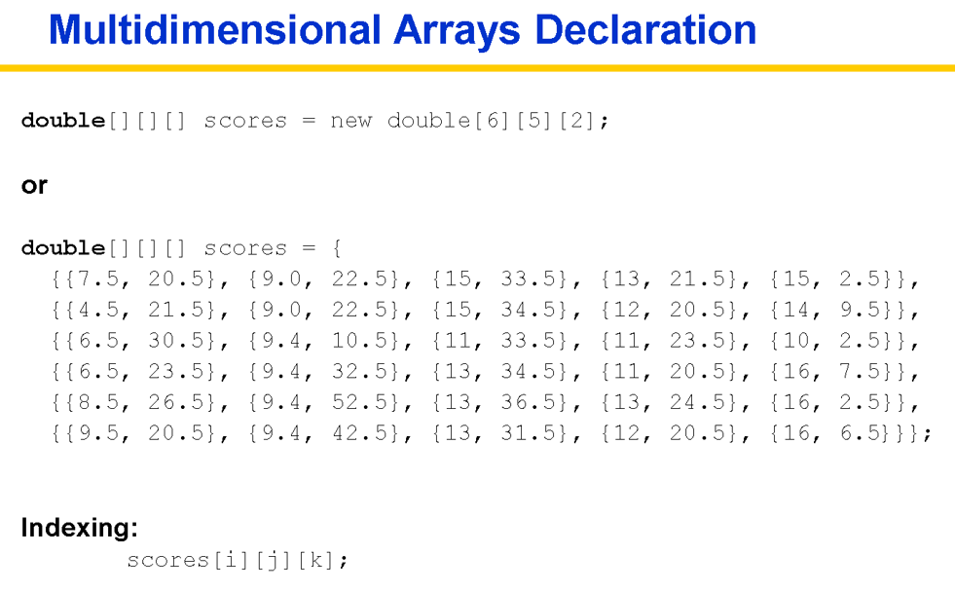

Slide 13
2. ArrayList Class
Limitations of traditional array
Cannot change the size or length of an array after it is created
ArrayList class facilitates creating array-like structure, BUT it can dynamically increase or decrease in length
Includes large number of predefined methods

Slide 14
ArrayList Class
The ArrayList class is a generic class: ArrayList<T> collects objects of type T:
add method adds an object to the end of the array list
ArrayList<Employee> empArray =
new ArrayList<Employee>(); empArray.add(new Employee(“John Lee”,40,50.00)); empArray.add(new Employee(“Jane Tan”,45,72.00)); empArray.add(new Employee(“Ravi Nathan”,50,65.00));

Slide 15
Retrieving Array List Elements
Use get method to retrieve an object in array list
Index starts at 0
Error if index is out of range
size method returns the current size
Employee anEmployee = empArray.get(2); // gets the third element of the array list
int i = empArray.size(); anEmployee = empArray.get(i); // Error // legal index values are 0. . .i-1

Slide 16
Adding Elements
set overwrites an existing value
add with index adds a new value before the index
Employee anEmployee = new Employee(“Ravi Kumar”,50,75); empArray.set(2, anEmployee);
empArray.add(i, a)

Slide 17
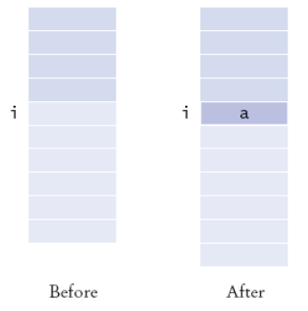
Adding Elements

Slide 18
Removing Elements
remove removes an element at an index
empArray.remove(i)

Slide 19
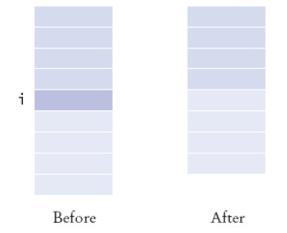
Removing Elements

Slide 20
Array vs ArrayList Example
class Car
{
private String regNumber;
public String getRegNumber( )
{
return regNumber;
}
public Car(String number)
{
regNumber = number;
}
}

Slide 21
Array vs ArrayList Example
class CarArray // using array
{
public static void main(String [] args)
{
Car[] cars = new Car[3];
cars[0] = new Car("ABC1234");
cars[1] = new Car("ABC5678");
cars[2] = new Car("ABC9999");
for (int i = 0; i < cars.length; i++)
{
Car c = cars[i];
System.out.println(c.getRegNumber());
}
}

Slide 22
Array vs ArrayList Example
import java.util.*;
class CarArrayList // using ArrayList class
{
public static void main(String [] args)
{
ArrayList<Car> carList = new ArrayList<Car>();
carList.add(new Car("ABC1234"));
carList.add(new Car("ABC5678"));
carList.add(new Car("ABC9999"));
for (int i = 0; i < carList.size(); i++)
{
Car c = carList.get(i);
System.out.println(c.getRegNumber());
}
}
}

Slide 23
ArrayList Example
Import java.util.*;
class ArrayListExample
{
public static void main(String [] args)
{
ArrayList <String> anArray = new ArrayList<String>();
anArray.add(“Today is my lucky day”);
anArray.add(“Enjoy it”);
anArray.add(“OK”);
anArray.add(“You may not get a second chance”);
System.out.println(“Count of elements in array:”+ anArray.size());
anArray.remove(2);
DisplayContents (anArray);
}
public static void DisplayContents (ArrayList<String> ar)
{
for (int i=0; i<ar.size(); i++)
System.out.println(ar.get(i));
}
}

