Slide 1
Chapter 13a
Window (GUI) Programming

Slide 2
Objectives
To distinguish simple GUI components.
To describe the Java GUI API hierarchy.
To create user interfaces using frames, panels, and simple UI components.
To understand the role of layout managers.
To use the FlowLayout, GridLayout, and BorderLayout managers to layout components in a container.
To specify colors and fonts using the Color and Font classes .
To use JPanel as subcontainers .

Slide 3
Swing vs. AWT
When Java was introduced, the GUI classes were bundled in a library known as the Abstract Windows Toolkit (AWT). For every platform on which Java runs, the AWT components are automatically mapped to the platform-specific components through their respective agents, known as peers.
However, AWT is prone to platform-specific bugs because its peer-based approach relies heavily on the underlying platform.

Slide 4
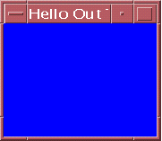
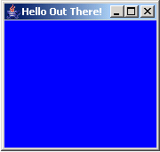
Swing vs. AWT
import java.awt.*;
class FrameEg {
Frame fr;
FrameEg () {
fr = new Frame("Hello Out There!");
fr.setSize(170, 170);
fr.setBackground(Color.BLUE);
fr.setVisible(true);
}
public static void main (String args[]) {
new FrameEg();
}
}

Slide 5
Swing vs. AWT
With the release of Java 2, the AWT user-interface components were replaced by a more robust, versatile, and flexible library known as Swing components.
Swing components are painted directly on canvases using Java code. Thus, they are less dependent on the target platform.
For this reason, Swing components that don’t rely on native GUI are referred to as lightweight components, and AWT components are referred to as heavyweight components.

Slide 6
GUI Class Hierarchy (Swing)
Dimension
Classes in the java.awt package
LayoutManager
Font
1
FontMetrics
Object
Color
Panel
Applet
JApplet
Graphics
Component
Container
Window
Frame
JFrame
*
Dialog
JDialog
JComponent
Swing Components
in the javax.swing package

Slide 7
Container classes
Dimension
Classes in the java.awt package
LayoutManager
Font
1
FontMetrics
Object
Color
Panel
Applet
JApplet
Graphics
Component
Container
Window
Frame
JFrame
*
Dialog
JDialog
Container classes can contain other GUI components.
JComponent
Swing Components
in the javax.swing package

Slide 8
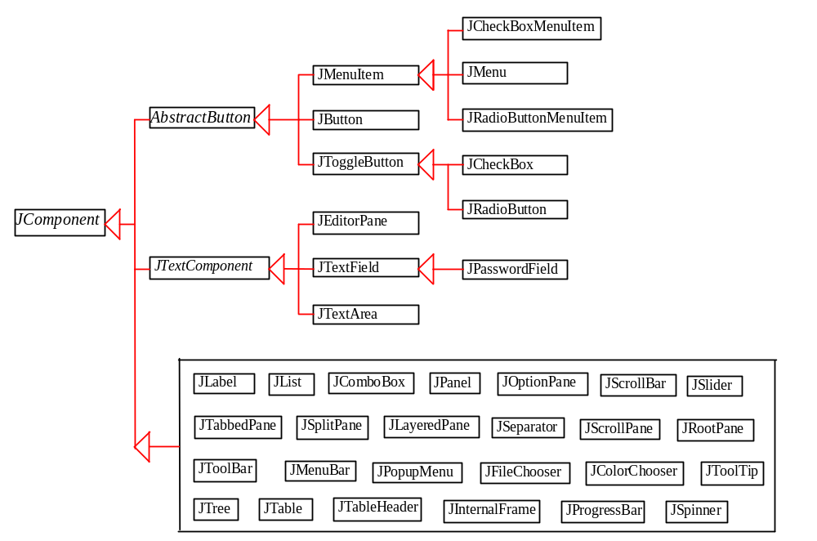
Swing GUI Components

Slide 9
Frames
Frame is a window that is not contained inside another window. Frame is the basis to contain other user interface components in Java GUI applications.
The Frame class can be used to create windows.
For Swing GUI programs, use JFrame class to create widows.

Slide 10
Creating Frames
JFrame constructors:
public JFrame()
- construct a new frame that is initially invisible.
public JFrame(String title)
– Creates a new, initially invisible Frame with the specified
title.

Slide 11
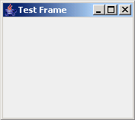
Creating Frames
  import javax.swing.*;
  public class MyFrame {
  public static void main(String[] args) {
  JFrame fr ;
  fr = new JFrame("Test Frame");
  fr.setVisible(true);
  }
}

Slide 12
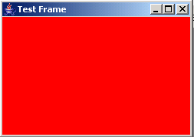
Creating Frames (cont’)
  import java.awt.*;
  public class MyFrame {
  public static void main(String[] args) {
  JFrame fr ;
  fr = new JFrame("Test Frame");
  fr.setSize(400, 400);
  fr.setDefaultCloseOperation(JFrame.EXIT_ON_CLOSE);
  Container container = fr.getContentPane();
  container.setBackground(Color.RED);
  fr.setVisible(true);
  }
  }

Slide 13

GUI Objects
// Create button
JButton jbtOK = new JButton("OK");
JButton jbtCancel = new JButton(“Cancel");
// Create a label
JLabel jlblName = new JLabel("Enter your name: ");
// Create text field
JTextField jtfName = new JTextField("Type Name Here");
JTextField jtfName2 = new JTextField(20);

Slide 14

Adding Components into a Frame
class MyFrame {
JFrame fr;
JButton jbtOK;
MyFrame() {
fr = new JFrame();
jbtOK = new JButton("OK");
fr.getContentPane().add(jbtOK);
fr.pack();
fr.setVisible(true);
}
public static void main (String args[]) {
new MyFrame();
}
}

Slide 15
Adding Components into a Frame (CONT’)
import javax.swing.*;
import java.awt.*;
class MyFrame {
JFrame fr;
JButton jbtOK;
Container container;
MyFrame() {
fr = new JFrame();
jbtOK = new JButton("OK");
container = fr.getContentPane();
container.add(jbtOK);
fr.pack();
fr.setVisible(true);
}
public static void main (String args[]) {
new MyFrame();
}}

Slide 16
Centering Frames
By default, a frame is displayed in the upper-left corner of the screen.
To display a frame at a specified location, you can use the setLocation(x, y) method in the JFrame class.
This method places the upper-left corner of a frame at location (x, y).

Slide 17
Centering Frames, cont.
import javax.swing.*;
import java.awt.*;
public class CenterFrame {
JFrame frame;
Dimension screenSize;
public CenterFrame () {
frame = new JFrame("CenterFrame");
frame.setSize(400, 300);
frame.setDefaultCloseOperation(JFrame.EXIT_ON_CLOSE);
// Get the dimension of the screen
screenSize=Toolkit.getDefaultToolkit().getScreenSize();
int screenWidth = screenSize.width;
int screenHeight = screenSize.height;
[continue…]

Slide 18
Centering Frames, cont.
[…continue]
// Locate the upper-left corner (x, y) of the centered frame
int x = (screenWidth - frame.getWidth()) / 2;
int y = (screenHeight - frame.getHeight()) / 2;
// Set the location of the frame
frame.setLocation(x, y);
frame.setVisible(true);
}
public static void main(String[] args) {
CenterFrame cf = new CenterFrame();
}
}

Slide 19
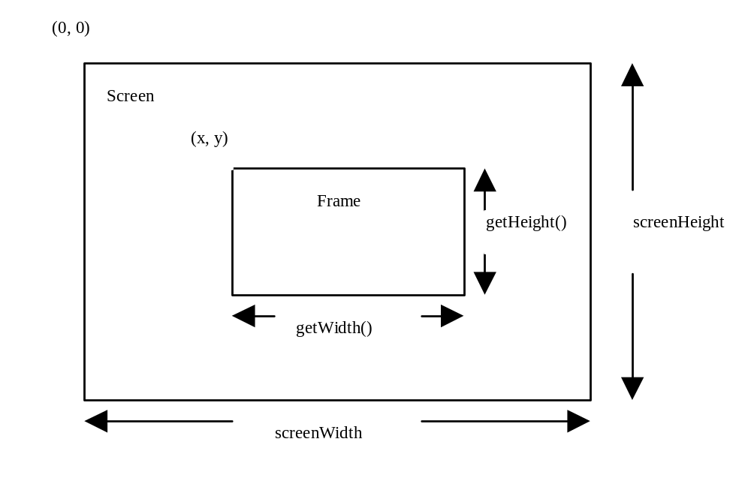
Centering Frames, cont.

Slide 20
Layout Managers
Java’s layout managers provide a level of abstraction to automatically map your user interface on all window systems.
The UI components are placed in containers. Each container has a layout manager to arrange the UI components within the container.
Layout managers are set in containers using the setLayout(LayoutManager) method in a container.

Slide 21
Kinds of Layout Managers
FlowLayout
GridLayout
BorderLayout

Slide 22
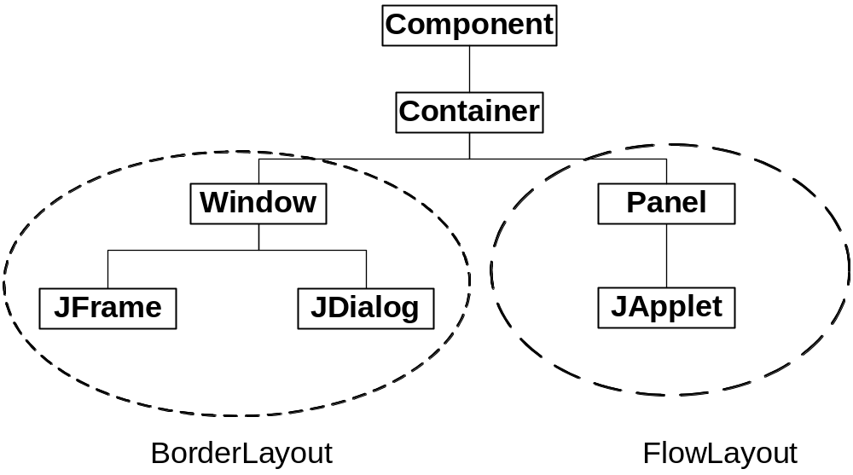
Default Layout Managers

Slide 23
FlowLayout Manager
The components are arranged in the container from left to right in the order in which they were added.
Default alignment is centered.
Uses components’ preferred sizes.
Use the constructor to tune the behavior.

Slide 24

FlowLayout Manager
import java.awt.*;
import javax.swing.*;
class MyFrame {
JFrame fr;
JButton bt1, bt2, bt3, bt4;
FlowLayout flow;
MyFrame() {
fr = new JFrame("Flow Layout");
bt1 = new JButton("button 1");
bt2 = new JButton("button 2");
bt3 = new JButton("button 3");
flow = new FlowLayout(); //center alignment
fr.setLayout(flow);
fr.getContentPane().add(bt1);
fr.getContentPane().add(bt2);
fr.getContentPane().add(bt3);
fr.pack();
fr.setVisible(true);
}…..

Slide 25
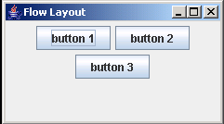
FlowLayout Manager
After user resizes

Slide 26

FlowLayout Constructor
import java.awt.*;
import javax.swing.*;
class MyFrame {
JFrame fr;
JButton bt1;
MyFrame() {
fr = new JFrame("Flow Layout");
bt1 = new JButton("button 1");
fr.setLayout( new FlowLayout(FlowLayout.LEFT));
fr.getContentPane().add(bt1);
fr.setSize(200, 80);
fr.setVisible(true);
}
:
}

Slide 27

FlowLayout Constructor
import java.awt.*;
import javax.swing.*;
class MyFrame {
JFrame fr;
JButton bt1;
MyFrame() {
fr = new JFrame("Flow Layout");
bt1 = new JButton("button 1");
fr.setLayout( new FlowLayout(FlowLayout.RIGHT));
fr.getContentPane().add(bt1);
fr.setSize(200, 80);
fr.setVisible(true);
}
:
}

Slide 28
BorderLayout Manager
The BorderLayout manager divides the container into five areas: East, South, West, North, and Center.
Only 1 component can be added to each of the five regions.
If no region is specified, the component will be added to the Center region.

Slide 29
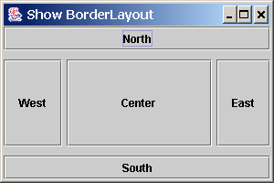
BorderLayout Manager

Slide 30
BorderLayout Manager
Components are added to a BorderLayout by using the add method.
add(Component) or
add(Component, constraint)
where constraint is
  BorderLayout.EAST,
  BorderLayout.SOUTH,
  BorderLayout.WEST,
  BorderLayout.NORTH, or
  BorderLayout.CENTER.

Slide 31
BorderLayout Manager
import javax.swing.*;
import java.awt.*;
public class ShowBorderLayout {
JFrame fr;
JButton bt1, bt2, bt3, bt4, bt5;
Container container;
public ShowBorderLayout() {
fr = new JFrame("ShowBorderLayout");
bt1 = new JButton("East");
bt2 = new JButton("South");
bt3 = new JButton("West");
bt4 = new JButton("North");
bt5 = new JButton("Center");
container = fr.getContentPane(); [continue….]

Slide 32
BorderLayout Manager
[…continue]
// Add buttons to the frame
container.add(bt1, BorderLayout.EAST);
container.add(bt2, BorderLayout.SOUTH);
container.add(bt3, BorderLayout.WEST);
container.add(bt4, BorderLayout.NORTH);
container.add(bt5, BorderLayout.CENTER);
fr.setDefaultCloseOperation(JFrame.EXIT_ON_CLOSE);
fr.setSize(300, 200);
fr.setVisible(true);
}
public static void main(String[] args) {
new ShowBorderLayout();
}
}

Slide 33

BorderLayout Manager
import javax.swing.*;
import java.awt.*;
class ShowLayout {
JFrame fr;
JButton bt;
JTextField tf;
public ShowLayout() {
fr = new JFrame("ShowBorderLayout");
bt = new JButton("Enter");
tf = new JTextField("Enter your password");
// Add buttons to the frame
fr.getContentPane().add(bt);
fr.getContentPane().add(tf);
fr.pack();
fr.setVisible(true);
}…………..

Slide 34
GridLayout Manager
The GridLayout manager arranges components
in a grid (matrix) formation with the number of
rows and columns defined by the constructor.
The components are placed in the grid from left to right starting with the first row, then the second, and so on.

Slide 35
GridLayout Constructors
public GridLayout(int rows,
int columns)
Constructs a new GridLayout with the specified number of rows and columns.
public GridLayout(int rows, int columns, int hGap, int vGap)
Constructs a new GridLayout with the
specified number of rows and columns,
along with specified horizontal and
vertical gaps between components.

Slide 36
GridLayout Constructors
import javax.swing.*;
import java.awt.*;
public class ShowGridLayout {
JFrame fr;
JLabel lb1, lb2, lb3;
JTextField tf1, tf2, tf3;
public ShowGridLayout() {
//constructs components
………………..
// Get the content pane of the frame
Container container = fr.getContentPane();
[continue…]

Slide 37
GridLayout Constructors
[….continue]
// Set GridLayout, 3 rows, 2 columns
container.setLayout(new GridLayout(3, 2));
container.add(lb1);
container.add(tf1);
container.add(lb2);
container.add(tf2);
container.add(lb3);
container.add(tf3);
…………………
}
public static void main(String[] args) {
ShowGridLayout gl = new ShowGridLayout();
}
}

Slide 38

GridLayout Constructors

Slide 39
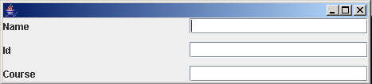
GridLayout Constructors
// Set GridLayout, 3 rows, 2 columns with 10 pixels horizontal & vertical
container.setLayout(new GridLayout(3, 2, 10, 10));
…………………

Slide 40
The Color Class
You can set colors for GUI components by using the java.awt.Color class.
Colors are made of red, green, and blue components, each of which is represented by a byte value that describes its intensity, ranging from 0 (darkest shade) to 255 (lightest shade). This is known as the RGB model.
  Color c = new Color(r, g, b);
r, g, and b specify a color by its red, green, and blue components.
Example:
  Color c = new Color(228, 100, 255);

Slide 41
Standard Colors
Thirteen standard colors (black, blue, cyan, darkGray, gray, green, lightGray, magenta, orange, pink, red, white, yellow) are defined as constants in java.awt.Color.
java.awt.Color has defined 13 standard colors as static constants, such as : BLACK, BLUE, CYAN, DARK_GRAY, GRAY, GREEN, LIGHT_GRAY, MAGENTA, ORANGE, PINK, RED, WHITE, and YELLOW.

Slide 42

Setting Colors
You can use the following methods to set the component’s background and foreground colors:
  setBackground(Color c)
  setForeground(Color c)
Example:
jbt1.setBackground(Color.RED);
jbt1.setForeground(Color.WHITE);
jbt2.setBackground(Color.BLUE);
jbt2.setForeground(Color.YELLOW);

Slide 43

The Font Class
Font Names
  Standard font names that are supported in all platforms are: SansSerif, Serif, Monospaced, Dialog, or DialogInput.
Font Style
  Font.PLAIN, Font.BOLD , Font.ITALIC, and Font.BOLD + Font.ITALIC
Font myFont = Font(name, style, size);
Example:
  Font myFont1 = new Font("SansSerif", Font.BOLD, 16);
  JButton jbtOK = new JButton("OK“);
  jbtOK.setFont(myFont1);

Slide 44
Using Panels as Sub-Containers
Panels act as sub-containers for grouping user interface components.
It is recommended that you place the user interface components in panels and place the panels in a frame. You can also place panels in a panel.
To add a component to JFrame, you actually add it to the content pane of JFrame. To add a component to a panel, you add it directly to the panel using the add method.

Slide 45
Creating a JPanel
You can use new JPanel() to create a panel with a default FlowLayout manager or new JPanel(LayoutManager) to create a panel with the specified layout manager.
Use the add(Component) method to add a component to the panel. For example,
  JPanel p = new JPanel();
  p.add(new JButton("OK"));

Slide 46

Creating a JPanel
import javax.swing.*;
import java.awt.*;
public class ShowWithPanel {
JFrame fr;
JButton jbt1, jbt2;
JLabel lb;
JTextField tf;
public ShowWithPanel() {
fr = new JFrame("Login");
jbt1 = new JButton("login");
jbt2 = new JButton("cancel");
lb = new JLabel("Login");
tf = new JTextField(10);
[CONTINUE…]

Slide 47
Creating a JPanel
[….COTINUE]
JPanel p = new JPanel();
p.add(lb);
p.add(tf);
JPanel p2 = new JPanel();
p2.add(jbt1);
p2.add(jbt2);
fr.getContentPane().add(p, BorderLayout.NORTH);
fr.getContentPane().add(p2);
fr.pack();
fr.setVisible(true);
}

Slide 48
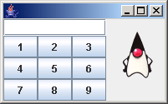
Creating a JPanel
:
p1.setLayout(new BorderLayout());
p1.add(tf, BorderLayout.NORTH);
p1.add(p2);
p2.setLayout(new GridLayout(3,3));
for (int n=0; n<bt.length; n++) {
…..
p2.add(bt[n]);
}
:
fr.getContentPane().add(lb, BorderLayout.EAST);
fr.getContentPane().add(p1);
:

Slide 49
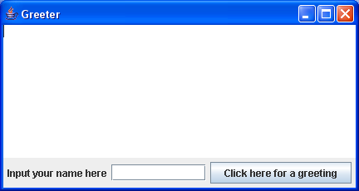
Example
Java contains many standard GUI components that we can use in our programs.
A JTextArea for displaying output.
A JLabel for the prompt.
A JButton for control.
A JTextField for input.

Slide 50
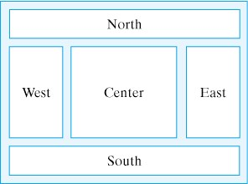
Adding Components to Window
The layout of the content pane is controlled by a layout manager.
It controls the arrangement of components.
A BorderLayout is an example of a layout manager.
contentPane.setLayout(new BorderLayout());

Slide 51
Adding Components to Window
We use an add() method to add components to content pane of JFrame.
contentPane.add(“Center”, display);
// adds the ‘display’ component in the center region
To add several components together into a region, we can use a JPanel.
A JPanel is another Container (like JFrame) where we can add components.
JPanel inputPanel = new JPanel();

Slide 52
Adding Components to Window
The default layout for JPanel is FlowLayout, which means that components are added left to right.
inputPanel.add(prompt); // Add JLabel to JPanel
inputPanel.add(inField); // Add JTextField to JPanel
inputPanel.add(goButton); // Add JButton to JPanel
Then, we add the JPanel to the content pane of JFrame.
contentPane.add("South", inputPanel); // Add JPanel
// to JFrame

Slide 53
Adding Components to Window
Container contentPane = getContentPane();
contentPane.setLayout(new BorderLayout());
JPanel inputPanel = new JPanel();
inputPanel.add(prompt);
inputPanel.add(inField);
inputPanel.add(goButton);
contentPane.add(“Center”, display);
contentPane.add(“South”, inputPanel);

