Slide 1
Chapter 13b
Window (GUI) Event-Driven Programming

Slide 2
Objectives
To explain the concept of event-driven programming.
To understand event, event source, and event classes.
To declare listener classes and write the code to handle events.
To register listener objects in the source object .
To write programs to deal with ActionEvent .
To write programs to deal with WindowEvent .

Slide 3
Events
An event can be defined as a type of signal to the program that something has happened.
The event is generated by external user actions such as mouse movements, mouse clicks, and keystrokes, or by the operating system, such as a timer.

Slide 4
Controlling the GUI’s Action
GUIs use event-driven programming.
In event-driven programming, the Java Virtual Machine (JVM) listens for events.
Events are handled by special objects called listeners.
There are different type of events defined in the java.awt.event package.

Slide 5
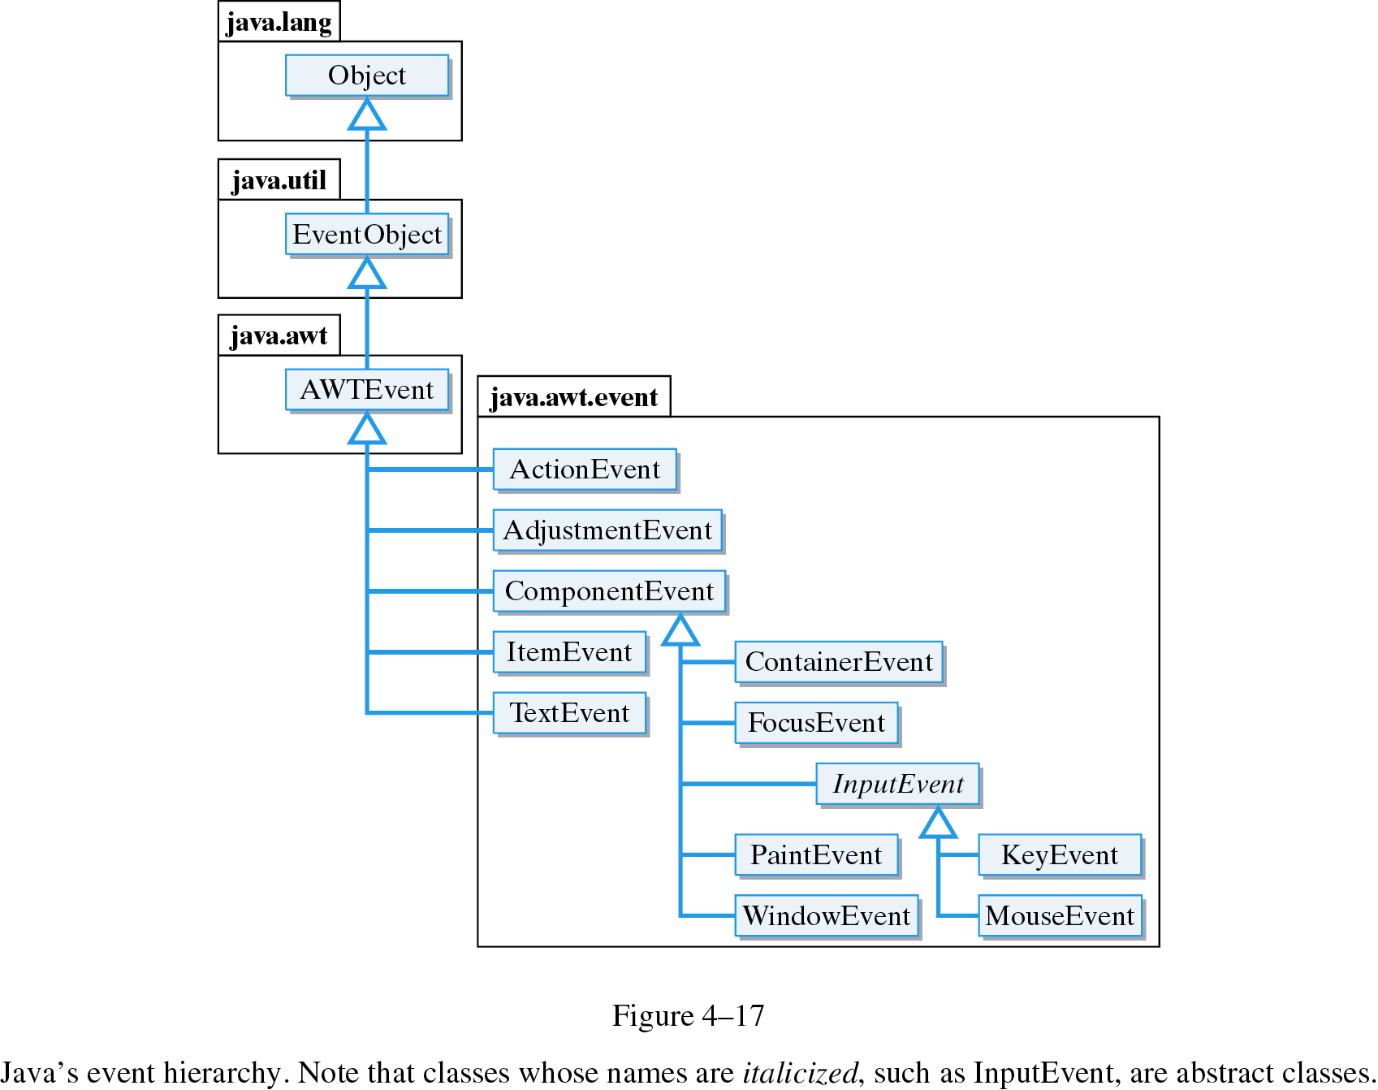
The Java Event Hierarchy
An action event occurs when an applet Button is clicked.
An key event occurs when the user types a key.
An mouse event occurs when the mouse is moved.

Slide 6
Listener
A listener is an object that listens for certain types of events and then takes action.
An ActionListener object listens for ActionEvents, the kind that occur when you click on a JButton or hit return in a JTextField.
When a user clicks the JButton, JVM will create an ActionEvent object. This object contains information about the event.

Slide 7
The ActionListener Interface
ActionListener is an inteface.
An interface is a class that contains abstract methods and constants (no instance variables).
An abstract method is one that lacks an implementation. It has no body.
public abstract interface ActionListener
extends EventListener
{
public abstract void actionPerformed(ActionEvent e);
}

Slide 8
Implementing an ActionListener
If we want our program to serve as a listener for action events, we must implement the ActionListener interface.
This means we must implement the actionPerformed() method.

Slide 9

Handling ActionEvent
import java.awt.*;
import java.awt.event.*;
import javax.swing.*;
class TestButton
implements ActionListener {
JFrame fr;
JButton bt;
JTextField tf;
TestButton() {
fr = new JFrame();
bt = new JButton("click me");
tf = new JTextField(20);
JPanel p = new JPanel();
p.add(bt); [CONTINUE……]

Slide 10
Handling ActionEvent
[…..CONTINUE]
bt.addActionListener(this);
fr.getContentPane().add(tf, BorderLayout.NORTH);
fr.getContentPane().add(p);
fr.setDefaultCloseOperation(JFrame.EXIT_ON_CLOSE);
fr.pack();
fr.setVisible(true);
}
public void actionPerformed (ActionEvent ae) {
tf.setText(" how are you ");
}
public static void main (String args[]) {
new TestButton();
}}

Slide 11
Event Information
An event object contains whatever properties are pertinent to the event.
You can identify the source object of the event using the getSource()
Returns the command string associated with this action by using the getActionCommand()

Slide 12
Handling Simple Action Events
import java.awt.*;
import java.awt.event.*;
import javax.swing.*;
class TestButtons implements ActionListener{
JFrame fr;
JButton bt, bt2, bt3;
JTextField tf;
TestButtons() {
fr = new JFrame();
bt = new JButton("one");
bt2 = new JButton("two");
bt3 = new JButton("three");
tf = new JTextField(20);

Slide 13
Handling Simple Action Events
:
:
bt.addActionListener(this);
bt2.addActionListener(this);
bt3.addActionListener(this);
:
}
public void actionPerformed (ActionEvent ae) {
if (ae.getSource() == bt)
tf.setText("satu");
else if (ae.getSource() == bt2)
tf.setText("dua");
else tf.setText("tiga");
}
:

Slide 14
Exercise
Write the Greeter class which has only one method called greet() with one parameter.
The greet() method returns a String “Hi” + name + “ nice to meet you.” where name is the parameter.

Slide 15
Implementing an ActionListener
The actionPerformed() method will be executed when the goButton is clicked.
How does JVM know that it should call this method?
We must tell JVM that GreeterGUI is the ActionListener for the goButton.
This is done in two steps.

Slide 16
Implementing an ActionListener
First we declare that GreeterGUI implements the ActionListener interface.
This means that GreeterGUI is an ActionListener just like extends JFrame makes GreeterGUI a JFrame in an inheritance relationship.

Slide 17
Implementing an ActionListener
Second, we use the addActionListener() method to associate the listener with the goButton.
The this keyword is a self-reference – that is, it always refers to the object in which it is used.
Here this refers to the GreeterGUI.
goButton.addActionListener(this);

Slide 18
An ActionListener Example
public class GreeterGUI extends JFrame
implements ActionListener
{ ...
private JButton goButton;
...
private void buildGUI()
{ ...
goButton = new JButton("Click here for greeting!");
goButton.addActionListener(this);
...
}
...
public void actionPerformed(ActionEvent e)
{ ...
}
...
}
The keyword this refers to this GreeterGUI object, which is defined as an ActionListener.

Slide 19
Using the GUI in an Application
The GUI is used with an application.
public class GreeterApplication
{
public static void main(String args[])
{
new GreeterGUI("Greeter");
}
}

Slide 20
The Complete Greeter Application
import javax.swing.*;
import java.awt.*;
import java.awt.event.*;
public class GreeterGUI extends JFrame
implements ActionListener
{
private JTextArea display;
private JTextField inField;
private JButton goButton;
private Greeter greeter;

Slide 21
The Complete Greeter Application
public GreeterGUI(String title)
{ greeter = new Greeter();
buildGUI();
setTitle(title);
pack(); // sizes frame according to components added
setVisible(true);
} // GreeterGUI()
private void buildGUI()
{ Container contentPane = getContentPane();
contentPane.setLayout(new BorderLayout());
display = new JTextArea(10,30);
inField = new JTextField(10);
goButton = new JButton(“Click here for a greeting”);
goButton.addActionListener(this);

Slide 22
The Complete Greeter Application
JPanel inputPanel = new JPanel();
inputPanel.add(new JLabel(“Input your name here”));
inputPanel.add(inField);
inputPanel.add(goButton);
contentPane.add(“Center”, display);
contentPane.add(“South”, inputPanel);
} // buildGUI()
public void actionPerformed(ActionEvent e)
{ if (e.getSource() == goButton)
{ String name = inField.getText();
display.append(greeter.greet(name) + "\n");
}
} // actionPerformed()
} // GreeterGUI class

Slide 23
The Complete Greeter Application
public class Greeter
{
public String greet(String name)
{ return “Hi ” + name + “ nice to meet you.”;
} // greet()
} // Greeter class
public class GreeterApplication
{
public static void main(String args[])
{ new GreeterGUI(“Greeter”);
} // main()
} // GreeterApplication

Slide 24
Handling Window Events
Any subclass of the Window class can generate the following window events:
  window opened, closing, closed, activated, deactivated, iconified, and deiconified.

Slide 25
Handling Window Events
import java.awt.event.*;
import javax.swing.*;
class TestFrame implements WindowListener{
JFrame fr;
TestFrame() {
fr = new JFrame();
fr.addWindowListener(this);
fr.setSize(100, 100);
fr.setVisible(true);
}
}
[continue………….]

Slide 26
Handling Window Events
[……..continue]
public void windowOpened (WindowEvent we) { }
public void windowClosed (WindowEvent we) { }
public void windowClosing (WindowEvent we) { }
public void windowIconified (WindowEvent we) {}
public void windowDeiconified (WindowEvent we) {}
public void windowActivated (WindowEvent we) {}
public void windowDeactivated (WindowEvent we) {}
public static void main (String args[]) {
TestFrame tf = new TestFrame();
}
}

Slide 27
Set Components’ value
JTextField setText (String value)
JPasswordField setText (String value)
JRadioButton/JCheckBox setSelected(boolean b)
doClick();
JList setSelectedIndex(int i)
setSelectedIndices(int[] i)
setSelectedValue(String s, boolean shouldScroll)

Slide 28
Set Components’ value (cont’)
JComboBox setSelectedIndex(int i)
setSelectedItem(String s)
JTextArea append(String s)
insert(String str, int pos)
setText(String str)

Slide 29
Retrieve Components’ value
JTextField String getText()
JPassword char[] getPassword()
JRadioButton boolean isSelected()
JList int getSelectedIndices()
String getSelectedValue()
String[] getSelectedValues()
boolean isSelectedIndex(int)

Slide 30
Retrieve Components’ value
JComboBox int getSelectedIndex()
String getSelectedItem()
JTextArea String getText()

