Slide 1
Internet Protocol
Outline
  Introduction to Internet Protocol
  Header and address formats
  ICMP
  Tools
CS 640

Slide 2
Background
Spanning Tree
  Broadcast
  Tree Construction
Also we want to be able to connect heterogeneous networks
  to build internetwork – a collection of heterogeneous networks that provides host to host delivery service
Key to this is IP Protocol
CS 640

Slide 3
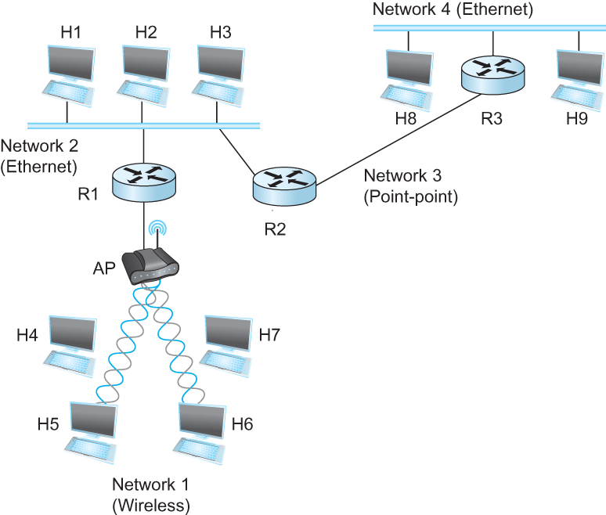
Internetworking
What is internetwork
  An arbitrary collection of networks interconnected to provide some sort of host-host to packet delivery service
  A simple internetwork where H represents hosts and R represents routers
Notes:
The University of Adelaide, School of Computer Science
Chapter 2 — Instructions: Language of the Computer

Slide 4
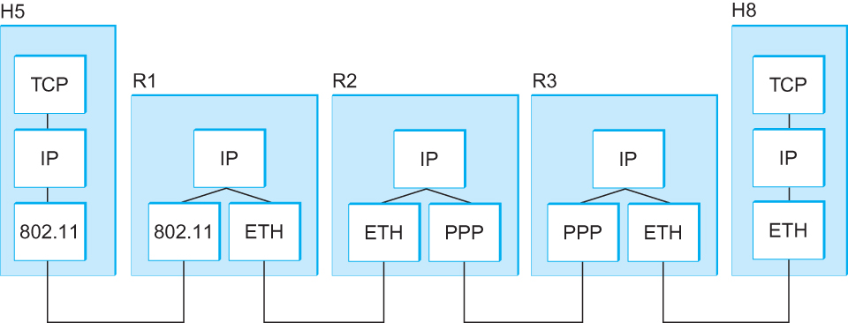
Internetworking
What is IP
  IP stands for Internet Protocol
  Key tool used today to build scalable, heterogeneous internetworks
  It runs on all the nodes in a collection of networks and defines the infrastructure that allows these nodes and networks to function as a single logical internetwork
  A simple internetwork showing the protocol layers
Notes:
The University of Adelaide, School of Computer Science
Chapter 2 — Instructions: Language of the Computer

Slide 5
An IP Internet – Network of Networks
Network 1 (Ethernet)
H7
R3
H8
H1
H2
H3
Network 4
(point-to-point)
Network 2 (Ethernet)
R1
R2
H4
Network 3 (FDDI)
H5
H6
CS 640

Slide 6
Protocol Stack – IP is Common to All
H1
H8
TCP
R1
R2
R3
TCP
IP
IP
IP
IP
IP
ETH
ETH
FDDI
FDDI
PPP
PPP
ETH
ETH
CS 640

Slide 7
Service Model
Service Model ?
  What kind of host-to-host service?
Datagram – another term for packet. Carries all information for delivery
  Main challenges: can only provide something supported by individual physical layer
Connectionless (datagram-based)
Best-effort delivery (unreliable service)
  packets are lost
  packets are delivered out of order
  duplicate copies of a packet are delivered
  packets can be delayed for a long time
CS 640

Slide 8
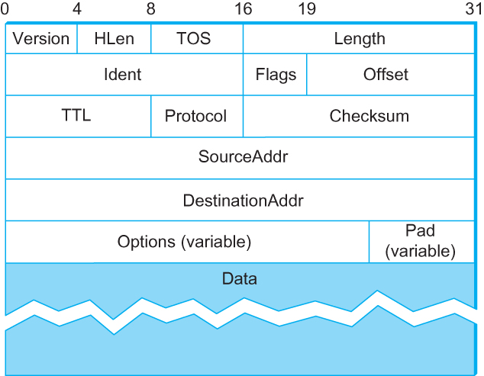
Packet Format
  Version (4): currently 4
  Hlen (4): number of 32-bit words in header
  TOS (8): type of service (not widely used)
  Length (16): number of bytes in this datagram
  Ident (16): used by fragmentation
  Flags/Offset (16): used by fragmentation
  TTL (8): number of hops this datagram has traveled, decremented at every router to prevent packets from lingering
  Protocol (8): demux key (TCP=6, UDP=17)
  Checksum (16): of the header only, needs recomputation at every hop as TTL changes
  DestAddr & SrcAddr (32)
Notes:
The University of Adelaide, School of Computer Science
Chapter 2 — Instructions: Language of the Computer

Slide 9
Fragmentation and Reassembly
Each network has some Maximum Transmission Unit (MTU)
  Largest datagram that a network can carry in a frame
Strategy
  fragment when necessary (MTU < Datagram)
  try to avoid fragmentation at source host
    Due to overhead of reassembly
  re-fragmentation is possible
  fragments are self-contained datagrams
  delay reassembly until destination host
    Keep this functionality out of the network
  do not recover from lost fragments
    End hosts try to reassemble fragmented packets –if a fragment is lost…
End hosts are encouraged to do MTU discovery
CS 640

Slide 10
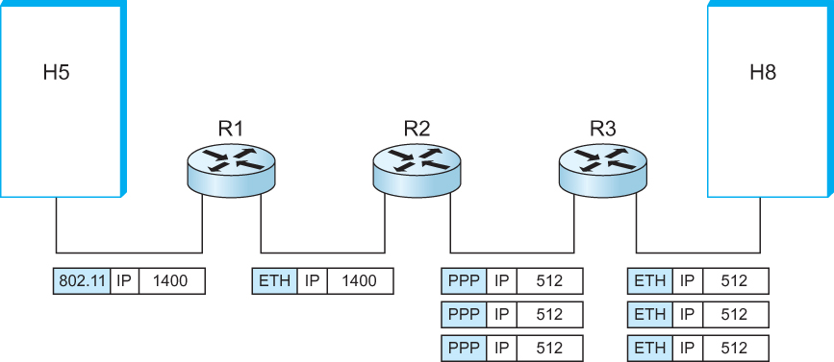
Example: IP Fragmentation and Reassembly
  IP datagrams traversing the sequence of physical networks
Notes:
The University of Adelaide, School of Computer Science
Chapter 2 — Instructions: Language of the Computer

Slide 11
Example continued…
Start of header
Ident
= x
1
Offset
= 0
Rest of header
Start of header
512 data bytes
Ident
= x
0
Offset
= 0
Rest of header
Start of header
Ident
= x
1
Offset
= 64
1400 data bytes
Rest of header
512 data bytes
Start of header
Ident
= x
0
Offset
= 128
Rest of header
376 data bytes

