Slide 1
Maintenance Cost Reduction Prediction Project
Evelyn Ding Ph.D.

Slide 2
Background & Targets
A company has a fleet of devices transmitting daily telemetry readings. They would like to create a predictive maintenance solution to proactively identify when maintenance should be performed. This approach promises cost savings over routine or time-based preventive maintenance, because tasks are performed only when warranted.
The goal of this project is to predict when/which devices potentially are going to fail next. Seven predictive models have been developed as comparison and the best model is recommended after comprehensive comparison. Data has been detailed exploratory and additional features are created as essential indication to improve the performance.

Slide 3
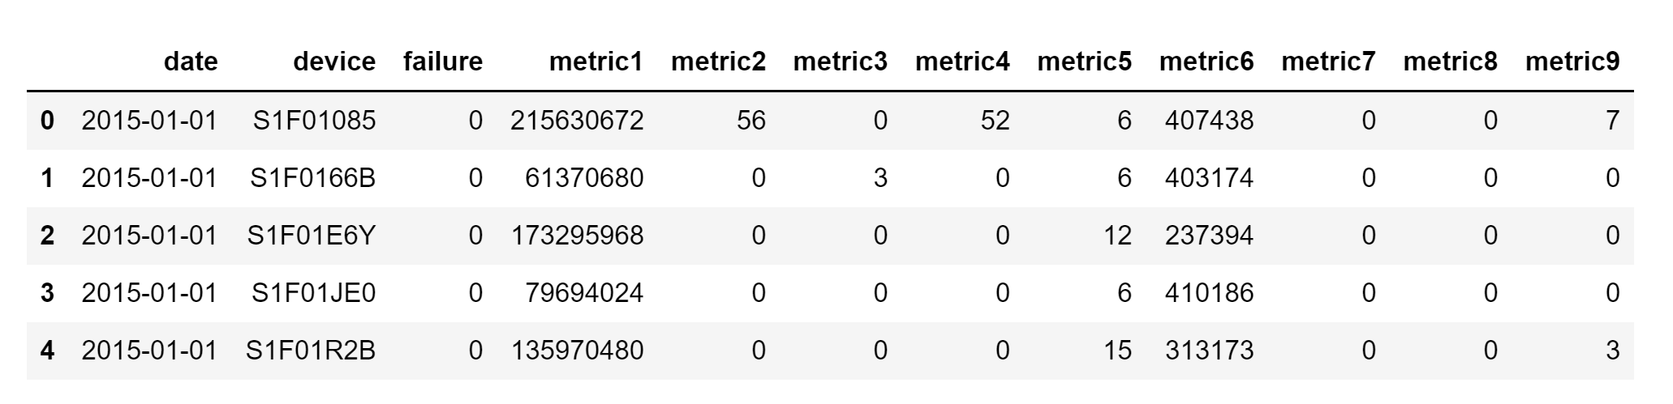
Raw Dataset Sample

Slide 4
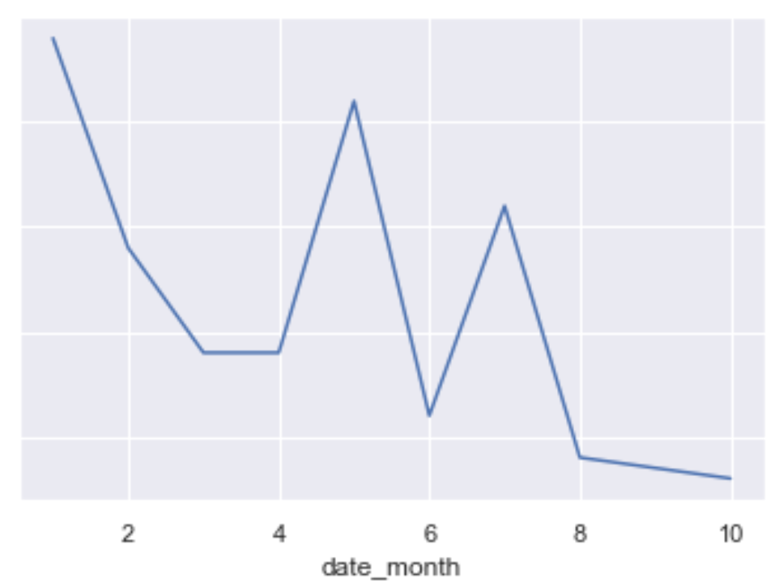
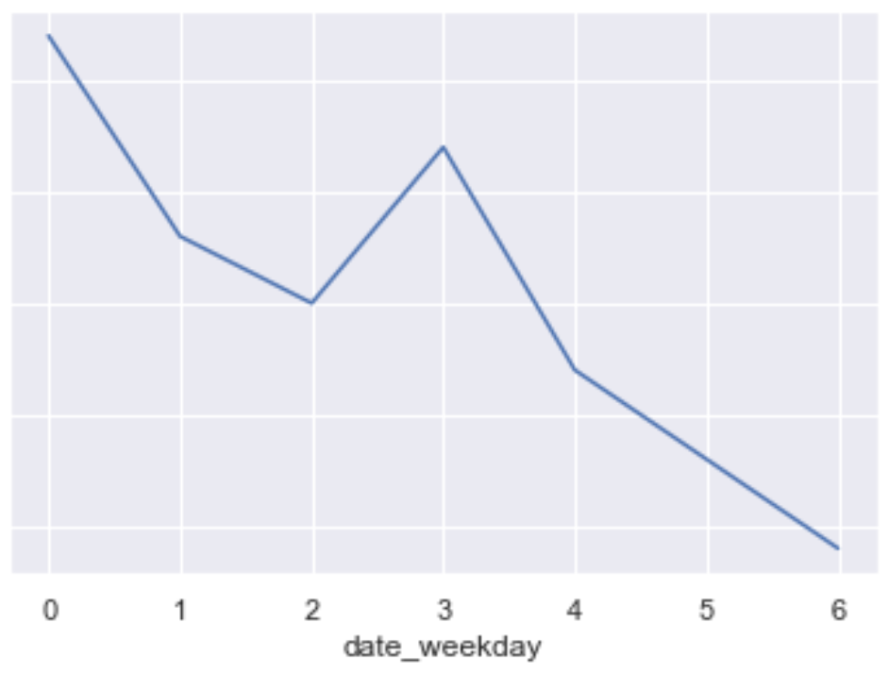
EDA – Date Feature

Slide 5
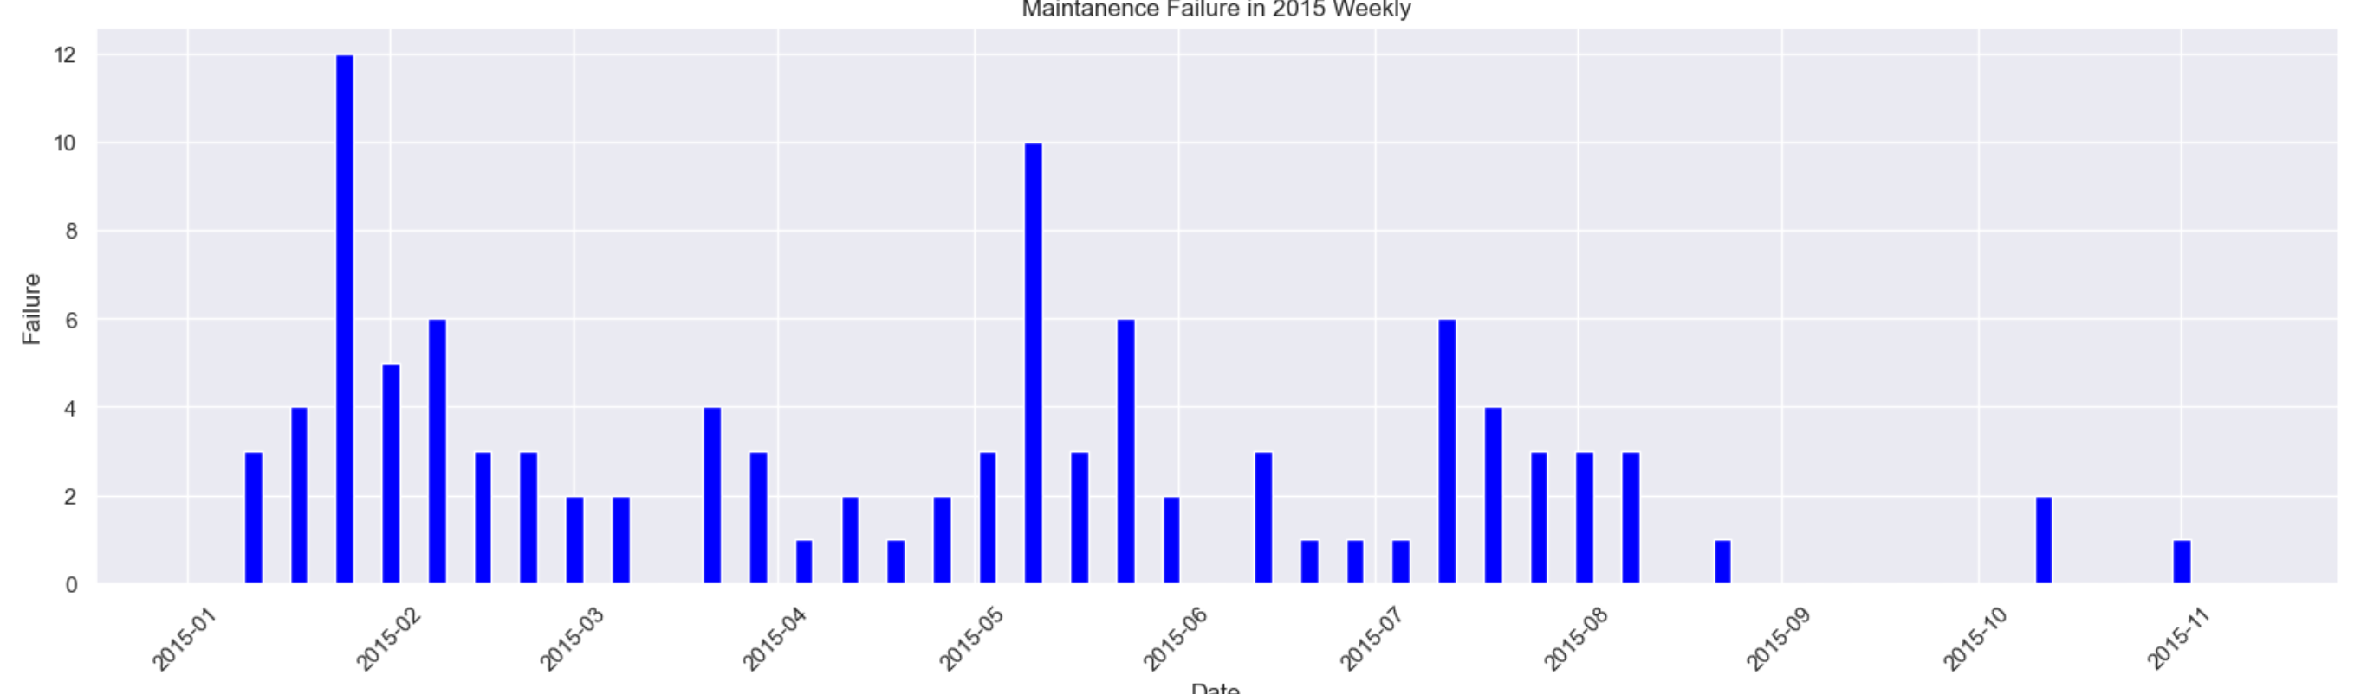
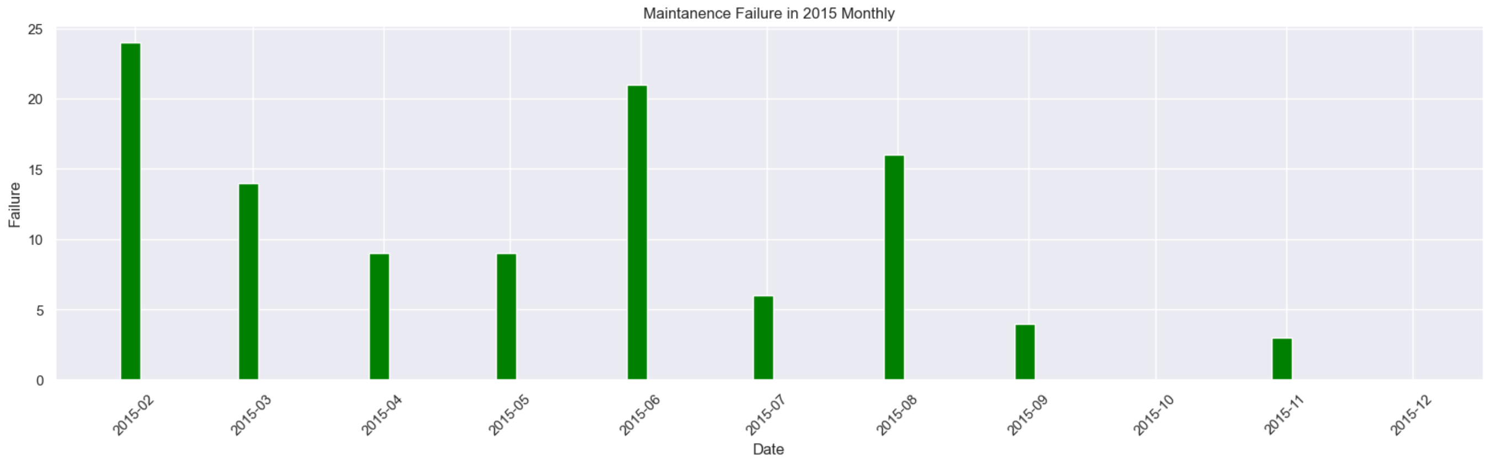
EDA – Date Feature

Slide 6
EDA – Date Feature - Summary
Every Thursday has peak time to have machine failure.
Within 2015-01~ 2015-11, there is no regular pattern of failure through each month.

Slide 7
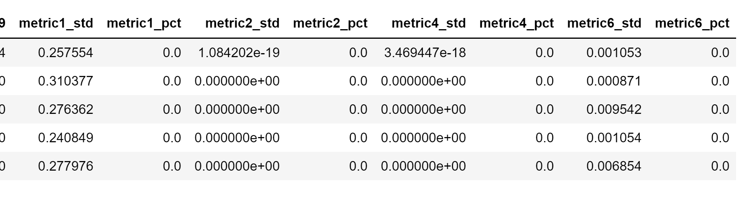
Feature Design
8 New Features:

Slide 8
Imbalance Processing:
Method 1: Upsampling random
Method 2: Smote upsampling
Method 3: Upsampling the machines with failure history

Slide 9
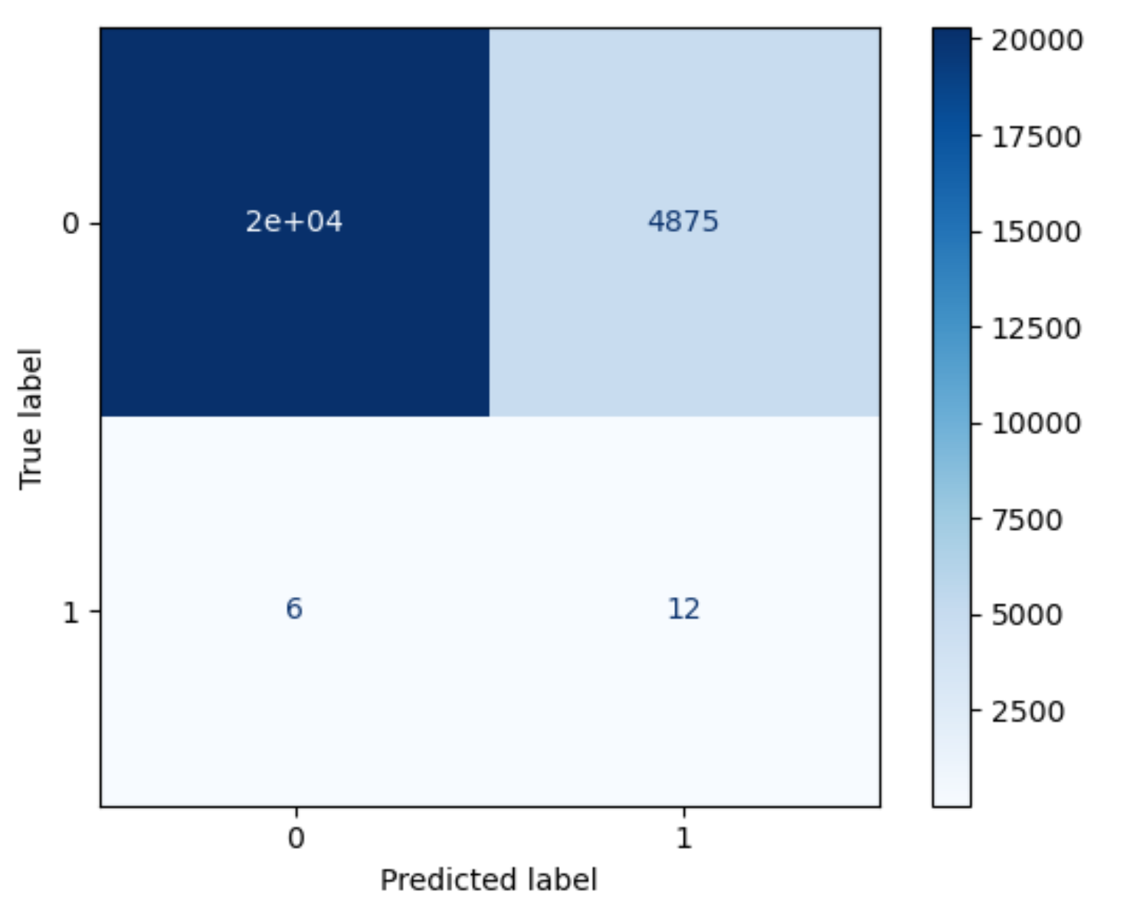
Model 1: Logistic Regression

Slide 10
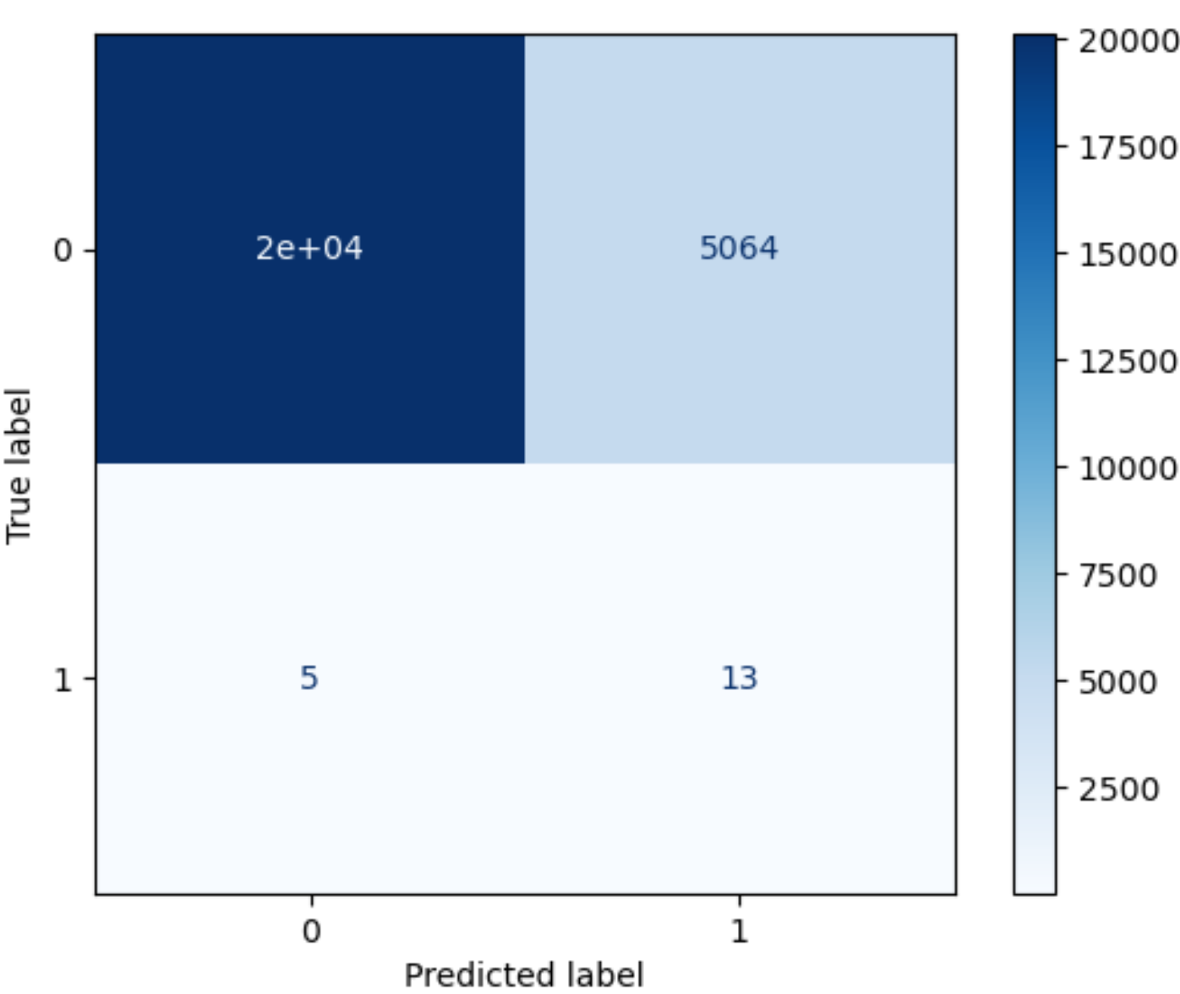
Model 2: SVM

Slide 11
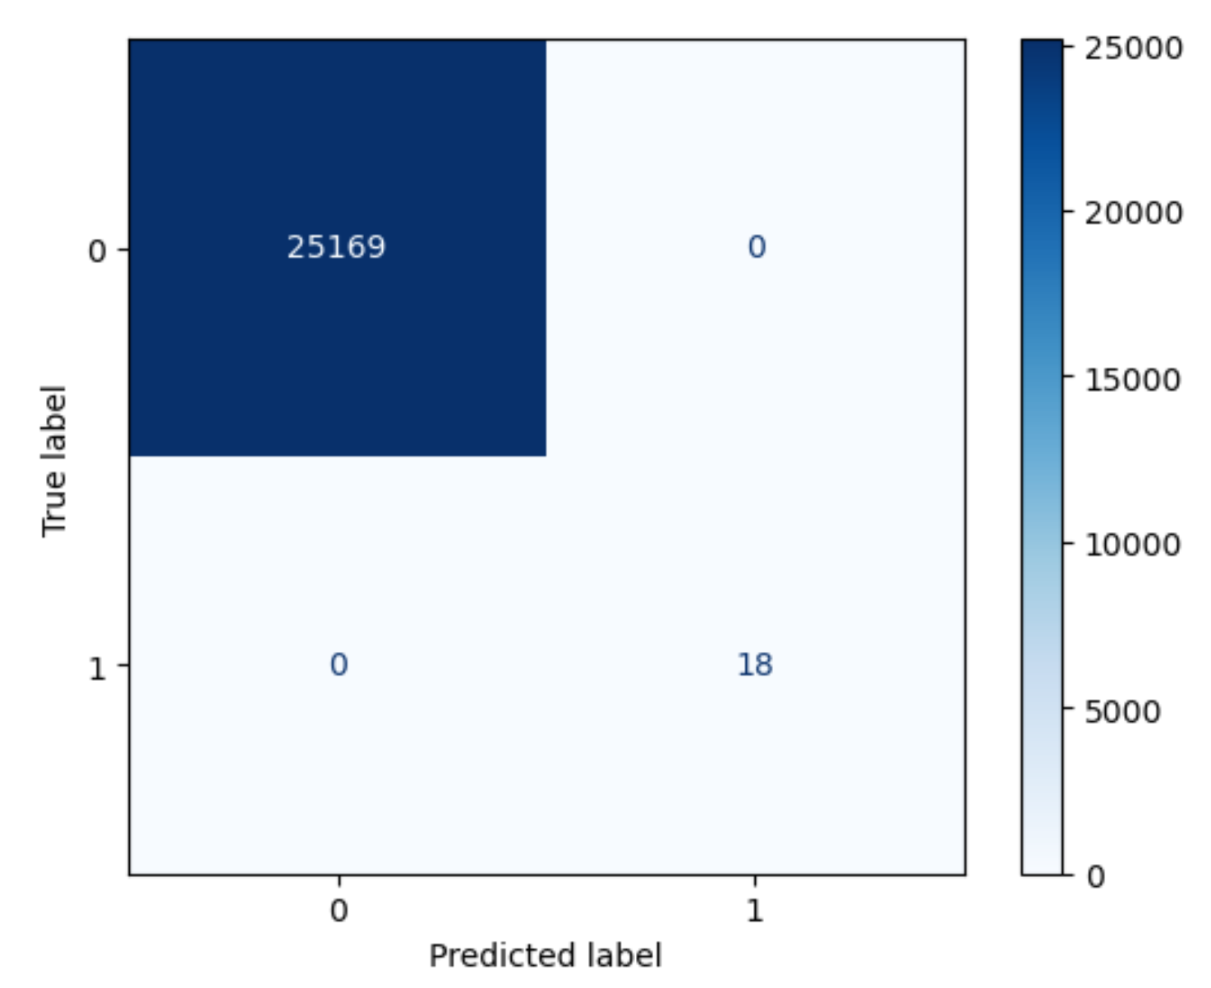
Model 3: Random Forest

Slide 12
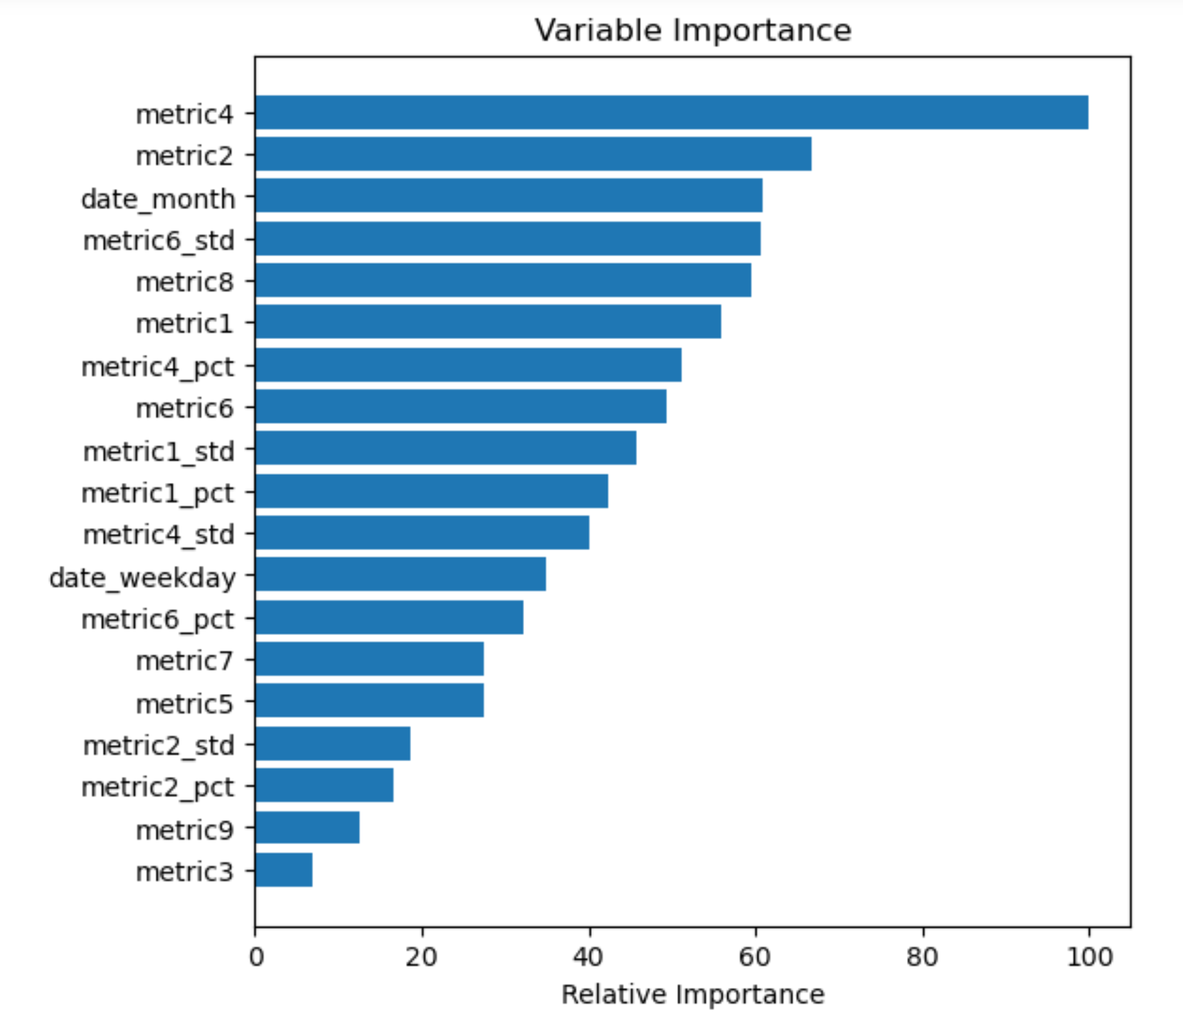
Model 3: Random Forest – Feature Ranking

Slide 13
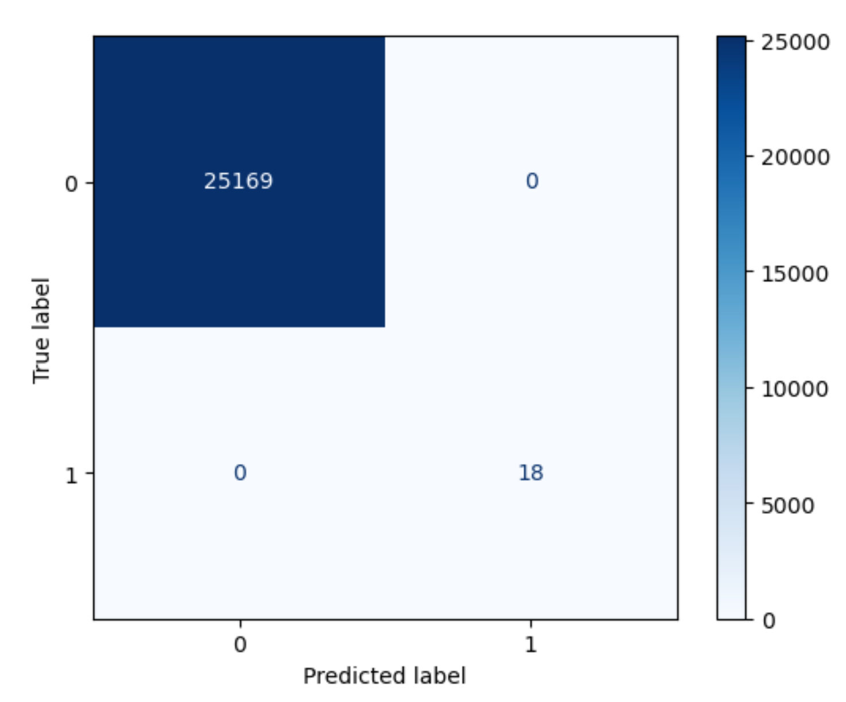
Model 4: Decision Tree

Slide 14
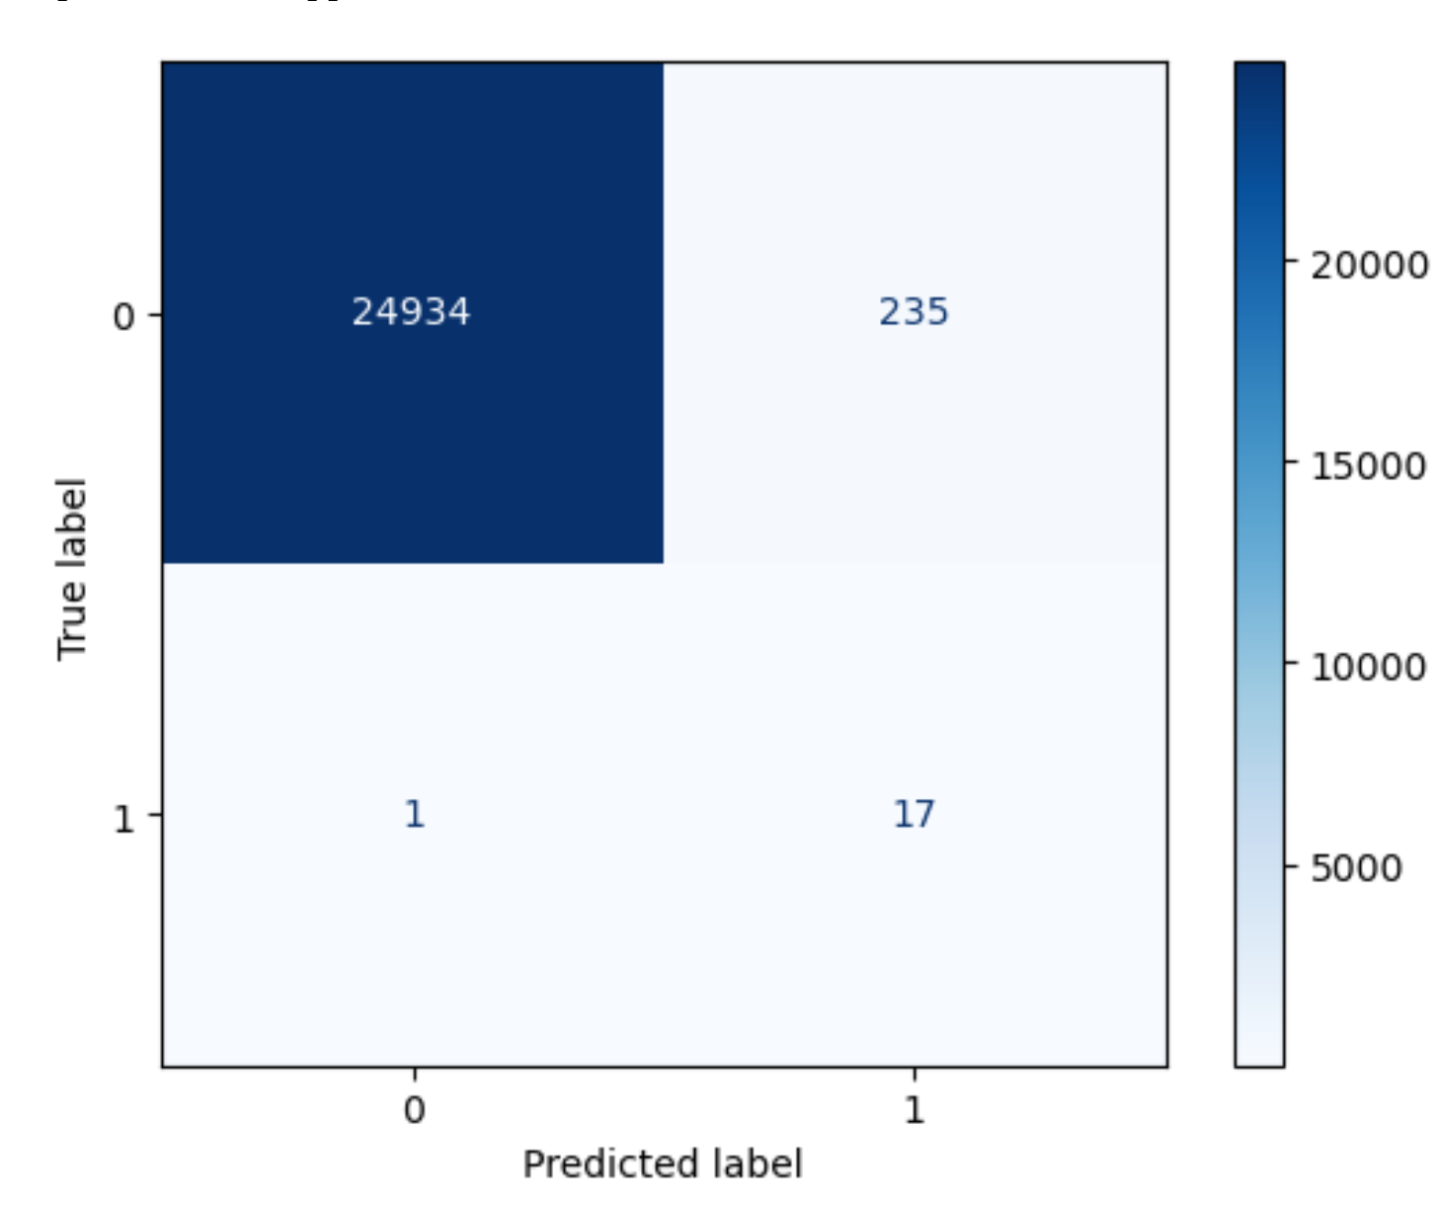
Model 5: Deep Learning - MLP

Slide 15
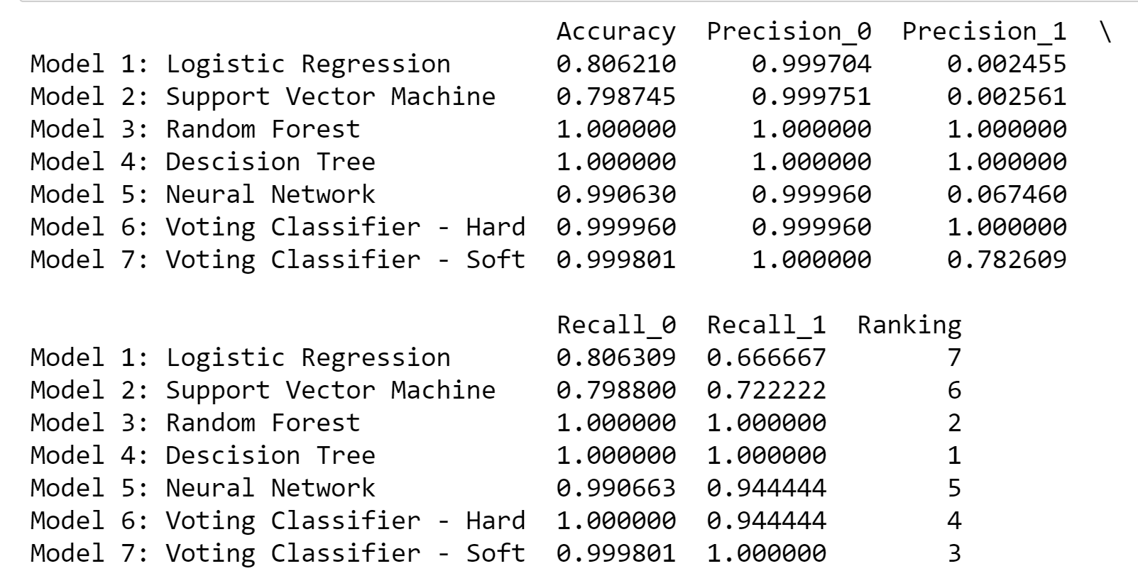
Model Comparison:

Slide 16
Summary and Conclusion:
SMOTE upsampling based on each device with failure history is an effective way to improve the performance of all the machine learning models as well as GroupShuffleSplit method.
Learning from the history data of each device, the standard deviaion and percentage change are good indicators to represent the abnormal performance before each failure. Before failure, there is always unusual reading from some metrics. Having new features created as these indicators improves the performance of models significantly.
Based on the importance/criteria of this project to minimize falsepositives and false negatives, the recommended models are determinedbased on the ranking column as above. It shows the Decision Tree is bestmodel with both Precision\_1/Recall\_1 with the highest scores as well as AUC\_pr score. The 2nd and 3rd best models are the Random Forest and the Voting Classifier(Soft). I would recommend to use the Decision Tree as the final model with the best prediction performance designed for this project.

Slide 17
Thank You

