Slide 1
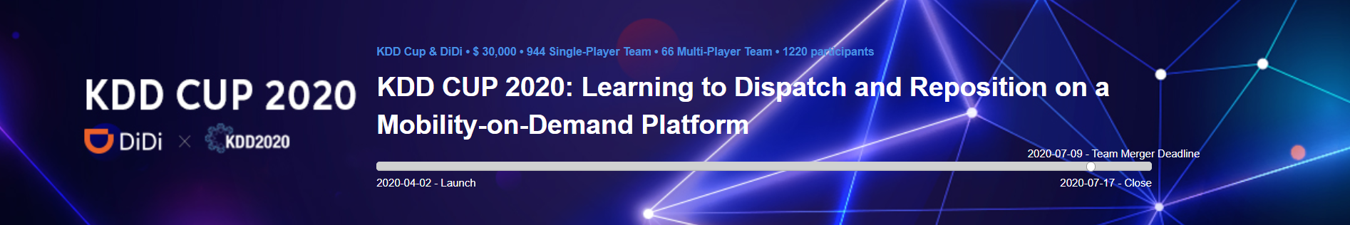


KDD CUP 2020
RL Track 1st Place Winner
Team: Polar Bear
Members: Yansheng Wang, Dingyuan Shi, Yuanfei Luo, Maoxiaomin Peng, Yi Xu, Yongxin Tong

Slide 2
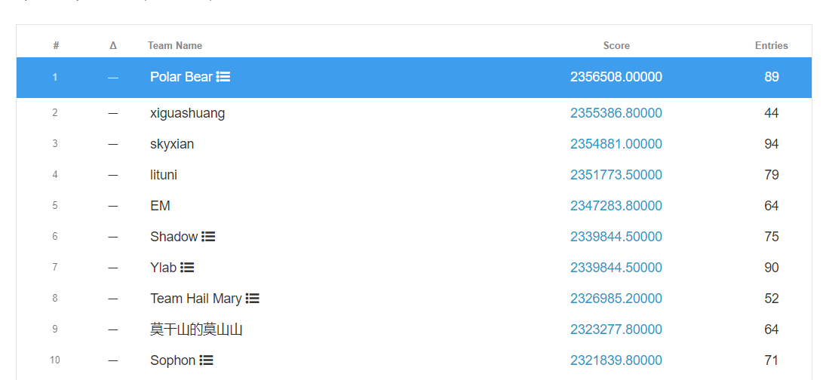
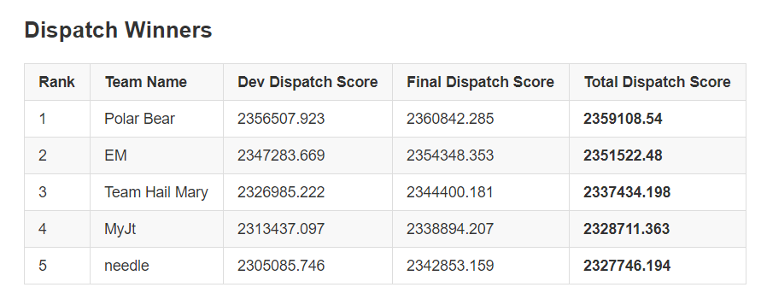
Result

Slide 3
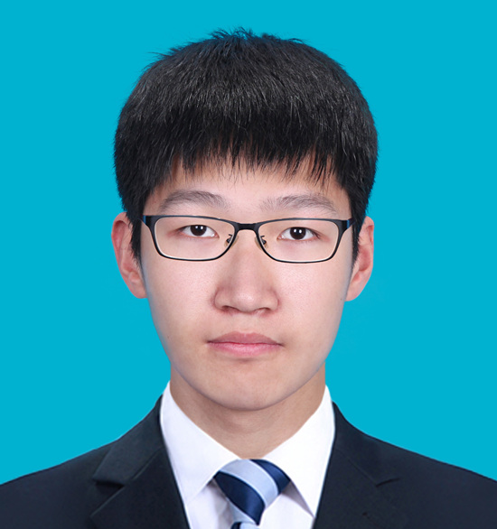
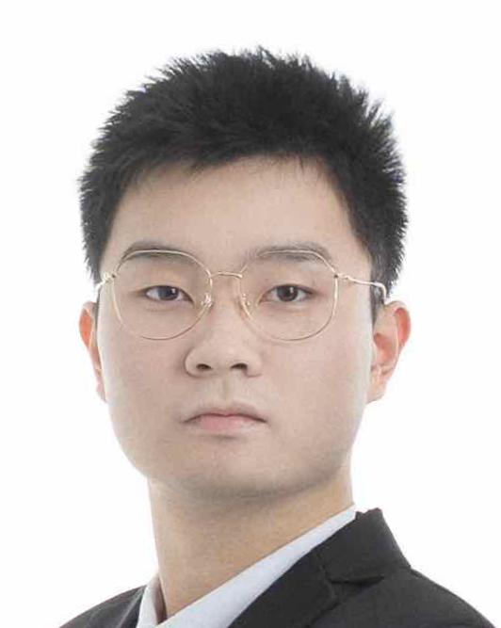
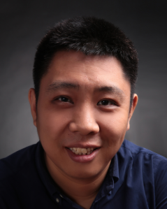
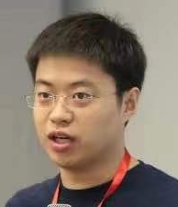
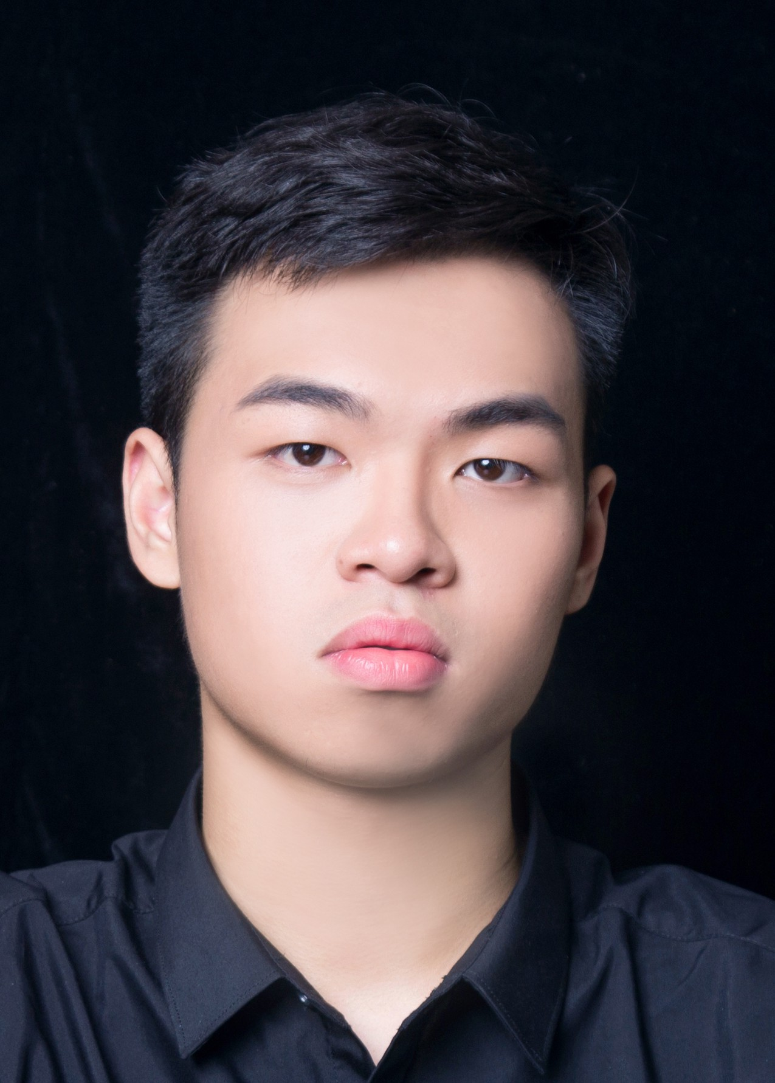
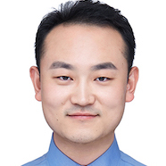
Our Team
Team Leader
Team Coach
Yansheng Wang
Beihang University
Dingyuan Shi
Beihang University
Yongxin Tong
Professor
Beihang University
Yuanfei Luo
4Paradigm Inc.
Maoxiaomin Peng
Beihang University
Yi Xu
Beihang University

