Slide 1
线性模型与非线性扩展
引言
线性回归
线性回归实例
线性模型的非线性拓展
通用的多类分类器

Slide 2
引言
机器学习的基本流程
回归与分类是两大类问题
回归问题的输出是连续值
分类问题的输出是离散值
区别：模型最后一层的设计方式不同
Step 1: function with unknown
Step 2: define loss from training data
Step 3: optimization

Slide 3
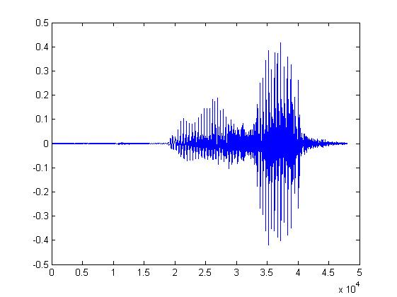

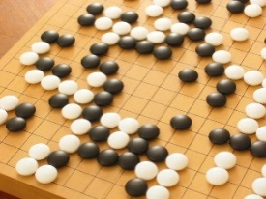
Machine Learning ≈ Looking for Function
Speech Recognition
Image Recognition
Playing Go
“How are you”
“Cat”
“5-5”
(next move)
Notes:
From Data

Slide 4

Different types of Functions
Regression: The function outputs a scalar.
Predict PM2.5
PM2.5 today
f
temperature
PM2.5 of tomorrow
Concentration
of O₃
Classification: Given options (classes), the function outputs the correct one.
Spam
filtering
f
Yes/No

Slide 5
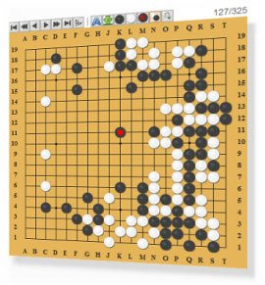

Different types of Functions
Classification: Given options (classes), the function outputs the correct one.
Each position is a class
(19 x 19 classes)
Function
a position on the board
Next move
Playing GO
Notes:
Reinforcement learning?

Slide 6
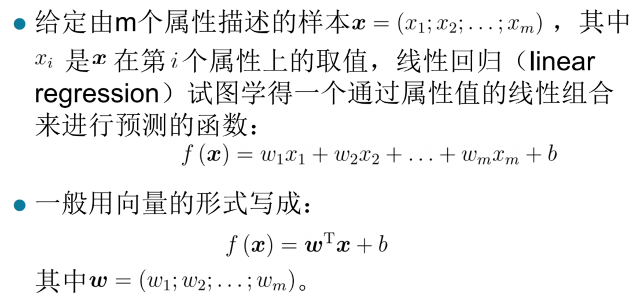
线性回归

Slide 7
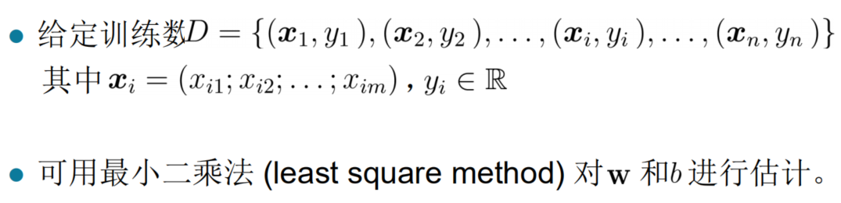

Slide 8
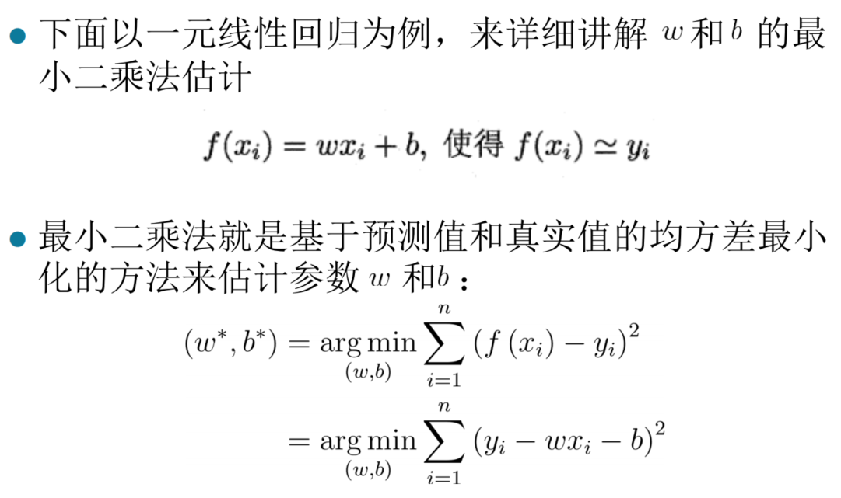

Slide 9
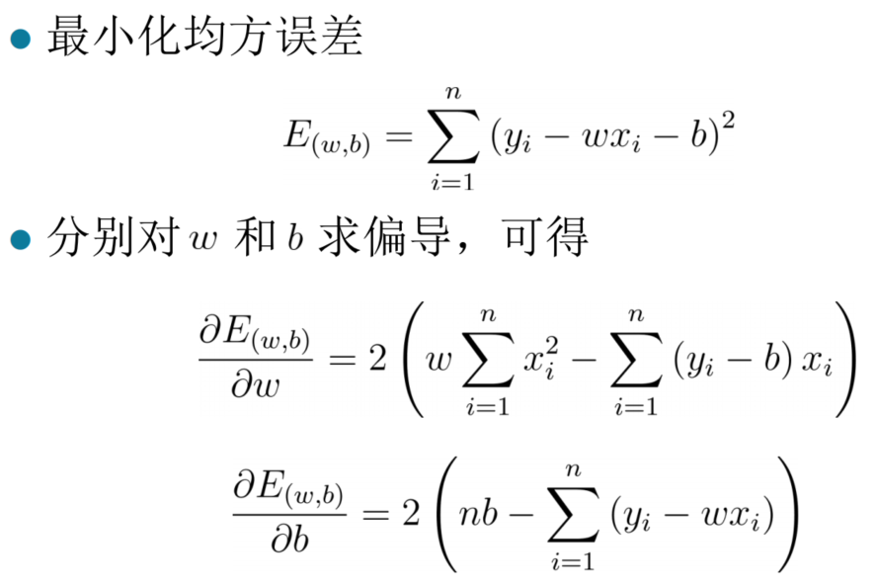

Slide 10
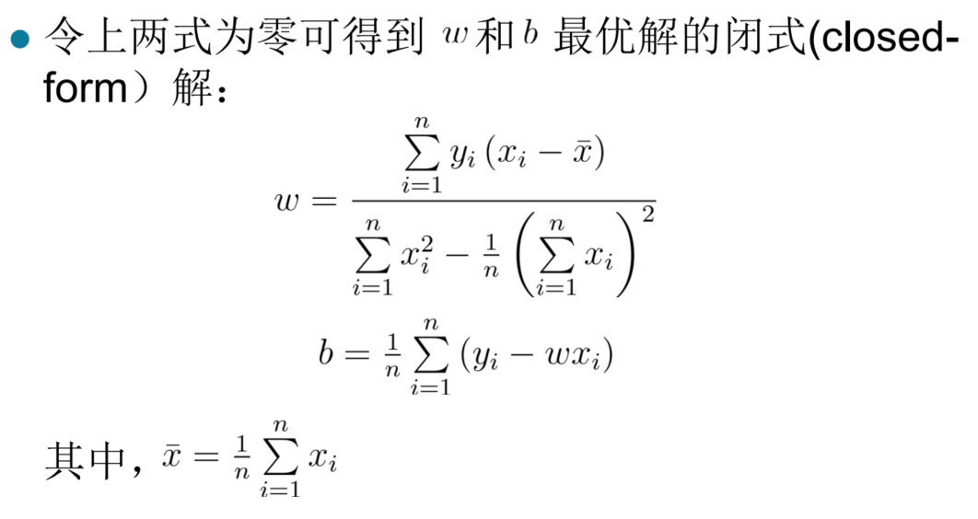
实际应用中一般不采用显式求解的方法，往往通过优化方法来进行迭代寻找最优参数。比如梯度下降法

Slide 11
线性回归实例
目标：视频网站的特定视频观看次数预测
特征：连续若干天的观看次数分布
预测：明天的观看次数
机器学习步骤
定义一个带有未知参数的函数（模型）
定义损失函数
基于优化方法得到最优参数

Slide 12
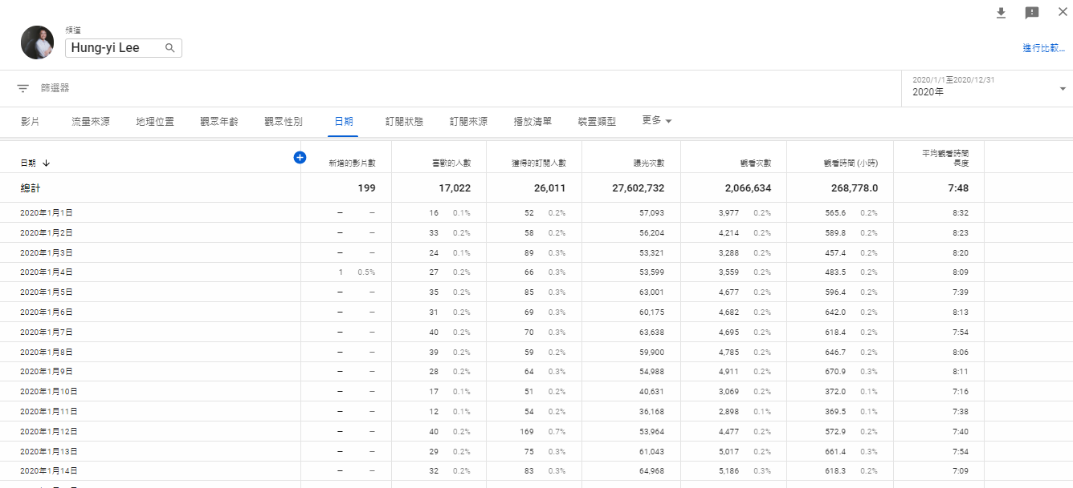

1. Function with Unknown Parameters
Model
based on domain knowledge
feature
weight
bias

Slide 13









2. Define Loss from Training Data
Loss is a function of parameters
Loss: how good a set of values is.
How good it is?
Data from 2017/01/01 – 2020/12/31
……
2017/01/01
01/02
01/03
2020/12/30
12/31
4.8k
4.9k
7.5k
3.4k
9.8k
5.3k
label
4.9k
Notes:
Mean Square Error (MSE)

Slide 14








2. Define Loss from Training Data
Loss is a function of parameters
Loss: how good a set of values is.
How good it is?
Data from 2017/01/01 – 2020/12/31
……
2017/01/01
01/02
01/03
2020/12/30
12/31
4.8k
4.9k
7.5k
3.4k
9.8k
5.4k
4.9k
7.5k
9.8k
Notes:
Mean Square Error (MSE)

Slide 15

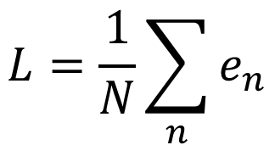



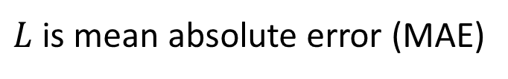

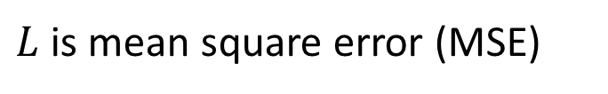
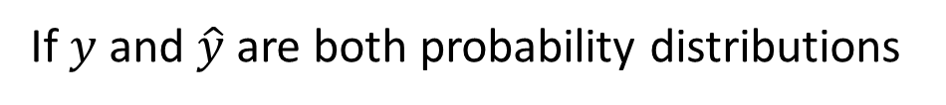
2. Define Loss from Training Data
Loss is a function of parameters
Loss: how good a set of values is.
4.8k
4.9k
Loss:
4.9k
Cross-entropy

Slide 16

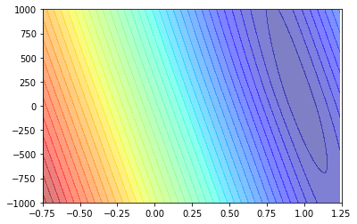
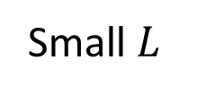

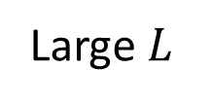

2. Define Loss from Training Data
Loss is a function of parameters
Loss: how good a set of values is.
Model
Error Surface
Notes:
MAE

Slide 17

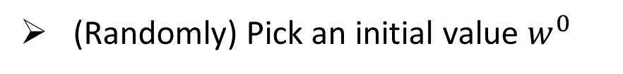
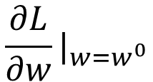
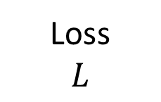


3. Optimization
Gradient Descent
Compute
Negative
Increase w
Positive
Decrease w
Notes:
In this case, this optimization problem can be solved directly.

Slide 18
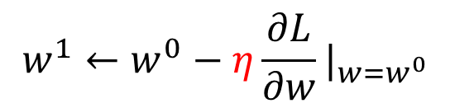
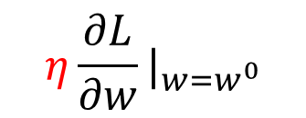
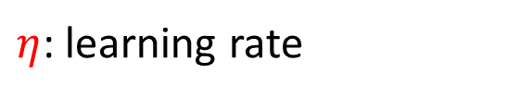


3. Optimization
Gradient Descent
Compute
hyperparameters
Notes:
Eta
In this case, this optimization problem can be solved directly.

Slide 19



3. Optimization
Gradient Descent
Compute
Does local minima truly cause the problem?
local minima
global minima
Notes:
In this case, this optimization problem can be solved directly.

Slide 20
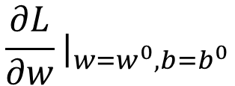
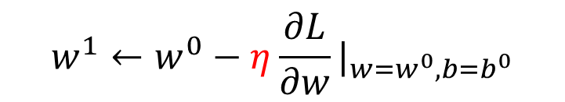
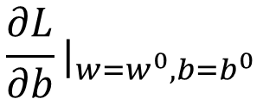

3. Optimization
Compute
Can be done in one line in most deep learning frameworks

Slide 21

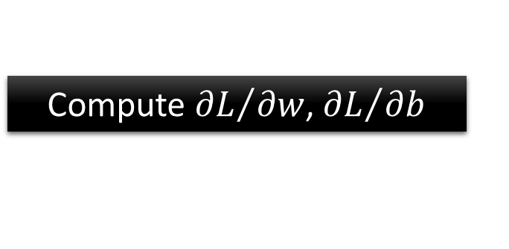


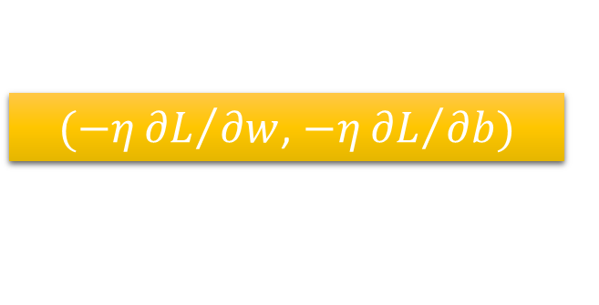



3. Optimization
Model

Slide 22



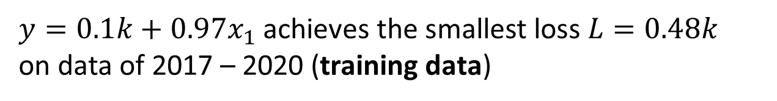

Machine Learning is so simple ……
Step 1: function with unknown
Step 2: define loss from training data
Step 3: optimization
Training
How about data of 2021 (unseen during training)?

Slide 23

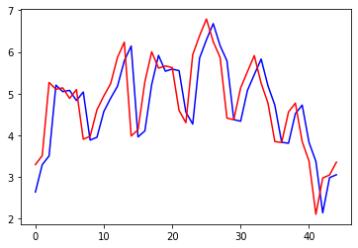
Red: real no. of views
blue: estimated no. of views
Views
(k)
2021/01/01
2021/02/14

Slide 24



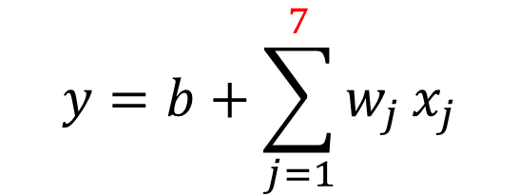


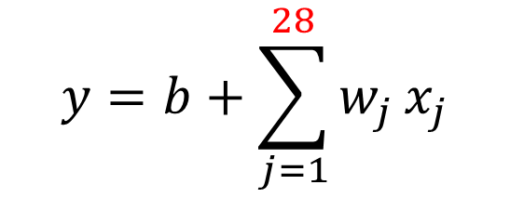





2017 - 2020
2021
2017 - 2020
2021
2017 - 2020
2021
2017 - 2020
2021
Linear models

Slide 25

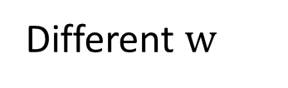
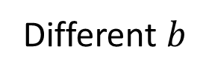


线性模型的非线性拓展
Linear models are too simple … we need more sophisticated modes.
Linear models have severe limitation.
Model Bias
We need a more flexible model!
Notes:
How to fit this one?
The summation of the blue functions is the green one.

Slide 26
red curve =
constant +
sum of a set of
1
3
0
2
Notes:
How to fit this one?
The summation of the blue functions is the green one.
Is it a

Slide 27
All Piecewise Linear Curves
constant +
sum of a set of
=
More pieces require more

Slide 28


Beyond Piecewise Linear?
Approximate continuous curve by a piecewise linear curve.
To have good approximation, we need sufficient pieces.
Notes:
How to fit this one?

Slide 29

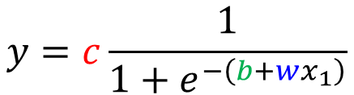


red curve =
constant +
sum of a set of
How to represent this function?
Hard Sigmoid
Sigmoid Function
Notes:
Hard

Slide 30
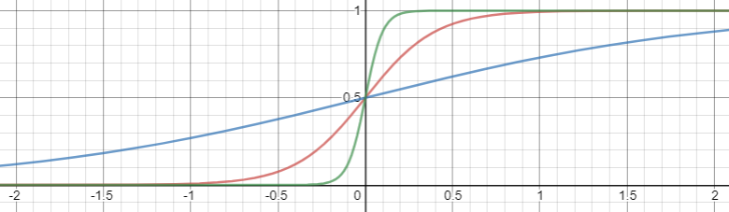
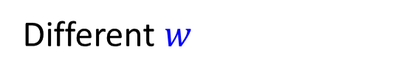
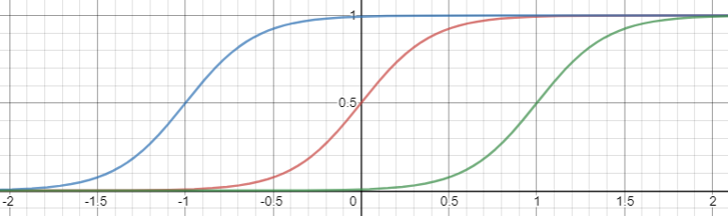
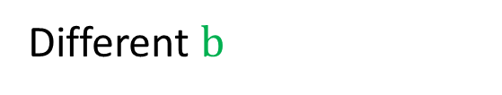
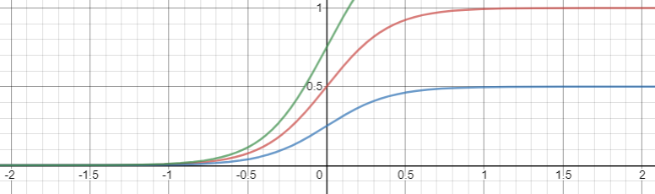
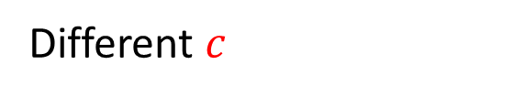
Change slopes
Shift
Change height

Slide 31


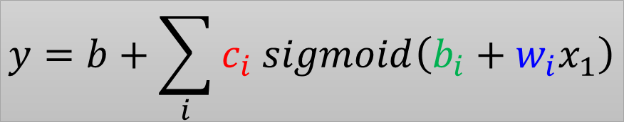

red curve =
sum of a set of
+ constant
1
3
0
0
+
1
+
2
+
3
2
Notes:
How to fit this one?
The summation of the blue functions is the green one.

Slide 32

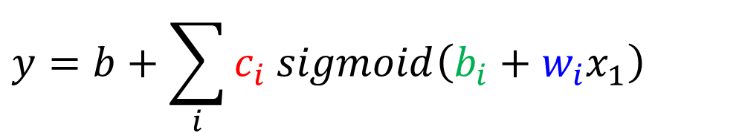
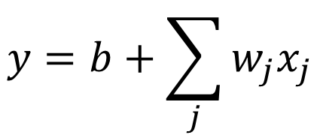
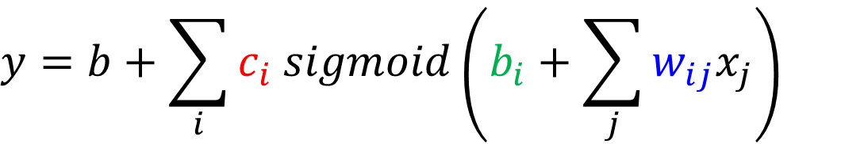
New Model: More Features

Slide 33
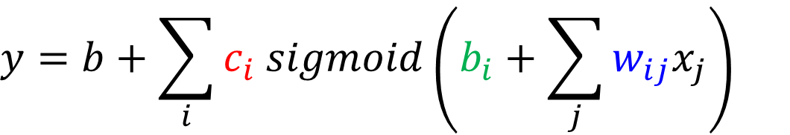
















no. of features
no. of sigmoid
1
+
1
2
+
1
3
+
1

Slide 34


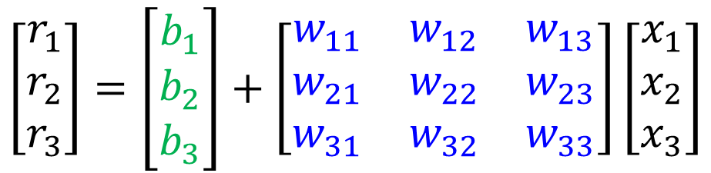







Slide 35





1
+
1
2
+
1
3
+
1
Notes:
10 9.1967
50 7.2083
100 6.5856

Slide 36

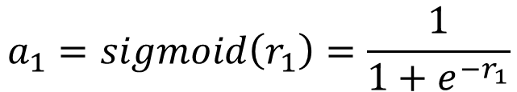





1
+
1
2
+
1
3
+
1

Slide 37










1
+
1
2
+
+
1
1
3
+
+
1

Slide 38





















1
+
1
2
+
+
1
1
3
+
+
1

Slide 39





1
+
1
2
+
+
1
1
3
+
1
+
+

Slide 40




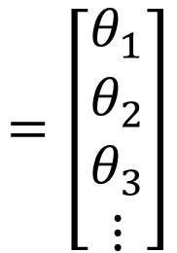

Function with unknown parameters
+
+
feature
……
Unknown parameters

Slide 41


Back to ML Framework
Step 1: function with unknown
Step 2: define loss from training data
Step 3: optimization
+
+

Slide 42




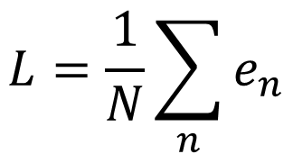
Loss
Loss is a function of parameters
Loss means how good a set of values is.
feature
+
+
label
Given a set of values
Loss:

Slide 43
Back to ML Framework
Step 1: function with unknown
Step 2: define loss from training data
Step 3: optimization
+
+

Slide 44
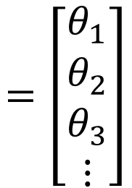






Optimization of New Model
gradient

Slide 45






Optimization of New Model

Slide 46










Optimization of New Model
B
batch
batch
update
N
update
batch
update
batch
1 epoch = see all the batches once

Slide 47
Optimization of New Model
Example 1
10,000 examples (N = 10,000)
Batch size is 10 (B = 10)
B
batch
How many update in 1 epoch?
1,000 updates
batch
N
Example 2
1,000 examples (N = 1,000)
Batch size is 100 (B = 100)
batch
How many update in 1 epoch?
batch
10 updates

Slide 48
Back to ML Framework
Step 1: function with unknown
Step 2: define loss from training data
Step 3: optimization
+
+
More variety of models …

Slide 49





How to represent this function?
Rectified Linear Unit (ReLU)

Slide 50


Activation function
Which one is better?

Slide 51
Back to ML Framework
Step 1: function with unknown
Step 2: define loss from training data
Step 3: optimization
+
+
Even more variety of models …

Slide 52









+
+
1
1
+
+
1
or
1
……
+
+
1
1
+
+

Slide 53
Experimental Results
Loss for multiple hidden layers
100 ReLU for each layer
input features are the no. of views in the past 56 days
 | 1 layer | 2 layer | 3 layer | 4 layer
2017 – 2020 | 0.28k | 0.18k | 0.14k | 0.10k
2021 | 0.43k | 0.39k | 0.38k | 0.44k

Slide 54

Red: real no. of views
blue: estimated no. of views
3 layers
Views
(k)
?
2021/01/01
2021/02/14

Slide 55
Back to ML Framework
Step 1: function with unknown
Step 2: define loss from training data
Step 3: optimization
+
+
It is not fancy enough.
Let’s give it a fancy name!

Slide 56



hidden layer
hidden layer
+
+
1
1
+
+
1
1
……
+
+
Neuron
1
1
Neural Network
This mimics human brains … (???)
Many layers means Deep
Deep Learning

Slide 57



Deep = Many hidden layers
22 layers
19 layers
8 layers
6.7%
7.3%
16.4%
AlexNet (2012)
VGG (2014)
GoogleNet (2014)

Slide 58

Deep = Many hidden layers
119 layers
152 layers
Special
structure
Why we want “Deep” network, not “Fat” network?
3.57%
7.3%
6.7%
16.4%
AlexNet (2012)
VGG
(2014)
GoogleNet
(2014)
Residual Net
(2015)
上海中心大厦2015
Notes:
169層

Slide 59
Why don’t we go deeper?
Loss for multiple hidden layers
100 ReLU for each layer
input features are the no. of views in the past 56 days
 | 1 layer | 2 layer | 3 layer | 4 layer
2017 – 2020 | 0.28k | 0.18k | 0.14k | 0.10k
2021 | 0.43k | 0.39k | 0.38k | 0.44k
Better on training data, worse on unseen data
Overfitting

Slide 60
Let’s predict no. of views today!
If we want to select a model for predicting no. of views today, which one will you use?
 | 1 layer | 2 layer | 3 layer | 4 layer
2017 – 2020 | 0.28k | 0.18k | 0.14k | 0.10k
2021 | 0.43k | 0.39k | 0.38k | 0.44k

Slide 61






Classification as Regression?
通用的多类分类器
Regression
Classification as regression?
Model
Model
class
1 = class 1
similar?
different?
2 = class 2
3 = class 3

Slide 62












Class 1
Class 2
Class 3
Class as
one-hot vector
or
or
+
only output one value
1
+
+
1
1
How to output multiple values?
+
1

Slide 63



Class 1
Class 2
Class 3
Class as
one-hot vector
or
or
+
+
1
1
+
+
1
1
+
+
1
1

Slide 64









Regression
feature
label
+
+
Classification
feature
+
+
label
0 or 1
Make all values between 0 and 1
Can have any value
Notes:
這裡需要想想怎麼解釋比較好

Slide 65








Soft-max
Softmax
How about binary classification? ☺
0.88
3
20
0.12
2.7
1
≈0
-3
0.05
logit
22.75

Slide 66








Loss of Classification
label
Network
softmax
Mean Square Error (MSE)
Cross-entropy
Minimizing cross-entropy is equivalent to maximizing likelihood.

Slide 67














-10 ~ 10
-10 ~ 10
Network
softmax
-1000
Mean Square Error (MSE)
Cross-entropy
large
large
stuck!
small
small
Changing the loss function can change the difficulty of optimization.

