Slide 1
Software Architecture 软件体系结构
Lecture 6. Event-based Software Architecture
基于事件的软件体系结构
Professor: Yushan (Michael) Sun
Fall 2023

Slide 2
Lecture 4. Event-based Software Architecture
Content of the lecture
基于事件系统的概念
事件处理策略
使用观察者模式的设计的例子

Slide 3
Concept of Event-based System
基于事件系统的概念

Slide 4
1. Concept of Event-based System
显式调用. Explicit Invocation:
传统上，在组件能提供子程序和函数集合的系统（如面向对象系统）中，各个组件通常通过显式调用这些子程序来相互交互。
Traditionally, in a system in which the component provides a collection of routines and functions, such as an object-oriented system, components typically interact with each other by explicitly invoking those routines.

Slide 5
1. Concept of Event-based System
显式调用的特点：调用者必须知道被调用者的类名、构造方法（包括参数）与要调用的方法（包括参数）
Explicit invocation: the invoking object must know the name of the class being invoked and the method (including parameters) in the class
Ob2
op1(p1, p2)
Ob1
op3(p1, p2, p3)
op2(p)
Ob3

Slide 6
1. Concept of Event-based System
事件系统使用隐式调用
Event system uses implicit invocation:
在基于事件的系统中，事件将调用某些过程，这些过程将自动运行。
事件系统使用隐式调用。
In an event based system, an event will invoke some procedures and the procedures will run automatically.
Event system uses implicit invocation.

Slide 7
1. Concept of Event-based System
基于事件系统的定义：
Definition of an event-based system:
基于事件的系统是这样一种系统，在这种系统中，过程不会被直接调用（即，间接地或隐式地调用）。An event based system is such a system in which procedures are not invoked directly (that means, indirectly, or implicitly).
What is a procedure （什么是过程）?
A procedure is a module in program design language, with or without parameters.
It is executed by procedural calls. The result will be
assigned to the calling parameter, or to
modify a gloabal variable within this subroutine.

Slide 8
1. Concept of Event-based System
事件广播与处理机制
Event broadcast and processing mechanism:
广播机制. A component can broadcast one or more events.
注册机制. Other components in the system can register an interest in an event
系统调用. Once an event is broadcasted, the system will automaticaly invoke all of the procedures that have registered for the event. (implicitly)
事件发布者可能不负责调用

Slide 9
1. Concept of Event-based System
汽车进口公司的预定与购买系统
Bradcast events
Register for
Honda
B1
buy()
Event space
The method in the object will automatically run once the registered event is triggered
eve= “Honda”
Broadcast events
Register for Honda
B2
buy()
基于事件的系统：事件广播，事件注册，自动调用已注册对象的方法

Slide 10

显式调用与隐式调用的区别
显式调用：
Obj2
op1
想调用谁，就
直接调用谁。
op3
Obj1
Obj3
op2
隐式调用：
1）一个对象广播一个
事件到事件空间
Event
space
2）系统自动调用所有已经
注册了该事件的过程
op1
ev1
op2
Obj1
Obj2
Obj3
op3

Slide 11
1. Concept of Event-based System
Structure of a component (部件结构)
组件的结构：隐式调用风格中的组件是一个模块，其接口同时提供
一个过程集合（C++中的函数、java中的方法）与
一个事件的集合
Components: the components in an implicit invocation style are modules whose interfaces provide both
a collection of procedures (functions in C++, methods in Java) and
a set of events

Slide 12
1. Concept of Event-based System
例：使用事件系统架构设计的股票交易系统部分组件
Pr 1
Et 1
Et 2
Proc1
中石油=15元
Proc2
中石化=10元
Proced 1
Evt1
中国铝业
Proced 2
Evt2
中国航空
Proced 3
Evt 1
event space
Evt 2

Slide 13
1. Concept of Event-based System
Example: Integrated Development Environment
集成开发环境的例子
考虑一个针对C、C++或Java的集成开发环境。
这样的IDE包含如下的工具
编辑器. Editors for source code,
变量监控器. Variable monitors,
调试器. A debugger, etc.
这样的系统可以采用基于事件的架构进行设计

Slide 14
1. Concept of Event-based System
Debugger
调试器
Editor
Variable monitors
编辑器
变量监控器

Slide 15
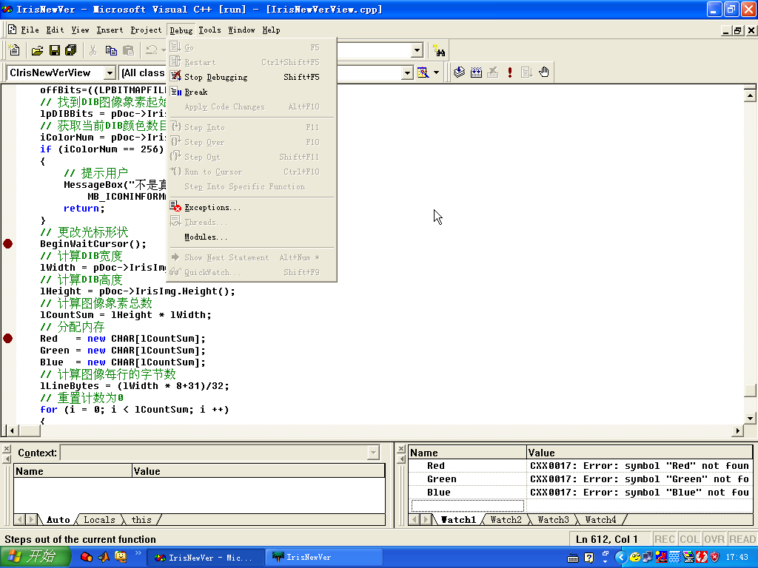

Slide 16
1. Concept of Event-based System
Editors与Variable monitor对象注册Debugger的断点节点事件。
Debugger
Debugger’s
Break-point events
我注册
我注册
Variable monitors
Editor
Legend:
Register event
Send event

Slide 17
1. Concept of Event-based System
当调试器运行到断点处而停止时，它会宣布一个事件，允许系统自动调用那些已注册的工具的过程。
Debugger
运行debugger
广播事件
Hits break-point event
调用
调用
Editor
Variable monitors

Slide 18
1. Concept of Event-based System
这些过程可以
将编辑器滚动到源码的适当的行或
显示监视变量的值。
Debugger
Editor
Variable monitors
注：
调试器仅仅广播了一个事件，但是不知道其它的组件将要做什么。
松耦合
Source file
Bbbbbbbbbbbbbb
Cccccccccccccc
Dddddddddddddd
Eeeeeeeeeeeee
Fffffffffffffffffffffffffffffffff
Gggggggggggggggggg
hhhhhhhhhhhhhhhhhhh
emp=“张虹”
salary=2348
Back

Slide 19
Strategy of Events Handling
事件处理策略

Slide 20
2. Strategy of Events Handling
既然在事件系统中，当一个事件被广播了，系统将自动调用那些已经注册了的组件，那么就有了以下的问题。
问题：怎样将事件发送到已经注册了的组件中呢?
这个问题要分两种情况考虑:
策略1：有独立事件调度模块的系统。Systems with a separate dispatcher module
策略2：无中心事件调度模块的系统。Systems without central dispatcher module

Slide 21
2. Strategy of Events Handling
事件调度模块的责任
What the dispatcher module does?
The dispatcher module is responsible for
接收事件。receiving all incoming events and
分发事件。dispatching them to other modules in the system.

Slide 22
2. Strategy of Events Handling
Strategy 1. Systems with Separate Dispatcher Module (有独立事件调度模块的系统)
分发事件
Dispatcher
调度模块
读取
事件
Event space
事件广播

Slide 23
2. Strategy of Events Handling
而调度模块以两种方式分发事件
Two ways to dispatch events
广播事件给系统的全部模块 The dispatcher may broadcast events to all modules in the system
仅发送事件给那些已经注册了该事件的模块。The dispatcher sends an event just to those modules that registered for that event: Publish/Subscribe strategy (发布/订阅策略)

Slide 24
2. Strategy of Events Handling
方式1：调度模块向全部模块广播事件
The dispatcher may broadcast events to all modules in the system
Dispatcher
调度模块
Module 1
Module 2
Module 3

Slide 25
2. Strategy of Events Handling
方式2：调度模块只向那些注册了该事件的模块发送事件。
publisher
dispatcher
I did not register and so I did not get event
subscriber
subscriber
subscriber
Publish event
2. Publish/Subscribe strategy
Subscribe
Send event

Slide 26
2. Strategy of Events Handling
Strategy 2. 无独立事件调度模块的系统 (Systems without a
central dispatcher module)
listen
Event Space
listen
listen
listen
listen
Observable/Observer modle

Slide 27
2. Strategy of Events Handling
This modle is usually called observable/Observer
每个模块都允许其它模块对其所发送的事件感兴趣
Each module allows other modules to declare interest
in events that it is sending.
只将事件发送给注册者
Whenever a module sends an event it sends that event
to exactly those modules that registered interest in that
event.

Slide 28
2. Strategy of Events Handling
Observable
Observer
Observer
Observer
Observable/Observer modle
(被观察者/观察者模型)
Legend:
Register event
Send event
Back

Slide 29
Design Examples Using the
Observer Pattern
使用观察者模式进行设计的例子
观察者模式可以用于简单的事件系统

Slide 30
Observerble/Observer example
4. Design Examples Using the Observer Pattern
Example: 设计一个机场信息显示系统
机场信息显示系统的责任：接收将要飞离机场与到达机场的航班信息并将这些信息通知给旅客，包括所有到港飞机和离港飞机的准时、延误等信息。
初步设计三个类，
InforCenter类: 收集所有的航班信息
VoiceInfo类: 广播所有的航班信息给所有的旅客
WordInfo类: 以文字的形式将所有的航班信息显示在屏幕上

Slide 31
4. Design Examples Using the Observer Pattern
可理解该系统为一个事件系统(航班准时，延迟是事件)，设计如下：
<<interface>>
Observable
<<interface>>
Observer
notifies
+notifyObservers()
+register(obs: Observer)
+unRegister(obs:Observer)
1 1..*
+update( Observable subject, Object arg)
VoiceInfo
WordInfo
InfoCenter
+update(s, arg)
+update(s, arg)
+notifyObservers()
+register(obs: Observer)
+unRegister(obs:Observer)
+getFlightInfo()
1 1..*
1 1..*
利用观察者模式设计的机场信息发布系统

Slide 32
4. Design Examples Using the Observer Pattern
观察者模式可以被用来设计与实现比较简单的事件系统
观察者模式可以被认为是Observable/Observer 模型（无事件空间；事件空间由Observables产生）

Slide 33
Observable c = InfoCenter()
Observer v = new VoiceInfo();
Observer w = new WordInfo();
c.register(v);
c.register(w);
Client
<<interface>>
Observable
<<interface>>
Observer
+update(Observable subject, Object arg)
register(obs: Observer)
unRegister(obs:Observer)
notifyObservers()
VoiceInfo
WordInfo
c(主题), arg(事件)
c(主题), arg(事件)
InfoCenter
update( c，arg)
update( c, arg)
v (观察者对象)
w (观察者对象)
传入c, arg
利用c调用
利用c调用
getState()
notifyObservers()
register(obs: Observer)
unRegister(obs:Observer)
传入c, arg
利用观察者模式设计的机场信息发布系统的典型交互

Slide 34
4. Design Examples Using the Observer Pattern
Design highlights: Two interfaces
Observable
Observer
claimed some proper methods.
In InfoCenter, you need to implement all the methods:
notifyObservers()
register(obs: Observer)
unRegister(obs:Observer)
In VoiceInfo and WordInfo, you need to implement the method:
update(Observable subject, Object arg)
Back

