Slide 1
Software Architecture
Lecture 4-2. Dataflow Systems
Pipes and Filters Architecture
管道过滤器架构
Professor:
Yushan (Michael) Sun
Fall 2023

Slide 2
本讲内容
Concept of Pipes-and-filters architecture
Example programs designed in pipes and filters architecture
Unix support for pipes and filters architecture
Comparison of batch sequential architecture and pipes and filters architecture
管道-过滤器架构的优缺点

Slide 3
Concept of Pipes and Filters architecture
管道-过滤器架构

Slide 4
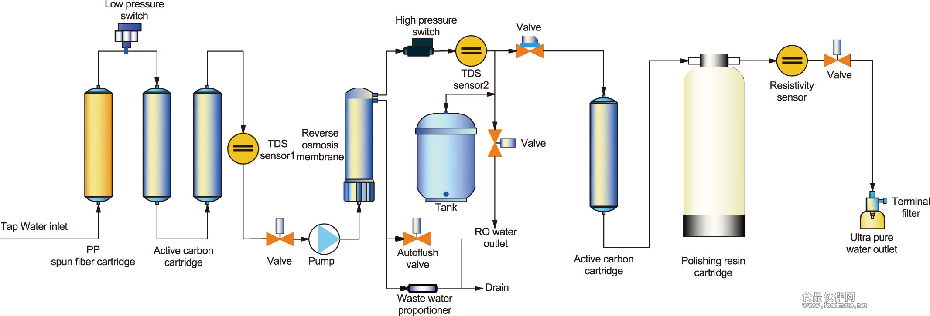
管道-过滤器软件体系结构 (Pipes and Filters architecture)
聚丙烯跨度纤维过滤器
活性炭
过滤器
反渗
透膜
活性炭
过滤器
树脂
载体
纯净水生产流程图：每个过滤器都有其特定的功能

Slide 5
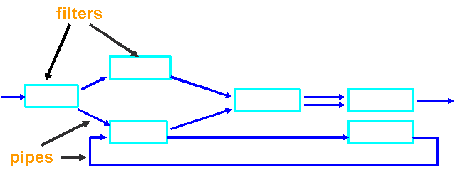
Pipes and Filters architecture
管道-过滤器软件体系结构的定义：
Pipes and filters architecture is composed of filters to do data processing and pipes that carry data from one filter to the next filter.
Processing step
此架构适合流数据的处理，e.g.,宇宙飞船传回的数据
Data stream
Pipes and filters architecture

Slide 6
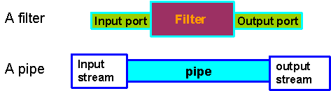
Pipes and Filters architecture
A program
Process data
transmit data
filter structure and pipe structure

Slide 7
Pipes and Filters architecture
过滤器的功能(Functionalities of Filters):
Incrementally transform some of the source data into sink data
添加信息. Enrich data by computing and adding information
变换数据. Transform data by changing representation
流对流变换. Stream to stream transformation
不保留状态. Preserve no state between instantiations (forget what has happened)

Slide 8
Pipes and Filters architecture
管道的功能(Functionalities of a Pipe):
move data from a filter’s output to a filter’s input
单向流. One way flow
数据传输图. Pipes form data transmission graph

Slide 9
Pipes and Filters architecture
整体运行机制(Overall operations)
运行管道与过滤器，一直到没有任何计算Run pipes and filters until no more computations are possible
数据搬运是中介，Action is mediated by data delivery
Return

Slide 10
Example programs designed in
pipes and filters architecture

Slide 11
Pipes and Filters architecture
例1. 千年虫与国名问题 (Year 2000 problem and Country name)
In a text file,
change all year expressions “xx” into “19xx”, e.g., “89” into “1989”, and
change all expressions “Holland” into “Netherlands”
legacy.txt
Input
Y2K
Country
name
Output
new.txt
Legacy file update system designed using Pipes and filters architecture

Slide 12
Pipes and Filters architecture
legacy.txt
Input
Y2K
Country
name
Output
new.txt
After Input: Television $3800 Holland 95-12-11
After Y2K: Television $3800 Holland 1995-12-11
After Country name: Television $3800 Netherlands 1995-12-11
After Output: Television Netherlands $3800 China 1995-12-11
数据以数据流的方式从左端流入，流经各个过滤器，对数据进行处理；对于处理完的数据，立即写入到下游管道.

Slide 13
Pipes and Filters architecture
例2: 编译器(Compiler example)
A typical architecture of a compiler example is pipes
and filters architecture describing in the next page.

Slide 14
Pipes and Filters architecture
ASCII program text
Lexical Analysis
进行词法分析
Scanner
token stream
Syntax Analysis
进行语法分析
Parser
abstract syntax tree
Semantic Analysis
进行语义分析
Semantic checker
augmented abstract syntax tree
生成字节码
Byte code generator
program running on virtual machine
优化字节码
Byte code optimizer
Virtual machine
生成机器代码
Machine code generator
machine instructions of
a specific processor

Slide 15
Pipes and Filters architecture
Functionalities of each filter
Scanner: Lexical Analysis （词法分析）
Misspellings: such as “String” into “Sting”
Parser: Syntax Analysis （语法分析）
Omission, wrong order of tokens
Semantic checker: Semantic Analysis （语义分析）
Incompatible types: e.g., “float”, “double”
Byte code generator (字节代码生成器) : byte code generation:
C/C++ compiler: from source code to assembly code
Java compiler: from Java code to bytecode。
Java跨平台其实就是基于相同的bytecode规范做不同平台的虚拟机，我们的Java程序编译成bytecode后就可以在不同平台跑了。
Byte code optimizer: optimizing byte code
Machine code generator: generating machine code
Return

Slide 16
Unix support for
pipes and filters architecture

Slide 17
Pipes and Filters architecture
例3. 在Unix环境下怎样搭建、实现管道-过滤器架构
Example 4. 如下的Unix命令组成一个管道/过滤器程序，将in.txt文件
的包含“Heroin”的行进行排序，然后将结果输出到out.txt文件中。
命令行：
cat in.txt | grep “Heroin” | sort > out.txt
Cat: 将指定的文件按照标准输出到显示器
Grep: 在本文档
中查找字符串
Sort:
将文档内容排序

Slide 18
Pipes and Filters architecture
以上命令行的管道/过滤器结构图如下。
in.txt
Cat
Grep
Sort
out.txt
Grep负责在文件in.txt中搜索包含
表达式“Heroin”的所有的行，
并且将它们输出到下游管道。
将上游管道来的
行进行排序，以后
写到out.txt中

Slide 19
Pipes and Filters architecture
带有分支的管道-过滤器架构
The pipes and filters pattern allows filters with multiple input and/or multiple output pipes to be connected in any directed graph (有向图) structure.
In the UNIX system, the tee filter provides a mechanism to split a stream into two streams

Slide 20
Pipes and Filters architecture
例4. 在Unix下搭建分支的管道-过滤器架构
Task: 打印在一篇txt文档中出现过两次与两次以上的文字（需要排序）
以下4个命令行即可实现以上程序。
mknod pipeA p
mknod pipeB p
sort pipeA > pipeB &
cat file1 | tee pipeA | sort -u | comm -13 - pipeB > file2
Tee: 读取标准输入的数据，并将其内容输出成几个文件。
comm命令可以用于两个文件之间的比较。前提：两个文件必须有序。

Slide 21
Pipes and Filters architecture
以上命令行的管道/过滤器结构图如下。
pipeA
pipeB
Sort
file1
cat
tee
file2
Sort
comm
分叉
合并
最后将在file1中出现过2次或者更多次的文字打印出来
Return

Slide 22
批处理架构与管道-过滤器架构的比较

Slide 23
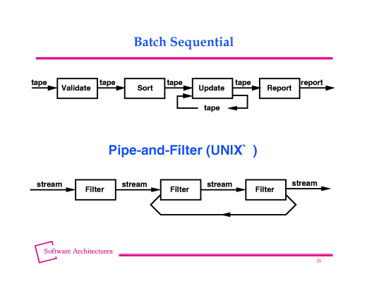
Pipes and Filters architecture
Comparison between batch sequential architecture
and pipes-and-filters architecture

Slide 24
Pipes and Filters architecture
相似之处：处理过程之间互不调用 (independent processing
modules)
区别1： 数据处理方式不同:
批处理架构，数据以 块状 形式传输,
管道-过滤器架构，数据以 流 的形式传输
区别 2：所处理的数据量不同 :
批处理架构，数据量是有限的
管道-过滤器架构，数据量是无限的
Return

Slide 25
管道-过滤器架构的优缺点

Slide 26
管道-过滤器架构的优点(Advantages):
复用(reuse)性好: It supports reuse, since each filter can function in isolation
容易扩展(Easy evolution): New functions are easily added to the system by inserting filters at the appropriate points in the processing sequence.
容易修改(Easy modification): it’s easy to modify the system since filters are logically independent of other filters.

Slide 27
管道-过滤器架构的缺点(Disadvantages):
人-机交互差 (Poor Interaction)
纯粹的管道-过滤器架构设计的软件没有人-机交互；但是在实际应用中，可以改善此架构，例如，对于每个过滤器，都可以增加一个用户图像界面
浪费内存 (Waste of space):
由于每个过滤器必须不断地将数据(流)从输入端口复制到其输出端口，因此对于内存空间使用空间效率低下。
Return

