Slide 1
Synchronization Constructs
Rong Chen
Institute of Parallel and Distributed Systems
Shanghai Jiao Tong University
http://ipads.se.sjtu.edu.cn/rong_chen
Some slides adjusted from. Elsa L Gunter (UIUC), Jonathan Walpole (PSU)
Paul McKenney (IBM) Tom Hart (University of Toronto)

Slide 2
Outline
Recap
MCS Lock
Read-write Lock
Lock-free coordination

Slide 3
Recap: What is scalability?
Application does N times as much work on N cores as it could on 1 core
Scalability may be limited by Amdahl's Law:
Locks, shared data structures, ... Shared hardware (DRAM, NIC, ...)

Slide 4
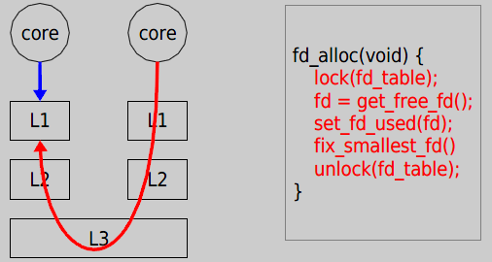
Recap: Why throughput drops?
Now it takes 121 cycles!

Slide 5
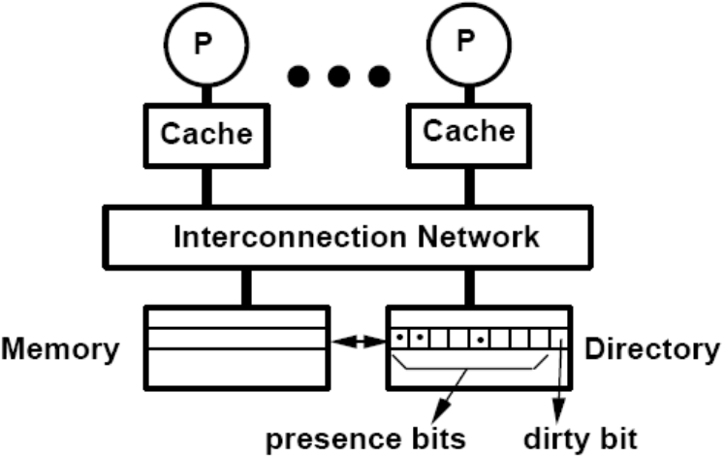
Recap: Directory-based cache coherence
Load
Read response
Shared

Slide 6
Recap: Allocate a ticket read current ticket and spin

Slide 7
General idea of MCS lock
mcs_lock
NULL

Slide 8
General idea of MCS lock
Use compare and swap to change
mcs_lock point to self node
Check previous node
NULL in this case, no need to wait
mcs_lock
waiting: 0
next: NULL

Slide 9
General idea of MCS lock
mcs_lock
Previous node is not NULL
Current waiting is 1
Wait until lock holder
set waiting to 0
waiting: 0
next:
waiting: 1
next: NULL

Slide 10
General idea of MCS lock
mcs_lock
Previous node is not NULL
Current waiting is 1
Wait until lock holder
set waiting to 0
waiting: 0
next:
waiting: 0
next: NULL

Slide 11
General idea of MCS lock
mcs_lock
Previous node is not NULL
Current waiting is 1
Wait until lock holder
set waiting to 0
waiting: 0
next: NULL

Slide 12
Using scalable locks: FOPS

Slide 13
Synchronization Constructs
Read-write Lock
Lock-free

Slide 14
Reader-writer Lock

Slide 15
Motivating Example: Calendar
Goal: online calendar for a class
Lots of people may read it at the same time
Only one person updates it (Prof, TAs)
Shared data
map<date, listOfEvents> EventMap
listOfEvents GetEvents(date)
AddEvent(data, newEvent)

Slide 16
Basic Code – Single Threaded
GetEvents(date) {
List events = EventMap.find(date).copy();
return events;
}
AddEvent(data, newEvent) {
EventMap.find(date) += newEvent;
}

Slide 17
Inefficient Multi-threaded code
GetEvents(date) {
lock(mapLock);
List events = EventMap.find(date).copy();
unlock(mapLock);
return events;
}
AddEvent(data, newEvent) {
lock(mapLock);
EventMap.find(date) += newEvent;
unlock(mapLock);
}

Slide 18
How to do with reader – writer locks?
GetEvents(date) {
List events = EventMap.find(date).copy();
return events;
}
AddEvent(data, newEvent) {
EventMap.find(date) += newEvent;
}

Slide 19
Reader – Writer Locks
Problem definition:
Shared data that will be read and written by multiple threads
Allow multiple readers to access shared data when no threads are writing data
A thread can write shared data only when no other thread is reading or writing the shared data

Slide 20
Interface
readerStart()
readerFinish()
writerStart()
writerFinish()
Many threads can be in between a readStart and readerFinish
Only one thread can be between writerStart and writierFinish

Slide 21
How to do with reader – writer locks?
GetEvents(date) {
readerStart(maRWLock);
List events = EventMap.find(date).copy();
readerFinish(mapRWLock);
return events;
}
AddEvent(data, newEvent) {
writerStart(maRWLock);
EventMap.find(date) += newEvent;
writerFinish(mapRWLock);
}

Slide 22
Additional Layer of Synchronization
Concurrent programs
Even higher-level synchronization
High-level synchronization provided by software
Low-level atomic operations provided by hardware

Slide 23
Reader – Writer Locks using Monitors
Note: Implement Reader/Writer Locks as an abstractions, not as an integrated part of code
Central Questions:
Shared Data?
Ordering Constraints?
How many Condition Variables?

Slide 24
Reader – Writer Locks using Monitors
Note: Implement Reader/Writer Locks as an abstractions, not as an integrated part of code
Central Questions:
Shared Data? NumReaders, NumWriters
Ordering Constraints?
How many Condition Variables?

Slide 25
Reader – Writer Locks using Monitors
Note: Implement Reader/Writer Locks as an abstractions, not as an integrated part of code
Central Questions:
Shared Data? NumReaders, NumWriters
Ordering Constraints?
readerStart must wait if there are writers
writerStart must wait if there are readers or writes
How many Condition Variables?

Slide 26
Reader – Writer Locks using Monitors
Note: Implement Reader/Writer Locks as an abstractions, not as an integrated part of code
Central Questions:
Shared Data? NumReaders, NumWriters
Ordering Constraints?
readerStart must wait if there are writers
writerStart must wait if there are readers or writes
How many Condition Variables?
One: condRW (no readers or writers)

Slide 27
Basic Implementation
readerStart() {
}
readerFinish() {
}

Slide 28
Basic Implementation
readerStart() {
lock(lockRW);
while(numWriters > 0){
wait(lockRW, condRW);
};
numReaders++;
unlock(lockRW);
}
readerFinish() {
lock(lockRW);
numReaders--;
broadcast(lockRW, condWR);
unlock(lockRW);
}

Slide 29
Basic Implementation
writerStart() {
lock(lockRW);
while(numReaders > 0||
numWriters >0){
wait(lockRW, condRW);
};
numWriters++;
unlock(lockRW);
}
writerFinish() {
lock(lockRW);
numWriters--;
broadcast(lockRW, condWR);
unlock(lockRW);
}

Slide 30
Better Implementation
readerStart() {
lock(lockRW);
while(numWriters > 0){
wait(lockRW, condRW);
};
numReaders++;
unlock(lockRW);
}
readerFinish() {
lock(lockRW);
numReaders--.
if(numReaders == 0){
signal(lockRW, condWR);
};
unlock(lockRW);
}

Slide 31
Scalability of reader/writer locking
CPU 0
critical
section
read-acquire
memory barrier
lock
read-acquire
memory barrier
read-acquire
memory barrier
critical
section
CPU 1
Reader/writer locking does not scale due to critical
section efficiency!

Slide 32
Reader/writer spin locks (rwlock) in Linux
rwlock_t mr_rwlock = RW_LOCK_UNLOCKED;
read_lock(&mr_rwlock);
/* critical section (read only) ... */
read_unlock(&mr_rwlock);
write_lock(&mr_rwlock);
/* critical section (read and write) ... */
write_unlock(&mr_rwlock);

Slide 33
Scalability of rwlock?
Reading
Counter -> #readers
Writing
Counter = -1
W
Counter = 0
Counter = 1
Counter = 2
R
R
R
R
R
R

Slide 34
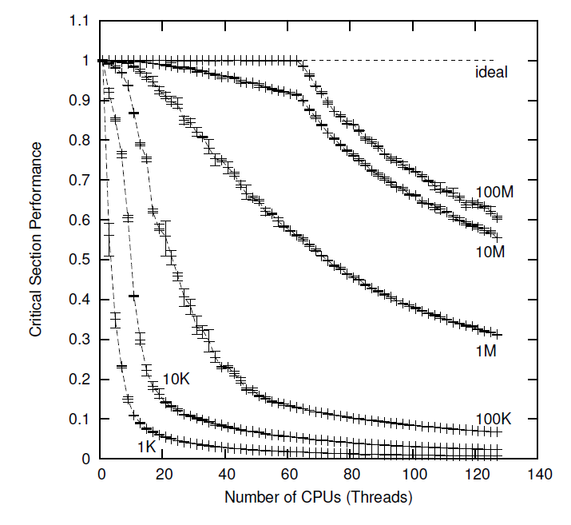
Traditional RW lock performance

Slide 35
Problem
Reader Lock Acquisition
add_and_fetch(&counter)
Need to wait for message (current #reader)
Need to send message (next reader)
Acquisition serialized by messages!!
Occupies a great deal of message bandwidth!!

Slide 36
Solutions
Idea 1
Reduce time to wait for message (GOLL)
Idea 2
Reduce #message (BR lock)

Slide 37
GOLL
Reduce time to wait for message
W
0
1
1
0
2
0
R
R
R
R
R
R
Waiting domain is split into pieces
Reduce #remote messages

Slide 38
BR lock
Reduce #message
W
R
R
R
R
No reader messages if there’s no writer

Slide 39
RCU Synchronization

Slide 40
Overview of the basic idea
Writers create new versions
Using locking or NBS to synchronize with each other
Register call-backs to destroy old versions when safe
call_rcu() primitive registers a call back with a reclaimer
Call-backs are deferred and memory reclaimed in batches
Readers do not use synchronization
While they hold a reference to a version it will not be destroyed
Completion of read-side critical sections is “inferred” by the reclaimer from observation of quiescent states

Slide 41
RCU Overview
Publish-Subscribe
insertion
reader-writer synchronization
Wait for pre-existing readers to complete
deletion
change – wait for readers – free
safe memory reclamation
Maintain multiple versions of update objects
for readers

Slide 42






RCU – List Update– Basic Strategy
Starting List
New Node
Copy B to B’ and Modify
Move A.Next to B’
B still visible, but not for new readers
Readers complete, remove B
RCU Semantics: A First Attempt
McKenney & Walpole

Slide 43
Quiescent states and grace periods
Example quiescent states
Context switch (non-preemptive kernels)
Voluntary context switch (preemptive kernels)
Kernel entry/exit
Blocking call
Grace periods
A period during which every CPU has gone through a quiescent state

Slide 44
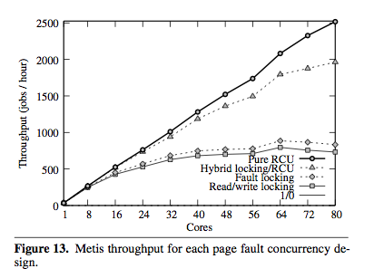
Read-Copy Update Performance

Slide 45
Lock-free Synchronization

Slide 46
Optimistic synchronization
Use lock-free, “optimistic” synchronization
Execute the critical section unconstrained, and check at the end to see if you were the only one
If so, continue. If not roll back and retry
Synthesis uses no locks at all!

Slide 47
Locking is pessimistic
Murphy's law: “If it can go wrong, it will...”
In concurrent programming:
“If we can have a race condition, we will...”
“If another thread could mess us up, it will...”
Solution:
Hide the resources behind locked doors
Make everyone wait until we're done
That is...if there was anyone at all
We pay the same cost either way
Notes:
凡是可能出錯的事必定會出錯

Slide 48
Optimistic synchronization
The common case is often little or no contention
Or at least it should be!
Do we really need to shut out the whole world?
Why not proceed optimistically and only incur cost if we encounter contention?
If there's little contention, there's no starvation
So we don’t need to be “wait-free” which guarantees no starvation
Lock-free is easier and cheaper than wait-free
Small critical sections really help performance

Slide 49
How does it work?
Copy
Write down any state we need in order to retry
Do the work
Perform the computation
Atomically “test and commit” or retry
Compare saved assumptions with the actual state of the world
If different, undo work, and start over with new state
If preconditions still hold, commit the results and continue
This is where the work becomes visible to the world (ideally)

Slide 50
Example – stack pop
Pop() {
retry:
old_SP = SP;
new_SP = old_SP + 1;
elem = *old_SP;
if (CAS(old_SP, new_SP, &SP) == FAIL)
goto retry;
return elem;
}

Slide 51
Example – stack pop
Pop() {
retry:
old_SP = SP;
new_SP = old_SP + 1;
elem = *old_SP;
if (CAS(old_SP, new_SP, &SP) == FAIL)
goto retry;
return elem;
}
loop

Slide 52
Example – stack pop
Pop() {
retry:
old_SP = SP;
new_SP = old_SP + 1;
elem = *old_SP;
if (CAS(old_SP, new_SP, &SP) == FAIL)
goto retry;
return elem;
}
Global - may change any time!
Locals -
won’t change!
“Atomic”
read-modify-write
instruction

Slide 53
CAS
CAS – single word Compare and Swap
An atomic read-modify-write instruction
Semantics of the single atomic instruction are:
CAS(copy, update, mem_addr)
{
if (*mem_addr == copy) {
*mem_addr = update;
return SUCCESS;
} else
return FAIL;
}

Slide 54
Example – stack pop
Pop() {
retry:
old_SP = SP;
new_SP = old_SP + 1;
elem = *old_SP;
if (CAS(old_SP, new_SP, &SP) == FAIL)
goto retry;
return elem;
}
Copy
global
to local

Slide 55
Example – stack pop
Pop() {
retry:
old_SP = SP;
new_SP = old_SP + 1;
elem = *old_SP;
if (CAS(old_SP, new_SP, &SP) == FAIL)
goto retry;
return elem;
}
Do Work

Slide 56
Example – stack pop
Pop() {
retry:
old_SP = SP;
new_SP = old_SP + 1;
elem = *old_SP;
if (CAS(old_SP, new_SP, &SP) == FAIL)
goto retry;
return elem;
}
Test

Slide 57
Example – stack pop
Pop() {
retry:
old_SP = SP;
new_SP = old_SP + 1;
elem = *old_SP;
if (CAS(old_SP, new_SP, &SP) == FAIL)
goto retry;
return elem;
}
Copy
Do Work
Test

Slide 58
What made it work?
It works because we can atomically commit the new stack pointer value and compare the old stack pointer with the one at commit time
This allows us to verify no other thread has accessed the stack concurrently with our operation
i.e. since we took the copy
Well, at least we know the address in the stack pointer is the same as it was when we started
Does this guarantee there was no concurrent activity?
Does it matter?
We have to be careful !

Slide 59
Stack push
Push(elem) {
retry:
old_SP = SP;
new_SP = old_SP – 1;
old_val = *new_SP;
if(CAS2(old_SP, old_val, new_SP, elem, &SP, new_SP)
== FAIL)‏ goto retry;
}

Slide 60
Stack push
Push(elem) {
retry:
old_SP = SP;
new_SP = old_SP – 1;
old_val = *new_SP;
if(CAS2(old_SP, old_val, new_SP, elem, &SP, new_SP)
== FAIL)‏ goto retry;
}
Copy

Slide 61
Stack push
Push(elem) {
retry:
old_SP = SP;
new_SP = old_SP – 1;
old_val = *new_SP;
if(CAS2(old_SP, old_val, new_SP, elem, &SP, new_SP)
== FAIL)‏ goto retry;
}
Do Work

Slide 62
Stack push
Push(elem) {
retry:
old_SP = SP;
new_SP = old_SP – 1;
old_val = *new_SP;
if(CAS2(old_SP, old_val, new_SP, elem, &SP, new_SP)
== FAIL)‏ goto retry;
}
Test and
commit

Slide 63
Stack push
Push(elem) {
retry:
old_SP = SP;
new_SP = old_SP – 1;
old_val = *new_SP;
if(CAS2(old_SP, old_val, new_SP, elem, &SP, new_SP)
== FAIL)‏ goto retry;
}
Compare
Unnecessary
Note: this is a double compare and swap!
Its needed to atomically update both the
new item and the new stack pointer

Slide 64
Thanks
Next class
Concurrency bugs, race detection

