Slide 1
Data Race & DeadLock
Rong Chen

Slide 2
Outline
Happens-before Race Detection
Lockset-Based Race Detection
Deadlocks
Detecting deadlocks using Lockset Analysis

Slide 3
Data Race Detection

Slide 4

What is Race?

Slide 5
Data Race
An undesirable situation that occurs when a device or system attempts to perform two or more operations at the same time, but the operations must be done in the proper sequence in order to be done correctly
multithread
distributed Programs
Key reason
separate processes or threads of execution depends on same shared state

Slide 6
Data Race
v = 0
[thread-1]
v += 1;
[thread-2]
v += 1;
v = ?

Slide 7
Data Race
v = 0 (memory)
T1 reads 0 to %reg
T1 increments %reg to 1
T1 stores %reg to v (v = 1)
T2 reads 1 to %reg
T2 increments %reg to 2
T2 stores %reg to v (v = 2)
v = 2; (memory)
v = 0
[thread-1]
%reg = v;
%reg++;
v = %reg;
[thread-2]
%reg = v;
%reg++;
v = %reg;
v = ?

Slide 8
Data Race
v = 0 (memory)
T1 reads 0 to %reg
T2 reads 0 to %reg
T1 increments %reg to 1
T2 increments %reg to 1
T1 stores %reg to v (v = 1)
T2 stores %reg to v (v = 1)
v = 1; (memory)
v = 0
[thread-1]
%reg = v;
%reg++;
v = %reg;
[thread-2]
%reg = v;
%reg++;
v = %reg;
v = ?

Slide 9
Data Race
The definition of data race:
1.two concurrent threads access a shared variable
2.at least one access is a write
3.the threads use no explicit mechanism to prevent the accesses from being simultaneous.

Slide 10
Remove Race Condition
Critical Sections
v = 0
[thread-1]
%reg = v;
%reg++;
v = %reg;
[thread-2]
%reg = v;
%reg++;
v = %reg;
v = ?

Slide 11
Remove Race Condition
Mutually-exclusive
lock & unlock
cli & sti
v = 0
[thread-1]
lock(mu)
%reg = v;
%reg++;
v = %reg;
unlock(mu)
[thread-2]
lock(mu)
%reg = v;
%reg++;
v = %reg;
unlock(mu)
v = 2

Slide 12
Data Race Bug
Thread-1
OpenInputStream()
{
PostEvent();
...
m_inputStream = ...
...
}
file: nsSocketTransport.cc
Thread-2
ProcessCurrentURL()
{
WaitEvent();
...
if (m_inputStream){
AsyncRead(m_inputStream);
}
...
}
file: nsImapProtocol.cpp
*Data race bug in Mozilla

Slide 13
Data Race Detectors
Two major categories:
Happens-before based
Lockset based

Slide 14
Happens-before Based

Slide 15

Happens-before Relation
The happens-before relation is a means of ordering events based on the causal relationship of pairs of events in a concurrent system
denoted:
Formulated by Leslie Lamport
strict partial order on events
without using physical clocks
*Times, Clocks, and Ordering of Events in a Distributed System

Slide 16
Rules in HB Relation
For the events A and B,
HB1: On the same sequential thread, A B if A executes before B.
HB2: On the different threads, A B if there is a synchronization that dictates A precedes B.
HB3: If A B and B C then A C
SAME Thread
DIFF Threads
R
R
execution order
W
synchronization dictates
W

Slide 17
HB based Detectors
The definition of data race:
1.a pair of accesses to the same memory location
2.at least one access is a write
3.neither one happens-before the other

Slide 18

Example
v = 0
[thread-1]
%reg = v;
%reg++;
v = %reg;
[thread-2]
%reg = v;
%reg++;
v = %reg;
without HB relation !!
v = ?

Slide 19
Example
v = 0
without HB relation !!
[thread-1]
%reg = v;
%reg++;
v = %reg;
[thread-2]
%reg = v;
%reg++;
v = %reg;
v = ?

Slide 20
Example
v = 0
[thread-1]
lock(mu)
%reg = v;
%reg++;
v = %reg;
unlock(mu)
[thread-2]
lock(mu)
%reg = v;
%reg++;
v = %reg;
unlock(mu)
HB relation !
v = 2

Slide 21
Pros and Cons
Pros:
Detect true data race
Cons:
Difficult to implement efficiently
Each thread, shared-memory location, and concurrent access
Depend on the interleaving produced by the scheduler
Miss data race

Slide 22
Lockset Based

Slide 23
Lock
The definition of lock:
1.a synchronization object used for mutual exclusion
2.a lock is either available or owned by a thread.
3.the operations on a lock m are lock(m) and unlock(m)

Slide 24
Lockset based Detectors
The definition of data race:
1.a pair of accesses to the same memory location
2.at least one access is a write
3.No lock protects all accesses to the same data

Slide 25
Lockset
Locking Discipline
A programming policy that ensures the absence of data races
e.g. “every variable shared between threads is protected by a mutual exclusion lock”
Principle
Check all shared memory accesses follow a consistent lock discipline
monitors all reads and writes, and infer the protection relation from the execution history

Slide 26
Algorithm of Lockset
The summary:
1.Let locks_held(t) be the set of locks held by thread t
2.For each v, initialize C(v) to the set of all locks
3.On each access to v by thread t, set C(v):= C(v) ∩ locks_held(t) if C(v)={ }, then issue a warning

Slide 27
Example
Programs locks_held(t) C(v) .
{ }
{mu1}
{mu1, mu2}
{mu1}
{}
{mu2}
{mu1, mu2}
{mu1, mu2}
{mu1}
{}
lock(mu1);
lock(mu2);
v = v + 1;
unlock(mu2);
v = v + 2;
unlock(mu1);
lock(mu2);
v = v + 1;
unlock(mu2);
Warning!!

Slide 28
Three Challenges
#1 Initialization
Shared variables are frequently initialized without holding a lock
#2 Read-only Shared Variable
write once and read all the time without lock
#3 Read-Write Lock

Slide 29
Solution to #1 and #2
Delay the refinement until the shared variable has been initialized
No easy way to know when initialization is done
Heuristic way: the first time to be accessed by the 2nd thread

Slide 30
Solution to #1 and #2
1.
Virgin
1.
the variable is NEW and has not yet been referenced by any thread.
read or write
by 1st thread
2.
3.
Exclusive
2.
the variable has been accessed by ONE thread only. Not update C(v)
C(v) is updated, but data races are NOT reported even if C(v) is empty.
read by new thread
write by new thread
4.
Shared
Shared- Modified
3.
write
4.
C(v) is updated, and data races are reported if C(v) is empty.
read or write
read

Slide 31
Solution to #3
Modify the algorithm:
1.Let locks_held(t) and write_locks_held(t) be the set of locks held in any mode and write mode by thread t
2.For each v, initialize Cr(v) and Cw(v) to the set of all locks
3.On each read to v by thread t, set Cr(v):= Cr(v) ∩ locks_held(t) if Cr(v)={ }, then issue a warning
4.On each write to v by thread t, set Cw(v):= Cw(v) ∩ write_locks_held(t) if Cw(v)={ }, then issue a warning

Slide 32
Pros and Cons
Pros:
More efficient way to detect data race
Predict data race that have not manifest
Cons:
Exists report false positive
Memory reuse
Limits the synchronization method to lock

Slide 33
Deadlock

Slide 34


What is a deadlock
This guy has no experience!!!
How can I get experiences without a job!!!

Slide 35
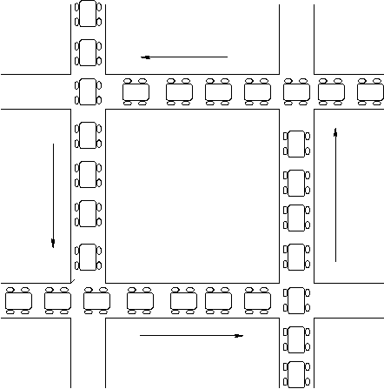
Deadlock Definition
A set of processes is deadlocked when
every process in the set is waiting for an event that can only be generated by some process in the set
Notes:
In the definition of deadlock we assume the set of processes contains at least two processes.
— A single process can deadlock itself, however, this is most likely a programmer error and there is little that the OS can do here.
Contrast deadlock with starvation (in the context of scheduling):
— When processes are deadlocked they are all in the waiting state.
— When a process is being starved it is continually in the ready state.
— Moreover, unlike deadlock, it is possible for a starved process to make the transition to the running state. It’s just that entities in the system are conspiring to ensure that this transition never occurs.
— When processes deadlock, it is a provable certainty that a state transition can never occur.

Slide 36
Deadlock
Circular waiting for resources
Thread A owns Res 1 and is waiting for Res 2 Thread B owns Res 2 and is waiting for Res 1
Thread
A
Wait
For
Owned
By
Res 1
Res 2
Owned
By
Wait
For
Thread
B

Slide 37
Four requirements for Deadlock
Mutual exclusion
Only one thread at a time can use a resource.
Hold and wait
Thread holding at least one resource is waiting to acquire additional resources held by other threads
No preemption
Resources are released only voluntarily by the thread holding the resource, after thread is finished with it
Circular wait
There exists a set {T1, …, Tn} of waiting threads
T1 is waiting for a resource that is held by T2
T2 is waiting for a resource that is held by T3
…
Tn is waiting for a resource that is held by T1

Slide 38
A Graph Theoretic Model of Deadlock
Basic components of any resource allocation problem
Processes and resources
Model the state of a computer system as a directed graph (called resource allocation graph, or RAG)
G = (V, E)
P_{i}
R_{j}
V = the set of vertices =
{P₁, ..., P_{n}} ∪ {R₁, ..., R_{m}}
E = the set of edges = {edges from a resource to a process} ∪ {edges from a process to a resource}
process
resource
(with 3 instances)
request
edge
allocation
edge
P_{i}
P_{k}
R_{j}
Notes:
For allocation edges, the edge is from a resource node (and not from an instance of the resource), to a process node.
— Resource instances are not nodes. They are an annotation.

Slide 39
Resource Allocation Graphs Example
A PostScript interpreter that is waiting for the frame buffer lock and a visualization process that is waiting for memory
V = {PS interpret, visualization} ∪ {memory frames, frame buffer lock}
Visualization
Process
Memory Frames
PostScript
Interpreter
Frame Buffer
Notes:
Are these serially reusable or consumable resources?
— Serially reusable! There are reused serially by processes.
How do you read this graph?
— 3 memory frames are allocated to the PostScript interpreter.
— The frame buffer is allocated to the visualization process.
— The visualization process is requesting memory.
— The PostScript interpreter is requesting the frame buffer.
This system is deadlocked.
— A set of processes are waiting for an event that can only be generated by another process in the set.
— But note that not all the processes are waiting for the same event. (There are several events (2 in this case) that can undeadlock the system.)

Slide 40
Resource Allocation Graphs & Deadlock
Theorem: If a resource allocation graph does not contain a cycle then no processes are deadlocked
A cycle in a RAG is a necessary condition for deadlock
Is the existence of a cycle a sufficient condition?
Game
Memory Frames
Visualization
Process
PostScript
Interpreter
Frame Buffer
Notes:
This Theorem says that a cycle in a resource allocation graph is a necessary condition for deadlock to occur.
In this example, these processes are not deadlocked.
— The memory request can be satisfied.
— Thus a cycle is not a sufficient condition for deadlock.

Slide 41
Single Resource RAG & Deadlocks
Theorem: If there is only a single unit of all resources then a set of processes are deadlocked iff there is a cycle in the resource allocation graph
Memory Frames
Visualization
Process
PostScript
Interpreter
Frame Buffer
Notes:
For the special case of single-unit resources, a cycle is a necessary and sufficient condition for deadlock.

Slide 42
An operational definition of deadlock
A set of processes are deadlocked iff the following conditions hold simultaneously
Mutual exclusion is required for resource usage
A process is in a “hold-and-wait” state
Preemption of resource usage is not allowed
Circular waiting exists (a cycle exists in the RAG)
Visualization
Process
Memory Frames
PostScript
Interpreter
Frame Buffer
Notes:
The precise conditions for deadlock can be expressed in terms of a graph (cliques and knots).
— For our purposes we’ll use a more operational definition of deadlock.
Note that circular waiting does not imply hold-and-wait (that is, we need both conditions).
— Circular waiting does not imply that any resources have actually been allocated (that any process actually holds a resource).

Slide 43
Dealing With Deadlock
Adopt some resource allocation protocol that ensures deadlock can never occur
Deadlock prevention/avoidance
Guarantee that deadlock will never occur
Generally breaks one of the following conditions:
Mutex, Hold-and-wait, No preemption, Circular wait
Deadlock detection and recovery
Admit the possibility of deadlock occurring and periodically check for it
On detecting deadlock, abort
Breaks the no-preemption condition
Notes:
Deadlock prevention: Guarantee (by the design of the system) that deadlock can never occur.
— Thus one need not worry how resources are allocated.
How easy/hard is this to do?
— Prevention is not likely to be possible in general.
— Mutual exclusion and non-preemptive use are properties that are inherent to the resource and the OS can’t change.
— At best the OS can only effect the hold-and-wait and circular waiting conditions.
Deadlock avoidance: Deadlock will be possible but we’ll continually check to ensure that it does not occur.

Slide 44
Deadlock Avoidance by Resource Ordering
Eliminate circular waiting by ordering all locks (or semaphores, or resources)
All code grabs locks in a predefined order
Problems?
Maintaining global order is difficult, especially in a large project
Global order can force a client to grab a lock earlier than it would like, tying up a resource for too long
Notes:
Where to start when aborting processes?
— Low priority processes.
— Processes with the most resources allocated.
Similar set of issues when trying to stop a system from thrashing…
A new approach is to checkpoint processes periodically and then “roll back” processes to the point of their last checkpoint rather than abort them completely.
— A roll-back is a form of partial abort.

Slide 45
Deadlock Detection & Recovery
Detection: periodic check RAG for cycles
How often should the OS check for deadlock?
After every resource request?
Only when we suspect deadlock has occurred?
Recovery: break the deadlock
Abort all deadlocked processes & reclaim their resources?
Abort one process at a time until all cycles in the RAG are eliminated?
Start from low priority process?
Start from processes with most allocation of resources?
Notes:
Where to start when aborting processes?
— Low priority processes.
— Processes with the most resources allocated.
Similar set of issues when trying to stop a system from thrashing…
A new approach is to checkpoint processes periodically and then “roll back” processes to the point of their last checkpoint rather than abort them completely.
— A roll-back is a form of partial abort.

Slide 46

LiveLock
Similar to a deadlock
The states of the processes constantly change with regard to one another
none progressing

Slide 47
Deadlock Pitfalls in Reality
Even deadlock-free code would deadlock once deployed
Due to dependencies on deadlock-prone third party libraries or runtimes
Examples: web browsers plug-ins, Java beans.
Upgrade of such libraries/runtimes can introduce new deadlocks during execution.

Slide 48
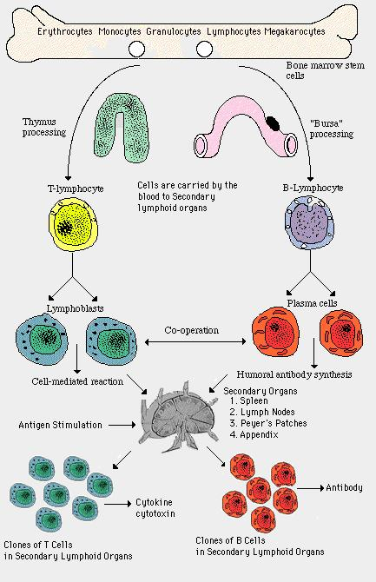


Slide 49
Dimmunix - Teaser
So, it is often hard to handle a deadlock. But what if…
Deadlock immunity:
once afflicted by a given deadlock, develop resistance against future concurrences of that and similar deadlocks
Dimmunix - a tool for developing deadlock immunity.
The first time a deadlock pattern manifests
Dimmunix automatically captures it’s signature and subsequently avoids entering the same pattern.

Slide 50
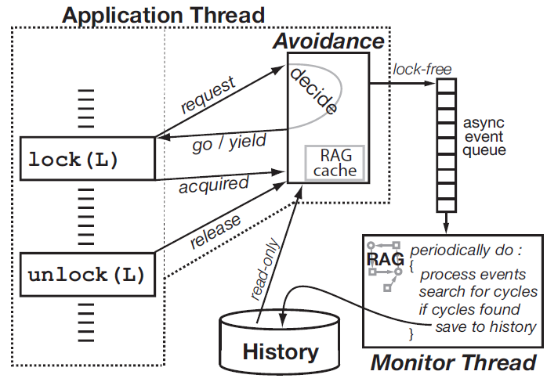
Dimmunix Architecture

Slide 51
RaceX: Static LockSet Analysis for DeadLock
Slides from Dawson Engler@Stanford

Slide 52
The RacerX experience
How to use:
List locking functions & entry points. Small:
Linux: 18 + 31, FreeBSD: 30 + 36, System X: 50 + 52
Emit trees from source code (2x cost of compile)
Run RacerX over emitted trees
Links all trees into global control flow graph (CFG)
Checks for deadlocks & races
~2-20 minutes for Linux.
Post-process to rank errors (most of IQ spent here)
Inspect
Your
System
mc-gcc
slicer
RacerX
Bugs
Notes:
You have

Slide 53
Lockset analysis
Lockset: set of locks currently held [Eraser]
For each root, do a flow-sensitive, inter-procedural DFS traversal computing lockset at each statement
Speed: If stmt s was visited before with lockset ls, stop.
Inter-procedural:
Routine can exit with multiple locksets: resume DFS w/ each after callsite.
Record <in-ls, {out-ls}> in fn summary. If ls in summary, grab cached out-ls’s and skip fn body.
initial ➔ lockset = { }
lock(l) ➔ lockset = lockset U { l }
unlock(l) ➔ lockset = lockset – { l }
Notes:
Or how the lockset anlysis can be used to an operating system.

Slide 54
Lockset
connect() {
lock(a);
open_conn();
send();
}
{ a }
{ a }
{ a }
summary:
{ a } ➔
?
open_conn() {
if (x)
lock(b);
else
lock(c);
}
{ a }
{ a, b }
{ a }
{ a, c }
{ a, b }
{ a, c }

Slide 55
Lockset
connect() {
lock(a);
open_conn();
send();
}
{ a }
{ a }
{ a, b }, {a, c}
summary:
{ a } ➔
{ a, b }, {a, c}
open_conn() {
if (x)
lock(b);
else
lock(c);
}
{ a }
{ a, b }, {a, c}
{ a, b }
{ a }
{ a, c }
{ a, b }, {a, c}

Slide 56
Big picture: Deadlock detection
Pass 1: constraint extraction
emit 1-level locking dependencies during lockset analysis
Pass 2: constraint solving
Compute transitive closure & flag cycles.
“a➔b➔a” : T1 acquires a, T2 acquires b, boom.
Ranking:
Global locks over local
Depth of callchain & number of conditionals (less better)
Number of threads involved (fewer MUCH better)
lock(a);
lock(b);
lock(b);
lock(a);
“a➔b”
“b➔a”
Notes:
You have

Slide 57
Simplest deadlock example
Constraint extraction emits “rtc_lock➔rtc_task_lock” and “rtc_task_lock➔rtc_lock”
Constraint solving flags cycle: T1 acquires rtc_lock, T2 acquires rtc_task_lock. Boom.
Ranked high: only two threads, global locks, local error.
// 2.5.62/drivers/char/rtc.c
int rtc_register(rtc_task_t *task) {
spin_lock_irq(&rtc_lock);
//...
spin_lock(&rtc_task_lock);
if (rtc_callback) {
spin_unlock(&rtc_task_lock);
spin_unlock_irq(&rtc_lock);
//2.5.62/drivers/char/rtc.c
rtc_unregister(rtc_task_t *task)
{
spin_lock_irq(&rtc_task_lock);
//...
spin_lock(&rtc_lock);
Notes:
You have

Slide 58
False positive trouble
Most FPs from bogus locks in lockset
Typically caused by mishandled data dependencies
Oversimplified typical example
Naïve analysis will think four paths rather than two, including false one that holds lock a at line 5.
Inter-procedural analysis makes this much worse.
Could add path-sensitivity, but undecidable in general
{}
1: if(x)
2: lock(a);
3: if(x)
4: unlock(a);
5: lock(b);
{a}
{a}
{a}
“a➔b”
Notes:
You have

Slide 59
Unlockset analysis
Observations:
In practice, all false positives due to the A in “A➔B”, most because A goes “too far”
We had unconsciously adopted pattern of inspecting errors where there was an explicit unlock of “A” after “A➔B” since that strongly suggested “A” was held.
// 2.5.62/drivers/char/rtc.c
rtc_register(rtc_task_t *task) {
spin_lock_irq(&rtc_lock);
//...
spin_lock(&rtc_task_lock);
if (rtc_callback) {
spin_unlock(&rtc_task_lock);
spin_unlock_irq(&rtc_lock);
rtc_lock➔rtc_task_lock
Notes:
You have

Slide 60
Unlockset analysis
At statement S remove any lock L from lockset if there exists no successor statement S’ reachable from S that contains an unlock of L.
Key: lockset holds exactly those locks the analysis can handle. Scales with analysis sophistication.
1: if(x) {}
2: lock(a); {a}
3: if(x) {a}
4: unlock(a);
5: lock(b); {a} ➔ {}
Notes:
You have

Slide 61
Unlockset implementation sketch
Essentially compute reaching definitions
Run lockset analysis in reverse from leaves to roots
Unlockset holds all locks that will be released
During lockset analysis:
Main complication: function calls.
Different locks released after different callsites. Don’t want to mix these up (context sensitivity)
initial ➔ unlockset = { }
lock(l) ➔ unlockset = unlockset - { l }
unlock(l) ➔ unlockset = unlockset U { l }
s.unlockset = s.unlockset U unlockset
lockset = intersect(s.unlockset, lockset);
Notes:
You have

Slide 62
Deadlock results
A bit surprised at the low bug counts
Main reason seems to be not that many locks held simultaneously
< 1000 unique constraints, only so many chances for error.
System Confirmed Unconfirmed False
System X 2 3 7
Linux 2.5.62 4 8 6
FreeBSD 2 3 6
Total 8 14 19
Notes:
You have

Slide 63
The most surprising error
T1 enters FindHandle with scsiLock, calls Validate, calls CpuSched_wait (rel scsiLock, sleep w/ handleArrayLock)
T2 acquires scsiLock and calls FindHandle. Boom.
// Entered holding scsiLock
int FindHandle(int handleID) {
prevIRQL = SP_LockIRQ(&handleArrayLock, …);
Validate(handle);
...
int Validate(handle) {
ASSERT(SP_IsLocked(&scsiLock));
while (adapter->openInProgress) {
CpuSched_Wait(&adapter->openInProgress,
CPUSCHED_WAIT_SCSI, &scsiLock);
SP_Lock(&scsiLock);
Notes:
You have

Slide 64
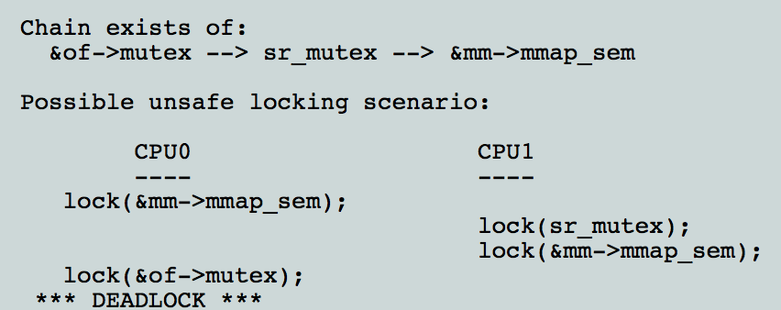
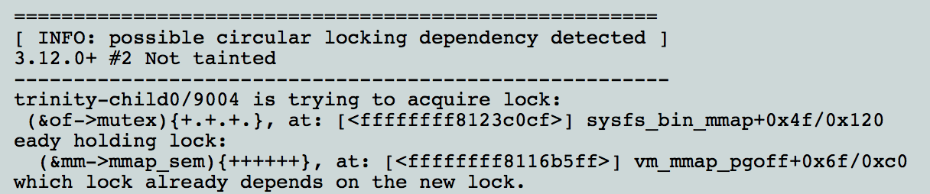
Lock Analysis in Real World
Lockdep analysis
https://www.kernel.org/doc/Documentation/lockdep-design.txt

Slide 65
Valgrind: a useful tool for program debugging/analysis

Slide 66
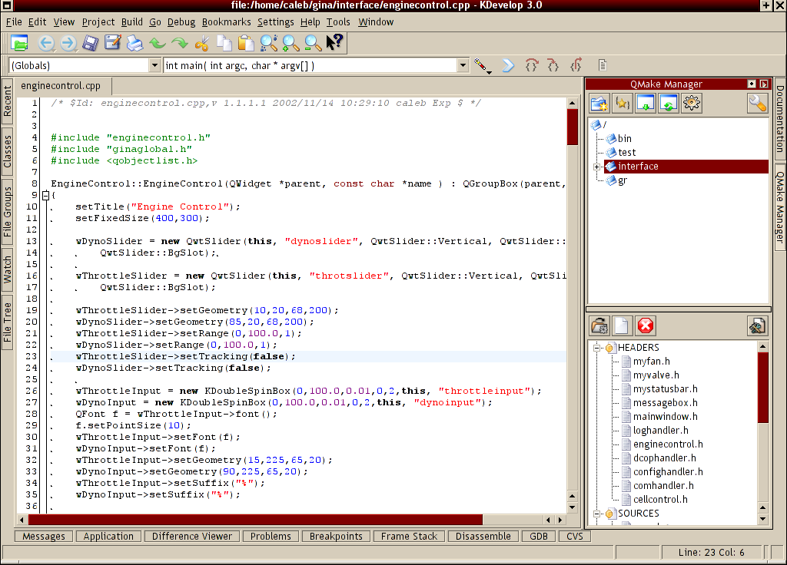
What is Valgrind
Linux, x86, program analyzer
Advantages
powerful
no recompiles, just binaries
any language (!)
extensible, configurable
free, GPL'd goodness
Speed slowdown

Slide 67

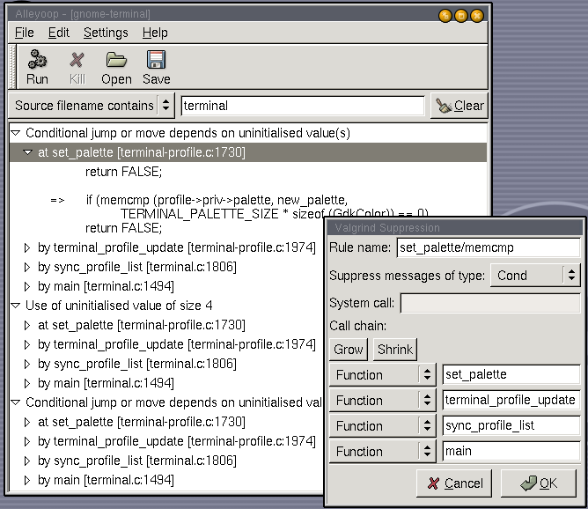
What are the existing skins
MemCheck
Heavy duty memory checker
AddrCheck
Faster, cheaper
Cachegrind
Caching info
Helgrind
Thread semantics
Others

Slide 68
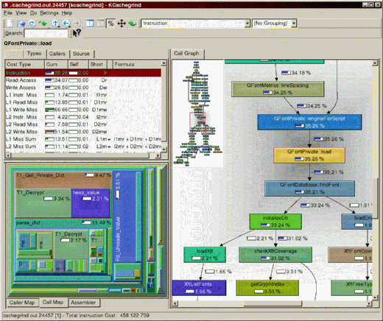
Other features
Callgraphs
Multiple other patches
Open file descriptors
Suppressions
Selective understanding
Ignore System libs
Yes, bugs
/dev/random

Slide 69
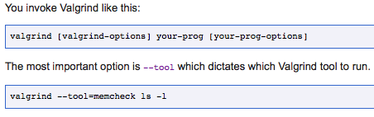
How to Use it
Apt-get install valgrind

Slide 70
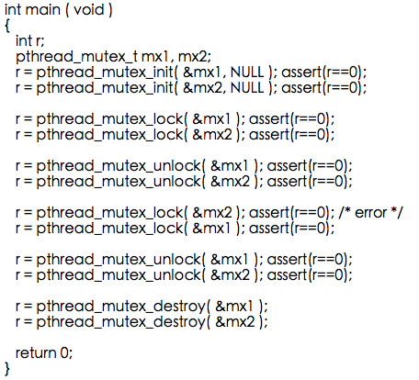
Example code

Slide 71
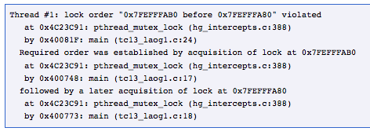
How Valgrind Detect it

Slide 72
Many Other useful features

Slide 73
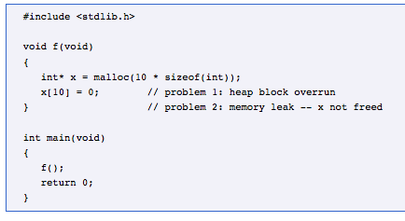
Example Uses of MemCheck

Slide 74
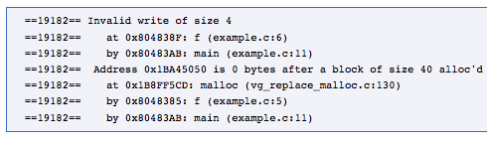


Slide 75
Cachegrind: a cache profiler

Slide 76
Cachegrind
Cache behavior is crucial
L1 misses: ~10 cycles
L2 misses: ~200 cycles
But difficult to predict
Cachegrind gives three outputs:
Total hit/miss counts and ratios (I1, D1, L2)
Per-function hit/miss counts (sorted from most to least)
Per-line hit/miss counts (source code annotations)
Source code annotations are the most useful
Most fine-grained data
Data that programmers can act on to speed up their programs

Slide 77
Sample output
--------------------------------------------------------------------------------
Ir I1mr I2mr Dr D1mr D2mr Dw D1mw D2mw
--------------------------------------------------------------------------------
14,789,396 547 544 6,329,792 751 689 2,111,757 1,113,292 1,094,855 PROGRAM TOTALS
--------------------------------------------------------------------------------
Ir I1mr I2mr Dr D1mr D2mr Dw D1mw D2mw file:function
--------------------------------------------------------------------------------
14,688,273 1 1 6,294,531 0 0 2,098,178 1,113,088 1,094,656 example.c:main
--------------------------------------------------------------------------------
-- Auto-annotated source: example.c
--------------------------------------------------------------------------------
Ir I1mr I2mr Dr D1mr D2mr Dw D1mw D2mw
. . . . . . . . . int main(void)
10 0 0 0 0 0 1 0 0 {
. . . . . . . . . int i, j, a[1024][1024];
. . . . . . . . .
4,100 1 1 2,049 0 0 1 0 0 for (i = 0; i < 1024; i++) {
4,198,400 0 0 2,098,176 0 0 1,024 0 0 for (j = 0; j < 1024; j++) {
5,242,880 0 0 2,097,152 0 0 1,048,576 65,536 56,320 a[i][j] = 0; // fast
5,242,880 0 0 2,097,152 0 0 1,048,576 1,047,552 1,038,336 a[j][i] = 0; // slow
. . . . . . . . . }
. . . . . . . . . }
1 0 0 0 0 0 0 0 0 return 0;
2 0 0 2 0 0 0 0 0 }

Slide 78
How Cachegrind works
Each instruction is instrumented
Call to a C cache simulation function
Different functions for loads, stores, modifies
Some combining of C calls for efficiency
Each source code line gets a cost centre
Holds counters: accesses, hits and misses
Uses debug info to map each instruction to a cost centre
Online simulation (i.e. no trace gathering)
Cost centres dumped to file at end
Simple but compact text format
Post-processing script produces previous slide’s output

Slide 79
Cache simulation
Approximates an AMD Athlon hierarchy
I1, D1, inclusive L2
Write-allocate
LRU replacement
Each cache is command-line configurable:
Cache size
Line size
Associativity
On x86/AMD64 can use CPUID to auto-detect these parameters
Simulation can be replaced easily

Slide 80
Inaccuracies
Imperfect address trace
No kernel code
Other processes ignored (arguably good)
Conversion to Valgrind’s IR changes a very small number of loads/stores
Incorrect addresses
Virtual addresses
Memory layout and thread scheduling is different under Cachegrind compared to native
Prefetches and cache-bypassing are ignored
Difficult to handle well without detailed microarchitectural simulation
Still useful for general insights

Slide 81
How is it used?
Characterization:
Program A vs. program B
Cache hierarcy A vs. cache hierarchy B
Optimisation:
Identifies cache-unfriendly code
Fixing such code requires non-trivial insight
But easier (i.e. not impossible!) than fixing without this data
Evaluation of optimizations:
Program A vs. optimized program A

Slide 82
Cachegrind summary
Cachegrind is a cache simulator
Gives total, per-function and per-line hit/miss counts
Simulation is imperfect, but still useful
Used for characterization, optimisation and evaluation

Slide 83
Callgrind: a call graph profiler

Slide 84
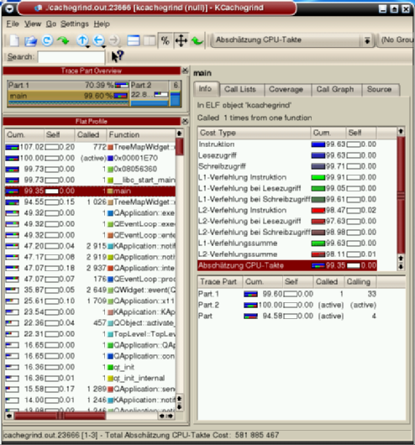
Callgrind
Extension of Cachegrind
By Josef Weidendorfer
Also provides:
Call graph information
Graphical results viewer (KCachegrind)
Allows interactive browsing of results
Accepts Cachegrind results also
Greater selectivity of what code is profiled

Slide 85
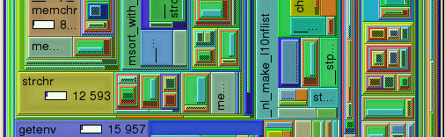
KCachegrind’s tree-map view
Box sizes represent relative counts
Nesting of boxes represents call chains
Interactive: can drill down through boxes

Slide 86
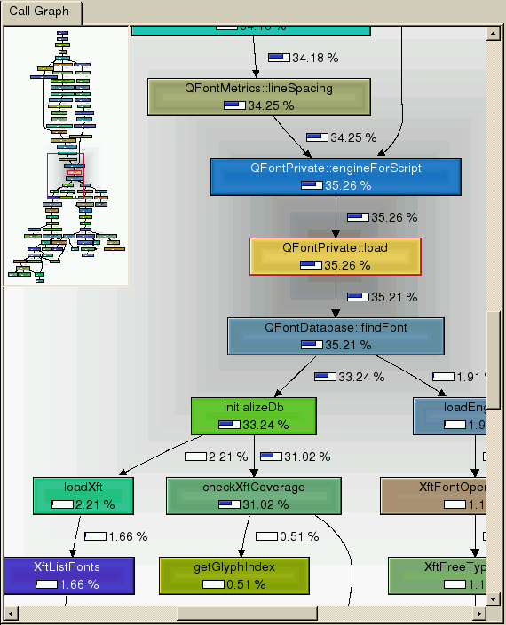
KCachegrind’s call graph view
Shows whole call graph
Boxes show count proportions
Interactive

Slide 87
Selective profiling
Can dump counts at particular times
At termination (same as Cachegrind)
Periodically (every N code blocks)
At entry/exit of named functions
At particular program points (using client requests)
At any time (by invoking a separate script)
Counters are zeroed after each dump
Can choose which events to count
Instructions
Memory events (for cache simulation)
Function entries/exits

Slide 88
An interesting difficulty
Callgrind maintains a call stack
For tracking function entries/exits
Several difficulties:
setjmp/longjmp
Tail recursion
Dynamic linking
Calls through jump tables
Jump table patched on first call after loading
Stack switching
Missed entries/exits can throw everything out

Slide 89
Massif: a heap profiler

Slide 90
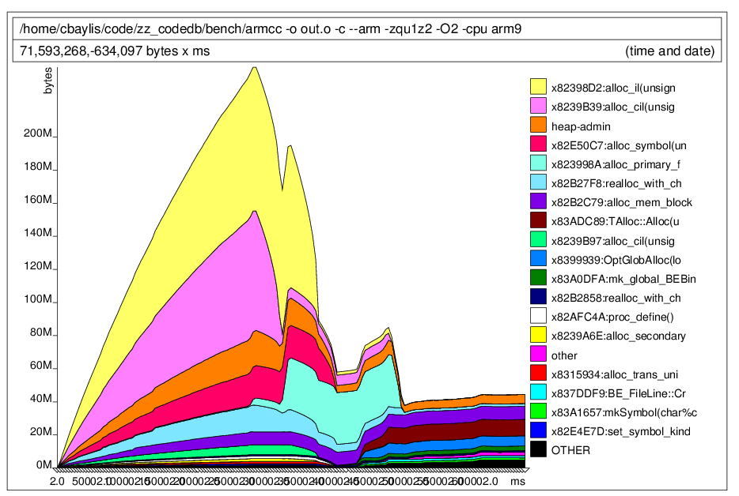
Massif heap graph

Slide 91
Massif
Measures heap and stack
Each heap allocation site is a band
Stack is a band
Also produces HTML output
Represents the call graph underlying allocations
Users can drill down through calling chains from allocation sites
Simple interaction with Valgrind’s core
Only uses function wrapping
No instrumentation of code blocks
Complexity in the tool, not at the core/tool boundary

Slide 92
Thanks
Next class
Virtualization

