Slide 1
Exception
Yubin Xia
IPADS, SJTU
ACKs: Some slides are adapted from the textbook’s original slides and Frans’s os course notes

Slide 2
Review: IPC
Cooperating processes need inter-process communication (IPC)
Two models of IPC
Shared memory
Message passing
In POSIX
Pipe, msg passing, signal, shared memory, semaphore, etc.
LRPC: Lightweight RPC

Slide 3
Concepts
Exception
refers to an illegal program action
Interrupt
refers to a signal generated by a hardware device
System call
a user program can ask for an operating system service

Slide 4
Exception

Slide 5
CPU’s ‘fetch-execute’ cycle
User
Program
Fetch instruction at IP
ld
add
st
mul
ld
sub
bne
add
jmp
…
Decode the fetched instruction
Save context
IP
Execute the decoded instruction
Get INTR ID
Lookup ISR
Advance IP to next instruction
Execute ISR
Interrupt?
yes
IRET
no

Slide 6
Exception Table
Exception
numbers
code for
exception handler 0
1. Each type of event has a unique exception number k
2. Exception table entry k points to a function (exception handler).
3. Handler k is called each time exception k occurs.
Exception
table
code for
exception handler 1
0
1
code for
exception handler 2
2
...
n-1
...
code for
exception handler n-1

Slide 7
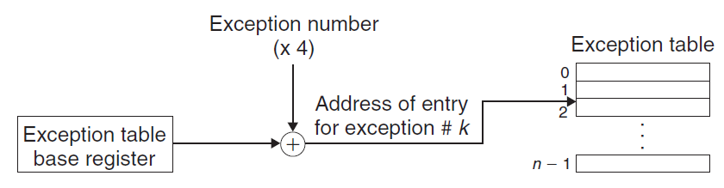
Exception Table

Slide 8
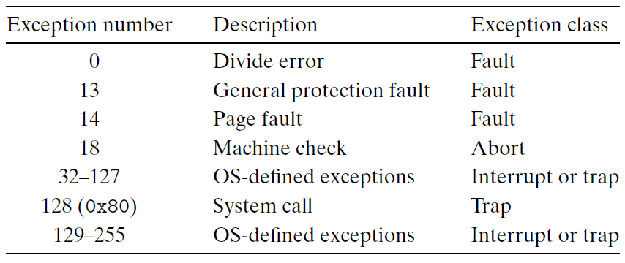
Some Exception on Intel CPU
Notes:
Questions:
What is the difference between an exception and an interrupt caused by hardware?
Can system call be implemented by using int 0x81 or 0x82?

Slide 9
IDT (or Trap Vector in xv6)
IDT: interrupt descriptor table
Another name of exception table
Has 256 entries
Each giving the %cs and %eip to be used when handling the corresponding interrupt
System call
A program invokes int n
n specifies the index into the IDT

Slide 10
Exception Handler
The processor pushes a return address on the stack, the return address is
either the current instruction
or the next instruction
The processor also pushes some additional processor state onto the stack
will be necessary to restart the interrupted program when the handler returns
e.g. the current condition codes

Slide 11
Exception Handler
All items are pushed onto the kernel stack
Rather than onto the user’s stack
If control is being transferred from a user program to the kernel
Exception handlers run in kernel mode
Means they have complete access to all system resources

Slide 12
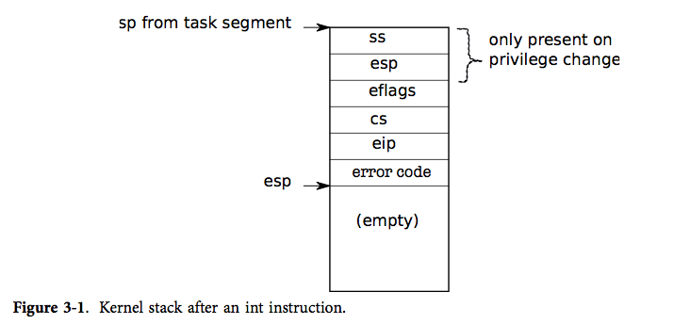
Kernel Stack

Slide 13
Stack Change
Question: why not use user’s stack?
执行完之后有IRET指令，这个指令室内和权限执行的 ，所以如果在
用户栈上，用户可能会做ROP攻击。

Slide 14
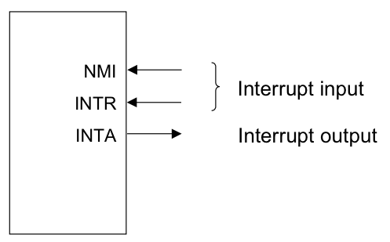
Sources of Events cause User->Kernel
Device interrupt: external
Nonmaskable interrupt (NMI) input pin
Interrupt (INTR) input pin
Software interrupt: execution of the Interrupt instruction
e.g., INT
Program faults: If some error condition occur by the execution of an instruction. E.g.,
divide-by-zero interrupt

Slide 15
What Has to Happen?
Must save the processor’s registers for future transparent resume
Must be set up for execution in the kernel
Must chose a place for the kernel to start executing
Must be able to retrieve information about the event, e.g., system call arguments
Must all be done securely
Must maintain isolation of user processes and the kernel

Slide 16
Return From Interrupt Handler in Kernel
The ‘iret’ instruction
Restore the process’s context
Switch from kernel mode to user mode
Continue the execution of user’s process

Slide 17
Simplified: Call OS Services from Apps and Devices
Exception
Application (CPU)
Exception
Table
OS
Services
I/O Device
Interrupt
Notes:
Question: what if

Slide 18
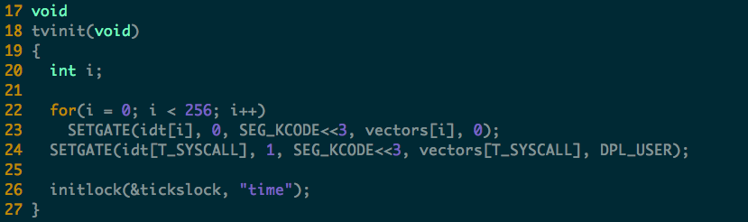
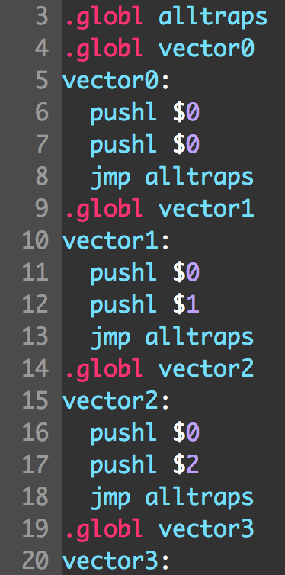
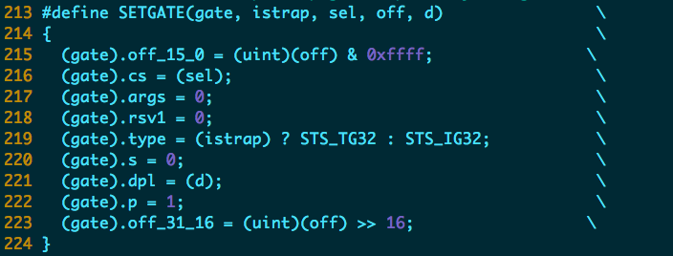
xv6: Initialize the Exception Table

Slide 19
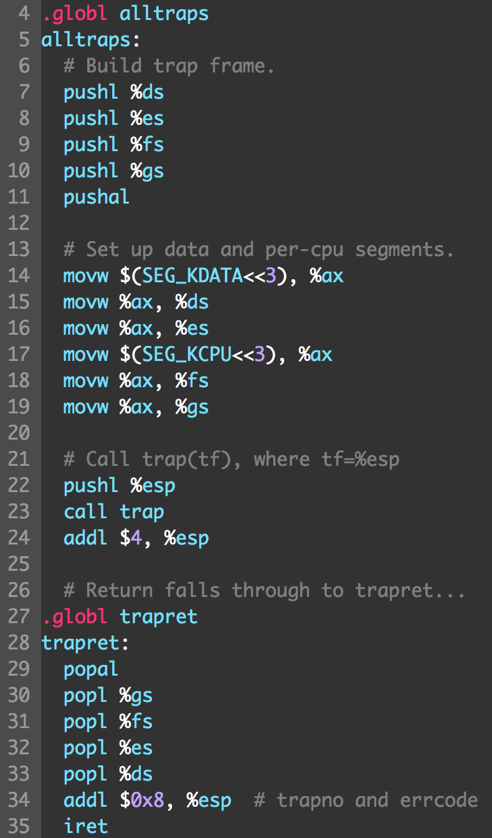
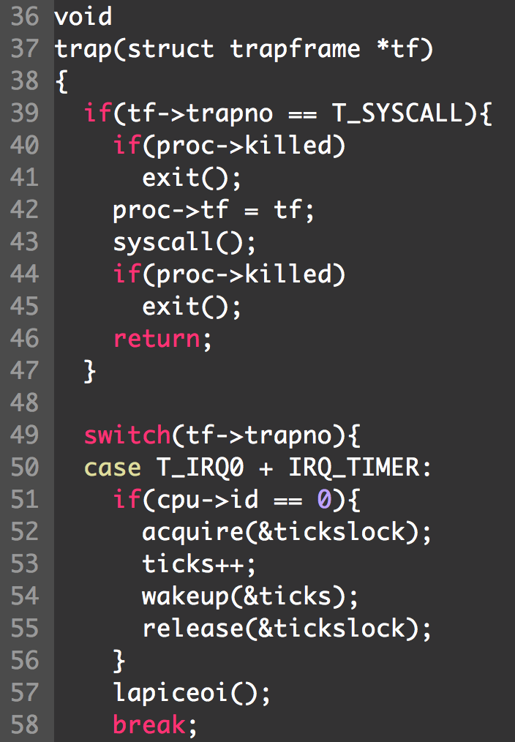
xv6: Trap

Slide 20
Interrupt

Slide 21
Varying Terminology for Intel
Interrupts (asynchronous, device generated)
Maskable: device-generated, associated with IRQs (interrupt request lines); may be temporarily disabled (still pending)
Nonmaskable: some critical hardware failures
Exceptions (synchronous, from software)
Processor-detected
Faults – correctable (restartable); e.g. page fault
Traps – no reexecution needed; e.g. breakpoint
Aborts – severe error; process usually terminated (by signal)
Programmed exceptions (software interrupts)
int (system call), int3 (breakpoint)
into (overflow), bounds (address check)

Slide 22
Terms
Vector, Interrupt vector, Trap number
IRQ: Interrupt Request
(Soft IRQ: A mechanism to implement bottom half)
Has nothing to do with IRQ!
Interrupt, trap, fault, exception
Software interrupt / system call
IDT: Interrupt Descriptor Table
ISP: Interrupt Service Procedure

Slide 23
Intel-Reserved ID-Numbers
Of the 256 possible interrupt ID numbers, Intel reserves the first 32 for ‘exceptions’
OS’s such as Linux are free to use the remaining 224 available interrupt ID numbers for their own purposes (e.g., for service-requests from external devices, or for other purposes such as system-calls)
Examples:
0: divide-overflow fault
6: Undefined Opcode
7: Coprocessor Not Available
11: Segment-Not-Present fault
12: Stack fault
13: General Protection Exception
14: Page-Fault Exception

Slide 24
Interrupts
Interrupts are similar to system calls, except devices generate them at any time
There is hardware on the motherboard to signal the CPU when a device needs attention (e.g., the user has typed a character on the keyboard)
We must program the device to generate an interrupt, and arrange that a CPU receives the interrupt

Slide 25
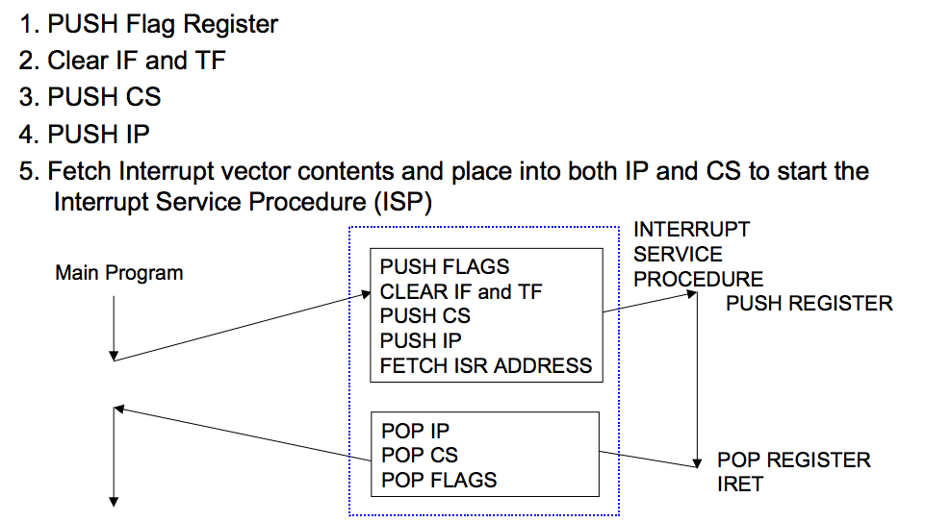
Interrupt Response Sequence

Slide 26
Early Boards
PIC (Programmable Interrupt Controller)
picirq.c
8259A chip
Each PIC handles 8 interrupts, and multiplex them on the interrupt pin of the processor
PIC can be cascaded
Master: 0 to 7
Slave: 8 to 15
Read timer.c for timer init

Slide 27
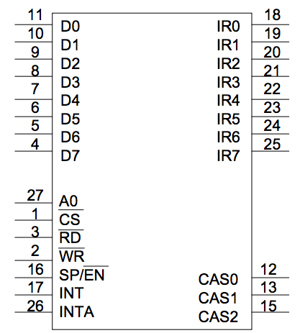
8259A Programmable Interrupt Controller (PIC)
8259A is a 28-pin integrated circuit which was designed specifically for the 8088/8086 microprocessors
Notes:
❚ The 28 pins of the 8259A include:
1. Data pins D0-D7 - connected to the data bus to allow programming
2. IR0-IR7 - 8 interrupt inputs
3. CAS0-CAS2 - cascade lines (used in multiple 8259A systems)
4. SP/EN - functions as data buffer enable output (when buffered mode)
or as an input to program the 8259A as a master or slave
5. A0 - input which selects different command words in the 8259A
❚ Usually IR0 has the highest priority and IR7 the least priority.
❚ Fully nested interrupts are supported (higher priority interrupts may
interrupt the interrupt service routine of a lower priority interrupt) if bit 4 of
ICW is set. (Refer to data sheets for further details.)

Slide 28
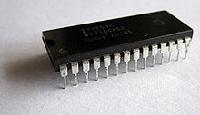
Interrupt Hardware
Legacy PC Design
(for single-proc
systems)
IRQs
Slave
PIC
(8259)
Master
PIC
(8259)
x86
CPU
Ethernet
INTR
SCSI Disk
Real-Time Clock
Keyboard Controller
Programmable Interval-Timer
I/O devices have (unique or shared) Interrupt Request Lines (IRQs)
IRQs are mapped by special hardware to interrupt vectors, and passed to the CPU
This hardware is called a Programmable Interrupt Controller (PIC)

Slide 29
APIC, IO-APIC, LAPIC
Advanced PIC (APIC) for SMP systems
Used in all modern systems
Interrupts “routed” to CPU over system bus
IPI: inter-processor interrupt
Local APIC (LAPIC) versus “frontend” IO-APIC
Devices connect to front-end IO-APIC
IO-APIC communicates (over bus) with Local APIC
Interrupt routing
Allows broadcast or selective routing of interrupts
Ability to distribute interrupt handling load
Routes to lowest priority process
Special register: Task Priority Register (TPR), i.e., locking
Arbitrates (round-robin) if equal priority

Slide 30
Multiple Processors
Multi-CORE CPU
CPU
0
CPU
1
I/O
APIC
LOCAL
APIC
LOCAL
APIC
Advanced Programmable Interrupt Controller is needed to
perform ‘routing’ of I/O requests from peripherals to CPUs
(The legacy PICs are masked when the APICs are enabled)
Notes:
External hardware INTerrupt sources are routed to pins of the IO APIC. These include motherboard sources such as the 8254 timer, as well asISA/PCI card slots. INTerrupts are "collected" by this part, and forwarded via the APIC bus to one or more CPUs when they occur.

Slide 31
Multi-processor PC Boards
Two parts in XV6
IO APIC, for the I/O system
ioapic.c
Local APIC, for each processor
lapic.c
XV6 is designed for multi-processor
Each processor must be programmed to receive interrupts

Slide 32
Assigning IRQs to Devices
IRQ assignment is hardware-dependent
Sometimes it’s hardwired, sometimes it’s set physically, sometimes it’s programmable
PCI bus usually assigns IRQs at boot
Some IRQs are fixed by the architecture
IRQ0: Interval timer
IRQ2: Cascade pin for 8259A
Linux device drivers request IRQs when the device is opened
Note: especially useful for dynamically-loaded drivers, such as for USB or PCMCIA devices
Two devices that aren’t used at the same time can share an IRQ, even if the hardware doesn’t support simultaneous sharing

Slide 33
Some Details on IRQ
Some hardware IRQs are pre-determined
such as the system timer (IRQ0), Keyboard controller (IRQ1),
floppy controller (IRQ6), real-time clock (IRQ8) and
Math Co-processor (IRQ13).
Most others are ‘user’ determined
via hardware (with jumpers)
via software (such as installable drivers) with firmware (PNP)
IRQs that are usually available for add-on devices:
Modem (IRQ5), printer (IRQ7), Sound Card (IRQ9/IRQ10),
Video Card (IRQ11) and PS/2 mouse (IRQ12).
IRQ3 and IRQ4 are usually reserved for serial ports
IRQ14 and IRQ15 are used for the IDE (primary and secondary).

Slide 34
Assigning Vectors to IRQs
Vector: index (0-255) into interrupt descriptor table
Vectors are usually IRQ# + 32
Below 32 reserved for non-maskable intr & exceptions
Maskable interrupts can be assigned as needed
Vector 128 used for syscall
Vectors 251-255 used for IPI

Slide 35
Putting It All Together
Memory Bus
IRQs
0
PIC
idtr
CPU
INTR
IDT
0
vector
N
handler
Mask points
255

Slide 37
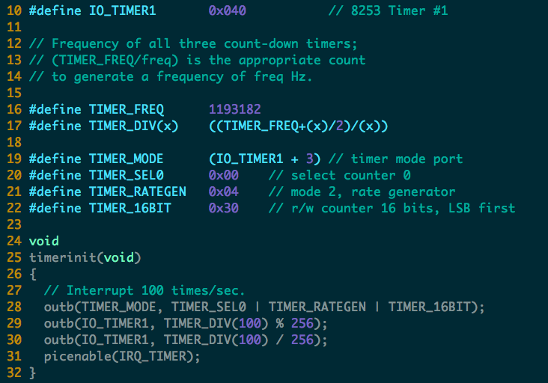

Slide 38
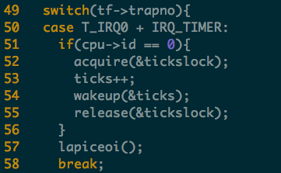
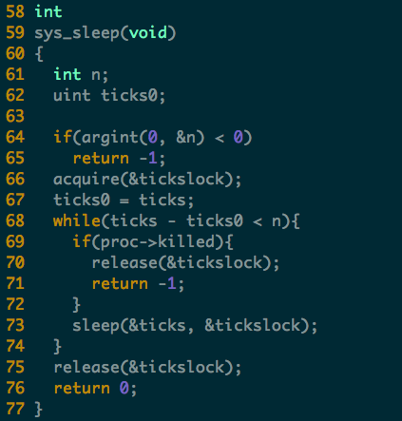
Timer Interrupt

Slide 39
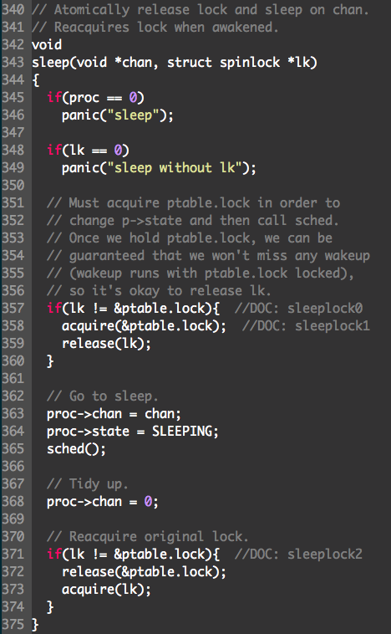
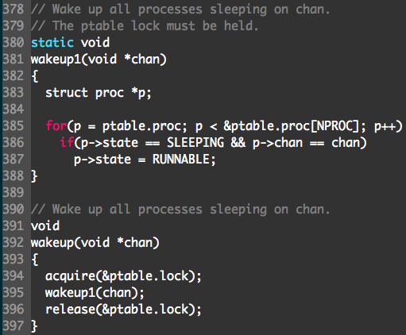
Sleep & Wakeup

Slide 40
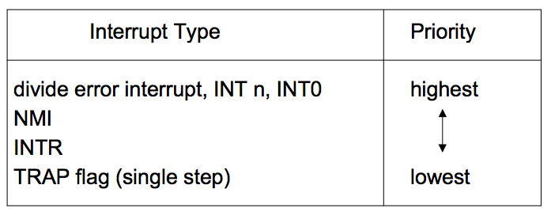
Interrupt Priority
When different types of interrupt (ie. software, NMI, INTR or exceptions) occur at the same time, the one with the highest priority is handled first. Intel microprocessors use the following order of priority:

Slide 41
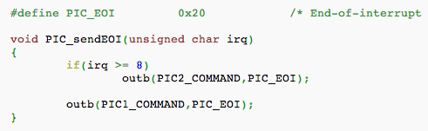
EOI: End of Interrupt
Issued to the PIC chips at the end of an IRQ-based interrupt routine
If the IRQ came from the Master PIC, it is sufficient to issue this command only to the Master PIC;
If the IRQ came from the Slave PIC, it is necessary to issue the command to both PIC chips

Slide 42
Nested Interrupts
What if a second interrupt occurs while an interrupt routine is excuting?
Generally a good thing to permit that — is it possible?
And why is it a good thing?

Slide 43
Maximizing Parallelism
You want to keep all I/O devices as busy as possible
In general, an I/O interrupt represents the end of an operation; another request should be issued as soon as possible
Most devices don’t interfere with each others’ data structures; there’s no reason to block out other devices

Slide 44
Handling Nested Interrupts
As soon as possible, unmask the global interrupt
As soon as reasonable, re-enable interrupts from that IRQ
But that is not always a great idea, since it could cause re-entry to the same handler
IRQ-specific mask is not enabled during interrupt-handling

Slide 45
Nested Execution
Interrupts can be interrupted
By different interrupts; handlers need not be reentrant
Small portions execute with interrupts disabled
Interrupts remain pending until acked by CPU
Exceptions can be interrupted
By interrupts (devices needing service)
Exceptions can nest two levels deep
Exceptions indicate coding error
Exception code (kernel code) shouldn’t have bugs
Page fault is possible (trying to touch user data)

Slide 46
Interrupt Masking
Two different types: global and selective (per-IRQ)
Global — delays all interrupts
Selective — individual IRQs can be masked selectively
Selective masking is usually what’s needed — interference most common from two interrupts of the same type
NMI (Non-Maskable Interrupt)

Slide 47
Triple Fault
Things never to do in an OS #1: Swap out the page swapping code (triple-fault here we come) —Kemp
When a fault occurs, the CPU invokes an exception handler.
If a fault occurs while trying to invoke the exception handler, that's called a double fault, which the CPU tries to handle with yet another exception handler.
If that invocation results in a fault too, the system reboots with a triple fault.
Notes:
A triple fault is usually a sign that the exception handler called is faulty, or worse, that the whole exception handling in your system is screwed up. (LDT or GDT issues, bogus pointers or faulty memory mappings are frequent offenders.)
Another frequent cause of triple faults is a kernel stack overflow. If the stack reaches an invalid page (one with its present bit clear), a page fault is generated. However, the CPU faults while trying to push the exception information on to the stack, so a double fault is generated. The same problem still exists so a triple fault is generated.

Slide 48
/proc/interrupts
$ cat /proc/interrupts
CPU0
0: 865119901 IO-APIC-edge timer
1: 4 IO-APIC-edge keyboard
2: 0 XT-PIC cascade
8: 1 IO-APIC-edge rtc
12: 20 IO-APIC-edge PS/2 Mouse
14: 6532494 IO-APIC-edge ide0
15: 34 IO-APIC-edge ide1
16: 0 IO-APIC-level usb-uhci
19: 0 IO-APIC-level usb-uhci
23: 0 IO-APIC-level ehci-hcd
32: 40 IO-APIC-level ioc0
33: 40 IO-APIC-level ioc1
48: 273306628 IO-APIC-level eth0
NMI: 0
ERR: 0
Columns: IRQ, count, interrupt controller, devices

Slide 49
More in /proc/pci:
$ cat /proc/pci
PCI devices found:
Bus 0, device 0, function 0:
Host bridge: PCI device 8086:2550 (Intel Corp.) (rev 3).
Prefetchable 32 bit memory at 0xe8000000 [0xebffffff].
Bus 0, device 29, function 1:
USB Controller: Intel Corp. 82801DB USB (Hub #2) (rev 2).
IRQ 19.
I/O at 0xd400 [0xd41f].
Bus 0, device 31, function 1:
IDE interface: Intel Corp. 82801DB ICH4 IDE (rev 2).
IRQ 16.
I/O at 0xf000 [0xf00f].
Non-prefetchable 32 bit memory at 0x80000000 [0x800003ff].
Bus 3, device 1, function 0:
Ethernet controller: Broadcom NetXtreme BCM5703X Gigabit Eth (rev 2).
IRQ 48.
Master Capable. Latency=64. Min Gnt=64.
Non-prefetchable 64 bit memory at 0xf7000000 [0xf700ffff].

Slide 50
Three crucial data-structures
The Global Descriptor Table (GDT)
defines the system’s memory-segments and their access-privileges, which the CPU has the duty to enforce
The Interrupt Descriptor Table (IDT)
defines entry-points for the various code-routines that will handle all ‘interrupts’ and ‘exceptions’
The Task-State Segment (TSS)
holds the values for registers SS and ESP that will get loaded by the CPU upon entering kernel-mode

Slide 51
How does CPU find GDT/IDT?
Two dedicated registers: GDTR and IDTR
Both have identical 48-bit formats:
Segment Base Address
Segment Limit
47
16
15
0
Kernel must setup these registers during system startup (set-and-forget)
Privileged instructions: LGDT and LIDT used to set these register-values
Unprivileged instructions: SGDT and SIDT used for reading register-values

Slide 52
How does CPU find the TSS?
Dedicated system segment-register TR holds a descriptor’s offset into the GDT
The kernel must set up the
GDT and TSS structures
and must load the GDTR
and the TR registers
GDT
TSS
TR
The CPU knows the layout
of fields in the Task-State
Segment
GDTR

Slide 53
Bottom half

Slide 54
Interrupt Handling Philosophy
Do as little as possible in the interrupt handler
Defer non-critical actions till later
Structure: top and bottom halves
Top-half: do minimum work and return (ISR)
Bottom-half: deferred processing (softirqs, tasklets, workqueues, kernel threads)
Top half
Bottom half
tasklet
softirq
workqueue
kernel thread

Slide 55
Top Half: Do it Now!
Technically is the interrupt handler
Perform minimal, common functions: save registers, unmask other interrupts. Eventually, undoes that: restores registers, returns to previous context.
Often written in assembler
IRQ is typically masked for duration of top half
Most important: call proper interrupt handler provided in device drivers (C program)
Don’t want to do too much here
IRQs are masked for part of the time
Don’t want stack to get too big
Typically queue the request and set a flag for deferred processing in a bottom half

Slide 56
Top Half: Find the Handler
On modern hardware, multiple I/O devices can share a single IRQ and hence interrupt vector
First differentiator is the interrupt vector
Multiple interrupt service routines (ISR) can be associated with a vector
Each device’s ISR for that IRQ is called
Device determines whether IRQ is for it

Slide 57
Bottom Half: Do it Later!
Mechanisms to defer work to later:
softirqs
tasklets (built on top of softirqs)
work queues
kernel threads
All can be interrupted
Top half
Bottom half
tasklet
softirq
workqueue
kernel thread

Slide 58
Warning: No Process Context
Interrupts (as opposed to exceptions) are not associated with particular instructions
They’re also not associated with a given process (user program)
The currently-running process, at the time of the interrupt, as no relationship whatsoever to that interrupt
Interrupt handlers cannot sleep!

Slide 59
What Can’t You Do?
You cannot sleep
or call something that might sleep
You cannot refer to current
You cannot allocate memory with GPF_KERNEL (which can sleep), you must use GPF_ATOMIC (which can fail)
You cannot call schedule()
You cannot do a down() semaphore call
However, you can do an up()
You cannot transfer data to/from user space
E.g., copy_to_user(), copy_from_user()

Slide 60
Interrupt Stack
When an interrupt occurs, what stack is used?
Exceptions: The kernel stack of the current process, whatever it is, is used (There’s always some process running — the “idle” process, if nothing else)
Interrupts: hard IRQ stack (1 per processor)
SoftIRQs: soft IRQ stack (1 per processor)
These stacks are configured in the IDT and TSS at boot time by the kernel

Slide 61
Softirqs
Statically allocated: specified at kernel compile time
Limited number:
Priority Type
0 High-priority tasklets
1 Timer interrupts
2 Network transmission
3 Network reception
4 Block devices
5 Regular tasklets

Slide 62
When Do Softirqs Run?
Run at various points by the kernel:
After system calls
After exceptions
After interrupts (top halves/IRQs, including the timer intr)
When the scheduler runs ksoftirqd
Softirq routines can be executed simultaneously on multiple CPUs:
Code must be re-entrant
Code must do its own locking as needed
Hardware interrupts always enabled when softirqs are running

Slide 63
Rescheduling Softirqs
A softirq routine can reschedule itself
This could starve user-level processes
Softirq scheduler only runs a limited number of requests at a time
The rest are executed by a kernel thread, ksoftirqd, which competes with user processes for CPU time

Slide 64
Tasklets
Built on top of softirqs
Can be created and destroyed dynamically
Run on the CPU that scheduled it (cache affinity)
Individual tasklets are locked during execution; no problem about re-entrancy, and no need for locking by the code
Tasklets can run in parallel on multiple CPUs
Same tasklet can only run on one CPU
Were once the preferred mechanism for most deferred activity, now changing

Slide 65
The Trouble with Tasklets
Hard to get right
One has to be careful about sleeping
They run at higher priority than other tasks in the systems
Can produce uncontrolled latency if coded badly
Ongoing discussion about eliminating tasklets
Will likely slowly fade over time

Slide 66
Work Queues
Always run by kernel threads
Are scheduled by the scheduler
Softirqs and tasklets run in an interrupt context; work queues have a pseudo-process context
i.e., have a kernel context but no user context
Because they have a pseudo-process context, they can sleep
Work queues are shared by multiple devices
Thus, sleeping will delay other work on the queue
However, they are kernel-only; there is no user mode associated with it
Don’t try copying data into/out of user space

Slide 67
Kernel Threads
Always operate in kernel mode
Again, no user context
2.6.30 introduced the notion of threaded interrupt handlers
Imported from the realtime tree
request_threaded_irq()
Now each bottom half has its own context, unlike work queues
Idea is to eventually replace tasklets and work queues

Slide 68
Comparing Approaches
 | ISR | SoftIRQ | Tasklet | WorkQueue | KThread
Will disable all interrupts? | Briefly | No | No | No | No
Will disable other instances of self? | Yes | Yes | No | No | No
Higher priority than regular scheduled tasks? | Yes | Yes* | Yes* | No | No
Will be run on same processor as ISR? | N/A | Yes | Yes | Yes | Maybe
More than one run can on same CPU? | No | No | No | Yes | Yes
Same one can run on multiple CPUs? | Yes | Yes | No | Yes | Yes
Full context switch? | No | No | No | Yes | Yes
Can sleep? (Has own kernel stack) | No | No | No | Yes | Yes
Can access user space? | No | No | No | No | No
*Within limits, can be run by ksoftirqd

