Slide 1
PC Programming & Booting
Yubin Xia & Rong Chen

Slide 2
Our Tools
QA Site:
http://ipads.se.sjtu.edu.cn/courses/qa
Reference
http://pdos.csail.mit.edu/6.828/2012/xv6.html
Both the code and book
http://wiki.osdev.org
IA-32 Intel Architecture Software Developer's Manuals
Volume 3A: System Programming Guide, Part 1
Volume 3B: System Programming Guide, Part 2

Slide 3
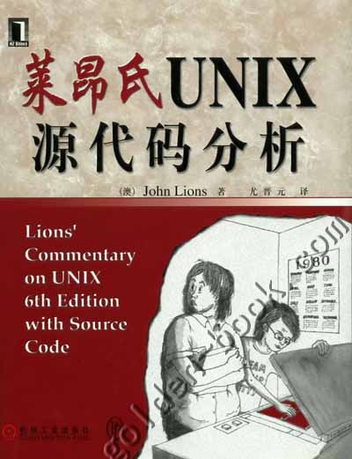
Once upon a time …
Lion’s commentary
Based on UNIX v6
Which is not on x86
But PDP-11
Xv6
Unix v6
For x86!
Runnable!

Slide 4
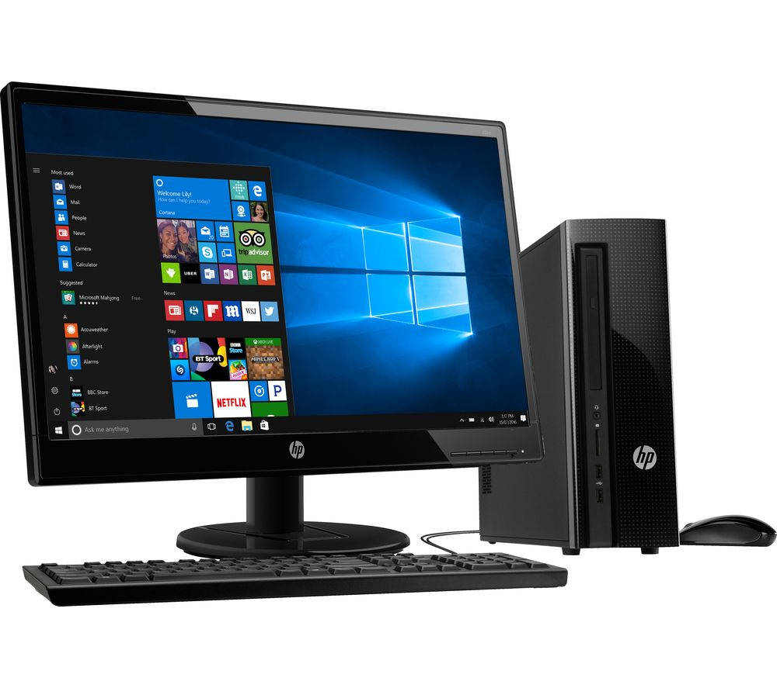
A PC
How to make it to do something useful?

Slide 5
Outline
PC Architecture
Memory
Execution
PC Emulation
Notes:
Big ideas: data can be instructions, stack, hardware == software

Slide 6
PC Architecture
Memory
Execution
PC Emulation
Notes:
Big ideas: data can be instructions, stack, hardware == software

Slide 7
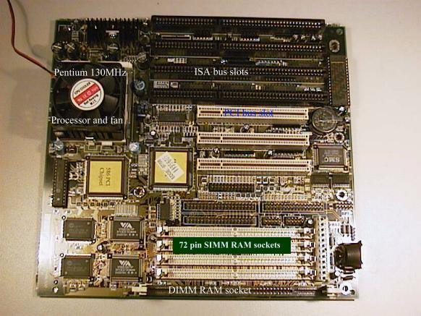
PC board
Notes:
CPU, address and data signals, memory, disk, keyboard, display, BIOS ROM, clock, …

Slide 8
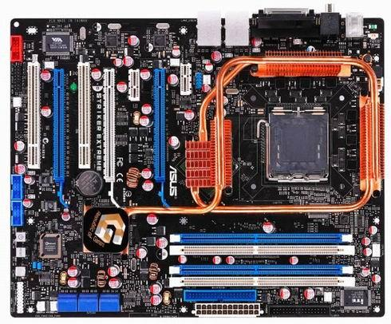
PC board - Nowadays
Notes:
CPU, address and data signals, memory, disk, keyboard, display, BIOS ROM, clock, …

Slide 9
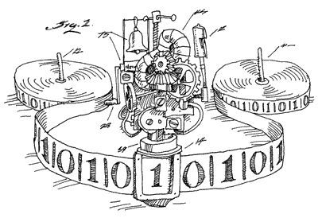
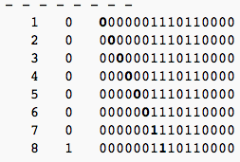
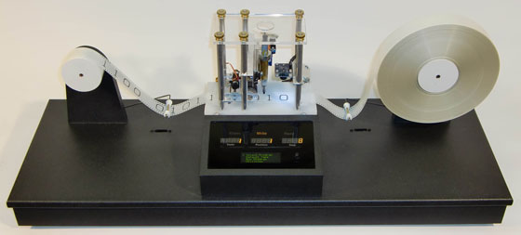
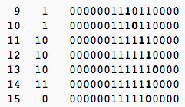
The Turing Machine
Calculate 3+2: 0000001110110000

Slide 10
The von Neumann Model
Central
Processing
Unit
Input/ Output
Main
Memory
I/O: communicating data to and from devices
CPU: digital logic for performing computation
Memory: N words of B bits

Slide 11
The Stored Program Computer
Main memory
CPU
instruction
instruction
for (;;) {
next instruction
}
instruction
…
data
data
data
CPU interpreter of instructions
Memory holds instructions and data

Slide 12

x86 implementation
instruction
2³²-1
instruction
instruction
…
data
data
data
0
EIP is incremented after each instruction
Instructions are different length
EIP modified by CALL, RET, JMP, and cond. JMP

Slide 13
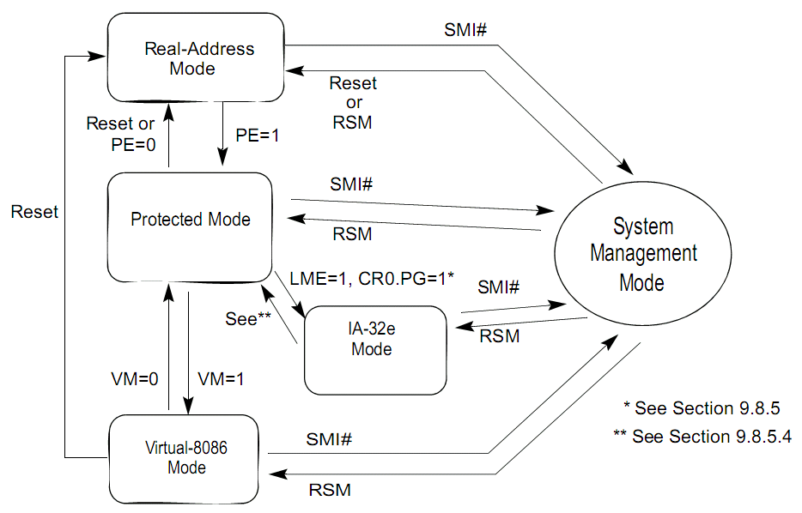
System Architecture Overview
Volume 3A: System Programming Guide, Part 1
2.1~2.5
Modes
Real Mode
Protected Mode
SMM

Slide 14
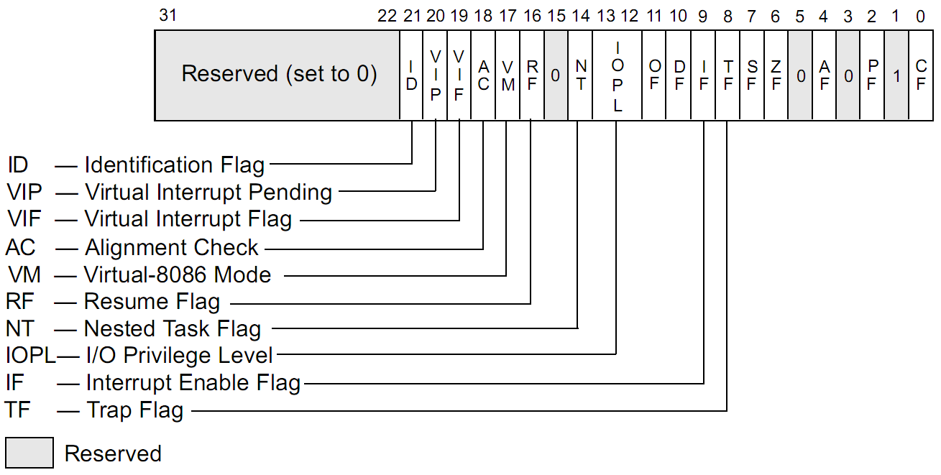
System Architecture Overview
System Flags in the EFLAGS

Slide 15
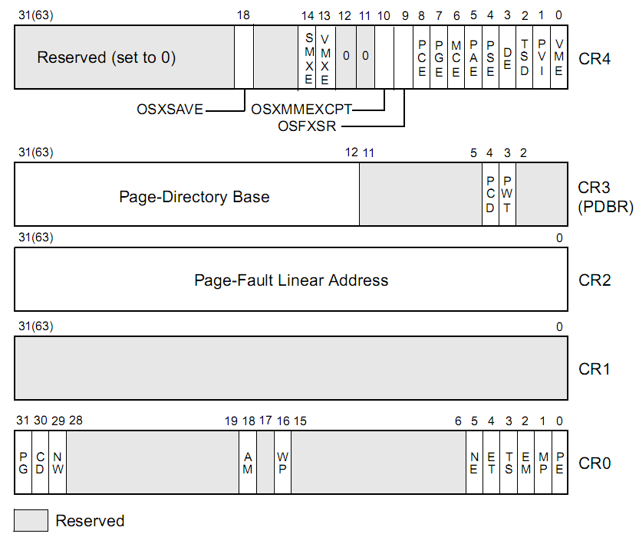
System Architecture Overview
Control Registers
PG: Paging
PE: Protection

Slide 16
System Architecture Overview
Memory-Management Registers
GDTR (Global Descriptor Table Register)
Base Address, Limit …
IDTR (Interrupt Descriptor Table Register)
Handler Address, Ring Level …
TR (Task Register)
TSS

Slide 17
PC Architecture
Memory
Execution
PC Emulation
Notes:
Big ideas: data can be instructions, stack, hardware == software

Slide 18
Memory Model
8086: 16-bits microprocessor
Real Mode: physical addr = 16 * segment + offset
Space: 64KB
External address to 20-bits
Space: 1MB
The extra 4 bits come segment registers
CS: code segment, for EIP
SS: stack segment, for SP and BP
DS: data segment for load/store via other registers
ES: another data segment, destination for string ops
e.g. CS=f000 IP=fff0 => ADDR: ffff0

Slide 19
Memory Model
80386: 32-bit data and bus addresses
Protected Mode
Now: the transition to 64-bit addresses
Backwards compatibility:
Boots in 16-bit real mode, and switches to 32-bit protected mode
See: “boot/boot.S”

Slide 20
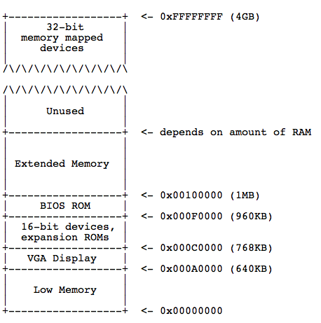
Physical Address Space Layout

Slide 21
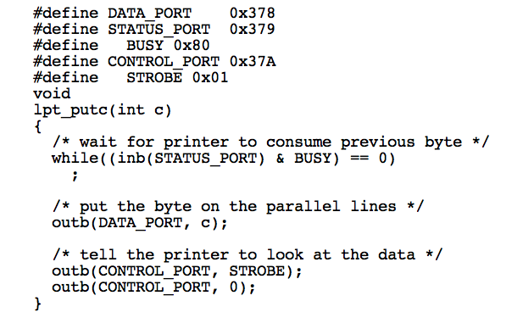
I/O space and instructions
static __inline uint8_t inb(int port)
{
uint8_t data;
__asm __volatile("inb %w1,%0"
: "=a" (data) : "d" (port));
return data;
}
static __inline void
outb(int port, uint8_t data)
{
__asm __volatile("outb %0,%w1"
: : "a" (data), "d" (port));
}

Slide 22
Memory-mapped I/O
Use normal addresses
No need for special instructions
No 1024 limit
System controller routes to device
Works like “magic” Memory
Addressed and accessed like memory
But does not behave like memory
Reads and writes have “side effects”
Read result can change due to external events
Recall: the “volatile” keyword

Slide 23
PC Architecture
Memory
Execution
PC Emulation
Notes:
Big ideas: data can be instructions, stack, hardware == software

Slide 24
XV6 Booting code

Slide 25
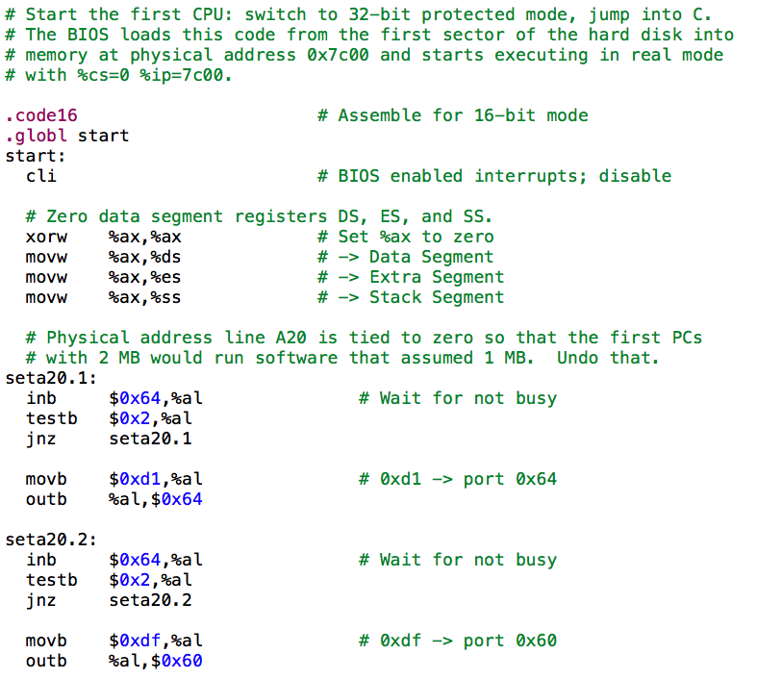
Notes:
A20: http://blog.csdn.net/ruyanhai/article/details/7181842

Slide 26
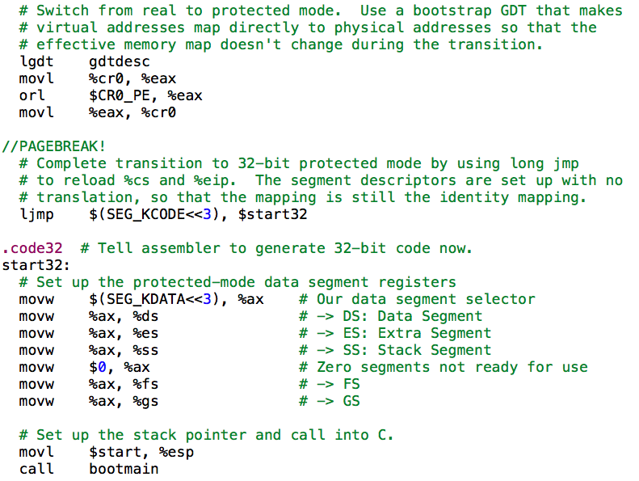

Slide 27
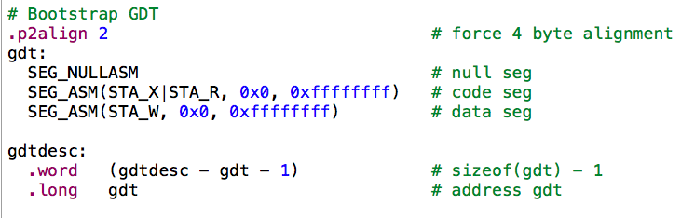
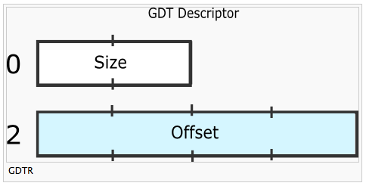
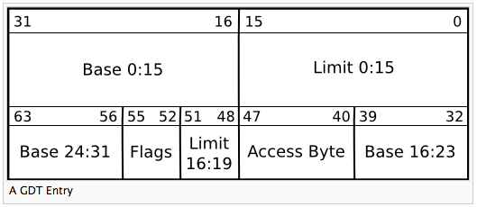
http://wiki.osdev.org/Global_Descriptor_Table

Slide 28
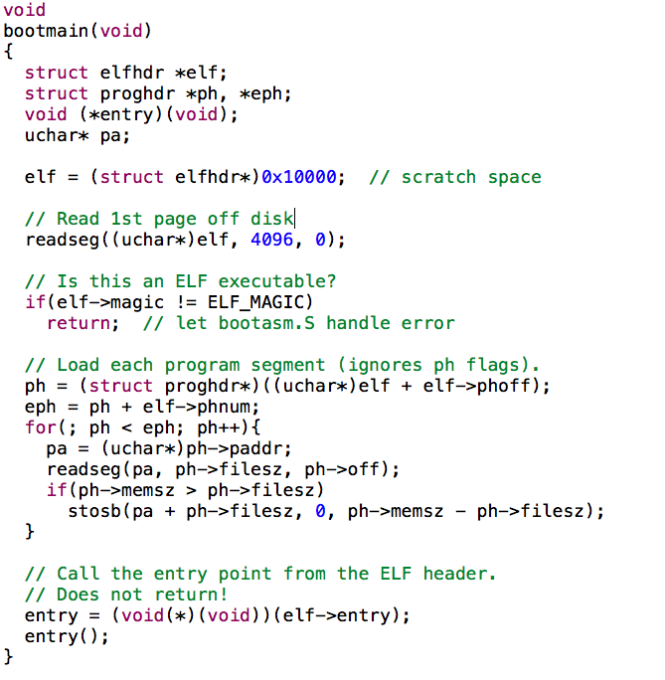

Slide 29
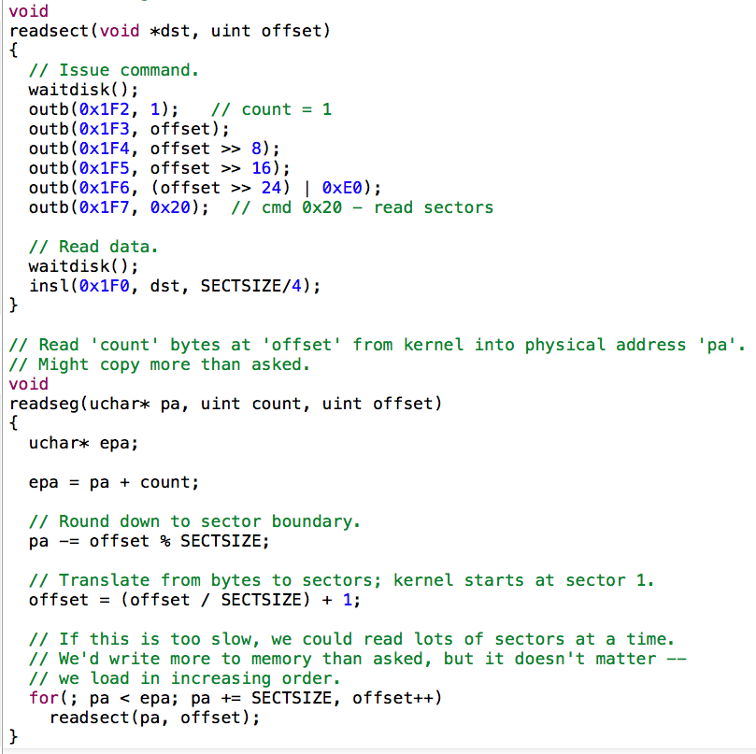

Slide 30
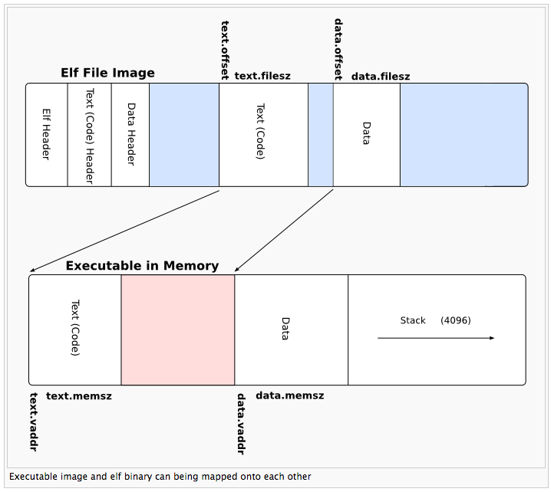

Slide 31
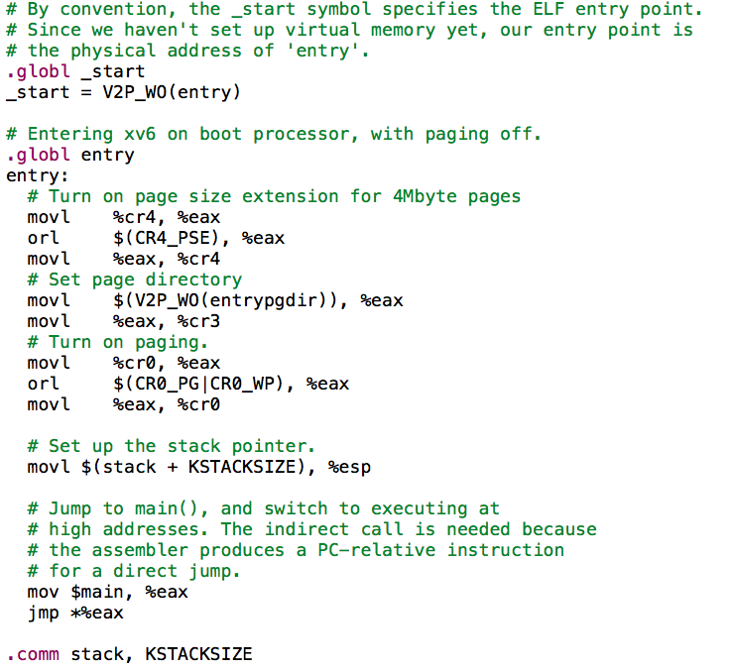

Slide 32
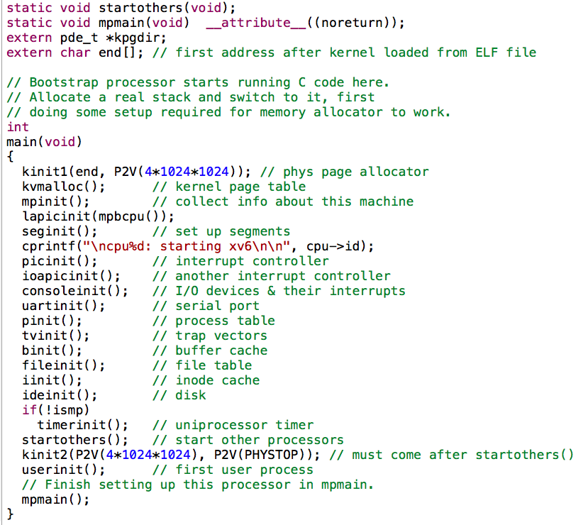

Slide 33
PC Architecture
Memory
Execution
PC Emulation
Notes:
Big ideas: data can be instructions, stack, hardware == software

Slide 34
Development using PC emulator
Bochs PC emulator
does what a real PC does
Only implemented in software!
JOS
Runs like a normal program on “host” operating system
PC emulator
Linux
PC

Slide 35
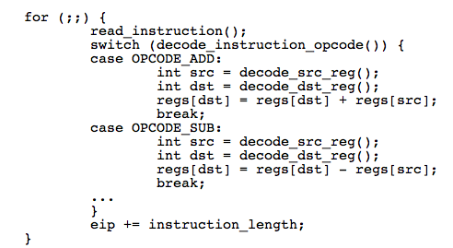
Emulation of CPU
OPCODE_ADD

Slide 36
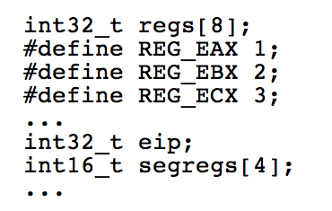

Emulation of Memory

Slide 37
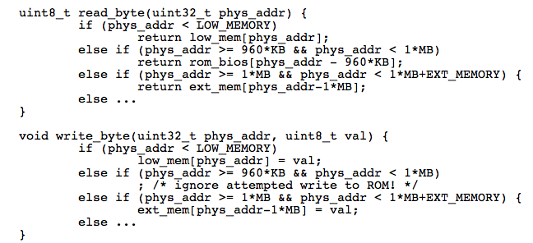
Emulation of x86 Memory
Low Memory
Extended Memory

Slide 38
Emulation of Devices
Hard disk: using a file of the host
VGA display: draw in a host window
Keyboard: host’s keyboard API
Clock chip: host’s clock
Etc.

Slide 39
Why Emulator
OS Test and Debug
Increase Utilization
Just as Why IBM’s Virtualization
IBM’s M44/44X, in 1960s
Notes:
39

Slide 40
Thanks
Next time:
Intro to PC booting & OS structure

Slide 41
Homework
What is the difference between user-level ISA and system-level ISA?
What is memory addressing mode? How many modes are there (please describe them)? Why not just use one?
Use your own word (and figures, if you want) to describe the process from power-on to BIOS end (just before kernel starts)

