Slide 1
XV6 & VM
Rong Chen & Yubin Xia
Some slides are based on Frans Kaashoek’s slides
kaashoek@mit.edu

Slide 2
Outline
Segment, Paging
LA, VA, PA
VM in xv6
Initial page table
Kernel page table
User page table
Page Fault

Slide 3
Review: ExoKernel
OS
App
Logic
User-Mode
Kernel-Mode
DOS
UNIX
MicroKernel
ExoKernel
Notes:
Q1: what are difference? Consider file system, page fault handler, device driver, cpu scheduling
Q2: what is address space? Note that the kernel and apps share the same space
Q3: which one has the best performance
Q4: what is virtual machine’s architecture? Both Xen and KVM

Slide 4
Virtual Memory

Slide 5
Recap: Integrating Caches and VM
VA
PA
miss
Trans-
lation
Cache
Main
Memory
CPU
hit
data

Slide 6
Recap: Integrating Caches and VM
PTE
CPU Chip
PTE
MMU
PTEA
hit
Memory
PTEA
PTEA
miss
PTEA
CPU
VA
PA
miss
PA
PA
PA
hit
Data
L1
cache
Data

Slide 7
Translating with a k-level Page Table
VIRTUAL ADDRESS
n-1
p-1
0
VPN 1
VPN 2
...
VPN k
VPO
Level 1
page table
Level 2
page table
Level k
page table
...
...
PPN
m-1
p-1
0
PPN
PPO
PHYSICAL ADDRESS

Slide 8
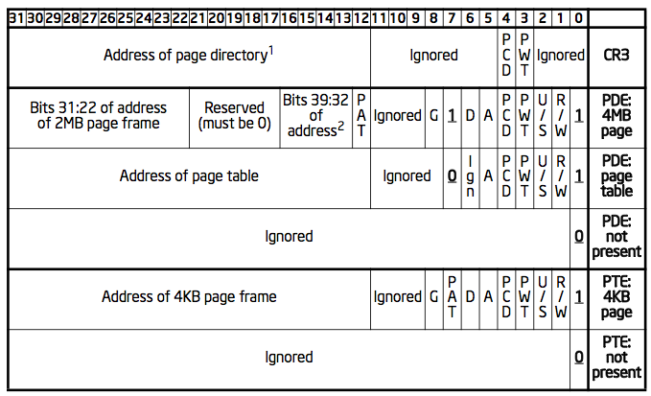
Page Table Entry (PTE)
P: present
R/W: readable / writable
U/S: user / supervisor
WT: write-through (1) / write-back (0)
CD: cache disabled
A: accessed (set by CPU, clear by OS)
D: dirty
PAT: page table attribute index
G: global page (no TLB updating on the address if CR3 is reset)
Notes:
The Global, or 'G' above, flag, if set, prevents the TLB from updating the address in its cache if CR3 is reset. Note, that the page global enable bit in CR4 must be set to enable this feature.
A: Note that, this bit will not be cleared by the CPU, so that burden falls on the OS (if it needs this bit at all).

Slide 9
Page Table Entry (PDE)
PS: page size (0=4KB, 1=4MB)
4MB: super page

Slide 10
Question
When the CPU is setting dirty bit of PTE, will it also set the dirty bit of corresponding PDE?
Let’s check the manual!

Slide 11
Quiz#1
In IA32 architecture, when the CR4_PSE bit in %cr4 register is set, then superpage mode is enabled, and the operating system can use either 4KB sized page or 4MB sized page. There are tradeoffs between small page and large page.
Consider the following scenarios:
a) Dump the content of a large file of several hundred megabytes mapped to the RAM by mmap() function to another location:
memcpy(addr_of_new_location, addr_of_mapped_file, sizeof_file);
b) Do the following calculation, where A, B are int pointers:
for(i=0; i<0x40000; ++i){
A[i] += B[i] & 0x3FFFFF;
}
Which sized (4KB or 4MB) page performs better in each scenario? Give your reasons.
Notes:
For a), 4MB sized page performs better. Since the workload is data-intensive, using 4MB sized page will make the TLB more efficient, which avoids the costly TLB misses and reduces the average address translation time.
For b), 4KB sized page performs better. Since the workload is small and CPU-intensive, using 4KB sized page will have more effective memory use.

Slide 12
PAE: Physical Address Extension
Enabled when
CR0.PG=1 && CR4.PAE=1
32-bit linear address -> 36-bit physical address
Can be more than 36
Maintains a set of 4 PDPTE registers
Page directory pointer table
64-bit PTE
Instead of 32-bit

Slide 13
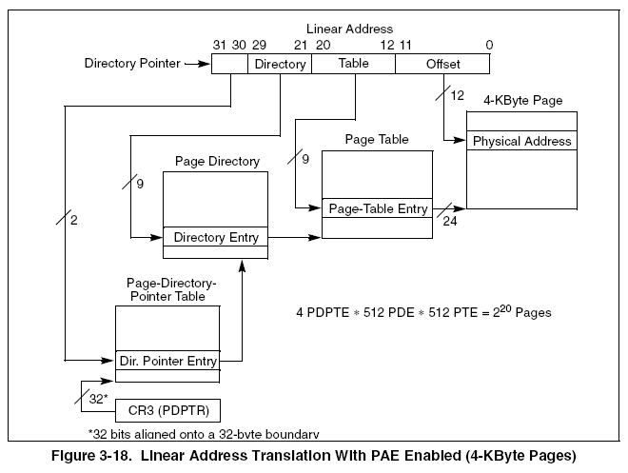
Address translation: PAE-4k

Slide 14
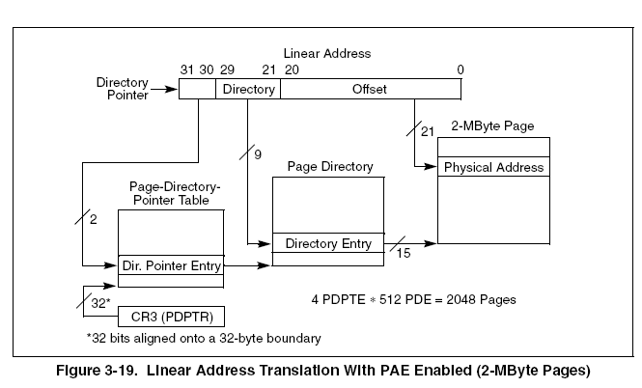
Address translation: PAE-2M
Question: Why 2M instead of 4M?

Slide 15
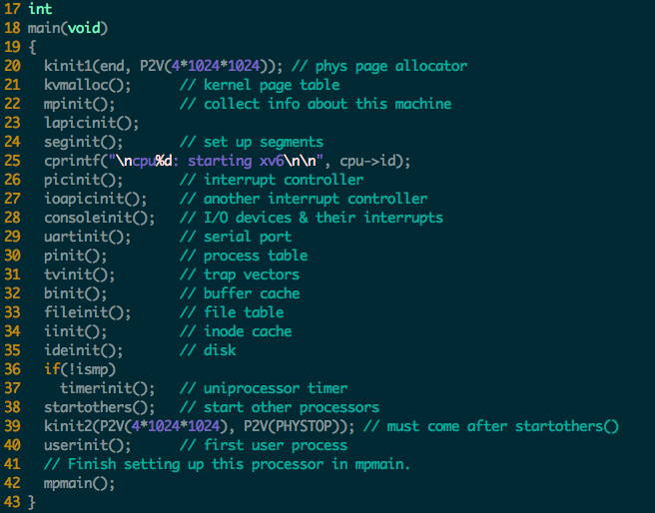

Slide 16
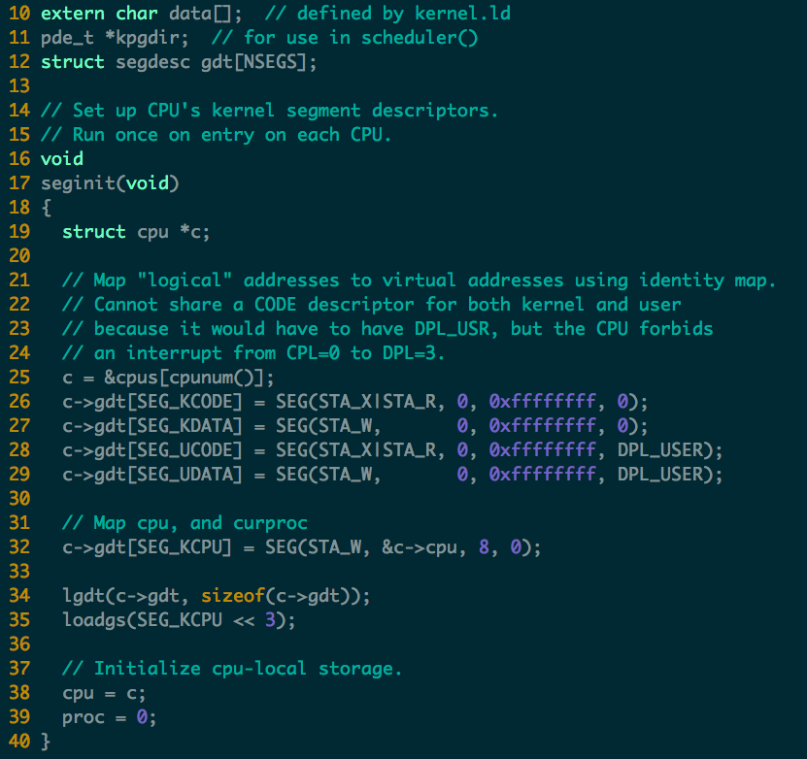

Slide 17
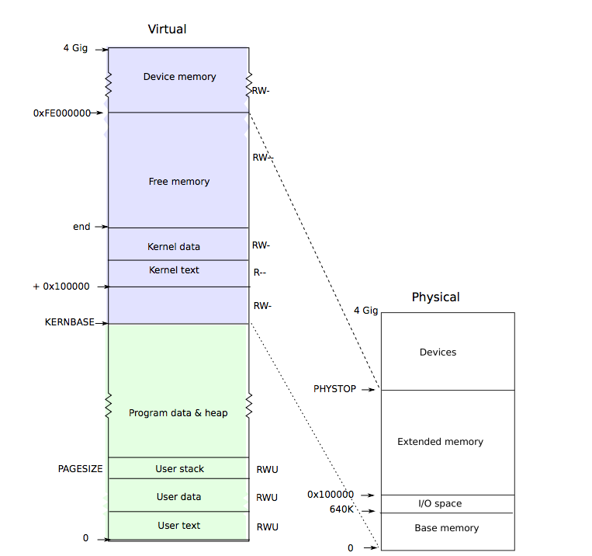

Slide 18
big picture of xv6's virtual addressing scheme
0x00000000:0x80000000
user addresses below KERNBASE
0x80000000:0x80100000
map low 1MB devices (for kernel)
0x80100000:?
kernel instructions/data
? :0x8E000000
224 MB of DRAM mapped here
0xFE000000:0x00000000
more memory-mapped devices

Slide 19
4 KB pages
entrypgdir was simple
array of 1024 PDEs, each mapping 4 MB but 4 MB is too large a page size!
very wasteful if you have small processes xv6 programs are a few dozen kilobytes
4 MB pages require allocating full 4 MB of phys mem
solution: x86 MMU supports 4 KB pages
kvmalloc

Slide 20
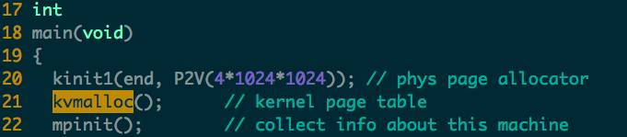
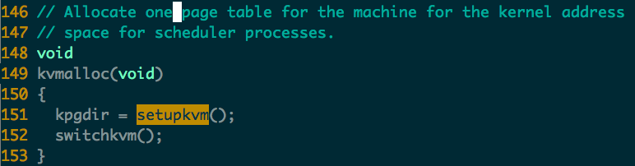
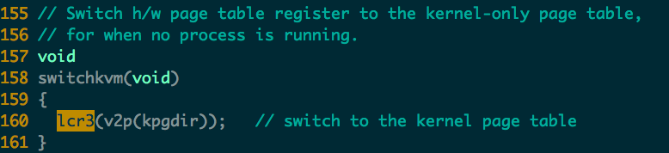

Slide 21
Setup_kvm
Usage
creates a page table
install mappings the kernel will need
will be called once for each new process
Process
must allocate PD, allocate some PTs, put mappings in PTEs
alloc allocates a physical page for the PD
returns that page's virtual address above 0x8000000
so we'll have to call V2P before installing in cr3
memset so that default is no translation (no P bit)
a call to mappages for each entry in kmap[]

Slide 22
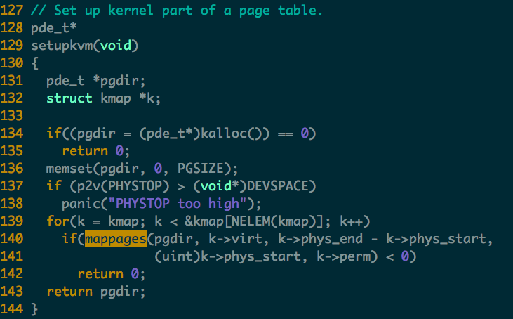

Slide 23
what is kmap[]?
an entry for each region of kernel virtual address space
same as address space setup from earlier in lecture
0x80000000 -> 0x00000000 (memory-mapped devices)
0x80100000 -> 0x00100000 (kernel instructions and data)
data -> data-0x80000000 (phys mem after where kernel was loaded)
DEVSPACE -> DEVSPACE (more memory mapped devices)
note no mappings below va 0x80000000 -- future user memory there

Slide 24
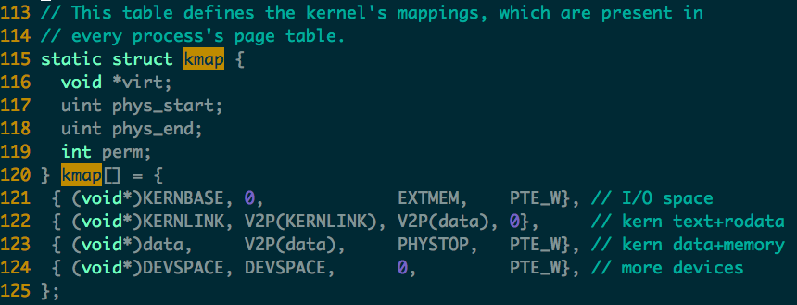

Slide 25
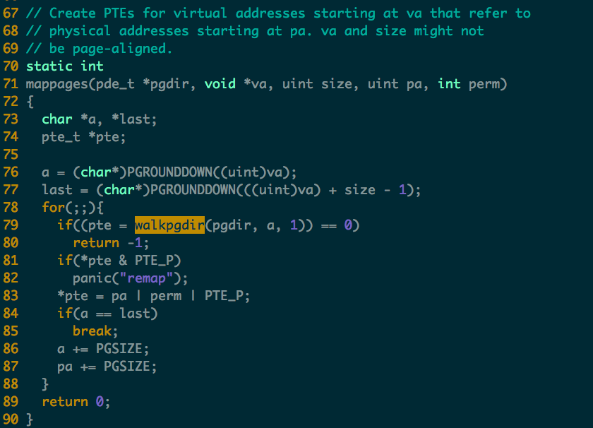

Slide 26
mappages
arguments are PD, va, size, pa, perm
adds mappings from a range of va's to corresponding pa's
rounds because other uses pass in non-page-aligned addresses
for each page-aligned address in the range
call walkpgdir to find address of PTE need the PTE's address (not just content) because we want to modify

Slide 27
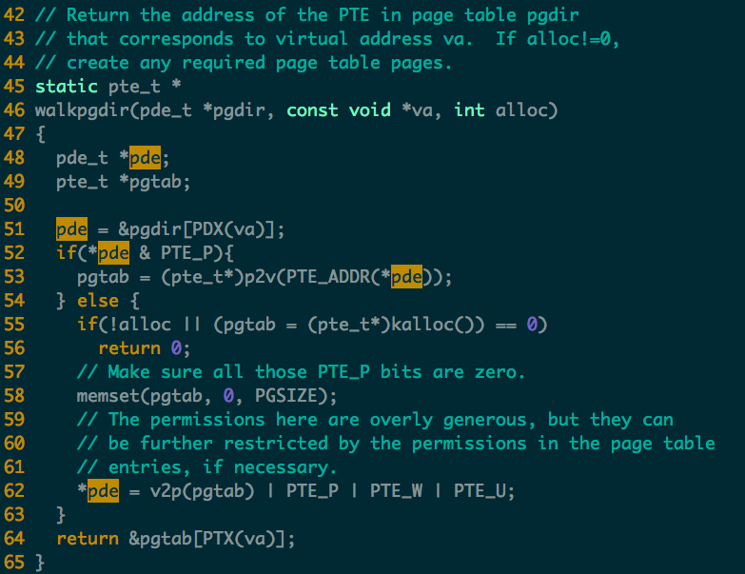

Slide 28
walkpgdir
mimics how the paging h/w finds the PTE for an address
a little complex since xv6 allocates page-table pages lazily
might not be present, might have to allocate
PDX extracts top ten bits
&pgdir[PDX(va)] is the address of the relevant PDE
now *pde is the PDE
if PTE_P
the relevant page-table page already exists
PTE_ADDR extracts the PPN from the PDE
p2v() adds 0x80000000, since PTE holds physical address
if not PTE_P
alloc a page-table page
fill in PDE with PPN -- thus v2p
now the PTE we want is in the page-table page
at offset PTX(va) , which is 2nd 10 bits of va

Slide 29
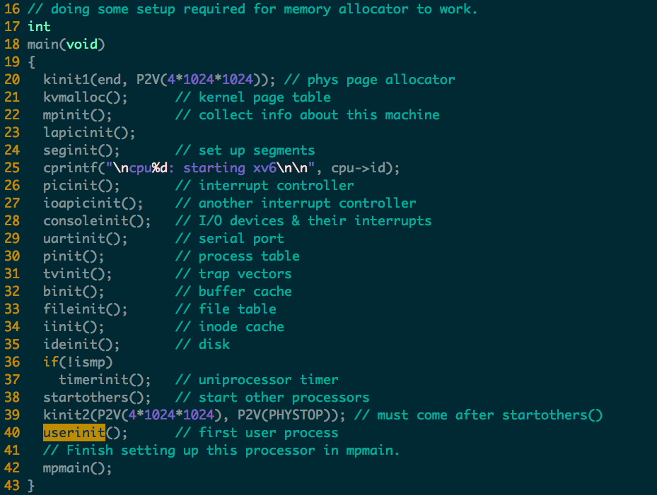

Slide 30
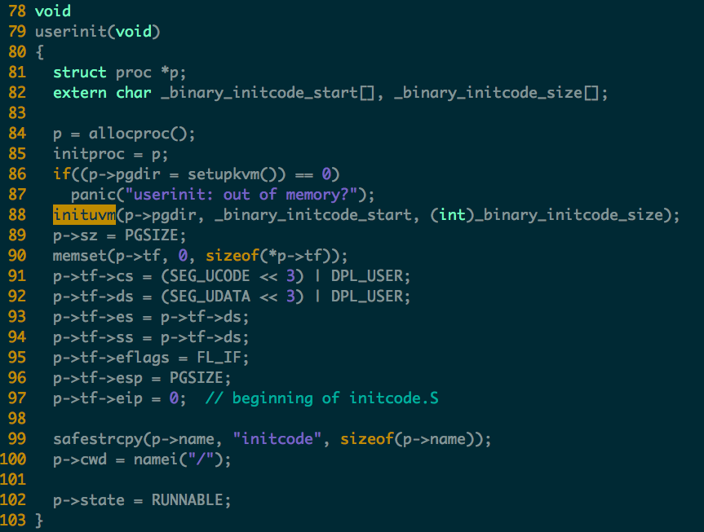

Slide 31
User VM mapping
Create a process
Inituvm : initialized user VM
Loaduvm: load program segment
Context switch
switchuvm
Grow/shrink/free VM
allocuvm
deallocuvm
Freeuvm
Fork
copyuvm

Slide 32
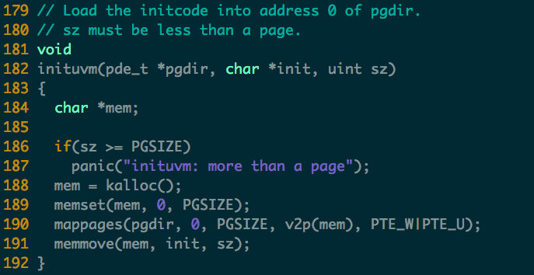

Slide 33
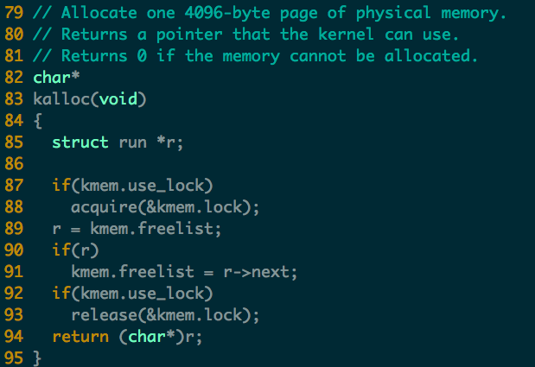

Slide 34
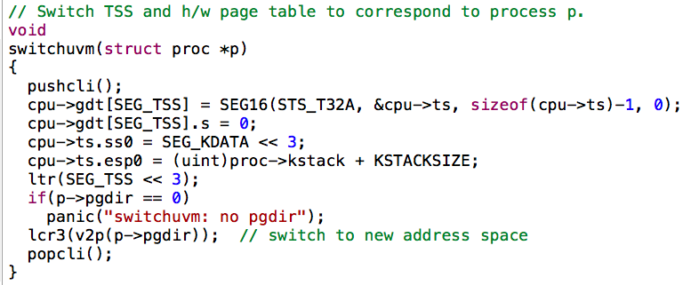

Slide 35
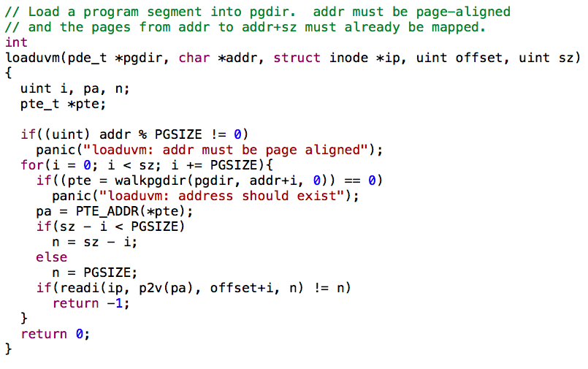

Slide 36
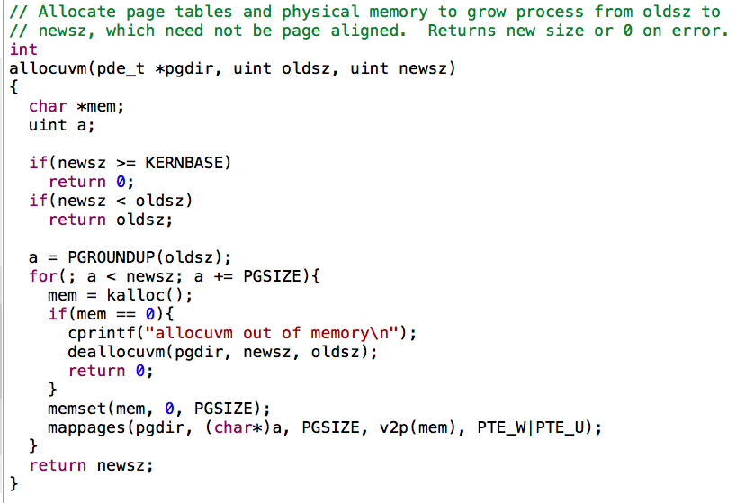

Slide 37
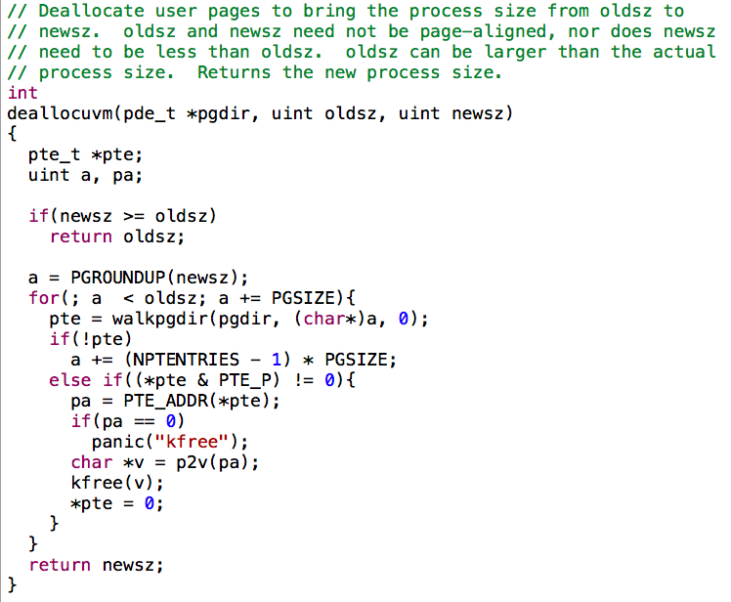

Slide 38
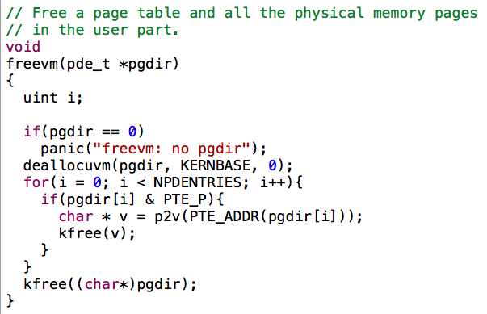

Slide 39
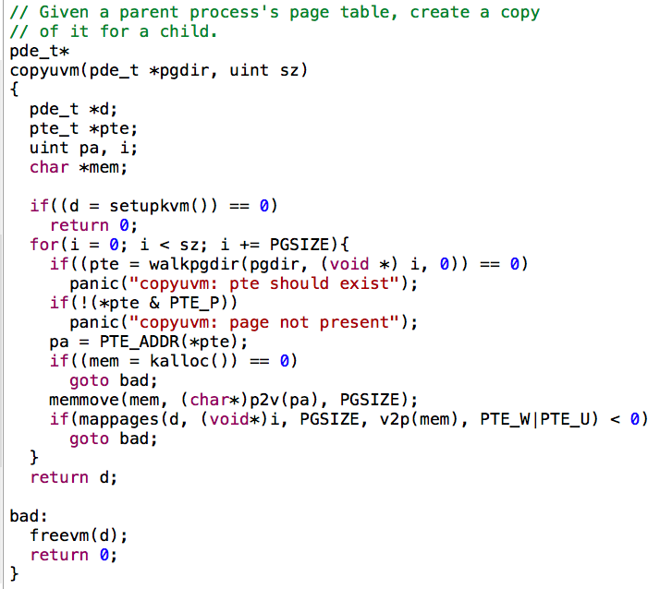

Slide 40
