Slide 1
Processes
Yubin Xia
IPADS, SJTU
ACKs: Some slides are adapted from the textbook’s original slides and Frans’s os course notes

Slide 2
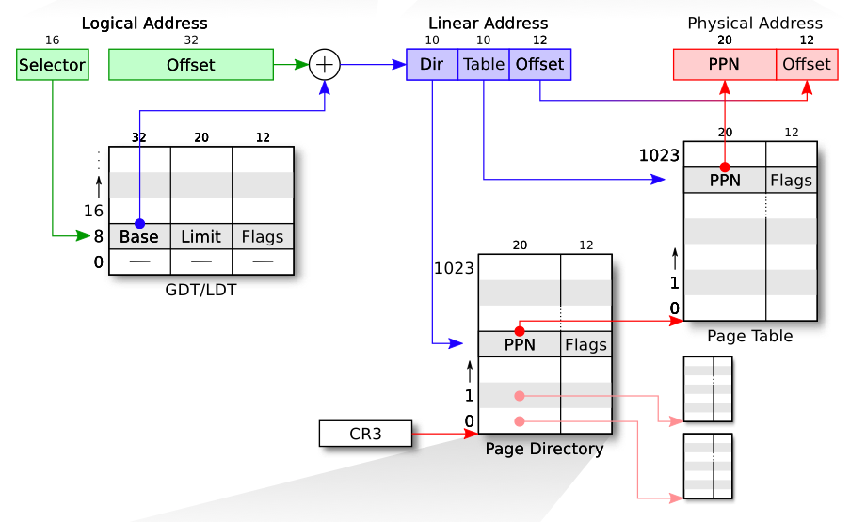
Review: LA->LA->PA

Slide 3
Review
Booting: enabling segment and paging
Segment: set GDT & use long jmp (ljmp)
Paging: temporary page table (entrypgdir) with kernel mapped at both 0x80100000 and 0x100000
Different page size: 4KB vs. 4MB(2MB)

Slide 4
Process in xv6

Slide 5
Processes Outline
Process Concept
Process Scheduling
Operations on Processes
Interprocess Communication
Examples of IPC Systems
Communication in Client-Server Systems

Slide 6
Process: Big Picture
More programs than processors
How to share the limited number of processors among the programs?
Observation: most programs do not need the processor continuously
because they frequently have to wait for input (from user, disk, network, etc.)
Idea: when one program must wait, it releases the processor, and gives it to another program

Slide 7
Threads
Mechanism: thread of computation, an active computation.
A thread is an abstraction that contains
the minimal state that is necessary to stop an active and resume it at some point later
The state is depends on the processor
On x86, it is the processor registers

Slide 8
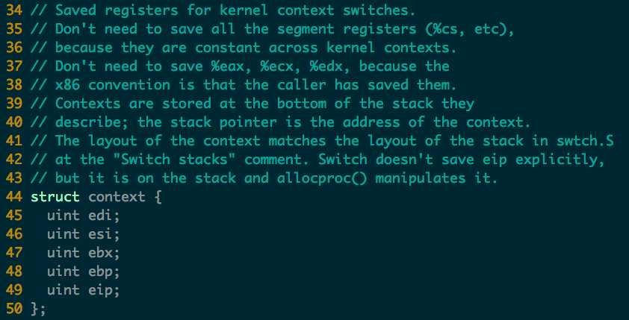
Threads in xv6

Slide 9
Address spaces and threads
Address spaces and threads are in principle independent concepts
One can switch from one thread to another thread in the same address space
or one can switch from one thread to another thread in another address space

Slide 10
Process Concepts
Process: a program in execution
one address space + one or more threads of computation
A process includes:
program counter, stack, data section
In xv6 all user programs contain one thread of computation and one address space

Slide 11
Process State
As a process executes, it changes state
new: The process is being created
running: Instructions are being executed
waiting: The process is waiting for some event to occur
ready: The process is waiting to be assigned to a processor
terminated: The process has finished execution
In xv6
Notes:
Embryo: 萌芽, 初期

Slide 12
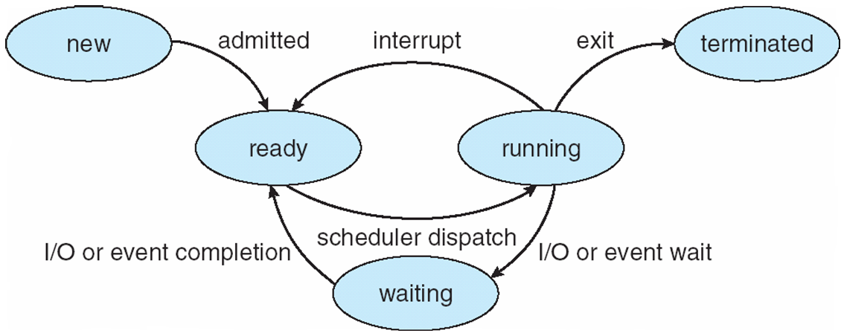
Diagram of Process State

Slide 13
Process Control Block (PCB)
Information associated with each process
Process state
Program counter
CPU registers
CPU scheduling information
Memory-management information
Accounting information
I/O status information

Slide 14
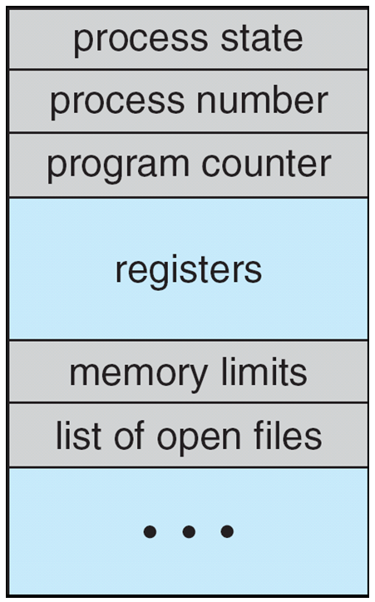
Process Control Block (PCB)

Slide 15
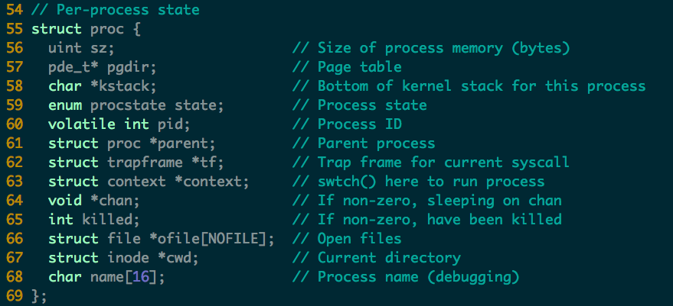
Process in xv6 (proc.c)

Slide 16
Context Switch
When CPU switches to another process, the system must do it via a context switch
save the state of the old process
load the saved state for the new process Context of a process represented in the PCB
Context-switch time is overhead
the system does no useful work while switching
Time dependent on hardware support

Slide 17
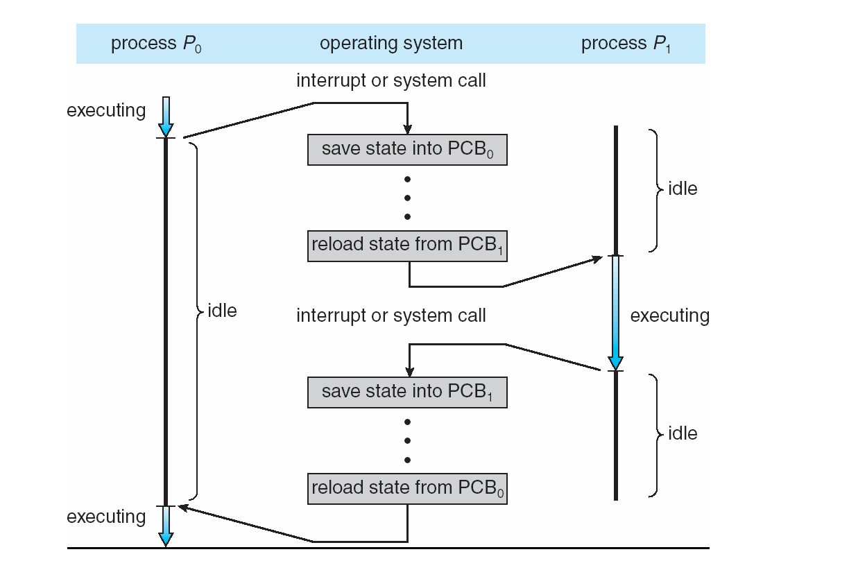
CPU Switch From Process to Process

Slide 18
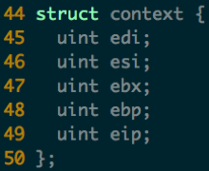
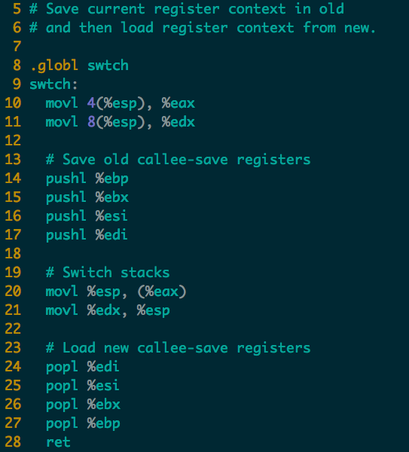

Context Switch in xv6 (swtch.S)
push
pop
new
new
old
old
ret addr
ret addr
ebp
ebp
ebx
ebx
esi
esi
edi
edi
esp
esp
Notes:
Note that the 4 pushl will generate a struct context. One missing field is eip, where is it?
Where is the old context saved?

Slide 19
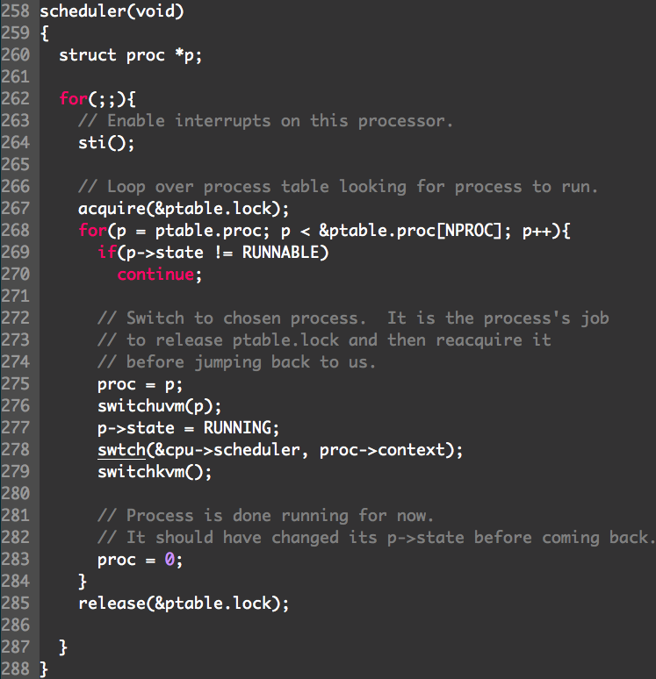
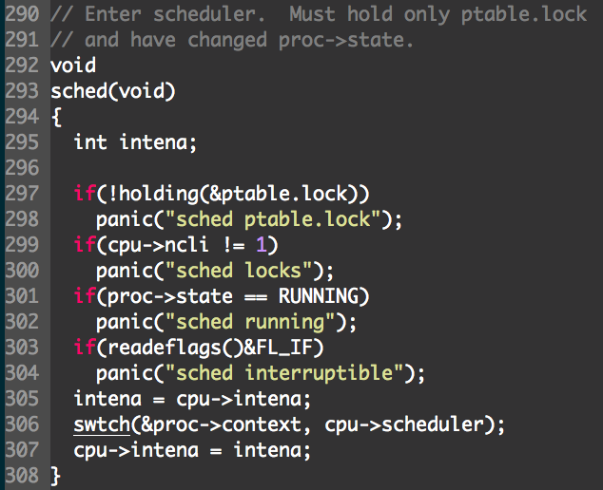
User space
User -> kernel -> user
Notes:
sched => switch to Scheduler => switchkvm (to kernel) => switchuvm (to user) => switch to P => sched

Slide 20
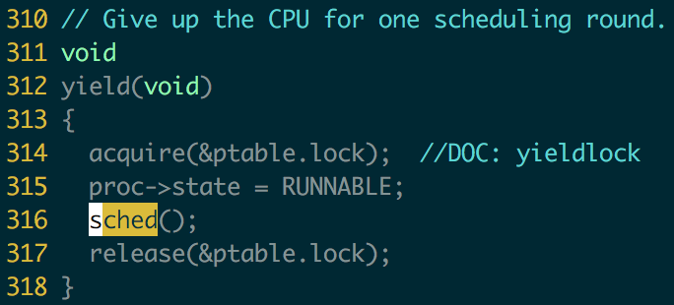
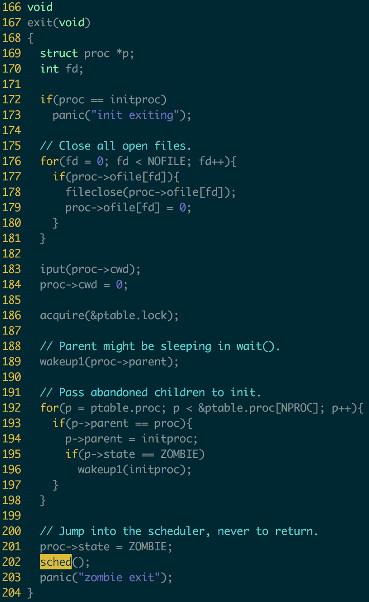
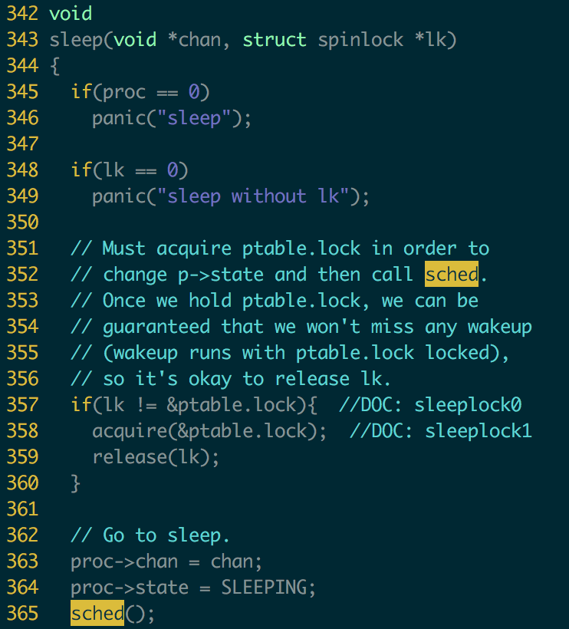

Slide 21
Process Scheduling Queues
Job queue – set of all processes in the system
Ready queue – set of all processes residing in main memory, ready and waiting to execute
Device queues – set of processes waiting for an I/O device
Processes migrate among the various queues

Slide 22
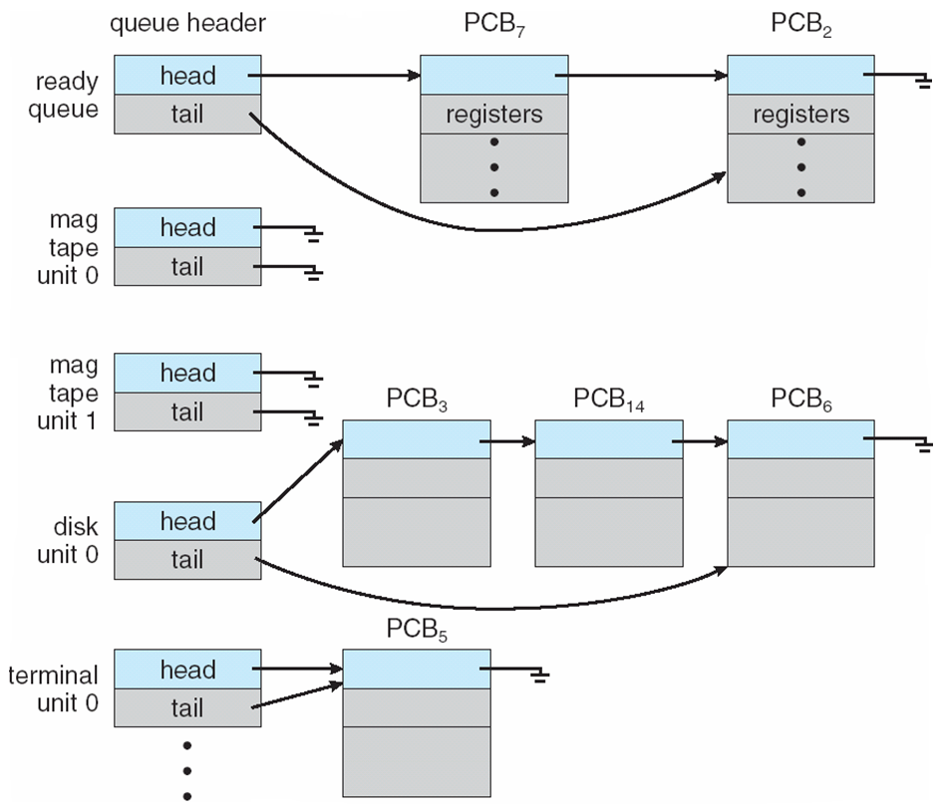
Ready Queue & Various I/O Device Queues

Slide 23
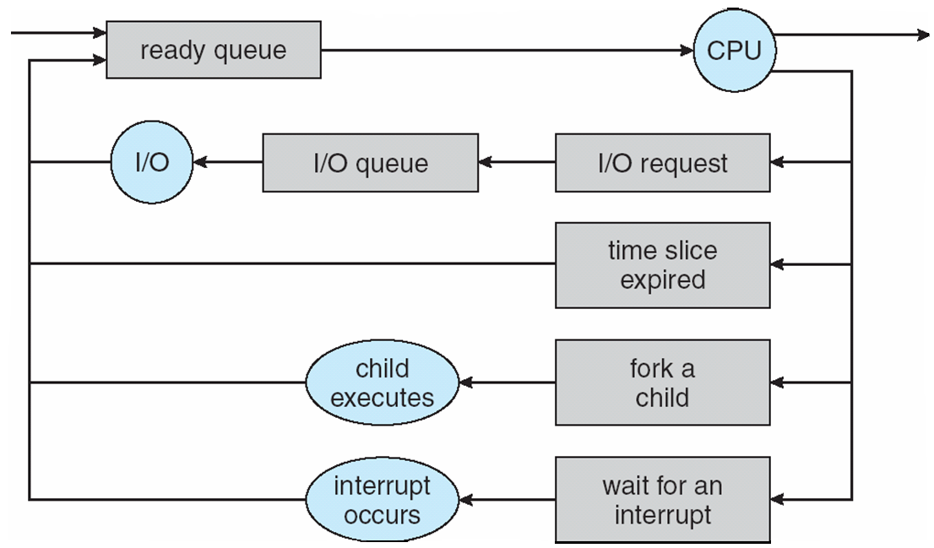
Representation of Process Scheduling

Slide 24
Schedulers
Long-term scheduler (or job scheduler) – selects which processes should be brought into the ready queue
Short-term scheduler (or CPU scheduler) – selects which process should be executed next and allocates CPU

Slide 25
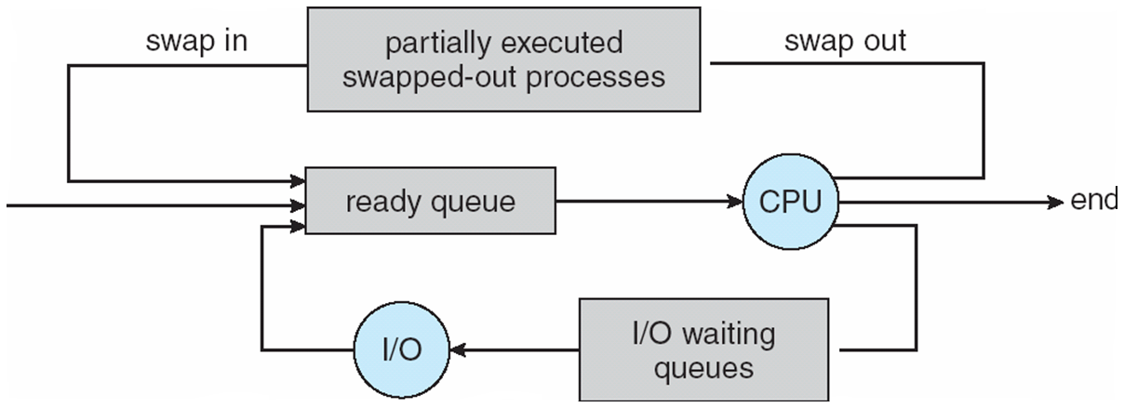
Addition of Medium Term Scheduling

Slide 26
Schedulers (Cont)
Short-term scheduler is invoked very frequently (milliseconds) ⇒ (must be fast)
Long-term scheduler is invoked very infrequently (seconds, minutes) ⇒ (may be slow)
The long-term scheduler controls the degree of multiprogramming

Slide 27
Scheduler (cont.)
Processes can be described as either:
I/O-bound process – spends more time doing I/O than computations, many short CPU bursts
CPU-bound process – spends more time doing computations; few very long CPU bursts

Slide 28
Process Creation
Parent process create children processes
forming a tree of processes
Generally, process identified and managed via a process identifier (pid)
Resource sharing policies
share all resources
share subset of parent’s resources
share no resources

Slide 29
Process Creation (Cont)
Execution
Parent and children execute concurrently
Parent waits until children terminate
Address space
Child duplicate of parent’s
Child has a program loaded into it
UNIX examples
fork system call creates new process
exec system call used after a fork to replace the process’ memory space with a new program

Slide 30
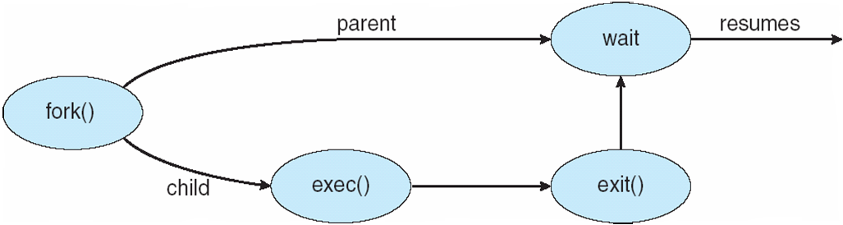
Process Creation

Slide 31
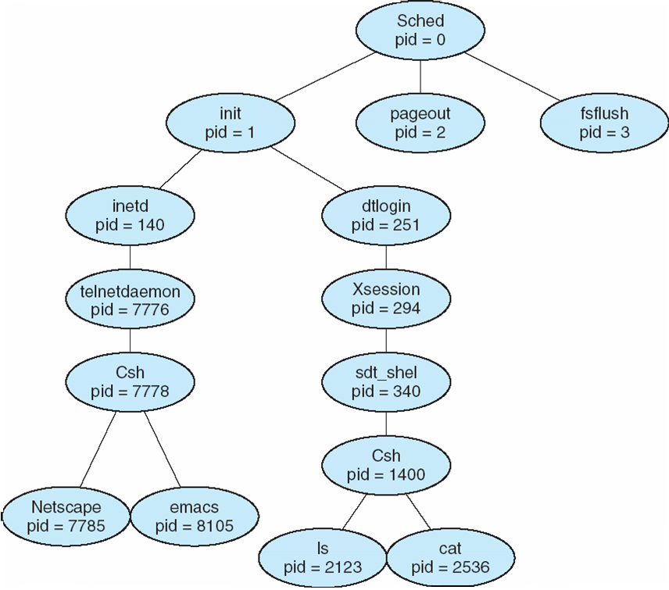
A tree of processes on a typical Solaris

Slide 32
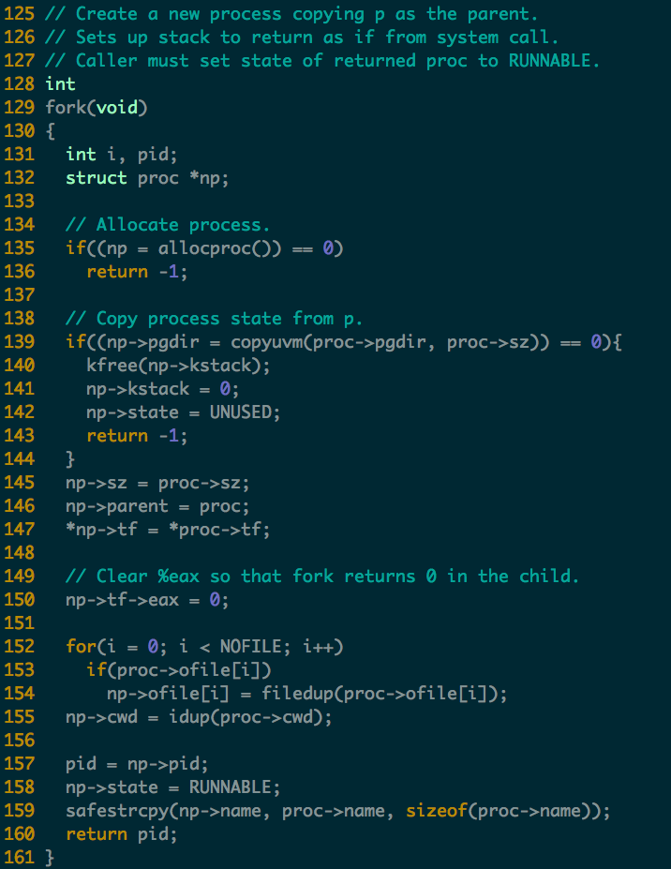
Process Creation in xv6
Read following code
allocproc()

Slide 33
Process Termination
Process executes last statement and asks the operating system to delete it (exit)
Output data from child to parent (via wait)
Process’ resources are deallocated by operating system
Parent may terminate execution of children processes (abort)
Child has exceeded allocated resources
Task assigned to child is no longer required

Slide 34
Process Termination (Cont.)
If parent is exiting
Some operating system do not allow child to continue if its parent terminates
All children terminated - cascading termination

Slide 35
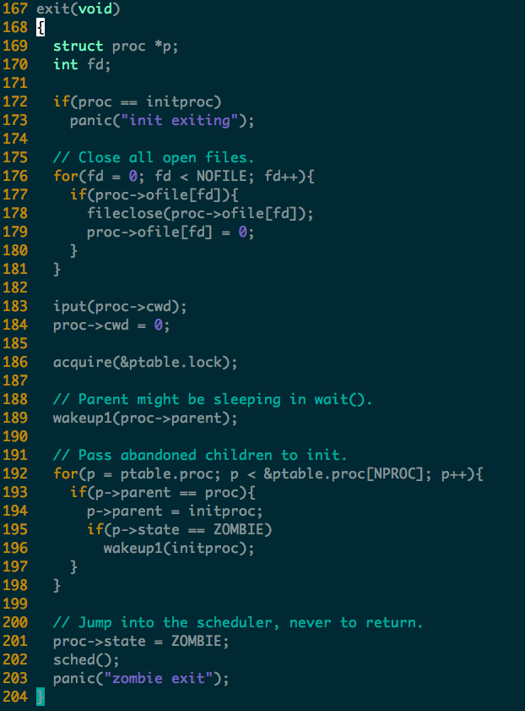

Slide 36
Cooperating Processes
Independent process cannot affect or be affected by the execution of another process
Cooperating process can affect or be affected by the execution of another process
Advantages of process cooperation
Information sharing
Computation speed-up
Modularity
Convenience

Slide 37
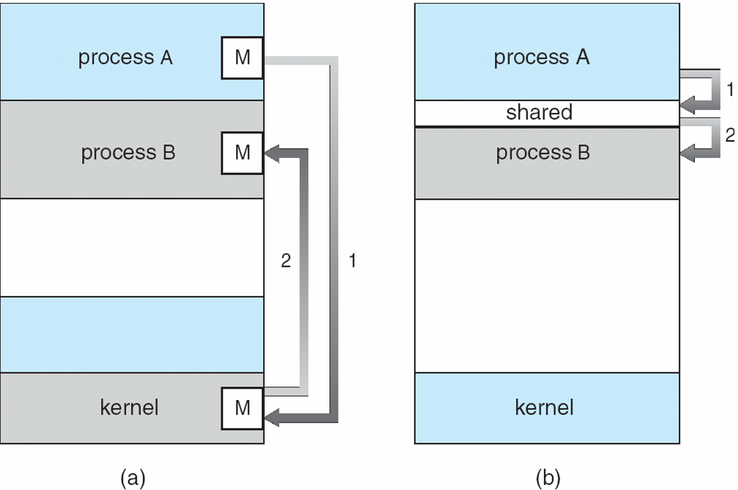
Communications Models

Slide 38
IPC
Cooperating processes need interprocess communication (IPC)
Two models of IPC
Shared memory
Message passing

Slide 39
Producer-Consumer Problem
Producer process produces information that is consumed by a consumer process
unbounded-buffer places no practical limit on the size of the buffer
bounded-buffer assumes that there is a fixed buffer size

Slide 40
Bounded-Buffer – Shared-Memory Solution
Shared data
#define BUFFER_SIZE 10
typedef struct {
. . .
} item;
item buffer[BUFFER_SIZE];
int in = 0;
int out = 0;
Solution is correct, but can only use BUFFER_SIZE-1 elements

Slide 41
Bounded-Buffer – Producer
while (true) { /* Produce an item */
while (((in = (in + 1) % BUFFER SIZE count)
== out)
; /* do nothing -- no free buffers */
buffer[in] = item;
in = (in + 1) % BUFFER SIZE;
}

Slide 42
Bounded Buffer – Consumer
while (true) {
while (in == out)
; // do nothing -- nothing to consume
// remove an item from the buffer
item = buffer[out];
out = (out + 1) % BUFFER SIZE;
return item;
}

Slide 43
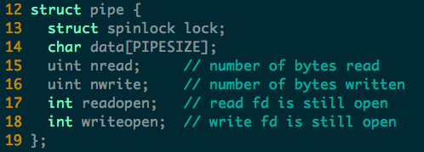
Example of IPC in xv6: Pipe (pipe.c)

Slide 44
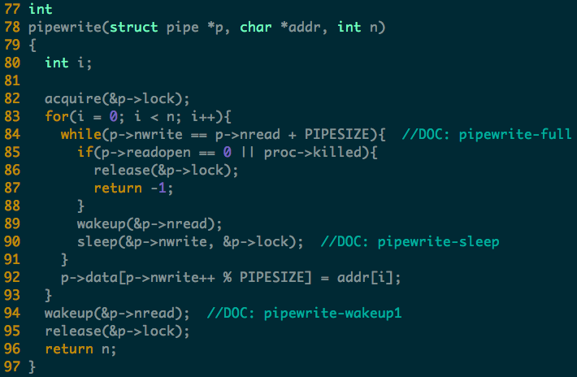
Notes:
Two wakeup here
The first wakeup is since the buffer is full and thus need to be read (previous write).
The second wakeup is similar, ask to read the (current write).
Note: sleep with lock

Slide 45
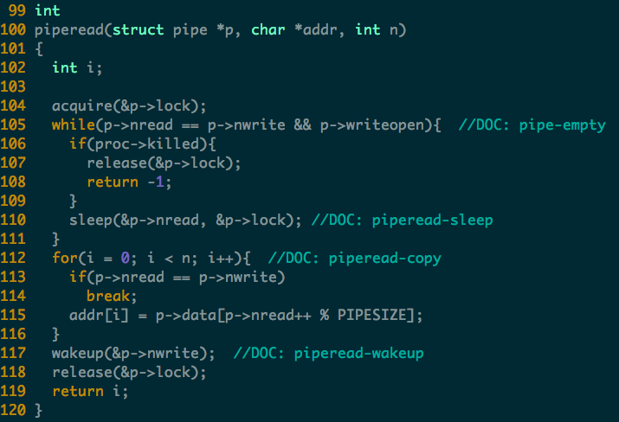
Notes:
Why only one wakeup(writer) here?
In the while loop, no need to wakeup writer since the buffer is empty and no write will sleep
After the for loop, some writer may be waiting (e.g., the buffer was full before read), so wake them up.

Slide 46
Interprocess Communication – Message Passing
Mechanism for processes to communicate and to synchronize their actions
Message system
processes communicate with each other without resorting to shared variables
IPC facility provides two operations:
send(message) – message size fixed or variable
receive(message)

Slide 47
Message Passing (Cont.)
If P and Q wish to communicate, they need to:
establish a communication link between them
exchange messages via send/receive
Implementation of communication link
physical (e.g., shared memory, hardware bus)
logical (e.g., logical properties)

Slide 48
Implementation Questions
How are links established?
Can a link be associated with more than two processes?
How many links can be between every pair of communicating processes?
What is the capacity of a link?
Is the size of a message that the link can accommodate fixed or variable?
Is a link unidirectional or bi-directional?

Slide 49
Direct Communication
Processes must name each other explicitly:
send (P, message) – send a message to process P
receive(Q, message) – receive a message from process Q
Properties of communication link
Links are established automatically
A link is associated with exactly one pair of communicating processes
Between each pair there exists exactly one link
The link may be unidirectional, but is usually bi-directional

Slide 50
Indirect Communication
Messages are directed and received from mailboxes (also referred to as ports)
Each mailbox has a unique id
Processes can communicate only if they share a mailbox

Slide 51
Indirect Communication
Properties of communication link
Link established only if processes share a common mailbox
A link may be associated with many processes
Each pair of processes may share several communication links
Link may be unidirectional or bi-directional

Slide 52
Indirect Communication
Operations
create a new mailbox
send and receive messages through mailbox
destroy a mailbox
Primitives are defined as:
send(A, message) – send a message to mailbox A
receive(A, message) – receive a message from mailbox A

Slide 53
Indirect Communication
Mailbox sharing
P₁, P₂, and P₃ share mailbox A
P₁, sends; P₂ and P₃ receive
Who gets the message?
Solutions
Allow a link to be associated with at most two processes
Allow only one process at a time to execute a receive operation
Allow the system to select arbitrarily the receiver. Sender is notified who the receiver was.

Slide 54
Synchronization & Asynchronous
Message passing may be either blocking or non-blocking
Blocking is considered synchronous
Blocking send has the sender block until the message is received
Blocking receive has the receiver block until a message is available
Non-blocking is considered asynchronous
Non-blocking send has the sender send the message and continue
Non-blocking receive has the receiver receive a valid message or null

Slide 55
Buffering
Queue of messages attached to the link; implemented in one of three ways
1. Zero capacity – 0 messages Sender must wait for receiver (rendezvous)
2. Bounded capacity – finite length of n messages Sender must wait if link full
3. Unbounded capacity – infinite length Sender never waits

Slide 56
Examples of IPC Systems - POSIX
POSIX Shared Memory
Process first creates shared memory segment
segment id = shmget(IPC PRIVATE, size, S IRUSR | S IWUSR);
Process wanting access to that shared memory must attach to it
shared memory = (char *) shmat(id, NULL, 0);
Now the process could write to the shared memory
sprintf(shared memory, "Writing to shared memory");
When done a process can detach the shared memory from its address space
shmdt(shared memory);

Slide 57
Examples of IPC Systems – WinXP
Message-passing centric via local procedure call (LPC) facility
Only works between processes on the same system
Uses ports (like mailboxes) to establish and maintain communication channels

Slide 58
Examples of IPC Systems – WinXP (cont.)
Communication works as follows:
The client opens a handle to the subsystem’s connection port object
The client sends a connection request
The server creates two private communication ports and returns the handle to one of them to the client
The client and server use the corresponding port handle to send messages or callbacks and to listen for replies

Slide 59
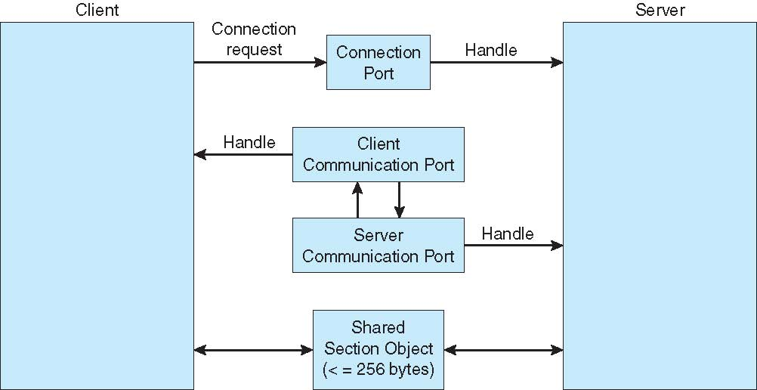
Local Procedure Calls in Windows XP

Slide 60
Communications in Client-Server Systems
Sockets
Remote Procedure Calls
Remote Method Invocation (Java)

Slide 61
Interrupt, Trap, SYS CALL

Slide 62
Concepts
System call
a user program can ask for an operating system service
Exception
refers to an illegal program action
Interrupt
refers to a signal generated by a hardware device

Slide 63
Requirements
Must save the processor’s registers for future transparent resume
Must be set up for execution in the kernel
Must chose a place for the kernel to start executing
Must be able to retrieve information about the event, e.g., system call arguments
Must all be done securely
Must maintain isolation of user processes and the kernel

Slide 64
IDT
IDT: interrupt descriptor table
Has 256 entries
Each giving the %cs and %eip to be used when handling the corresponding interrupt
System call
A program invokes int n
n specifies the index into the IDT

Slide 65
System Call
Fetch the n’th descriptor from the IDT, where n is the argument of int.
Check that CPL in %cs is <= DPL, where DPL is the privilege level in the descriptor.
Save %esp and %ss in a CPU-internal registers, but only if the target segment selector’s PL < CPL.
Load %ss and %esp from a task segment descriptor.
Push %ss, %esp, %eflags, %cs, %eip,
Clear some bits of %eflags
Set %cs and %eip to the values in the descriptor

Slide 66
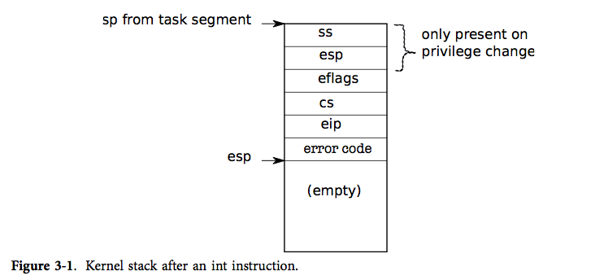
Kernel Stack

Slide 67
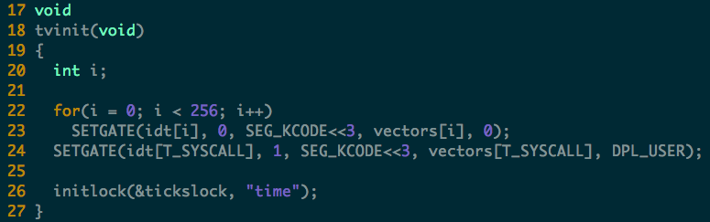
tvinit

Slide 68
Homework
In xv6, one process contains only one thread. If we allow one process contains multiple thread, which state of the original PCB (process control block) should be per-thread and which should be per-process?

