Slide 1
System Calls
Yubin Xia
IPADS, SJTU
ACKs: Some slides are adapted from the textbook’s original slides and Frans’s os course notes

Slide 2
Review: Exception

Slide 3
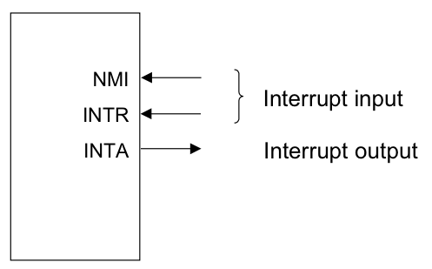
Review: Events causing User->Kernel
Device interrupt: external
Nonmaskable interrupt (NMI) input pin
Interrupt (INTR) input pin
Software interrupt: execution of the Interrupt instruction
e.g., INT
Program faults: If some error condition occur by the execution of an instruction. E.g.,
divide-by-zero interrupt

Slide 4
Review: OS as Services
Exception
Application (CPU)
Exception
Table
OS
Services
I/O Device
Interrupt
Notes:
Question: what if

Slide 5
Review: Terminology for Intel
Interrupts (asynchronous, device generated)
Maskable: device-generated, associated with IRQs (interrupt request lines); may be temporarily disabled (still pending)
Nonmaskable: some critical hardware failures
Exceptions (synchronous, from software)
Processor-detected
Faults – correctable (restartable); e.g. page fault
Traps – no reexecution needed; e.g. breakpoint
Aborts – severe error; process usually terminated (by signal)
Programmed exceptions (software interrupts)
int (system call), int3 (breakpoint)
into (overflow), bounds (address check)

Slide 6
Bottom half (in Linux)

Slide 7
Interrupt Handling Philosophy
To preserve IRQ order on the same line, must disable incoming interrupts on same line
New interrupts can get lost if controller buffer overflow
Interrupt preempts what CPU was doing, which may be important
Even not important, undesirable to block user program for long
So, handler must run for a very short time!
Do as little as possible in the interrupt handler
Often just: queue a work item and set a flag
Defer non-critical actions till later
Notes:
What disable mean: cpu or PIC not accepting, but device controller can still accept (limited by buffer size)

Slide 8
Intr Handlers Have No Process Context
Interrupts (as opposed to exceptions) are not associated with particular instructions
They are also not associated with a given process (user program)
The currently-running process, at the time of the interrupt, as no relationship whatsoever to that interrupt
Interrupt handlers cannot sleep!

Slide 9
What Can’t You (ISR) Do?
You cannot sleep
or call something that might sleep
You cannot refer to current
You cannot allocate memory with GPF_KERNEL (which can sleep), you must use GPF_ATOMIC (which can fail)
You cannot call schedule()
You cannot do a down() semaphore call
However, you can do an up()
You cannot transfer data to/from user space
E.g., copy_to_user(), copy_from_user()

Slide 10
Interrupt Stack
When an interrupt occurs, what stack is used?
Exceptions: The kernel stack of the current process, whatever it is, is used (There’s always some process running — the “idle” process, if nothing else)
Interrupts: hard IRQ stack (1 per processor)
SoftIRQs: soft IRQ stack (1 per processor)
These stacks are configured in the IDT and TSS at boot time by the kernel

Slide 11
Top and Bottom Halves
Top-half: do minimum work and return (ISR)
Bottom-half: deferred processing (softirqs, tasklets, workqueues, kernel threads)
Top half
Bottom half
tasklet
softirq
workqueue
kernel thread

Slide 12
Top Half: Do it Now!
Perform minimal, common functions: saving registers, unmasking other interrupts. Eventually, undoes that: restores registers, returns to previous context.
Most important: call proper interrupt handler provided in device drivers (C program)
Typically queue the request and set a flag for deferred processing
Top half
softirq
Softirq flag = 0
Softirq flag = 1

Slide 13
Bottom Half: Do it Later!
Mechanisms to defer work to later:
softirqs
tasklets (built on top of softirqs)
work queues
kernel threads
All can be interrupted
Top half
Bottom half
tasklet
softirq
workqueue
kernel thread

Slide 14
Softirqs
Statically allocated: specified at kernel compile time
Limited number:
Priority Type
0 High-priority tasklets
1 Timer interrupts
2 Network transmission
3 Network reception
4 Block devices
5 Regular tasklets

Slide 15
When Do Softirqs Run?
Run at various points by the kernel:
After system calls
After exceptions
After interrupts (top halves/IRQs, including the timer intr)
When the scheduler runs ksoftirqd
Softirq routines can be executed simultaneously on multiple CPUs:
Code must be re-entrant
Code must do its own locking as needed
Hardware interrupts are always enabled when softirqs are running

Slide 16
Rescheduling Softirqs
A softirq routine can reschedule itself
i.e., raise one softirq when handling a softirq
Problem: while processing one softirq, another is raised. Process it?
No -> long delay for new irq
Always -> starve user program when long softirq burst
Livelock!
Solution: Quota + dedicated context ksoftirqd
Softirq scheduler only runs a limited number of requests at a time
The rest are executed by a kernel thread, ksoftirqd, which competes with user processes for CPU time
Ksoftirqd subject to scheduling, as user process
ksoftirqd

Slide 17
Tasklets
Problem: softirq is static
To add a new type of Softirq, need to convince Linus!
Solution: tasklets
Built on top of softirq
New types are created and destroyed dynamically
Simplified for muliticore processing: at any time, only one tasklet among all of the same type can run
Problem with softirq and tasklets: they have no process contexts either, thus cannot sleep

Slide 18
Tasklets
Can be created and destroyed dynamically
Run on the CPU that scheduled it (cache affinity)
Individual tasklets are locked during execution; no problem about re-entrancy, and no need for locking by the code
Tasklets can run in parallel on multiple CPUs
Same tasklet can only run on one CPU
Were once the preferred mechanism for most deferred activity, now changing

Slide 19
The Trouble with Tasklets
Hard to get right
One has to be careful about sleeping
They run at higher priority than other tasks in the systems
Can produce uncontrolled latency if coded badly
Ongoing discussion about eliminating tasklets
Will likely slowly fade over time

Slide 20
Work Queues
Softirqs and tasklets run in an interrupt context; work queues have a process context
The idea:
You throw work (fn, args) to a workqueue
Workqueue add to an internal FIFO queue
A dedicated workqueue process loops forever, dequeuing (fn, args), and running fn(args)
Because they have a process context, they can sleep
They are kernel-only; no user mode associated with it
Don’t try copying data into/out of user space
Notes:
To create a workqueue, call creat_workqueue(“name”)
The add a deferred task, call queue_work(), which will add a work item (fn, args) to a queue
Kernel will create a thread, looping forever (until workqueue destroyed). Each iteration will dequeue (fn, args), and run fn on args.

Slide 21
Work Queues
Always run by kernel threads
Are scheduled by the scheduler
Softirqs and tasklets run in an interrupt context; work queues have a pseudo-process context
i.e., have a kernel context but no user context
Because they have a pseudo-process context, they can sleep
Work queues are shared by multiple devices
Thus, sleeping will delay other work on the queue
However, they are kernel-only; there is no user mode associated with it
Don’t try copying data into/out of user space

Slide 22
Kernel Threads
Always operate in kernel mode
Again, no user context
2.6.30 introduced the notion of threaded interrupt handlers
Imported from the realtime tree
request_threaded_irq()
Now each bottom half has its own context, unlike work queues
Idea is to eventually replace tasklets and work queues

Slide 23
Comparing Approaches
 | ISR | SoftIRQ | Tasklet | WorkQueue | KThread
Will disable all interrupts? | Briefly | No | No | No | No
Will disable other instances of self? | Yes | Yes | No | No | No
Higher priority than regular scheduled tasks? | Yes | Yes* | Yes* | No | No
Will be run on same processor as ISR? | N/A | Yes | Yes | Yes | Maybe
More than one run can on same CPU? | No | No | No | Yes | Yes
Same one can run on multiple CPUs? | Yes | Yes | No | Yes | Yes
Full context switch? | No | No | No | Yes | Yes
Can sleep? (Has own kernel stack) | No | No | No | Yes | Yes
Can access user space? | No | No | No | No | No
*Within limits, can be run by ksoftirqd

Slide 24
System Calls

Slide 25
System Call
Fetch the n’th descriptor from the IDT, where n is the argument of int.
Check that CPL in %cs is <= DPL, where DPL is the privilege level in the descriptor.
Save %esp and %ss in a CPU-internal registers, but only if the target segment selector’s PL < CPL.
Load %ss and %esp from a task segment descriptor.
Push %ss, %esp, %eflags, %cs, %eip,
Clear some bits of %eflags
Set %cs and %eip to the values in the descriptor

Slide 26
System Call: INT Instruction
decide the vector number, in this case it's the 0x80 in ``int 0x80’’
fetch the interrupt descriptor for vector 0x80 from the IDT.
(the CPU finds it by taking the 0x40'th 8-byte entry starting at the physical address that the IDTR CPU register points to)
check that CPL <= DPL in the descriptor (but only if INT instruction).
save ESP and SS in a CPU-internal register (but only if target segment selector's PL < CPL) (*)
load SS and ESP from TSS
push user SS (*)
push user ESP (*)
push EFLAGS
push CS
push EIP
clear some EFLAGS bits (on interrupts, see below)
set CS and EIP from IDT descriptor's segment selector and offset
4, 6 and 7 are not needed if trap happens in kernel space

Slide 27
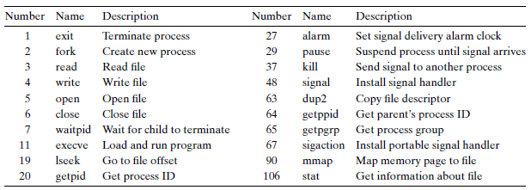
System Calls in Previous Classes (Partial)

Slide 28
Tracing System Calls
Linux has a powerful mechanism for tracing system call execution for a compiled application
Output is printed for each system call as it is executed, including parameters and return codes
The ptrace() system call is used
Also used by debuggers (breakpoint, singlestep, etc)
Use the “strace” command (man strace for info)
You can trace library calls using the “ltrace” command

Slide 29
Using strace
int main() {
write(1, “Hello world!\n”, 13);
}
$ strace -o hello.out ./hello
execve(“./hello2”, [“./hello2”], [/* 59 vars */]) = 0
uname({sys=“Linux”, node=“kiwi”, ...}) = 0
brk(0) = 0xca9000
brk(0xcaa1c0) = 0xcaa1c0
arch_prctl(ARCH_SET_FS, 0xca9880) = 0
brk(0xccb1c0) = 0xccb1c0
brk(0xccc000) = 0xccc000
write(1, “Hello world!\n”, 13) = 13
exit_group(13) = ?
Notes:
arch_prctl: set architecture-specific thread state. ARCH_SET_FS Set the 64-bit base for the FS register to addr.

Slide 30
Make a System calL

Slide 31
2 Ways to Do System Calls: From Coder’s View
Using C (glibc)
E.g., open()
Application
1
Using assembly
E.g., “int 0x80”
Library
2
Kernel

Slide 32
3 Ways to Do System Calls: From Machine’s View
int 0x80
SYSENTER
SYSCALL
Application
Library
Kernel

Slide 33
Example of Calling exit()
int main(int argc, char *argv[]) {
unsigned int syscall_nr = 60; // 60 is for exit()
int exit_status = 42; // 42 is the return value
asm (“movl %0, %%eax\n”
“movl %1, %%ebx\n”
“int $0x80”
:
: “m” (syscall_nr), “m” (exit_status)
: “eax”, “ebx”);
}

Slide 34
Lib call/Syscall Return Codes
Library calls return -1 on error and place a specific error code in the global variable errno
System calls return specific negative values to indicate an error in %eax
Most system calls return -errno
The library wrapper code is responsible for conforming the return values to the errno convention

Slide 35
Passing system call parameters
The first parameter is always the syscall #
eax on Intel
Linux allows up to six additional parameters
ebx, ecx, edx, esi, edi, ebp on Intel
System calls that require more parameters package the remaining params in a struct and pass a pointer to that struct as the sixth parameter
Problem: must validate pointers
Could be invalid, e.g. NULL ➔ crash OS
Or worse, could point to OS, device memory ➔ security hole

Slide 36
How to validate user pointers?
Too expensive to do a thorough check
Need to check that the pointer is within all valid memory regions of the calling process
Solution: No comprehensive check
Linux does a simple check for address pointers and only determines if pointer variables are within the largest possible range of user memory (more details when talking about process)
Even if a pointer value passes this check, it is still quite possible that the specific value is invalid
Dereferencing an invalid pointer in kernel code would normally be interpreted as a kernel bug and generate an Oops message on the console and kill the offending process
Linux does something very sophisticated to avoid this situation

Slide 37
Handling faults due to user-pointers
Kernel code must access user-pointers using a small set of “paranoid” routines (e.g. copy_from_user)
Thus, kernel knows what addresses in its code can throw invalid memory access exceptions (page fault)
When a page fault occurs, the kernel’s page fault handler checks the faulting EIP (recall: saved by hw)
If EIP matches one of the paranoid routines, kernel will not oops; instead, will call “fixup” code
Many violations of this rule in Linux. Once built a checker and found tons of security holes

Slide 38
Paranoid functions to access user pointers
Function | Action
get_user(), __get_user() | reads integer (1,2,4 bytes)
put_user(), __put_user() | writes integer (1,2,4 bytes)
copy_from_user(), __copy_from_user | copy a block from user space
copy_to_user(), __copy_to_user() | copy a block to user space
strncpy_from_user(), __strncpy_from_user() | copies null-terminated string from user space
strnlen_user(), __strnlen_user() | returns length of null-terminated string in user space
clear_user(), __clear_user() | fills memory area with zeros

Slide 39
New Instruction: SYSENTER/SYSEXIT & SYSCALL/SYSRET
“int 0x80” is Obsolete
Windows XP does not use it any more
That’s why it requires at least Pentium II
New Instructions
SYSENTER/SYSEXIT: Intel, and then AMD
SYSCALL/SYSRET: AMD, and then Intel

Slide 40
Simplify System Call by SYSCALL/SYSRET
SYSCALL/SYSRET has lower latency
Less than 25% of the cycles of previous solution
Why faster?
Assume OS implements a flat-memory model
Simplifies calls to and returns from the OS
Eliminating unneeded checks, and by loading pre-determined values into the CS and SS segment registers
More details: http://wiki.osdev.org/SYSENTER

Slide 41
Compatibility across Intel and AMD
For a 32-bit Kernel
SYSENTER/SYSEXIT are the only compatible pair
For a 64-bit Kernel
SYSCALL/SYSRET are the only compatible pair
In Long mode only (not Long Compat mode)

Slide 42
Using SYSCALL to Invoke the exit() System Call
#include <unistd.h>
int main(int argc, char *argv[]) {
unsigned long syscall_nr = 60;
long exit_status = 42;
syscall(syscall_nr, exit_status);
}
int main(int argc, char *argv[]) {
unsigned long syscall_nr = 60;
long exit_nr = 42;
asm (“movq %0, %%rax\n”
“movq %1, %%rdi\n”
“syscall”
: :
“m” (syscall_nr), “m” (exit_nr) :
"rax", "rdi"); }

Slide 43
vDSO
Virtual Dynamic Shared Object

Slide 44
The Motivation of vDSO
The latency of syscall is not negligible
Especially for those called frequently
E.g., gettimeofday()
How to reduce the latency of syscall?
Most of the time is for state saving/restoring
If no mode switching, then no state saving/restoring

Slide 45
The Code of gettimeofday()
Defined by the kernel
As a part of kernel code during compiling
Run in user space
The code is loaded into a page shared with user
The page is as known as vDSO
Virtual Dynamic Shared Object
Time value is also mapped to user space (read-only)
Can only be changed in kernel mode
The source can be found in arch/x86/vdso/vclock_gettime.c

Slide 46
Where is the Shared Page for vDSO?
$ ldd `which bash`
linux-vdso.so.1 => (0x00007fff667ff000)
libtinfo.so.5 => /lib/x86_64-linux-gnu/libtinfo.so.5 (0x00007f623df7d000)
libdl.so.2 => /lib/x86_64-linux-gnu/libdl.so.2 (0x00007f623dd79000)
libc.so.6 => /lib/x86_64-linux-gnu/libc.so.6 (0x00007f623d9ba000)
/lib64/ld-linux-x86-64.so.2 (0x00007f623e1ae000)

Slide 47
Flex-SC
Flexible System Call Scheduling with Exception-Less System Calls, OSDI’10

Slide 48
The Motivation
How to further reduce the latency of syscall?
Not only for gettimeofday()
Where does the latency come from?
Mostly for the state switch
Save and restore states
Privilege checking
Cache pollution
Could we do syscall without state switching?

Slide 49
Flexible System Call
New syscall mechanism – Flexible System Call
Introduce system call page that is shared by user & kernel
User threads can push the system call requests into the system call page
kernel threads will poll the system call requests out the system call page
Exception-less syscall
Remove synchronicity by decoupling invocation from execution

Slide 50
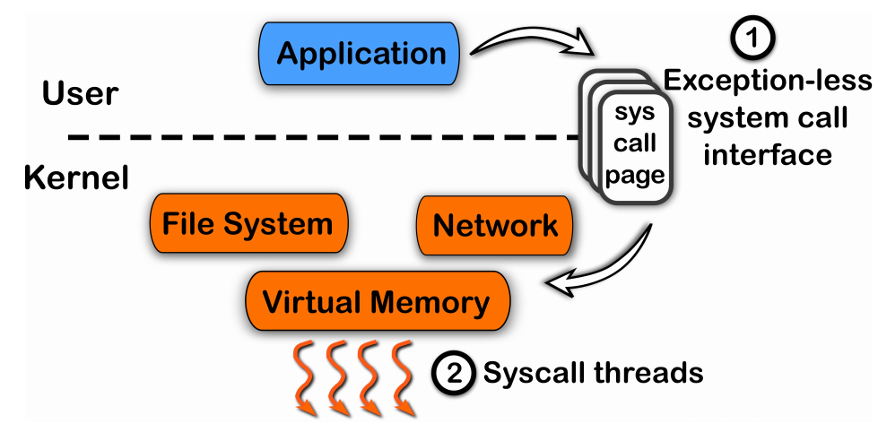
FlexSC: Another Way to System Call

Slide 51
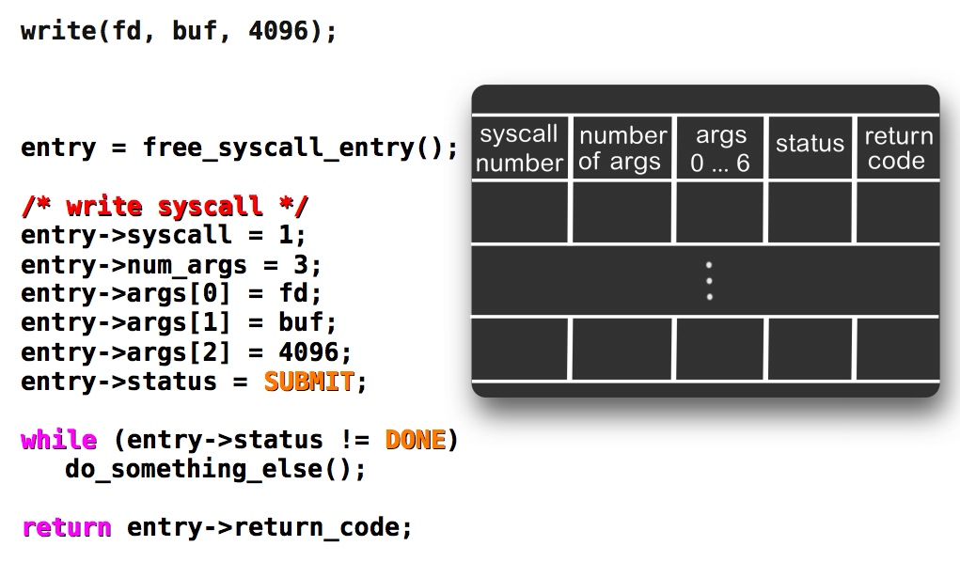
Exception-less System Call

Slide 52
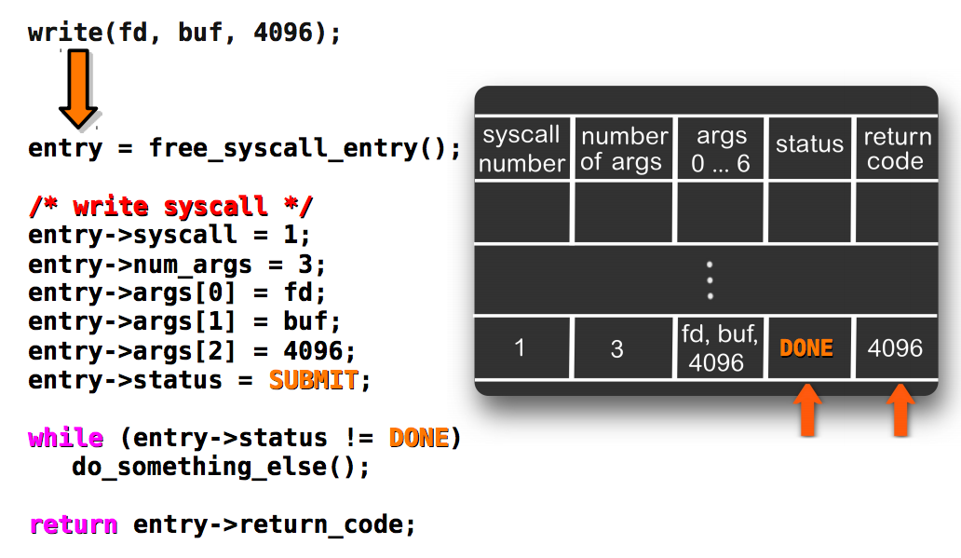
Kernel Fill the Results

Slide 53
Running on a Single Core: Single Threads
Application
Push system call
User
Kernel
Sys call page
Sys call page
Switch to user
Sys call page
Switch to kernel
a
b
c
d
Kernel threads
pull system call

Slide 54
Running on a Single Core: Multiple Threads
switch
switch
switch
user thread
user thread
user thread
user thread
user thread
user thread
user thread
user thread
Push system call
Sys call page
Push system call
Sys call page
Push system call
Push system call
Sys call page
a
b
User mode
Kernel mode
Switch to kernel
Switch to user
c
d
kernel thread
pull system call
FlexSC: Flexible System Call Scheduling with Exception-Less System Calls

Slide 55
Conclusion
System call VS. function call
Trap! Switching the mode
State saving/restoring, changing stack, checking…
‘Int 0x80’ is not enough
New instructions for lower latency
vDSO for reducing trapping
FlexSC for further reducing trapping by multi-core

Slide 56
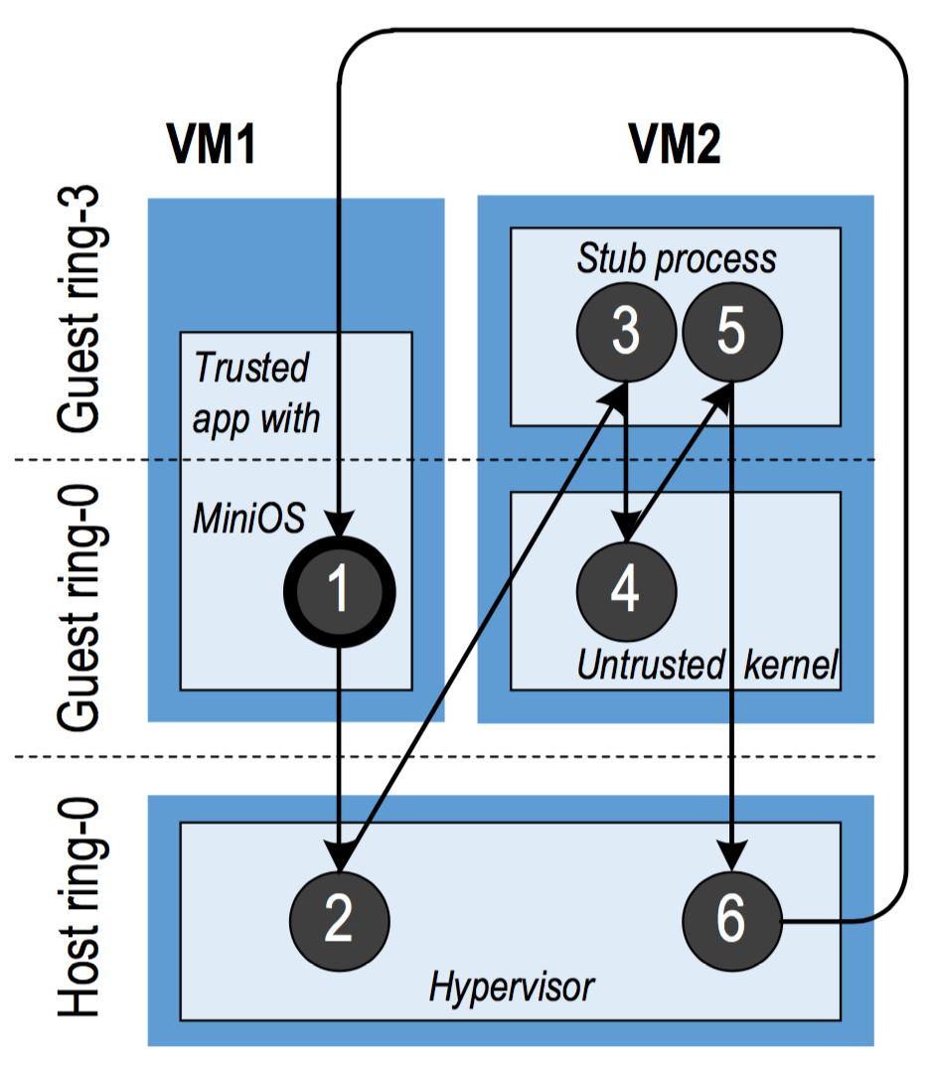
Cross-Mode Calls
ProxOS
Two virtual machines, one is trusted and the other is untrusted
Redirect untrusted system calls to the untrusted VMs
Overhead of mode switching could be high!
More
Nested Virtualization

Slide 57
Optimization for Cross-Mode Calls
Using shared memory (like FlexSC)
Make synchronous calls to asynchronous ones
Require app logic to be changed
How about a new instruction for world-call?
A world is just a mode (including VM, kernel/user, etc.)
Separating protection from managing
Configure by software (managing)
Check by hardware (protection)

