Slide 1
File System: XV6 ~ Ext4
Yubin Xia

Slide 2
Virtual File System Interface
Problem: the OS may mount several partitions containing different underlying file systems
It would be bad if processes had to use different APIs for different file systems
Linux uses a Virtual File System interface (VFS)
Exposes POSIX APIs to processes
Forwards requests to lower-level file system specific drivers
Windows uses a similar system

Slide 3


VFS Flowchart
Processes (usually) don’t need to know about low-level file system details
Relatively simple to add additional file system drivers
Process 1
Process 2
Process 3
Kernel
Virtual File System Interface
ext3 Driver
NTFS Driver
FAT32 Driver
ext3 Partition
NTFS Partition
FAT32 Partition

Slide 4
Xv6 FS Design
Implements a minimal Unix file system interface
Superblock
Inode
Dentry
Limitations
not pay attention to file system layout
doesn't do any disk scheduling.
Its cache is write-through
simplifies keeping disk data structures consistent
bad for performance.

Slide 5
xv6 File System
No disk scheduling
Write-through
Simplifies keeping on disk data structures consistent
Bad for performance
Block size: 512 bytes (BSIZE)

Slide 6
Disk Layout
Block 0: unused
Block 1: superblock
Block 2+
inode (ninodes / inodes_per_block)
in-use bitmap
data block
Log block
inodes
in-use bitmap
data block
Log block
unused
superblock
Notes:
// Block 0 is unused.
// Block 1 is super block.
// Blocks 2 through sb.ninodes/IPB hold inodes.
// Then free bitmap blocks holding sb.size bits.
// Then sb.nblocks data blocks.
// Then sb.nlog log blocks.

Slide 7
Recap: Free-Space List Bit Vector
Represent the list of free blocks as a bit vector:
111111111111111001110101011101111...
If bit i = 0 then block i is free, otherwise it is allocated
Simple to use but this can be a big vector:
2TB disk -> 512M blocks -> 64MB bits
If a disk is 90% full, then the average number of bits to be scanned is 10, independent of the size of the disk
Notes:
One of the key things a directory must do is make it easy to allocate new space on the disk.
— The directory must keep track of which blocks are free and which are allocated.
Often CPUs have instructions to perform this search in a small number of machine cycles.
But are free blocks uniformly spread out over the disk?
— Not likely. If they were then file I/O performance would likely be poor.

Slide 8
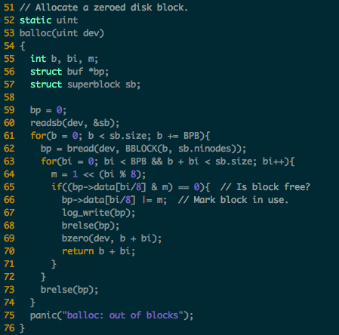
Managing Disk Blocks
Use a bitmap to maintain availability of disk blocks

Slide 9
Recap: Multi-level Indexed Allocation
inode
10
Data
Blocks
n
Data
Blocks
1st Level
Indirection
Block
IB
n²
Data
Blocks
IB
2nd Level
Indirection
Block
IB
IB
n³
Data
Blocks
IB
IB
IB
IB
3rd Level
Indirection
Block
IB
IB
IB
IB
Notes:
In this figure n is the number of pointer you can store in a disk block.
Assuming a first level block can contain 16 pointers then
— a “small” file is 8K bytes
— a “medium” file is 64 MB
— a “large” file is 512 GB!

Slide 10
Files and inode
Represented by an inode
[fs.h]
#define NADDRS (NDIRECT+1)
#define NDIRECT 12
#define INDIRECT 12
#define NINDIRECT (BSIZE / sizeof(uint))
#define MAXFILE (NDIRECT + NINDIRECT)
// On-disk inode structure
struct dinode {
short type; // File type
short major; // Major device number (T_DEV only)
short minor; // Minor device number (T_DEV only)
short nlink; // Number of links to inode in file system
uint size; // Size of file (bytes)
uint addrs[NDIRECT+1]; // Data block addresses
};
Notes:
#define T_DIR 1 // Directory
#define T_FILE 2 // File
#define T_DEV 3 // Special device

Slide 11
Files (cont.)
File size
Small: up to 12 block addresses (NADDRS – 1)
Large: Last address in the inode as a disk address for a block with 128 disk addresses (512 / 4)
At most 12 * 512 + 128 * 512 bytes

Slide 12
Directories
Directories are special files
Files with a bit of structure to them
Contains multiple dirent structures
// Directory is a file containing a sequence of dirent structures.
#define DIRSIZ 14
struct dirent {
ushort inum;
char name[DIRSIZ];
};

Slide 13
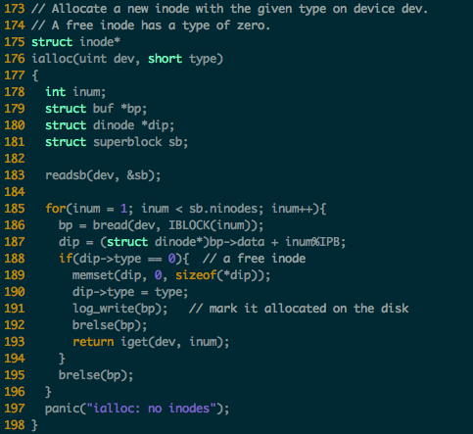
Allocating an inode

Slide 14
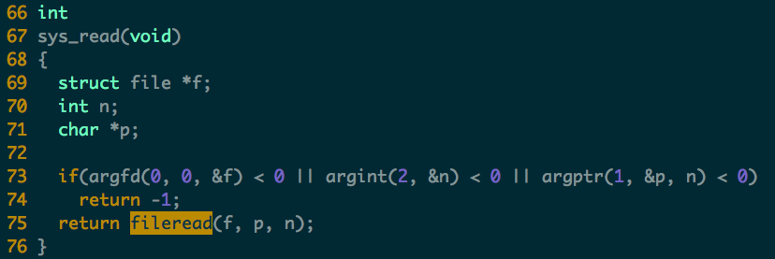
Case Study: read(fd, buf, 100)
sys_read()->fileread()->readi()
1. If it’s a special device file, use predefined operation
2. call bread() to get file buffer

Slide 15
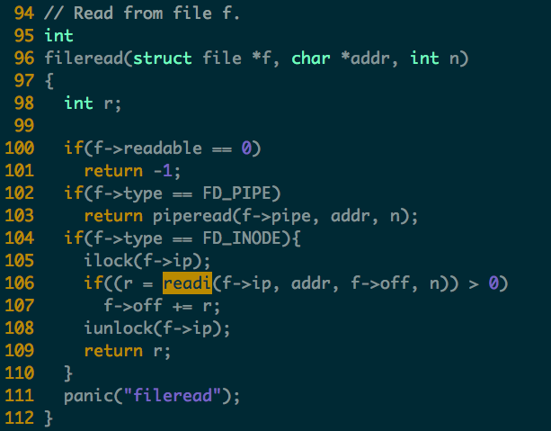

Slide 16
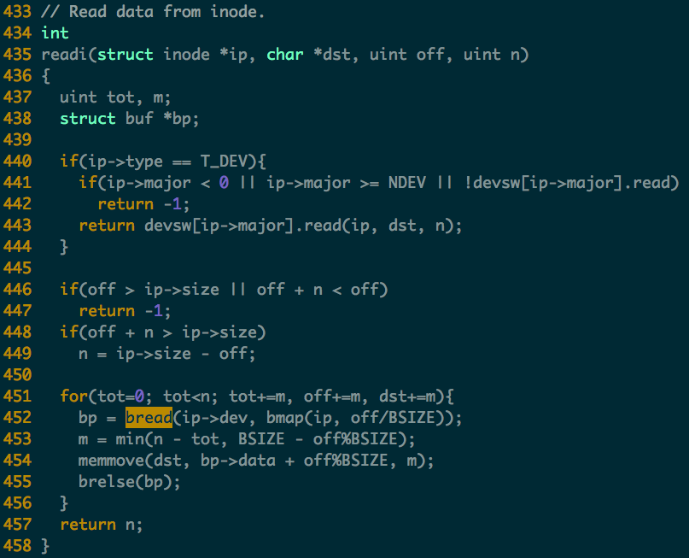

Slide 17
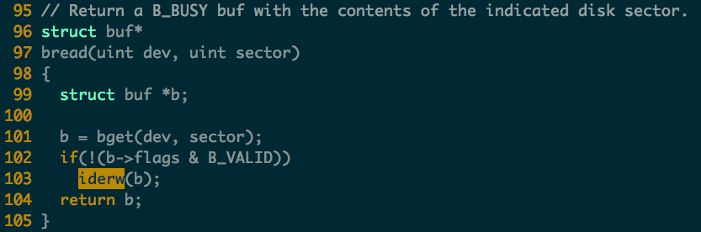
Case Study: read (cont.)
readi()->bread()
Call bget() to read from buffer cache first
If not found, call ide_rw() to read from disk, and mark as valid.

Slide 18
Case Study: read (cont.)
readi()->bread()->bget()
Implements a simple buffer cache of recently-read disk blocks
1. Look if the requested block is in the cache
2. If some other process has locked the block, wait until it releases
3. If it is not in the cache, find a cache entry to hold the block
4. Mark it ours, but not valid

Slide 19
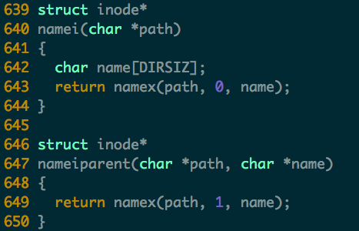

Slide 20
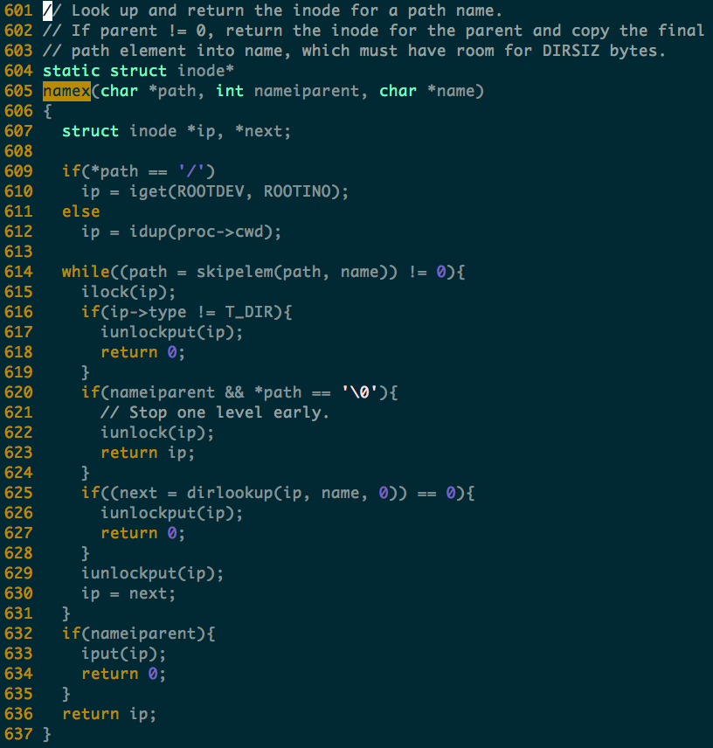
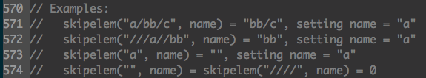

Slide 21
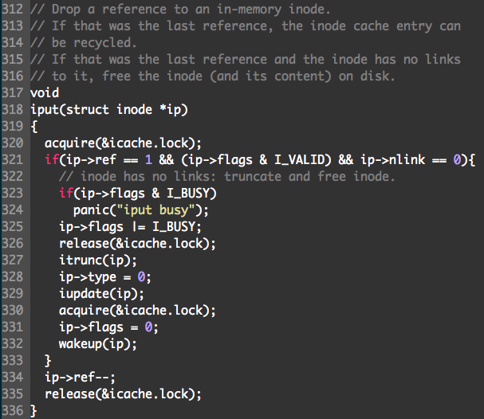
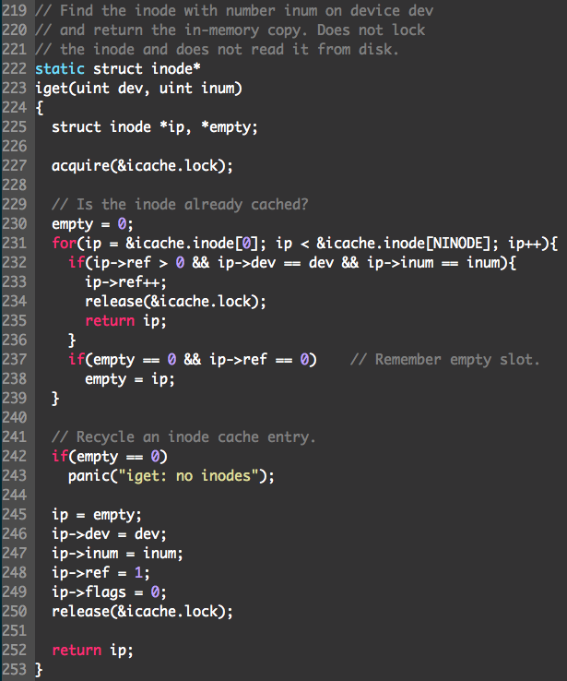

Slide 22
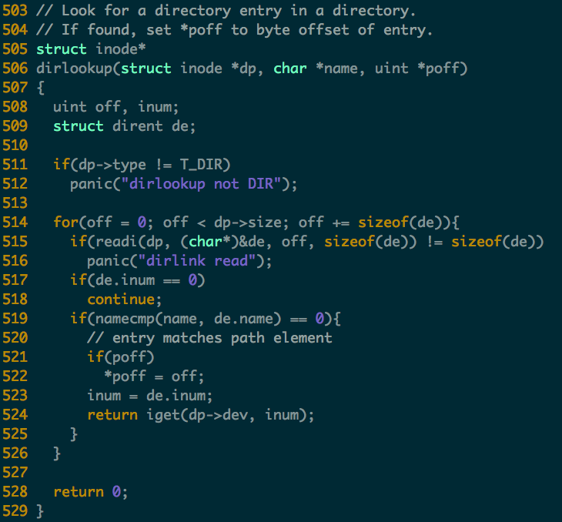

Slide 23
Ext File System

Slide 24
Advantages of inodes
Optimized for file systems with many small files
Each inode can directly point to 48KB of data
Only one layer of indirection needed for 4MB files
Faster file access
Greater meta-data locality → less random seeking
No need to traverse long, chained FAT entries
Easier free space management
Bitmaps can be cached in memory for fast access
inode and data space handled independently

Slide 25
Ext File System
Ext file system uses inode
inodes are imbalanced trees of data blocks
Optimized for the common case: small files
Problem: ext has poor locality
inodes are far from their corresponding data
This is going to result in long seeks across the disk
Problem: ext is prone to fragmentation
ext chooses the first available blocks for new data
No attempt is made to keep the blocks of a file contiguous

Slide 26
Fast File System (FFS) and Ext2
FFS developed at Berkeley in 1984
First attempt at a disk aware file system
i.e. optimized for performance on spinning disks
Observation: processes tend to access files that are in the same (or close) directories
Spatial locality
Key idea: place groups of directories and their files into cylinder groups
Introduced into ext2, called block groups

Slide 27
Block Groups
In ext, there is a single set of key data structures
One data bitmap, one inode bitmap
One inode table, one array of data blocks
In ext2, each block group contains its own key data structures
Inode
Bitmap
Data
Bitmap
Inodes
Data Blocks
SB
Block Group 1
Block Group 2
Block Group 3
Block Group 4
Block Group 5
Block Group 6

Slide 28


Allocation Policy
ext2 attempts to keep related files and directories within the same block group
amislove
home
cbw
SB
Block Group 1
Block Group 2
Block Group 3
Block Group 4
Block Group 5
Block Group 6

Slide 29
ext2: The Good and the Bad
The good – ext2 supports:
All the features of ext…
… with even better performance (because of increased spatial locality)
The bad
Large files must cross block groups
As the file system becomes more complex, the chance of file system corruption grows
E.g. invalid inodes, incorrect directory entries, etc.

Slide 30
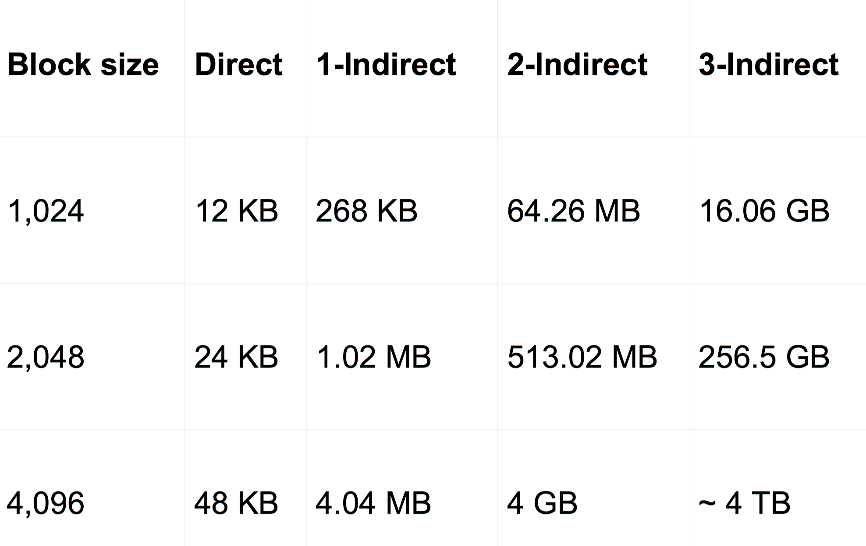
File-size upper limits for data block addressing

Slide 31
Extent
Indirect block maps are incredibly inefficient for large files
One extra block read (and seek) every 1024 blocks
Really obvious when deleting big CD/DVD image files
An extent is a single descriptor for a range of contiguous blocks
An efficient way to represent large file
Better CPU utilization, fewer metadata IOs

Slide 32
From Pointers to Extents
Modern file systems try hard to minimize fragmentation
Since it results in many seeks, thus low performance
Extents are better suited for contiguous files
inode
block 1
block 2
block 3
block 4
block 5
block 6
inode
block 1
length 1
block 2
length 2
block 3
length 3
Each extent includes a block pointer and a length

Slide 33
Implementing Extents
ext4 and NTFS use extents
ext4 inodes include 4 extents instead of block pointers
Each extent can address at most 128MB of contiguous space (assuming 4KB blocks)
If more extents are needed, a data block is allocated
Similar to a block of indirect pointers

Slide 34
Revisiting Directories
In ext, ext2, and ext3, each directory is a file with a list of entries
Entries are not stored in sorted order
Some entries may be blank, if they have been deleted
Problem: searching for files in large directories takes O(n) time
Practically, you can’t store >10K files in a directory
It takes way too long to locate and open files

Slide 35
From Lists to B-Trees
ext4 and NTFS encode directories as B-Trees to improve lookup time to O(log N)
A B-Tree is a type of balanced tree that is optimized for storage on disk
Items are stored in sorted order in blocks
Suppose items i and j are in the root of the tree
The root must have 3 children, since it has 2 items
The three child groups contain items a < i, i < a < j, and a > j

Slide 36
Example B-Tree
ext4 uses a B-Tree variant known as a H-Tree
The H stands for hash (sometime called B+Tree)
Suppose you try to open(“my_file”, “r”)
hash(“my_file”) = 0x0000C194
H-Tree Root
0x00AD1102 | 0xCFF1A412
H-Tree Node
0x0000C195 | 0x00018201
H-Tree Node
H-Tree Node
H-Tree Leaf
0x0000A0D1 | 0x0000C194
H-Tree Leaf
H-Tree Leaf
my_file → inode

Slide 37
ext4: The Good and the Bad
The good – ext4 (and NTFS) supports:
All of the basic file system functionality we require
Improved performance from ext3’s block groups
Additional performance gains from extents and B-Tree directory files
The bad:
Next-gen file systems have even nicer features
Copy-on-write semantics (btrfs and ZFS)

