Slide 1
FS: FAT32, NTFS
Yubin Xia

Slide 2
Review: Ext2
The good – ext2 supports:
All the features of ext…
… with even better performance (because of increased spatial locality)
The bad
Large files must cross block groups
As the file system becomes more complex, the chance of file system corruption grows
E.g. invalid inodes, incorrect directory entries, etc.

Slide 3
Review: Extent in FS
Indirect block maps are incredibly inefficient for large files
One extra block read (and seek) every 1024 blocks
Really obvious when deleting big CD/DVD image files
An extent is a single descriptor for a range of contiguous blocks
An efficient way to represent large file
Better CPU utilization, fewer metadata IOs

Slide 4
Review: From Pointers to Extents
Modern file systems try hard to minimize fragmentation
Since it results in many seeks, thus low performance
Extents are better suited for contiguous files
inode
block 1
block 2
block 3
block 4
block 5
block 6
inode
block 1
length 1
block 2
length 2
block 3
length 3
Each extent includes a block pointer and a length

Slide 5
FAT File System

Slide 6
Clusters and Sectors
Sector: smallest storage unit on disk
512 bytes
Cluster: smallest allocated disk space to hold file
Data clusters are located after metadata of partition
Different cluster sizes depending on volume size
Volume Size FAT32 Cluster Size
<32MB Not Supported
32MB ~ 64MB 512 bytes
65MB ~ 128MB 1KB
129MB ~ 256MB 2KB
257MB ~ 8GB 4KB
8GB ~ 16GB 8KB
16GB ~ 32GB 16KB
Default FAT Cluster Sizes
Notes:
6

Slide 7
Organization of an FAT Volume
Boot Sector
Reserved Sectors
FAT 1
FAT 2 (Duplicate)
Root Folder
Other Folders and All Files
Boot Sector
- Layout of the volume
- File system structure
- Boot code
Root Folder
- Describes the files and folders in the root of the partition
FAT 1
- Original FAT
Other Folder and All Files
- Contains the data for the files and folders within the file system.
FAT 2 (Duplicate)
- Backup copy of FAT
Notes:
7

Slide 8
Stores basic info about the file system
FAT version, location of boot files
Total number of blocks
Index of the root directory in the FAT
File allocation table (FAT)
Marks which blocks are free or in-use
Linked-list structure to manage large files
Store file and directory data
Each block is a fixed size (4KB – 64KB)
Files may span multiple blocks
Super Block
Disk

Slide 9
FAT Boot Sector
FAT Boot Sector
Locate at the first logical sector of each partition
Created when you format a volume
End with a 2-byte sector marker (always 0x55AA)
Component
An x86-based CPU jump instruction
Original Equipment Manufacturer Identification (OEM ID)
BIOS Parameter Block (BPB)
Extended BPB
Executable boot code
Notes:
9

Slide 10
FAT 1 and FAT 2
File Allocation Table
identifies all clusters as
unused, cluster in use by a file, bad cluster, last cluster in a file
FAT 2 is used to consistency-checking program
Notes:
10

Slide 11
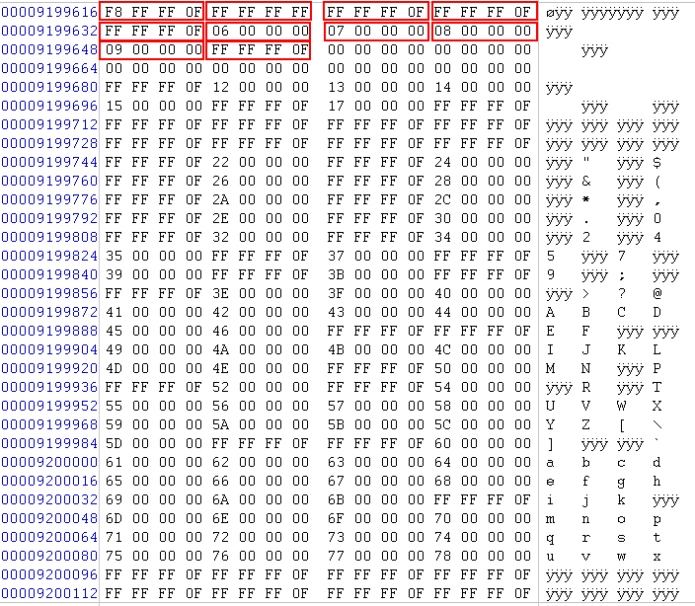
A Sample of FAT

Slide 12
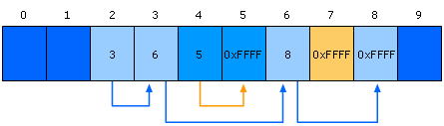
File Processing on FAT Clusters
Store file information
Continues to store file info in the next available cluster
when the file requires space greater than the cluster’s size.
e.g.
Three Files: 1 with (2-3-6-8), 2 with(4-5) 3 with (7)
Notes:
12

Slide 13
FAT Root Folder
FAT Root Folder Structure
Root Folder Entry
Size
Description
Name
11B
Name in 8.3 format
Attribute Byte
1B
Information about entry
(e.g. archive, system, hidden, and read-only)
Creation Time and Date
5B
Time and date file was create
Last Access Date
2B
Date file was last accessed
Last Modification Time and Date
4B
Time and data file was last modified
First Cluster
2B
Starting cluster number in the file allocation table
File Size
4B
Size of the file
Notes:
13

Slide 14
File Naming
File Names in Windows Server 2003
Support long file name, up to 255 characters
Generate a 8.3 short file name
Support Long File Name
The main folder entry stores 8.3 short file name
The secondary folder entries store long file name
Each stores 13 characters in Unicode
Notes:
14

Slide 15
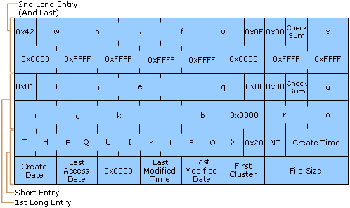
File Naming (cont.)
e.g. file with “The quick brown.fox” and “Thequi~1.fox”
long file name
short file name
Notes:
15

Slide 16
FAT32 Long File Name
Using 0xF in directory entry
Means this entry is part of long file name
0xF is not used in DOS/WIN32 (consider as invalid)
Using unicode for storage
2 bytes (64 bits)
The short (8.3) file name is still there
The system cannot work without short name

Slide 17
Short Name Generation
What if there is already a file with name THEQUI~1FOX?
Then use THEQUI~2FOX
If still conflict, using THEQUI~3FOX
If still conflict, using …
If still conflict, using T~999999FOX
If still conflict, error

Slide 18
Question
What is the process of searching a file by its long name?
Notes:
Sequentially search!

Slide 19
File Name Search in ExFAT
Search name by hash value first
Hash the upper case version of the file name
Each record in the directory is searched by comparing the hash value
When a match is found, the filenames are compared to ensure that the proper file was located in case of collisions
Only two characters have to be compared, why?

Slide 20
FAT: The Good and the Bad
The Good – FAT supports:
Hierarchical tree of directories and files
Variable length files
Basic file and directory meta-data
The Bad
At most, FAT32 supports 2TB disks
Locating free chunks requires scanning the entire FAT
Prone to internal and external fragmentation
Large blocks → internal fragmentation
Reads require a lot of random seeking

Slide 21




Lots of Seeking
FAT may have very low spatial locality, thus a lot of random seeking
Consider the following code:
int fd = open(“my_file.txt”, “r”);
int r = read(fd, buffer, 1024 * 4 * 4); // 4 4KB blocks
56
57
58
59
60
61
62
63
64
65
67
68
FAT
67
0xFFFF
0
0xFFFF
63
0
56
57
0
0
59
60
56
57
58
59
60
61
62
63
64
65
67
68
Blocks

Slide 22
NTFS

Slide 23
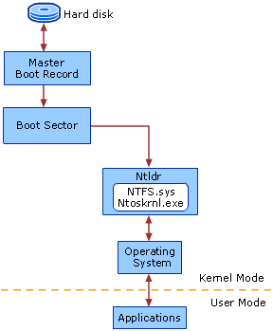
NTFS Architecture
Contains one or more partitions
BIOS
Contains executable code
- partition table
the SAME to FAT Architecture
(except that the driver is NTFS.sys)
Bootable partition
- layout of the volume
- file system structures
- boot code (load Ntldr)
NT Loader
- load file system
- lunch boot menu (boot.ini)
Notes:
23

Slide 24
NTFS Clusters
Cluster: smallest allocated disk space to hold file
Sequentially logical cluster numbers from the beginning of the partition
Clusters start at sector ZERO (different to FAT)
Floppy disks don’t use NTFS
Different cluster sizes depending on volume size
Volume Size NTFS Cluster Size
7MB ~ 512MB 512 bytes
513MB ~ 1GB 1KB
1GB ~ 2GB 2KB
2GB ~ 2TB 4KB
Default NTFS Cluster Sizes
Notes:
24

Slide 25
Organization of an NTFS Volume
NTFS Boot Sector
Master File Table
File System Data
Master File Table Copy
NTFS Boot Sector
- Layout of the volume
- File system structure
- Boot code
File System Data
- Data no contained within MFT
Master File Table
- Attributes of files
- Attributes of folders
(Most Important)
Master File Table Copy
- a copy of MFT
Notes:
25

Slide 26
Master File Table
Master File Table (MFT)
A relational database
Rows: file records
Columns: file attributes
Contains at least one entry for every file
Metadata files
Describe the MFT
The first 16 records of MFT for metadata files
Begin with a dollar sign. e.g. $Mft, $MftMirr, $LogFile, …
Notes:
26

Slide 27
MFT
The MFT is an array of file records
Each record is 1024 bytes
The first record in the MFT is for the MFT itself
The name of the MFT is $MFT
The first 16 records in the MFT are reserved for metadata files
MFT Entry
Header
Attributes
Unused
Space
1024 Bytes

Slide 28
Metadata Files in MFT
System File
Name Rec
Purpose of File
Master File Table
$Mft 0
Contains file record for each file and folder on a NTFS volume.
Master File Table Mirror
$MftMirr 1
Duplicate image of the first four records of MFT
Log File
$LogFile 2
Restores metadata for fast recovery
Volume File
$Volume 3
Contains information about the volume
Attribute Definitions
$AttrDef 4
Lists attribute names, numbers, and descriptions
Root File Name Index
. 5
The root file
Cluster Bitmap
$Bitmap 6
Represents the volume by showing free and unused clusters.
Notes:
28

Slide 29
Metadata Files in MFT (cont.)
System File
Name Rec
Purpose of File
Boot Sector
$Boot 7
Includes the BPB and additional bootstrap loader code
Bad Cluster file
$BadClus 8
Contains bad clusters for a volume
Security File
$Secure 9
Contains unique security descriptors for all files
Upcase Table
$Upcase 10
Used to match Unicode uppercase characters
NTFS Extension File
$Extend 11
Optional extensions such as quotas, reparse point data ...
12-15
Reserved for future use
Notes:
29

Slide 30
MFT Zone
MFT contains a record for each file and folder on the volume
File and folder records are 1KB each
MFT Zone
Exclusive use of the MFT
Prevent fragmentation
Dedicate 12.5% of volume by default
On demand allocation for additional MFT zone
Notes:
30

Slide 31
NTFS File Record Attributes
File Attributes
View each file and folder as a set of file attributes
Resident Attributes vs. Nonresident Attributes
Small files and folders are entirely contained within the file’s MFT record (typically, less than 900 bytes)
Types:
Standard Info: access mode, timestamp, link count …
Attribute List: locations of all nonresident attributes
File Name: long and short file names
Data / Index: data of file or index of folder
Object ID: volume-unique file identifier
…
Notes:
31

Slide 32
NTFS File Record Attributes
Index of Folder
Folder records contain index information (directory entry)
Organized B-tree structure for large folders
Last Access Time
The most up-to-data LAT is always stored in memory
Written to disk
WHERE: file’s attribute AND directory entry for the file
WHEN: more than an hour OR update other file attributes
Notes:
32

Slide 33
File Naming
File Names in Windows Server 2003
Support long file name, up to 255 characters
NTFS generate a 8.3 short file name
HOW to generate short file name
Deletes all of unsupported characters (e.g. space)
Deletes all extra periods (abc.def.txt)
Truncates the file name to six characters and appends a tilde(~) and a number
Translates all characters in file name and extension to uppercase
“This is test 1.txt” -> “THISIS~1.TXT”
Notes:
33

Slide 34
Compression of Files and Folders
NTFS Compression
Implemented within NTFS
Compression only in disk
Uncompress before moving data to memory
Moving and Copying Files or Folders
Change compression state
Add overhead to the system
Notes:
34

Slide 35
Hard Links
Hard Links
Add a directory entry for the hard link without duplicating the original file
Application can modify a file by using any of its hard Links
Can not give a file different security descriptors on a per-hard-link basis
Notes:
35

Slide 36
Sparse Files
Sparse Files
Focus on the file contain large sections of data composed of zeros
Store
Allocates disk clusters only for the data explicitly specified by the application
Non-specified ranges of the file are represented by non-allocated space on the disk
Read
From allocated ranges, return the data stored
From non-allocated ranges, return ZERO
Notes:
36

Slide 37
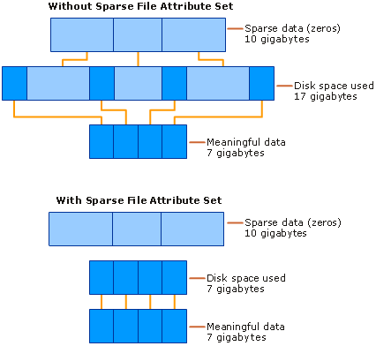
Sparse Files (cont.)
Notes:
37

Slide 38
MBR & Mount

Slide 39
The Master Boot Record
Address |  | Description | Size (Bytes)
Hex | Dec.
0x000 | 0 | Bootstrap code area | 446
0x1BE | 446 | Partition Entry #1 | 16
0x1CE | 462 | Partition Entry #2 | 16
0x1DE | 478 | Partition Entry #3 | 16
0x1EE | 494 | Partition Entry #4 | 16
0x1FE | 510 | Magic Number | 2
 |  | Total: | 512
Includes the starting LBA and length of the partition
MBR
Partition 1
(ext3)
Partition 2
(swap)
Partition 3
(NTFS)
Partition 4
(FAT32)
Disk 1
MBR
Partition 1
(NTFS)
Disk 2

Slide 40
Extended Partitions
In some cases, you may want >4 partitions
Modern OSes support extended partitions
MBR
Partition 1
(ext3)
Partition 2
(swap)
Partition 3
(Extended Partition)
Ext. Part.
Logical Partition 1
(NTFS)
Logical Partition 2
(NTFS)
Partition 4
(FAT32)
Disk 1
Extended partitions may use OS-specific partition table formats (meta-data)
Thus, other OSes may not be able to read the logical partitions

Slide 41
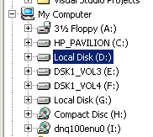
Types of Root File Systems
Windows exposes a multi-rooted system
Each device and partition is assigned a letter
Internally, a single root is maintained
Linux has a single root
One partition is mounted as /
All other partitions are mounted somewhere under /
Typically, the partition containing the kernel is mounted as / or C:

Slide 42
Mounting a File System
Read the super block for the target file system
Contains meta-data about the file system
Version, size, locations of key structures on disk, etc.
Determine the mount point
On Windows: pick a drive letter
On Linux: mount the new file system under a specific directory
Filesystem Size Used Avail Use% Mounted on
/dev/sda5 127G 86G 42G 68% /media/cbw/Data
/dev/sda4 61G 34G 27G 57% /media/cbw/Windows
/dev/sdb1 1.9G 352K 1.9G 1% /media/cbw/NDSS-2013

Slide 43
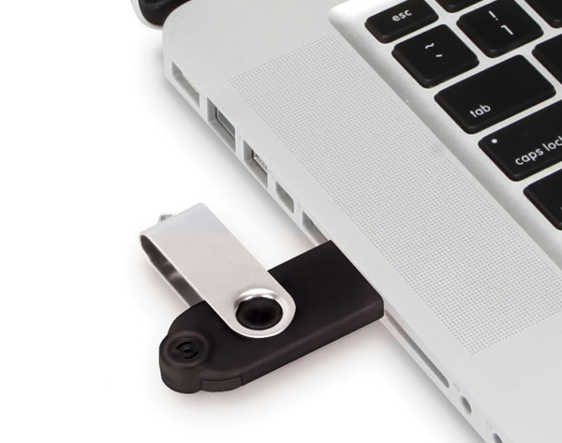
Mount isn’t Just for Bootup
When you plug storage devices into your running system, mount is executed in the background
Example: plugging in a USB stick
What does it mean to “safely eject” a device?
Flush cached writes to that device
Cleanly unmount the file system on that device

Slide 44
Homework
Please learn about btrfs, use your own words to describe its system architecture, and states its pros and cons (you can compare it with ext4/fat/ntfs)
(optional) you can also check ReiserFS and ZFS, they also have very interesting features

