Slide 1
GFS and NFS
Rong

Slide 2
Outline
Google file system
NFS

Slide 3
Intro to GFS

Slide 4
Introduction to google file system
Shares same goals as previous distributed file systems, but with some differences.
Component failures are considered the norm rather than the exception.
Files are huge by traditional standards.
Most files are mutated by appending new data rather than overwriting existing data.
Co-designing the file system and applications increases flexibility in development.

Slide 5
Design Assumptions
System is built from commodity hardware which fails as the norm.
The system must be able to detect and recover from such occurrences.
The system must be optimized to deal with large files. (Multi-GB)
Two types of reading
Large streaming reads
Small random reads

Slide 6
Design Assumptions
Large sequential writes
Appending data to files which are seldom altered again.
Atomicity in concurrent writes from multiple clients
High sustained bandwidth is more valuable than low latency

Slide 7
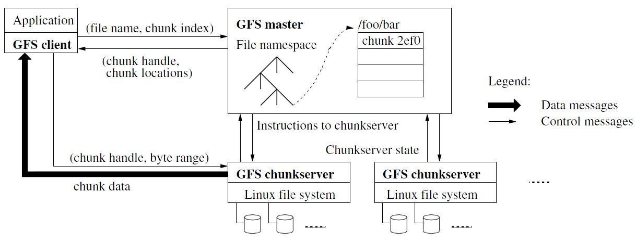
Architecture

Slide 8
Architecture Design
GFS Cluster (accessed by clients)
Single Master + Multiple Chunkservers
Chunkserver
Files of fixed sized chunks
Each chunk has a globally unique 64 bit chunk handle.
Master
Maintains file system metadata
Namespace
Access Control Information
Mapping from files to chunks
Current locations of chunks

Slide 9
Single Master
Clients do not read or write through the master
The master relays relevant chunkserver location information to the client
The client temporarily caches the chunkserver data and directly accesses the chunkserver
Shadow Masters (fault tolerance)

Slide 10
Metadata
Three major types:
Chunk namespaces
Mapping from files to chunks
Location of chunk replicas
Chunk location is not stored persistently and is instead read on each startup
Metadata is stored in memory
Master monitors chunk location through heartbeat messages with each chunk.

Slide 11
Chunkserver
Contains chunks (blocks) of a fixed size
64 MB
Fewer chunk location, fewer metadata
Chunks are replicated regularly
Default: 3-way mirror (across machines and racks)
Talks with master through heartbeat messages

Slide 12
System Interactions
Mutation
Write
Append
Acts on all of the chunk’s replicas
Lease
Initial timeout of 60 seconds, which can be renewed or revoked.
Data Flow
Decoupled control flow from data flow
Data pushed linearly to avoid bottlenecks and high latency links

Slide 13
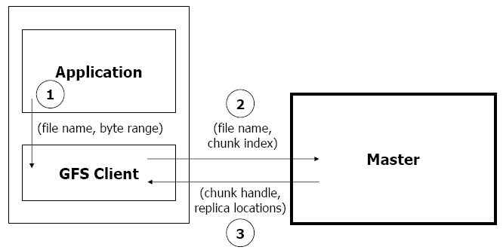
Read Algorithm

Slide 14
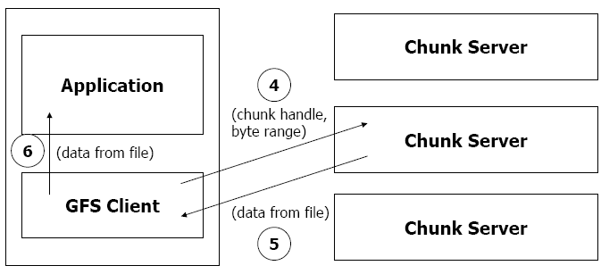
Read Algorithm

Slide 15
Read Algorithm
1. Application originates the read request.
2. GFS client translates the request from (filename, byte range) -> (filename, chunk index), and sends it to master.
3. Master responds with chunk handle and replica locations (i.e. chunk servers where the replicas are stored).
4. Client picks a location and sends the (chunk handle, byte range) request to that location.
5. Chunk server sends requested data to the client.
6. Client forwards the data to the application.

Slide 16
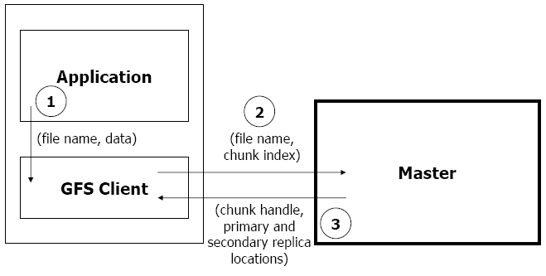
Write Algorithm

Slide 17
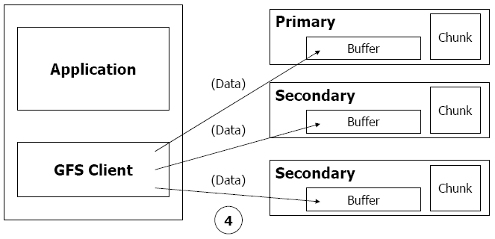
Write Algorithm

Slide 18
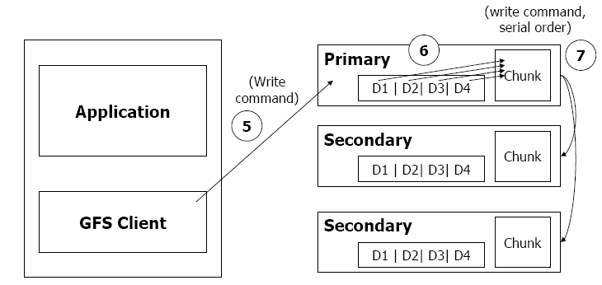
Write Algorithm

Slide 19
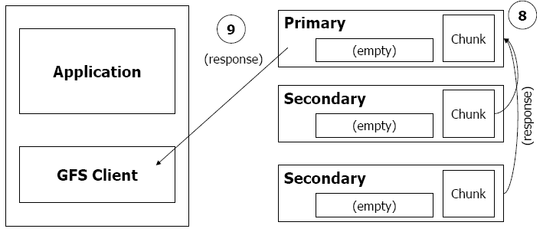
Write Algorithm

Slide 20
Write Algorithm
1. Application originates write request.
2. GFS client translates request from (filename, data) -> (filename, chunk index), and sends it to master.
3. Master responds with chunk handle and (primary + secondary) replica locations.
4. Client pushes write data to all locations. Data is stored in chunkservers’ internal buffers.
5. Client sends write command to primary.

Slide 21
Write Algorithm
6. Primary determines serial order for data instances stored in its buffer and writes the instances in that order to the chunk.
7. Primary sends serial order to the secondaries and tells them to perform the write.
8. Secondaries respond to the primary.
9. Primary responds back to client.
Note: If write fails at one of chunk servers, client is informed and retries the write.

Slide 22
Master Operation
Replica Placement
Creation, Re-replication, Rebalancing
Garbage Collection
Stale Replica Detection

Slide 23
Fault Tolerance and Diagnosis
Fast recovery
Master and chunkserver are designed to restore their states and start in seconds
Chunk replication : 3-way mirrors
across multiple machines, across multiple racks.

Slide 24
Fault Tolerance and Diagnosis
Master Mechanisms:
Log of all changes made to metadata.
Periodic checkpoints of the log.
Log and checkpoints replicated on multiple machines.
Master state is replicated on multiple machines.
“Shadow” masters for reading data if “real” master is down.

Slide 25
Fault Tolerance and Diagnosis
Data integrity
A chunk is divided into 64-KB blocks
Each with its 32 bit checksum
Verified at read and write times
Also background scans for rarely used data

Slide 26
Summary of GFS
Runs on commodity hardware and is scalable
Performs well for the specified tasks and assumptions previously mentioned
Innovation
File system API tailored to stylized workload
Single-master design to simplify coordination
Metadata fit in memory

Slide 27
Summary of GFS
Flat namespace
Dedicated Care for Component Failure
hard disk failure, data corruption, network disconnection, etc.
High-throughput
Minimized the master involvement
Chunk servers themselves send and receive the client data
The master leases authority to mutate chunks

Slide 28
Intro to NFS

Slide 29
Accessing Remote Files
FTP, telnet, …
Explicit access
User-directed connection to access remote resource
We want more transparency
Allow user to access remote resource just as local ones
NAS: Network Attached Storage

Slide 30
File Service Types
Upload/Download model
Read file: copy file from server to client
Write file: copy file from client to server
Advantage
Simple
Problem
Wasteful “what if client needs small piece?”
Problematic “what if client doesn’t have enough space?”
Consistency “what if others modify the same file?”

Slide 31
File Service Types
Remote access model
File service provide functional interface (create, delete, read, write, etc …)
Advantage
Client gets only what’s needed
Server can manage coherent view of file system
Problem
Possible server and network congestion
Servers are accessed for duration of file access
Same data may be requested repeatedly

Slide 32
Remote File Service
File Service
Provides file access interface to clients
Directory Service
Maps textual names for file to internal locations that can be used by file service
Client module (driver)
Client side interface for file & directory service
If done right, helps provide access transparency
e.g. implement the FS under the VFS layer

Slide 33
Semantics of File Sharing
Sequential semantics
Read returns result of last write
Easily achieved if
Only one server
Clients do not cache data
BUT
Performance problem if no cache
We can write-through
Must notify clients holding copies
Requires extra state, generates extra traffic

Slide 34
Semantics of File Sharing
Session semantics
Relax the rules
Changes to an open file are initially visible only to the process that modified it
Last process to modify the file wins

Slide 35
Accessing Remote Files
Implement the client module as a FS under VFS
System Call Interface
VFS
Sockets
ext4
procfs
RemoteFS
Network Protocols
Network
NIC
Kernel-level sockets interface

Slide 36
Stateful or Stateless
Stateful →
Shorter requests
Better performance in processing requests
Cache coherence is possible
Server can know who’s accessing what
File locking is possible
Server maintains client-specific state
Notes:
State: e.g., offset, ..

Slide 37
Stateful or Stateless
Stateless →
Each request must identify file and offsets
Server/Client can crash and recovery
No state to lose
No open/close needed
No server space used for state (scalable)
Problems if file is deleted on server
File locking not possible
Server maintains no info for client

Slide 38
Caching
Hide latency to improve performance for repeated accesses by bringing the data closer to where it’s needed
Three places to replicate data
Server’s buffer cache
Client’s buffer cache
Client’s disk
WARNING:
Potential cache consistency problem

Slide 39
Approaches to Caching
Write-through
Keep data cached at the client but send modifications to the server
What if another client reads its own (out-of-data) cache copy?
All accesses will require checking with server
Or … server maintains state of clients and sends invalidations

Slide 40
Approaches to Caching
Delayed writes (write-behind)
Data is cached locally (watch out for consistency – others won’t see updates)
Remote files updated (immediately) periodically
One bulk write is more efficient than lots of little writes
Problem: semantics become ambiguous

Slide 41
Approaches to Caching
Read-ahead (prefetch)
Request chunks of data before it is needed
Minimize wait when it actually is needed
Write on close
Admit that we have session semantics
Centralized control
Keep track of who has what open and cached on each node
Stateful file system with signaling traffic

Slide 42
NFS: Network File System
Design Goals
Any machine can be a client or server
Must support diskless workstations
Heterogeneous system must be supported
Different HW, OS, underlying file system
Access transparency
Recovery from failure
Stateless, UDP, client retries
High performance
Use caching and read-ahead

Slide 43
NFS Protocols: Mount
Mounting Protocol: Request access to exported directory tree
Client sends pathname to server
Requests permission to access contents
Server returns file handle
Client: parses pathname
contacts server for file handle
Client: create in-memory VFS inode at mount point
internally points to rnode for remote files (client keeps state, not the server)

Slide 44
NFS Protocols: Mount
Static mounting
mount request contacts server
Server:
add list of shared directories to /etc/exports
Client:
mount r900:/users/paul /home/paul

Slide 45
NFS Protocols: Access
Directory and File Access Protocol: Access files and directories (read, mkdir, …)
First, perform a lookup RPC
Returns file handle and attributes
“lookup” is not like “open”
Establish state on the client only (no information on server)
Call the NFS lookup function
The handle passed as a parameter for other file access function
e.g., read(handle, offset, count)

Slide 46
NFS Performance
Usually slower than local
Improve by caching at client
Goal: reduce number of remote ops
Caching: read, readlink, getattr, lookup, readdir
Cache file data at client (buffer cache)
Cache file attribute information at client
Cache pathname bindings for faster lookup
Server side
Caching is “automatic” via buffer cache
All NFS writes are write-through to disk

Slide 47
Validation
Inconsistencies may arise in NFS
Try to resolve by validation
Save timestamp of file
When file opened or server contacted for new
Compare last modification time
If remote is more recent, invalidate cached data
Always invalidate data after some time
open files (3 sec), directories (30 sec)
If data block is modified, it is:
Marked dirty, then flushed on file close

Slide 48
Improving Read Performance
Transfer data in large chunks
8KB default
Read-ahead
Optimize for sequential file access
Send requests to read disk blocks before they are requested by the applications

Slide 49
Problem with NFS
File consistency
Assumes clocks are synchronized
Open with append can’t be guaranteed to work
Locking cannot work
Separate lock manager added (stateful)
No reference counting of open files
You can delete a file opened by yourself/others
Global UID space assumed
…

Slide 50
Thanks
Next class
Journaling

