Slide 1
Virtualization: CPU and Memory
Yubin Xia
Software School
Shanghai Jiao Tong University
Some Slides adapted from VMWare’s academic course plan

Slide 2
Recap: Traditional
Linux
Linux (devel)
XP
Vista
MacOS
Virtual Machine Monitor
Hardware
Examples: IBM VM/370, Stanford DISCO
Notes:
Here the monitor needs to be self-sufficient. There is no help from an Operating System. What does this mean the monitor needs to have:
CPU scheduler
Memory allocator
Device Drivers
File system
Network stack for administration

Slide 3
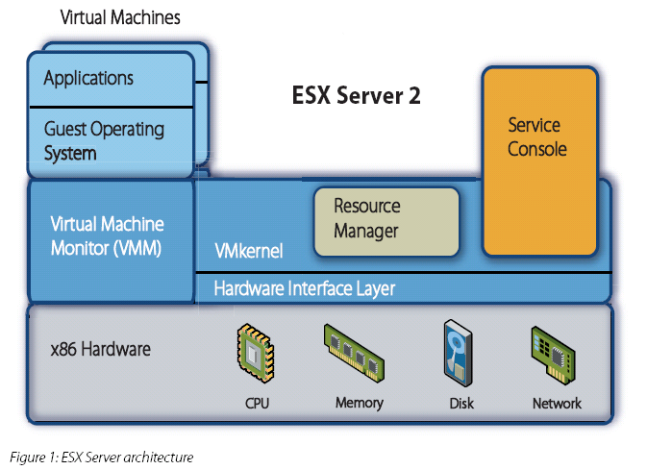
Recap: VMware ESX 2.0
Source: http://www.vmware.com/pdf/esx2_performance_implications.pdf
Notes:
Traditional arch for cpu scheduling, memory allocation, virtual disk, virtual network. Console OS is there for legacy devices, USB, and as a management platform, i.e. it has the network stack.

Slide 4
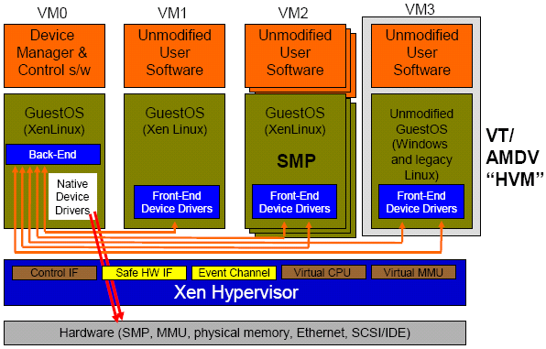
Hybrid Ex 2 - Xen 3.0
Para –virtualization
Linux Guest
Hardware-supported virtualization
Unmodified Windows
Isolated Device Drivers
Source: Ottawa Linux Symposium 2006 presentation.
http://www.cl.cam.ac.uk/netos/papers/

Slide 5
CPU Virtualization

Slide 6
Formal Requirement of Virtualization
Popek & Goldberg, 1974 “Formal Requirements for Virtualizable Third Generation Architectures”
Provide by “virtual machine monitor” with three essential characteristics:
Essentially identical execution environment (as real machine)
Minor performance penalty for programs in VM
VMM has complete control over system resources

Slide 7
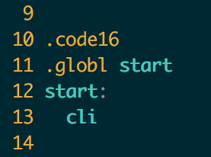
Review: Run OS as an Application
Stuck at the very first instruction
cli : disable interrupt
It’s a privilege instruction
Cannot run in user mode!
Similar instructions
E.g., change CR3, set IDT, etc.
These instructions will change machine states
xv6: bootasm.S

Slide 8
Recap: CPU Organization
Instruction Set Architecture (ISA)
Defines:
the state visible to the programmer
registers and memory
the instruction that operate on the state
ISA typically divided into 2 parts
User ISA
Primarily for computation
System ISA
Primarily for system resource management

Slide 9
Recap: System ISA
Privilege Levels
Control Registers
Traps and Interrupts
Hardcoded Vectors
Dispatch Table
System Clock
MMU
Page Tables
TLB
I/O Device Access
User
System
User
Extension
Kernel
Level 0
Level 1
Level 2

Slide 10
Challenges of Privilege Instruction
Guest OS-1
Guest OS-2
Guest OS-3
Guest OS-4
Mov $100, CR3
Mov $80, CR3
Mov $120, CR3
Mov $200, CR3
Host OS
CPU
Mem
Device
Guest OS executes privilege instructions
Guest OS are not allowed to run the privilege instructions

Slide 11
Solution: Trap & Emulate
Trap: running privilege instructions in user-mode will trap to the VMM
Emulate: those instructions are implemented as functions in the VMM
System states are kept in VMM’s memory, and are changed according
Guest OS-1
Guest OS-2
Guest OS-3
Trap
Mov $100, CR3
Host OS
Emulate
Emulate
Mov $20, CR3
CPU
Mem
Device

Slide 12
X86 is not Strictly Virtualizable
Example: the popf instruction
popf takes a word off the stack and puts in into the flags register
One flag in that register is the interrupt enable flag (IF)
At system level the IF flag is updated by popf
At user level the IF flag is not updated, and CPU silently drops updates to the IF
There 17 such instructions in X86
SGDT, SIDT, SLDT, SMSW, PUSHF, POPF, LAR, LSL, VERR, VERW, POP, PUSH, CALL, JMP, INT n, RET, STR, MOV

Slide 13
How to Deal with the 17 Instructions?
Instruction Interpretation: emulate them by software
Binary translation: translate them to other instructions
Para-virtualization: replace them in the source code
New hardware: change the CPU

Slide 14
Sol-1: Instruction Interpretation
Emulate Fetch/Decode/Execute pipeline in software
Emulate all the system status using memory
E.g., using an array GPR[8] for general purpose registers
None guest instruction executes directly on hardware
E.g., Bochs
Positives
Easy to implement & minimal complexity
Negatives
Very slow!

Slide 15
Sol-2: Binary Translator
Translate before execution
Translation unit is basic block (why?)
Each basic block -> code cache
Translate the 17 instructions to function calls
Implemented by the VMM
E.g., VMware, Qemu

Slide 16
Issues with Binary Translation
PC synchronization on interrupts
Now interrupt will only happen at basic block boundary
But on real machine, interrupt may happen at any instruction
Carefully handle self-modifying code (SMC)
Notified on writes to translated guest code

Slide 17
Sol-3: Para-virtualization
Modify OS and let it cooperate with the VMM
Change sensitive instructions to calls to the VMM
Also known as hypercall
Hypercall can be seen as trap
E.g., Xen
Widely used by industry like Amazon’s EC2

Slide 18
Sol-4： Hardware Supported CPU Virtualization
VMX root operation:
Full privileged, intended for Virtual Machine Monitor
VMX non-root operation:
Not fully privileged, intended for guest software
Both forms of operation support all four privilege levels from 0 to 3

Slide 19
Virtual Machine Control Structure (VMCS)
Data structure that manages VM entries and VM exits.
VMCS is logically divided into:
Guest-state area
Host-state area.
VM-execution control fields
VM-exit control fields
VM-entry control fields
VM-exit information fields
VM entries load processor state from the guest-state area.
VM exits save processor state to the guest-state area and the exit reason, and then load processor state from the host-state area.
Notes:
VM entries and VM exits are managed by a new data structure called the virtual-machine control structure.
Processor operation is changed substantially in VMX non-root operation. The most important change is that many instructions and events cause VM exits. Some instructions (e.g. INVD) cause VM exits unconditionally and thus can never be executed in VMX non-root operation. Other instructions (e.g. INVLPG) and all events can be configured to do so conditionally using VM-execution control fields in the VMCS.
Guest-state area. Processor state is saved into the guest-state area on VM exits and loaded from there on VM entries.
Host-state area. Processor state is loaded from the host-state area on VM exits.
VM-execution control fields. These fields control processor behavior in VMX non-root operation. They determine in part the causes of VM exits.
VM-exit control fields. These fields control VM exits.
VM-entry control fields. These fields control VM entries.
VM-exit information fields. These fields receive information on VM exits and describe the cause and the nature of VM exits. They are read-only.

Slide 20
VT-x Operations
VM 1
VM 2
VM n
VMX
Non-root
Operation
Ring 3
Ring 3
Ring 3
. . .
Ring 0
Ring 0
Ring 0
VM Exit
VMCS
1
VMCS
2
VMCS
n
IA-32
Operation
Ring 3
VMX Root
Operation
Ring 0
VMLAUNCH
VMRESUME
VMXON

Slide 21
VT-x New instructions
VMXON and VMXOFF
To enter and exit VMX-root mode.
VMLAUNCH: Used on initial transition from VMM to Guest
Enters VMX non-root operation mode
VMRESUME: Used on subsequent entries
Enters VMX non-root operation mode
Loads Guest state and Exit criteria from VMCS
VMEXIT
Used on transition from Guest to VMM
Enters VMX root operation mode
Saves Guest state in VMCS
Loads VMM state from VMCS
VMPTRST and VMPTRLD
To Read and Write the VMCS pointer.
VMREAD, VMWRITE, VMCLEAR
Read from, Write to and clear a VMCS.
Notes:
The VT-x instructions are available on VMX root mode only.

Slide 22
Memory Virtualization

Slide 23
Virtualizing Memory
VMM constructs a page table that maps guest address to host physical address
E.g., if guest VM has 1GB of memory, it can access memory address 0~1GB
Each guest VM has its own mapping for memory address 0, etc.
Different host physical address used to store data for those memory locations

Slide 24
Virtualizing the Page Tables
Terminology: 3 types of address now
GVA->GPA->HPA (Guest virtual. Guest physical. Host physical)
Guest VM's page table contains GPA
Setting CR3 to point to guest page table would not work
E.g., a processes in VM might access host physical address 0~1GB, which might not belong to that guest VM
Solution-1: shadow paging
Solution-2: direct paging
Solution-3: new hardware

Slide 25
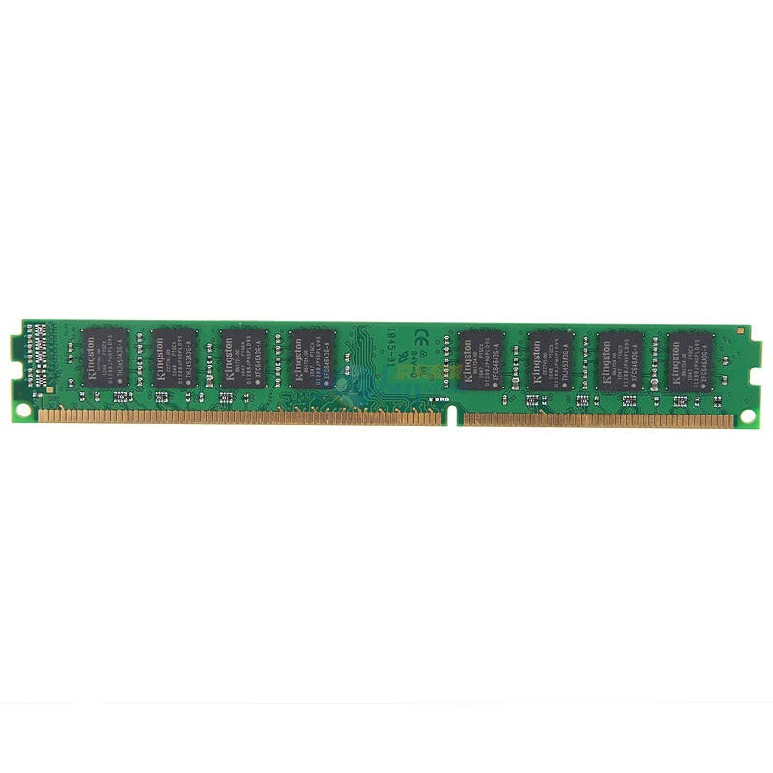
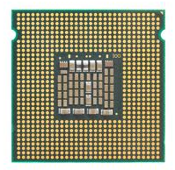
Solution-1: Shadow Pages
Guest VM
GVA
GVA
GPT
GPA
GPA
HPT
SPT
HPA
HPA
CR3

Slide 26
Two Page Tables Become One
VMM intercepts guest OS setting the virtual CR3
VMM iterates over the guest page table, constructs a corresponding shadow page table
In shadow PT, every guest physical address is translated into host physical address
Finally, VMM loads the host physical address of the shadow page table

Slide 27
Setup Shadow Page Table
set_cr3 (guest_page_table):
for GVA in 0 to 220
if guest_page_table[GVA] & PTE_P:
GPA = guest_page_table[GVA] >> 12
HPA = host_page_table[GPA] >> 12
shadow_page_table[GVA] = (HPA<<12)|PTE_P
else
shadow_page_table = 0
CR3 = PHYSICAL_ADDR(shadow_page_table)

Slide 28
What if Guest OS Modifies Its Page Table?
Real hardware would start using the new page table's mappings
Virtual machine monitor has a separate shadow page table
Goal:
VMM needs to intercept when guest OS modifies page table, update shadow page table accordingly
Technique:
Use the read/write bit in the PTE to mark those pages read-only
If guest OS tries to modify them, hardware triggers page fault
Page fault handled by VMM: update shadow page table & restart guest

Slide 29
Protect Kernel-only Pages
How do we selectively allow / deny access to kernel-only pages in guest PT?
Hardware doesn't know about our virtual U/K bit
Idea:
Generate two shadow page tables, one for U, one for K
When guest OS switches to U mode, VMM must invoke set_ptp(current, 0)

Slide 30
Two Memory Views of Guest VM
When guest OS
is running
When application
is running
Kernel space
No user access
User space
User access

Slide 31
Sol-2: Direct Paging (Para-virtualization)
Modify the guest OS
No GPA is needed, just GVA and HPA
Guest OS directly manages its HPA space
Use hypercall to let the VMM update the page table
The hardware CR3 will point to guest page table
VMM will check all the page table operations
The guest page tables are read-only to the guest

Slide 32
Sol-2: Direct Paging (Para-virtualization)
Positive
Easy to implement and more clear architecture
Better performance: guest can batch to reduce trap
Negatives
Not transparent to the guest OS
The guest now knows much info, e.g., HPA
May use such info to trigger rowhammer attacks

Slide 33
Sol-3: Hardware Supported Memory Virtualization
Hardware implementation
Intel’s EPT (Extended Page Table)
AMD’s NPT (Nested Page Table)
Another table
EPT for translation from GPA to HPA
EPT is controlled by the hypervisor
EPT is per-VM

Slide 34
Guest VM
VMM
GVA
PT
GPA
VA
EPT
PT
HPA
PA
Non-root mode
Root mode

Slide 35
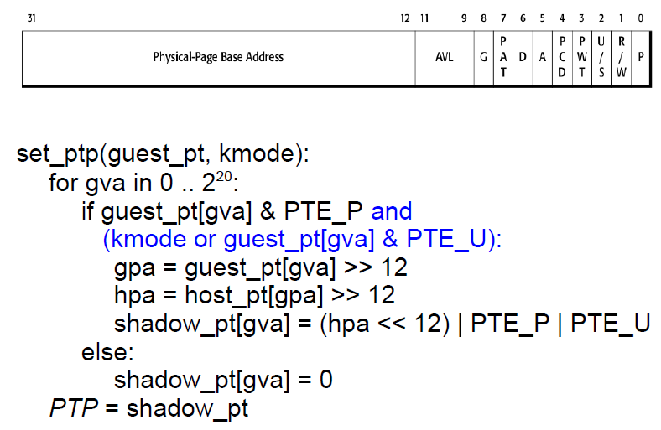
Protect Kernel-only Pages

Slide 36
Managing Memory in VMM
Configure VMs to use more memory than actually available
What happens when running out of memory?
Strawman: use LRU paging at VMM
OS already uses LRU → doubling paging
OS will recycle whatever page VMM just paged out
Better to do random eviction

Slide 37
Vmware ESX: Reclaiming Pages
Idea: trick OS to return memory to VMM
OS is better at deciding what to swap
Normally OS uses all available memory
E.g. buffer cache contains old pages, OS won‘t discard if it does not need memory
ESX trick: balloon driver

Slide 38
Memory Balooning
Baloon inflates by requesting
lots of “pinned” memory pages
Baloon is a special
pseudo-device loaded into OS
VMM instructs baloon to
inflate or deflate depending
on memory pressure
OS1
OS2
Baloon tells VMM to recycle
its “private” pinned pages
VMM
To accommodate inflated baloon,
OS releases/swaps out
some of its memory pages

Slide 39
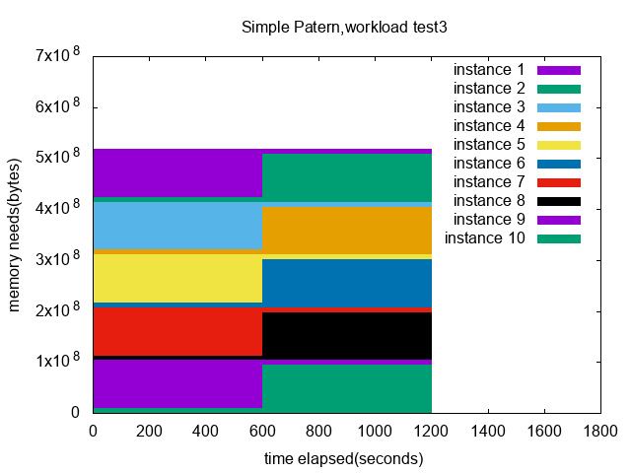
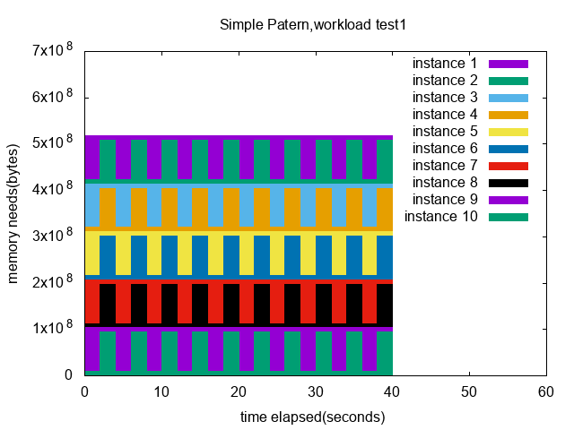

A simple pattern evaluation
10 small VMs configured with initial memory 90MB, maxmem 256MB.
Three tests with three pattern change intervals.
Notes:
So me and DD conducted some performance evaluation based on a simple pattern workload.
We run 10 TinyD VMs configured with initial memory of 90 MB, and maximum memory of 256 MB.
We divide the VMs into 5 groups. For each pair of VMs in a group, one of them runs a high-memory-demand workload, while the other runs a low-memory-demand workload.
We have three tests with three pattern change intervals, that is 2 seconds, 20 seconds, and 600 seconds.

Slide 40
Ballooning policy analysis
Notes:
Here are examples of test results on KVM.
We can see that different policies have magnitudes of difference in performance.
The performance of some policies might reach somewhere close to the performance of running as process in this workload,
While some other policies might behave as if there’s no ballooning taking place at all.
结论：policy related to workload pattern

Slide 41
ESX: Sharing Pages across VMs
Many VMs run same OS and programs
Many Linux boxes with Apache server
Idea: use 1 machine page for identical physical pages
Periodically scan to find identical machine pages
Do copy-on-write to eliminate redundancy
Optimization: use a hash table keyed by hash(content)
Allows quick lookup based on page content

Slide 42
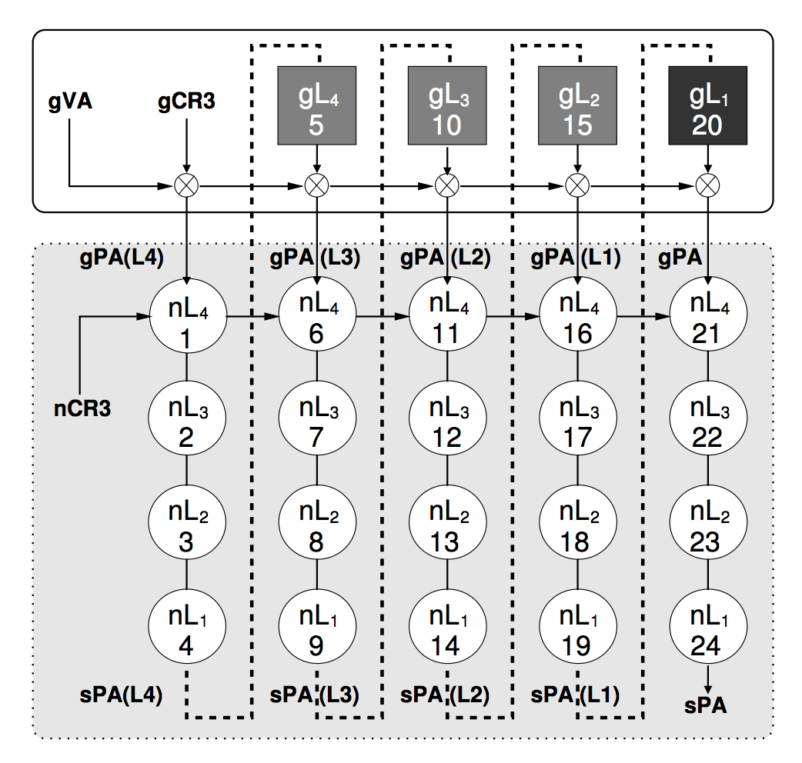
EPT Increases Memory Access
sPA == HPA
nCR3 == hCR3
nL₁ == hL₁
One memory access from the guest VM may lead up to 20 memory accesses!

Slide 43
Page Table Isolation

Slide 44

Meltdown
Key:
0x0000 0001
….
attack:
LD RAX, Key
LD RBX, S[RAX]
…
probe:
Kernel
User
CPU
Permission Check Error !
Key → RAX_0
S[RAX_0] → RBX_0
…
EXCEPTION!!!
ROLLBACK
Probe()
S
Cache
*Key = 1

Slide 45
Solution
The bug may never be fixed on existing CPU
Hardware bug at pipeline level
Exist in all Intel CPUs
Cannot be fixed by micro-code patch
Software solution: Kernel Page Table Isolation (KPTI)
Two page tables (kernel & user)
Switch PT during kernel/user switching
Remove kernel address mappings in user page table

Slide 46
Motivation
Performance
Add MOV to CR3 during kernel/user switching
Up to 30% overhead on server application
Applicability
Patch on kernel source code
Patch only works for specific versions

Slide 47
Goals
Defend against Meltdown attack in cloud environment
Applicability
No kernel source code modification
No need to reboot a guest
Performance
Faster than KPTI

Slide 48
EPTI
Enable different mapping for guest user/kernel
With different EPT
Switch mappings during kernel/user switching
With VMFUNC
Enable protection on kernel Image
With binary rewriting
Kernel
Kernel
User
User
Kernel mapping
User mapping

Slide 49
Challenge
How to isolate kernel space in user mode?
How to enable the isolation without guest reboot?

Slide 50
Kernel Space Isolation
Remove GPA-to-HPA for kernel in EPT-u
gPT
EPT
Kernel
User
GVA
GPA
HPA

Slide 51
Kernel Space Isolation
Remove GPA-to-HPA for kernel
Cannot identify guest
physical memory for kernel
Remove GVA-to-GPA for kernel
gPT
EPT
Kernel
User
GVA
GPA
HPA

Slide 52
Kernel Space Isolation
Remove GPA-to-HPA for kernel
Cannot identify guest
physical memory for kernel
Remove GVA-to-GPA for kernel
Map gPT page to different
host physical pages
gPT
EPT
EPTu
00000000
EPTk
Kernel
User
GVA
GPA
HPA

Slide 53
Kernel Space Isolation
Remap kernel gL3 pages to new host physical page
Trace all enabled kernel gL3 pages
Trap MOV to CR3 and
gL4 modification
Opt1 ➔ Trap new CR3 (CR3_TARGET_VALUE)
OPT2 ➔ Only trap gL3
gL4
gL3
gL2
gL1
Kernel
User
Kernel
EPTk
User
EPTu
0000
0000

Slide 54
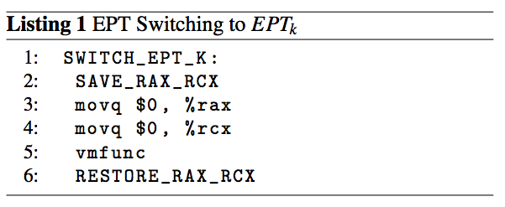
Enable Isolation
Identify the entry/exit point of kernel/user switching
Entry: 1) interrupt, pointed by IDT; 2) Syscall, pointed by MSR
Exit: sysret,…
Add VMFUNC trampoline
Code page + per_cpu stack page
Map trampoline into both EPTu and EPTk

Slide 55
Enable Isolation
Enable protection without guest reboot
Guest run on host w/o EPTI
Live migrate guest to host w/ EPTI
Identify all entries and exits in guest
Map trampoline in guest
Finish live migration

Slide 56
Security
Not work
VMFUNC can be executed in guest user mode
VMFUNC to EPTk
Perform meltdown
Meltdown test: cannot bypass non-executable permission
Map all memory except kernel code and kernel module as non-executable in EPTk
Kernel code → fixed after system boot
Kernel modules → fixed kernel space range, monitor gPT modification
attack:
LD RAX, Key
LD RBX, S[RAX]
…
probe:

Slide 57
Performance
Redis
Apache

Slide 58
Further Reading
www.govirtual.com
系统虚拟化--原理与实现
http://www.china-pub.com/45151&ref=xiangguan

