Slide 1
简易数据库系统
5140379061 唐宇新

Slide 2
Organization Format
KEY
LOCATION
LENGTH
Reference
VALUE

Slide 3
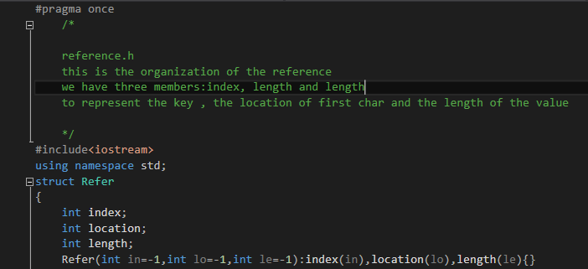
Reference
Index
Location
Length quick finding

Slide 4
Reference
Overloaded functions , index is the only standard for comparing
friend bool operator<(const Refer& father,const Refer& son)
{
if (father.index < son.index)return true;
else return false;
}

Slide 5
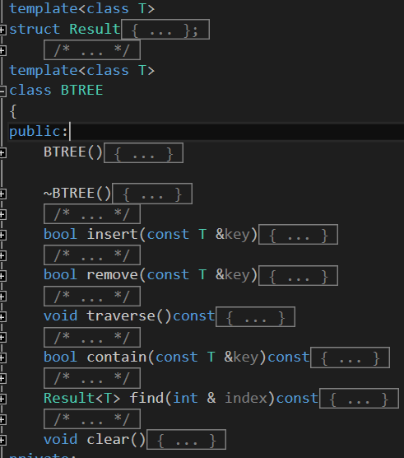
BTree
Insert()
Remove()
Traverse()
Contain()
Find()
Clear()

Slide 6
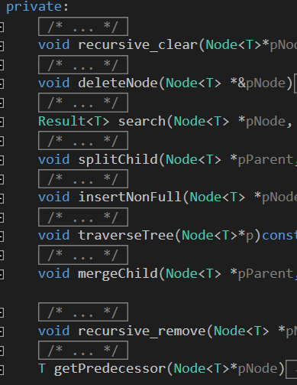
BTree
recursive_clear()
deleteNode()
search()
splitChild()
traverseTree()
mergeChild()
Recursive_remove()
getPredecessor()
getSuccessor()
Btree 的具体实现和算法 就不一一赘述。

Slide 7
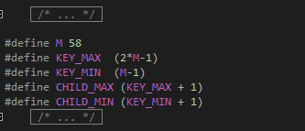
BTree
We set the M as half of key number, thus we can change M’s value to compare our database speed and the performance of BTree

Slide 8
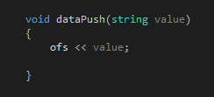
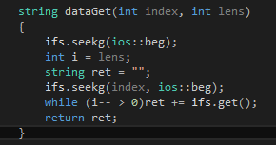
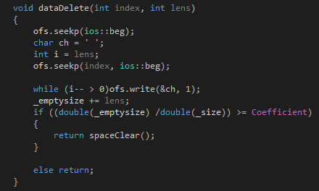
DataBase
Push: insert at the ending of the file
Get: copy the string in the file and return
Delete: change the string into a string of whitespace
Set: first delete then push

Slide 9
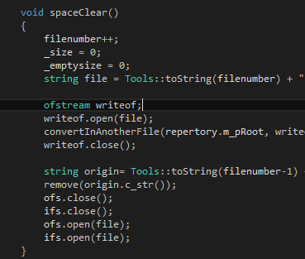
DataBase
Vector Model
When the whitespace is beyond our expectation, we use a vector model.

Slide 10
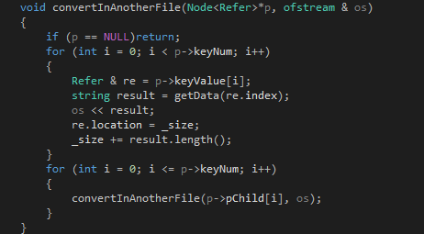
DataBase
Reference writing and reference reserve
A simple way -------traverse()

Slide 11
Test process
Correct Test: we use STL map to evaluate the correctness of our database
Speed Test: four small tests, pushing, getting, setting and deleting
Open File Test: We save the reference and data, we open them in another database
Vector Model Test: We use a vector model, thus we need to test
Compare Test: compare our database performance with STL map
User Friendly Function : easy for people to use and test

Slide 12
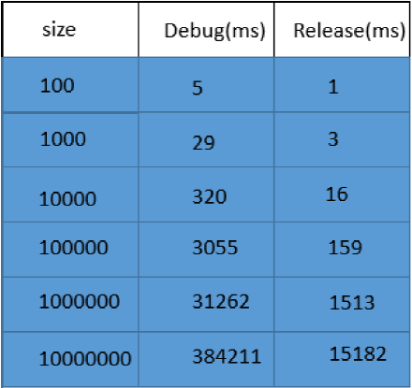
Results:

Slide 13
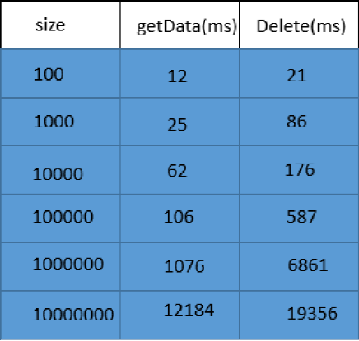
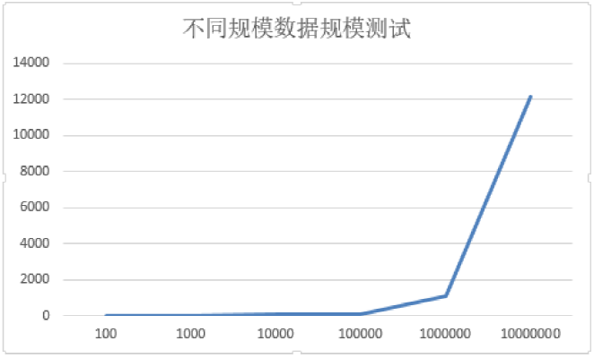
Results:

Slide 14
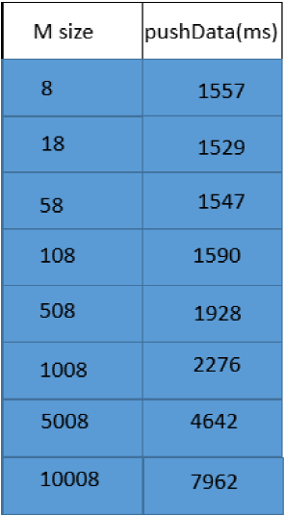
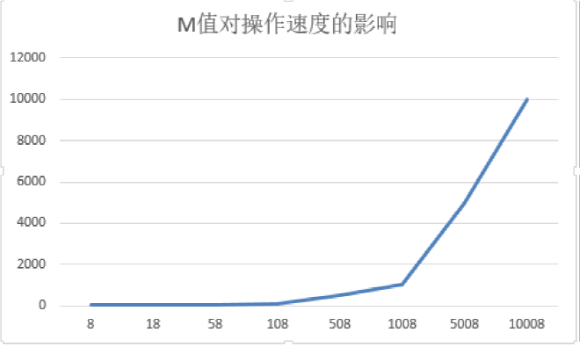
Results:

Slide 15
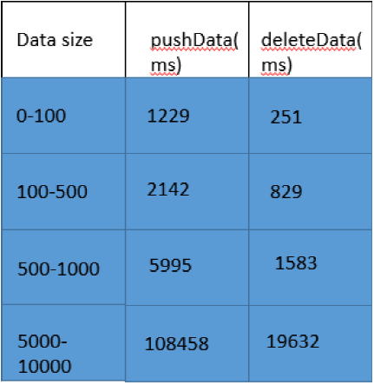
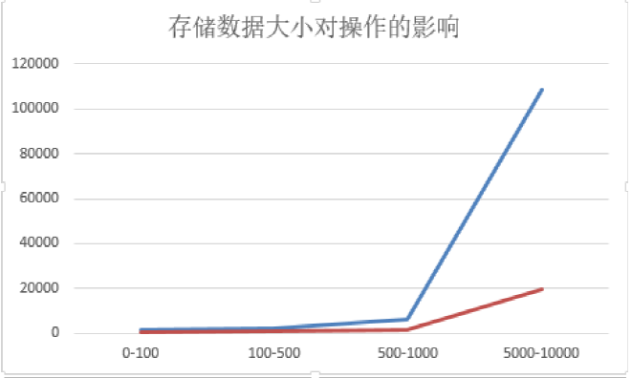
Results:

Slide 16
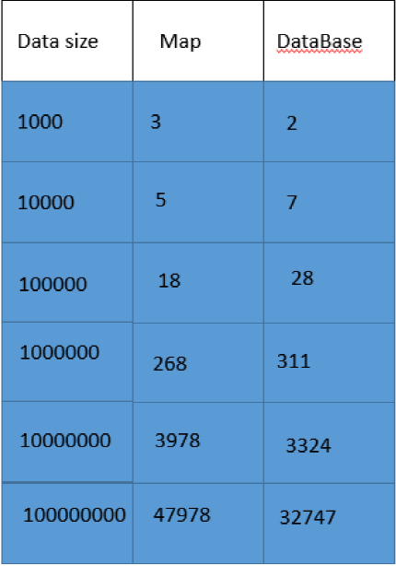
Results:

Slide 17
Conclusion:
IO in disk is too slow that we should try our best to avoid it.
How to organize our reference file is a big problem.
From this database, we learn a lot of things like implementation of Btree and the design of cache

Slide 18
Thank you!!!

