Slide 1


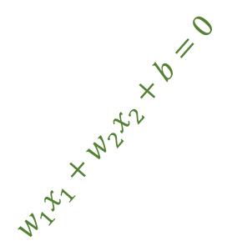
+1
$$w_{1}x_{1}+w_{2}x_{2}+b=0$$
-1

Slide 2
choose this?
choose this?
choose this?

Slide 3
support vectors
choose this?
choose this?
optimal hyperplane
choose this?
maximised margin

Slide 4

optimal hyperplane
???
optimal hyperplane
Kernel
$$Φ$$
1D
2D

Slide 5


optimal hyperplane
Kernel
$$Φ$$
2D
3D

Slide 6
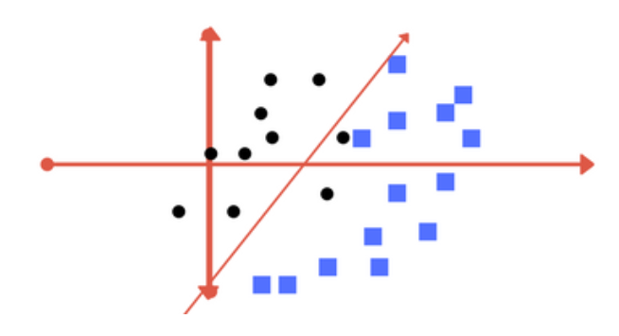
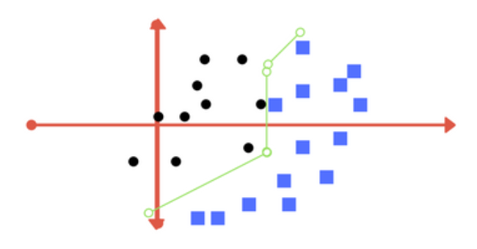
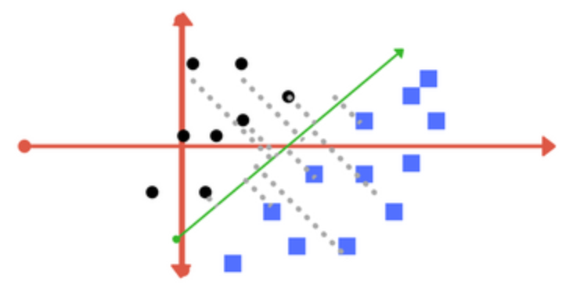
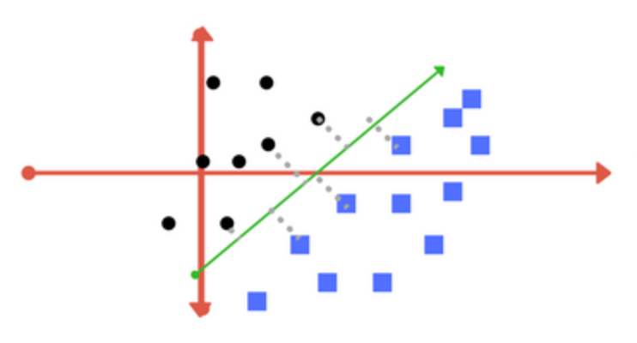
small C
big C
low gamma
high gamma
far away points are also considered
only nearby points are considered

Slide 7
small C
big C

Slide 8
low gamma
high gamma

Slide 9
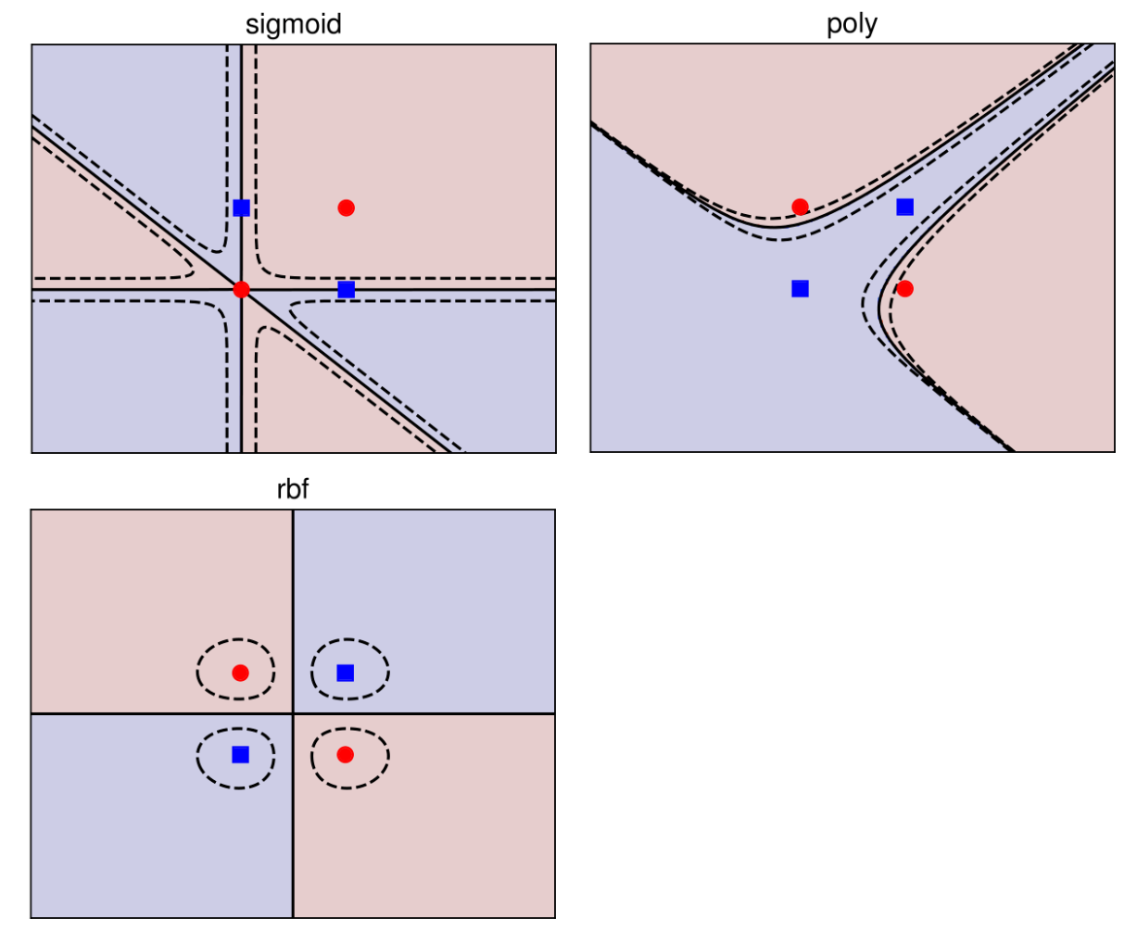
XOR problem
rbf is the best choice

Slide 10
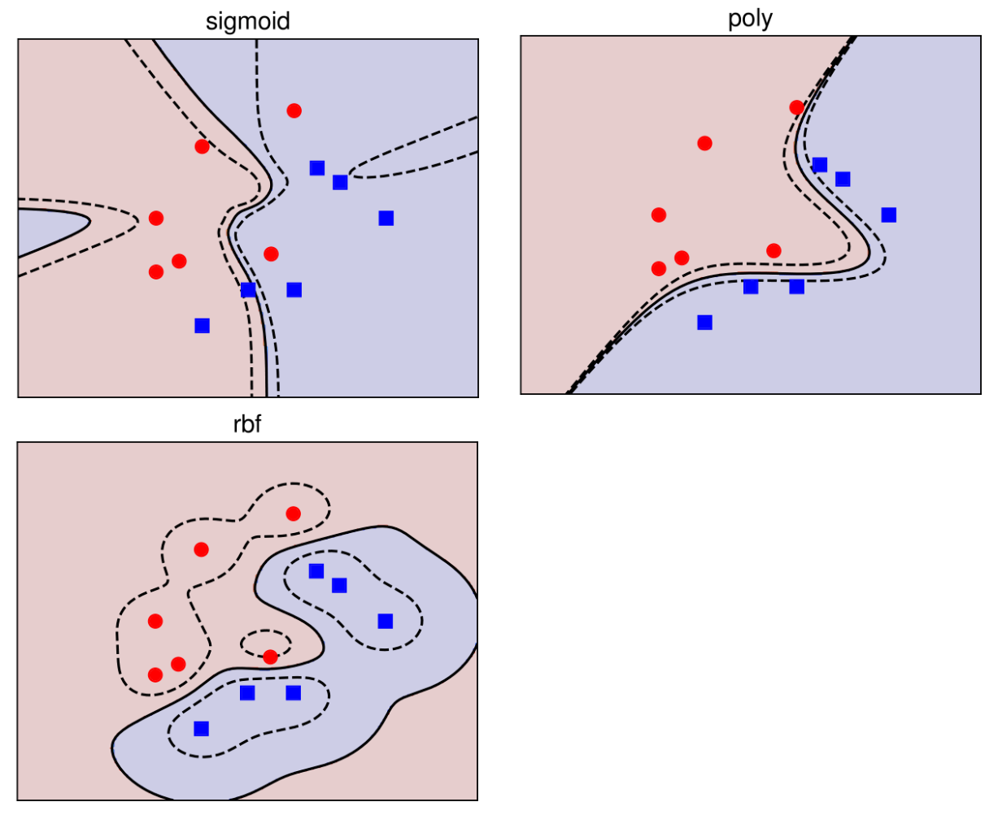
almost linearly separable data
poly is the best choice

