Slide 1
PCA
2D
1D

Slide 2
PCA
5D
2D

Slide 3
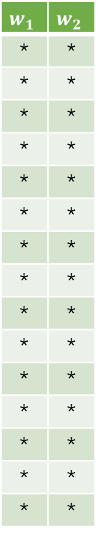
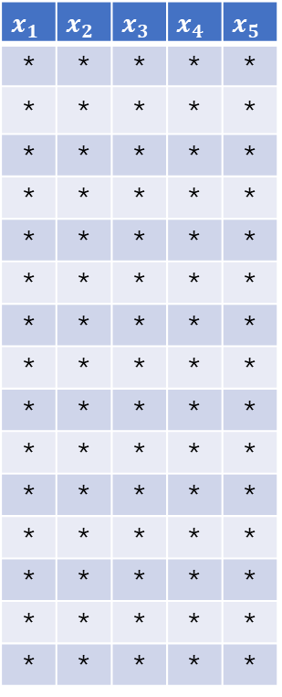
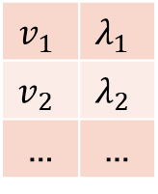
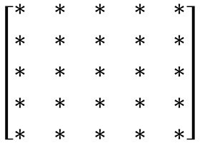
Large table
Small table
$$x_{1}$$ | $$x_{2}$$ | $$x_{3}$$ | $$x_{4}$$ | $$x_{5}$$
* | * | * | * | *
* | * | * | * | *
* | * | * | * | *
* | * | * | * | *
* | * | * | * | *
* | * | * | * | *
* | * | * | * | *
* | * | * | * | *
* | * | * | * | *
* | * | * | * | *
* | * | * | * | *
* | * | * | * | *
* | * | * | * | *
* | * | * | * | *
* | * | * | * | *
Covariance matrix
eigenstuffs
$$w_{1}$$ | $$w_{2}$$
* | *
* | *
* | *
* | *
* | *
* | *
* | *
* | *
* | *
* | *
* | *
* | *
* | *
* | *
* | *
$$\left[\begin{matrix}∗ & ∗ & ∗ & ∗ & ∗ \\ ∗ & ∗ & ∗ & ∗ & ∗ \\ ∗ & ∗ & ∗ & ∗ & ∗ \\ ∗ & ∗ & ∗ & ∗ & ∗ \\ ∗ & ∗ & ∗ & ∗ & ∗\end{matrix}\right]$$
big
$$v_{1}$$ | $$λ_{1}$$
$$v_{2}$$ | $$λ_{2}$$
… | …
small

Slide 4
choose this?
or choose this?

Slide 5

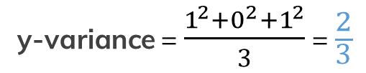

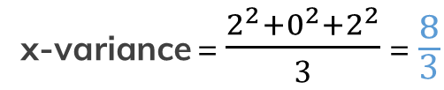
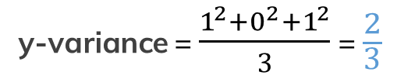
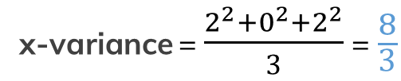
(-2;1)
(2;1)
-2
(0,0)
1
(0,0)
2
1
0
(2;-1)
1
(-2;-1)
0
1
-2
2
2
2
2
2
Mean = 0
Mean = 0
x-variance = $\frac{2^{2}+0^{2}+2^{2}}{3}$ =$\frac{8}{3}$
x-variance = $\frac{2^{2}+0^{2}+2^{2}}{3}$ =$\frac{8}{3}$
y-variance = $\frac{1^{2}+0^{2}+1^{2}}{3}$ =$\frac{2}{3}$
y-variance = $\frac{1^{2}+0^{2}+1^{2}}{3}$ =$\frac{2}{3}$
Covariance = $\frac{\left(−2\right)+0+\left(−2\right)}{3}$ =$−\frac{4}{3}$
Covariance = $\frac{2+0+2}{3}$ =$\frac{4}{3}$

