Slide 1
DATA SCIENCE Project Proposal

Slide 2

ABOUT US
Nguyễn Thành Đạt - QE170110 (Leader)
Ngô Đình Ẩn - QE170066
Hoàng Thanh Lâm - QE170013
Dương Thành Duy - QE170105
Trương Phước Trung - QE170090

Slide 3
TABLE OF CONTENTS
01
02
05
03
04
Exploratory Data Analysis
Model
Web
Create Bag Of Word
03
Data Processing

Slide 4
INTRODUCTION
Students’ feedback is a vital resource for the inter- disciplinary research combining of two fields: sentiment analysis and education. After having the dataset, we plan to build automatic students’ feedback classification tools to support effective management of training and learning activities of a university.

Slide 5
01
Data Analysis

Slide 6

The UIT-VSFC corpus
Data Analysis
Students’ feedback is not only a powerful source for improvement of education quality, but also an important resource for research on sentiment analysis and education.
sentiment-based classifications
topic-based classifications
The resource consists of over 16,000 sentences which are human annotated on the two tasks.

Slide 7
Sentiment-based task:
Topic-based task:
For lecturers
For curriculum
For facilities
Others
Positive
Negative
Neutral/Objective

Slide 8
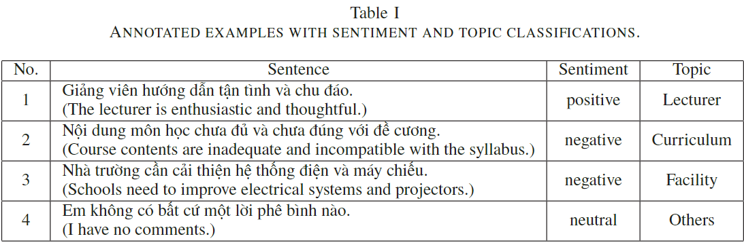

Slide 9


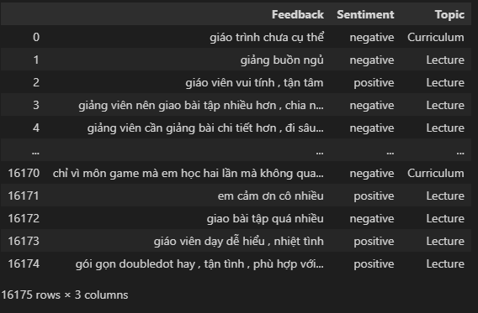
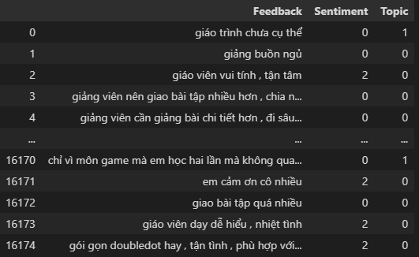

Slide 10
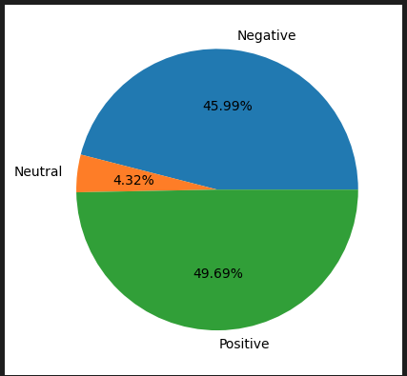
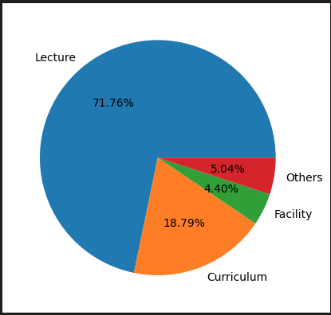
Percentage of student feedback

Slide 11
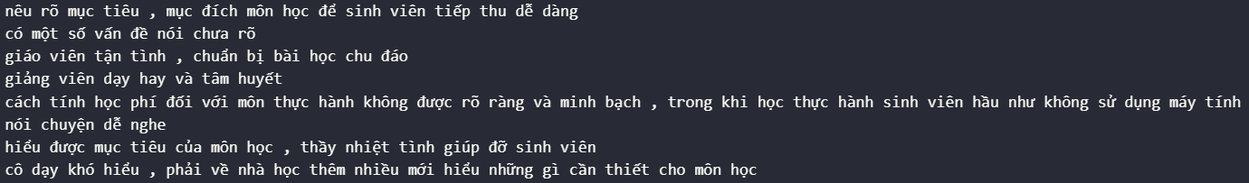
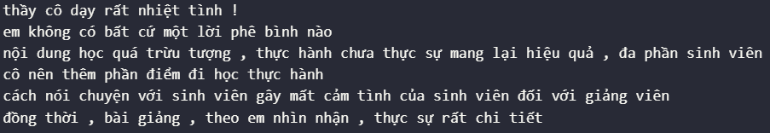
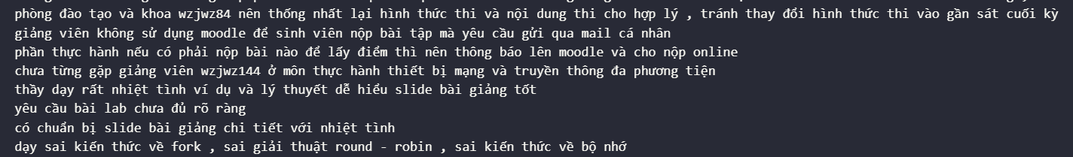
Problem
Stop Words
2. Punctuation
3. Pronoun

Slide 12
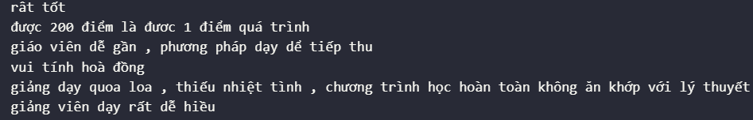
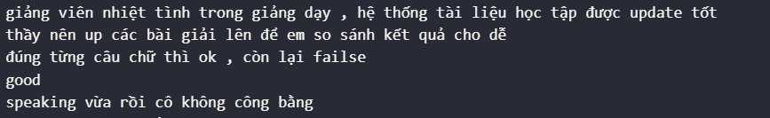
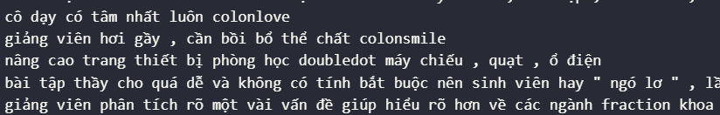
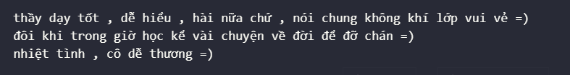
4. Spelling mistake
5. English
6. Icon

Slide 13
02
Create Bag Of Word

Slide 14
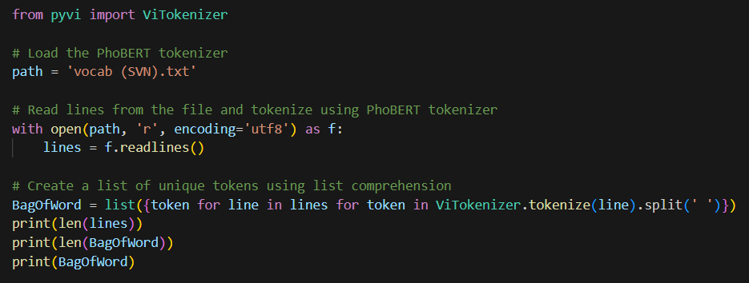
Using PhoBERT tokenizer

Slide 15
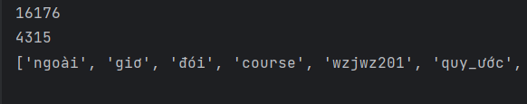
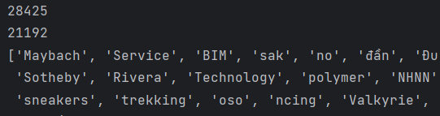
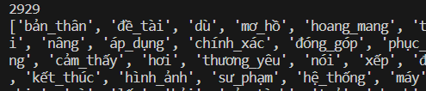
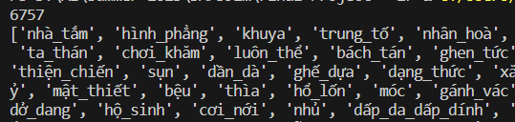
Using PhoBERT tokenizer
Available dataset:
External dataset:

Slide 16
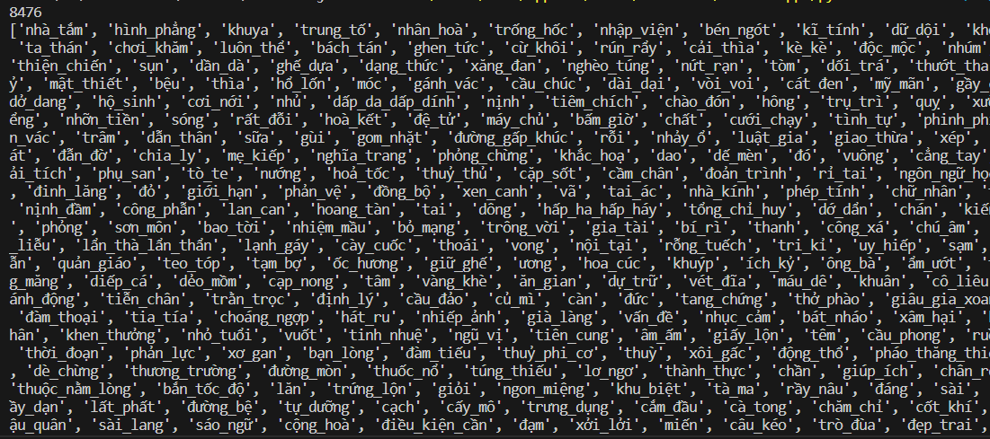
Using PhoBERT tokenizer

Slide 17
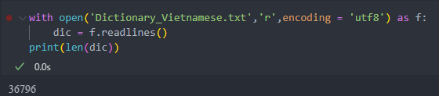

Slide 18
03
Data Processing

Slide 19
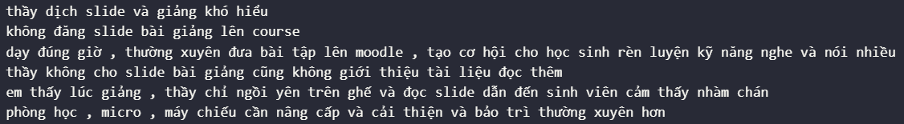
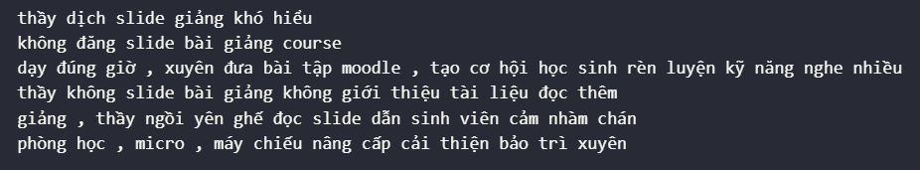
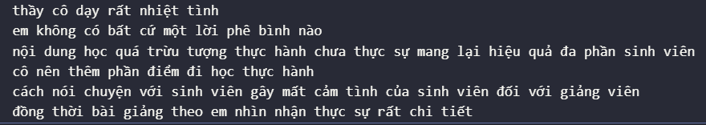
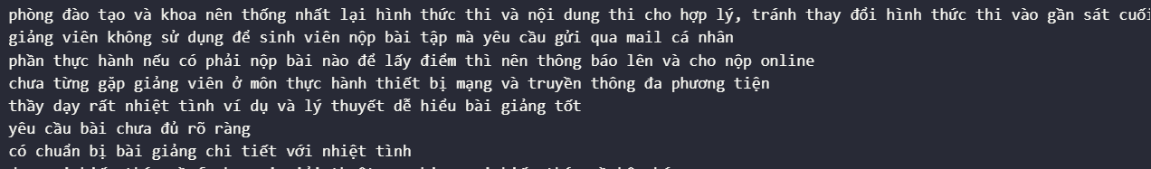
Technique
Stop words (127 word)
Punctuation
Pro noun (419 word)
Spell correct word (160 word)
Translate English to Vietnamese (98 word)
Icon:
Translate emoticon to Vietnamese
Emoticon
Emoji (Add more)
Before:
Before:
Before:
After:
After:
After:

Slide 20
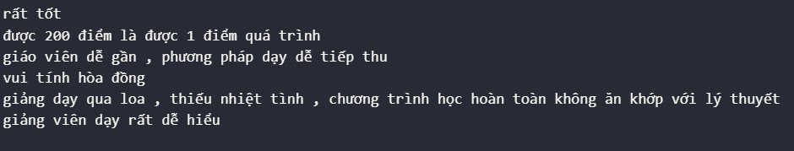
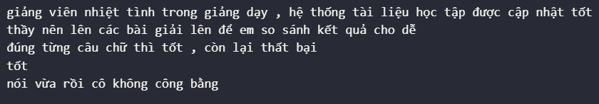
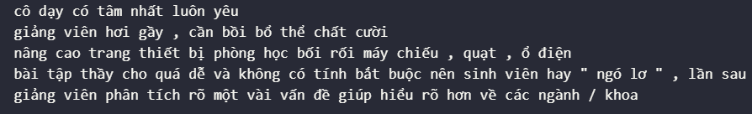
Technique
Spell correct word (160 word)
Icon:
Translate emoticon to Vietnamese
Emoticon
Emoji (Add more)
Translate English to Vietnamese (98 word)
Before:
Before:
Before:
After:
After:
After:

Slide 21
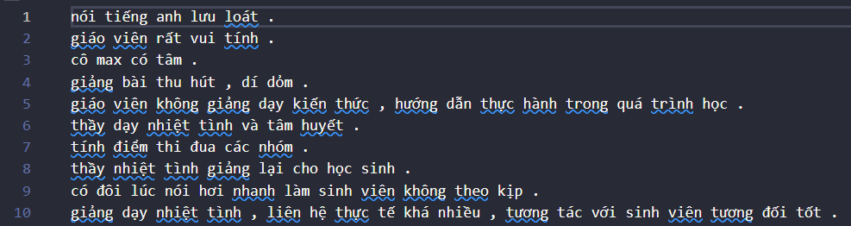
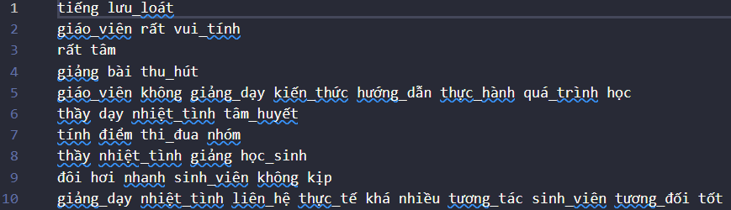
Data After Processing
Before
After

Slide 22

04
Modeling

Slide 23
05
Web Application

Slide 24
Thanks for listening

