Slide 1

Slide Demo Cấu hình Project NodeJS Unitest
Tên: Đinh Đăng Khoa
MSSV: 17080051
Nhóm: HKVD

Slide 2
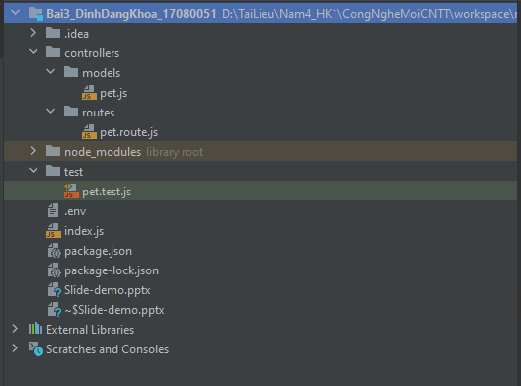
Cấu trúc Project

Slide 3
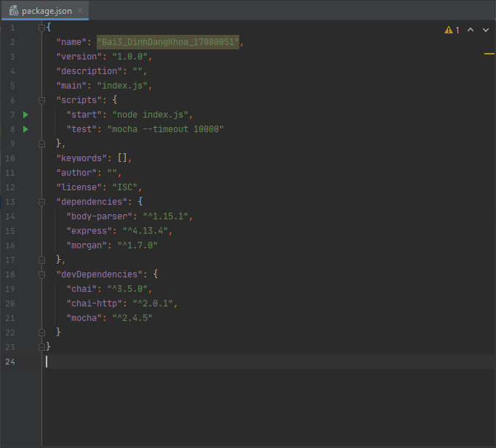
File package.json

Slide 4
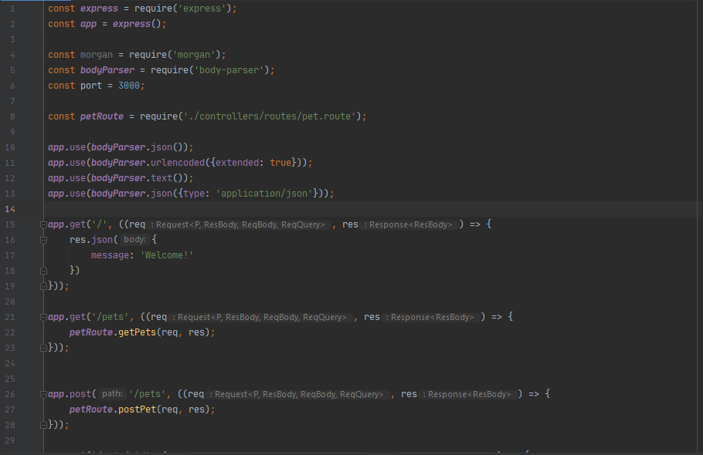
File index.js

Slide 5
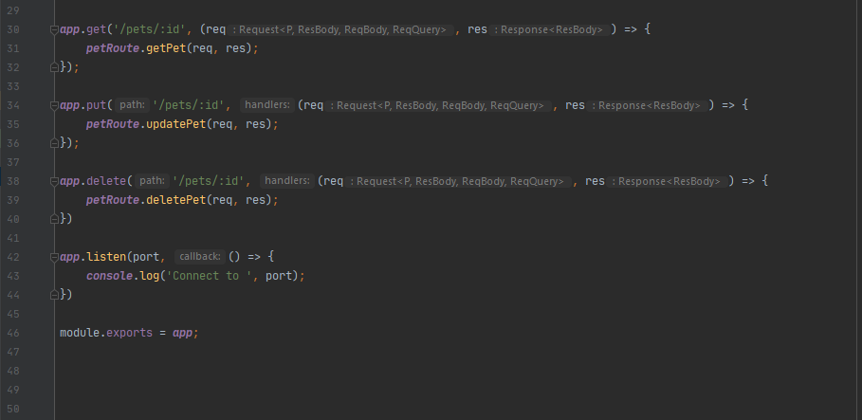
File index.js (cont)

Slide 6
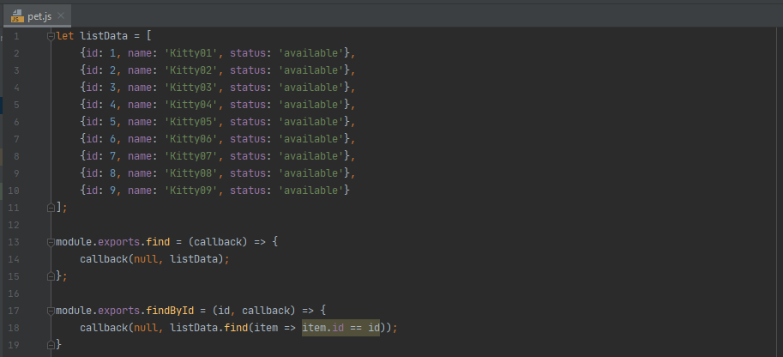
Model pet.js
find - findById

Slide 7
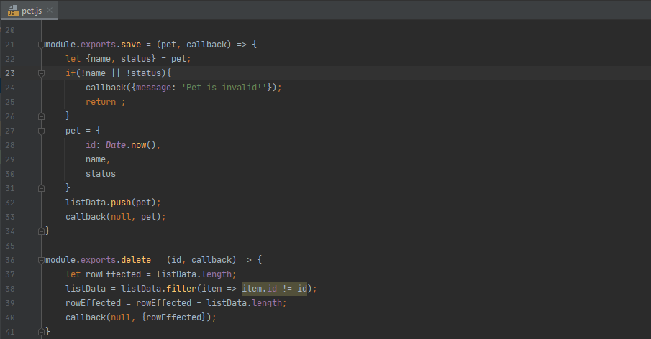
Model pet.js
save -delete

Slide 8
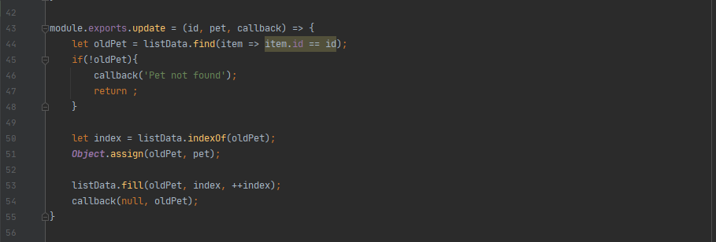
Model pet.js
update

Slide 9
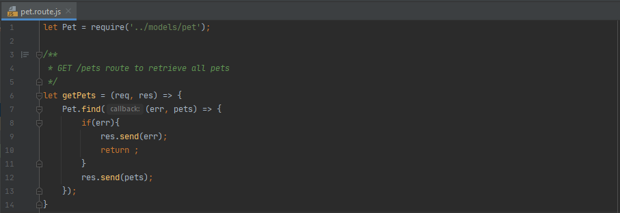
Route pet.route.js
GET /pets

Slide 10
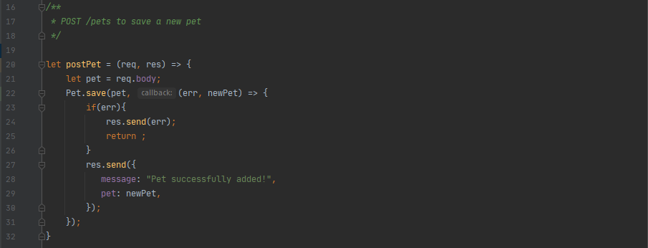
Route pet.route.js
POST /pets

Slide 11
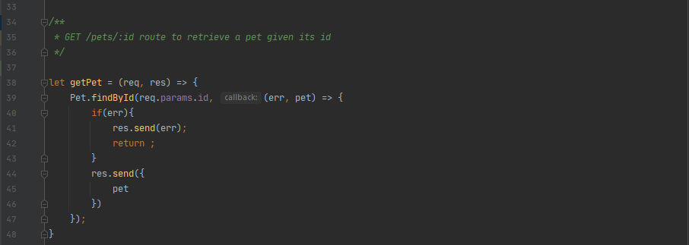
Route pet.route.js
GET /pets/:id

Slide 12
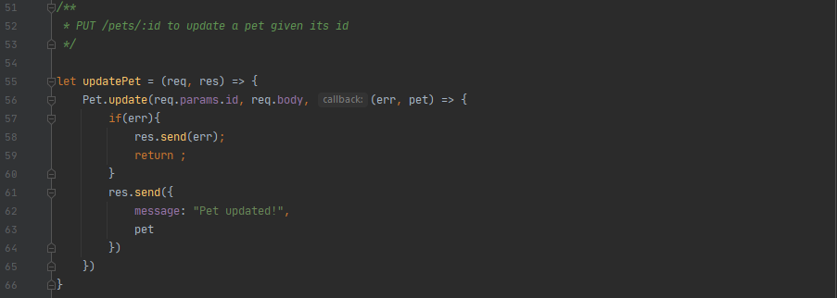
Route pet.route.js
PUT /pets/:id

Slide 13
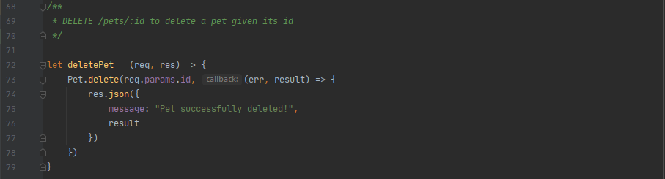
Route pet.route.js
DELET /pets/:id

Slide 14
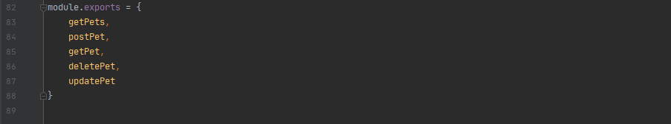
Route pet.route.js
module.export

Slide 15
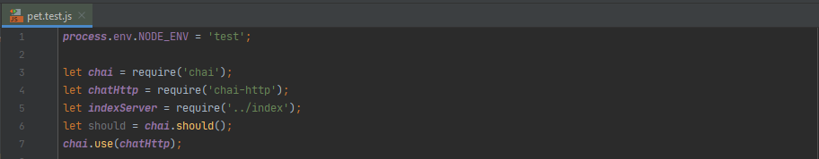
Test pet.test.js
require

Slide 16
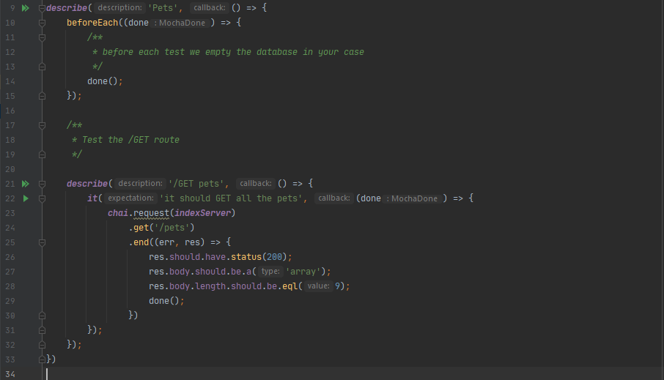
Test pet.test.js
/GET pets

Slide 17
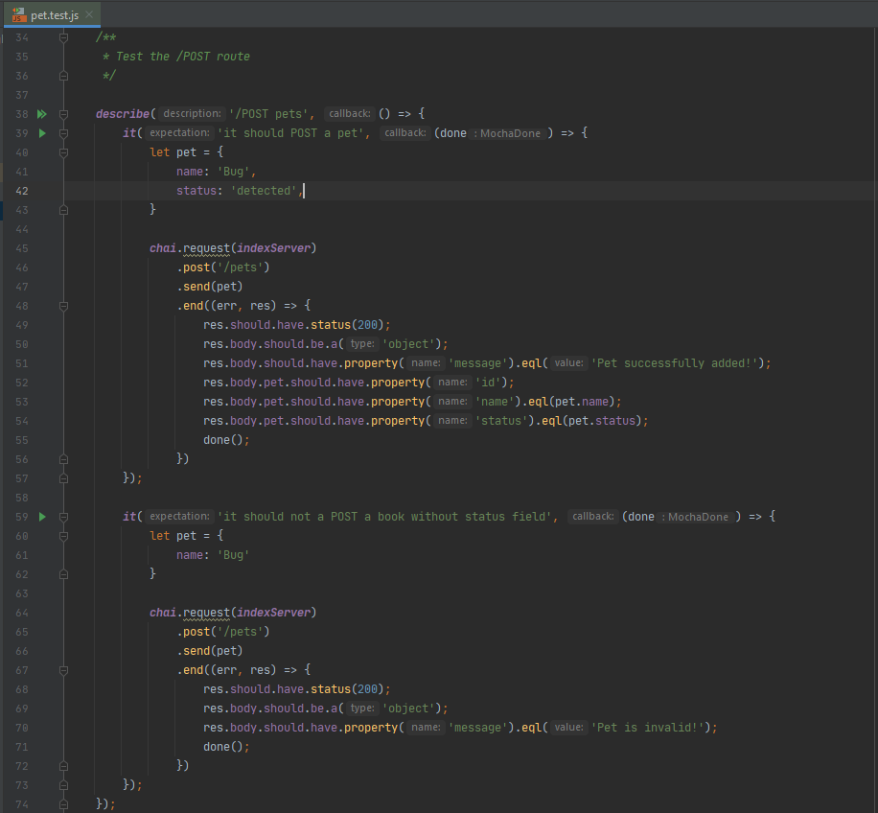
Test pet.test.js
/POST pets

Slide 18
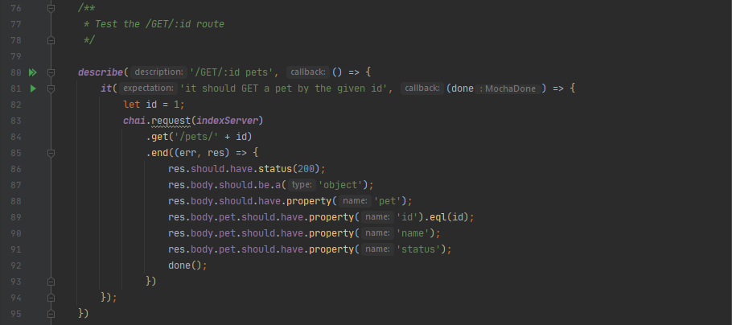
Test pet.test.js
/GET/:id pets

Slide 19
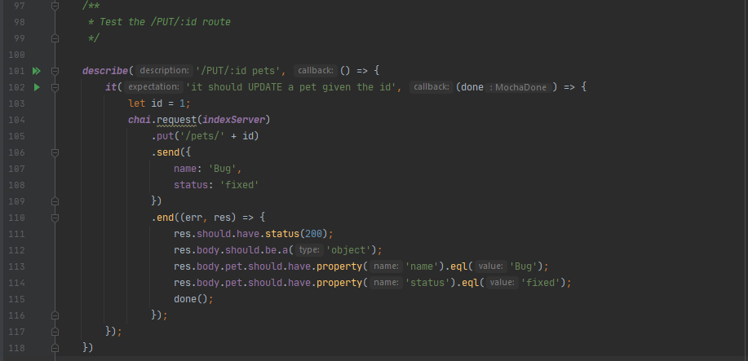
Test pet.test.js
/PUT/:id pets

Slide 20
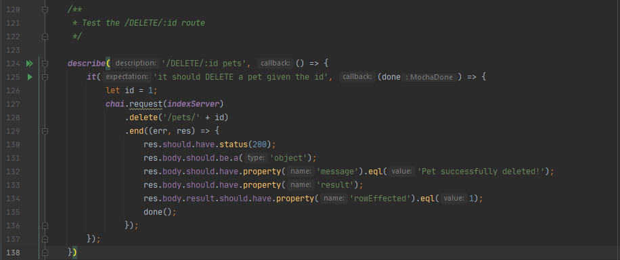
Test pet.test.js
/DELETE/:id pets

Slide 21
Thanks for watching

