Slide 1
YourMoney
Manage your money, manage your life!.
Giang Thanh Dinh – CE140538 Nguyen Thuy Hien – CE140350 Nguyen Tan Dai Phat – CE140539
Dang Le Thanh Nam – CE140343

Slide 2

Content
1
I. Work Assignments
Share tasks for member.
2
II. Problem
Define problems and the introduction of application
3
III. Solution
Solution for that problem
4
IV. Demo
Start to run application.

Slide 3
I. Work Assignment
Chart of merits of each member

Slide 4
I. Work Assignment
Specifically members.
Document.
+ Dinh: Content chapter 3, Conclusion.
+ Hien: Introduction, Content Chapter 1
+ Nam, Phat: Content chapter 2.

Slide 5
II.Problem
In today's life, the shopping needs of people are very high. The payment or financial management cause many disadvantages for some people. Therefore, in the era of technology 4.0, it is necessary to have many applications that can meet the needs and create convenience in financial management of everyone.
On the other hand, many fields such as health and education, in our country have been applying IT to information storage management to achieve many high achievements. The accuracy, quickness and diversity of management functions of software products help reduce effort and improve work efficiency.

Slide 6
III. Solution
Our team discussed and decided to create a YourMoney on desktop.
YourMoney financial management application helps to pay for electricity, water.
Free money transfer to friends ... helps minimize time, create many advantages for everyone.

Slide 7
III. Solution
Specifics Function
List user function:
Login.
Register.
Forget Password.
Transfer money with QR.
Transfer money with code account.
Create report history.
Create QR for user.
Change Information.
Deposit.
Withdraw.
List admin function:
Create report account.
Block user account.

Slide 8
III. Solution
specific tasks for members
Dinh:
Create report account
Create QR code.
Transfers money with QR code
Create how to authentication OTP
Hien:
Buy ticket movie
Payment Phone
Transfer Money with accoun code
Register

Slide 9
III. Solution
Nam:
Login
Deposit
Withdraw
Forget password
Phat:
Block account
History trade
Change information account

Slide 10
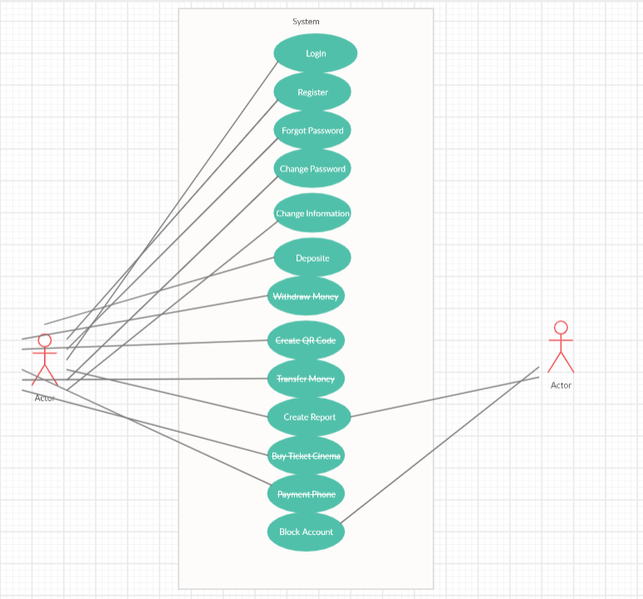
III.Solution

Slide 11
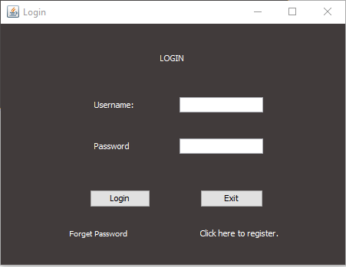
III.Solution
Form Login

Slide 12
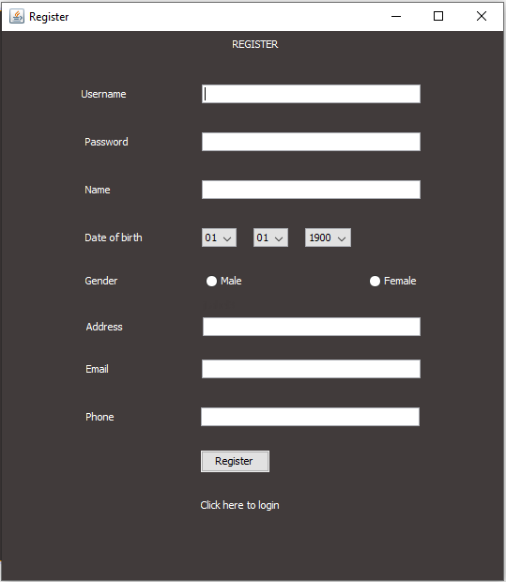
III.Solution
Form Register

Slide 13
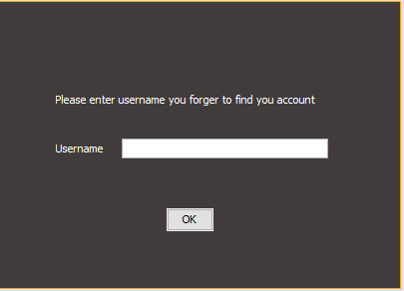
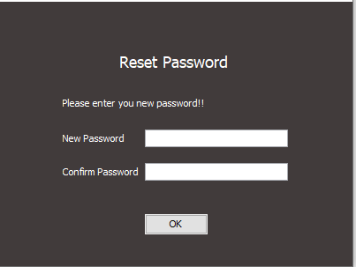
Form Reset Password

Slide 14
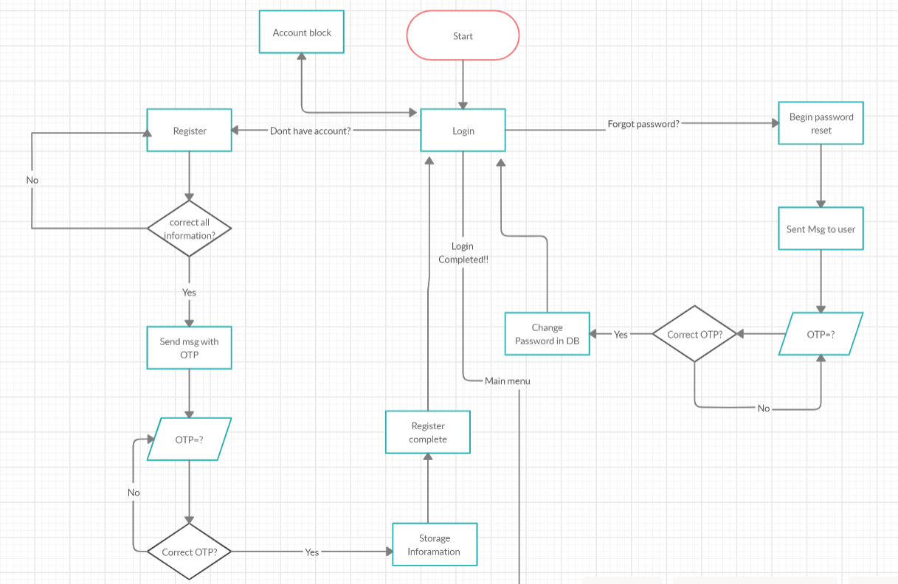

Slide 15
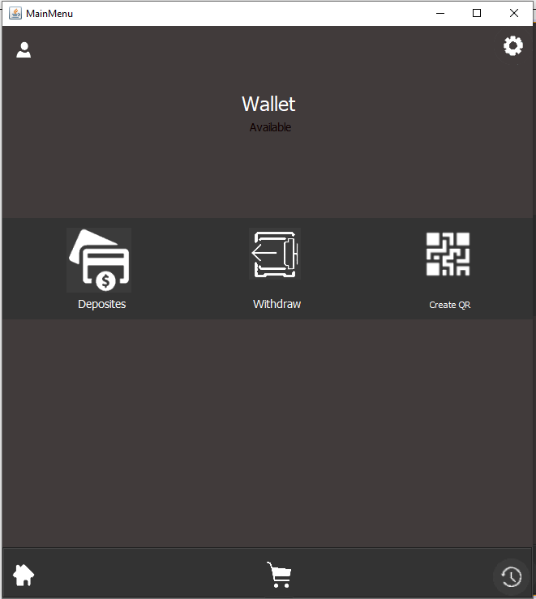
Form Mainmenu

Slide 16
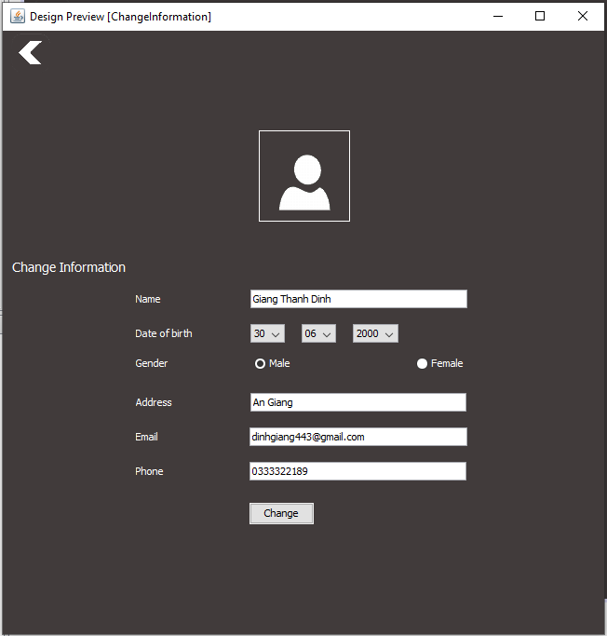
Form change information

Slide 17
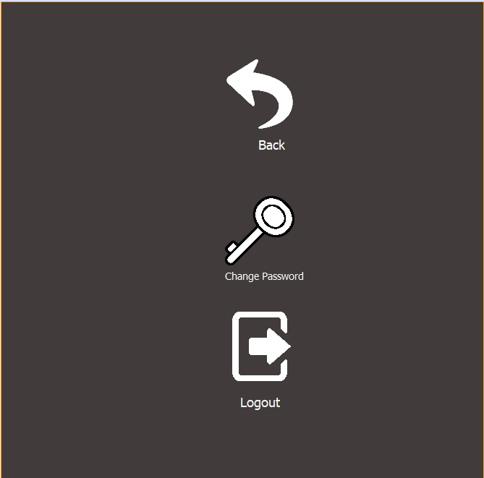
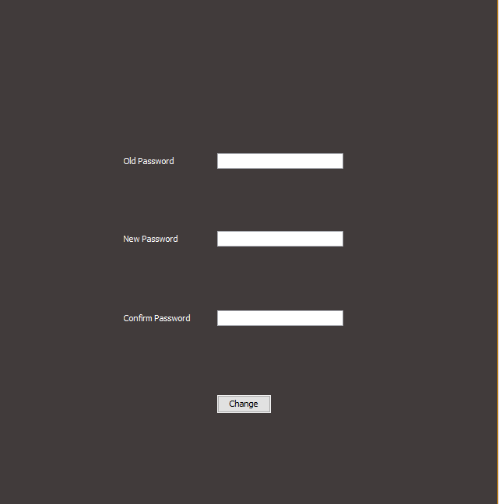
III.Solution
Setting form and change password form

Slide 18
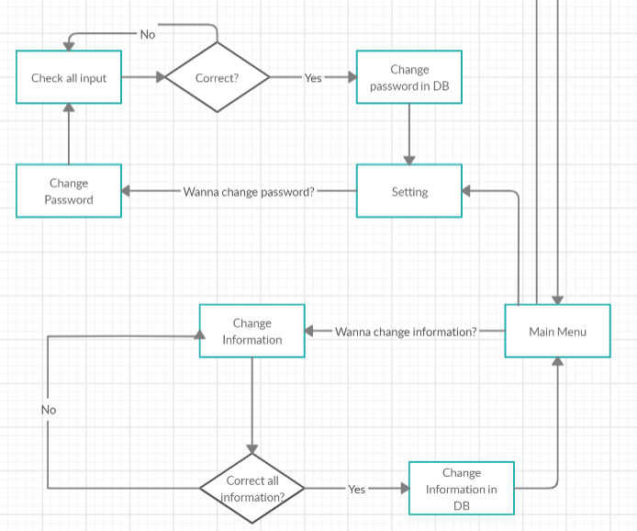
III.Solution
Flowchart change password and change information

Slide 19
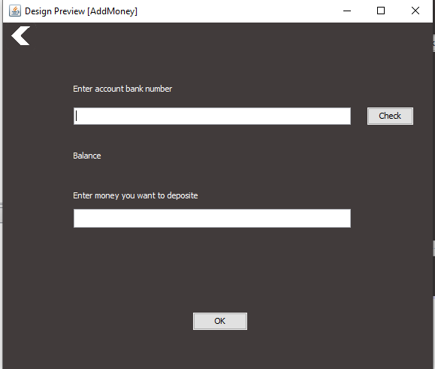
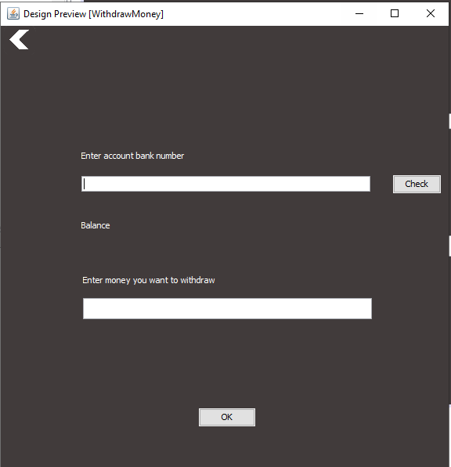
III.Solution
Deposite and Withdrawal

Slide 20
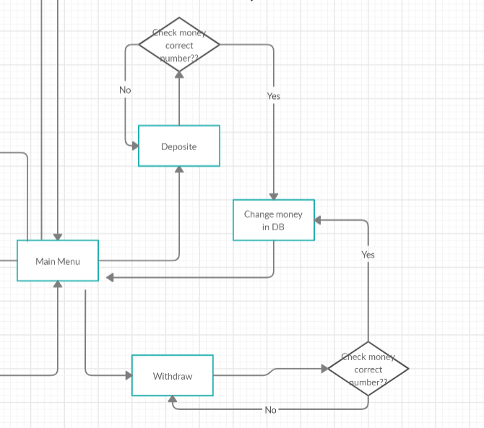
III.Solution
Flowchart for deposite and withdrawal

Slide 21
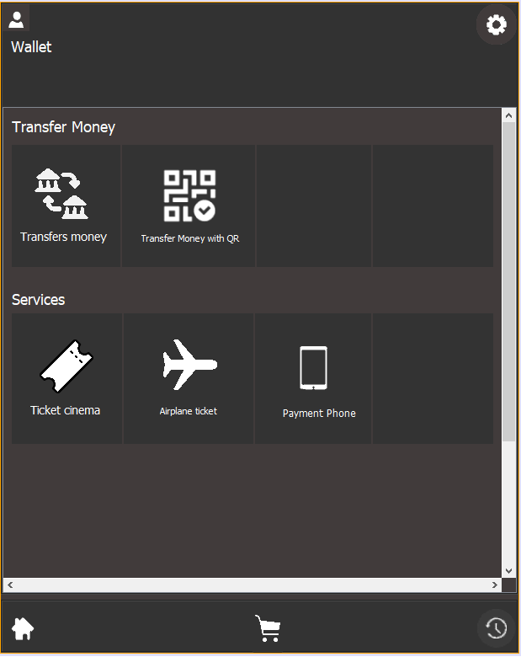
III.Solution
Menu Services

Slide 22
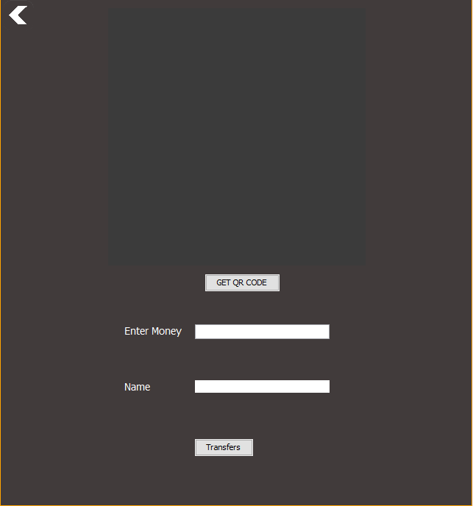
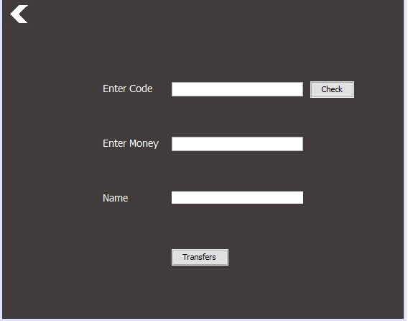
III.Solution
Transfer money with account code and QR code

Slide 23
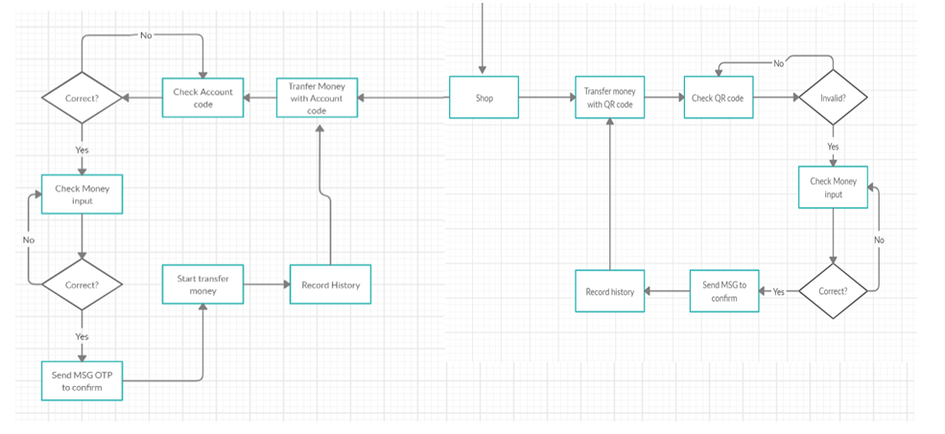
III.Solution
Flowchart transfer money

Slide 24
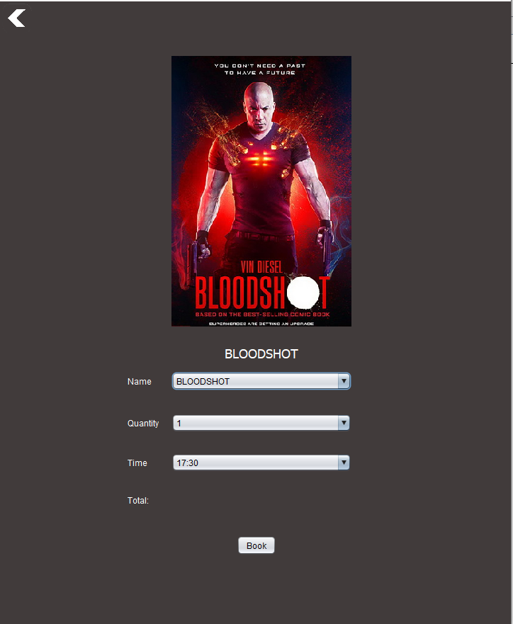
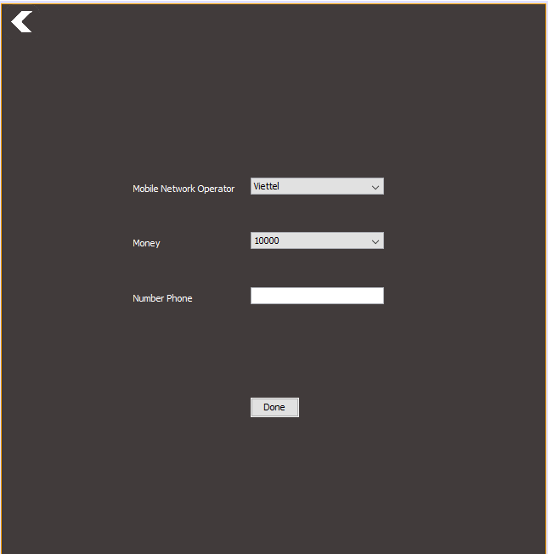
III.Solution
Buy Ticket Cinema and payment phone

Slide 25
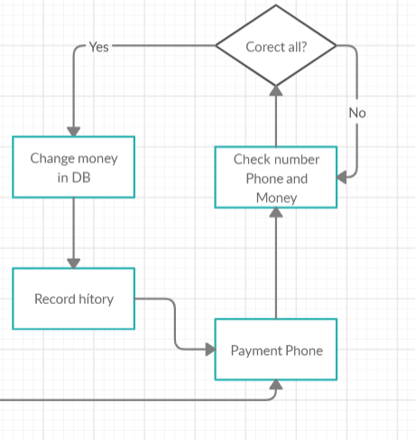
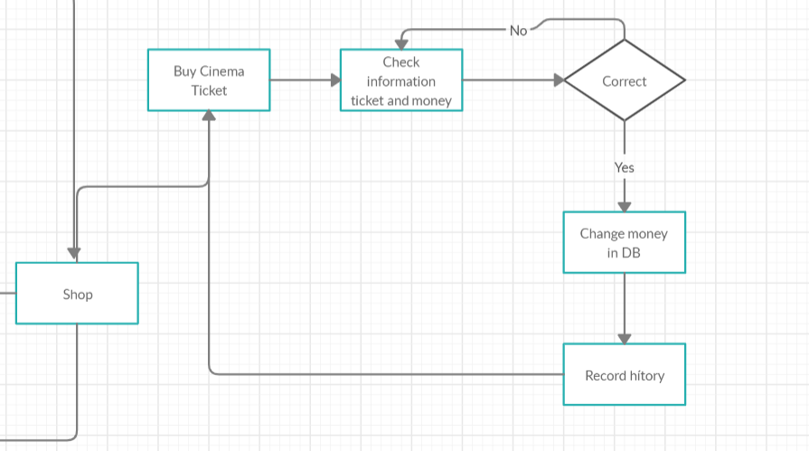
III.Solution
Flowchart

Slide 26
IV. Demo
Welcome to YourMoney

Slide 27
Thank you
PPT made by me GTD :>

