Slide 1
Microservices .Net Docker
Using .NET Core

Slide 2
CONTENT
Overview
Docker Instalation
How to fix WSL2 on windows
rt
Javascript
Javascript and CSS Isolation

Slide 3
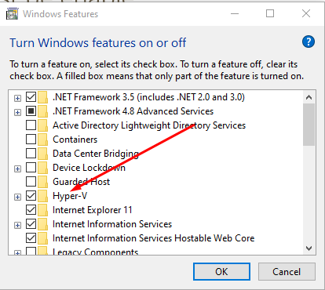
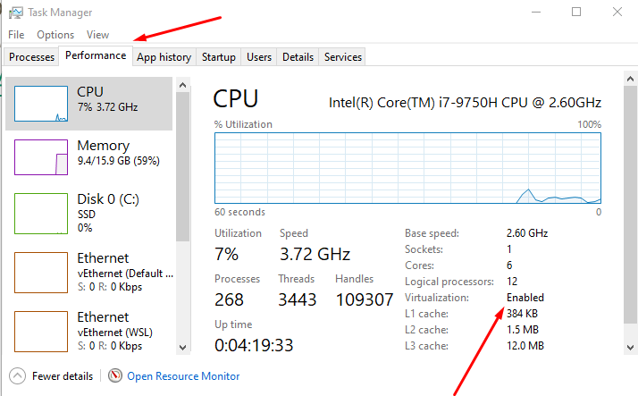
Install Docker
Windows 10 64bit: Pro, Interprise, or Edication (Build 15063 or higher)
Hyper-V and Container Windows Features must be enable
64bit processor with Second Level Address Translation (SLAT)
Download Docker form here the height of the element will recalculate following that formula

Slide 4
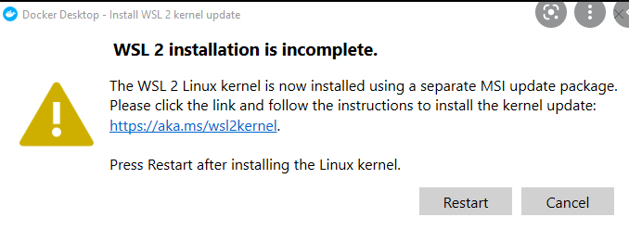
How to fix WSL2 on windows
Open PowerShell
Run command line:
Enable-WindowsOptionalFeature -online -FeatureName $("VirtualMachinePlatform","Microsoft-Windows-Subsystem-Linux")
Download the Linux kernel update package From here
View the video here

Slide 5
Create Linux container on windows machine
Run the command in PowerShell in Administrator mode
Enable-WindowsOptionalFeature -Online -FeatureName $("Microsoft-Hyper-V", "Containers") -All
Right click to docker icon and select “Switch to Windows Container”
Block-level are rendered as a block an hence take up all the available horzontal space. You can set margin-top and margin-bottom and two block-level elements will render in two different lines
Inline Element: on other hand only take up the space they require to fit their contain in. Hence two inline-element will fit into the same line

Slide 6
:note
.a:note(.active) { color: red; }

Slide 7
3. Events

Slide 8
3. EventCallback
EventCallback is a special type of Blazor which is allows us to pass methods as parameters to components

Slide 9
3. RenderFragment
Allow us to add dynamic contents into componentsd
Using the the default name ChildContent

Slide 10
5. Discussion
References:
Microsoft - Dependency injection in ASP.NET Core
Microsoft - Dependency injection in .NET
Tutorialsteacher - Dependency Injection in ASP.NET Core
IoC Container Benchmark - Performance comparison
Notes:
Generic version vs runtime version

Slide 11
THANKS FOR LISTENING

