Slide 1
Blazor Components
Using .NET Core

Slide 2
CONTENT
Overview
Parameters
Events
RenderFragment
Javascript
Javascript and CSS Isolation

Slide 3
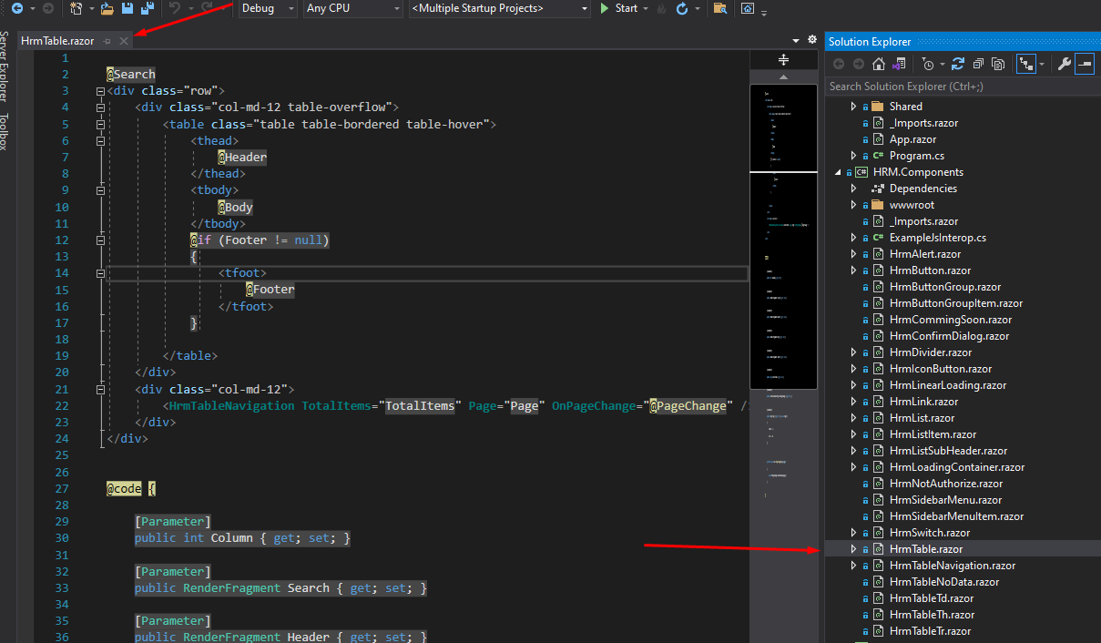
1. What is component?
A Component is a reusable piece of user Interface, which may contain logic
Component is a class

Slide 4
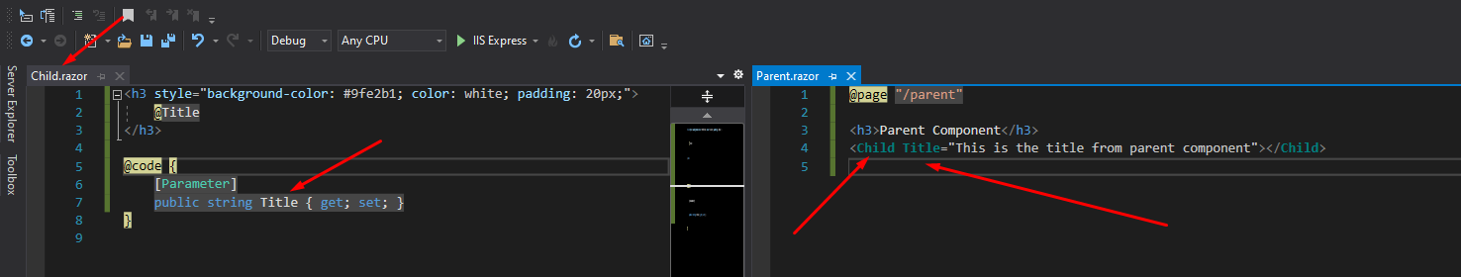
2. Parmeters
A Component can receive parameters through its parameters
Parameters can be data, events, content

Slide 5
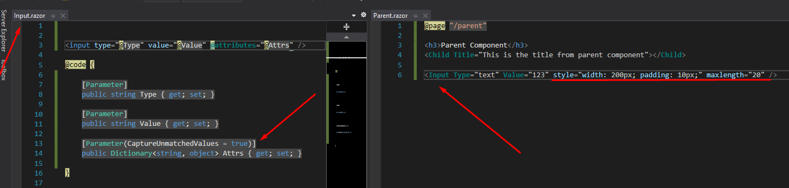
2. Arbitrary Parmeters
When you want to custom element and you want to use some input attributes without declaring parameters inside a custom component
Accept all parameters are not declared in the component

Slide 6
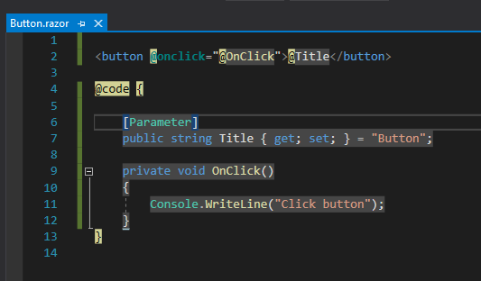
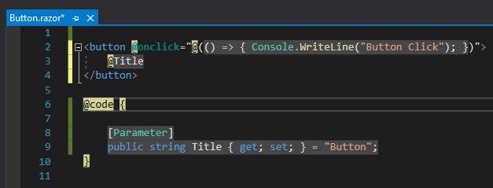
3. Events

Slide 7
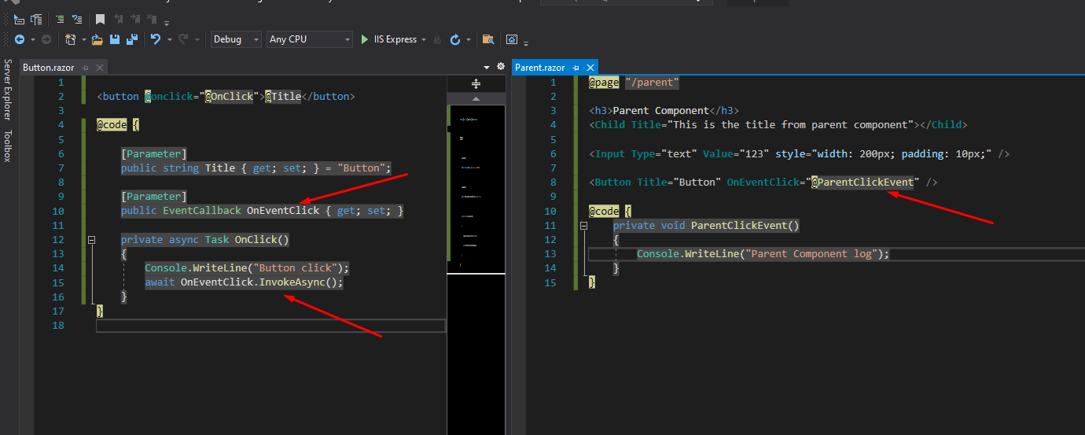
3. EventCallback
EventCallback is a special type of Blazor which is allows us to pass methods as parameters to components

Slide 8
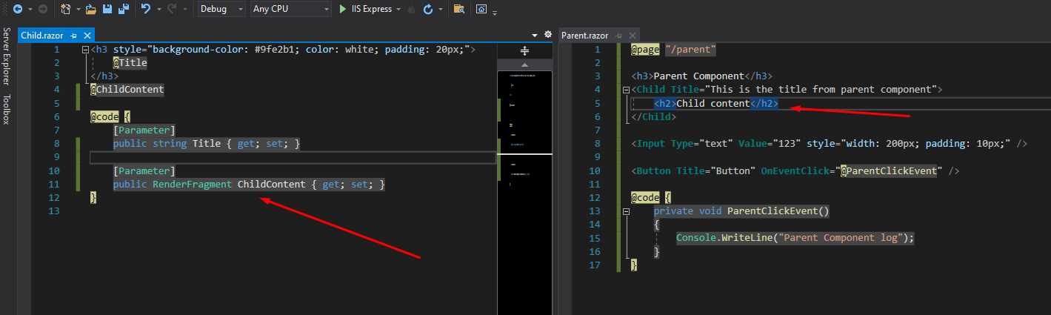
3. RenderFragment
Allow us to add dynamic contents into components
Using the the default name ChildContent

Slide 9
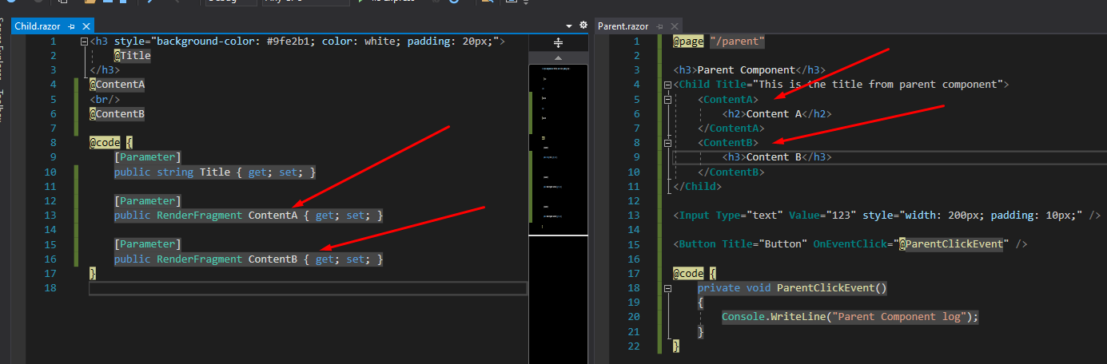
3. RenderFragment
Allow us to add dynamic contents into components
Using the the default name ChildContent

Slide 10
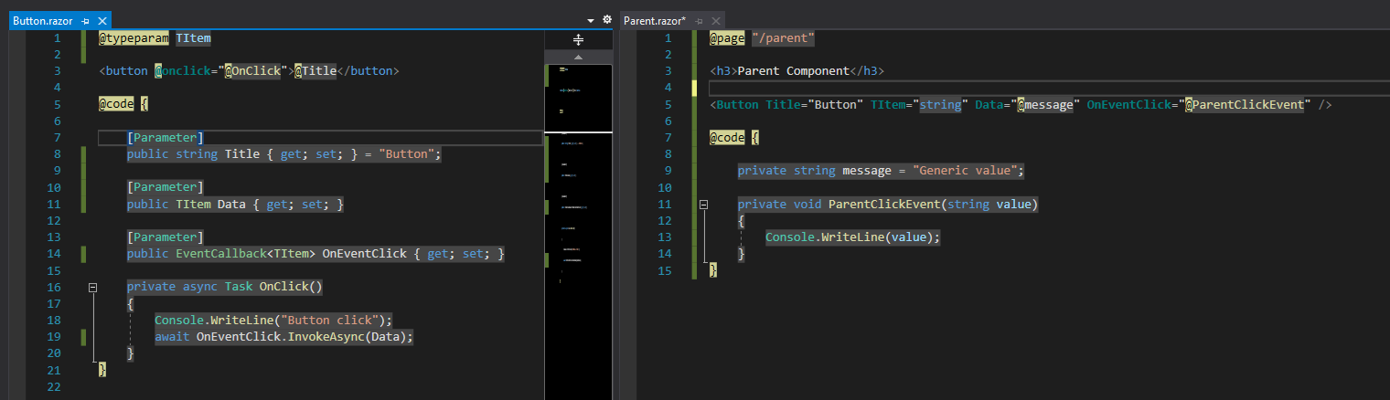
3. Generic RenderFragment
Allow us to pass dynamic data into a component

Slide 11
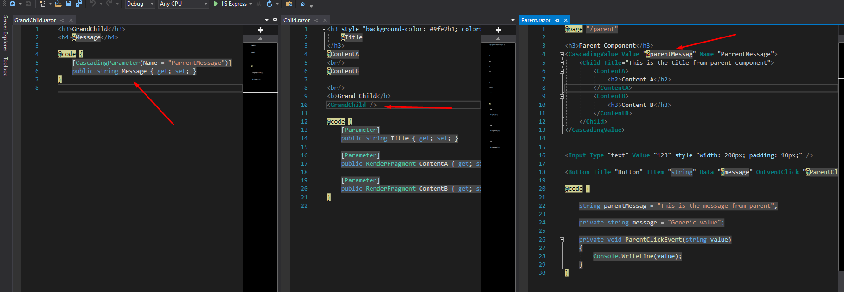
4. Cascading Parameter
Allow us to pass a value from a component to all of its descendants without having to use traditional component parameters

Slide 12
5. Discussion
References:
Microsoft - Dependency injection in ASP.NET Core
Microsoft - Dependency injection in .NET
Tutorialsteacher - Dependency Injection in ASP.NET Core
IoC Container Benchmark - Performance comparison
Notes:
Generic version vs runtime version

Slide 13
THANKS FOR LISTENING

