Slide 1
Blazor Components
Using .NET Core

Slide 2
CONTENT
Overview
Parameters
Events
RenderFragment
Partial Classes
Layout
JavaScript and CSS Isolation

Slide 3
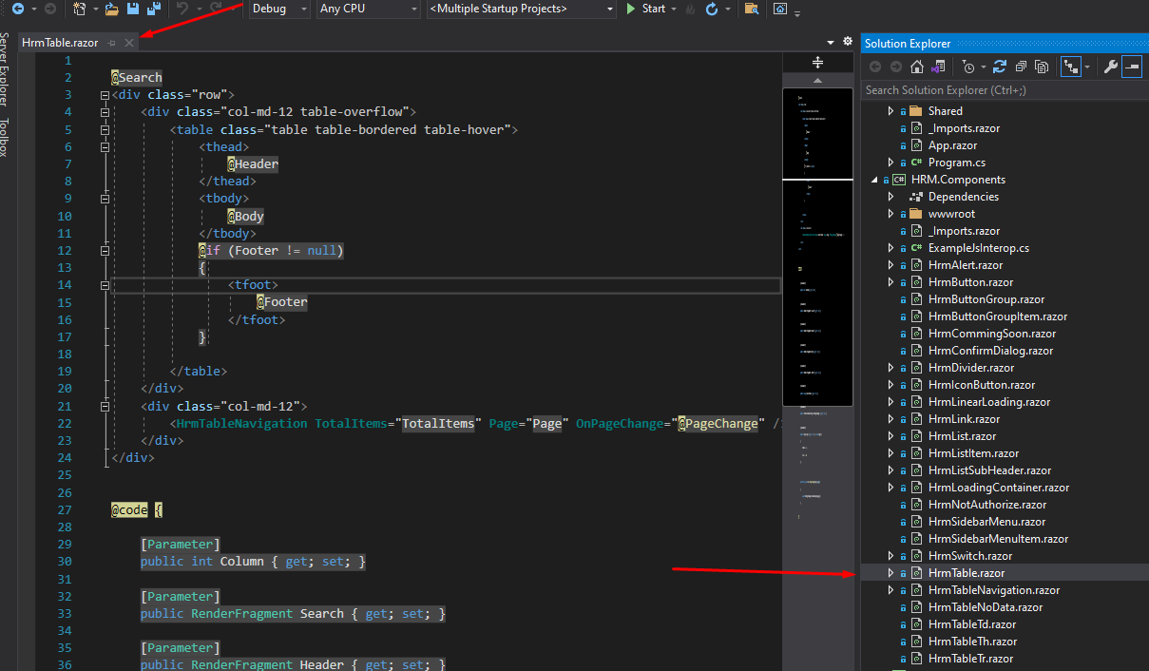
1. What is component?
A Component is a reusable piece of user Interface, which may contain logic
Component is a class

Slide 4
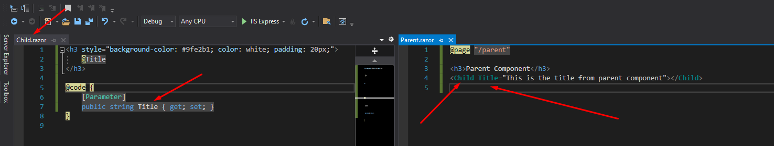
2. Parmeters
A Component can receive parameters through its parameters
Parameters can be data, events, content

Slide 5
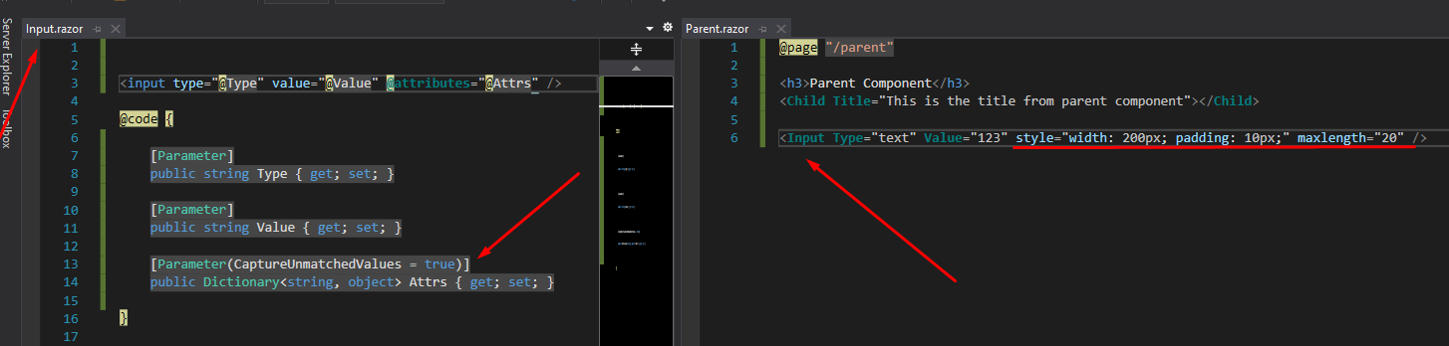
2. Arbitrary Parmeters
When you want to custom element and you want to use some input attributes without declaring parameters inside a custom component
Accept all parameters are not declared in the component

Slide 6
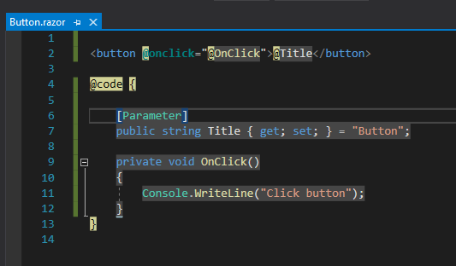
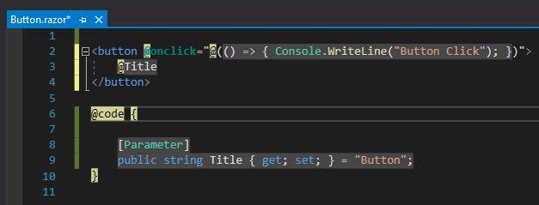
3. Events

Slide 7
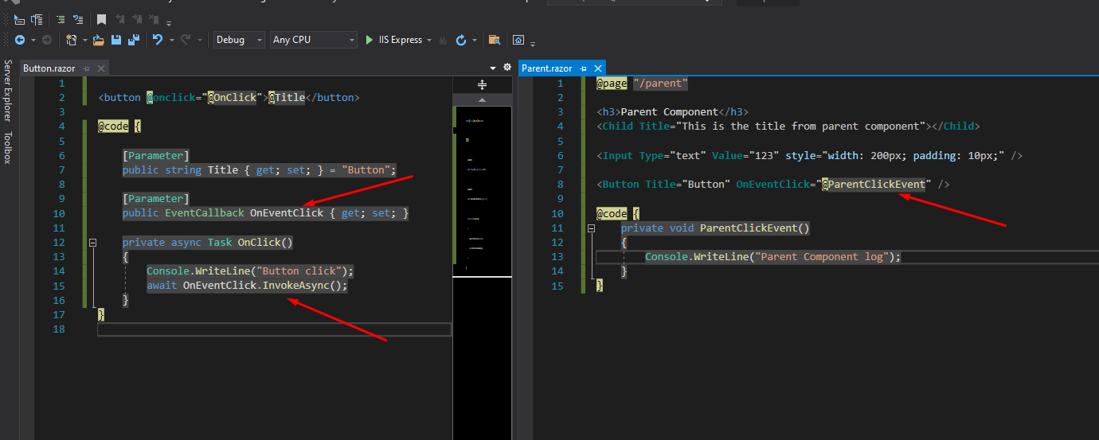
3. EventCallback
EventCallback is a special type of Blazor which is allows us to pass methods as parameters to components

Slide 8
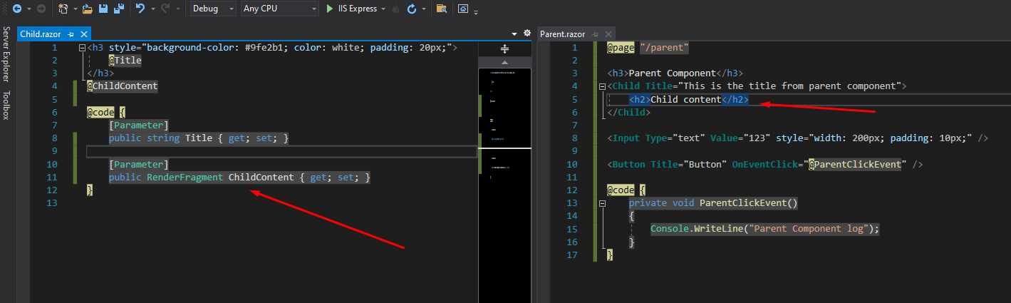
3. RenderFragment
Allow us to add dynamic contents into components
Using the the default name ChildContent

Slide 9
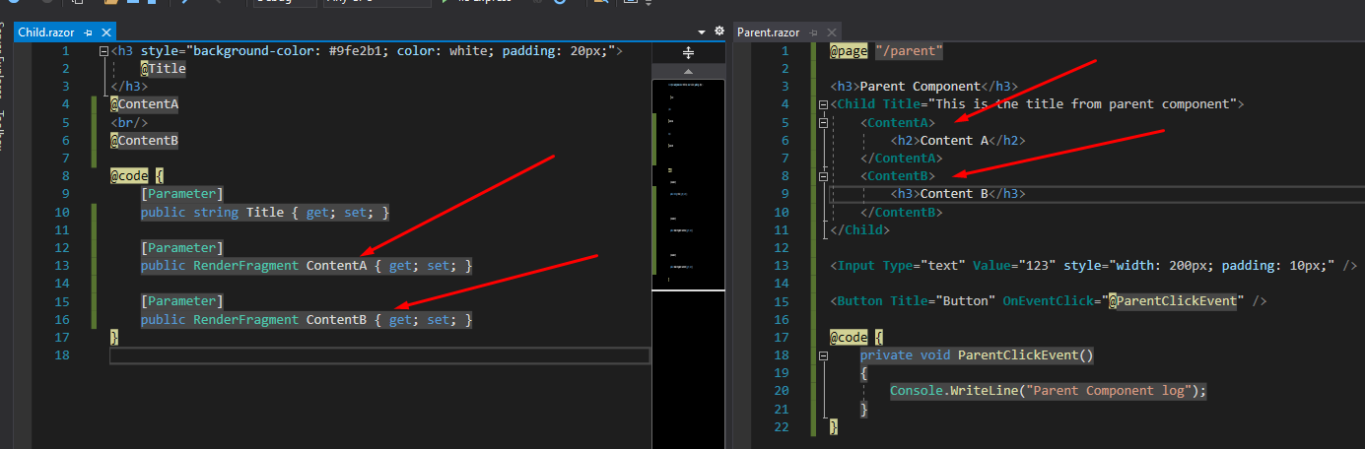
3. RenderFragment
Allow us to add dynamic contents into components
Using the the default name ChildContent

Slide 10
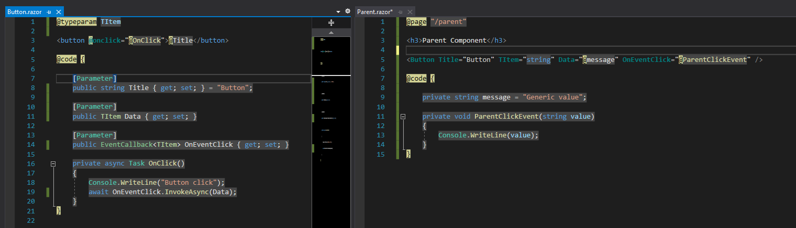
3. Generic RenderFragment
Allow us to pass dynamic data into a component

Slide 11
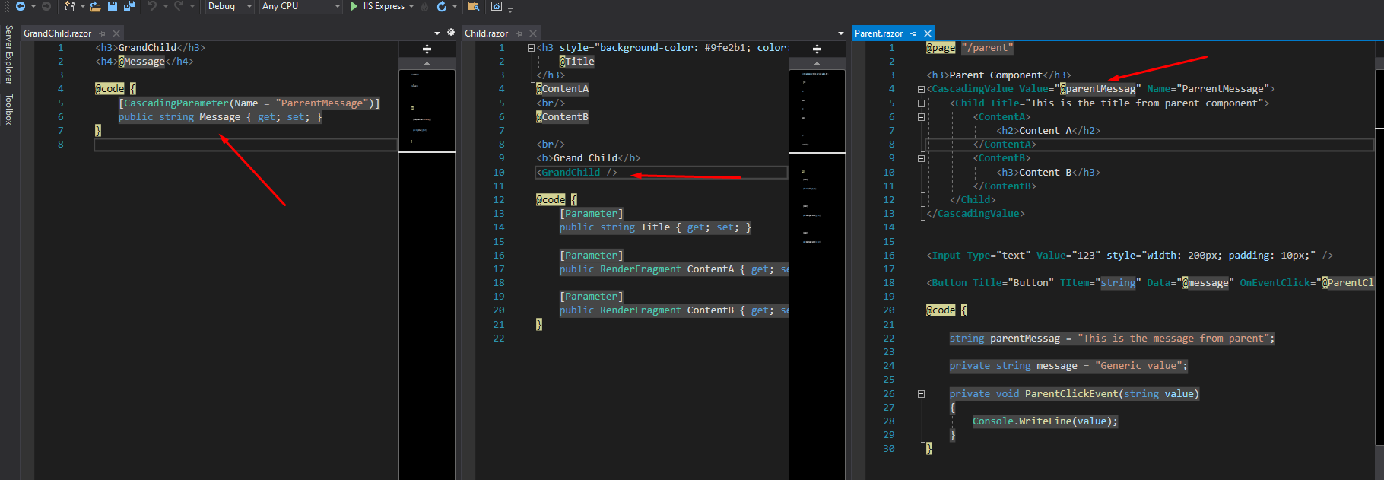
4. Cascading Parameter
Allow us to pass a value from a component to all of its descendants without having to use traditional component parameters

Slide 12
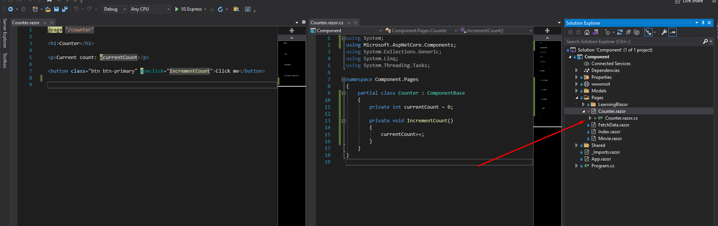
5. Parial Classes
Allow us to pass a value from a component to all of its descendants without having to use traditional component parameters
The cs class has must be the same name with the razor component

Slide 13
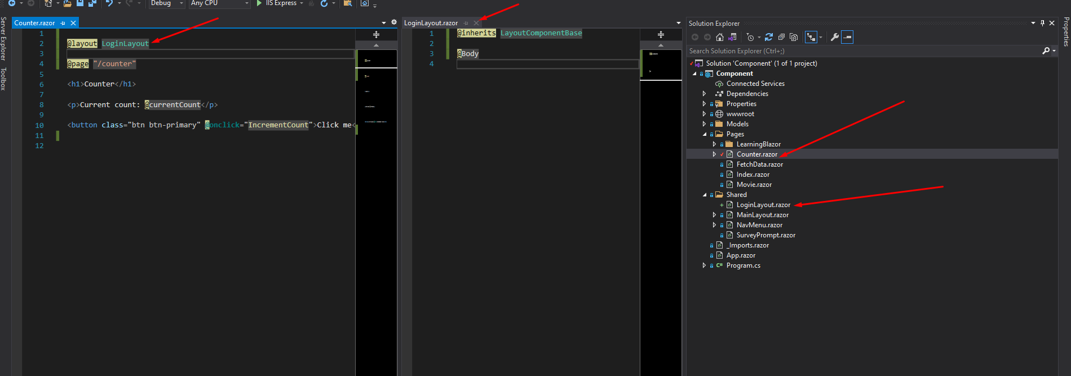
6. Layout
You can define your own layout and use it

Slide 14
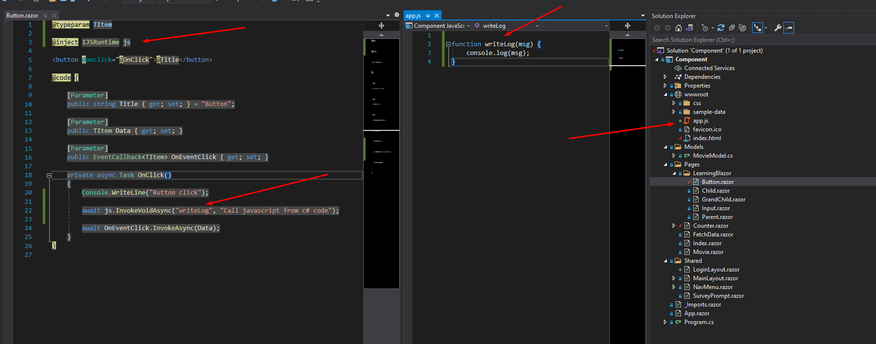
7. Invoking JS function from C#

Slide 15
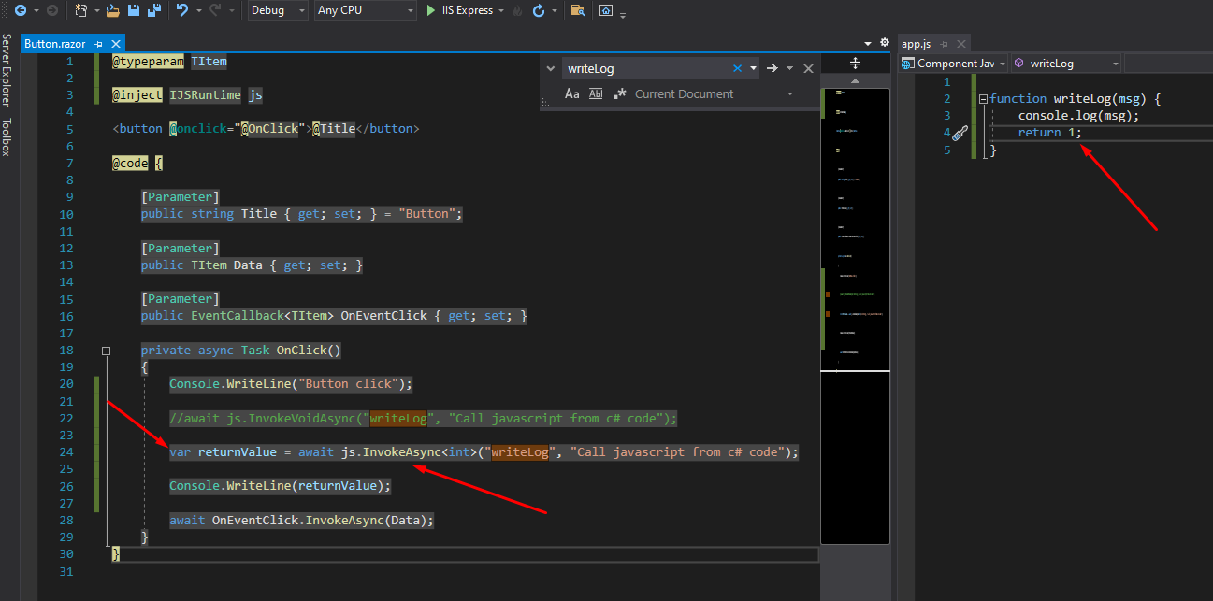
7. Invoking JS function from C#
Call JS function and get return value

Slide 16
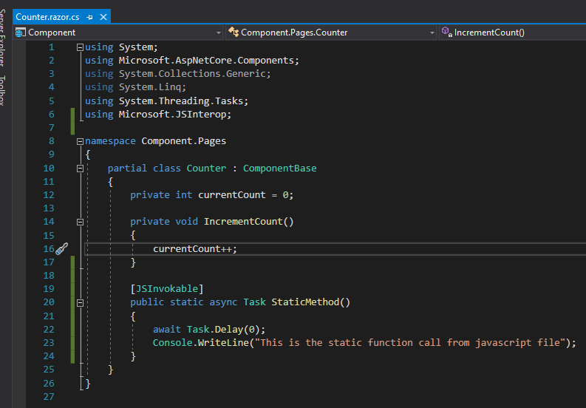
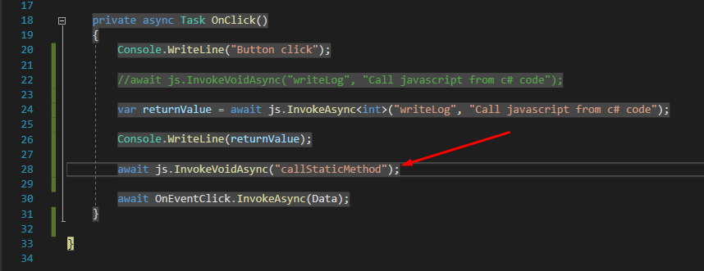
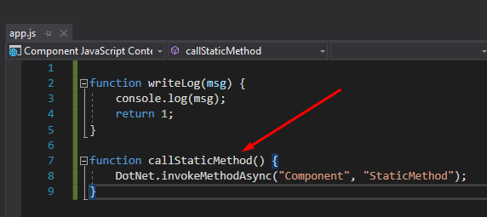
7. Invoking static C# function from JS

Slide 17
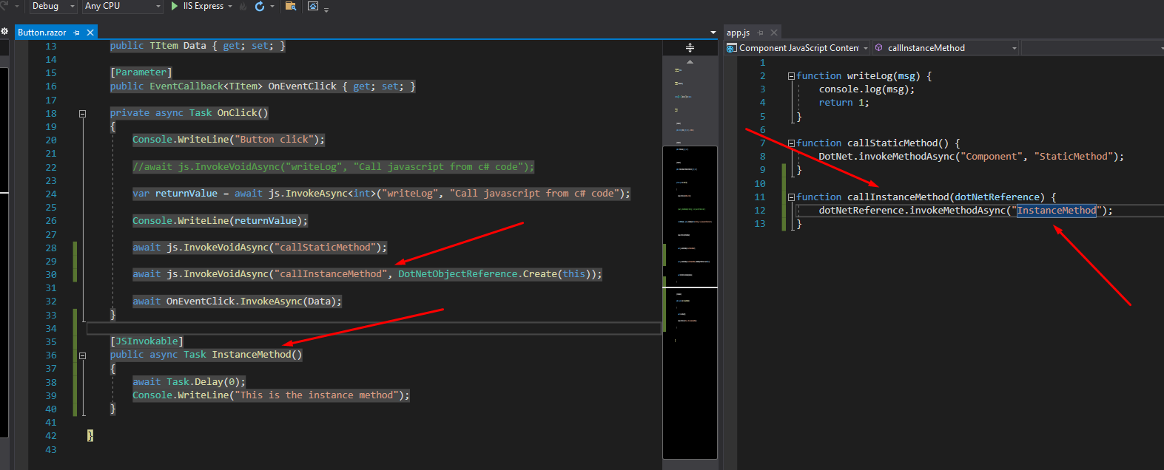
7. Invoking instance C# function from JS

Slide 18
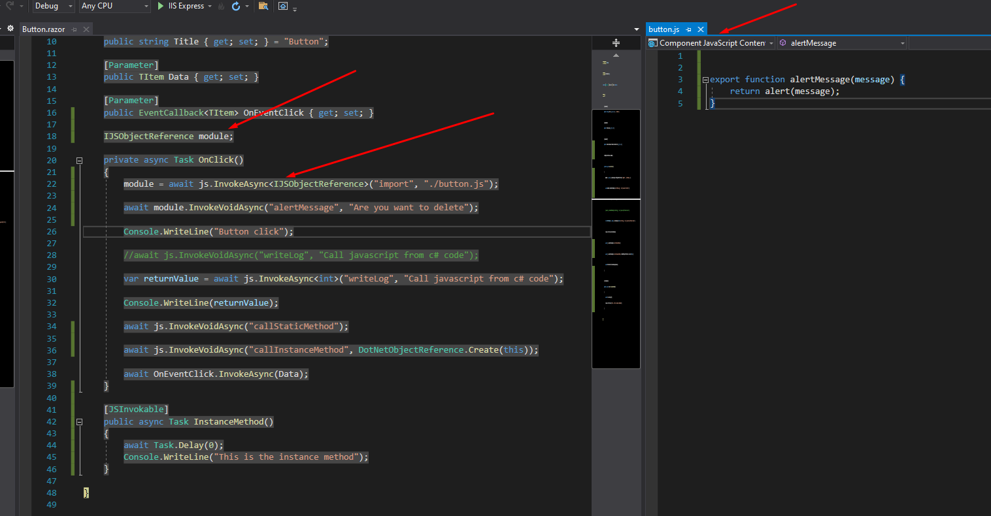
7. JavaScript isolation
We want to load certain JS files on a component that were are in.

Slide 19
7. JavaScript isolation
We want to load certain JS files on a component that were are in.

Slide 20
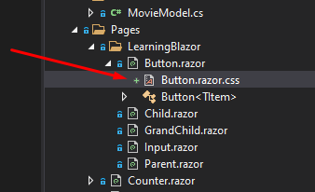
7. CSS isolation
To create a css only use for a component, Please create a css file with the same name with the component

Slide 21
THANKS FOR LISTENING

