Slide 1

Heart Disease Statistical Analysis
By: Kristine Dinh

Slide 2
Introduction
Retrieved data from Kaggle
Use logistic regression for model development
Use bootstrapping method for model selection and validation
Introduce simple R syntax for statistical modeling

Slide 3
outline
Logistic Regression
Data Cleaning
Data Exploratory Analysis
Modeling Bootstrap
Limitation/Future Research

Slide 4
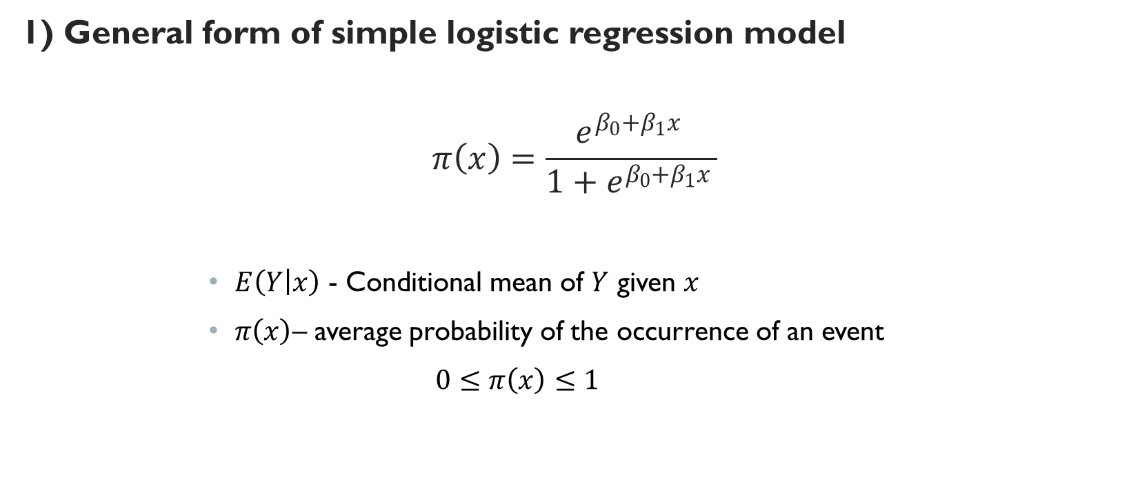
Introductory to Logistic Regression
1) General form of simple logistic regression model
$$π\left(x\right)=\frac{e^{β_{0}+β_{1}x }}{{1+e}^{β_{0}+β_{1}x }}$$
$E\left(Y | x\right)$ - Conditional mean of $Y$ given $x$
$π\left(x\right)$– average probability of the occurrence of an event
$0≤$ $π\left(x\right)≤1$

Slide 5

2) Transformation to linear regression model:
$$g\left(x\right)=log\left[\frac{π\left(x\right)}{1−π(x)}\right]=β_{0}+β_{1}x$$
$g(x)$ – continuous linear function
$x$ - Independent variable
$β_{0}$ - Intercept
$β_{1}$ - Slope

Slide 6

3) Fitting the model:
Logistic Likelihood function
$$L\left(β\right)=\log\left(l\left(β\right)\right)=\sum_{i=1}^{n}{\left\{y_{i}log\left[π(x_{i})\right]+\left(1−y_{i}\right)log\left[1−π(x_{i})\right]\right\}}$$

Slide 7

4) Testing for Significant:
i. Deviance (D statistics) ~ Sum of squares residual
$D=−2\sum_{i=1}^{n}{\left[y_{i}log\left(\frac{{\hat{π}}_{i}}{y_{i}}\right)+\left(1−y_{i}\right)log\left(\frac{{1−\hat{π}}_{i}}{{1−y}_{i}}\right)\right]}$, where ${\hat{π}}_{i}=\hat{π}(x_{i})$
ii. G statistics
$$G=2\left\{\sum_{i=1}^{n}{\left[y_{i}\log\left({\hat{π}}_{i}\right)+\left(1−y_{i}\right)\log\left(1−{\hat{π}}_{i}\right)\right]−\left[n_{1}\log\left(n_{1}\right)+n_{0}\log\left(n_{0}\right)−nlog(n)\right]}\right\} \sim χ_{1}^{2}$$

Slide 8
5) Confident Interval
Wald-based CI
Positive square root of the variance estimator
Venzon and Moolgavkar method
Plot log-likelihood function vs coefficient values
Maximizing log-likelihood

Slide 9
Data cleaning
Add description factor variables
1
Add reference level for factor variables
2
Add bins for continuous variables
3
data.frame 303 obs. of 14 variables

Slide 10
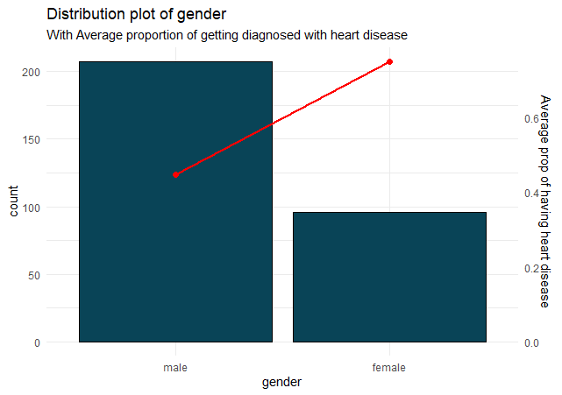
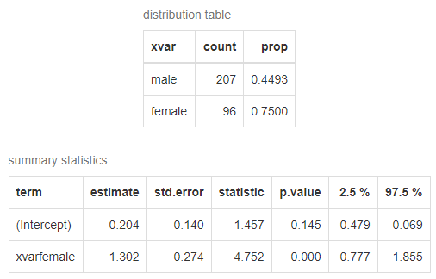
Data exploratory analysis
Gender
Reference level: male

Slide 11
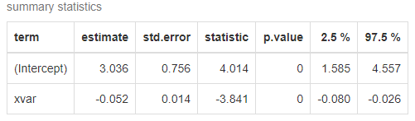
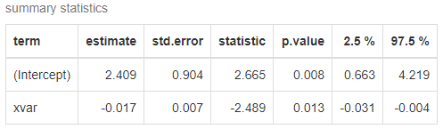
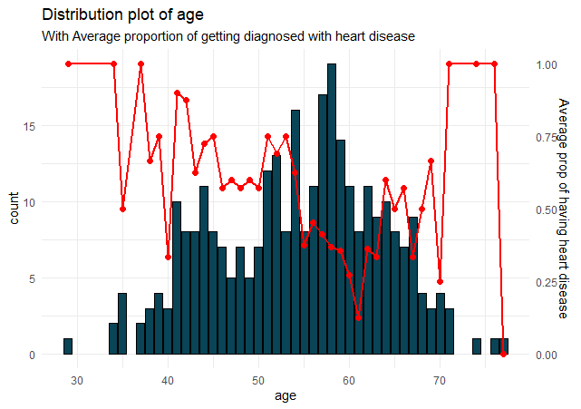
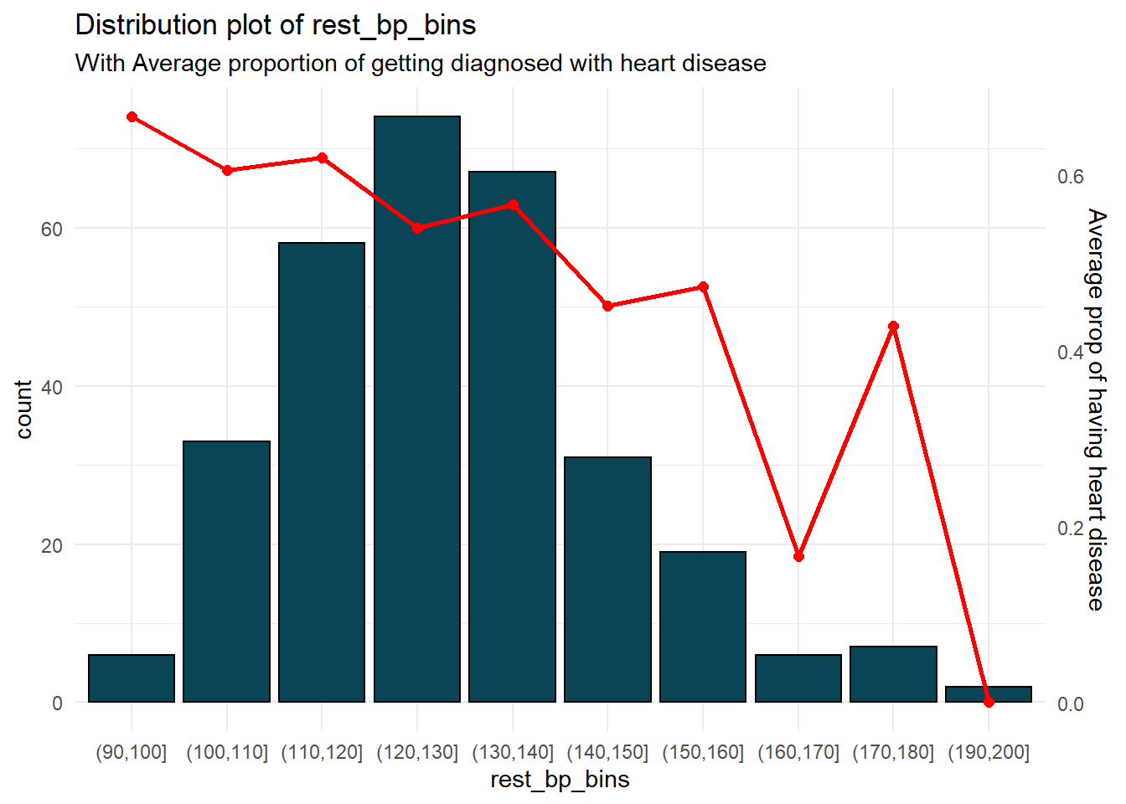
Age
Resting Blood Pressure

Slide 12
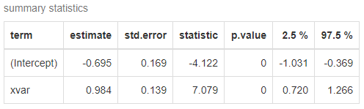
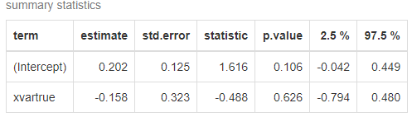
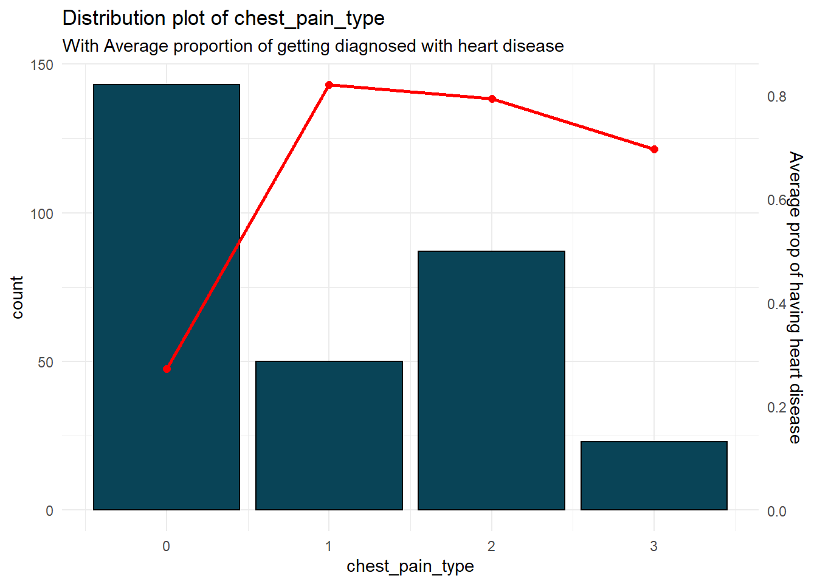
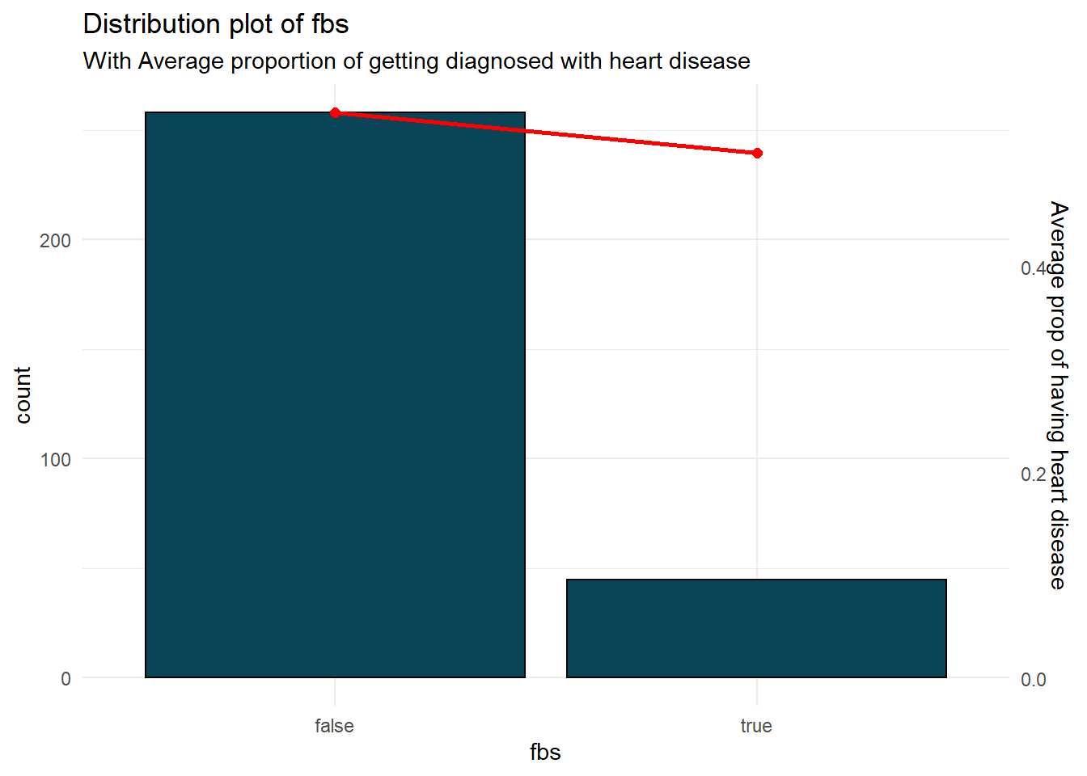
Chest Pain Type
Fasting Blood Sugar > 120 mg/dl

Slide 13
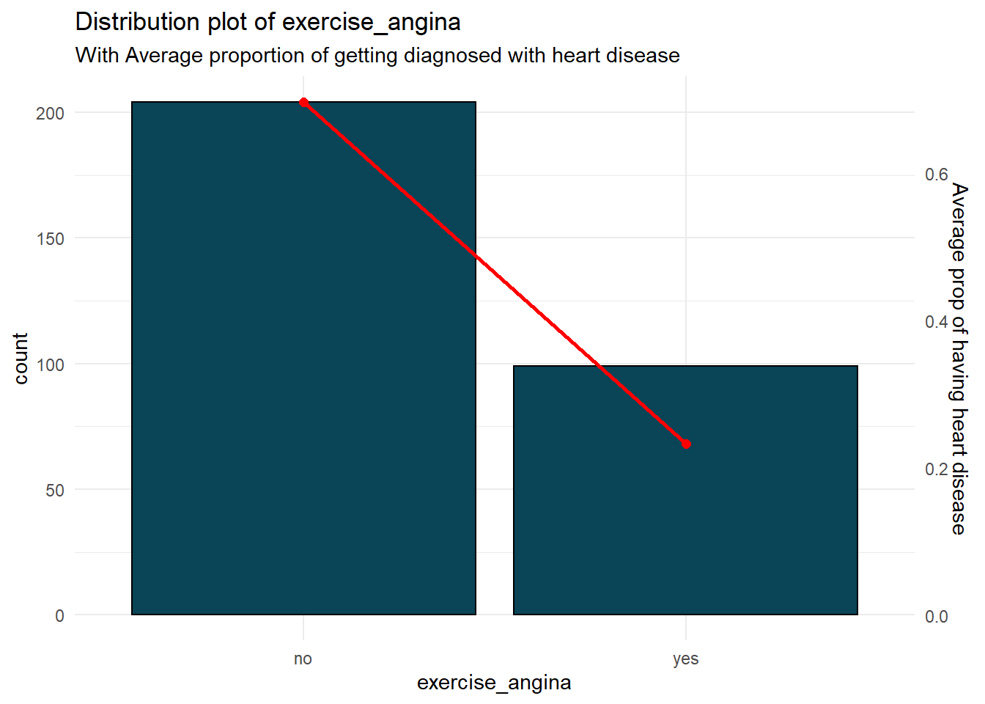
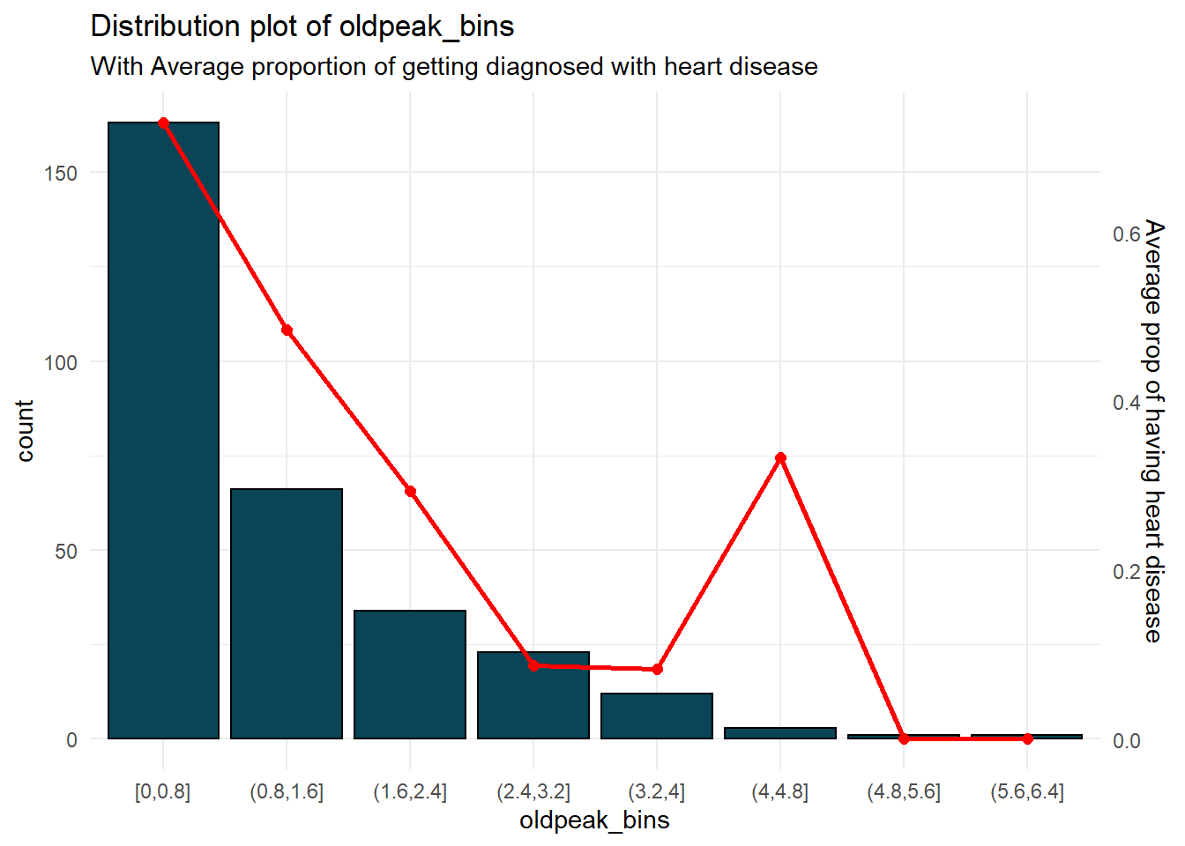
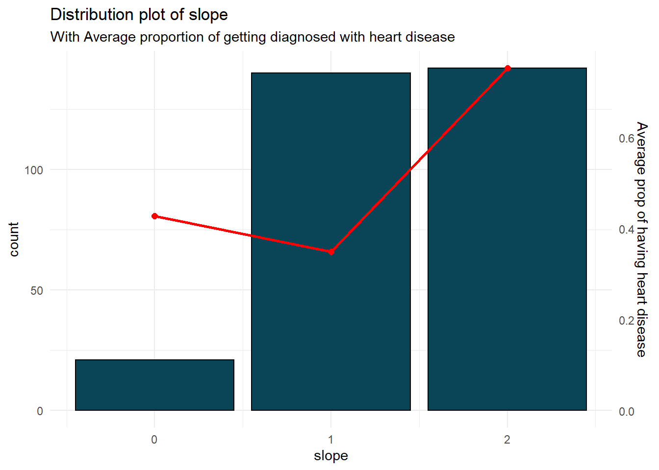
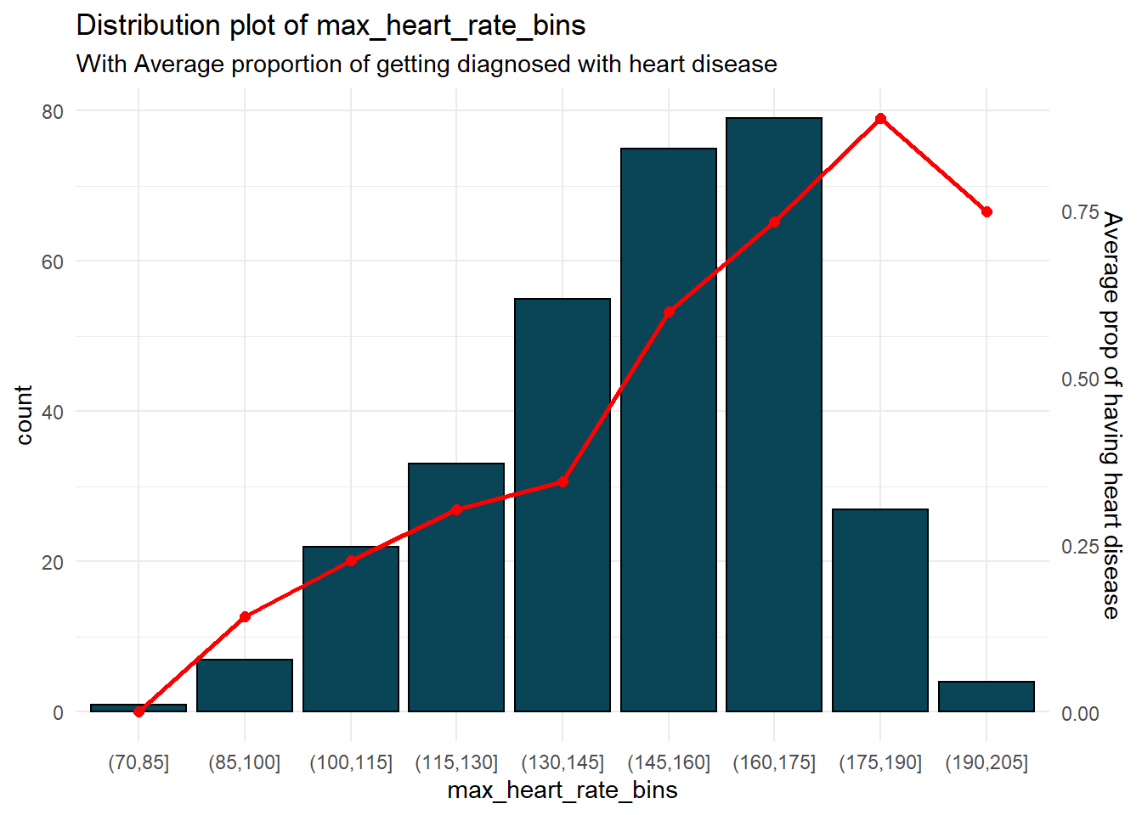

Slide 14
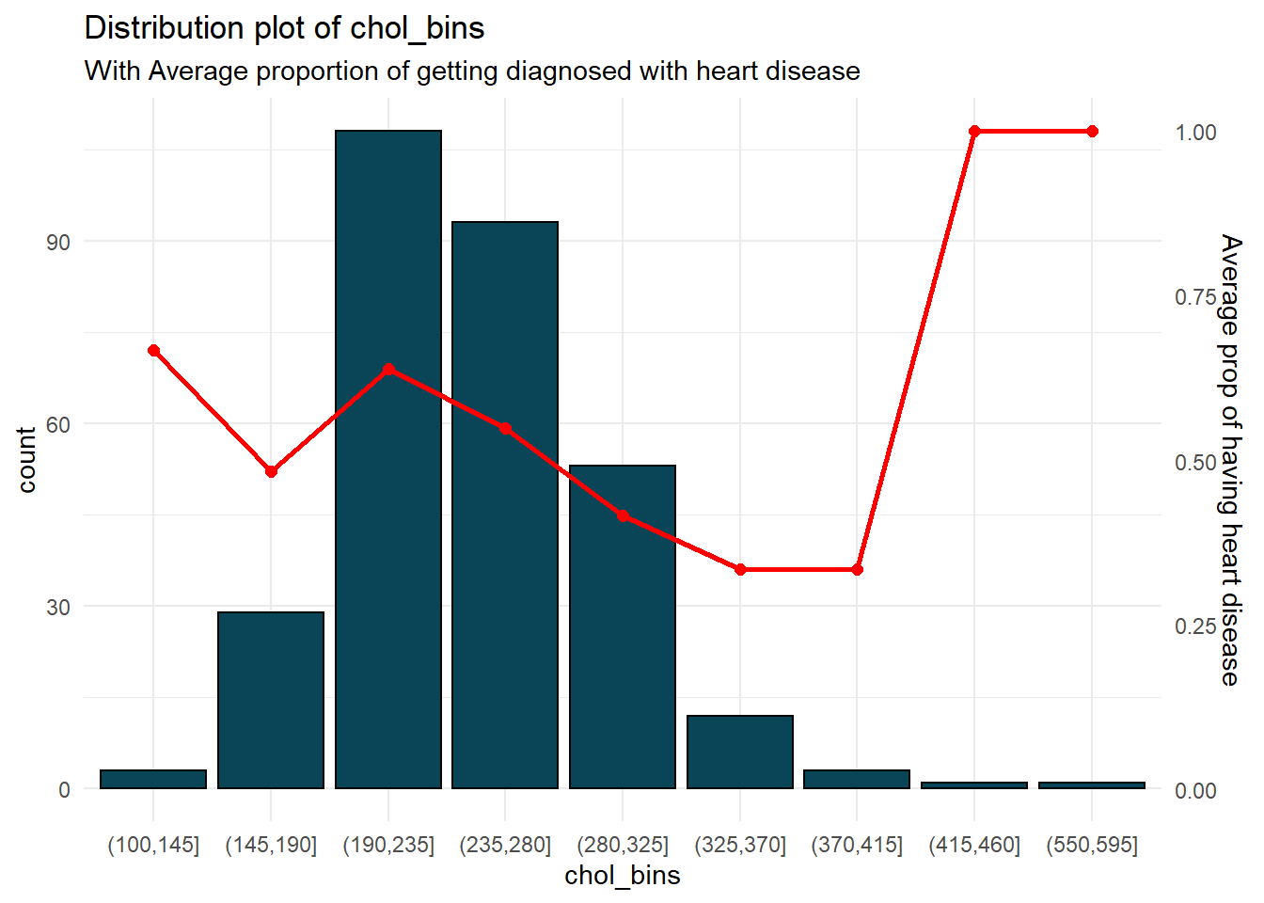
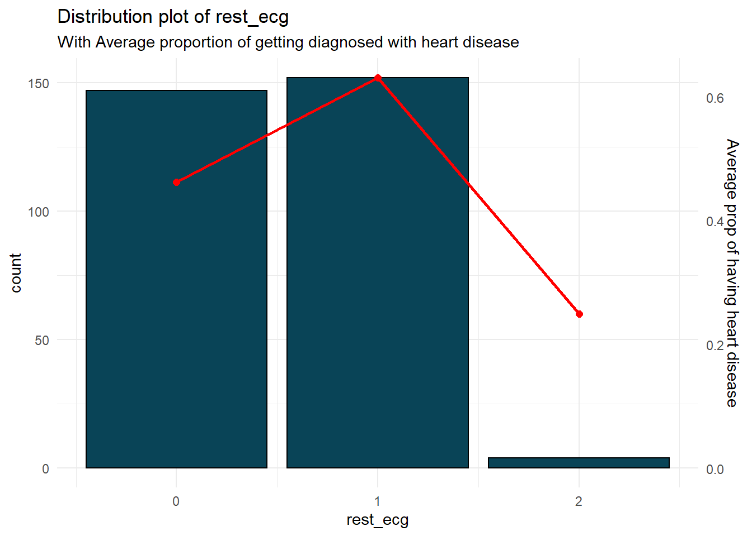
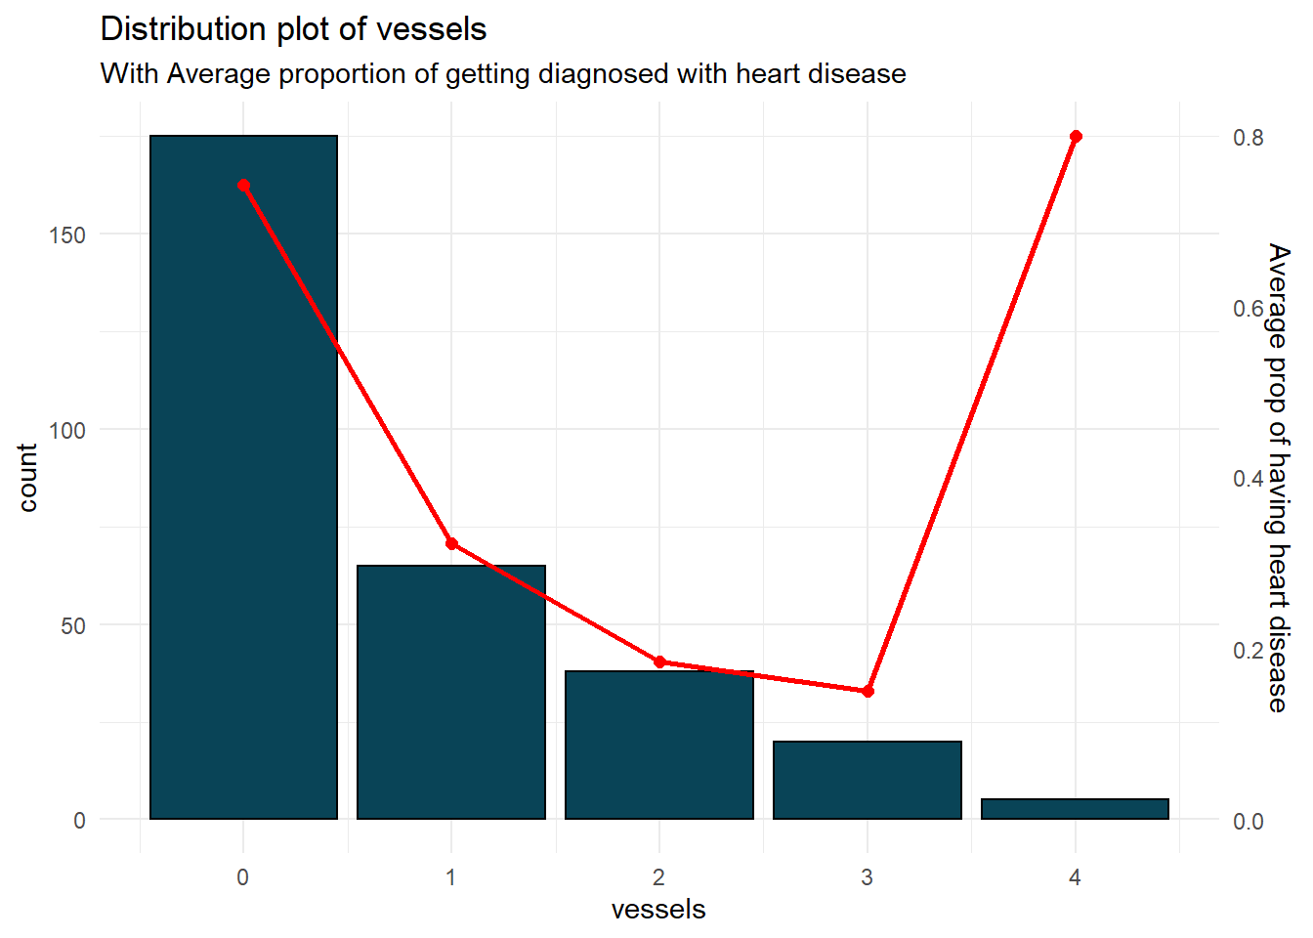
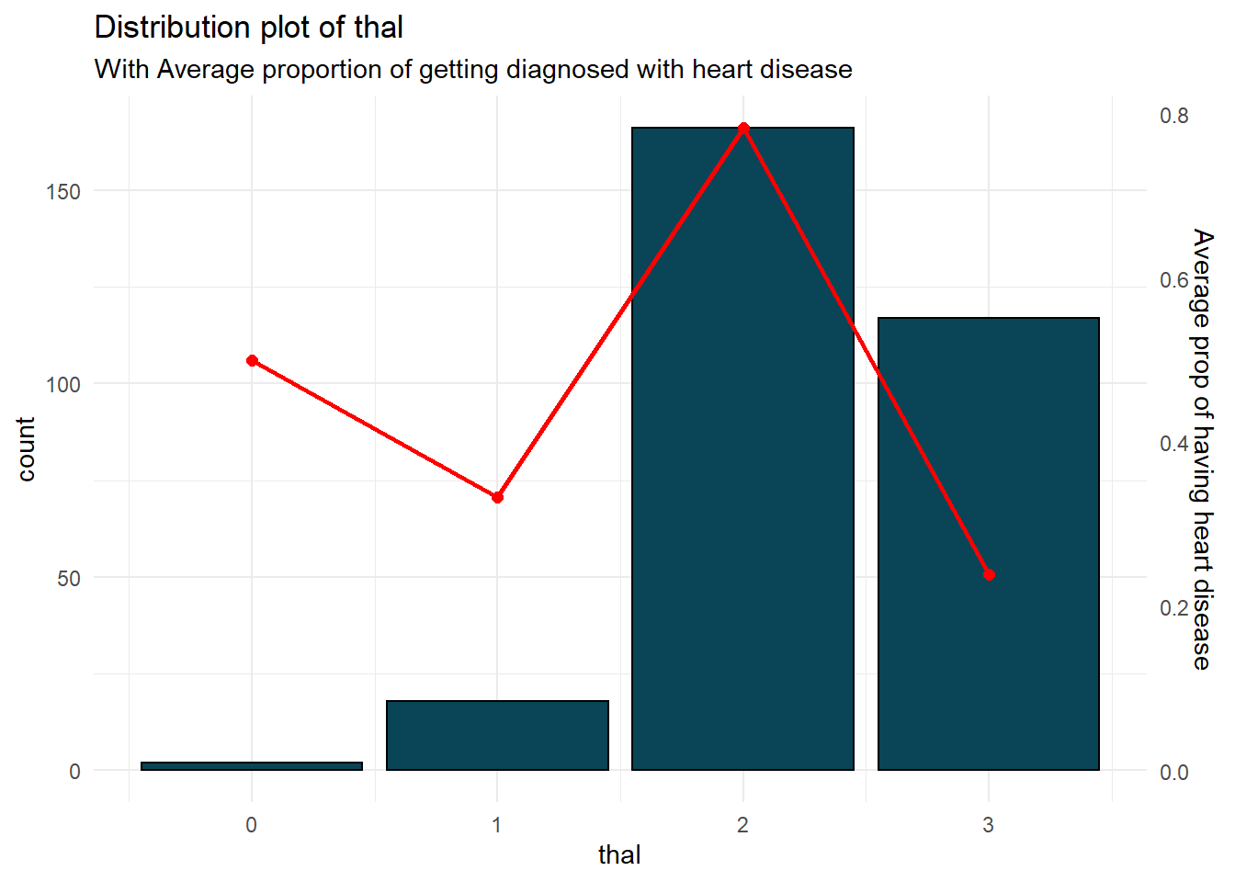

Slide 15
bootstrapping
fit <- glm(y ~ x, data = train, family = "binomial")
y - response variable x - one or more explain variables data - training data family - distribution
for (i in xvars){
for (j in nrounds){
for (k in rp){
modeling functions
}
}
}
Random partition: 0.60, 0.70, 0.80, 0.90, and 0.99
Repeated: 10 times
Features selection: from 1 to all variables
Validation metric: AIC and AUC

Slide 16
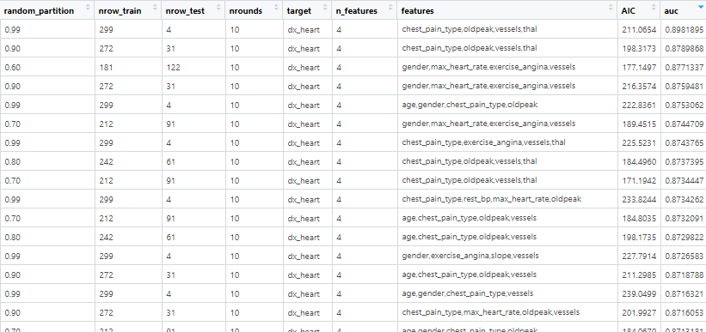
Features selection

Slide 17
Features selection

Slide 18
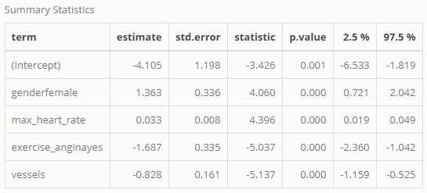
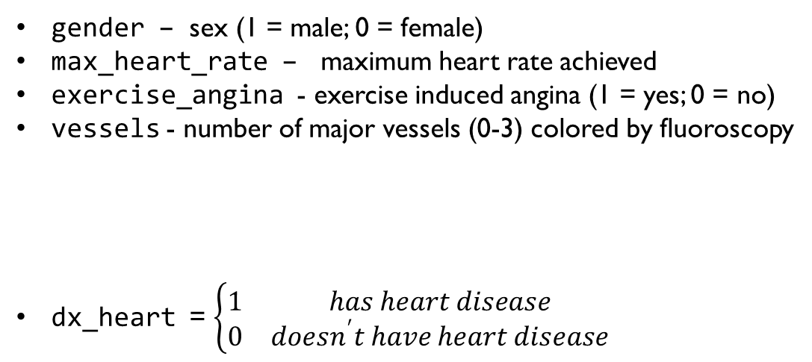
Final Model
fit <- glm(dx_heart ~ gender + max_heart_rate + exercise_angina + vessels,
data = data,
family = "binomial")
gender – sex (1 = male; 0 = female)
max_heart_rate – maximum heart rate achieved
exercise_angina - exercise induced angina (1 = yes; 0 = no)
vessels - number of major vessels (0-3) colored by fluoroscopy
dx_heart = $\left\{\begin{matrix}1 & has heart disease \\ 0 & doesn^{′}t have heart disease\end{matrix}\right.$

Slide 19
Limitation & Future research
AUC is too high, need more data
Explore more variables from different dataset
Other diseases the patient have
What type of work does the patient do
Explore different types of model to compare
XGboost
Ridge regression
Random forest

Slide 20
More information
Data Set Information: https://archive.ics.uci.edu/ml/datasets/Heart+Disease
Data Set Download: https://www.kaggle.com/ronitf/heart-disease-uci
Applied Logistic Regression Textbook: https://www.google.com/books/edition/Applied_Logistic_Regression/bRoxQBIZRd4C?hl=en&gbpv=1&printsec=frontcover
GLM R function: https://www.rdocumentation.org/packages/stats/versions/3.6.2/topics/glm
Bootstrapping Method: https://en.wikipedia.org/wiki/Bootstrapping_(statistics)

Slide 21

Email: kdinh@sdsu.edu

