Slide 1

A Technique for Generating Test Data using Genetic Algorithm
Dinh Ngọc Thi, Vo Dinh Hieu, Nguyen Viet Ha
Faculty of Information Technology
VNU University of Engineering and
Technology, Hanoi, Vietnam

Slide 2
Outline
1. Introduction
2. Background
3. Related work
4. Proposed approach
5. Experimental result
6. Conclusion

Slide 3
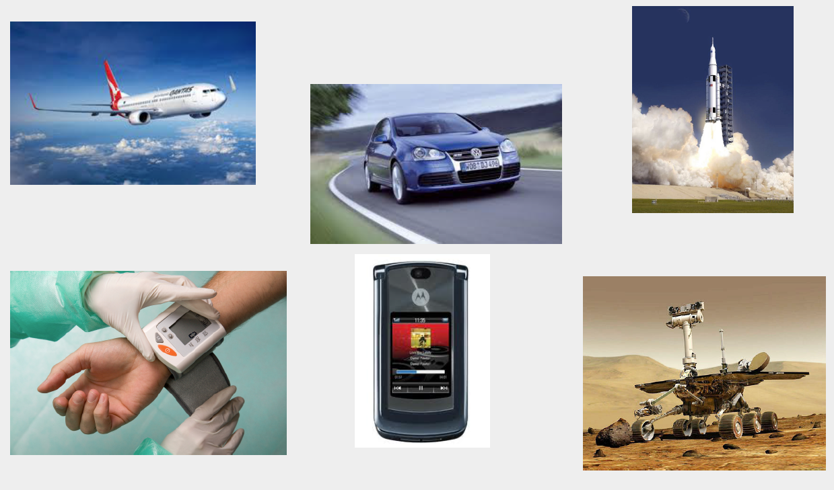
software is everywhere
errors are expensive
annual cost of software errors to US economy is $ ~60B [NIST’02]

Slide 4
approaches to finding errors
static analysis
dynamic analysis

Slide 5
Outline
1. Introduction
2. Background
3. Related work
4. Proposed approach
5. Experimental result
6. Conclusion

Slide 6
Outline
1. Introduction
2. Background
3. Related work
4. Proposed approach
5. Experimental result
6. Conclusion

Slide 7
Outline
1. Introduction
2. Background
3. Related work
4. Proposed approach
5. Experimental result
6. Conclusion

Slide 8
Outline
1. Introduction
2. Background
3. Related work
4. Proposed approach
5. Experimental result
6. Conclusion

Slide 9
Outline
1. Introduction
2. Background
3. Related work
4. Proposed approach
5. Experimental result
6. Conclusion

