Slide 1


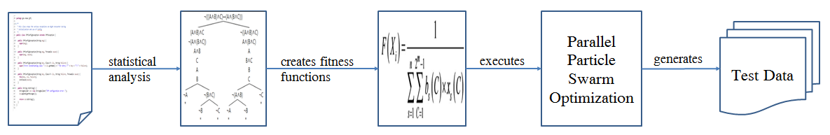
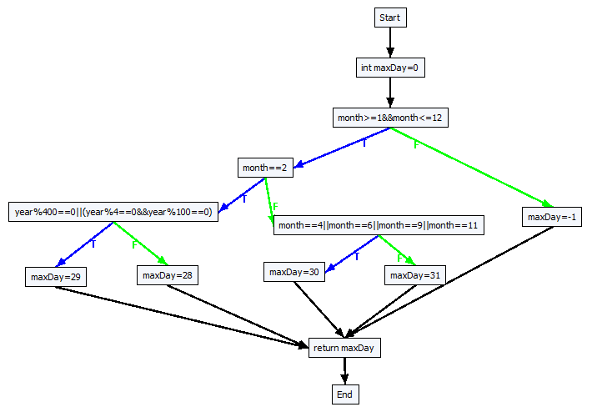
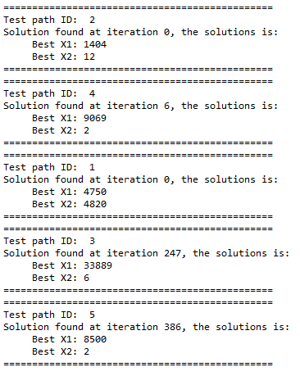
PhD Student Scientific Workshop
Generating Test Data for Software Structural Testing using
Parallel Particle Swarm Optimization
Dinh Ngoc Thi, Vo Dinh Hieu, Nguyen Viet Ha
Abstract
Evolutionary structural testing is an approach to automatically generating test cases that achieve high structural code coverage. In recent
investigations particle swarm optimization (PSO), an alternative search technique, often outperformed other meta-heuristic search techniques
when applied to various problems. This paper proposes the approach of combination of static analysis program and Parallel Particle Swarm
Optimization (PPSO) in order to generate test data simultaneously for each test path of the given program under test (PUT). The proposed
approach is also applied to some PUTs of the given benchmark. Experimental results demonstrate that the proposed PPSO which can
automatically generate suitable test data has higher structural code coverage than the previous one.
Introduction
Proprosed approach
In recent years, meta-heuristic search techniques has been widely applied in software testing,
forming a research trend called search-based software testing, which is especially applied to
automatic test data generation. Among the existing meta-heuristic search techniques, such as
simulated annealing (SA) and generic algorithm (GA), are the most popular algorithms, and
have been widely adopted in generating test data. However even though they can generate test
data with appropriate fault-prone ability, they fail to produce them quickly due to their slow
evolutionary speed. Recently, as a swarm intelligence technique, particle swarm optimization
(PSO) has become a hot research topic in the area of intelligent computing. Its significant
feature is the simplicity and fast convergence speed. Even so, there are still certain limitations
in current research on PSO usage in test data generation. For example, consider one program
under test which was used in Mao’s paper [9] as below:
Regarding this program under test, Mao [9] used PSO to generate test data through building the
one and only fitness function which was the combination of Korel formula [10] and the branch
weights. This proposal has two weaknesses: the branch weight function being entirely
performed manually and some PUTs not being able to generate test data to cover all test paths.
To overcome these weaknesses, we still use PSO to generate test data for the given PUT.
However, unlike Mao, our approach is to assign one fitness function for each test path. Then we
will use PPSO to find simultaneously the solution corresponding to this fitness function, which
is also the one being able to generate test data for this test path.
Step 1: Generate control flow graph(CFG) from the program under test(PUT)
int getDayNum(int year, int month) {
int maxDay=0;
if(month≥1 && month≤12) {
if(month=2) {
if(year%400=0||(year%4=0&&year%100=0))
//bch3: branch 3
maxDay=29; // path 5
else //bch4: branch 4
maxDay=28; // path 4
}
else if(month=4||month=6||month=9||month=11)
//bch5: branch 5
maxDay=30; // path 3
else //bch6: branch 6
maxDay=31; // path 2
}
else //bch7: branch 7
maxDay=-1; // path 1
return maxDay;
}
Step 2: Generate all test paths from the CFG
No | PathID | Path’s decision nodes
1 | path1 | [(month ≥ 1 && month ≤ 12), T], [(month = 2), T], [(year % 400 = 0 | | (year % 4 = 0 && year % 100 = 0)), T]
2 | path2 | [(month ≥ 1 && month ≤ 12), T], [(month = 2), T], [(year % 400 = 0 || (year % 4 = 0 && year % 100 = 0)), F]
3 | path3 | [(month ≥ 1 && month ≤ 12), T], [(month = 2), F], [(month = 4|| month = 6|| month = 9 || month = 11), T]
4 | path4 | [(month ≥ 1 && month ≤ 12), T], [(month =2), F], [(month = 4|| month = 6|| month = 9 || month =11), F]
5 | path5 | [(month ≥ 1 && month ≤ 12), F]
Step 3: Base on Korel formula, generate fitness function f_{i} for each decision node
No | Decision node | Fitness function | ID
1 | [(month ≥ 1 && month ≤ 12), T] | fBchDist(month, ≥, 1) + fBchDist (month, ≤, 12) | f₁T
2 | [(month ≥ 1 && month ≥ 12), F] | min(fBchDist (month, <, 1), fBchDist (month, >, 12)) | f₁F
3 | [(month = 2), T] | fBchDist (month, =, 2) | f₂T
4 | [(month = 2), F] | fBchDist (month, ≠, 2) | f₂F
5 | [(year % 400 = 0 || (year % 4 = 0 && year % 100 = 0)), T] | min(fBchDist (year %400, =, 0), (fBchDist (year %4, =, 0) + fBchDist (year %100, =, 0))) | f₃T
6 | [(year %400 = 0 || (year % 4 = 0 && year % 100 = 0)), F] | fBchDist (year %400, ≠, 0) + min(fBchDist (year %4, ≠, 0), fBchDist (year %100, ≠, 0)) | f₃F
7 | [(month = 4 || month = 6 || month = 9 || month = 11), T] | min(fBchDist (month, =, 4), fBchDist (month, =, 6), fBchDist (month, =, 9), fBchDist (month, =, 11)) | f₄T
8 | [(month = 4 || month = 6 || month = 9 || month = 11), F] | fBchDist (month, ≠, 4) + fBchDist (month, ≠, 6) + fBchDist (month, ≠, 9) + fBchDist (month, ≠, 11) | f₄F
Step 4: Generate fitness function F_{j} for each test path by summary all fitness function in each decision node
No | PathID | Test path fitness functions
1 | path1 | F₁ = f₁T + f₂T + f₃T
2 | path2 | F₂ = f1T + f2T + f3F
3 | path3 | F₃ = f1T + f2F + f4T
4 | path4 | F₄ = f1T + f2F + f4F
5 | path5 | F₅ = f1F
★Result: all test paths were covered by generated test data
Step 5: Using Particle Swarm Optimization(PPSO) for each fitness function F_{j,} then execute them in parallel
Algorithm: Parallel Particle Swarm Optimization(PPSO)
Input: list of fitness function
Output: test data for each fitness function
1: for each fitness function F_{j} 2: Initialize an object pso of class PSOProcess
3: Assign a fitness function F_{j} to object pso
4: Execute object pso: pso.start();
5: end for
Experimental Results
Conclusions
Advisor: Assoc. Prof. Nguyen Viet Ha, Dr. Vo Dinh Hieu

